Slide 1

Fundamentals of Neural Networks
Understanding How Neural Networks Learn — A Visual Journey for B.Tech Engineers

Slide 2
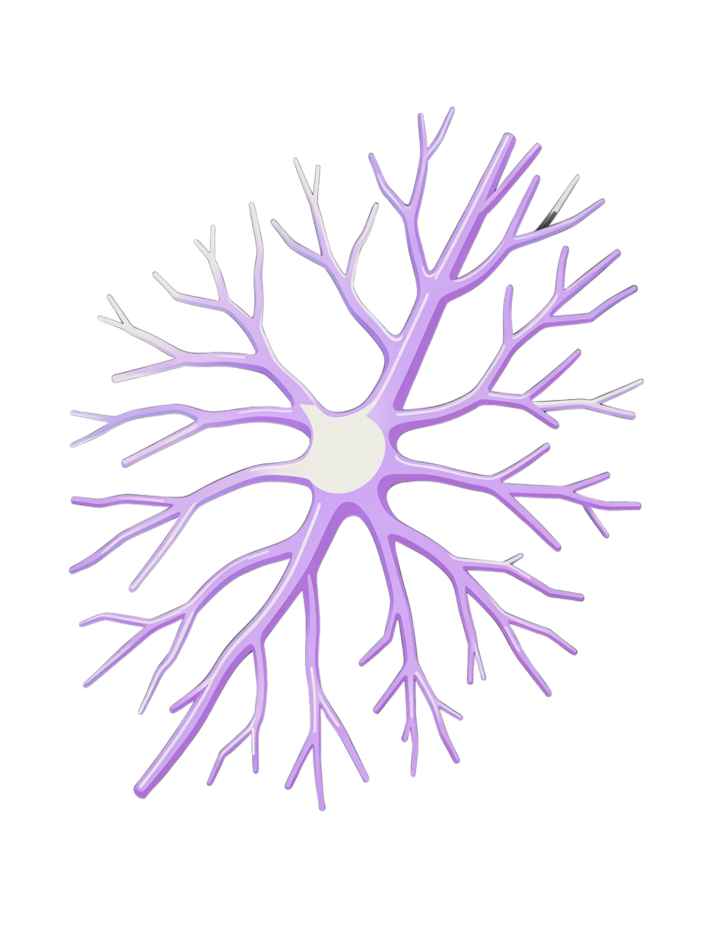
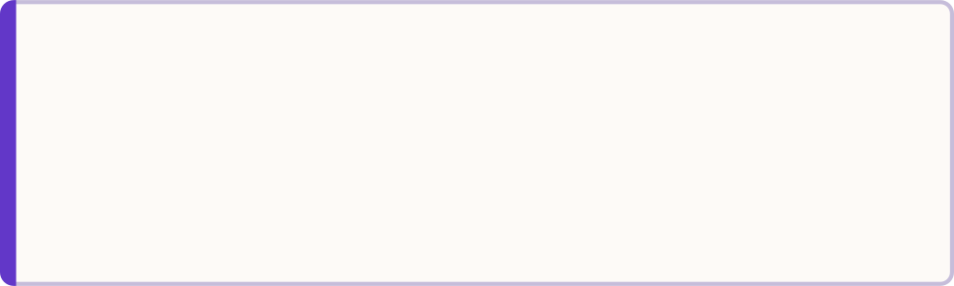

From Biological Neurons to Artificial Neural Networks
The Biological-to-Artificial Analogy
Practical Example: House Price Prediction
🧠 Biological Neuron
Receives signals → Processes information → Produces a signal
Inputs
Area · Bedrooms · Location · Age
⚡ Artificial Neuron
Process
Receives inputs → Combines information → Applies activation → Produces output
Neural Network learns patterns from training data
Output
Predicted House Price
Key Takeaway: Neural networks learn useful patterns from examples.

Slide 3
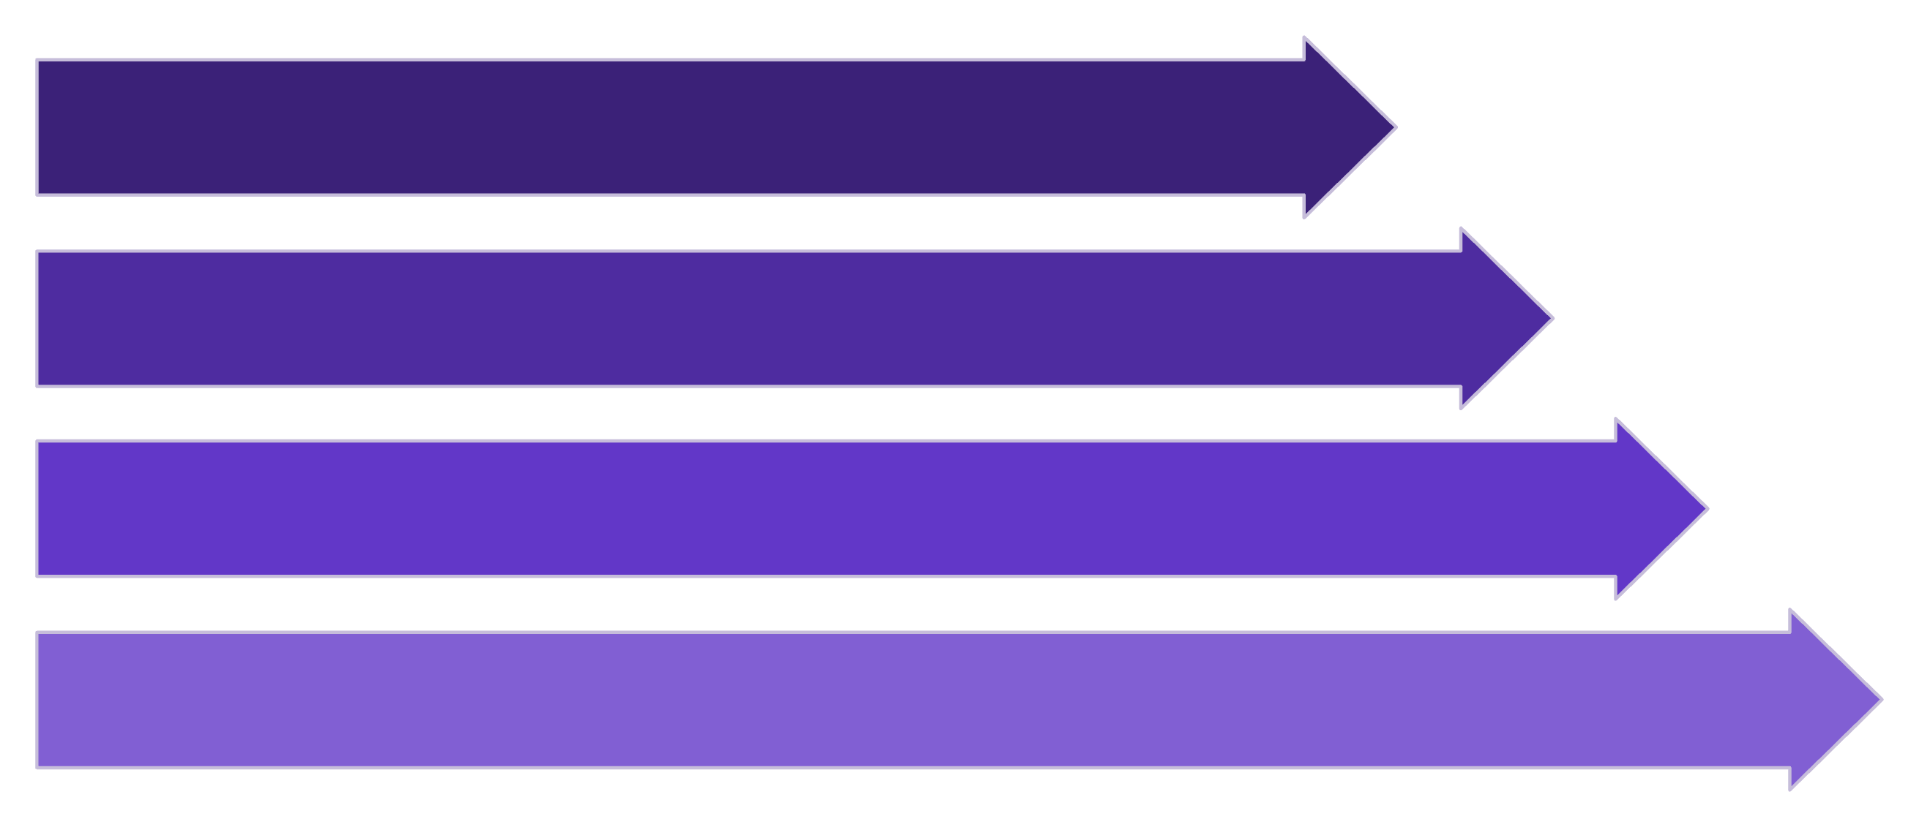
Inside a Single Artificial Neuron
Inputs
The Neuron Pipeline
Weights
Spam Detection Example: Words like "free," "winner," "urgent" carry higher weights than neutral words like "meeting."
Conceptual Formula: Output = Activation(Inputs × Weights)
Combination
Activation
01
02
Inputs (x₁, x₂, x₃, x₄)
Weights
Raw data entering the neuron
Determine how strongly each input influences the decision
03
04
Activation Function
Output
Determines how the neuron responds to combined input
Final signal passed to the next layer

Slide 4
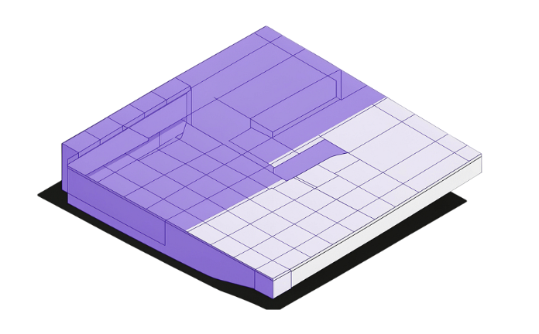
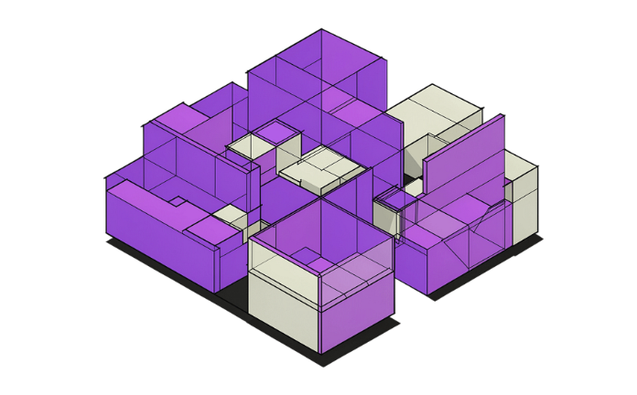
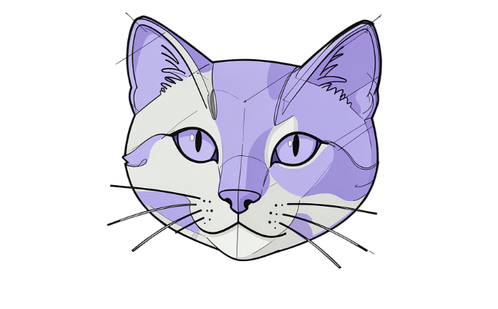


Why Do We Need Layers?
Layer 1 — Edges
Layer 2 — Shapes
Layer 3 — Parts
Output — "Cat"
Detects basic edges and simple visual patterns from raw pixel data
Combines detected edges into meaningful geometric shapes and contours
Recognizes object parts — eyes, ears, whiskers — from assembled shapes
Combines all parts into a confident classification of the complete object
Insight: Early layers learn simple features; later layers combine them into rich, complex representations.

Slide 5




How Does a Neuron Decide What to Pass Forward?
Without nonlinear activation functions, stacking many layers would severely limit what a network can represent. Activations introduce the complexity needed for real-world learning.
ReLU
Sigmoid
Passes positive values through; converts negatives to 0. Simple, efficient — the default choice for hidden layers.
Outputs values between 0 and 1. Ideal for binary classification and probability-style outputs.
Tanh
Softmax
Outputs values between −1 and 1. Similar to sigmoid but centered at zero for better balance.
Converts class scores into a probability distribution. Cat: 0.80 · Dog: 0.15 · Horse: 0.05

Slide 6
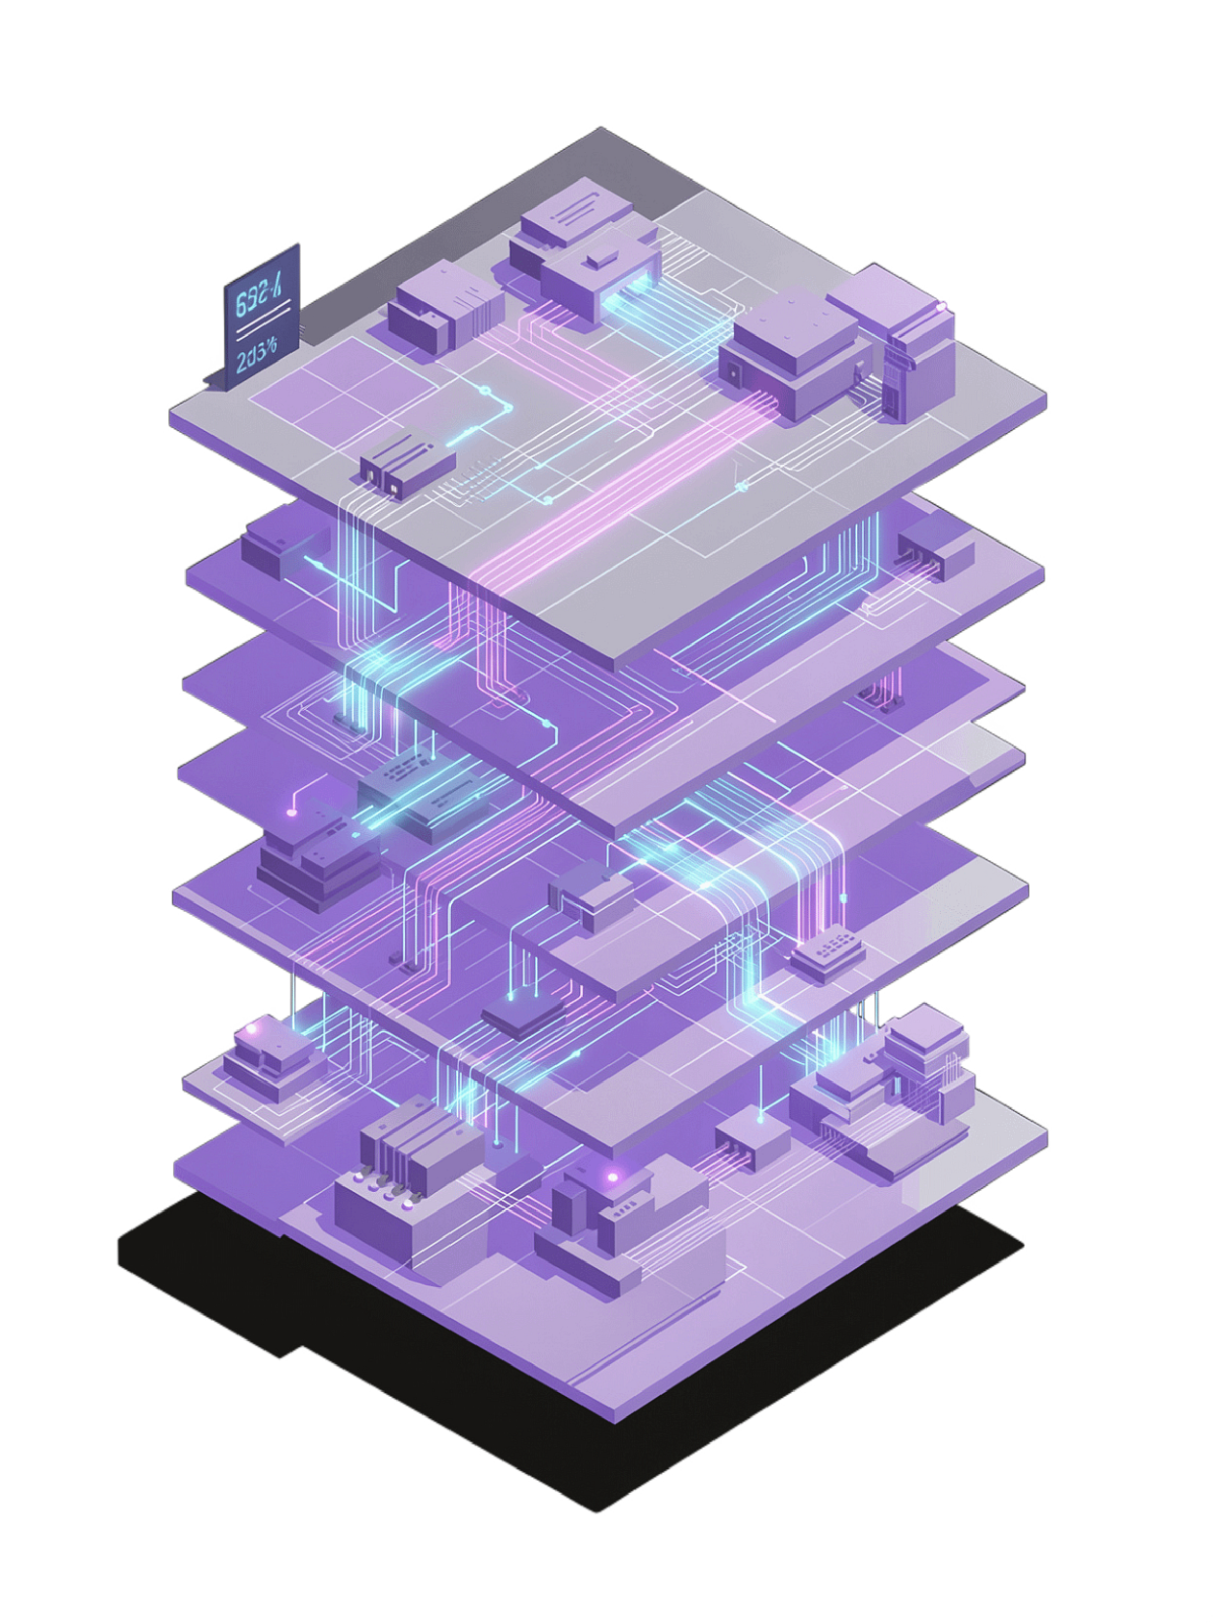
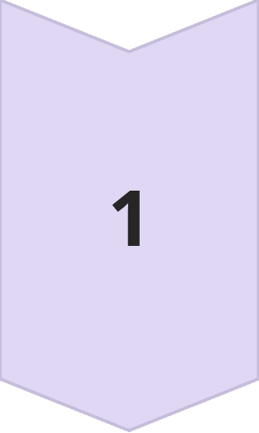
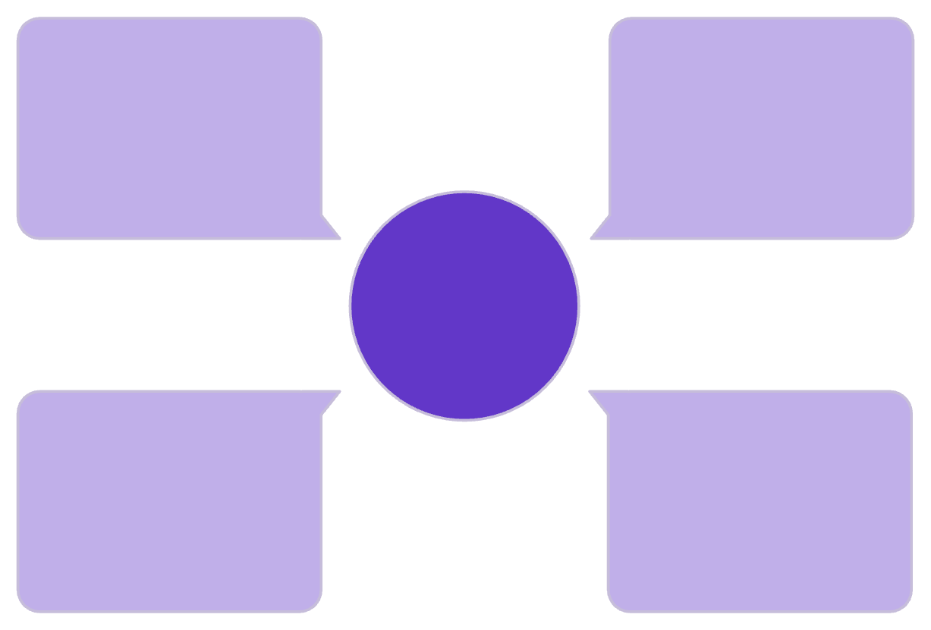
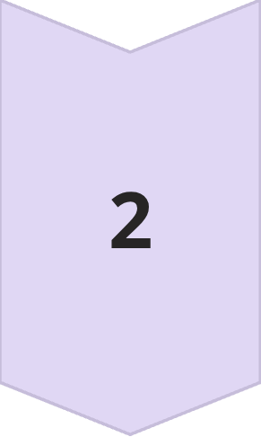
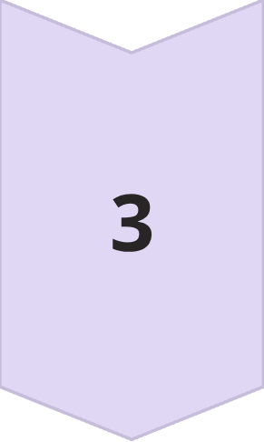
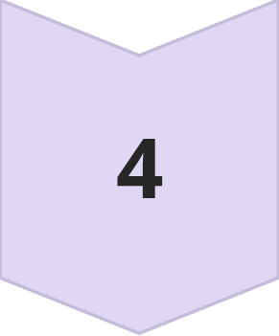
How Information Moves Through a Neural Network
Student Performance Prediction
Inputs
Forward Propagation
Study Hours · Attendance · Previous Score
Taking input data through the network layer-by-layer to produce a final prediction.
Hidden Layer 1
Output
Inputs
Pass probability = 0.87
Study Hours, Attendance, Previous Score
Learns intermediate patterns between input features
Forward Pass Overview
Hidden Layer 2
Hidden Layer 2
Hidden Layer 1
Combines and refines intermediate patterns further
Combines features into representations
Extracts intermediate patterns
Output
Pass probability = 0.87

Slide 7







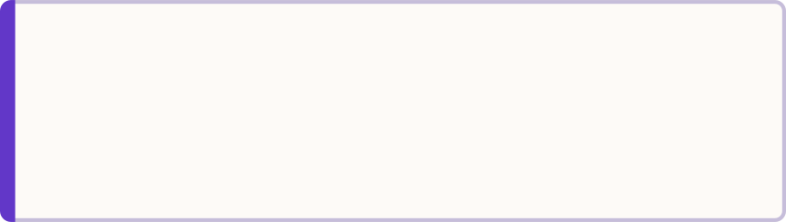







Training: Prediction → Error → Improvement
The Training Loop
Conceptual Example: Image Classification
Actual Label
Network Prediction
Dog
Cat — incorrect
Loss
Update
High — prediction is wrong
Network adjusts parameters toward correct answer
Next Prediction
Closer to correct
Key Insight: Backpropagation traces how each parameter influenced the error, guiding targeted improvements.
Predict
Network makes a prediction on training data
Measure Error
Compare prediction with actual answer; calculate loss
Backpropagate
Trace how each parameter contributed to the error
Update
Optimizer adjusts parameters to reduce error; repeat with next batch

Slide 8
How Training Progresses
20
0.01
32
Epochs
Learning Rate
Batch Size
Typical passes through training data for convergence
A common starting point — small enough for stability
Common mini-batch for balanced speed and stability
Key Training Concepts
Loss
Epoch
Measures how far predictions are from desired answers. Lower loss = better training performance.
One complete pass through the entire training dataset.
Batch
Learning Rate
A smaller group of examples processed together before updating parameters.
Too high = unstable training · Too low = very slow · Just right = smooth & steady

Slide 9


When a Neural Network Learns Too Much
Three Scenarios
Common Solutions
More Data
😕 Underfitting
✅ Good Fit
Collect more training examples or use data augmentation
Model too simple — poor performance on both training and validation data
Learns useful patterns — good performance on both training and validation data
Dropout
Randomly disable neurons during training to prevent co-dependence
⚠️ Overfitting
Regularization
Memorizes training data — 98% training vs 72% validation accuracy
Penalize excessively large weights to keep the model general
Goal: Generalize to unseen data — not memorize training data.
Early Stopping
Halt training when validation performance plateaus or declines
Simpler Architecture
Reduce layers or neurons so the model cannot over-memorize

Slide 10

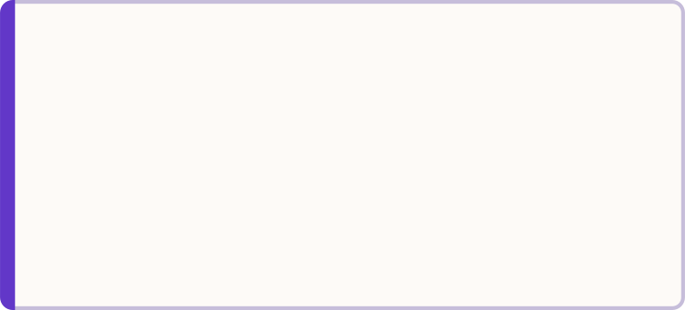
Building a Neural Network with Python
TensorFlow / Keras Implementation
Component Breakdown
from tensorflow.keras.models import Sequential
from tensorflow.keras.layers import Dense
model = Sequential([
Dense(64, activation="relu", input_shape=(10,)),
Dense(32, activation="relu"),
Dense(1, activation="sigmoid")
])
model.compile(
optimizer="adam",
loss="binary_crossentropy",
metrics=["accuracy"]
)
model.fit(
X_train, y_train,
epochs=20,
validation_split=0.2
)
Dense
ReLU
Fully connected layer — every neuron connects to all inputs
Nonlinear activation for all hidden layers
Sigmoid
Adam
Output activation — probability between 0 and 1 for binary classification
Optimizer that adapts learning rates automatically during training
Validation Split
Reserves 20% of data to continuously monitor generalization
Architecture: 10 inputs → 64 neurons → 32 neurons → 1 output

