Slide 1


Generative AI
From GANs & VAEs to Transformers & LLMs
Understanding How Machines Generate New Content
B.TECH ML/AI/DATA SCIENCE
2026 EDITION

Slide 2






What Is Generative AI?
Traditional AI / ML
Generative AI
Input → Model → Prediction
Prompt → Model → NEW CONTENT
Classification
Text
Image → Cat or Dog
Articles, answers, summaries
Detection
Image
Email → Spam or Not
Photorealistic or stylized visuals
Fraud
Audio
Transaction → Risk Score
Voice, music, sound effects
Predictive models classify or label existing inputs.
Code
Functions, scripts, full programs
Key Distinction: Generative models learn the underlying distribution of training data and sample new outputs — they do not retrieve or classify existing examples.

Slide 3
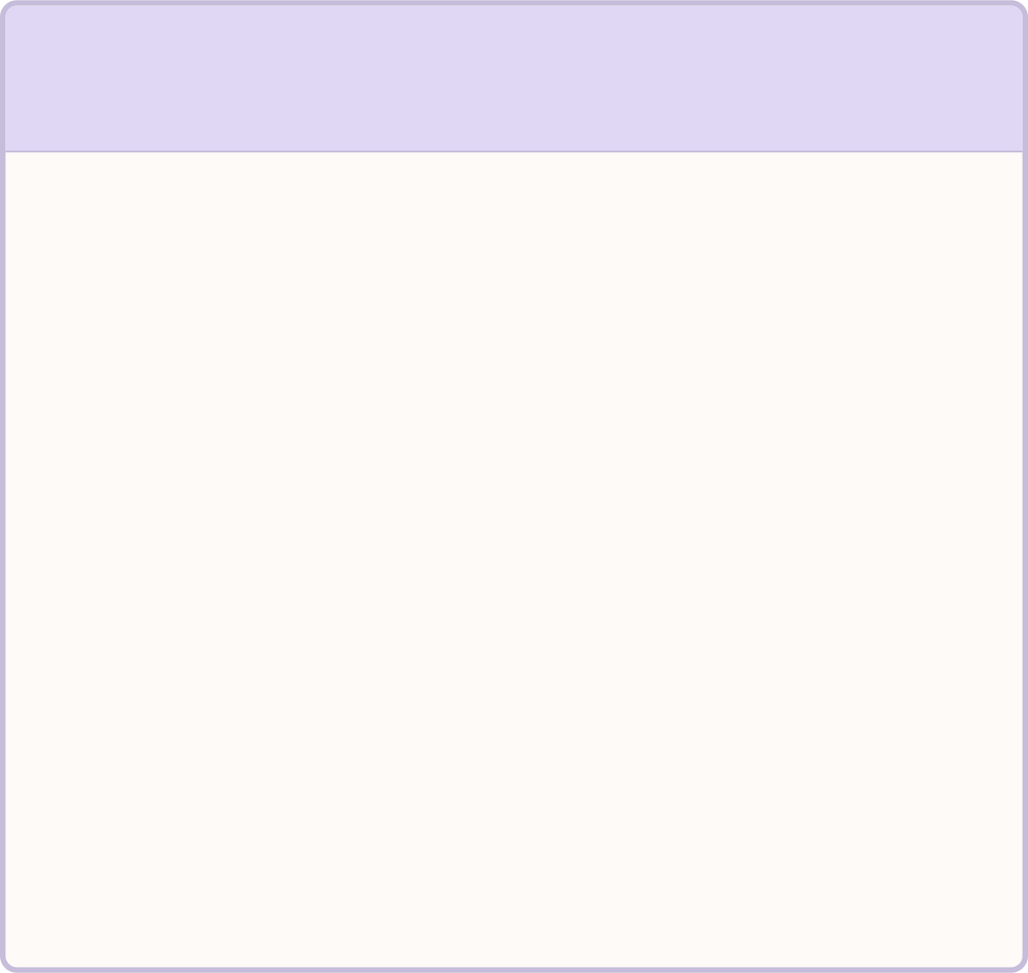



How Do Generative Models Work?
Three major architectural families power modern generative AI — each with a distinct learning strategy:
GANs — Generative Adversarial Networks
VAEs — Variational Autoencoders
LLMs — Large Language Models
Mechanism: Generator vs. Discriminator adversarial competition
Pipeline: Noise → Generator → Fake Image ↔ Discriminator → Feedback
Primary use: High-fidelity image synthesis
Mechanism: Encode → Latent Space → Decode
Pipeline: Input → Encoder → Latent Z → Decoder → Reconstruction
Primary use: Representation learning & controllable generation
Mechanism: Transformer-based next-token prediction
Pipeline: Tokens → Transformer Blocks → Next-Token Probabilities
Primary use: Text & code generation at scale
⚠ Modern context (2026): Diffusion models, autoregressive multimodal models, and mixture-of-experts architectures have also become prominent. GANs, VAEs, and Transformers remain the foundational building blocks.

Slide 4
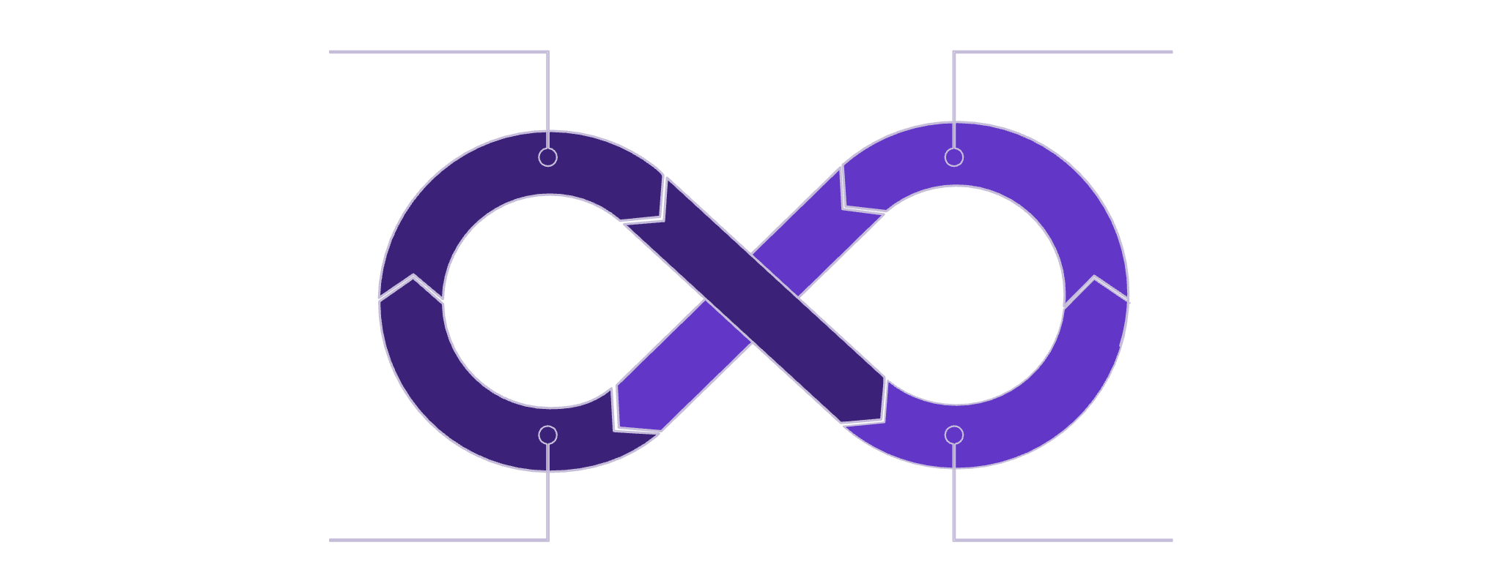
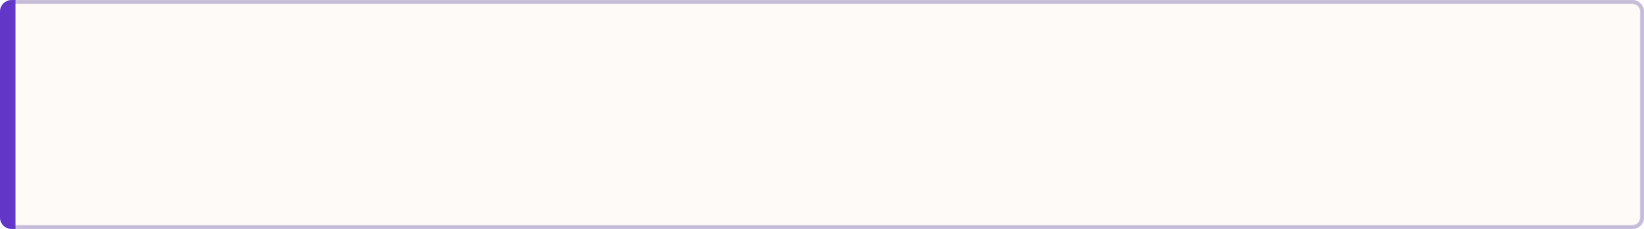
GANs — Two Networks Compete
The Adversarial Framework
Random Noise
Generator → Fake Image
Two networks train simultaneously in direct competition — the result is progressively more realistic output.
🎭 Generator
Random Noise → Fake Image
Goal: Fool the discriminator
Feedback: Improve
Discriminator Decision
🔍 Discriminator
Image → Real or Fake?
Goal: Catch the generator
Training ends at Nash Equilibrium: Generator produces samples the Discriminator cannot distinguish from real data.
Training Dynamics
Known Challenges
Each iteration the Generator gets better at deception; the Discriminator gets better at detection. This arms-race dynamic drives quality upward over thousands of training steps.
Training instability (loss divergence), mode collapse (Generator produces limited variety), and sensitive hyperparameter tuning are well-documented failure modes.

Slide 5
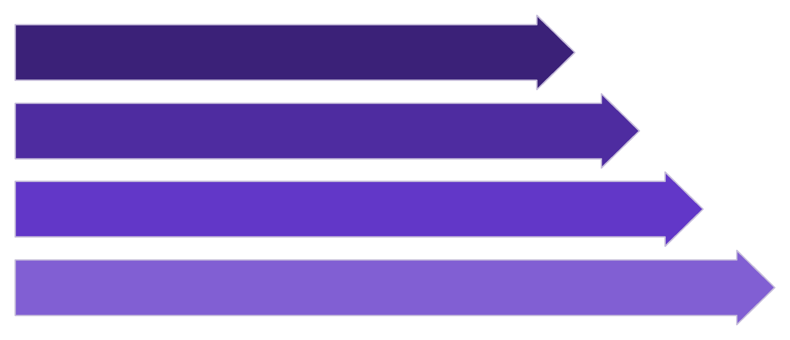






VAEs — Learning a Meaningful Latent Space
Three Conceptual Stages
Input Image
Encoder
Encoder
Compresses high-dimensional input into a compact latent vector z
Latent Space
Latent Space
Decoder
Structured representation capturing Pose, Style, Shape, Appearance as continuous dimensions
Decoder
Reconstructs or generates new samples from any sampled latent point
Interpolation
Attribute Manipulation
Novel Generation
Move between Face A and Face B in latent space → generate smooth intermediate faces
Shift a single latent dimension → change only one visual property (e.g., age, expression)
Sample a random point from latent space → Decoder produces an entirely new image

Slide 6
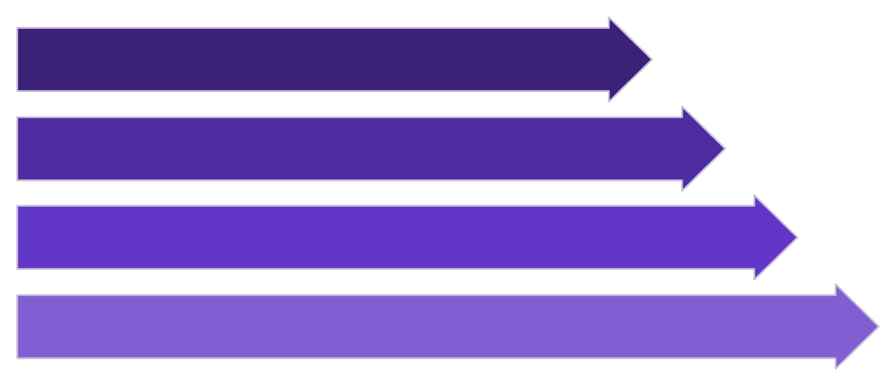




How Can Machines Generate New Images?
GANs and VAEs represent two distinct philosophies for image generation — each with characteristic strengths and failure modes.
GAN Approach — Adversarial Learning
VAE Approach — Latent Representation
Noise Input
Input
Generator
Encoder
Discriminator
Latent Z
Real or Fake
Decoder
✅ Strengths
⚠ Limitations
✅ Strengths
⚠ Limitations
Highly photorealistic outputs; strong record in image synthesis, super-resolution, and style transfer
Training instability; mode collapse; requires careful hyperparameter balancing
Structured, continuous latent space; smooth interpolation; useful for representation learning and downstream tasks
Generated outputs sometimes appear blurrier or less sharp compared to GAN outputs
Modern Context (2026): GANs and VAEs are foundational and remain widely studied. Modern production image generation (Stable Diffusion, DALL-E, Midjourney) predominantly uses diffusion models — an important architectural development that builds on these foundations.

Slide 7
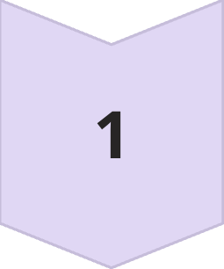
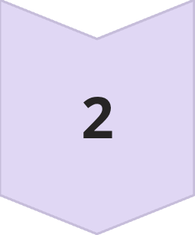
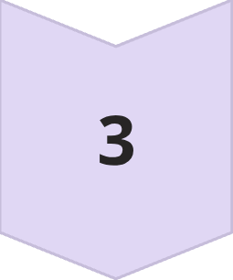
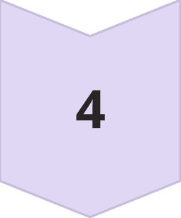

From Next-Word Prediction to Text Generation
Autoregressive Generation
Token-by-Token Visualization
Text generation is an incremental, token-by-token process. At each step, the model uses all previous tokens as context to predict the most likely next token.
The
Initial token generated from prompt
Context Window
All previously generated tokens fed as input
The capital
Second token: "capital" predicted from "The"
Model Scores
The capital of France
Assigns probability to every token in vocabulary
Sequence builds with each forward pass
Token Selected
The capital of France is Paris
Highest probability (or sampled) token appended
Final token "Paris" predicted with high confidence
Repeat
New token joins context → process restarts
Key Point: The model generates from learned parameters — it is not retrieving answers from a database. Every token is a statistical prediction conditioned on context.

Slide 8
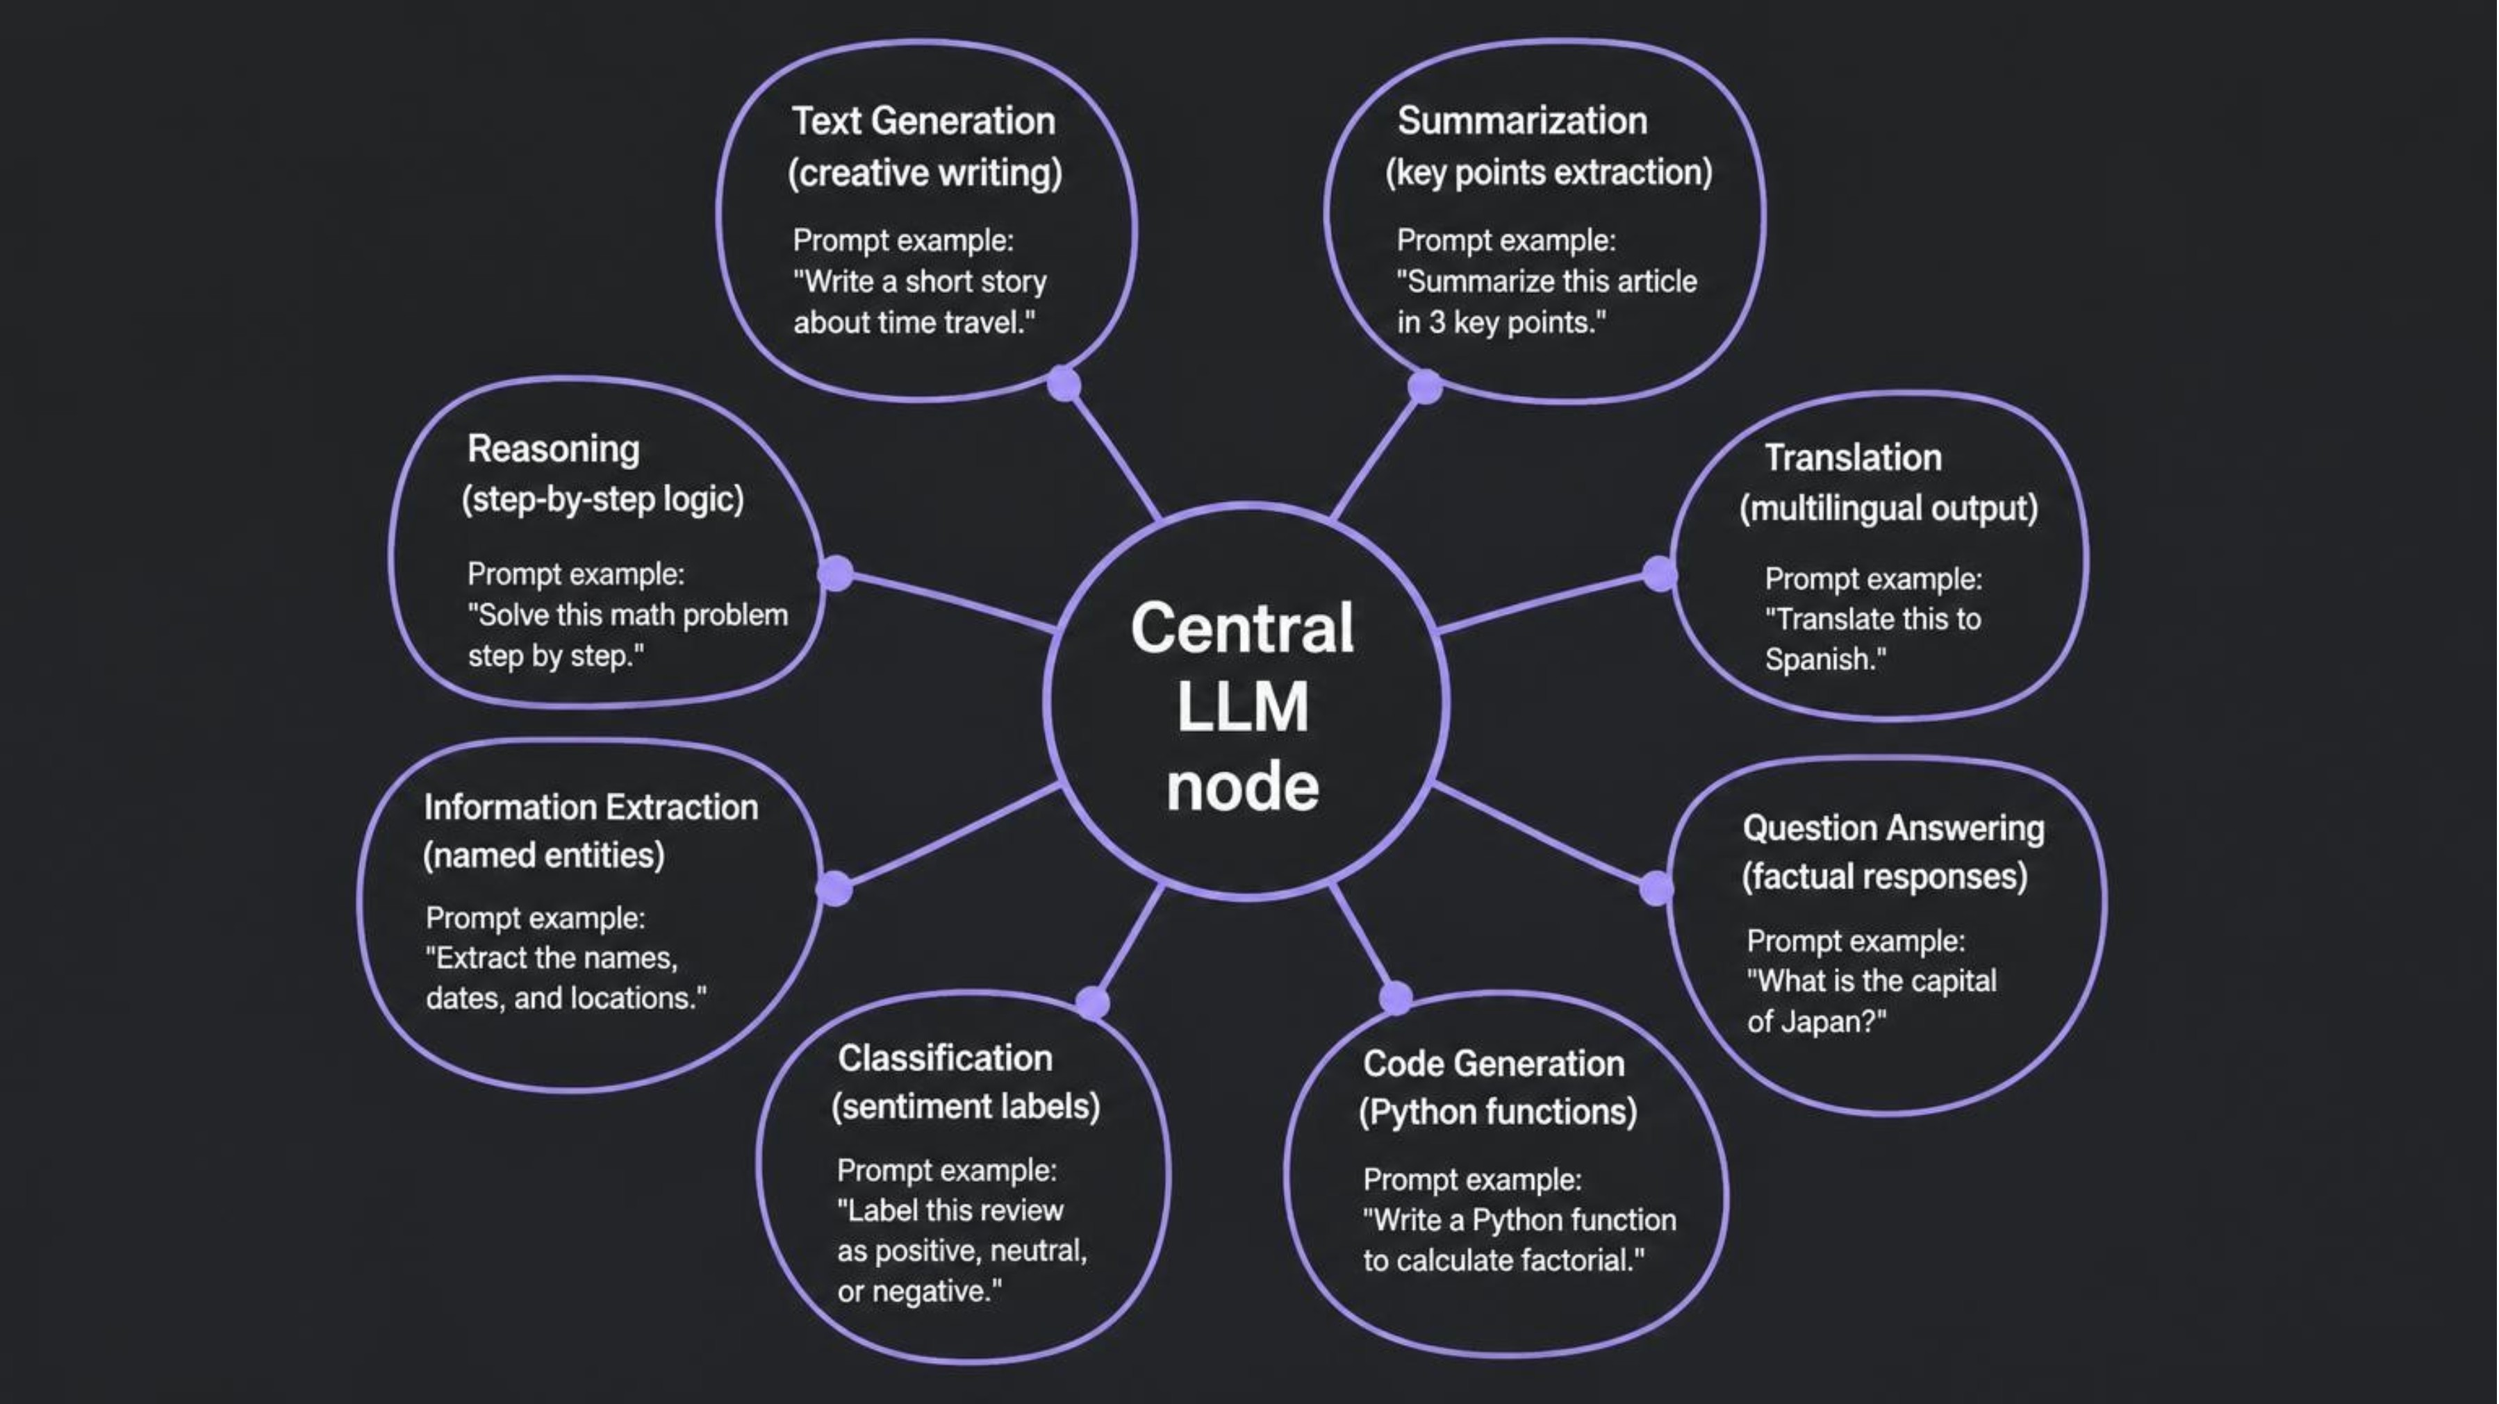
What Makes a Language Model 'Large'?
100B+
Tera-
Parameters
Tokens of Data
Learned numerical weights encoding world knowledge from training data
Web text, books, code, and scientific papers consumed during pre-training
1000s
8+
GPU Days
Tasks, One Model
Substantial compute required — training runs cost millions of dollars
A single LLM handles generation, summarization, translation, QA, classification, and more
One Model — Many Tasks via Prompting
Prompting Insight: The same pre-trained LLM handles all tasks above — only the input instruction changes. This generality is what distinguishes LLMs from earlier task-specific models.

Slide 9
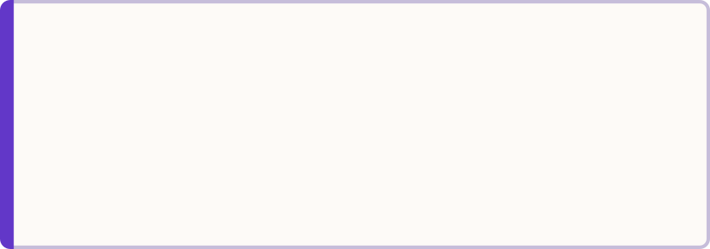
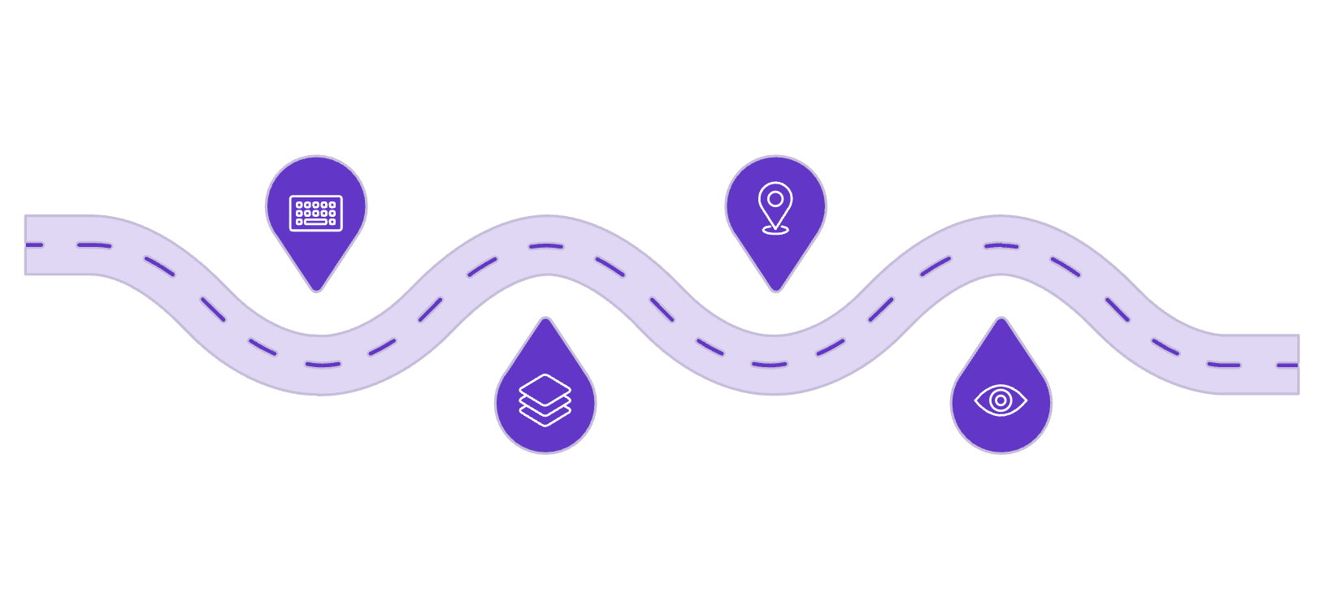
Why Transformers Changed Language AI
The Problem with Earlier Models
Transformer Block Architecture
RNNs — Sequential Processing
Transformer Solution
Input Tokens
Positional Encoding
Raw tokens enter the block
Add sequence position info
Process tokens one-by-one; hard to parallelize; long-range dependencies fade over many steps
Process all tokens simultaneously; attention mechanism connects any two tokens regardless of distance
Self-Attention — Intuitively
Token Embeddings
Self-Attention
"The animal didn't cross the street because it was tired."
Convert tokens to vectors
Which tokens matter
When the model processes "it", self-attention asks: "Which other tokens are most relevant?"
High attention weights assigned to: animal, cross, tired — allowing correct coreference resolution.
Self-Attention Question: "Which other tokens in this sequence should I pay attention to when representing myself?"
Token Embeddings
Positional Encoding
Self-Attention
Feed-Forward
Map discrete tokens to continuous vector representations
Inject sequence order since attention is order-agnostic
Compute token-to-token relevance across full sequence
Apply non-linear transformations to each position
Stack × N
Repeat blocks 12–96× for deeper representations

Slide 10
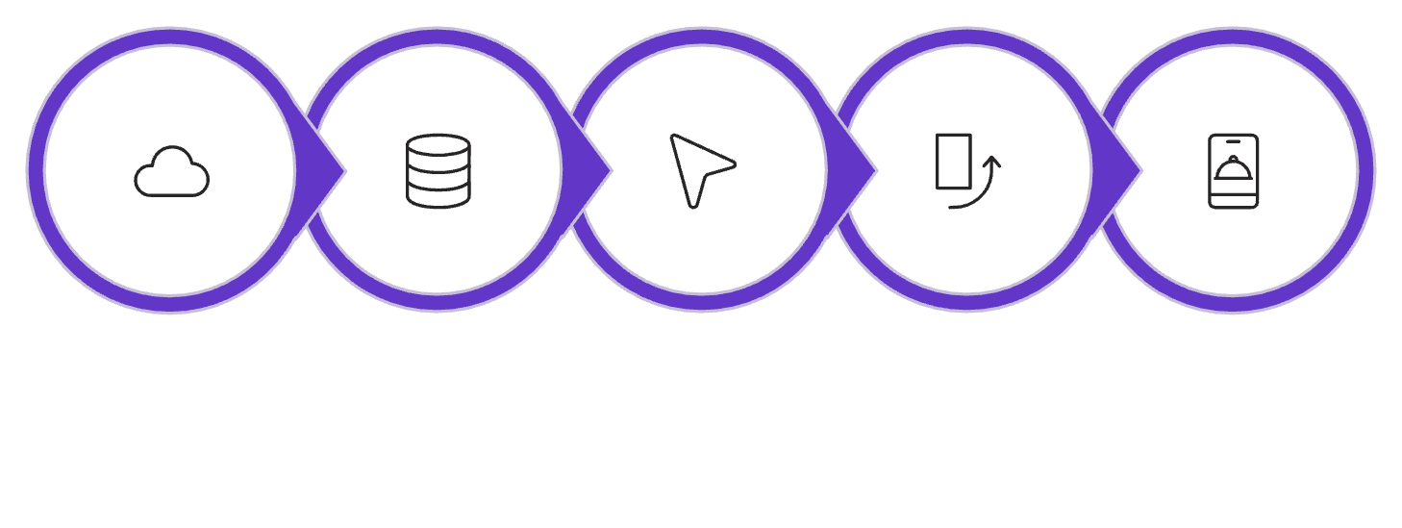
From BERT & GPT to Modern LLMs
Model Evolution Timeline
Architecture Distinctions
2017 — Transformer
BERT — Encoder
GPT — Decoder
"Attention Is All You Need" — foundational architecture introduced
Bidirectional · Sees full context · Best for: classification, NER, QA
Autoregressive · Left-to-right · Best for: generation, completion, chat
2018 — BERT & GPT-1
BERT: encoder, bidirectional, understanding tasks · GPT: decoder, autoregressive, generation
T5 — Enc-Dec
2019–2020 — GPT-2 & T5
Text-to-text · Flexible · Best for: translation, summarization, seq2seq
GPT-2: scale reveals emergent abilities · T5: encoder-decoder, text-to-text formulation
Hugging Face Workflow
2020–2022 — GPT-3 & Instruction Tuning
2022+ — ChatGPT Era
Few-shot prompting, RLHF alignment, InstructGPT emerge
Conversational interfaces, public accessibility, mainstream adoption
2023–2026 — Multimodal & Agentic
Model Hub
Load Model
Tokenizer
Pipeline
Application
Key advantage: Load existing pre-trained models instead of training from scratch. One pipeline() call handles tokenization, inference, and decoding.
Long-context, open-weight, multimodal, instruction-tuned, agentic systems

