Slide 1
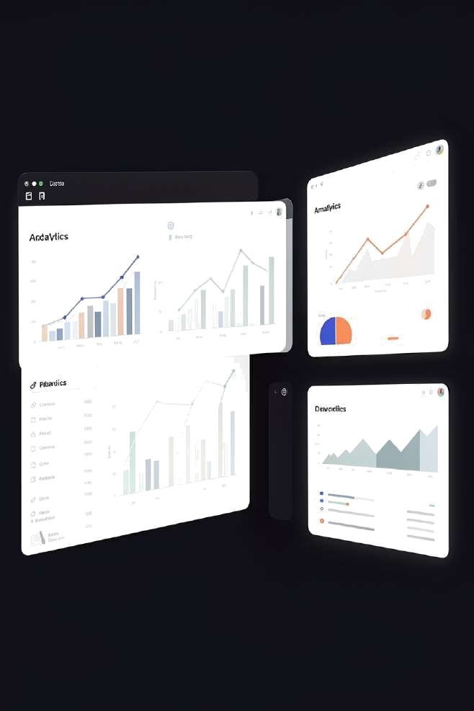
Customer Behaviour Analysis Dashboard
End-to-end dataana|ysis usingSQL,Python&DashboardVisuahsaGon
DATA ANALYTICS PORTFOLIO PROJ ECT

Slide 2

Project Overview
@ Objective
Understand customer purchasing patterns and behaviour through data
,| Approach
Extract, clean, analyse, and visualise customer data end- to end
g' Outcome
Actionable insights delivered via an interactive dashboard

Slide 3

The Problem
Blind Decisions
Businesses operate without clear visibility into customer behaviour or preferences
Revenue Leakage
Without data-driven insights, high- value segments and growth opportunities go undetected
The Solution
A structured analytics pipeline that turns raw data into actionable intelligence

Slide 4
Tools & Technologies
SQL
Data extraction, filtering, joins & aggregation via CodeWeSQL
3upyter Notebook
Interactive environment for analysis, visualisation & documentation
Python
Pandas & NumPy for data wrangling and transformation
Power BI / Tableau
Interactive dashboards with dynamic filters and KPI tracking

Slide 5

Data Pipeline
Extract
Clean
Analyse
Visualise
A structured pipeline ensures data quality and reproducibility at every stage — from raw database to polished dashboard.

Slide 6
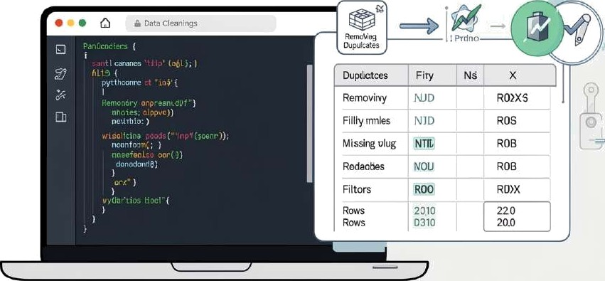
Data Cleaning
Raw data is rarely analysis-ready. Key preparation steps:
—$* Missing Values
Identified and imputed nulls to maintain dataset integrity
—$* Duplicate Removal
Eliminated redundant records to prevent skewed analysis
—$* Data Transformation
Standardised formats, encoded categories, and engineered features

Slide 7




Exploratory Data Analysis
Category
Key Findings from EDA
Outerwear
Outerwear leads all categories in revenue generation
Senior and middle-aged segments drive the majority of purchases
Non-subscribers form the largest customer group ( 72%)
Standard shipping is the most preferred fulfilment method
Footwear
Accessories
Clothing
Other
0
2k
4k
6k
8k
10k
Revenue (S)

Slide 8

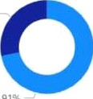




Dashboard Overview
KPI Tracking
Top-level metrics: customers, revenue, ratings
Dynamic Filters
Filter by category, subscription status & shipping type
Visual Insights
Chats, breakdowns&trendvews acrossa(segments
Nn Yes
Subscription
324
Number of customers
SUBSCRIPTION PERCENTA'SE
$57.17
Average purchase amount
3.75
Average review rating
No Yes
Category Accessories
P£VE/VL/£ BY CATEGORY
5AL£S BY CATEGORY
ClothinCj
Footwear
Revenue by Age Group
Sales by Age Group
Shipping
O 2-Day Shi..
Q Express
fl.1i':! .1I' '

Slide 9


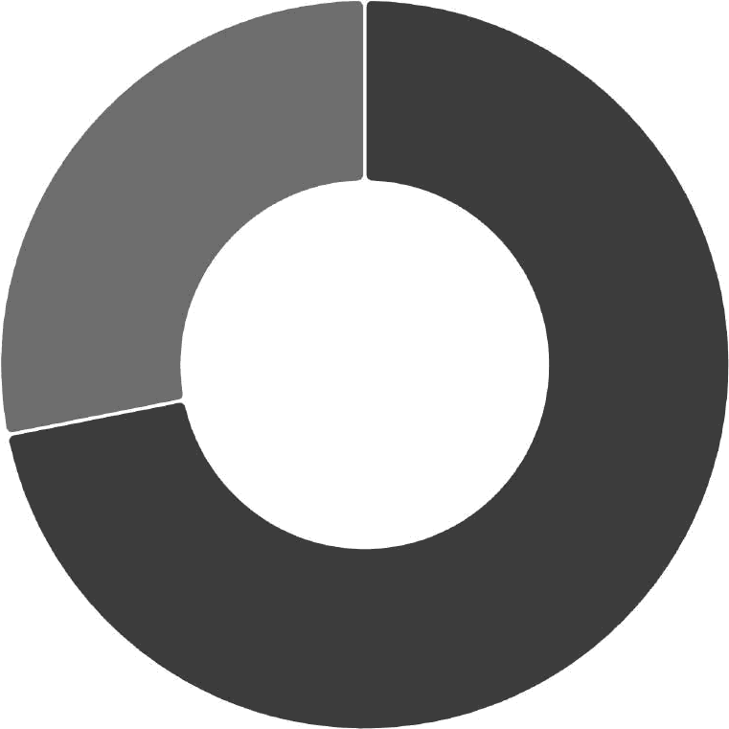
Key Metrics
Total Customers | Avg. Purchase Value | Avg. Rating
Unique customer records analysed | Average transaction value per customer | Mean customer satisfaction score out of
across alt segments | at t5T,17 | 5.0
'c Non-Subscribers ' 71.91%
*h Subscribers 28.09%+

Slide 10

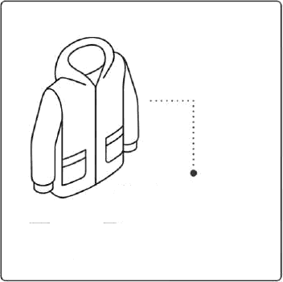

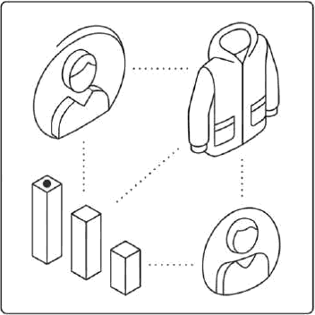

Key Insights
What This Means for Business
Subscription growth is a major untapped opportunity —
72% of customers are yet to subscribe
Outerwear investment should be prioritised in inventory and marketing budgets
Targeted campaigns for senior and middle-aged segments can maximise ROI
72^{O}0
Non-Subscribers.
Outerwear
Top Revenue
Senior
Middle-Aged
Younger
O These insights directly support strategic decisions in marketing, inventory, and customer retention.
Top Spenders

