Slide 1

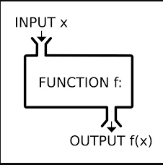

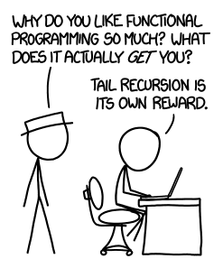
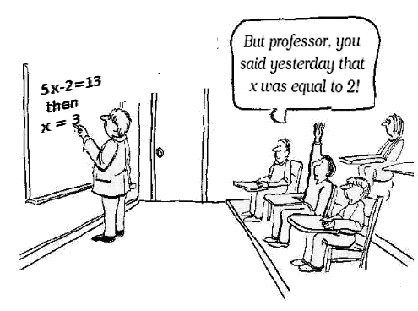
Erlang course
BET365

Slide 2
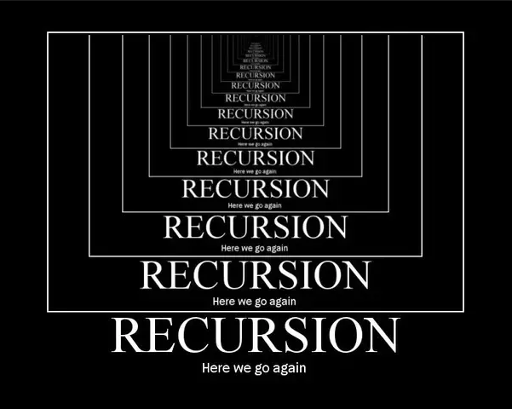


Slide 3
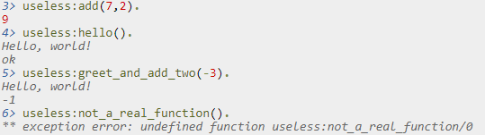
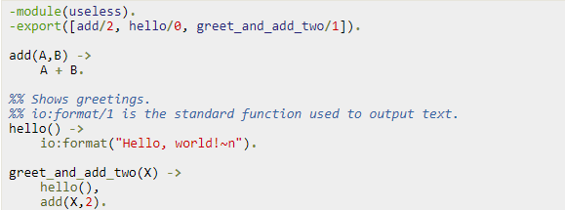
Modules
What are modules
Module declaration
Compiling the module
Developed by Ericsson for their telecommunication systems

Slide 4
io:format().
Prints on the console
Formatting is done with tokens being replaced in a string
io:format("~s!~n",["Hello"]).
io:format("~p~n",[<<"Hello">>]).
io:format("~~~n").
io:format("~f~n", [4.0]).
io:format("~30f~n", [4.0]).
Creating a snippet for it in Intellij (optional)
Type ifor + tab + tab → io:format(io:format("~s!~n",[])).

Slide 5
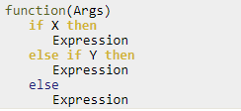

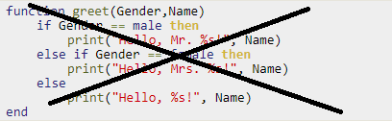

Pattern matcing
What is Pattern matcing
One of the main principles of functional programming
Similar to method overloading in C# but for parameter values
Each function is called function clause
Must be separated by → ;
Last function clause ends with → .

Slide 6


Guards
Compliment pattern mathching
Pattern match is limited
Guards extend it
function(arg) when {boolean expression} -> {function body}.
Boolean expressions
, same as andalso (&&)
, same as orelse (||)

Slide 7

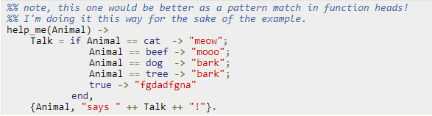
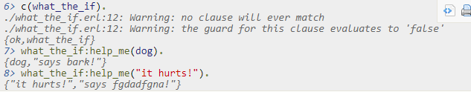
Ifs
Similar to pattern mathching
No if else construct

Slide 8
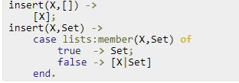

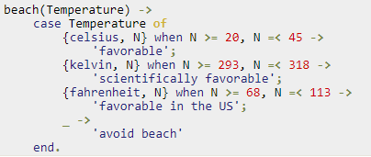
Case of
Used a lot in CBS
case {value} of {value1} -> ok; {value2} -> notok; _ -> alwaysok
Represented at lower level the same way as functions
Use whichever you prefer

Slide 9

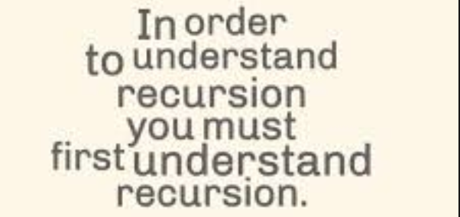
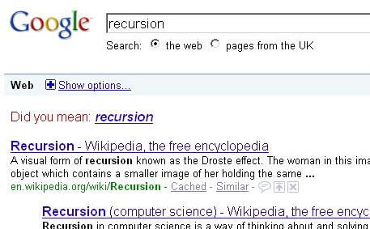
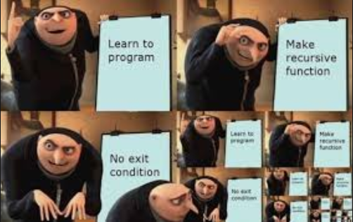

Slide 10



Recursion
What is recursion
A function the calls itself
No loops (for,while) in functional programming
Recursion is used for the above
Solve n factorial using recursion.

Slide 11
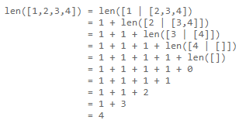



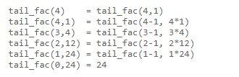
Tail Recursion
Normal recursion can be slower than it is needed
Tail recursion optimizes the function calls
It takes the same space for 4! And 1 000 000!

Slide 12
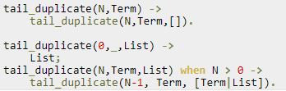


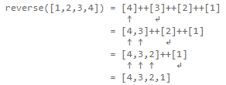


More recursion examples
Duplicate
Tail duplicate
Reverse
Don’t write your own reverse functions. Use lists:reverse/1. It is implemented as BIF and ++ is faster.
Very slow

Slide 13


More recursion examples
Sublist
Tail recursive functions reverse the list automatically.
Use lists:reverse/1 at the bottom of the recursion to fix this.
Sublist([1,2,3,4,5],3) would not return [1,2,3], but [3,2,1].

Slide 14
More recursion examples
Sublist
Tail recursive functions reverse the list automatically.
Use lists:reverse/1 at the bottom of the recursion to fix this.
Sublist([1,2,3,4,5],3) would not return [1,2,3], but [3,2,1].

Slide 15



More recursion examples (1)
Quicksort
Can be done in 3 lines using erlang

Slide 16
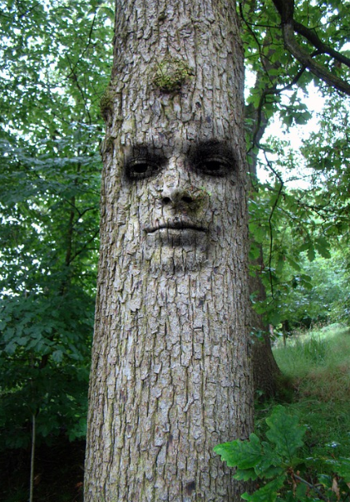

Slide 17
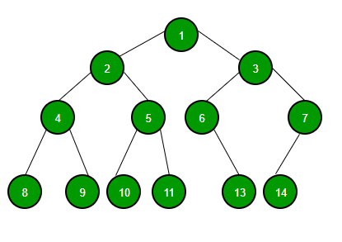
Trees
What are trees
Binary trees
Balanced trees
Search trees
DFS
BFS

Slide 18
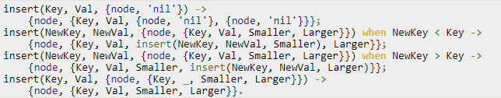
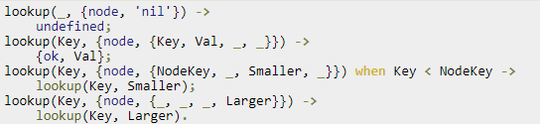

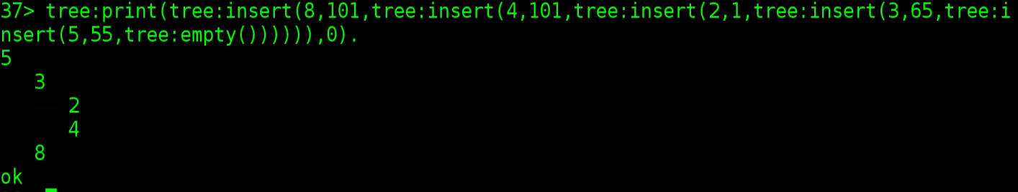
Trees in erlang
Done with tuples
Implement binary tree in erlang
Memory is being copied across by erlang VM
Use gb_trees in erlang

Slide 19
Homework
1. Implement Merge sort using erlang
2. Solve the first 10 tasks of “H-99: Ninety-Nine Haskell Problems” using erlang.
https://wiki.haskell.org/99_questions/1_to_10

