Slide 1

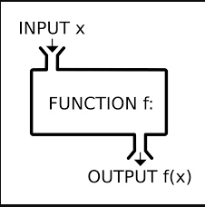

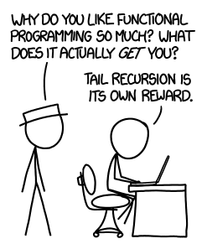
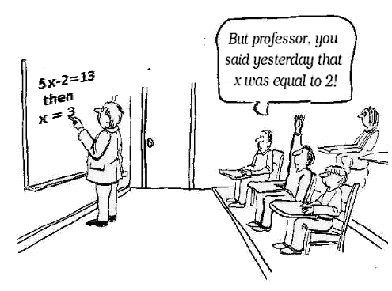
Erlang course
BET365

Slide 2
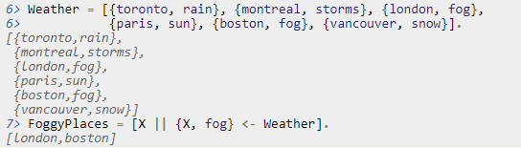
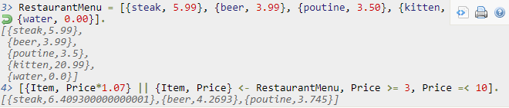

List Comprehensions
A way to build or modify lists. Similar to LINQ C#
NewList = [Expression || Pattern <- List, Condition1, Condition2, ... ConditionN].
Can be pattern matched
Used a lot
Strange syntax

Slide 3
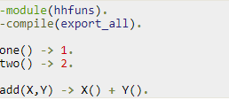
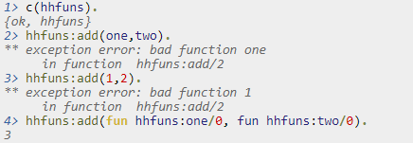
Higher order functions
Core principle in functional programming
Passing functions as parameters
Similard to delegates in C# or pointers to functions in C++
fun Module:Function/Arity

Slide 4

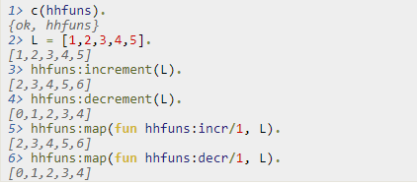

Higher order functions Example
Maps
Increment
Decrement

Slide 5
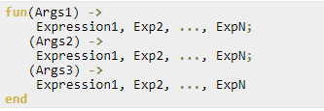
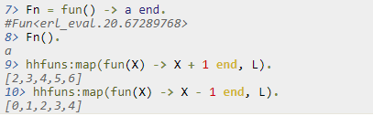
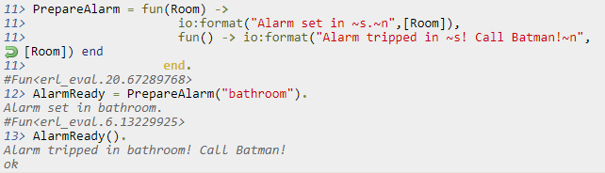
Anonymous functions
Similar to normal functions but without a name
Increment
Decrement

Slide 6

Closures
Function scope
Anywhere inside base1 you can refer to A and B
Parents can’t access children
Children inherit parents scope (like in real life)
Inherited scope follows the function even when passed down to another one

Slide 7
Install the erlang plugin
Go to \\pfs001b\gaming_team\Software\IntelliJ\Plugins
Copy the zip file to desktop
Open intellij and go to: file->settings->plugins
Click install plugin from disk
Find the copied zip file
Restart intellij
Enjoy Erlang
Add the erlang SDK in file-> project structure
C:\Program Files\erl10.2\erts-10.2

Slide 8
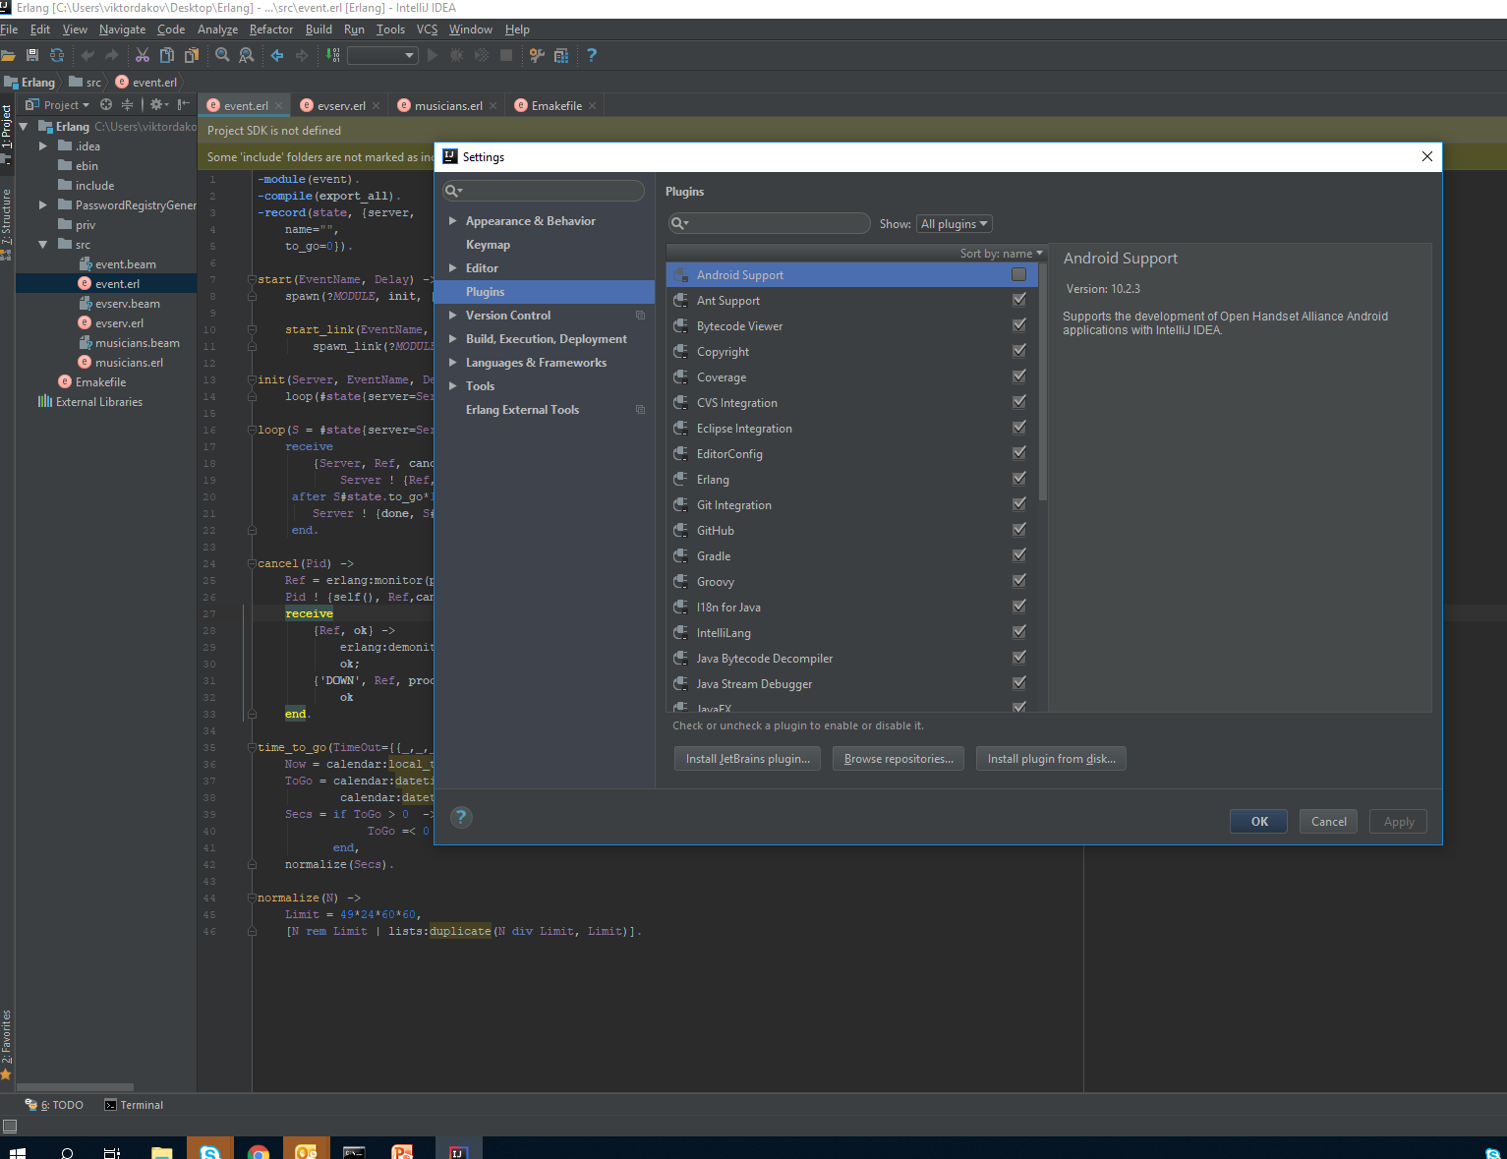

Slide 9
Homework
1. Implement a calculator (real one)
Read about reverse polish notation
Implement it using Erlang
Accept terms like ((5+5)/23) * (5 –(3+5/2))
3. Write a function that checks weather a tree is binary or not
2. 99 Haskell problems: 55
Construct completely balanced binary trees
In a completely balanced binary tree, the following property holds for every node: The number of nodes in its left subtree and the number of nodes in its right subtree are almost equal, which means their difference is not greater than one.
Write a function cbal-tree to construct completely balanced binary trees for a given number of nodes. The predicate should generate all solutions via backtracking. Put the letter 'x' as information into all nodes of the tree.
3. 99 Haskell problems: 57
Binary search trees (dictionaries)
Construct a binary search tree by given integers numbers
https://wiki.haskell.org/99_questions/1_to_10

