Slide 1
Main Memory Column-store CS 165 (Data Systems)
Pavan Kumar Kancherlapalli

Slide 2
Storage Layout
Database is a folder in the current working directory with name “db1”
Database catalog is a file at the same level that holds the metadata for the whole database
Each table is a folder inside “db1”
Each column is a binary file inside the respective table folder
Column index is also binary file at the same place.
Index files are named with column name suffixed with type of index
On start up, server looks at catalog file and accordingly reads the database files to read the data into memory.
The catalog manager is populated with base column pointers.

Slide 3
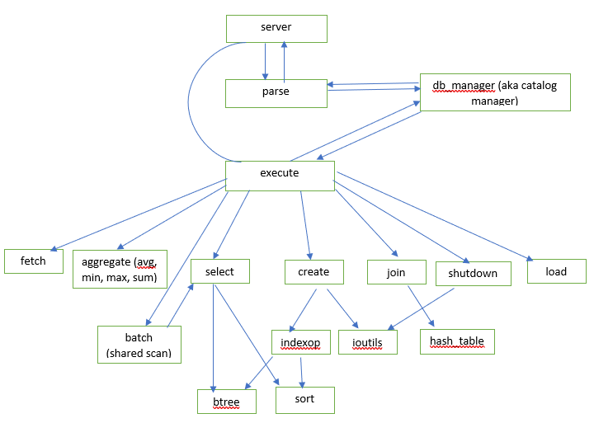
Architecture

Slide 4
Variable Pool and Basic SQL Commands
There are three types of variables that are stored in variable pool along with base column pointers that catalog manager maintains during life time of client.
Result – vector of data that results from fetch or any aggregate operators such as add, sub
PositionVector – vector of position ids that qualify select or join
Scalar – single value resulting from operators such as min, max, sum
SQL commands handled are
Create , Load, Select, Fetch, Print, Join, Avg, Min, Max, Add, Sub, Sum
All commands are processed in one pass except the load and print
Load command – reads the file on client side and passes the data in chunks to server as several load commands.
Print – server breaks the data that it needs to client into chunks
Data Types handled are int, long, double

Slide 5
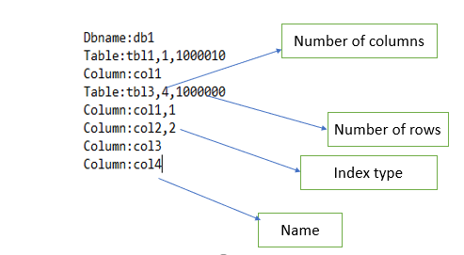
Metadata file for Database
Structure of the file is flat

Slide 6
Data size vs Response Time
Data sets of various sizes were generated from the given 1M data set
Scan was run on these different data sets fixing the selectivity to 5%
Data size (K) | Response Time(usec)
25 | 158
75 | 422
125 | 733
250 | 1375
500 | 2822
1000 | 5308

Slide 7
Shared Scan
Implemented using Threadpool and number of threads in Threadpool is a parameter
Each select query is added to a Task array during parse step.
Each item in the Task array has a function pointer based on the select
Each Thread in the Threadpool is assigned a specific task ids based on the Thread id which is index of the thread in Threadpool.
For e.g. if there are 16 tasks/queries and 4 threads,
Thread 1 will be assigned queries 1, 5, 9, 13. Thread 2 will be assigned queries 2, 6, 10, and 14. and so on
Once the task is assigned, the column data is scanned vector wise. Using the previous example.
Thread 2 starts processing query 2. Vector size is fixed to 3200
Thread calls the appropriate select method using the function pointer of task array item
The start position and running position vector to collect the qualifying tuples is passed
Start position is incremented by vector size
Once the scan of the column is done Thread 2 takes up query 6 and does same as above.

Slide 8
Shared Scan(continued..)
Ran different test on 4 –core machine with different number of queries
Performance improvement of only 1.15 is observed.
However on the test server, performance increase of 1.9 is observed.
 | Normal Scan | Shared Scan |  |  | NormalScan/Shared Scan for 4 Threads
# queries | 1 Thread (usec) | 2 Threads (usec) | 4 Threads (usec) | 8Threads (usec)
4 | 22380 | 20288 | 20669 | 20490 | 1.082780976
8 | 46694 | 41420 | 40142 | 44644 | 1.163220567
16 | 86006 | 75973 | 75748 | 88684 | 1.135422717
32 | 170656 | 146189 | 156130 | 157128 | 1.093037853

Slide 9
B-Tree and Sort Index
Sort Index
Merge sort for sorting the index column
For clustered index the sort order is propagated
Position vector stores the original position ids
B Tree Index
Merge sort for sorting the index column
Construct the B-Tree and store the original position ids at leaf nodes.
Order of the B-Tree is a parameter. Currently set to 1024

Slide 10
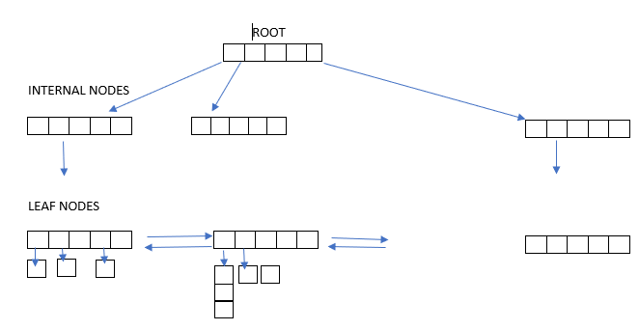
B-Tree

Slide 11
B-Tree Construction and Persistence
Bulk insertion vs Normal insertion with sorting
Persistence of B-Tree by serializing and reconstructing the tree on start up.
Index file is stored as preorder traversal of tree.
Compare time for test 20 before persistence and after persistence
B-Tree Fanout | Normal Insertion(usec) | Bulk Insertion(usec)
8 | 519329 | 343296
64 | 401829 | 329886
256 | 379245 | 327630
1024 | 369807 | 326220
Before Persistence (usec) | After Persistence (usec)
301212 | 12757

Slide 12
Select
Results of select operator for various scan methods on two random column of 1M.
Selectivity | NormalScan (usec) | IndexScan (BTree) (usec) | IndexScan (Sort) (usec)
0.1 | 5561 | 1242 | 1053
1 | 5680 | 1276 | 1176
5 | 6061 | 1292 | 1242
10 | 6361 | 1693 | 1453
25 | 8443 | 2396 | 2182

Slide 13
Fetch
Results for Fetch operator for different scan methods on two random columns of 1M
Selectivity (%) | NormalScan (usec) | IndexScan(BTree) (usec) | IndexScan(Sort) (usec)
0.1 | 56 | 85 | 4
1 | 150 | 258 | 33
5 | 399 | 938 | 158
10 | 463 | 1823 | 385
25 | 922 | 3662 | 1704

Slide 14
Joins
Different join algorithms were tried
Nested Loop
Hash Join
Sort merge
Grace Hash Join
Comparison of different join methods
%of tuples | NestedLoop(msec) | Hashjoin(msec) | Sortmerge(msec)
0.5 | 10947 | 70 | 4
1 | 21296 | 88 | 4
5 | 107237 | 373 | 4
10 | 212774 | 493 | 4

Slide 15
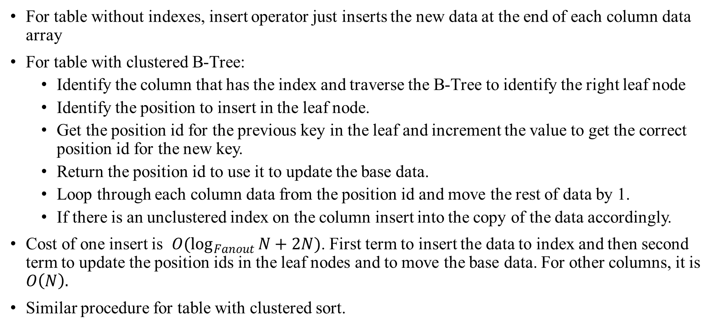
Insert
For table without indexes, insert operator just inserts the new data at the end of each column data array
For table with clustered B-Tree:
Identify the column that has the index and traverse the B-Tree to identify the right leaf node
Identify the position to insert in the leaf node.
Get the position id for the previous key in the leaf and increment the value to get the correct position id for the new key.
Return the position id to use it to update the base data.
Loop through each column data from the position id and move the rest of data by 1.
If there is an unclustered index on the column insert into the copy of the data accordingly.
Cost of one insert is $O(\log_{Fanout}{N+2N)}$. First term to insert the data to index and then second term to update the position ids in the leaf nodes and to move the base data. For other columns, it is $O\left(N\right).$
Similar procedure for table with clustered sort.

Slide 16
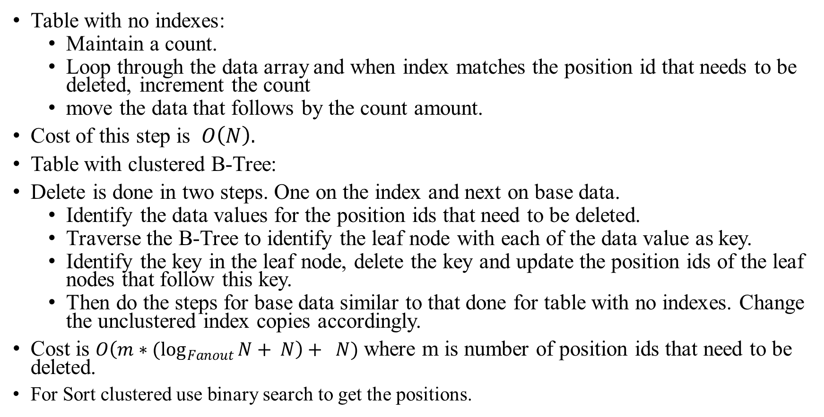
Delete
Table with no indexes:
Maintain a count.
Loop through the data array and when index matches the position id that needs to be deleted, increment the count
move the data that follows by the count amount.
Cost of this step is $O\left(N\right).$
Table with clustered B-Tree:
Delete is done in two steps. One on the index and next on base data.
Identify the data values for the position ids that need to be deleted.
Traverse the B-Tree to identify the leaf node with each of the data value as key.
Identify the key in the leaf node, delete the key and update the position ids of the leaf nodes that follow this key.
Then do the steps for base data similar to that done for table with no indexes. Change the unclustered index copies accordingly.
Cost is $O\left(m∗{(log}_{Fanout}{N}+ N\right)+ N)$ where m is number of position ids that need to be deleted.
For Sort clustered use binary search to get the positions.

Slide 17
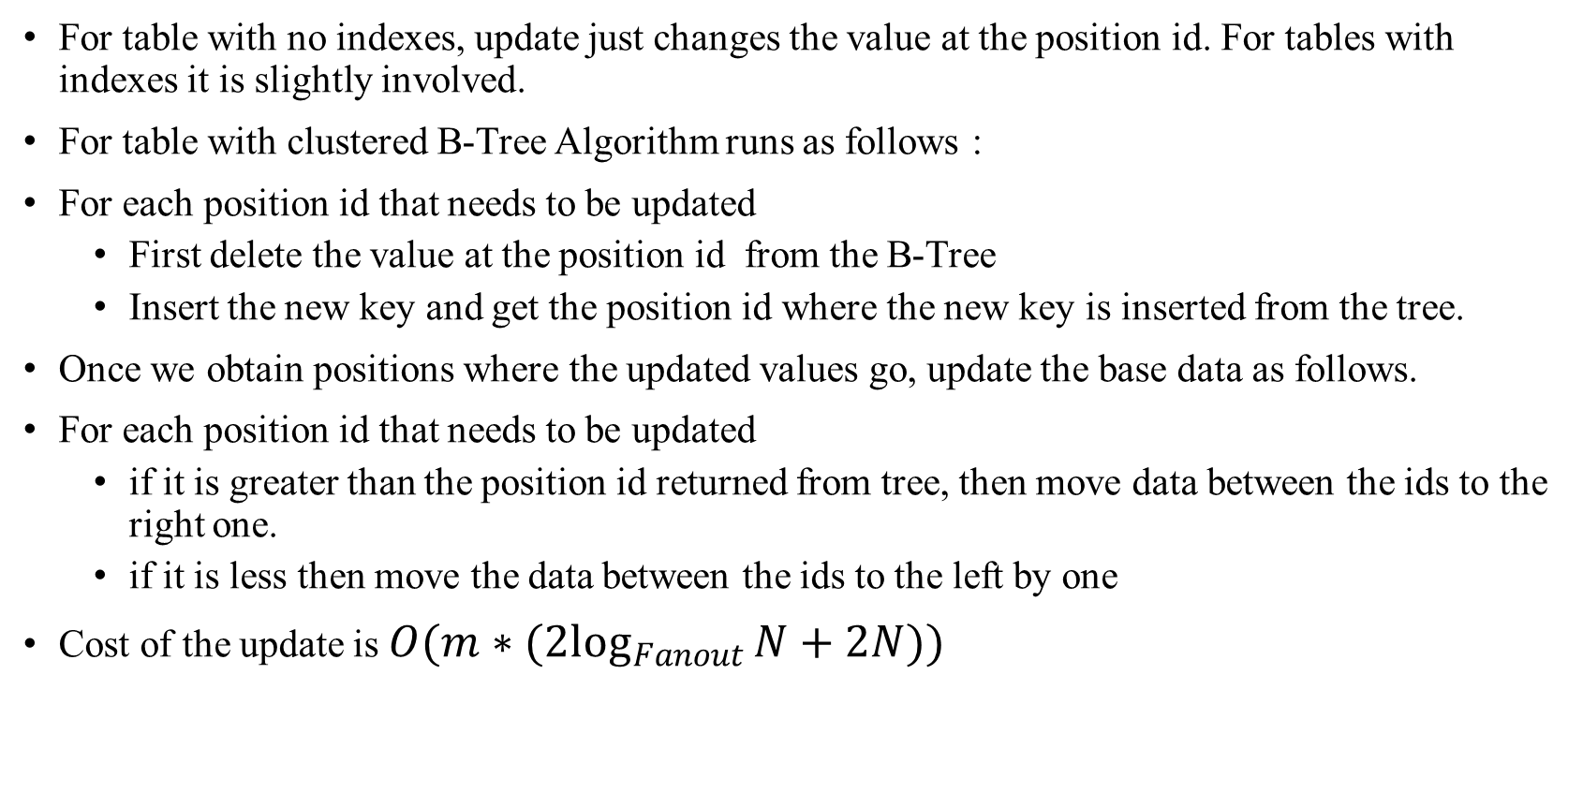
Update
For table with no indexes, update just changes the value at the position id. For tables with indexes it is slightly involved.
For table with clustered B-Tree Algorithm runs as follows :
For each position id that needs to be updated
First delete the value at the position id from the B-Tree
Insert the new key and get the position id where the new key is inserted from the tree.
Once we obtain positions where the updated values go, update the base data as follows.
For each position id that needs to be updated
if it is greater than the position id returned from tree, then move data between the ids to the right one.
if it is less then move the data between the ids to the left by one
Cost of the update is $O(m∗({2log}_{Fanout}{N+2N))}$

Slide 18
The End

