Slide 1
MUTUAL FUND ANALYTICS PLATFORM
Capstone Project | Bluestock Fintech Pvt. Ltd.
End-to-End Data Engineering | ETL Pipeline | Analytics | Power BI Dashboard
40
46K+
32K+
Rs.81L Cr
Fund Schemes
NAV Records
Transactions
Industry AUM
Individual Capstone | 7 Days | June 2026 | Data: AMFI India + mfapi.in + NSE/BSE
Intern, Data Analyst | github.com/kpavan97/bluestock_mf_capstone

Slide 2
Problem & Objective
P1
Data Fragmentation:
NAV, AUM, SIP and holdings data scattered across different AMFI sections in different formats.
P2
No Unified Analytics:
Investors cannot compare funds on risk-adjusted basis without computing Sharpe, Alpha, Beta themselves.
P3
No Benchmark Tracking:
Most retail investors do not know if their fund is beating the Nifty 50 or Nifty 100 index.
P4
Investor Behaviour Blind Spot:
AMCs lack visibility into how demographics and geography influence SIP and redemption patterns.
P5
Slow Static Reporting:
Monthly MF reports are static PDFs that take days to prepare with no drill-down capability.

Slide 3
Data Sources — 10 Real-World Datasets
File | Size | Description
01_fund_master.csv | 40 rows | 40 AMFI schemes — codes, fund house, expense ratio, risk grade
02_nav_history.csv | 46,000+ | Daily NAV Jan 2022 to May 2026 (anchored to real mfapi.in values)
03_aum_by_fund_house.csv | 90 rows | Quarterly AUM for top 10 AMCs (SBI Rs.12.5L Cr anchor)
04_monthly_sip_inflows.csv | 48 rows | Monthly SIP inflows, active accounts, SIP AUM (Dec 2025 Rs.31K Cr)
05_category_inflows.csv | 144 rows | Net inflows by category — Large Cap, Mid Cap, Small Cap, Liquid etc.
06_industry_folio_count.csv | 21 rows | Total MF folios growth from 13.26 Cr to 26.12 Cr
07_scheme_performance.csv | 40 rows | Sharpe, Sortino, Alpha, Beta, CAGR, Max Drawdown for all 40 funds
08_investor_transactions.csv | 32,000+ | SIP/Lumpsum/Redemption for 5,000 investors across 12 states
09_portfolio_holdings.csv | 320 rows | Top stock holdings, sector weights for all equity funds (Dec 2025)
10_benchmark_indices.csv | 8,050 rows | Nifty 50, Nifty 100, BSE SmallCap, CRISIL Liquid & Gilt daily closes

Slide 4
System Architecture — ETL Pipeline
1
2
3
4
5
EXTRACT
TRANSFORM
LOAD
ANALYSE
VISUALISE
AMFI CSV Files (10 datasets)
Parse dates, fix types, drop dupes
SQLite star schema (8 tables)
Jupyter notebooks (Days 3-6)
Power BI 4-page dashboard
mfapi.in REST API (live NAV)
Forward-fill weekends/holidays
SQLAlchemy ORM via df.to_sql()
Sharpe, Alpha, Beta, VaR, HHI
Interactive slicers & filters
NSE/BSE benchmark indices
Compute daily returns, CAGR, Sharpe
64,320 NAV rows loaded
15+ charts, fund scorecard
Exported PDF + PNG reports
Scripts: data_ingestion.py | live_nav_fetch.py | etl_pipeline.py | compute_metrics.py | recommender.py

Slide 5
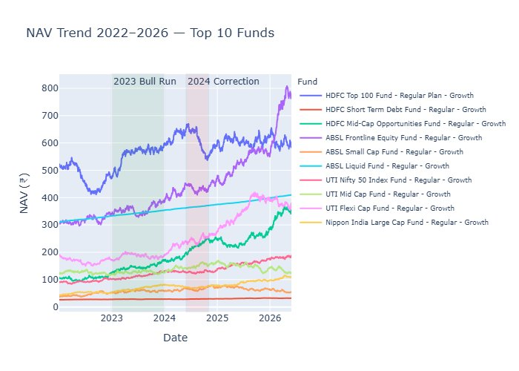
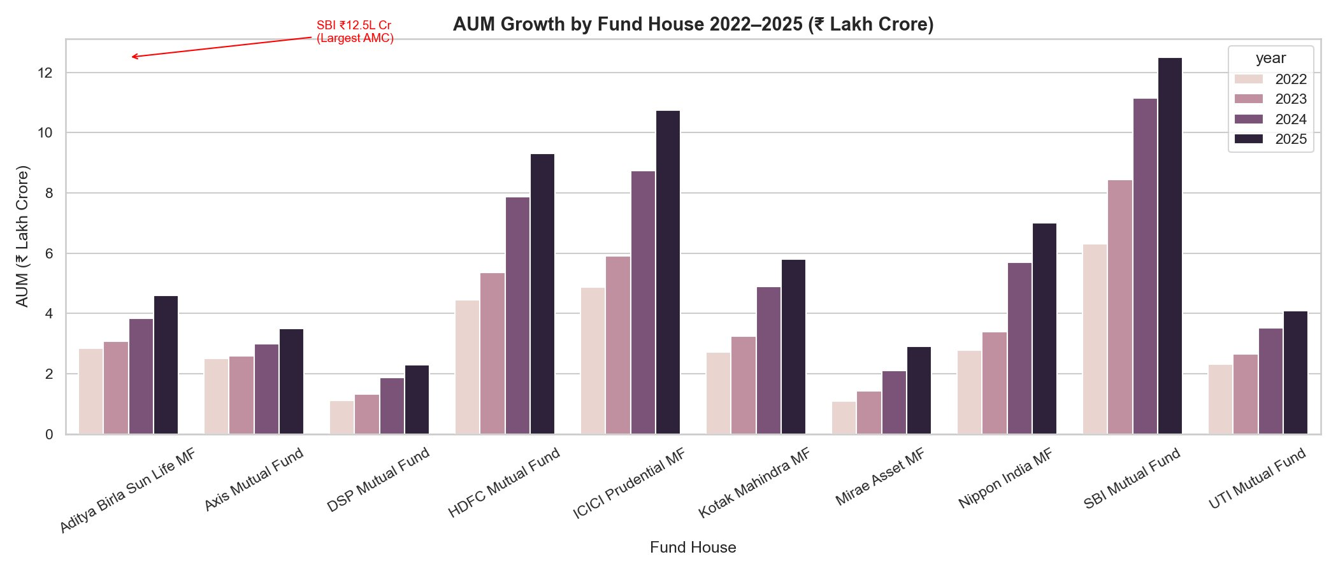
EDA Highlights — NAV Trends & AUM Growth
SBI leads at Rs.12.5L Cr AUM — nearly 20% of entire Indian MF industry.
NAV Trend 2022-2026: 2023 Bull Run (green) and 2024 Correction (red) clearly visible across all 10 funds.
Key Insight
All 10 fund houses grew AUM every year from 2022 to 2025. The industry is not slowing down — it is accelerating.

Slide 6
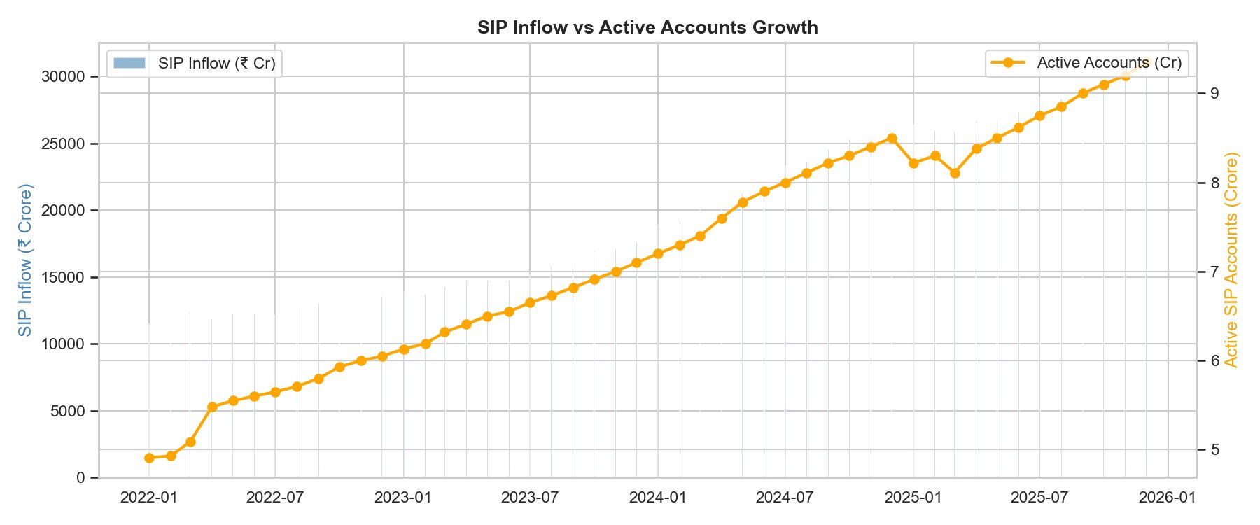
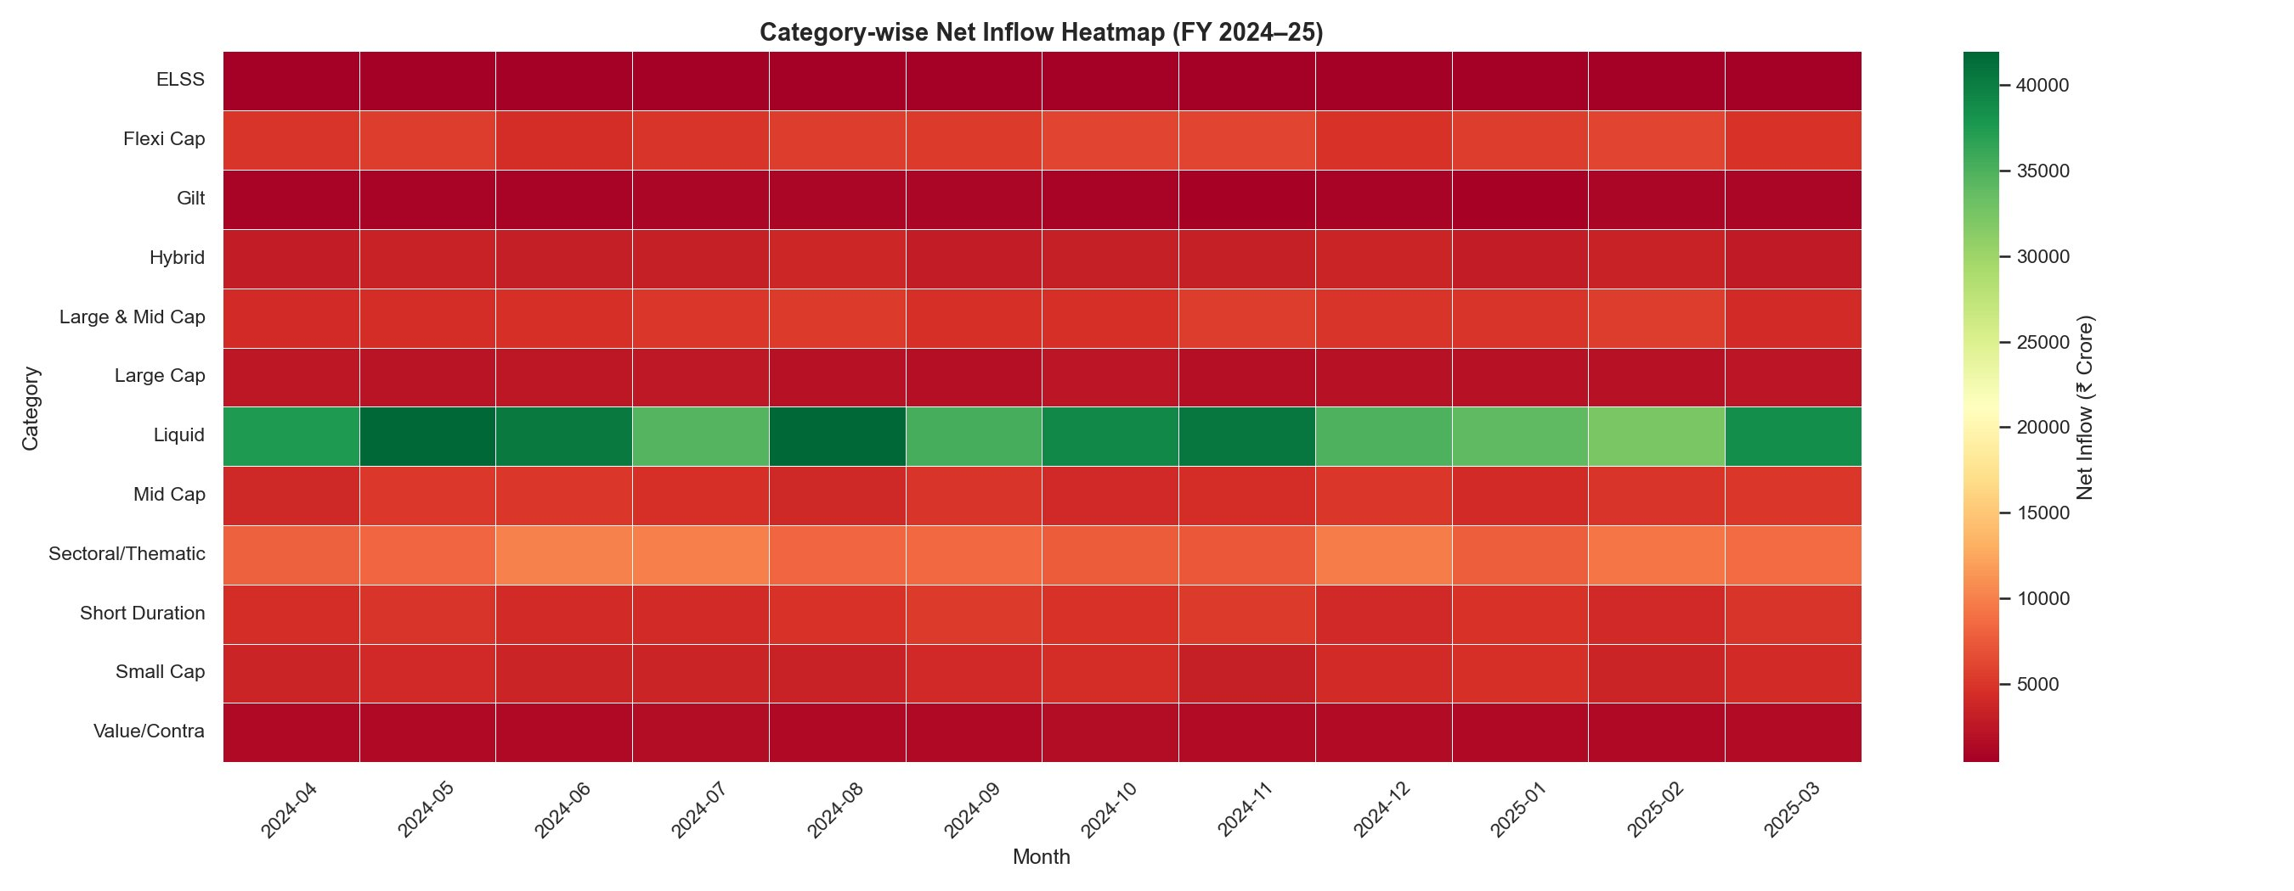
EDA Highlights — SIP Growth & Category Inflows
Rs. 31,002 Cr
Dec 2025 All-Time High
Monthly SIP Inflow
SIP inflows tripled from Rs.11K Cr (Jan 2022) to Rs.31K Cr (Dec 2025). Active accounts grew from 5 Cr to 9 Cr.
9.35 Crore
Active SIP Accounts
Dec 2025 — up from 5 Cr in Jan 2022
Liquid funds (green row) attract consistent inflows every month. Most equity categories show red during corrections.

Slide 7
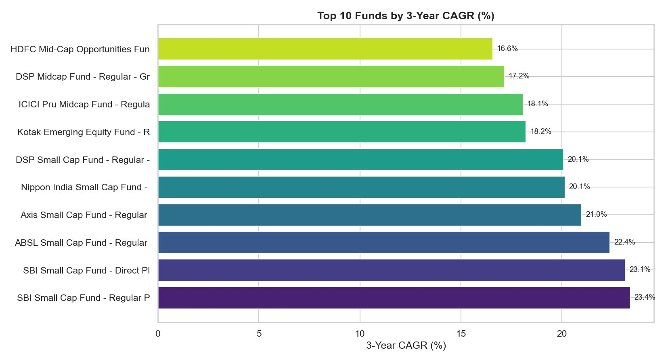
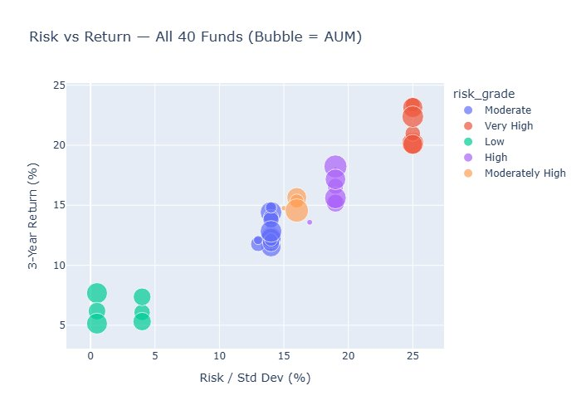
Performance Metrics — CAGR & Risk-Return
Risk vs Return scatter. High risk = high return as expected. Very High grade funds cluster top-right.
Top 10 funds by 3-Year CAGR. Small Cap funds dominate, led by SBI Small Cap Fund at 23.4%.
23.4%
7.68
Highest 3Y Return
Best Sharpe Ratio
SBI Small Cap Fund
ICICI Pru Liquid Fund

Slide 8
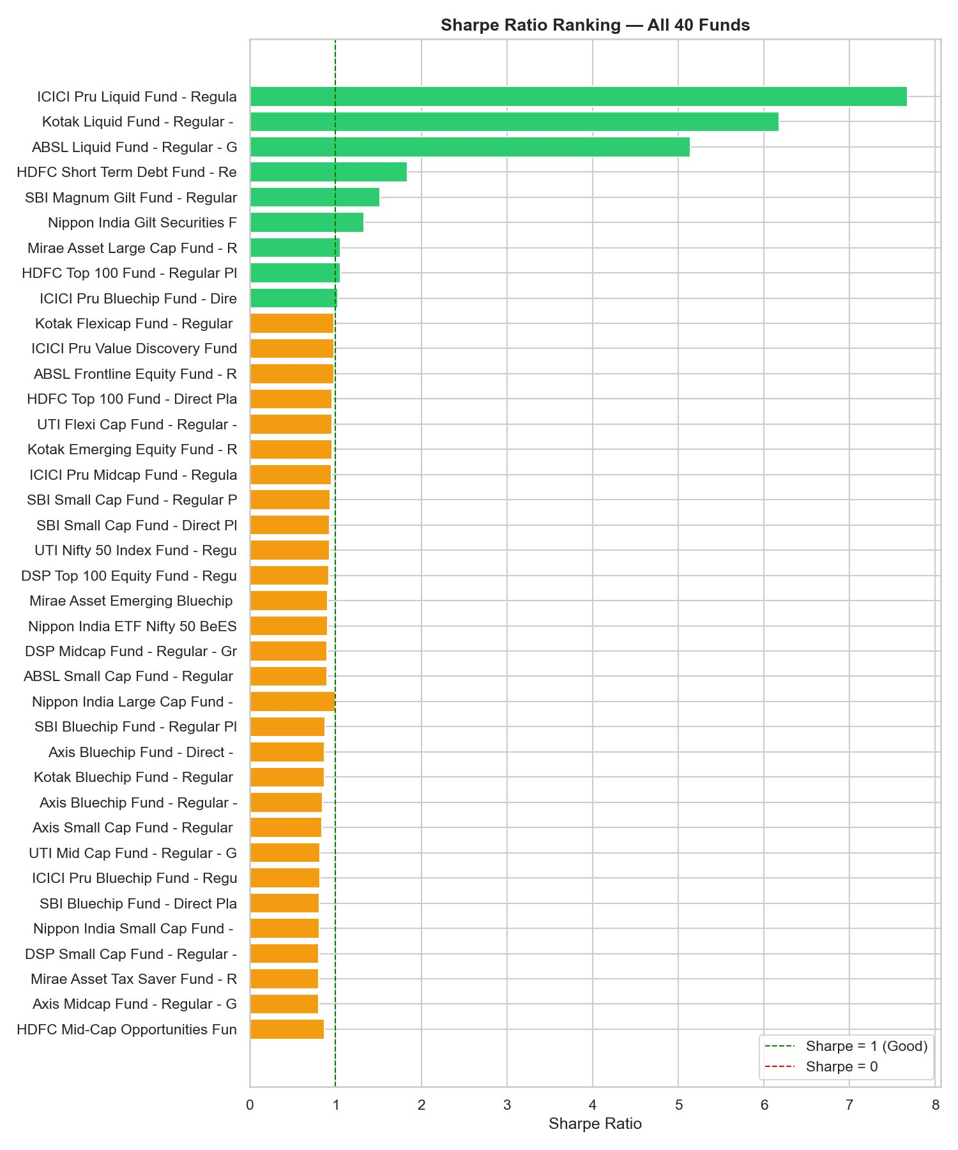
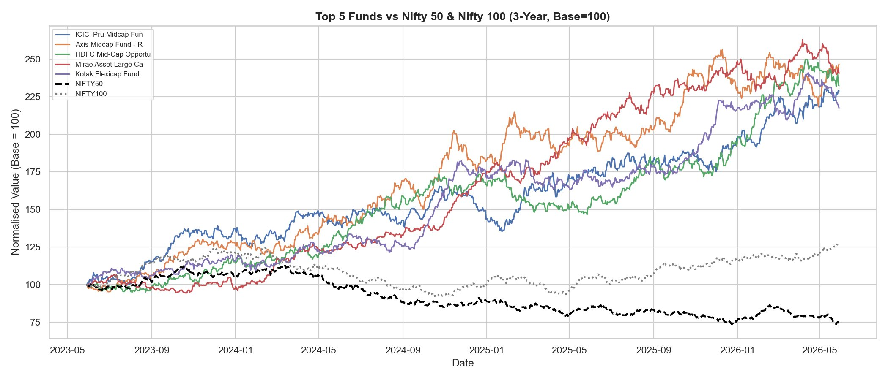
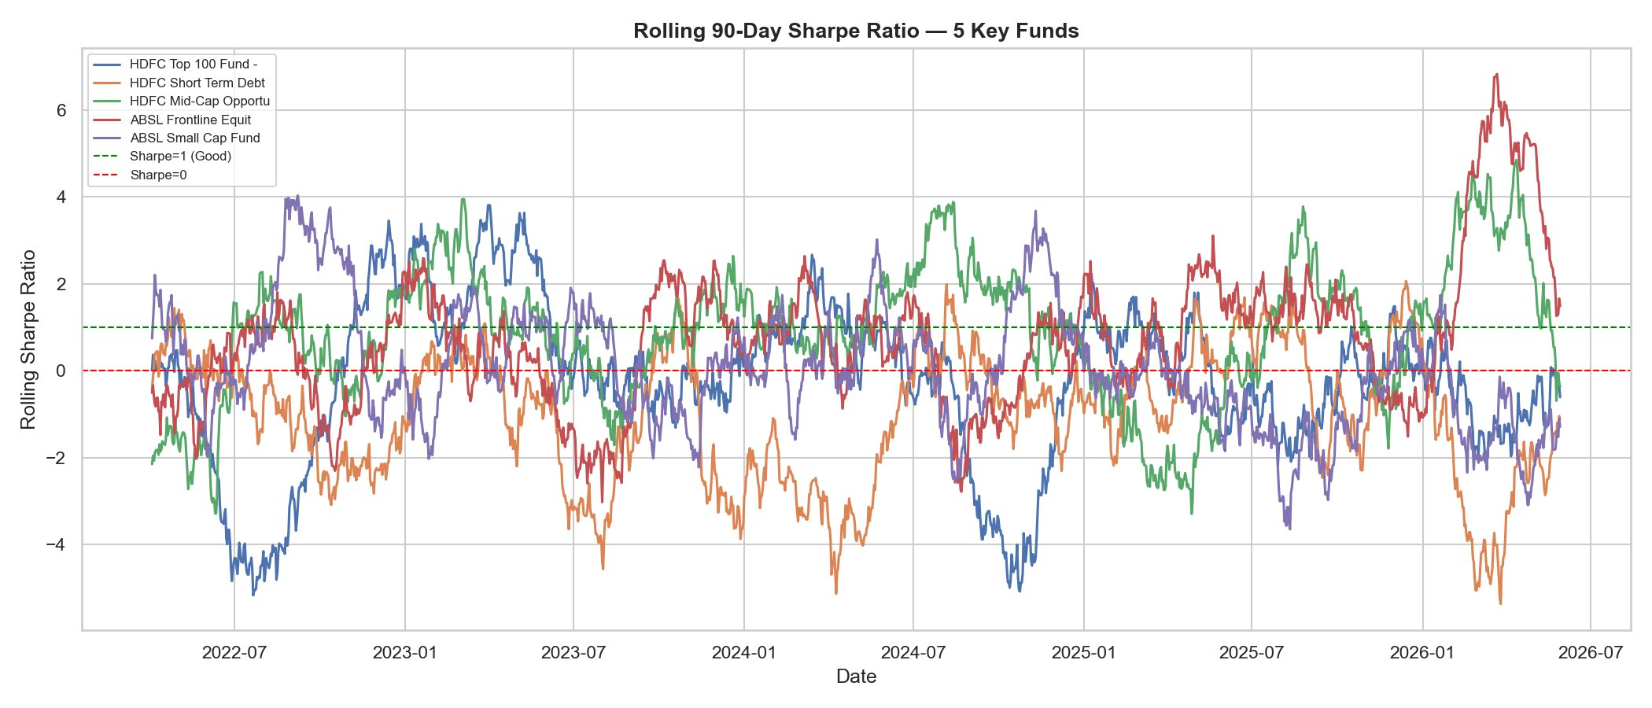
Performance Metrics — Sharpe Ratio & Benchmark
Top 5 funds vs Nifty 50 and Nifty 100 (Base=100). All 5 funds significantly outperform both indices over 3 years.
Sharpe Ratio ranking all 40 funds. Liquid funds lead at 5-7. Equity funds cluster around 1.0.
Rolling 90-day Sharpe. HDFC Mid-Cap most consistent above Sharpe=1 throughout 2022-2026.

Slide 9
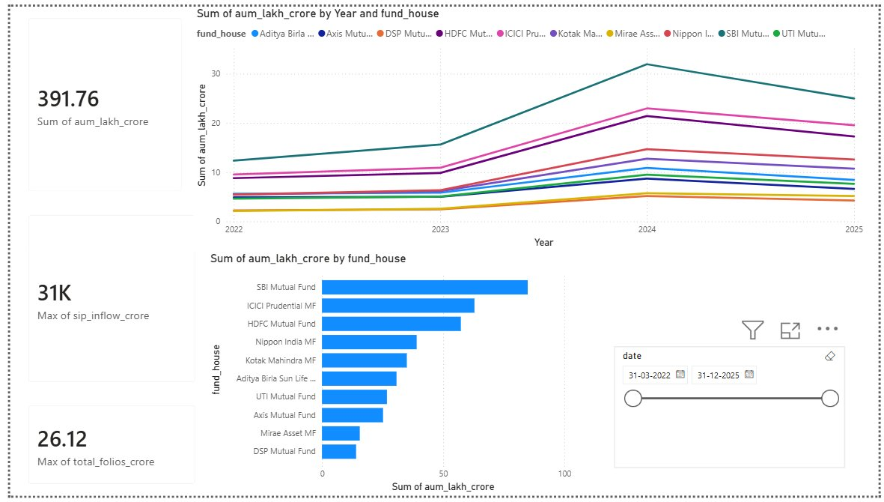
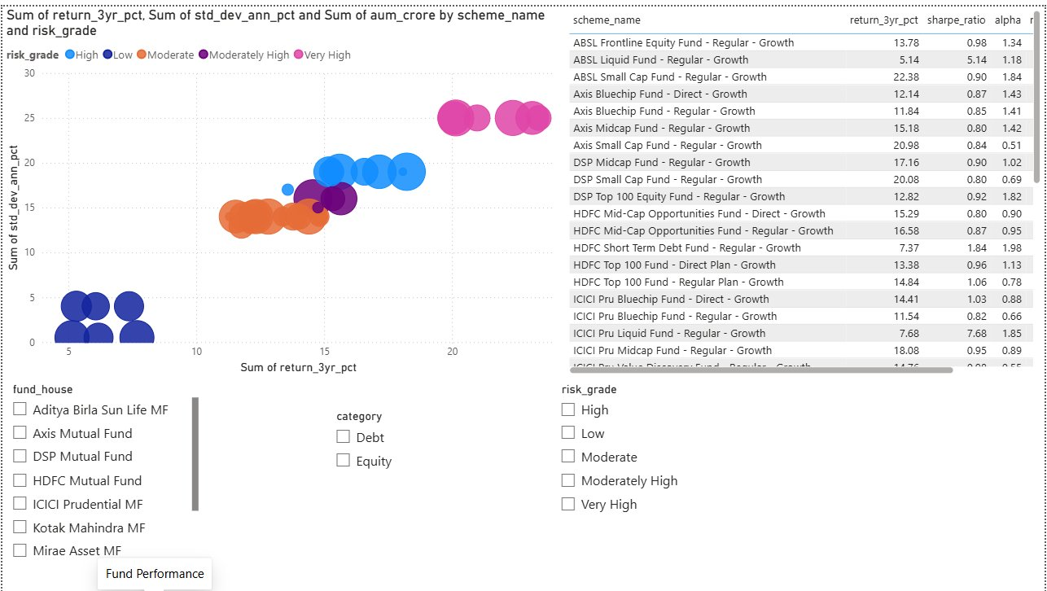
Dashboard — Industry Overview & Fund Performance
Page 1: Industry Overview
Page 2: Fund Performance

Slide 10
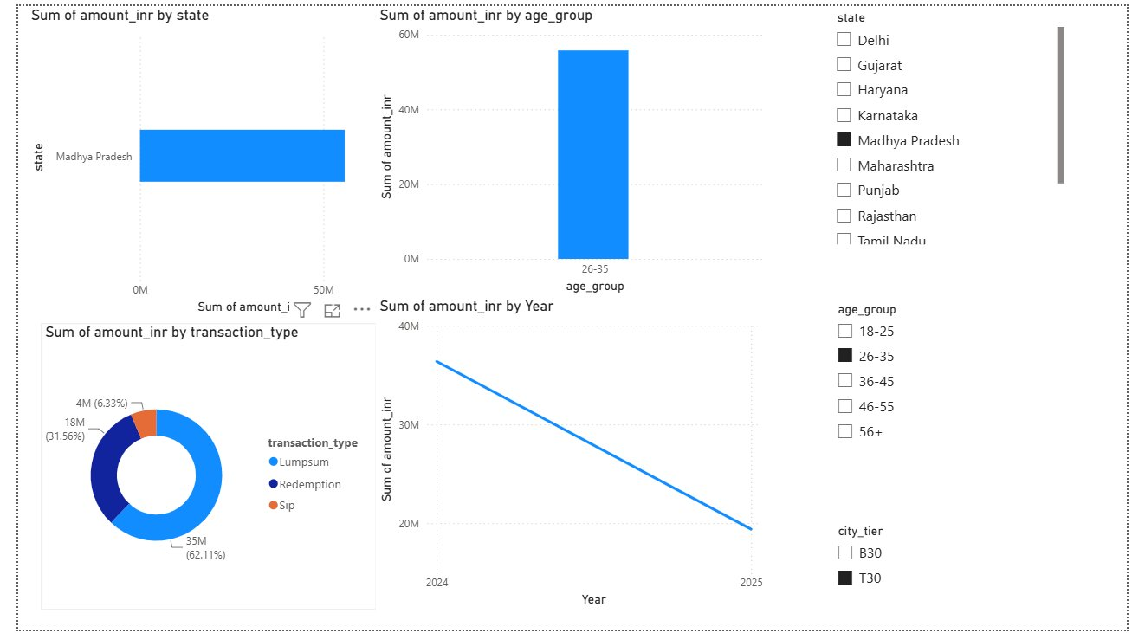
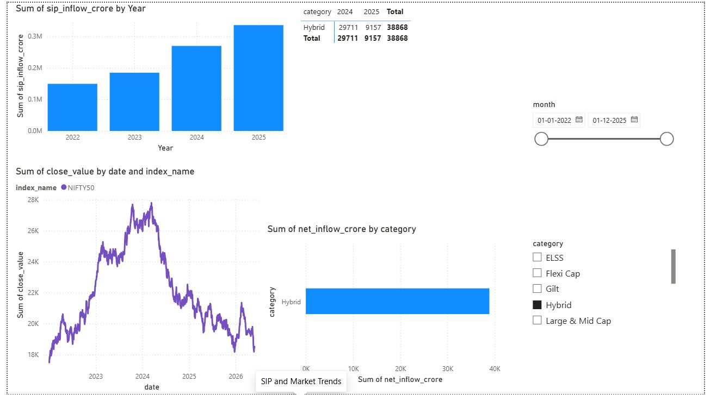
Dashboard — Investor Analytics & SIP Trends
Page 3: Investor Analytics
Page 4: SIP & Market Trends

Slide 11
10 Key Findings
01
SBI Mutual Fund is India's largest AMC with Rs.12.5 lakh crore AUM — nearly 20% of the entire industry.
06
ICICI Pru Liquid Fund leads all 40 schemes with a Sharpe Ratio of 7.68 — exceptional risk-adjusted return.
02
Monthly SIP inflows hit an all-time high of Rs.31,002 crore in December 2025, tripling from Rs.11K Cr in 2022.
07
All top 5 scored funds outperformed both Nifty 50 and Nifty 100 by a wide margin over 3 years.
03
Industry folios doubled from 13.26 crore to 26.12 crore between January 2022 and December 2025.
08
Banking and Financial Services dominates equity portfolios at 19.2%, followed by IT at 13.4%.
04
The 26-35 age group is the biggest SIP investor segment, reflecting a generational shift to equity investing.
09
Liquid funds are the only category with consistently positive net inflows every single month of the analysis.
05
Small Cap funds delivered the highest 3-year CAGR (above 23%) but also carry the highest risk.
10
Tier-2 cities are growing SIP participation 2.5x faster than Tier-1 cities, indicating huge untapped potential.

Slide 12
Thank You
Mutual Fund Analytics Platform — Bluestock Fintech Capstone
GH
DS
TS
GitHub
Data Source
Tech Stack
github.com/kpavan97/bluestock_mf_capstone
AMFI India + mfapi.in + NSE/BSE
Python | SQL | Power BI | Git
Intern, Data Analyst | Bluestock Fintech Pvt. Ltd. | June 2026
Mutual Fund investments are subject to market risks. This project is for educational purposes only.

