Slide 1
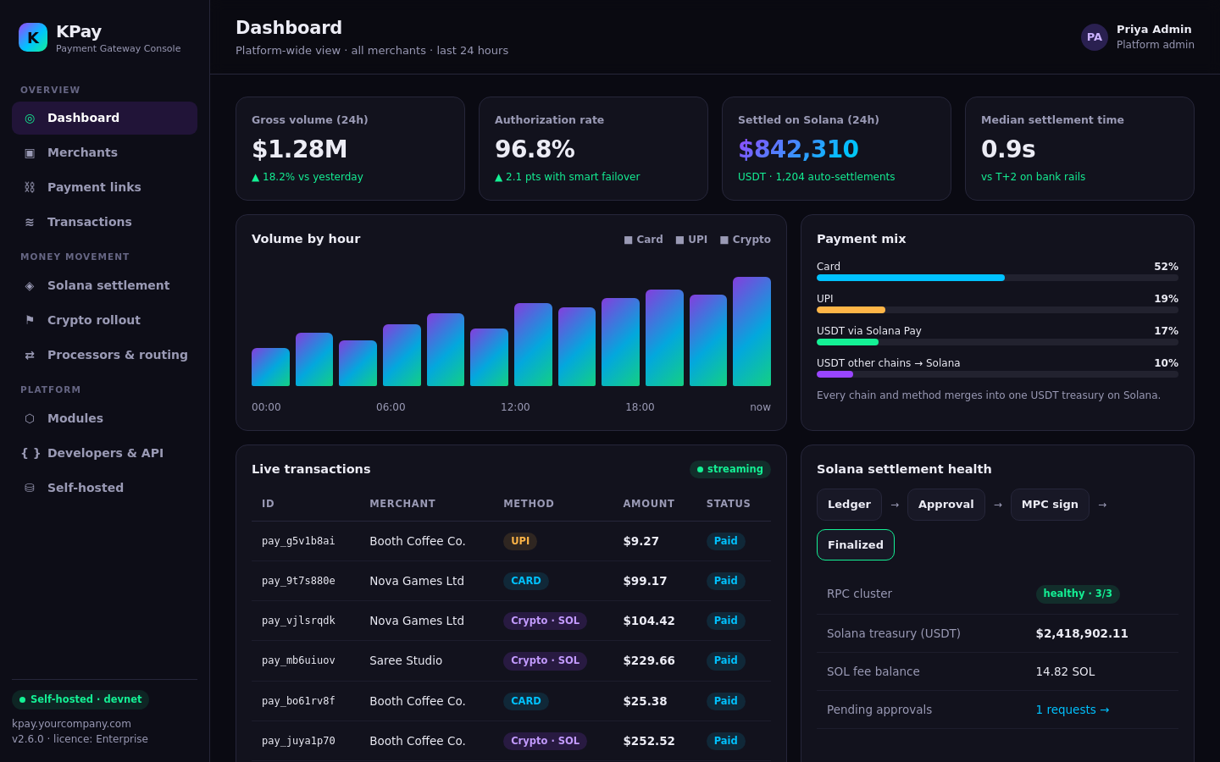
KPay
Accept anything.
Auto-settle on Solana.
Self-hosted · permissionless
Self-hosted private payment infrastructure for humans & AI agents. Card and crypto in, USDT on Solana out.
Live product · demo video inside
Notes:
KPay is a self-hosted payment gateway. Merchants accept cards, UPI and stablecoins through one checkout, and every merchant is settled in USDT on Solana. This deck covers the problem, the product (with a live demo), the APIs and why Solana is the settlement layer.

Slide 2



Money moves in seconds. Merchants wait days
Settlement, cost and control are still broken for global merchants
Slow settlement
Costly cross-border
Rented infrastructure
Bank rails settle T+1 to T+3, with weekend and holiday cut-offs. Working capital is stuck in transit.
FX spreads, correspondent and wire fees stack up, and high-risk or emerging-market merchants pay the most.
Hosted gateways own your data, pricing and uptime. Crypto processors skip cards and UPI entirely.
Notes:
Three pains we hear from every merchant and PSP we talk to.

Slide 3





KPay: one gateway, settled on Solana
Accept every local method, account for every cent, settle in USDT within seconds
Accept
Cards, UPI, Solana Pay, and USDT on Tron, Ethereum, Polygon, BNB Chain
Fiat & crypto in.
USDT out.
On your servers.
Merge
Other-chain USDT is swept and bridged straight into the Solana treasury
Account
Append-only double-entry ledger, MDR + tax per rule, rolling reserve, FX buffer earned on conversion
Every payment method a merchant needs, converted at a locked oracle quote and paid out as USDT to the merchant’s own Solana wallet — no bank cut-off, no weekends.
Settle
USDT auto-settles to the merchant Solana wallet; approval only above threshold
Own it
Self-hosted in your VPC with your keys. Commercial licence, closed source
Notes:
KPay does three jobs end to end. Accept: cards, UPI and stablecoins on five networks. Account: a double-entry ledger with oracle-priced conversion. Settle: USDT to the merchant wallet on Solana, maker-checker approved and chain-verified.

Slide 4




How KPay works, end to end
From any payer to a finalized USDT settlement in the merchant wallet
Payers
KPay core
Solana rail
Merchant
Solana Pay
Routing + failover
Sweep + bridge
USDT treasury
Own wallet
Tron · Ethereum
Auto-settle
Treasury
Double-entry ledger
Risk + rollout
Polygon · BSC
Finalized
Off-ramp
Hosted checkout
API + webhooks
Card · UPI
Everything above runs in your VPC · your keys (MPC / HSM) · your data · one licence
Notes:
Walk left to right. Payers use whatever they have. KPay core routes, prices, records and risk-checks the payment. Settlement runs on Solana as an SPL USDT transfer. Merchants receive funds in their own wallet and can hold, treasury-manage or off-ramp.

Slide 5




One install, four levels of use
The same gateway scales from one brand to a regulated bank
L4 · Bank
Regulated, multi-region
L3 · PSP
White-label for its merchants
L2 · Platform
Marketplace onboards sellers
L1 · Merchant
One brand, own checkout
Links + API
Onboarding + approval
Reseller + routing
HSM keys + residency
Notes:
KPay is used at four levels. A single merchant runs its own checkout. A platform or marketplace onboards sub-merchants. A PSP or acquirer white-labels KPay for its merchants. A bank or enterprise runs it multi-region with its own HSM and data residency. Same code, different modules switched on.

Slide 6
Why Solana is the settlement layer
Stablecoin payments have already moved here
$650B
400 ms
stablecoin transfers on Solana in Feb 2026
slot time; Alpenglow targets ~150 ms finality
≈$0.001
Visa
base network fee per settlement transfer
settles USDC with US banks on Solana
Sources: Blockeden.xyz (Artemis data), Mar–Apr 2026; Visa, Dec 2025. Figures rounded.
Notes:
Sources: Blockeden / Artemis data on stablecoin transfer volume (Feb and Apr 2026); Visa USDC settlement on Solana for US banks (late 2025). Fee figure is the 5,000-lamport base fee; priority fees can add a little at peak. Alpenglow aims for ~150ms finality and is expected later in 2026.

Slide 7
What only KPay does
The only self-hosted gateway that takes fiat and crypto in and settles on Solana
Capability | Hosted card gateways | Crypto-only processors | KPay
Self-hosted in your own VPC, your keys | ○ | ○ | ●
Cards + UPI + stablecoins in one checkout | ◐ | ◐ | ●
Any chain in, merged and auto-settled on Solana | ○ | ◐ | ●
Double-entry ledger + chain-verified finality | ◐ | ○ | ●
Multi-processor routing with failover | ◐ | ○ | ●
Governed crypto rollout: cohorts, caps, kill switch | ○ | ○ | ●
● full ◐ partial / limited ○ not offered
Notes:
Comparison is by category, not against any one company. Hosted card gateways are strong on cards but you rent them and they settle in fiat on bank rails. Crypto processors take crypto only. KPay combines both and runs on your own infrastructure.

Slide 8
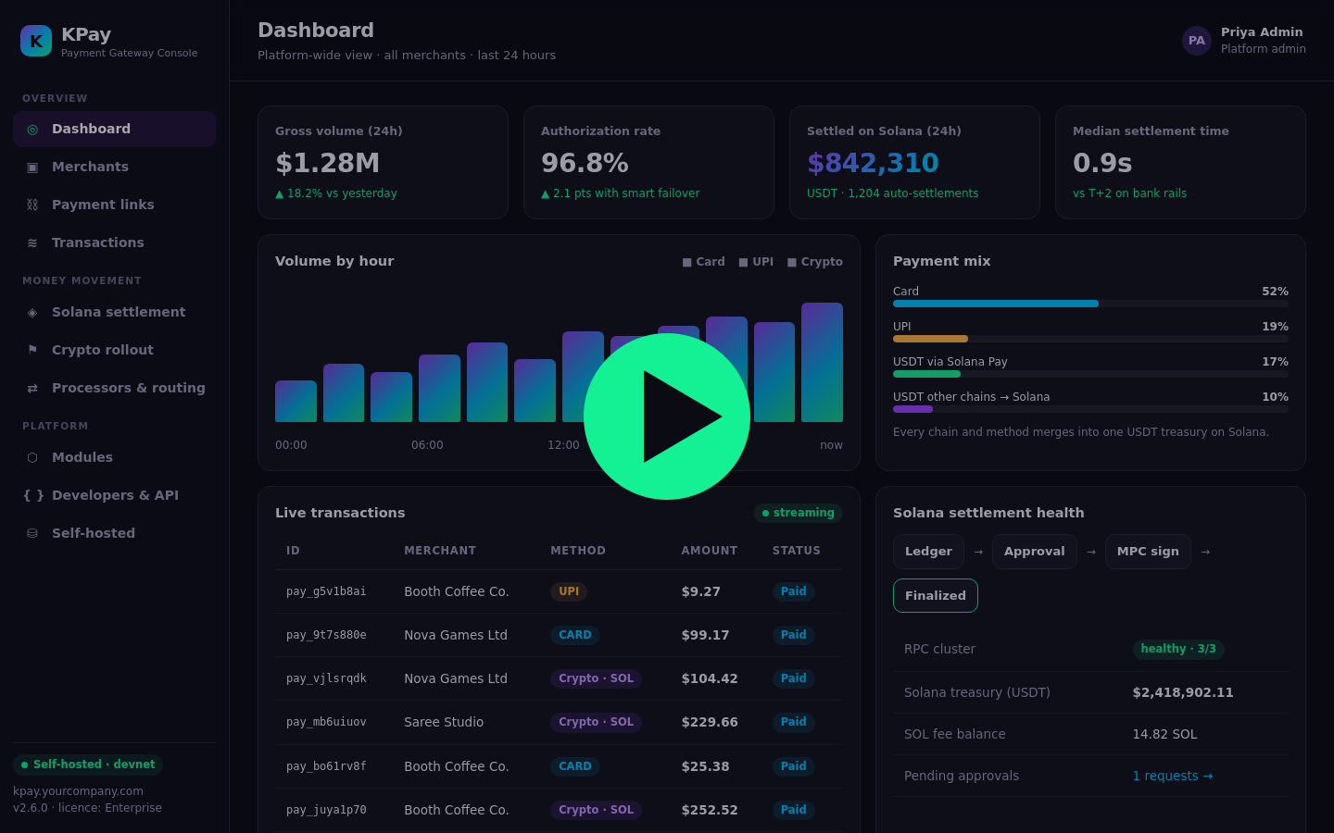
Product demo
Login → onboarding → payment link → Solana Pay → rollout → routing → settlement
Notes:
Play the embedded 110-second demo (also saved as video/kpay-demo.mp4). Each feature is captioned on screen. The following slides show the same flow as stills.

Slide 9
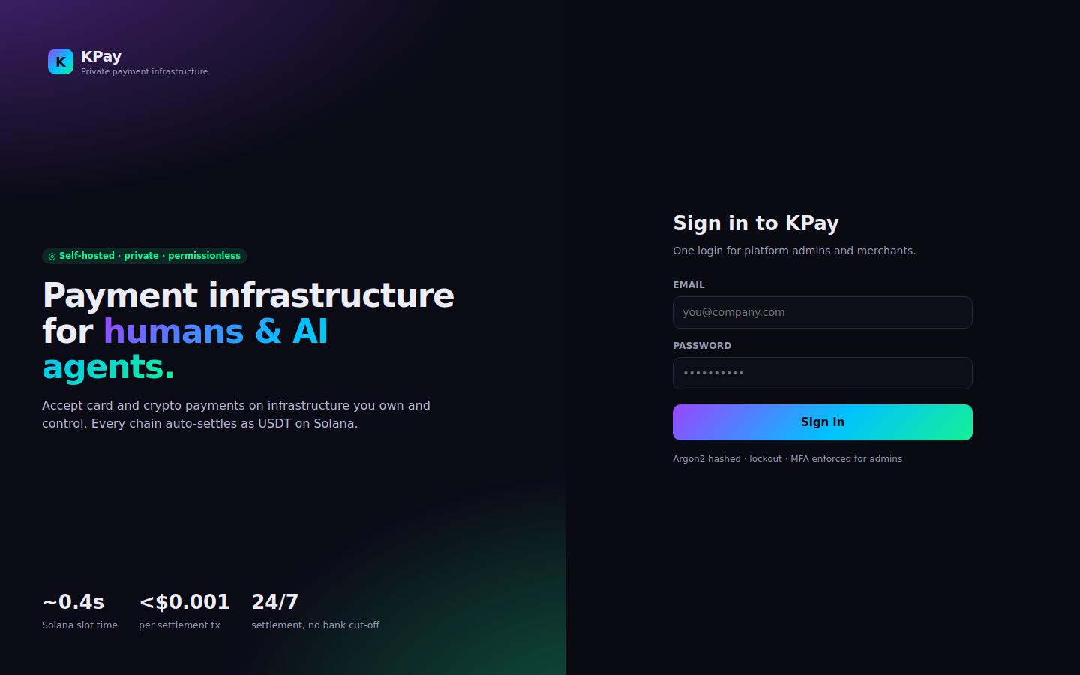


Admin login
One identity source for platform admins and merchants
Unified login
One URL resolves admin and merchant contexts
Argon2 + lockout
Brute-force protection on every account
MFA enforced
TOTP or WebAuthn for every admin
Roles + IP rules
Five platform roles, IP allow-list
Notes:
Unified login: one URL for every principal. Passwords are argon2-hashed with lockout. Admins must use MFA (TOTP or WebAuthn). Five platform roles, IP allow-listing on admin routes, and a fixation-safe session cookie.

Slide 10
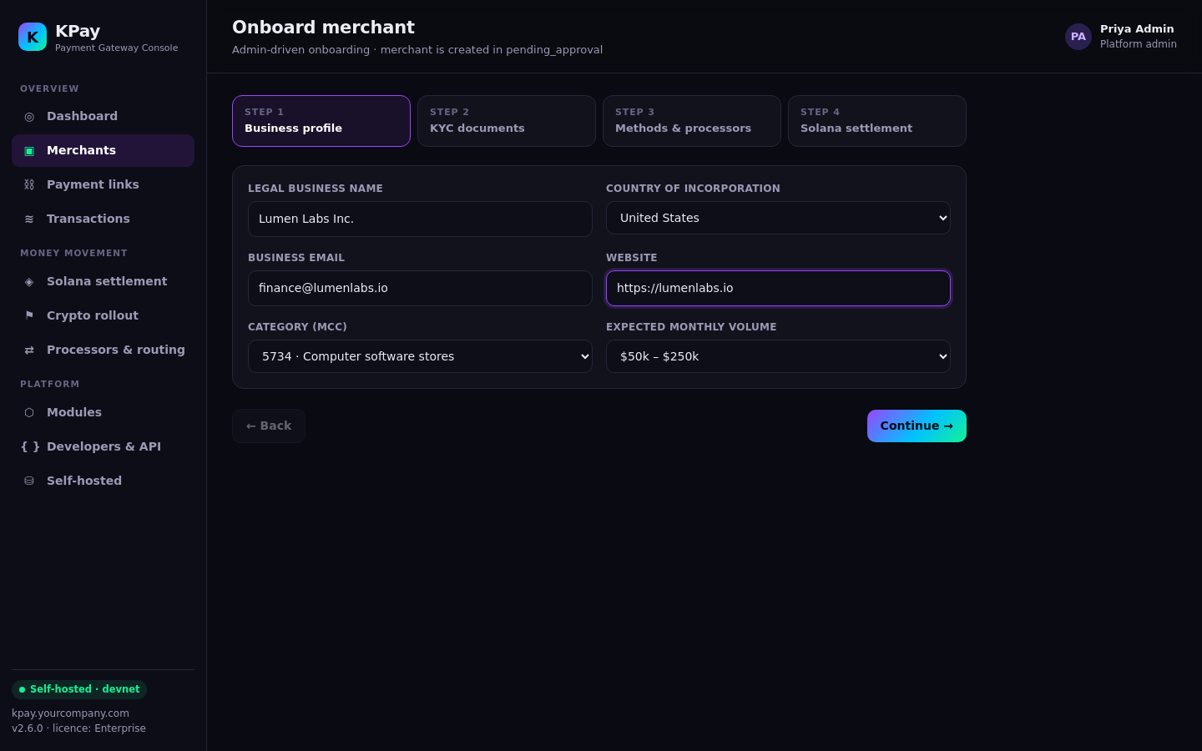
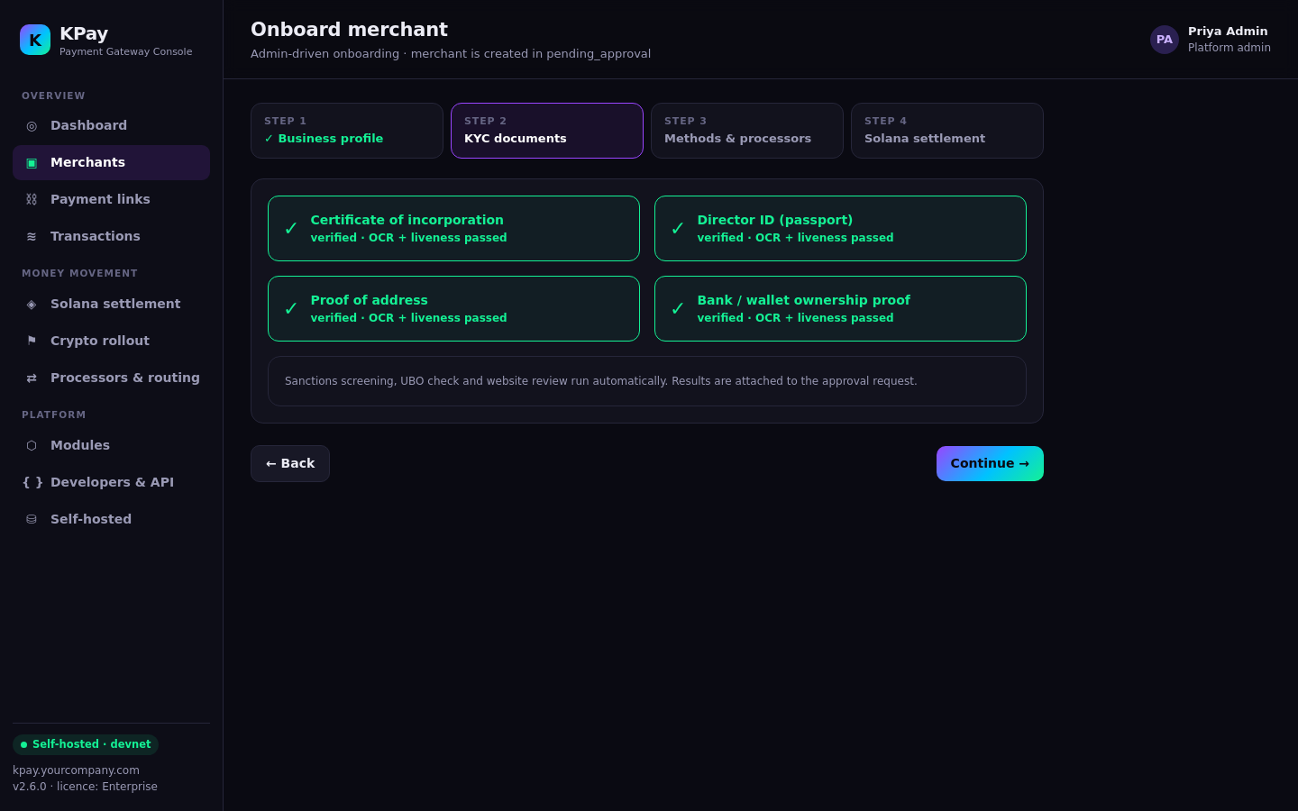



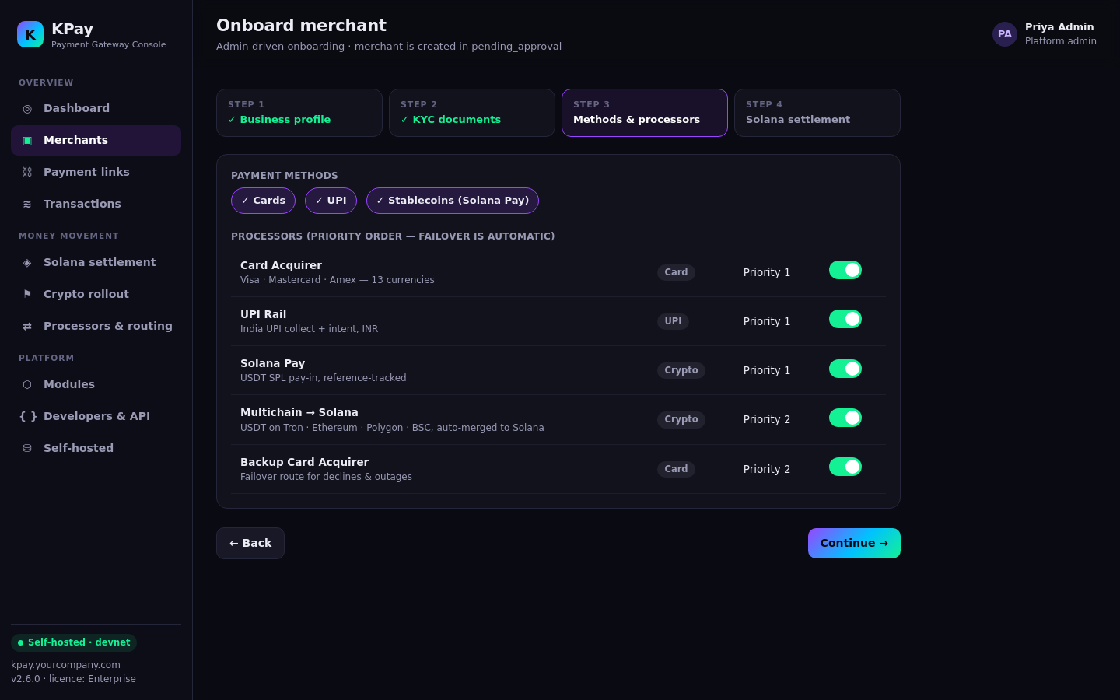
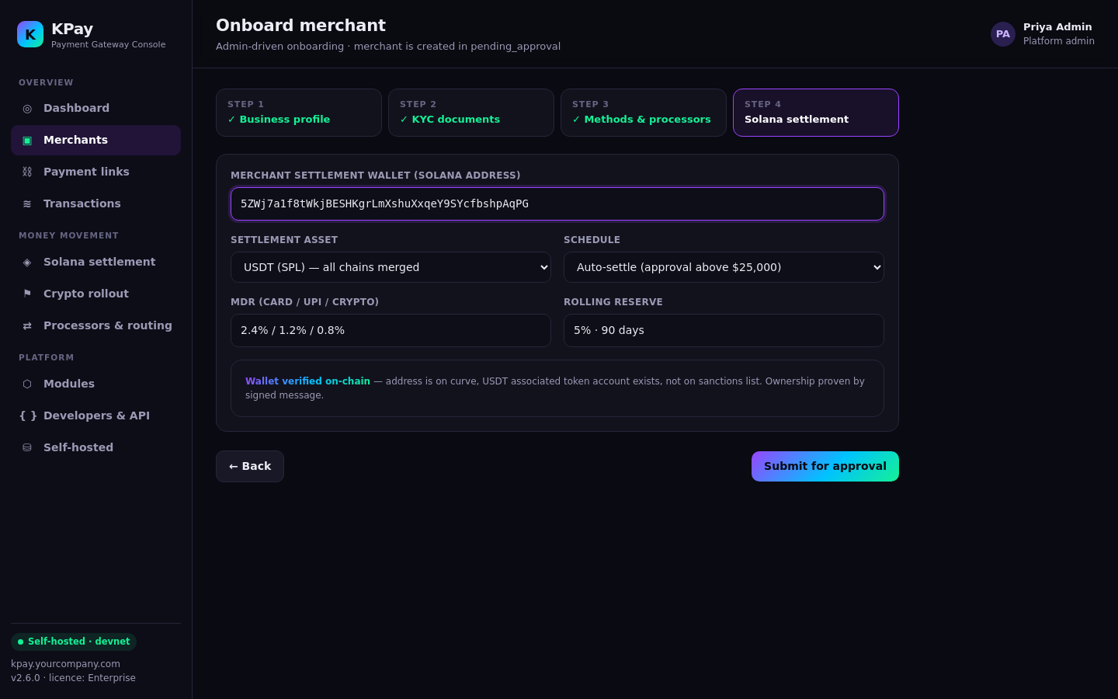

Merchant onboarding
Four guided steps, then a mandatory admin approval
1 · Business profile
Legal entity, MCC, expected volume
2 · KYC documents
OCR, liveness, sanctions and UBO checks
3 · Methods & processors
Card, UPI, Solana Pay, with failover order
4 · Solana settlement
Merchant wallet verified on-chain
Admin approves
Maker-checker gate, then the merchant goes live
Notes:
Admin-driven onboarding. Every merchant is born pending_approval; no auto-approve path exists. Step 4 captures the merchant Solana wallet and verifies it on-chain (on curve, USDT token account exists, ownership proven by a signed message). Approval enables exactly the selected connectors and flips the merchant live in one transaction.

Slide 11
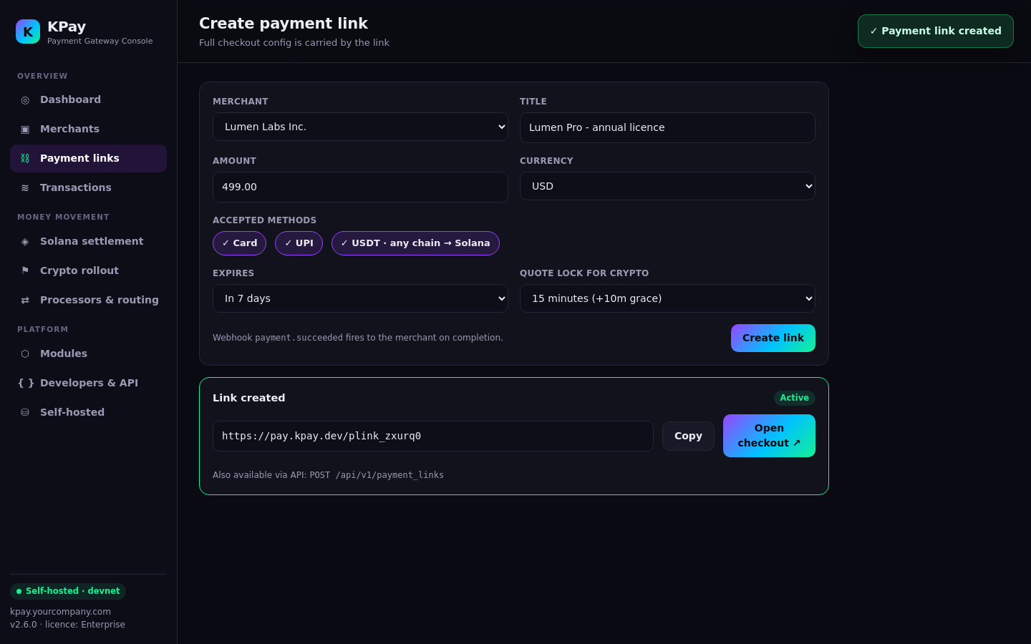
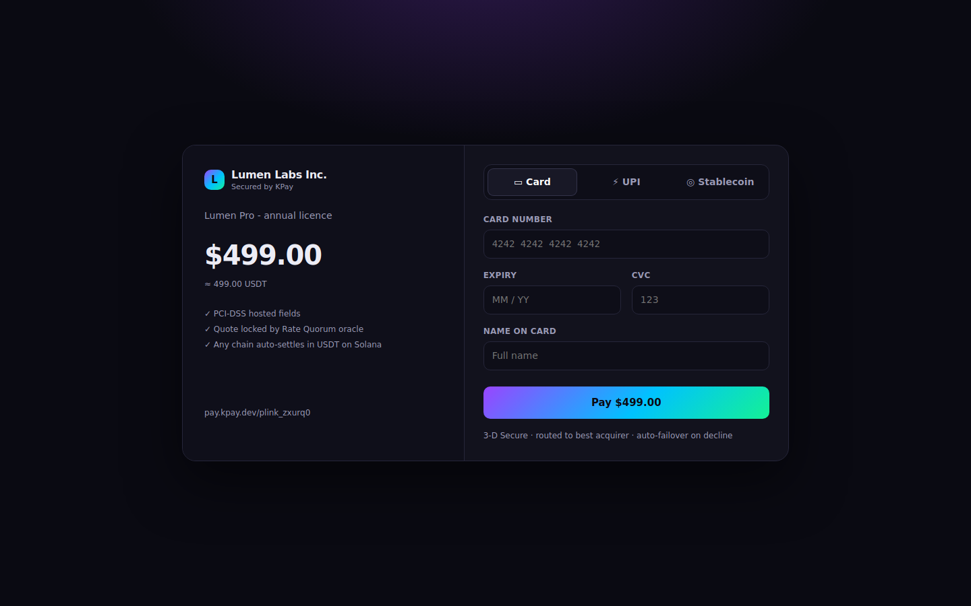
Payment link creation
No-code links in the console, or one API call
Create
Amount, currency, methods, expiry and a 15-minute crypto quote lock.
Share
One link takes card, UPI or stablecoin. The merchant always settles in USDT.
Notes:
The link carries the full checkout config: amount, currency, accepted methods, expiry and the crypto quote lock. The same thing is available through POST /api/v1/payment_links with an idempotency key.

Slide 12
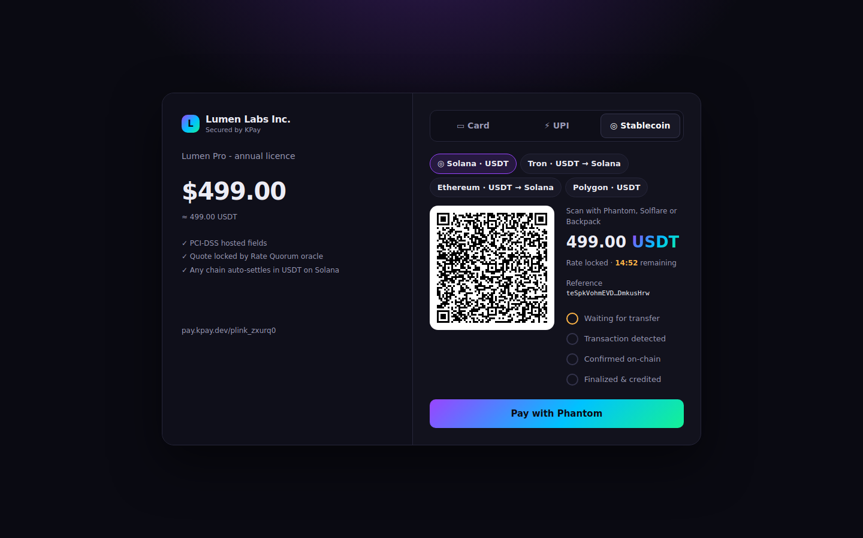
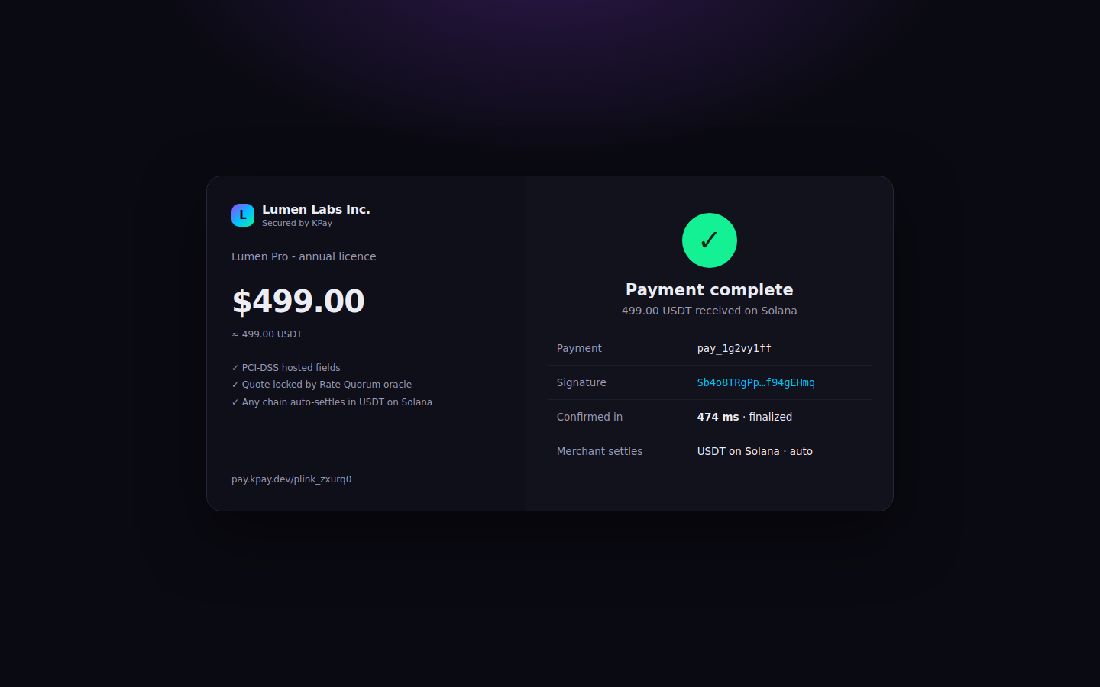
Stablecoin checkout with Solana Pay
Scan, pay, finalized: credited in seconds
1 QR = Solana Pay transfer request
2 Unique reference key per order
3 Amount + mint validated
4 Credited at finalized
Notes:
Checkout encodes a Solana Pay transfer request: recipient, amount, spl-token mint and a unique reference public key. KPay finds the transaction by that reference, validates amount and mint, and credits only once the signature reaches finalized commitment.

Slide 13
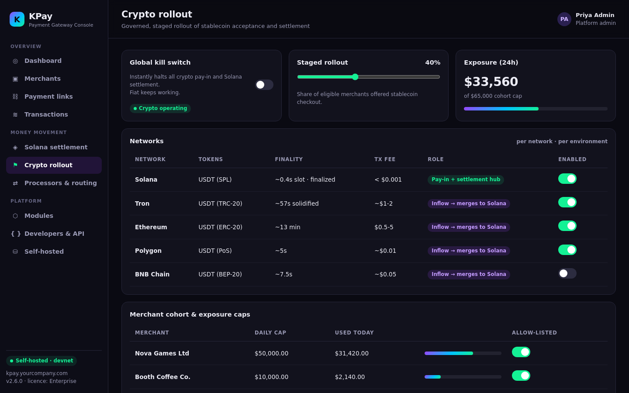




Crypto rollout, governed
Turn crypto on gradually and switch it off in one click
Global kill switch
Halts crypto in and out; fiat keeps running
Per-network control
Solana, Tron, Polygon, Ethereum, BNB, per env
Staged rollout
Offer stablecoins to a % of eligible merchants
Cohorts + caps
Allow-list merchants with daily exposure caps
Notes:
This is what lets a regulated PSP or bank say yes to crypto. Crypto rollout is controlled per network and environment, per merchant cohort with daily exposure caps, by staged percentage, and through a global kill switch that halts crypto pay-in and settlement while fiat keeps working.

Slide 14
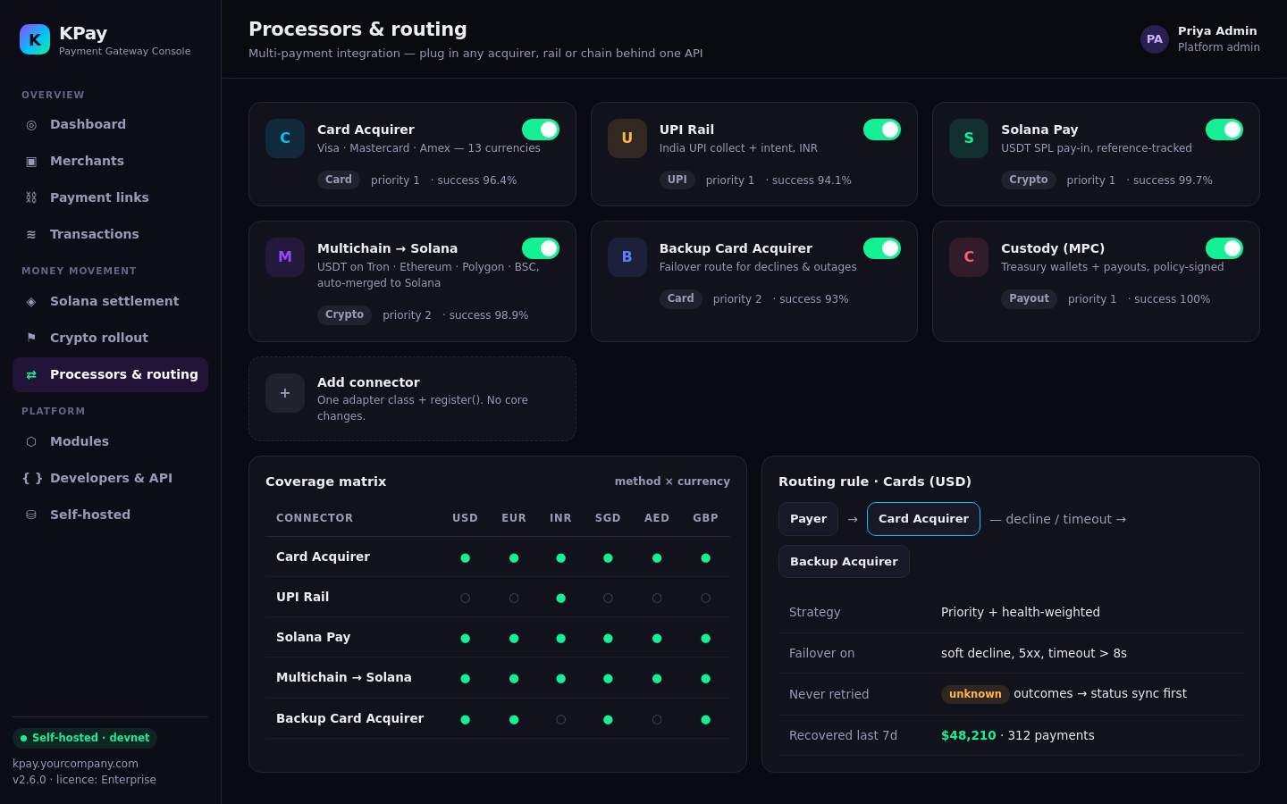

Multi-payment integration
Every acquirer, rail and chain behind one API
Cards + UPI + crypto
Card acquirers, UPI rail, Solana Pay, multichain USDT
Smart failover
Priority + health routing; unknowns synced first
Coverage matrix
Method × currency × credentials, at a glance
Add a processor
One adapter class + register(). No core edits
Notes:
Processors plug in through one adapter seam (authorize, capture, sync, void, refund, payout). Routing picks connectors by priority and fails over on soft declines and timeouts. Unknown outcomes are never blind-retried; they are status-synced first. A coverage matrix shows exactly which method and currency combinations can be offered.

Slide 15
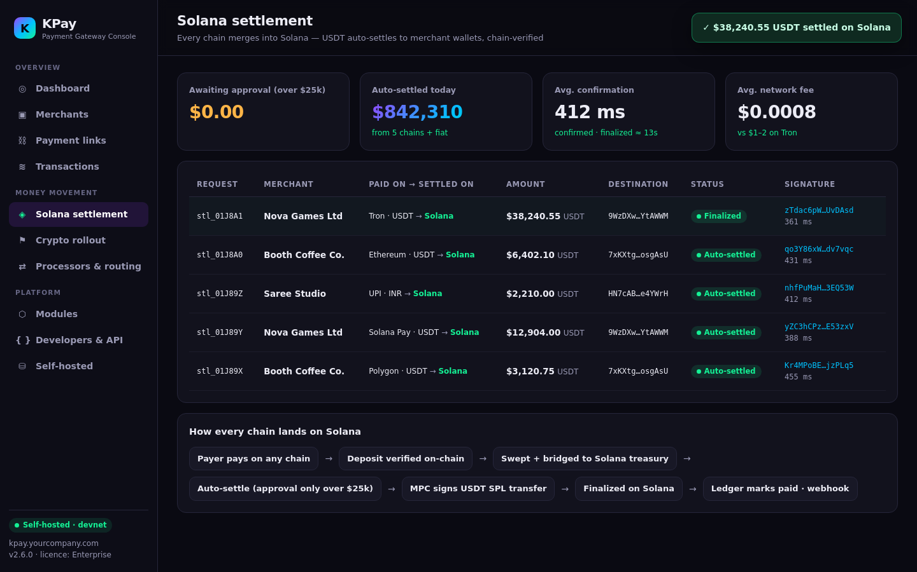
Auto-settlement on Solana
Every chain merges into Solana; approval only above threshold
412 ms
≈ 13 s
to confirmed
to finalized today
$0.0008
24 / 7
average network fee
no bank cut-off
Demo figures from devnet. Finalized ≈ 12.8 s today; Alpenglow targets ~150 ms.
Notes:
A merchant requests settlement. The ledger reserves the balance and an admin approves it (merchants can never self-settle to chain). MPC custody signs the SPL USDT transfer, broadcast with a priority fee. The ledger marks it paid only after the signature reaches finalized, then a webhook fires.

Slide 16
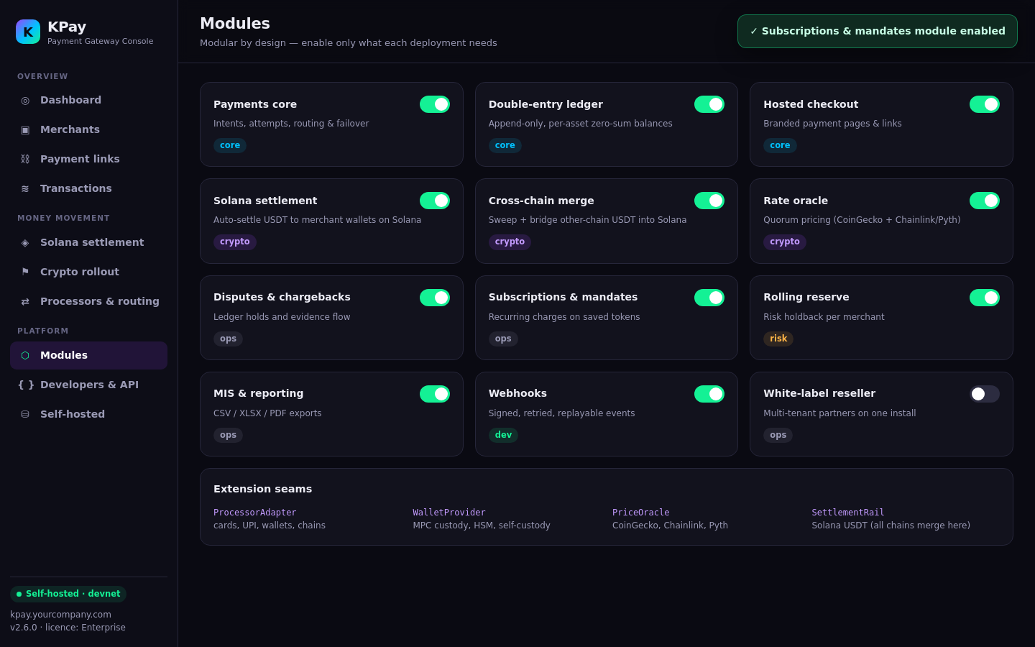

Modular by design
Switch on only what each deployment needs
ProcessorAdapter
Cards, UPI, wallets, chains
WalletProvider
MPC custody, HSM, self-custody
PriceOracle
CoinGecko, Chainlink, Pyth
SettlementRail
BridgeRoute: any chain → Solana
Notes:
Twelve modules, each with its own switch: payments core, ledger, checkout, Solana settlement, crypto pay-in, oracle, disputes, subscriptions, rolling reserve, reporting, webhooks and the white-label reseller module. Four extension seams mean new processors, custody providers, oracles and settlement rails plug in without core changes.

Slide 17
API surface
REST + OpenAPI 3 · Bearer scopes · idempotency · HMAC on money moves
Method | Endpoint | Purpose | Auth
POST | /api/v1/payment_links | Create a hosted payment link | Bearer + idempotency
POST | /api/v1/payment_intents | Create a server-side payment | Bearer + idempotency
POST | /api/v1/payment_intents/:id/capture | Confirm / capture / cancel | HMAC signed
POST | /api/v1/refunds | Refund a payment | HMAC signed
POST | /api/v1/payouts | Pay out to a wallet | HMAC signed
POST | /v2/api/web/admin/merchants/onboard | Onboard a merchant (pending) | Admin session
POST | /v2/api/web/admin/merchants/:id/approve | Approve to live | Admin session
GET | /openapi.json | Full contract incl. webhooks | Public
Notes:
These are real routes from the KPay codebase. Partner routes take Bearer keys with scopes and an Idempotency-Key. Money-moving mutations also need an HMAC X-KP-Signature. The full contract, including every webhook event, is published at /openapi.json.

Slide 18



Integrate in minutes, settle on Solana
One request in, one signed webhook out, Solana primitives underneath
Request
Signed webhook
Solana Pay
Transfer requests with reference keys
POST /api/v1/payment_links
Authorization: Bearer sk_live_…
Idempotency-Key: ord_2231
{
"amount": "249.00",
"currency": "USD",
"methods": ["card","upi","crypto"],
"pay_in_chains": ["solana","tron",
"ethereum","polygon","bsc"],
"settlement": {
"chain": "solana",
"asset": "USDT",
"mode": "auto"
}
}
// header x-kp-signature: t,v1
{
"type": "payment.succeeded",
"data": {
"id": "pay_01J8…",
"amount": "249.00",
"method": "crypto",
"paid_on": "tron",
"asset": "USDT",
"signature": "5h3Kq…xP9",
"commitment": "finalized"
}
}
SPL + Token-2022
USDT, USDC, PYUSD, ATAs
Priority fees
Reliable landing at peak
Finalized only
Ledger credits at finalized
Pyth / Chainlink
Quorum pricing for quotes
Notes:
Left: create a link that accepts card, UPI and Solana stablecoins and settles in USDT on Solana. Middle: the signed webhook the merchant receives, with the Solana signature and commitment. Right: the Solana building blocks KPay uses. The settlement block in the request is the Solana rail being added on the existing settlement-rail seam.

Slide 19
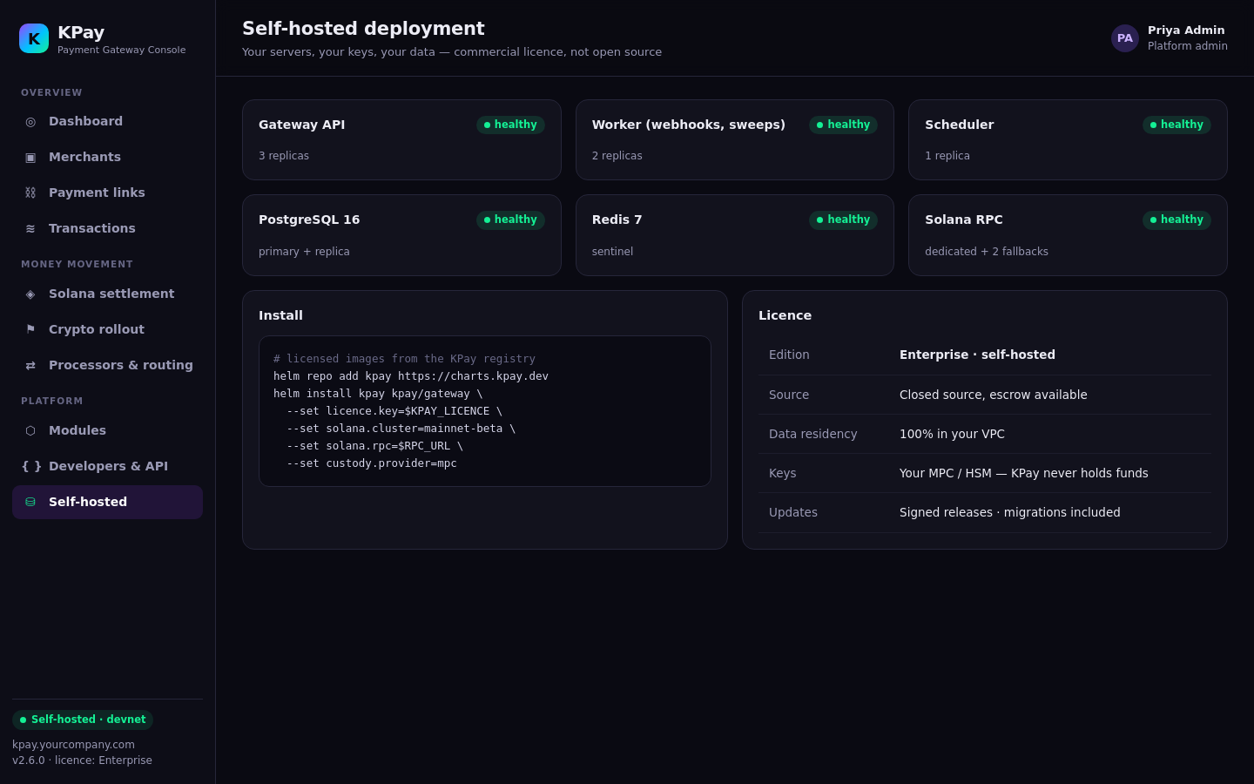


Self-hosted, not open source
Your servers, your keys, your data, under a commercial licence
Docker + Kubernetes
Signed images, Helm chart, migrations included
PostgreSQL 16 + Redis 7
Your database, your region
Your MPC / HSM
KPay never holds merchant funds
Commercial licence
Closed source; escrow for enterprise
Notes:
KPay ships as signed container images with Helm charts: gateway, worker and scheduler on PostgreSQL 16 and Redis 7, with your Solana RPC. Keys stay in your MPC or HSM, so KPay never touches funds. Licence is commercial and closed source, with source escrow for enterprises.

Slide 20



Business model
Recurring licence plus usage that grows with settled volume
Licence
Usage
Enterprise
Annual, per deployment, tiered L1 to L4
Basis points on volume settled on Solana
SLA support, white-label onboarding, escrow
Operators keep their own economics. MDR per method and the FX buffer on conversion are earned inside each deployment and reported per asset in Platform Earnings. KPay never sits in the flow of funds.
Notes:
Three revenue lines. Annual licence per deployment, tiered by level (merchant, platform, PSP, bank). A basis-point usage fee on volume settled through the Solana rail. Enterprise support, SLAs and white-label onboarding. On top, operators earn MDR and the FX buffer on conversion inside their own deployment.

Slide 21
Roadmap
From demo to every operator on Solana
Now · demo
Q4 2026
2027
Solana Pay USDT checkout
Other-chain USDT merged to Solana
Auto-settle USDT to merchant wallets
Onboarding, rollout, routing
Mainnet pilot with design partners
Bridge routes hardened per chain
Pyth in the oracle quorum
Devnet sandbox for integrators
Token-2022 stablecoins (PYUSD, USDG)
Alpenglow-era sub-second finality
Off-ramp partners in India, SEA, MENA
White-label PSP program
Notes:
Now (demo): Solana Pay checkout, other-chain USDT merged into Solana, and auto-settlement in USDT. Next: a mainnet pilot with design partners, then new stablecoins, faster finality and local off-ramps.

Slide 22

Own the stack.
Settle on Solana.
Our ask to the Solana ecosystem
Grant + co-marketing
Ship the Solana settlement rail GA
Stablecoin + off-ramp intros
Issuers and local off-ramp partners
KPay brings every PSP, platform and bank that installs it onto Solana as a settlement layer.
RPC infrastructure
Dedicated RPC for self-hosted installs
Pilot merchants + PSPs
Five design partners for Q4 2026
Notes:
Close on the ask. Every KPay install becomes a PSP, platform or bank settling on Solana, so the ecosystem gets distribution through operators rather than one merchant at a time.

