Slide 1
AI pricing with guardrails
SeatSense AI
Dynamic Ticket Pricing & Demand Intelligence for Sports Venues
Enterprise revenue intelligence for ticketing teams and venue operators
Predict demand, recommend guarded prices, and explain approval risk.

Slide 2
Business Problem
Static prices miss fast-changing demand signals.
Low-demand games leave seats unsold.
High-demand games are often underpriced.
Secondary markets capture value that should stay with the venue.
Revenue loss from static pricing
SeatSense AI · Revenue Intelligence

Slide 3
Market Context and Existing Customers
Customers: teams, arenas, venues, and ticketing departments.
Users: revenue managers, operations, marketing, fan experience, executives.
Existing market already values dynamic pricing tools.
SeatSense adds explainability, guardrails, and business KPI reporting.
Stakeholder map
SeatSense AI · Revenue Intelligence

Slide 4
Who, Why, How Framework
Who: teams, venues, fans, executives, and ticketing staff.
Why: demand is multivariate, volatile, and financially material.
How: model prediction plus governed pricing engine plus explanation.
Human approval remains in the decision workflow.
Who · Why · How
SeatSense AI · Revenue Intelligence

Slide 5
Why AI Is the Right Solution
Rules miss interactions among opponent, weather, sentiment, and resale gap.
Classification predicts Low, Medium, or High demand.
Probabilities support confidence-aware pricing decisions.
OpenAI-enabled explanation translates outputs into revenue-manager language with safe fallback.
Signals to decision
SeatSense AI · Revenue Intelligence

Slide 6
Product Overview: SeatSense AI
Use sample data or map client CSV exports.
Predict demand tier and class probability.
Recommend guarded price changes.
Estimate revenue uplift and resale leakage reduction.
Generate executive-ready explanations from model output.
Flag decisions that require human approval.
Product workflow
SeatSense AI · Revenue Intelligence

Slide 7
Data Pipeline and Feature Design
Semi-synthetic 20,500-row game-section-pricing-window dataset.
Five seasons, 410 games, 10 seat sections, five pricing windows.
Features include current inventory, sell-through, traffic, search, social, weather, price, resale, section, and historical behavior.
Leakage audit excludes final attendance, realized revenue, target labels, oracle price, and fairness-only affordability columns.
Ticketing-agency adapter maps vendor feeds, then Pydantic validates the SeatSense schema before retraining.
Data pipeline
SeatSense AI · Revenue Intelligence

Slide 8
Model Architecture
Demand classifier: simple decision-tree baseline vs tuned random forest.
Sell-through regressor estimates final inventory conversion.
Scalper-risk classifier estimates resale leakage pressure.
Time-based split: first 3 seasons train, 4th validation, 5th test.
Pricing optimizer simulates candidate prices and applies guardrails.
Model stack
SeatSense AI · Revenue Intelligence

Slide 9
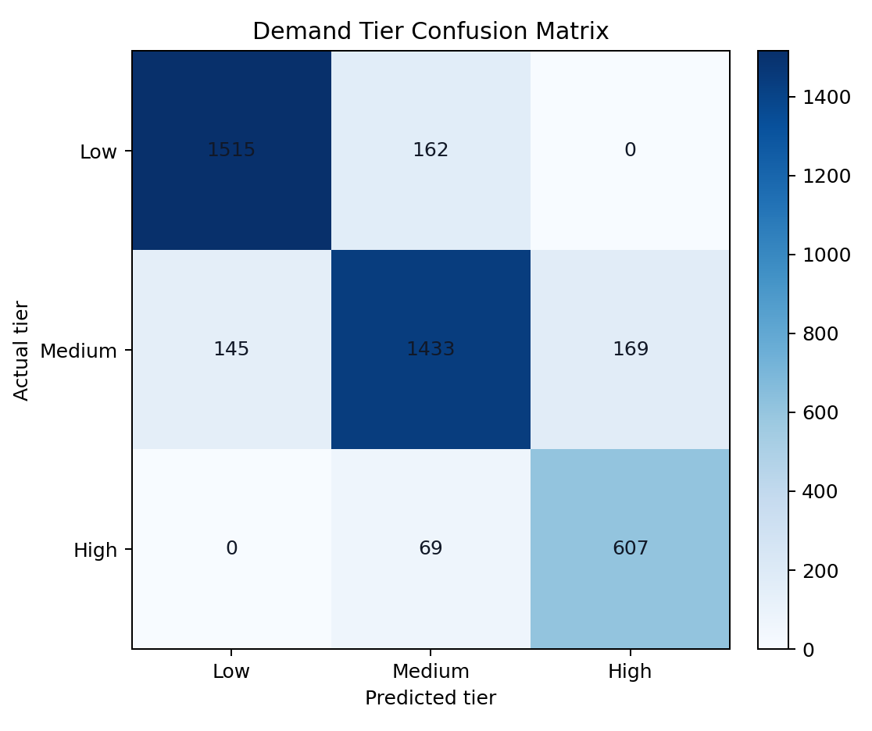
Model Performance
Final demand accuracy is about 86.7% with macro F1 about 86.1%.
High-demand recall is about 89.8%; ROC-AUC OVR is about 96.9%.
Sell-through RMSE is about 0.059; scalper-risk macro F1 is about 88.2%.
Confusion matrix shows costly pricing mistakes.
Leakage audit confirms no post-event or affordability-only columns are used as model inputs.
Data quality widgets include demand mix, price gap scatter, signal bubble, and section drill-down.
Confusion matrix
SeatSense AI · Revenue Intelligence

Slide 10
Pricing Recommendation Workflow
Inputs: current price, predicted demand, resale gap, days before game, section, sell-through.
Optional live APIs enrich ticket marketplace, weather, sports, social, and traffic signals.
Apply price caps, affordability rules, and premium-game approval.
Estimate revenue uplift and leakage reduction.
Return business action and approval status.
Pricing guardrails
SeatSense AI · Revenue Intelligence

Slide 11
Streamlit Product Screens
Executive Overview frames the problem and KPIs.
Pricing Workbench shows live API signal mode, probabilities, recommended price, and approval logic.
Model Performance shows flexible CSV import, agency-feed detection, schema validation, and drill-down charts.
Demand Intelligence explains drivers behind the forecast.
Streamlit demo
SeatSense AI · Revenue Intelligence

Slide 12
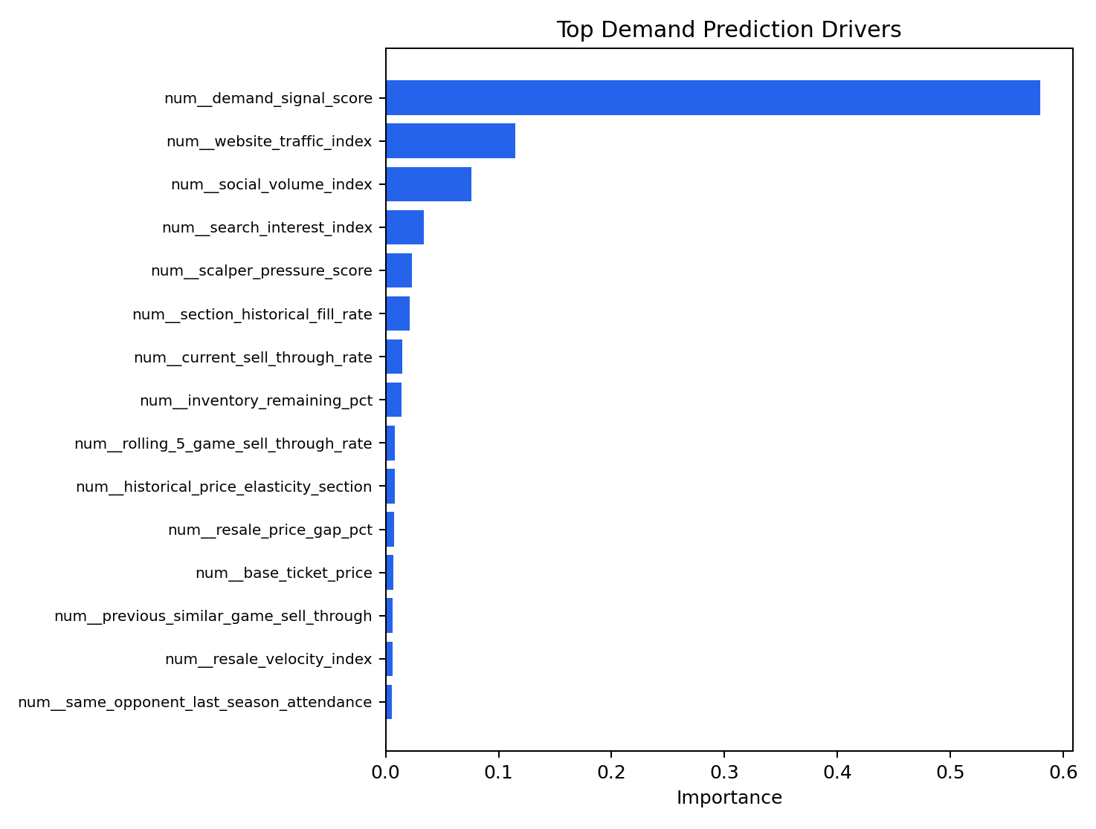
Business Impact and KPIs
Revenue per game and total ticket revenue uplift.
Sell-through and attendance rate.
Secondary-market leakage reduction.
Average price gap versus resale market.
Fan affordability score and approval rate.
KPI dashboard
SeatSense AI · Revenue Intelligence

Slide 13
Responsible AI and Fairness Guardrails
Lower-income fans may be priced out without controls.
No protected attributes are used directly.
Affordable ticket reserve and value-section caps.
Human review for premium games and large price moves.
Bias audit by affordability segment.
Responsible AI
SeatSense AI · Revenue Intelligence

Slide 14
Implementation Roadmap
Phase 1: historical data integration and offline validation.
Phase 2: pilot with revenue-manager review.
Phase 3: controlled A/B testing by section and game type.
Phase 4: production monitoring for drift, fairness, and fan sentiment.
Roadmap
SeatSense AI · Revenue Intelligence

Slide 15
Conclusion and Ask
SeatSense captures revenue that static pricing misses.
It reduces resale leakage while protecting attendance.
It combines trained predictive AI with explainable recommendations and fallback behavior.
Ask: approve a pilot using real historical venue data.
Pilot ask
SeatSense AI · Revenue Intelligence

