Slide 1
Red Hat JBoss Connectivity Options for SAP
Name
Bill Collins, Red Hat
Ted Jones, Red Hat
Kenny Peoples, Red Hat

Slide 2
Agenda
History of Integration
SAP NetWeaver Gateway
  OData
Data Virtualization/Demo
Fuse/SAP Camel Component/Demo
JBoss Fuse Integration with SAP/Demo
Resources
Questions

Slide 3
History of Solutions
SAP Enterprise Services Registry
  UDDI v3 Registry
  Web Services (WSDL)
JBoss Developer Studio (JBDS)
  Data Services (now known as Data Virtualization in v6)
Web Services client proxy generation

Slide 4
OData
Based on standards
Database-like access to data
ODBC for the Web
No knowledge of SAP required
REST-based Architecture
  GET, PUT, POST, DELETE
  Stateless
OData v4 and OASIS Standard
OData + SAP Annotations
OData
Atom Publishing Protocol
Atom Syndication Format

Slide 5
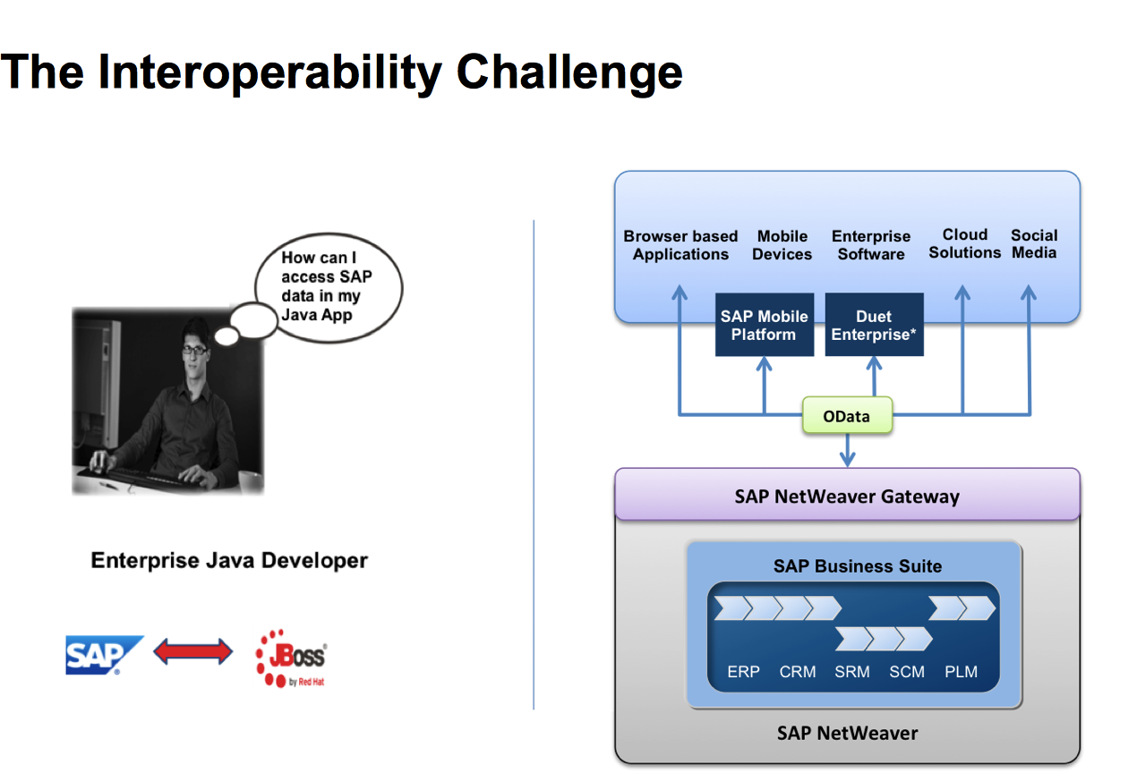

Slide 6
Data Virtualization
Access data from disparate systems
Integrate and transform the data
Expose information from multiple sources
  As a single source
  Through a variety of data access methods
    JDBC, ODBC, HTTP, etc.
  Access in “real-time” from the original source
Robust, mature tooling in JBDS\Teiid Designer

Slide 7
Data Virtualization
Two ways to integrate SAP
  Import an OData collection
  Import an entire OData service
DV is an OData consumer AND producer

Slide 8
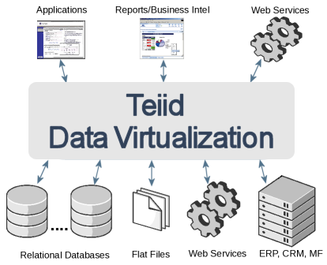

Slide 9
Data Virtualization Demo with SAP NetWeaver Gateway

Slide 10
Red Hat JBoss Fuse
SAP NetWeaver Camel Component

Slide 11
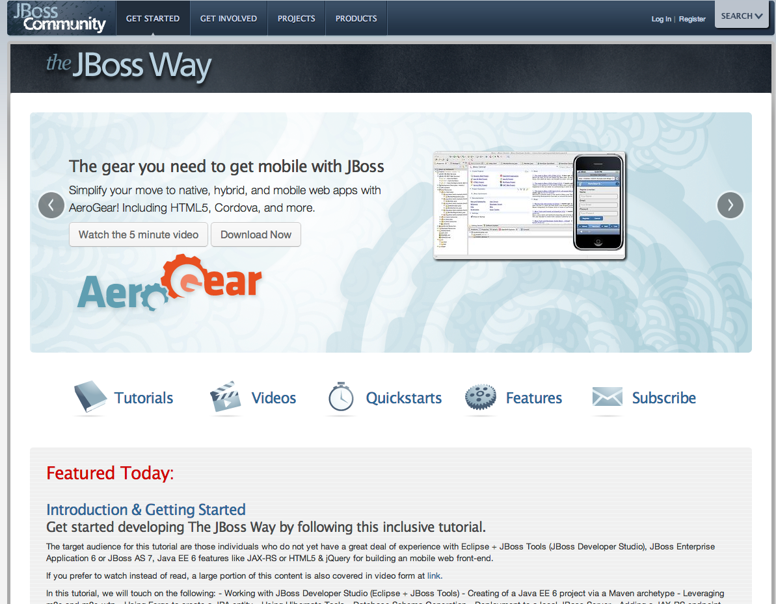
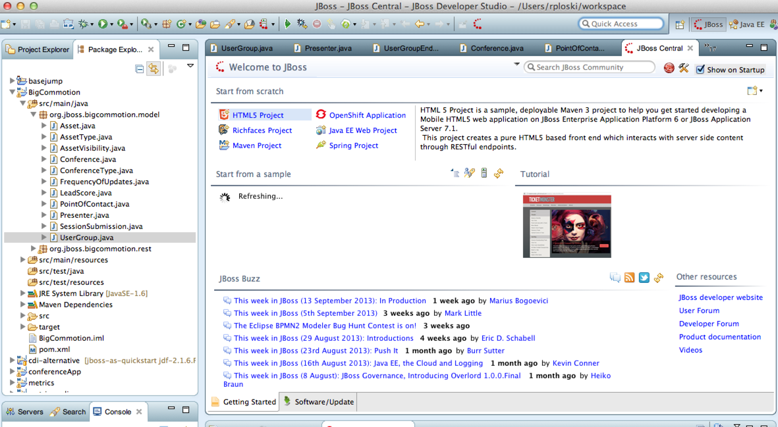
Join the Red Hat JBoss Developer Program Today
Sign up for your account now at JBoss.org
Download JBoss Developer Studio
Download Fuse
Get productive!

Slide 12
Developer Program Benefits
Access to Enterprise Binaries
  Build your apps on stable and certified codebase
  No need to migrate your applications from Community
Access to Enterprise Developer Forums
  Collaborate with Red Hat experts and other enterprise developers.
Exclusive Enterprise Content
  Quickstarts, tutorials and webinars available only to Developer Program members.

Slide 13
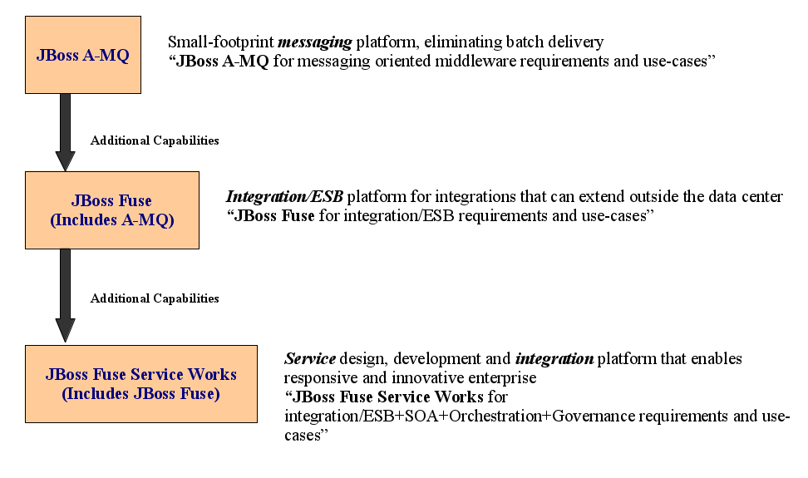
Red Hat JBoss Integration Product Line

Slide 14
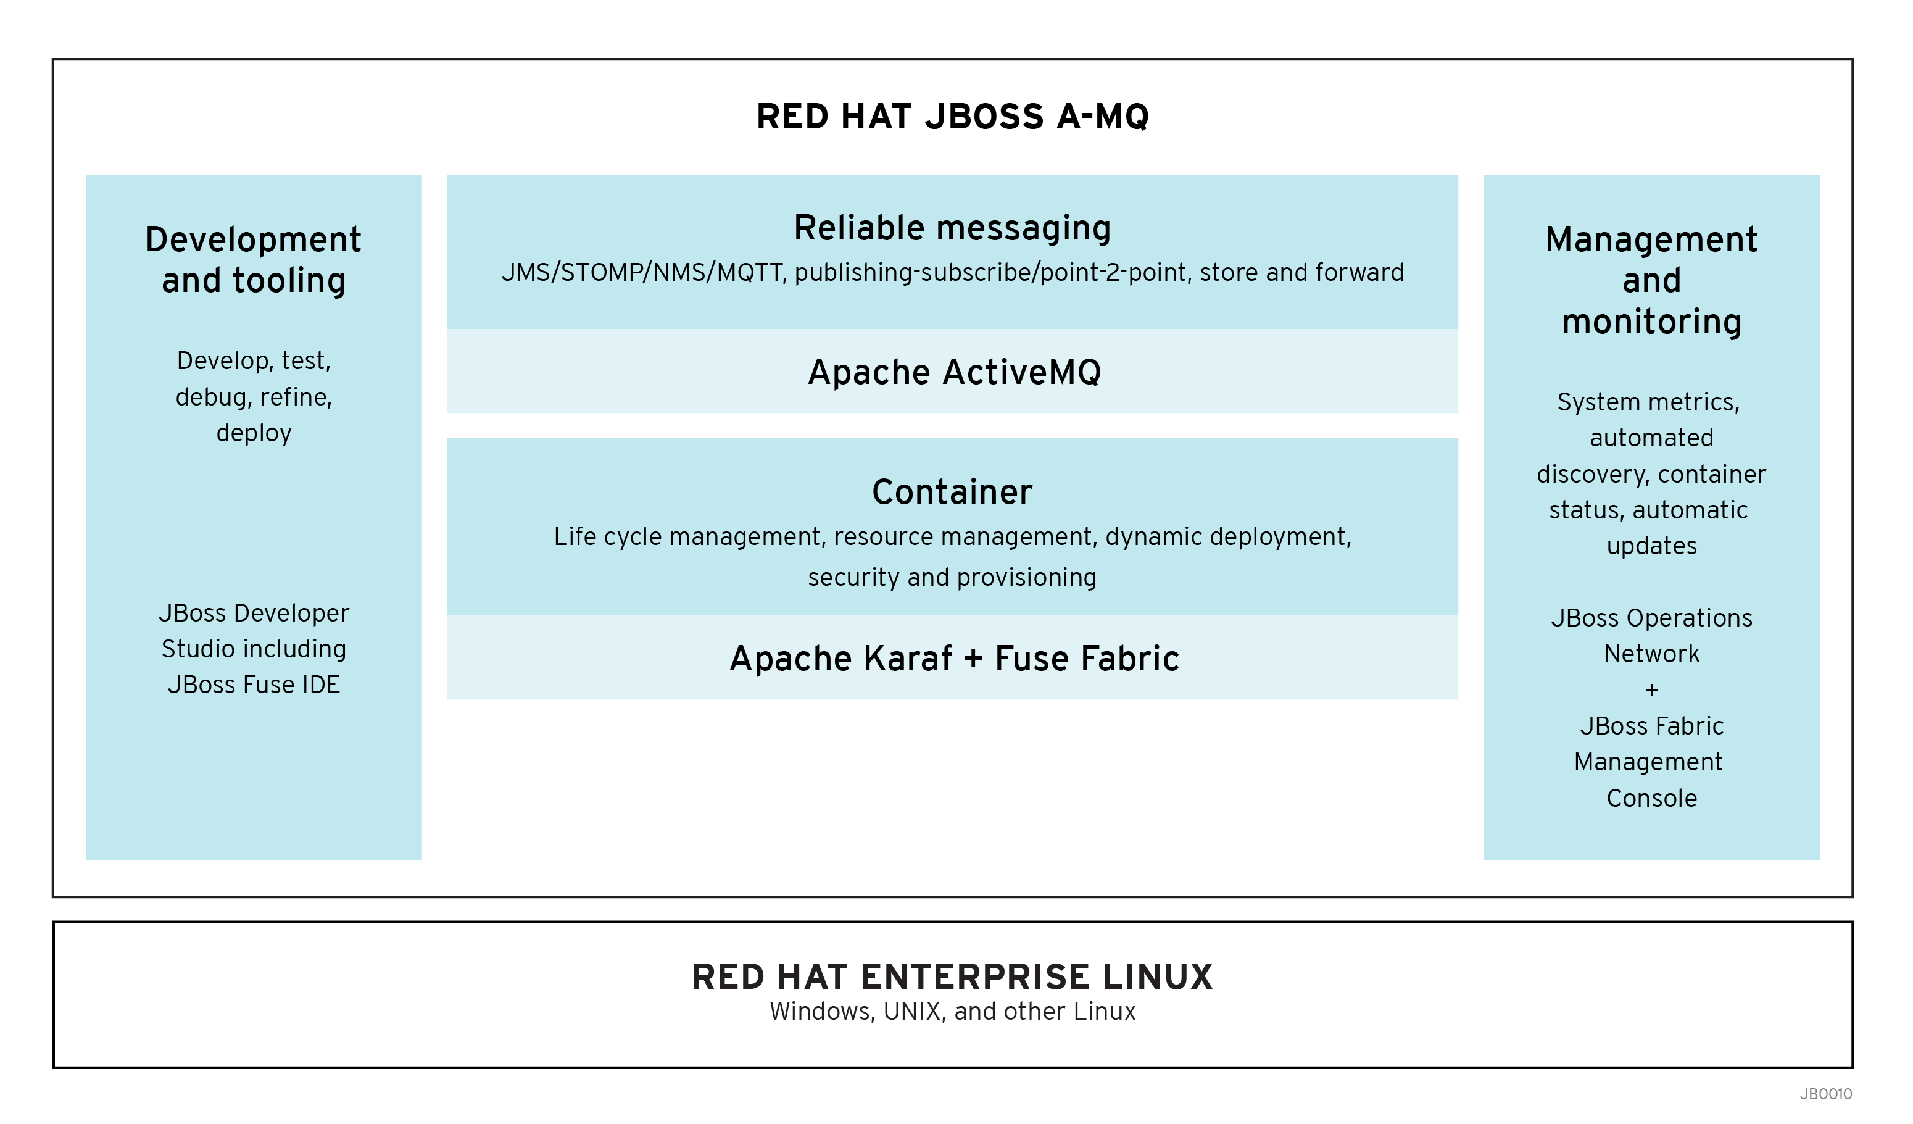
JBoss A-MQ – Value Proposition
Value Proposition:
  Easier to configure, monitor, manage and maintain: Small IT footprint
  Multiple deployment options – centralized, distributed, embedded: Small IT footprint
  Proven and robust platform: Based on popular Apache ActiveMQ, Standards-based reliable messaging & High-performance
  Multiple connectivity options: Multi-standards and multi-platform support
  Real-time and reliable integration: Supports messaging paradigms: Pub/Sub, Point-2-Point, Store and forward
New in 6.0:
AMQP 1.0 support (Tech Preview)
JBoss Developer Studio to include Fuse IDE
JBoss Operations Network + Fabric Management Console
Rebranding, repackaging
New in 6.1:
AMQP 1.0 support
<TO DO ADD THE REST>

Slide 15
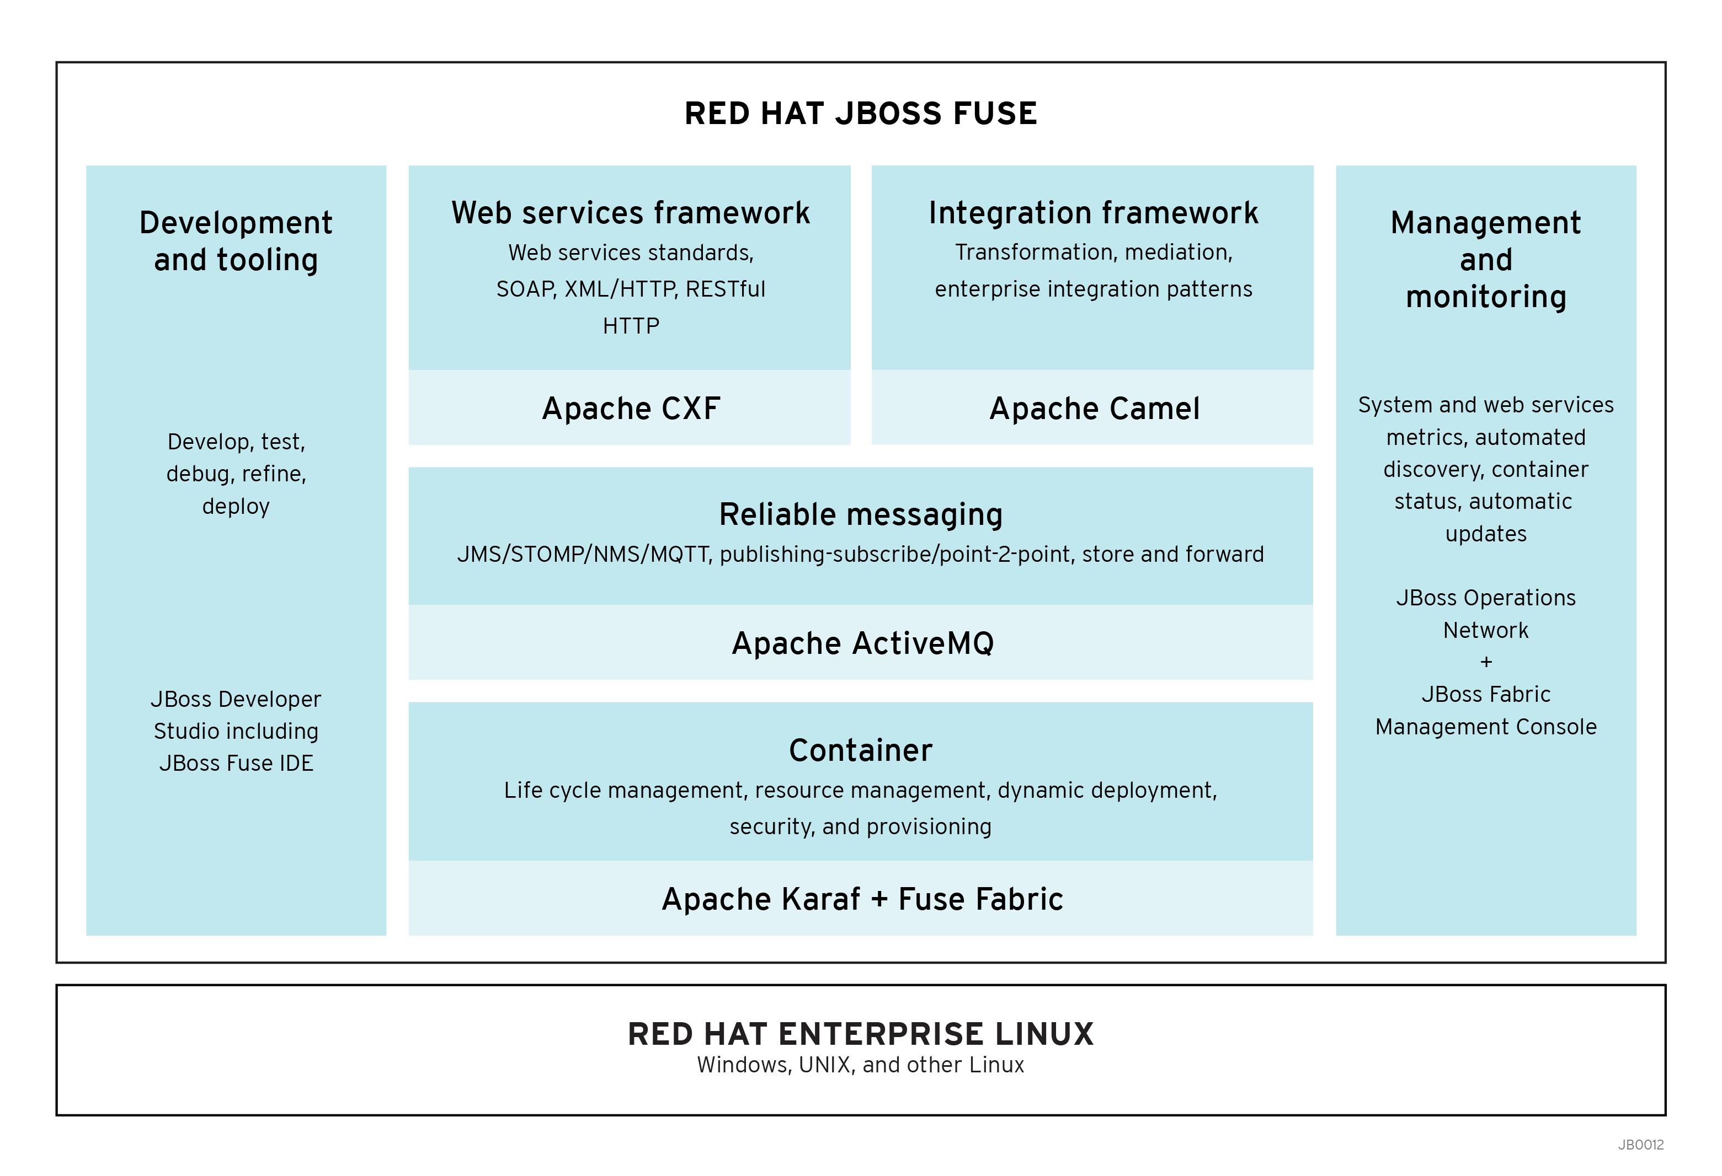
JBoss Fuse – Value Proposition
Value Proposition:
  Easier to configure, monitor, manage and maintain: Small IT footprint
  Multiple deployment options – centralized, distributed, embedded: Small IT footprint
  Faster time to solution: Apache Camel, excellent integration development platform and tooling
  Integrate all enterprise assets: Extensive connectivity options
  Lower total cost of ownership
  Innovative integration platform: based on popular open source projects with vibrant community
New in 6.0
  JBoss Developer Studio to include Fuse IDE
  JBoss Operations Network (JON) + Fabric Management Console (FMC)
  Rebranding, repackaging
New in 6.1
  <ADD LIST>

Slide 16
Camel SAP NetWeaver Gateway Component
Available as of Camel 2.12 which is available in Fuse 6.1
sap-netweaver integrates with the SAP Netweaver Gateway using HTTP Transports
Basic authentication schema used for logging into SAP NetWeaver
SAP NetWeaver system account required to be able to leverage the component
URI Format is sap-netweaver:https://host:8080/path?username=foo&password=secret with query options appended at the end ?option=value&option=value&...

Slide 17
Camel SAP NetWeaver Gateway Component
Message Header mandatory used by the producer – CamelNetWeaverCommand
The following dependency required in the pom.xml
<dependency>
  <groupId>org.apache.camel</groupId>
<artifactId>camel-sap-netweaver</artifactId>
<version>x.x.x</version>
<!-- use the same version as your Camel core version -->
</dependency>

Slide 18
Camel SAP NetWeaver Gateway Demo
Flight Demo Example from SAP
<ADD STEPS FOR DEMO> from http://www.ossmentor.com/2013/10/using-camel-sap-netweaver-gateway.html

Slide 19
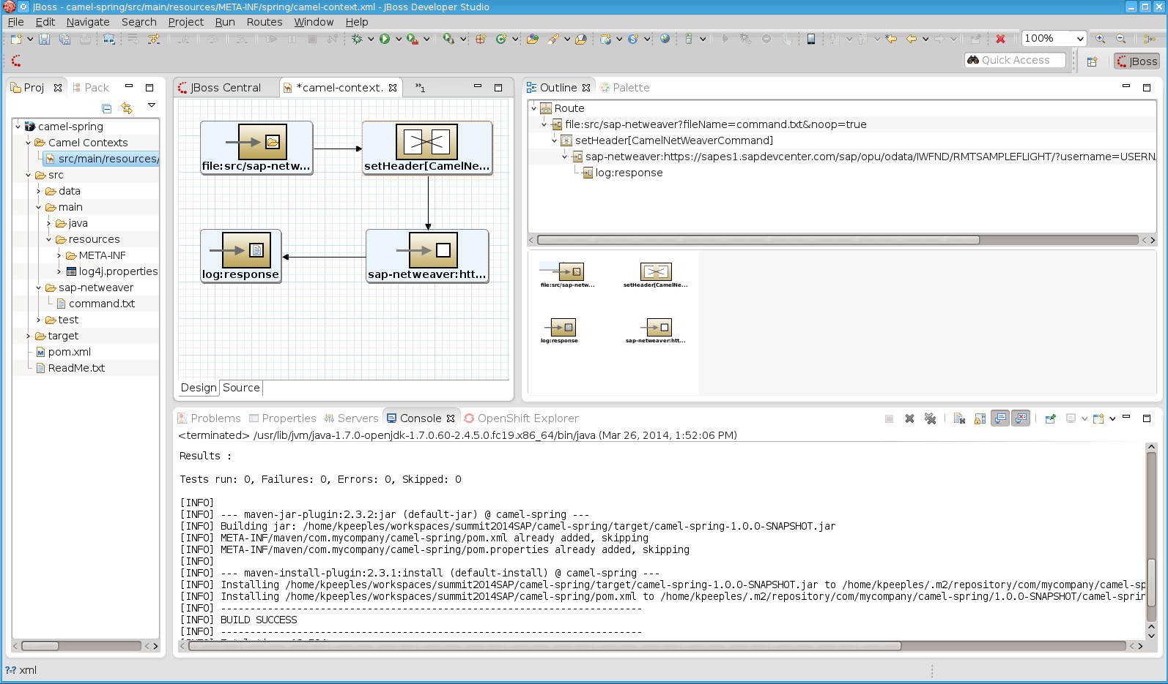
Camel SAP NetWeaver Gateway Demo

Slide 20
JBoss Fuse Integration with SAP
JBoss Fuse SAP Camel Component
Using the SAP Camel Component
Flight Booking Demo

Slide 21
JBoss Fuse Integration with SAP
JBoss Fuse SAP Camel Component Overview

Slide 22
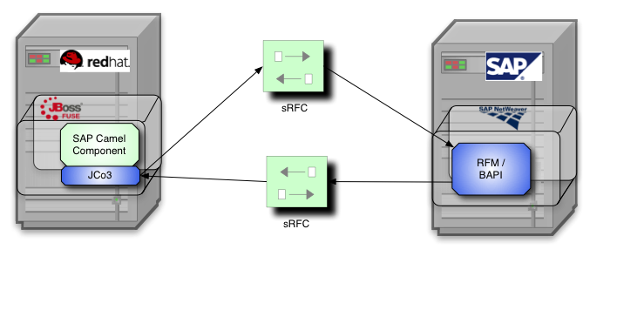
JBoss Fuse Integration with SAP
JCo3 Based OSGi Enabled Camel Component

Slide 23
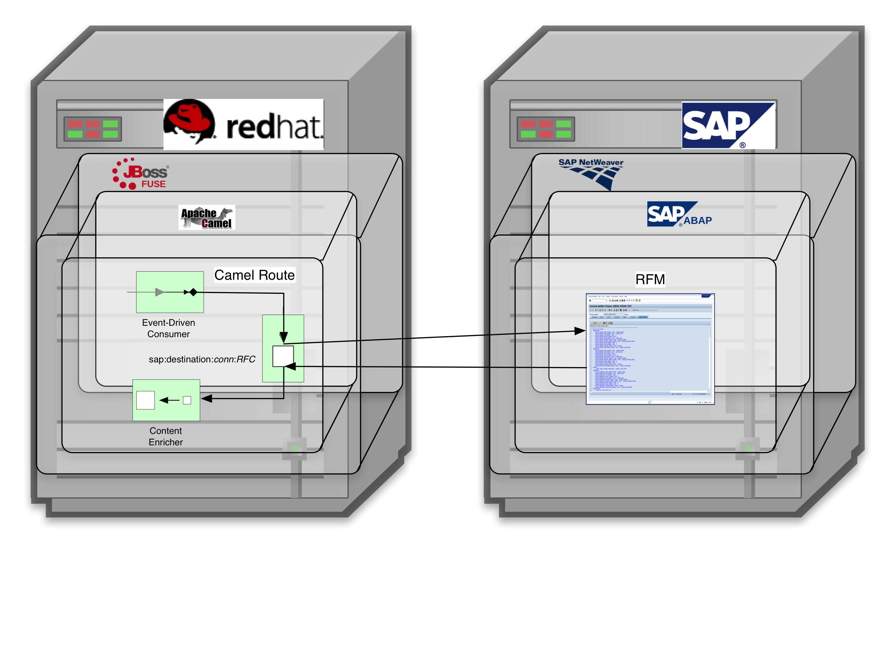
JBoss Fuse Integration with SAP
Enables Camel Routes to Invoke RFMs & BAPI Methods

Slide 24
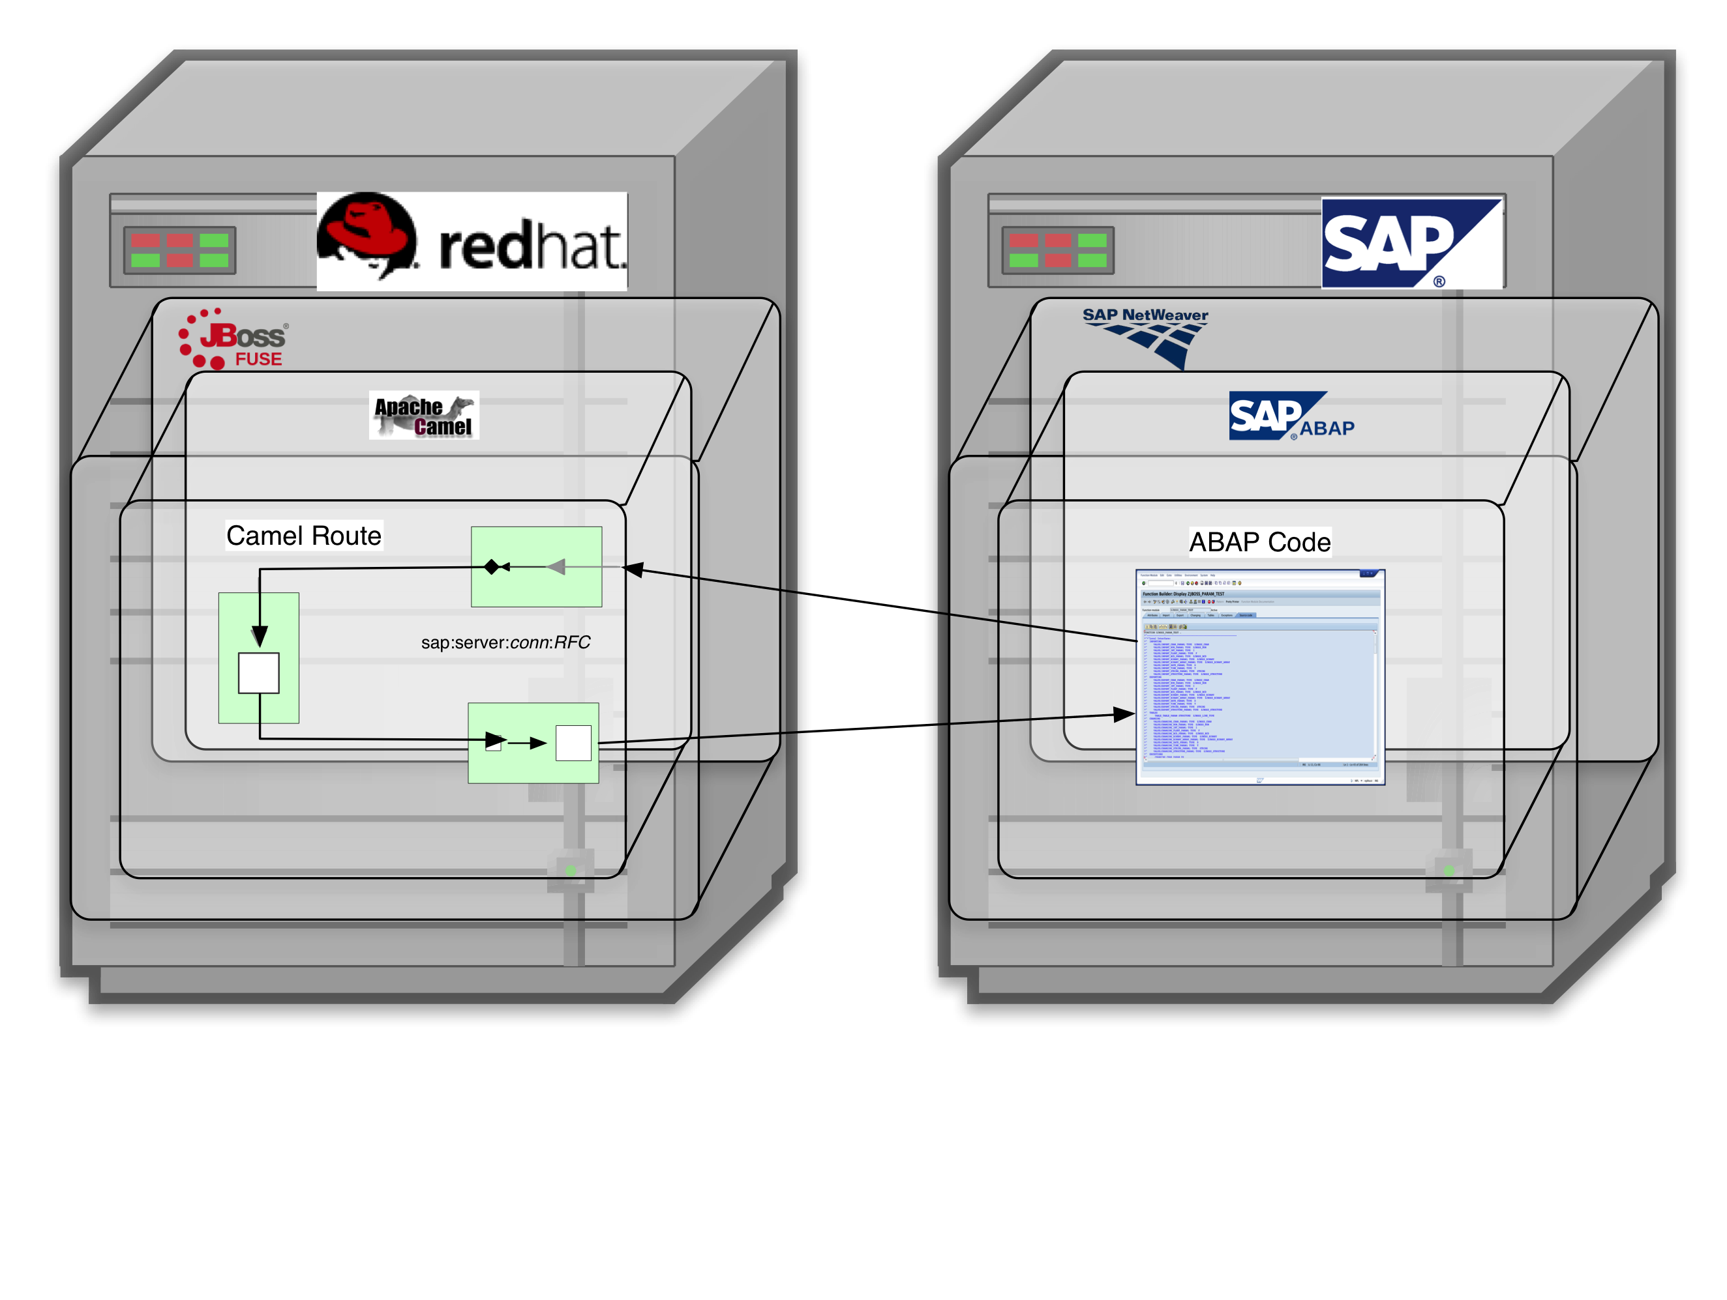
JBoss Fuse Integration with SAP
Enables SAP Code to invoke Camel Routes

Slide 25
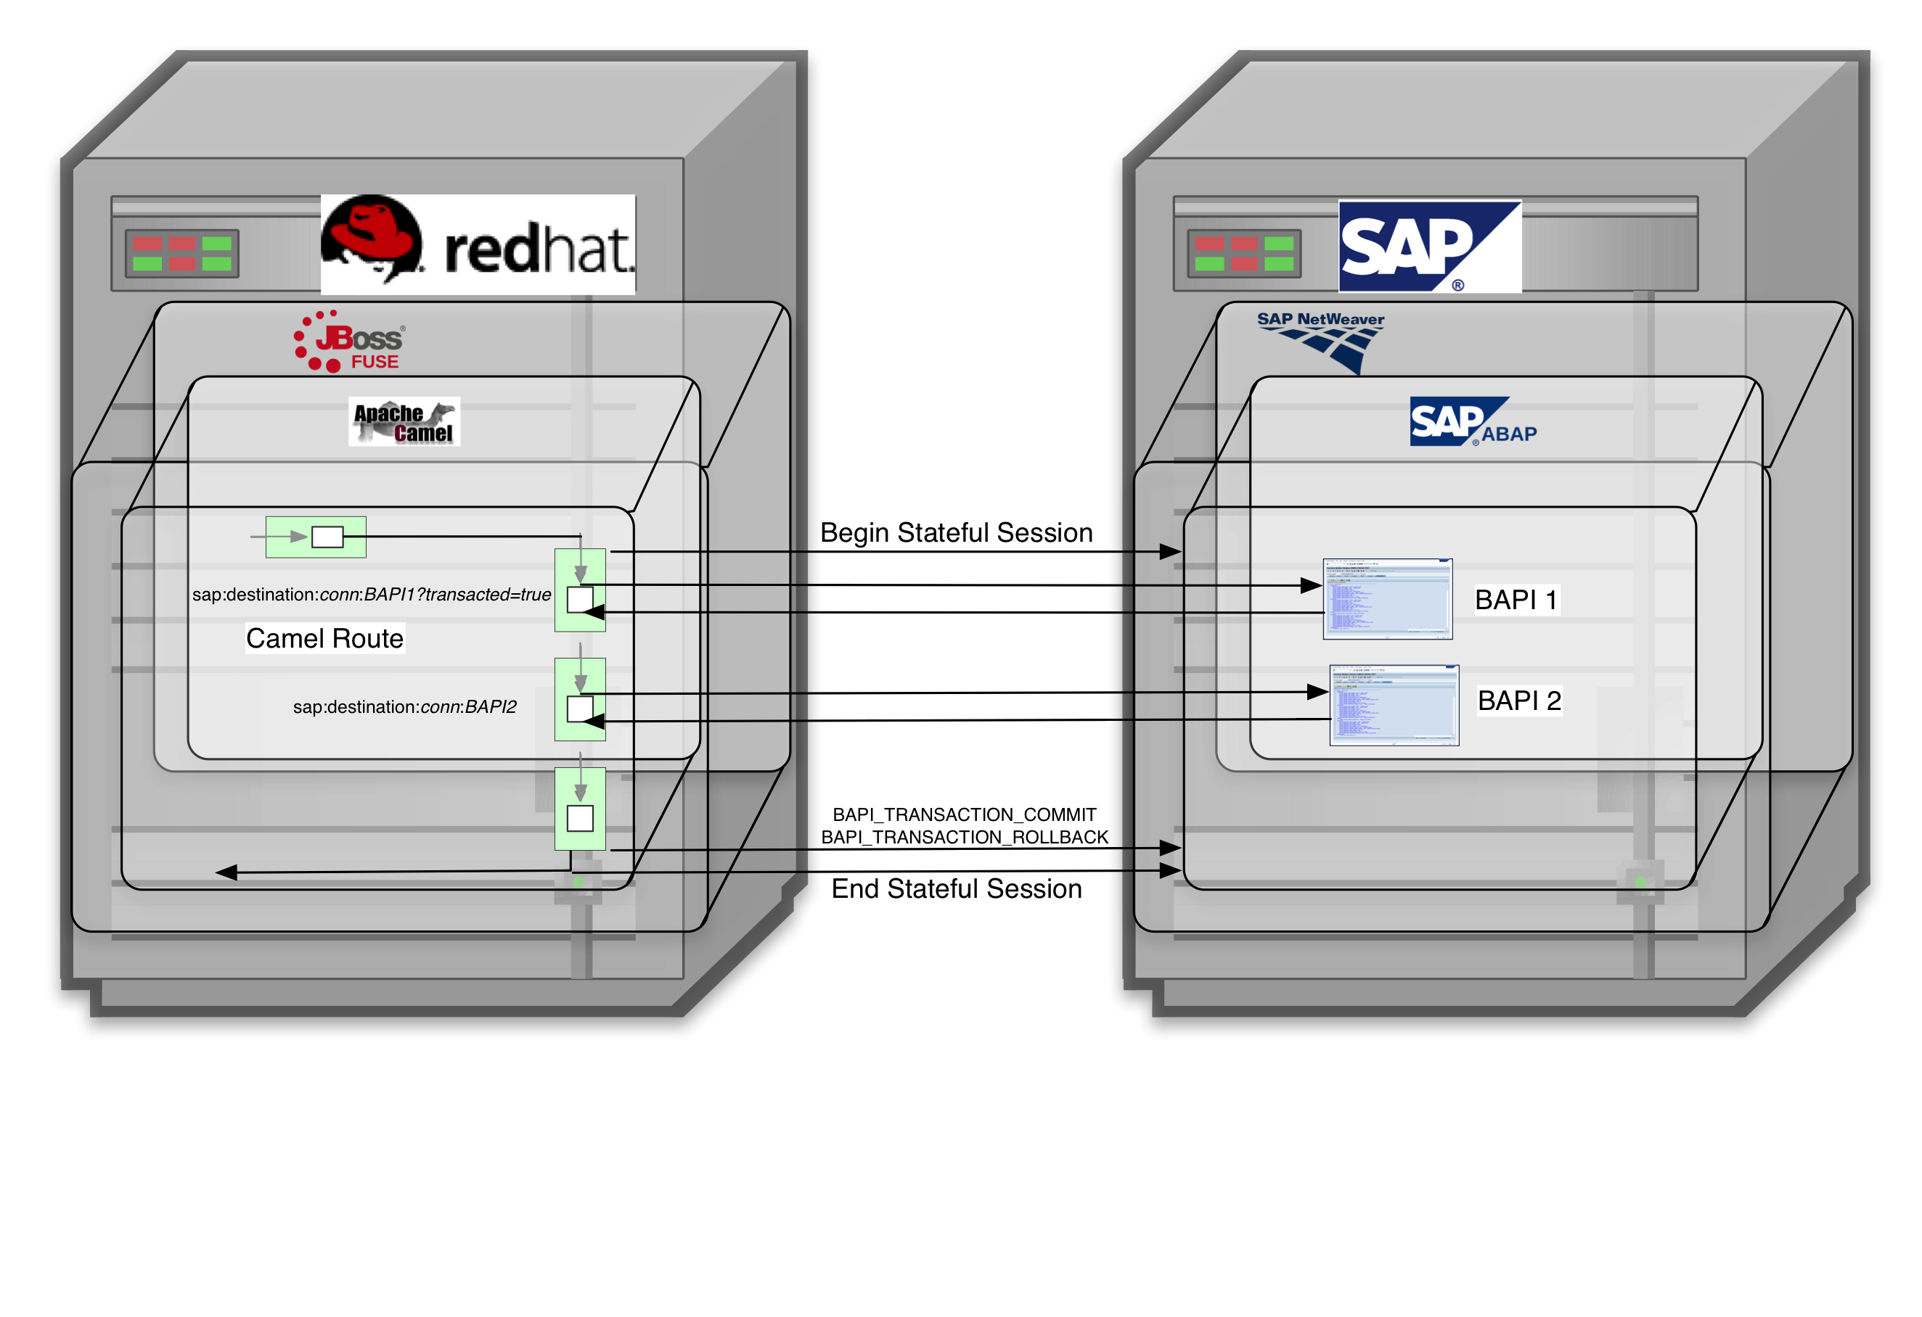
JBoss Fuse Integration with SAP
Supports SAP Transactions to Compliant BAPIs

Slide 26
JBoss Fuse Integration with SAP
Using the SAP Camel Component
Provisioning the Fuse Environment
Configuring the SAP Camel Component
Using SAP Endpoints in Camel Routes
SAP Component Data Layer

Slide 27
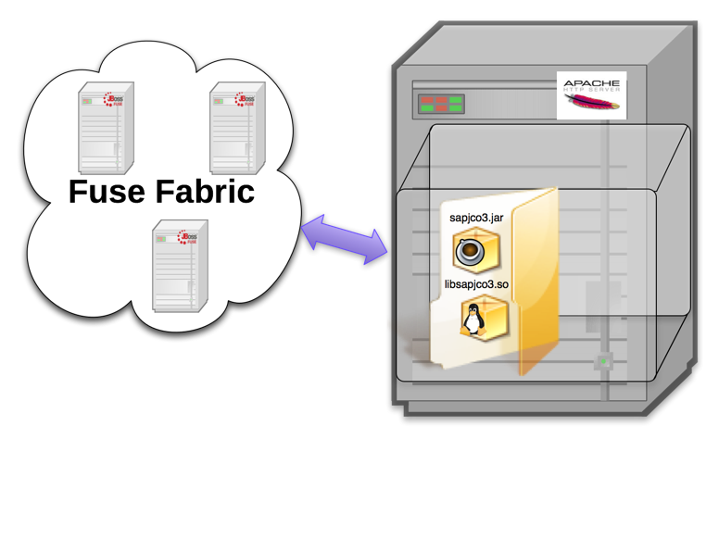
JBoss Fuse Integration with SAP
Provisioning the JBoss Fuse Environment

Slide 28
JBoss Fuse Integration with SAP
Deploying JCo3 Libraries to OSGi Environment
Use Fabric Profile to Provision JCo3 Libs into Fuse Container
  Deploy JCo3 Libraries
  Export Key JCo3 Packages

Slide 29
JBoss Fuse Integration with SAP
An Example Fabric Profile deploying JCo3 Libraries
#Profile:my-camel-sap-profile
attribute.parents = feature-camel
…
# Deploy JCo3 Libs to Container
lib.sapjco3.jar = <path_to_libs>/sapjco3.jar
lib.libsapjco3.jnilib = <path_to_libs>/libsapjco3.jnilib
# Expose Key JCo3 Packages to OSGi Environment
config.org.osgi.framework.system.packages.extra= \
org.apache.karaf.branding, \
com.sun.xml.bind.v2.model.core, \
com.sap.conn.jco, \
com.sap.conn.jco.ext, \
com.sap.conn.jco.monitor, \
com.sap.conn.jco.rt, \
com.sap.conn.jco.server

Slide 30
JBoss Fuse Integration with SAP
Configuring the SAP Camel Component
Destination Data Store
Server Data Store
Repository Data Store

Slide 31
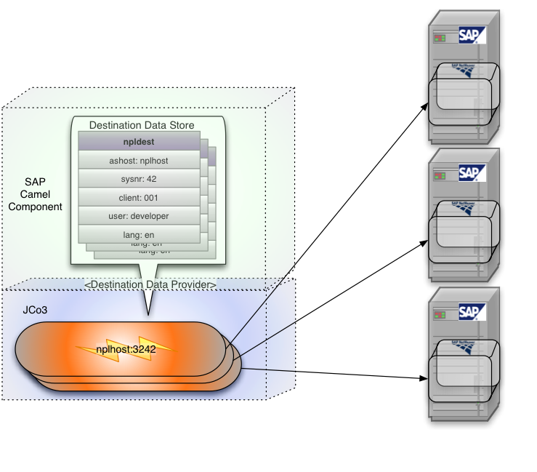
JBoss Fuse Integration with SAP
Destination Data Store

Slide 32

JBoss Fuse Integration with SAP
Server Data Store

Slide 33
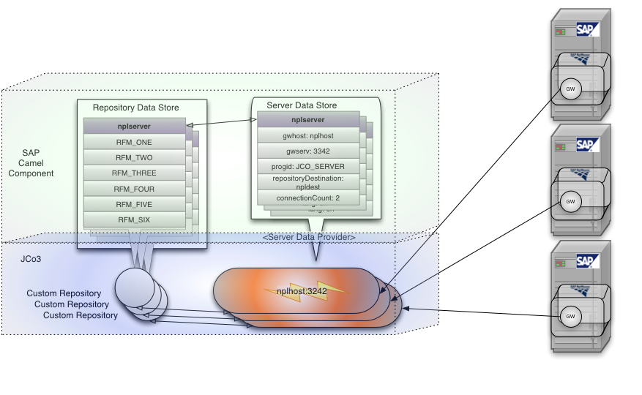
JBoss Fuse Integration with SAP
Repository Data Store

Slide 34
JBoss Fuse Integration with SAP
Using SAP Endpoints in Camel Routes
SAP Endpoint Types
SAP URL Formats
SAP Transaction Context

Slide 35
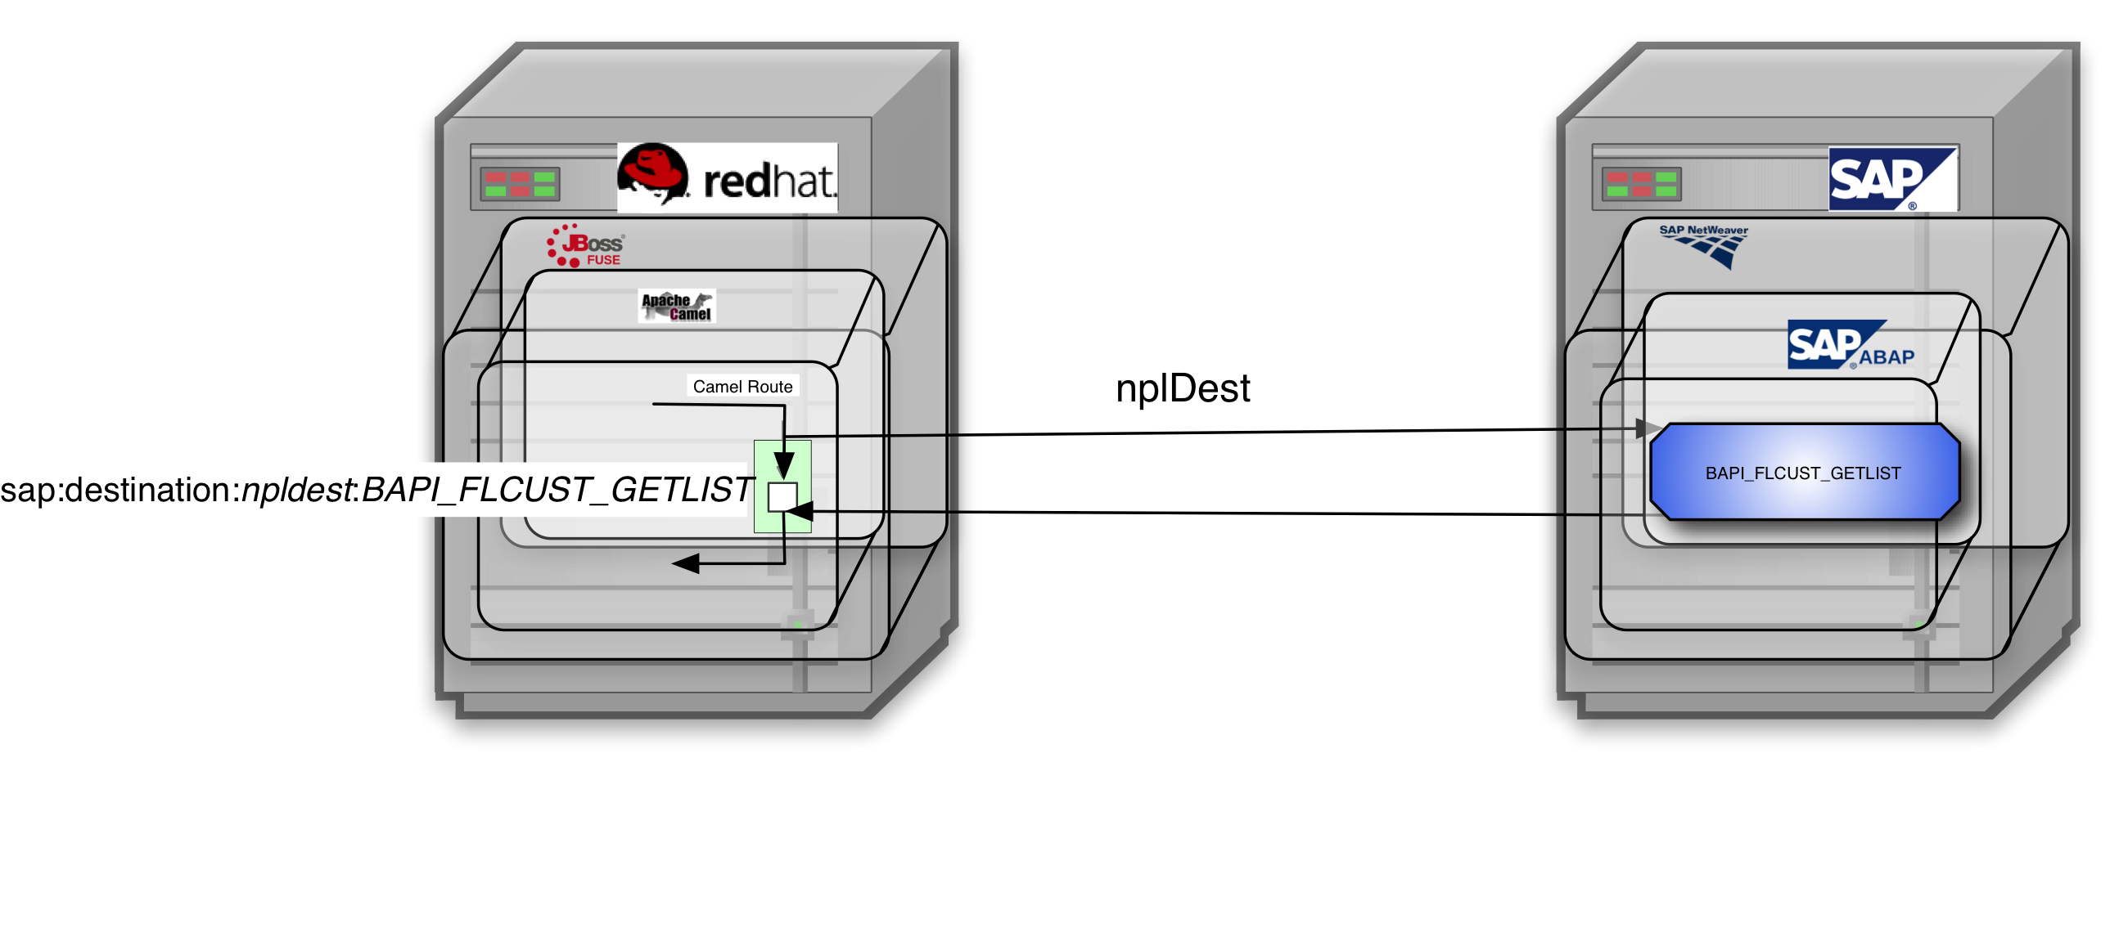
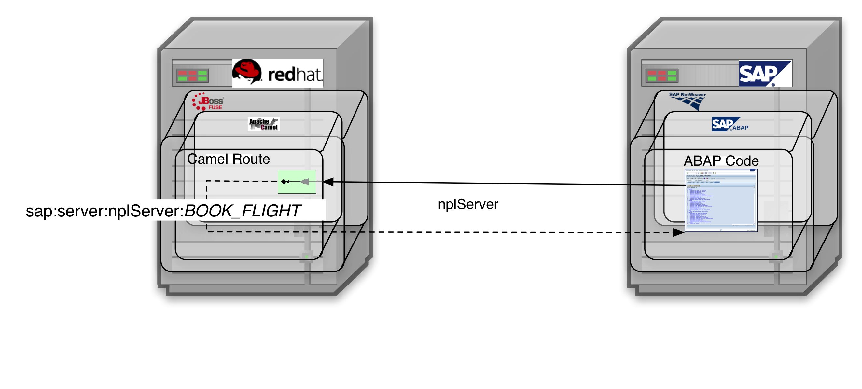
JBoss Fuse Integration with SAP
SAP Endpoint Types
Destination Endpoint
Server Endpoint

Slide 36
JBoss Fuse Integration with SAP
SAP Endpoint URL Formats
sap:server:<logical_sever_connection>:<function_module_name>
sap:destination:<logical_destination_connection>:<function_module_name>
sap:destination:<logical_destination_connection>:<function_module_name>?transacted=true

Slide 37
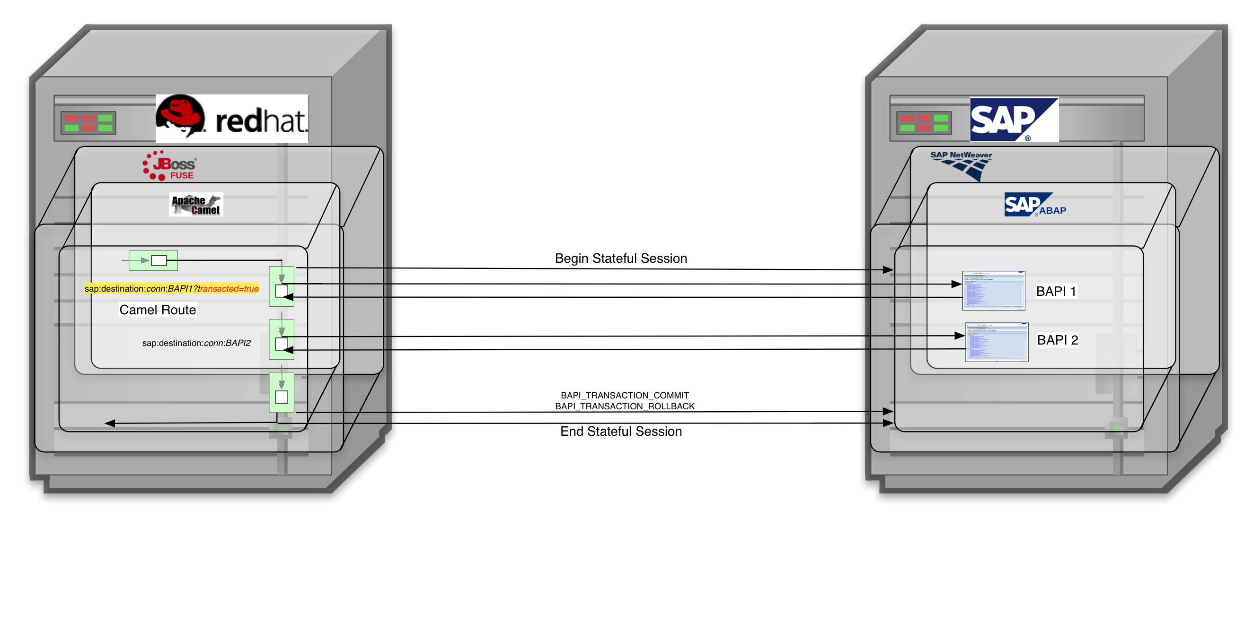
JBoss Fuse Integration with SAP
SAP Transaction Contexts

Slide 38
JBoss Fuse Integration with SAP
SAP Component Data Layer
Data Layer Overview
Endpoint Request & Response Runtime Objects
Building a Request
Processing a Response
Serialization Format
Custom Request & Response Objects

Slide 39
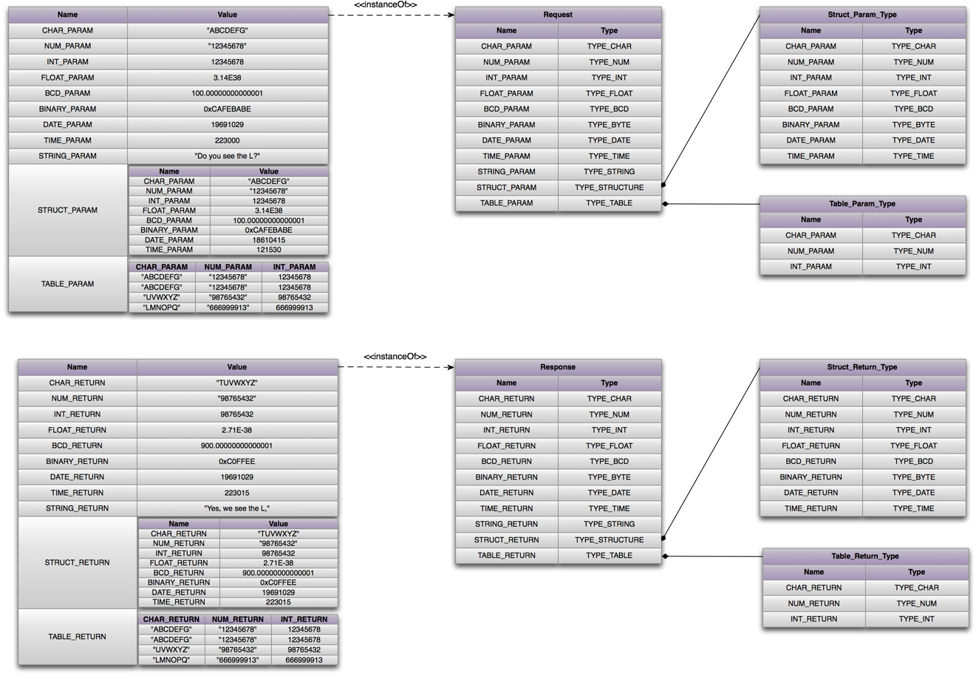
JBoss Fuse Integration with SAP
Data Layer Overview

Slide 40
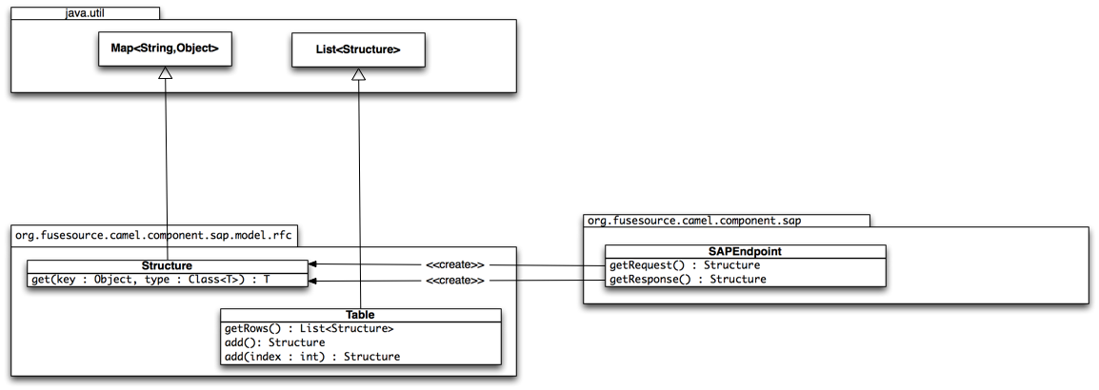
JBoss Fuse Integration with SAP
Data Layer Runtime Objects

Slide 41
JBoss Fuse Integration with SAP
Building a Request Example

Slide 42
JBoss Fuse Integration with SAP
Processing a Response Example
Notes:
Example of Processing a Response in a Processor Bean
Retrieve a Request from the Exhange
Extract Returned Values from Response

Slide 43
JBoss Fuse Integration with SAP
Data Layer Serialization Format

Slide 44
JBoss Fuse Integration with SAP
Custom Request and Response Objects

Slide 45
JBoss Fuse Integration with SAP
Flight Booking Demo
Demo Inbound & Outbound Communication with SAP
Initiating an SAP Transaction from Camel Route
Using Custom SAP Request and Response Objects

Slide 46
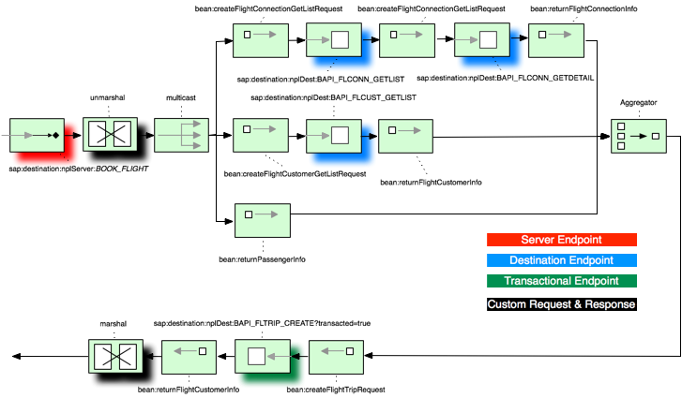
JBoss Fuse Integration with SAP
Flight Booking Route

Slide 47
Resources
Android App Demo of Fuse and DV with SAP NW Gateway
  http://www.ossmentor.com/2013/10/sap-nw-gateway-with-fuse-and-dv.html
SAP NetWeaver Camel Component
  https://camel.apache.org/sap-netweaver.html
Data Virtualization Product Page
  https://www.jboss.org/products/datavirt.html
Fuse Product Page
  https://www.jboss.org/products/fuse.html
SAP NW Gateway Developer Center
  http://scn.sap.com/community/developer-center/netweaver-gateway

Slide 48
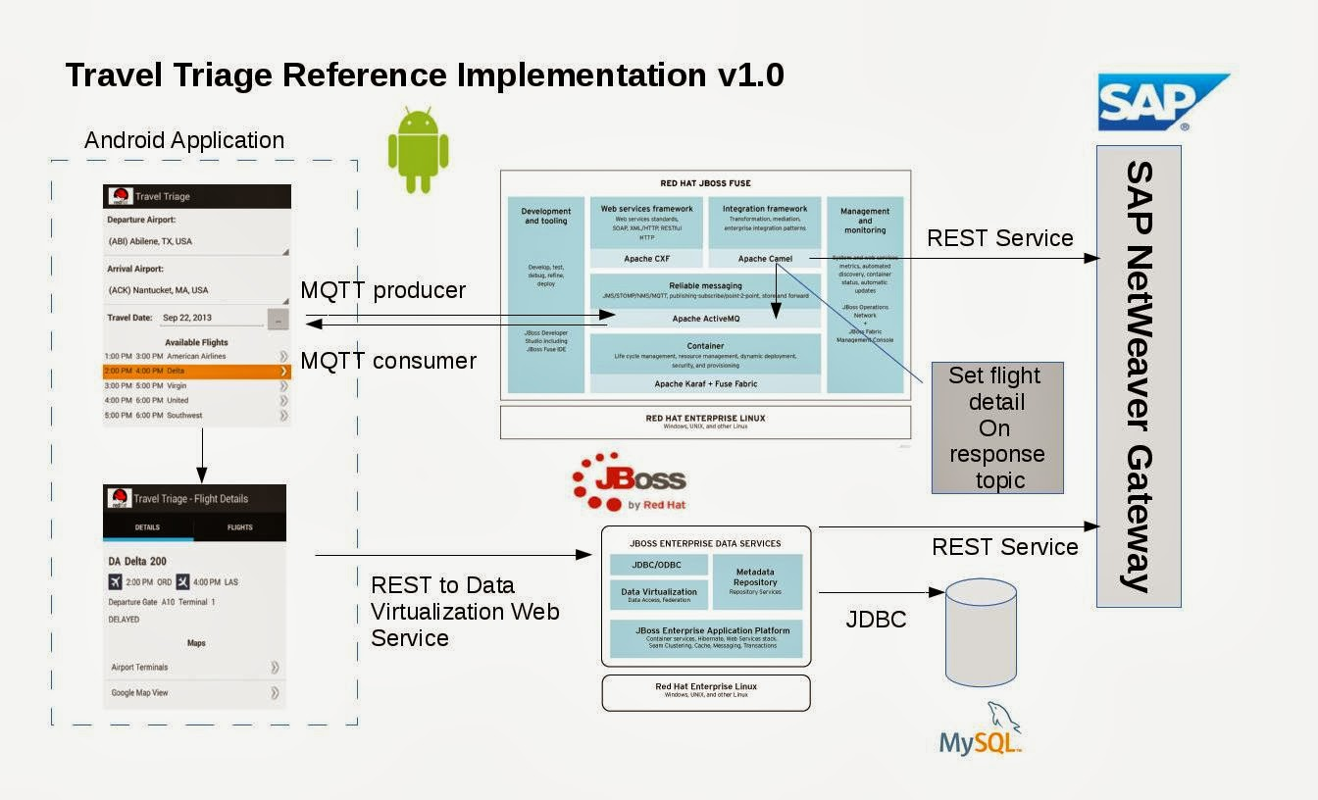
Travel Triage 1.0

Slide 49
Summary
Which solution is right for me?
1. Data Virtualization with SAP NetWeaver Gateway or Enterprise Services
  Data integration is needed.
2. SAP Camel Component
  ESB and/or Messaging is needed.
3. JCo SAP Camel Component
  Direct access to SAP NetWeaver.
  Do not have or want SAP NetWeaver Gateway

Slide 50
SAP NetWeaver Gateway - Pros and Cons
Pros
– Familiar tools and technologies for Java devs
– Existing ABAP functions/dialogs can easily be exposed as a Gateway service
Cons
– NetWeaver Gateway needs to be installed in SAP backend or separately at a cost
– Creating services in ABAP not trivial for more complex scenarios
– Not transactional

Slide 51
SAP Enterprise Services Pro and Cons
Pros
– Work well with SOA platforms
– Familiar tools and technologies for Java developers
– Use WDSL to generate client code
– Trivial to create Web Service wrapper in SAP
– No additional installs / hardware
Cons
– SOAP / WS-* complexity
– Not transactional

Slide 52
JCo Camel Component – Pros and Cons
Pros
– Fits well into Java EE world
– No additional installs on SAP backend
– Bidirectional communication (Java calls SAP, SAP calls Java)
– Transactional
Cons
– Proprietary protocol
– JCA Common Client Interface (CCI): overly generic, lots of glue code

Slide 53
Questions?

