Slide 1
Setting up a remote machine

Slide 2
Outline
Why
Where to rent
Background
Setup

Slide 3
Why
Your laptop and desktop are weak
Notes:
Laptop 6GB or so, but they are power hungry and laptops are limited in ability to keep gpu cool. Desktops are better but you dont live in a 65 degree server room, they will also struggle.

Slide 4
Why
Your laptop and desktop are weak
  Consumer grade components, not designed for 24/7 100% utilization, small GPUs
Notes:
Laptop 6GB or so, but they are power hungry and laptops are limited in ability to keep gpu cool. Desktops are better but you dont live in a 65 degree server room, they will also struggle.

Slide 5
Why
Your laptop and desktop are weak
  Consumer grade components, not designed for 24/7 100% utilization, small GPUs
Probably are not running linux (OS for almost all deep and machine learning)
Notes:
Laptop 6GB or so, but they are power hungry and laptops are limited in ability to keep gpu cool. Desktops are better but you dont live in a 65 degree server room, they will also struggle.

Slide 6
Why
Your laptop and desktop are weak
  Consumer grade components, not designed for 24/7 100% utilization, small GPUs
Probably are not running linux (OS for almost all deep and machine learning)
SOLUTION- Rent a remote machine!
Notes:
Laptop 6GB or so, but they are power hungry and laptops are limited in ability to keep gpu cool. Desktops are better but you dont live in a 65 degree server room, they will also struggle.

Slide 7



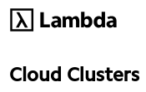

Where
There are a lot to choose from:

Slide 8
Where
We are going to use Paperspace

Slide 9
Why Paperspace?
Affordable (free, pro and growth)
Decent machines
Has jupyter lab (unlike Google colab or kaggle)
And a terminal window
Easy session limiting(defaults to 6 hours)
Setup steps will apply to other cloud providers

Slide 10
Why Paperspace?
Please signup for an account
They have free, but a pro account ($8/month) gives you more options

Slide 11
Why you don’t use remote desktop software with cloud compute
You connect to a remote machine over a network, which is much slower than doing everything locally
Network speed and latency are concerns
  If you try to use a remote desktop solution (x2go, GoToMyPC, etc..) you are sending a large portion of each video frame multiple times per second.
  Worst case: On this machine 1920x1080*32bits=8.3Mbytes/frame, sent 60 times per second
  YOU WILL NOTICE LAG AND DROPPED FRAMES!

Slide 12
Why you don’t use remote desktop software with cloud compute
Plus you have to waste GPU memory on your remote machine to produce a desktop to send over the network to your local machine.

Slide 13
Why you don’t use remote desktop software with cloud compute
Plus you have to waste GPU memory on your remote machine to produce a desktop to send over the network to your local machine.
Finally, it’s probably not supported by the cloud provider anyway

Slide 14
Solution: don’t have a desktop
Use Jupyter Lab and terminal instead: they send just a few characters, only when they are produced. Much, much lower bandwidth requirements.

Slide 15
Background: Paperspace storage
Some is permanent
  /storage
  /notebooks
some is reset every time machine starts
  Everything else, including all system software (python packages, aliases etc.)

Slide 16
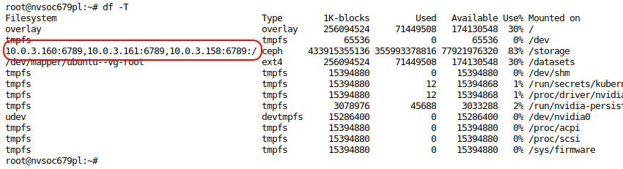
Background: Paperspace storage
Some is permanent
  /storage
  /notebooks
some is reset every time machine starts
  Everything else, including all system software (python packages, aliases etc.)

Slide 17
Background: Paperspace storage
Some is permanent
  /storage
  /notebooks
some is reset every time machine starts
  Everything else, including all system software (python packages, aliases etc.)
What this means is that all machine setup is lost when you power down instance

Slide 18
Background: Paperspace storage
Some is permanent
  /storage
  /notebooks
some is reset every time machine starts
  Everything else, including all system software (python packages, aliases etc.)
What this means is that all machine setup is lost when you power down instance
Way around this? Move all installed stuff to permanent storage, then symlink it back to original position

Slide 19
Background: Paperspace storage
Some is permanent
  /storage
  /notebooks
some is reset every time machine starts
  Everything else, including all system software (python packages, aliases etc.)
What this means is that all machine setup is lost when you power down instance
Way around this? Move all installed stuff to permanent storage, then symlink it back to original position
Put all the symlink setup as well as other system configuration information in a setup script

Slide 20
Background: Paperspace storage
Some is permanent
  /storage
  /notebooks
some is reset every time machine starts
  Everything else, including all system software (python packages, aliases etc.)
What this means is that all machine setup is lost when you power down instance
Way around this? Move all installed stuff to permanent storage, then symlink it back to original position
Put all the symlink setup as well as other system configuration information in a setup script
Run this script whenever you start machine!

Slide 21
Background: Paperspace storage
Some is permanent
  /storage
  /notebooks
some is reset every time machine starts
  Everything else, including all system software (python packages, aliases etc.)
What this means is that all machine setup is lost when you power down instance
Way around this? Move all installed stuff to permanent storage, then symlink it back to original position
Put all the symlink setup as well as other system configuration information in a setup script
Run this script whenever you start machine!
We will do this in class!

Slide 22
Setup:Stuff to cover
A little on the linux boot sequence
.bashrc file
Script files
Some linux commands (du, pwd, cd, which, whereis, mv etc.)
Permanent verses ephemeral storage (/storage and /notebooks are permanent on Paperspace, all else is ehemeral)
Symbolic links
A little vim
Universal ctags and code navigation
CLI apis (for Kaggle and Paperspace)

Slide 23
Setup: Demo
Demo configuring a vanilla linux machine to ensure that changes persists across sessions (aliases, packages, config files, data directories etc..)
I’ll show you how to do this manually, then port this process to a script(s), then port the script(s) and setup data to a git repo.
The git repo will serve as a guide for easily setting up a custom machine.

Slide 24
Format
Live video session so you can ask questions.
Recording will be posted online.

