Slide 1





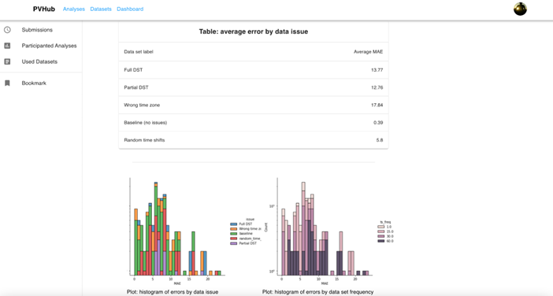
Funded by:
PV Validation Hub
B. Meyers¹, Duncan Ragsdale¹, K. Perry², Michael Deceglie², Matthew Muller², Mehmet Ogut³, Sara Miskovich¹, Mayank Malik¹
(1) SLAC National Accelerator Laboratory, Menlo Park, CA 94025, USA
(2) National Renewable Energy Laboratory, Golden, CO 80401, USA
(3) Stanford University, Palo Alto, CA 94305, USA
Purpose
Algorithm Validation
The PV Validation Hub website will allow developers in the PV community to submit executable code to benchmark against hosted sets for various problems.
One-stop shop for benchmarking and comparing algorithm performance for a variety of PV-related problems (degradation, soiling, etc.)
Consistent labeled data sets allow for side-by-side comparison of different algorithms
Plans to generate validation tests for the following types of analyses:
Estimating system degradation
Estimating soiling rate/ratio\
Detecting time zone/shift issues
Estimating azimuth and tilt of a PV system
Determining inverter ‘clipping’ intervals
And more!
Robust Ground Truth Data Sets
Labeled measured data
Synthetic data sets with typical field data issues (capacity issues, outages, soiling, shading, etc.)
Validation Hub Outputs
Developer Role
Public reporting: Scoreboard benchmarking all submitted algorithms’ performance
Private reporting: Detailed results returned to the developer, including how the algorithm performs in certain scenarios (ex: data at different sampling frequencies)
User Role
View leaderboards and access submitted algorithm solutions for each category
Create account
Submit code for designated analysis
Code runs on validation engine
Leaderboard updated
Private report sent to developer
Validation Hub algorithm submission process
ADD SCREENSHOT OF PUBLIC DASHBOARD HERE
Take our feedback survey:
ADD QR CODE HERE LINKING TO SURVEY
Example private report sent to the developer
This work was supported by the U.S. Department of Energy under Contract No. XXXX with the SLAC National Accelerator Laboratory, the National Renewable Energy Laboratory, and Stanford University.

