Slide 1
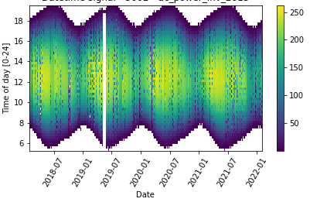
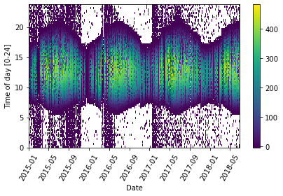
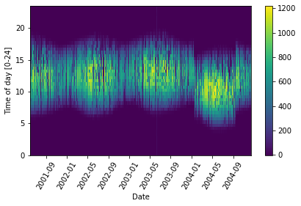
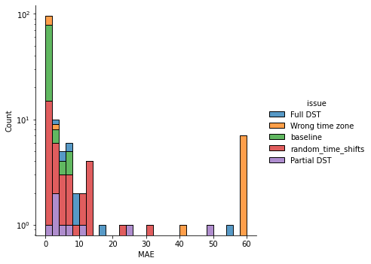
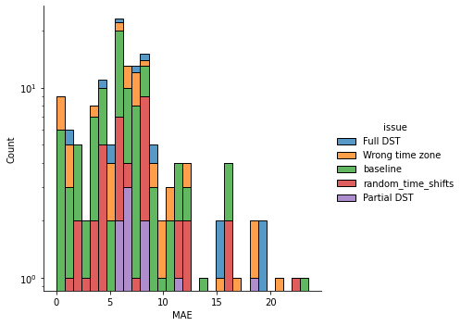
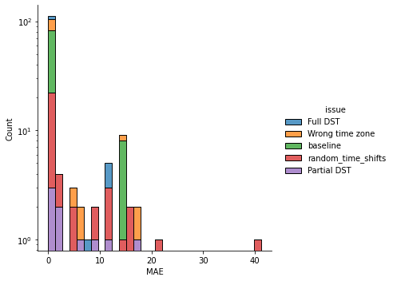
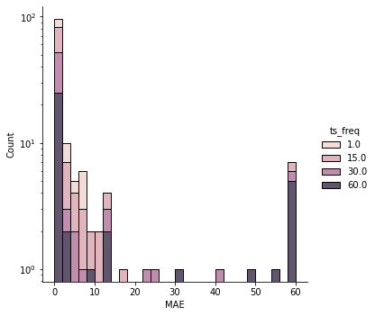
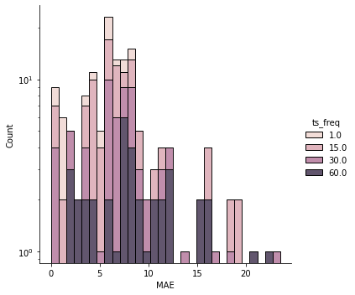
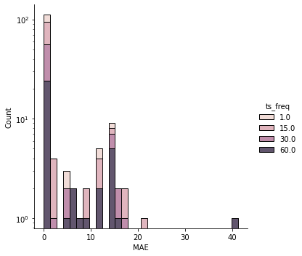
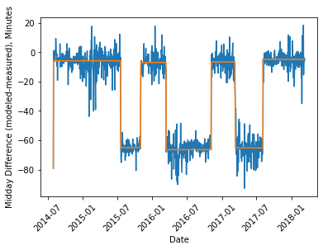
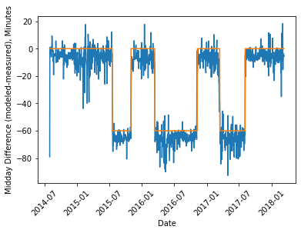
Survey of time shift detection algorithms for measured PV data
K. Perry¹, B. Meyers², M. Muller¹
(1) National Renewable Energy Laboratory, Golden, CO 80401, USA
(2) SLAC National Accelerator Laboratory, Menlo Park, CA 94025, USA
Introduction
Results
Measured PV data from fielded systems may be incorrectly labeled by time zone, erroneously contain daylight savings time (DST), or have time shift issues. Correcting this data is essential for future analysis, including degradation analysis.
This research aims to benchmark three open-source Python automated time shift detection algorithms–two from PVAnalytics and one from Solar-Data-Tools—on ground truth data sets with known time shifts.
Mean absolute error (MAE) in Minutes by Issue Type
Issue | SDT-Alpha Avg MAE | SDT-Omega Avg MAE | PV-OSD Avg MAE | PV-CPD Avg MAE
Full DST | 35.32 | 13.77 | 9.57 | 3.56
Partial DST | 22.27 | 12.76 | 8.78 | 5.35
Wrong time zone | 18.47 | 17.84 | 7.65 | 1.83
Baseline (no issues) | 0.12 | 0.39 | 6.35 | 1.55
Random time shifts | 14.02 | 5.80 | 7.31 | 5.03
Error Distribution by Issue Type
SDT-Omega Distribution
PV-OSD Distribution
PV-CPD Distribution
AC power time series data heat-mapped by hour of the day. The first time series contains no issues, the second contains DST, and the third contains a random time shift.
Methods
Error Distribution by Data Frequency
SDT-Omega Distribution
PV-OSD Distribution
PV-CPD Distribution
Data Sets
8 systems, comprising 19 unique AC power and irradiance streams free of time shifts, were identified in the NREL PVDAQ database
Data stream were resampled at 1-, 15-, 30-, and 60-minute frequencies
Time shift issues were randomly inserted into each data stream, including:
Erroneous DST (full series or partial series)
Random time shifts ranging from 15 minutes off to 120 minutes off
Incorrect time zone labeling
Inserted issues recorded for the purpose of algorithm benchmarking
PVAnalytics-Changepoint Detection (CPD) Approach Steps
Data pre-processing: removal or flatlined data, negative data, outliers
Data is run through a day-night masking algorithm to get sunrise and sunset times
Modeled sunrise and sunset values for the location are determined using PVLib
The midday time between sunrise and sunset is calculated for modeled and measured data. The measured midday point is subtracted from the modeled midday point, creating a midday time difference series
The midday time series is run sequentially through a Binary Segmentation CPD algorithm to find time shift points and amounts. Each segment mean is rounded to the nearest 15-minute period (settable)
Currently being adapted into PVAnalytics (https://github.com/pvlib/pvanalytics)
PVAnalytics-Optimization-Based Signal Decomposition (OSD) Approach Steps
Same pre-processing steps as PVAnalytics CPD algorithm
Instead of using a CPD algorithm to find time shifts, an OSD algorithm is used (https://github.com/cvxgrp/signal-decomposition). No rounding used here.
Solar-Data-Tools (SDT) Algorithm Approach Steps
Preprocessing/cleaning using SDT pipeline (DOI: 10.1109/PVSC45281.2020.9300847)
Estimate solar noon as avg of sunrise and sunset times
Apply signal decomposition (SD) with three component classes (DOI: 10.1561/2000000122)
Smooth and periodic
Piecewise constant
Residual term (sum-square small)
Piecewise constant component is the detector of the shift and provides the estimate of the locations and amounts
PARTIAL DST EXAMPLE: VISUALIZING TIME SHIFTS
Note the differences in the y-axis between the SDT results and PVAnalytics results. SDT shift detection is done on the measured solar noon signal, while PVA works with a difference between modeled and measured.
SDT
PVANALYTICS-OSD
PVANALYTICS-CPD
Differences between algorithm approaches
PV-CPD algorithm rounds to the nearest 15-minute period (settable), SDT and OSD methods don’t currently round and can take on any values (this could be altered).
For PVAnalytics methods, seasonality in the solar noon signal is removed by utilizing lat and lon to calculate the equation of time (EoT) directly
SDT does not require lat/lon as an input and handles the seasonality due to the EoT through an additional component in the SD model
Conclusions
PV-CPD highest overall performer, but results may be biased due to time series rounding
All algorithms were marginally less accurate when estimating time shifts in lower frequency data sets (60-minute sampled)
Preliminary analysis: We plan to create a more advanced benchmarking data set with field-representative issues for validation in the PVInsight Data Hub
Later testing to include algorithm run time analysis on common compute architecture
Data sets are generalizable while still allowing us to appropriately improve algorithms
This work was supported by the U.S. Department of Energy under Contract No. DE-AC36-08GO28308 and with the National Renewable Energy Laboratory. Associated SETO numbers are 38258 and 38529.
NREL PV Module Reliability Workshop, Golden CO, Feb.28-Mar.2, 2023

