Slide 1
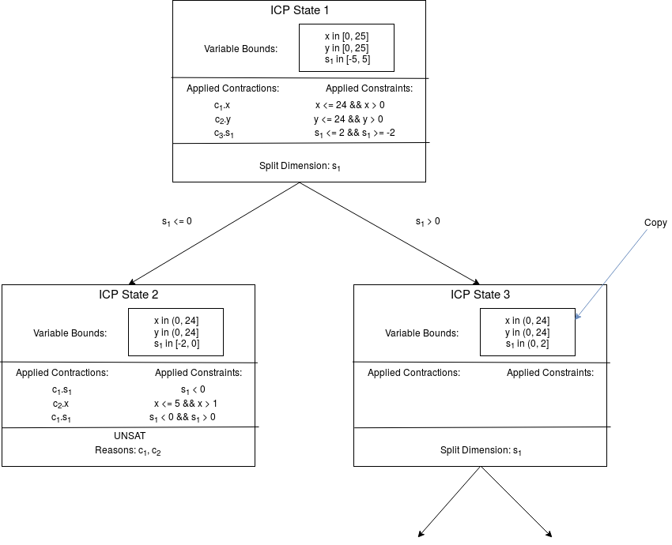
ICP Search Tree
Variable Bounds Copies,Independent Nodes → Easy Multi-Threading

Slide 2
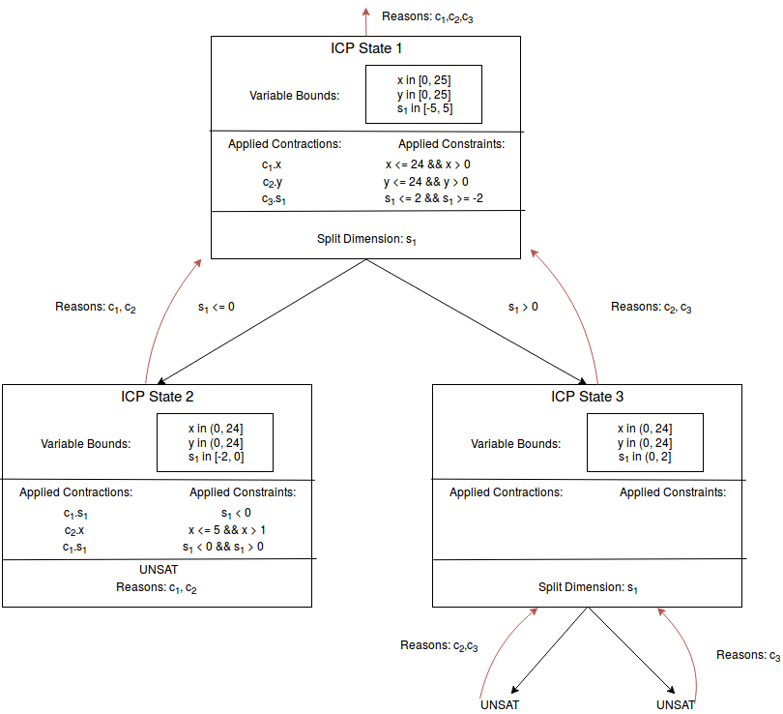
Unsat Cores
Transitive Closure, Bottom-Up

Slide 3
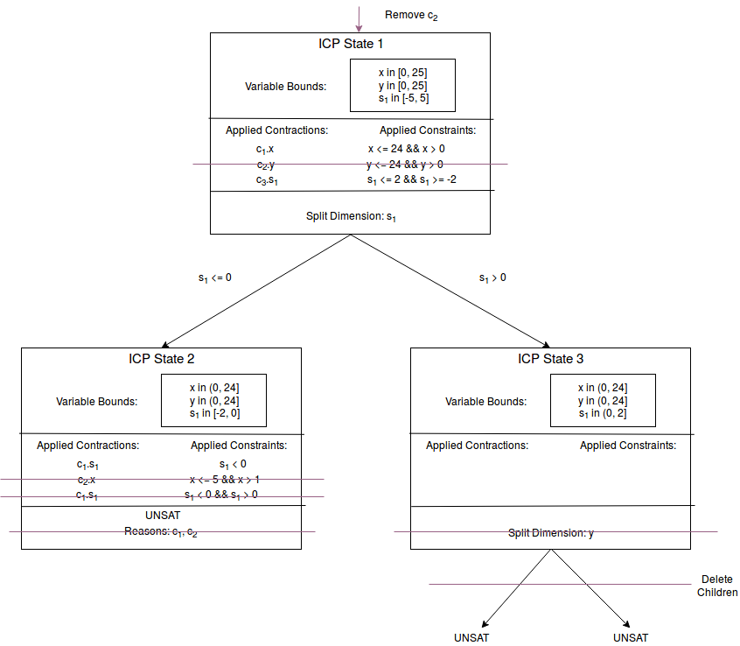
Removing Constraints
Transitive Closure, Top-Down

Slide 4
Governing Algorithm
Two priority queues: ICP States & Contraction Candidates
Take „best“ ICP State, contract it until:
  SAT: Return Model
  UNSAT: Continue with next State
  Split Occured: Add child states to queue
  Other Termination Condiditions: Ask Backend
When queue empty: Return UNSAT

