Slide 1
Initial dashboard
Add-ons: Responsive features
Menu bar
Filter: (1) State (2) County
FL MAP (67 counties)
Layers of median income
Index score
Uninsured pop %
Poor health days
Median income
Gauge chart
FL v score
Gauge chart
County v score
D3 scatter plot
(Y) death rate
Vs
Uninsured pop%
Poor health days
Median income (linear regression)

Slide 2
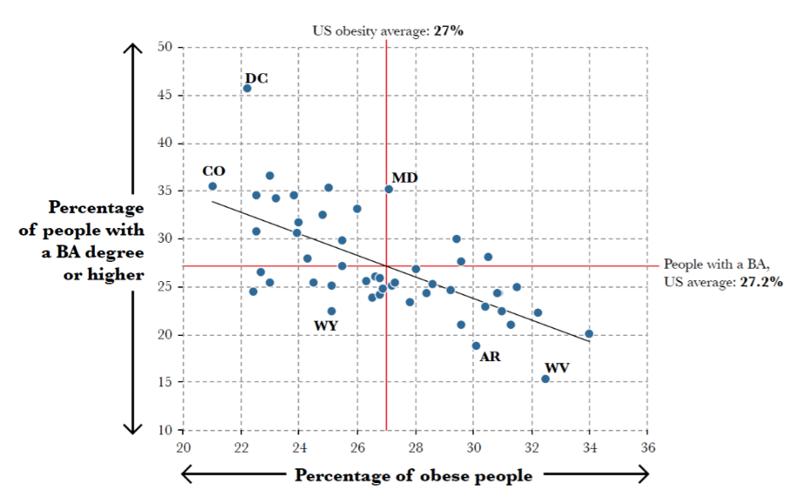
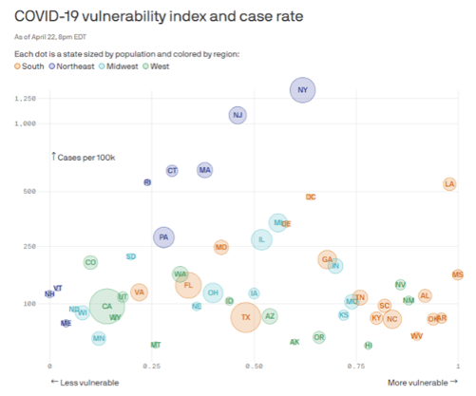
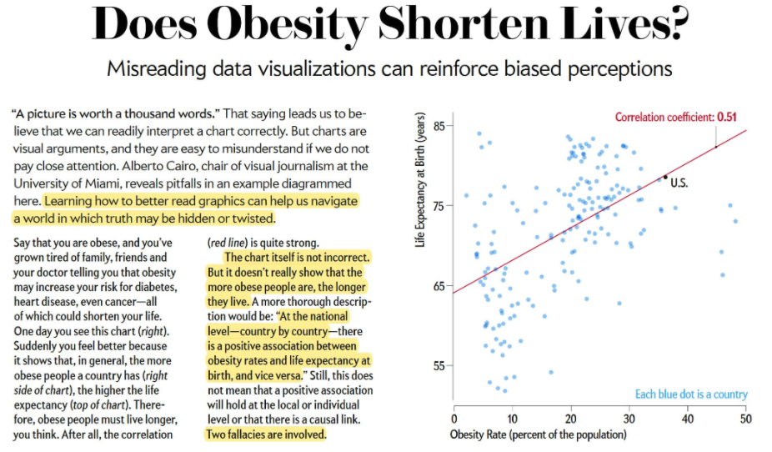
Design Inspiration
Bubble Chart
Correlation, R^2, coefficient

