Slide 1
Project FrailSafe ΥΔΑ
Πετράκης Κωνσταντίνος

Slide 2
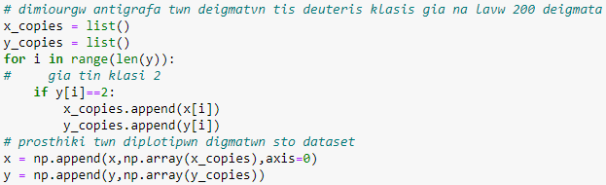


Preprocessing
Unbalanced Dataset
Non-Frail (0): 213
Pre-Frail (1): 227
Frail (2): 100

Slide 3
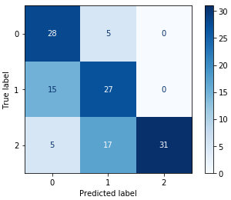
SVM results
Accuracy: 67.1875%
Balanced Accuracy: 69.2082%
Precision: 71.1451%
Recall: 69.2082%

Slide 4
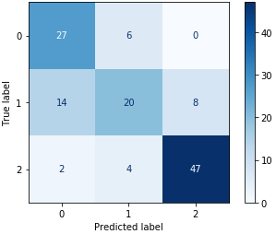

K-NN results
Accuracy: 73.4375%
Balanced Accuracy: 72.7055%
Precision: 71.6373%
Recall: 72.7055%

Slide 5
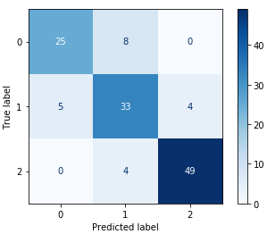
Random Forests results
Accuracy: 83.59375%
Balanced Accuracy: 82.2606%
Precision: 83.0398%
Recall: 82.2606%

Slide 6

Συγκεντρωτικά Αποτελέσματα
Μετρική | SVM | K-NN | RandomForests
Accuracy | 67.18% | 73.43% | 83.59%
Balanced_Accuracy | 69.20% | 72.70% | 82.26%
Precision | 71.14% | 71.63% | 83.03%
Recall | 69.20% | 72.70% | 82.26%

Slide 7
Preprocessing beacons
46782 δείγματα μετά και την αφαίρεση των λανθασμένων part_id
Μετακίνηση: 5sec.
Αλλαγή δωματίου σε <5sec θεωρείται σφάλμα των sensors.
End_time - begin_time - 5 ο χρόνος που πέρασε στο δωμάτιο με timestamp begin_time.

Slide 8

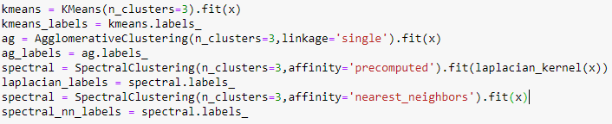

Clustering
laplacian_kernel: k(x,y) = exp(-γ${\left\|x−y\right\|}_{1}$),
γ=1/features_count

Slide 9

Clustering Results
K-means: 0.321828
Aggromerative: 0.379261
Spectral (laplacian_kernel): 0.343358
Spectral (nearest neighbors): 0.347362
Με PCA
K-means: 0.371994
Agglomerative: 0.221339
Spectral (laplacian kernel): 0.339670
Spectral (nearest neighbors): 0.401819

Slide 10
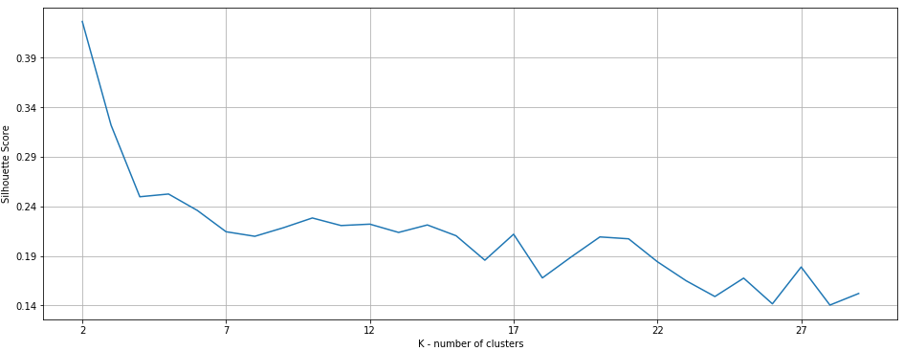
K-means silhouette

Slide 11
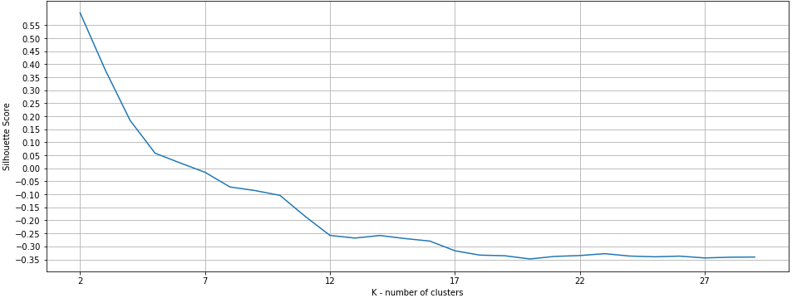
Agglomerative silhouette

Slide 12
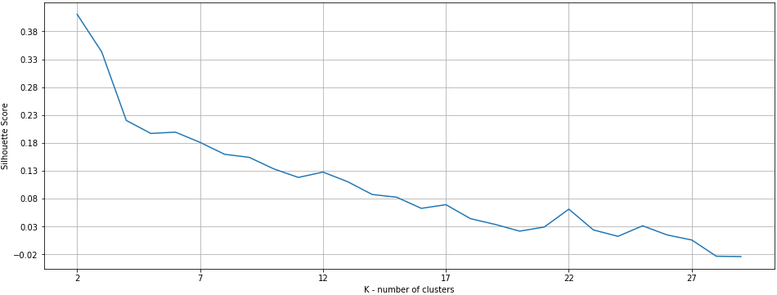
Laplacian kernel silhouette

Slide 13
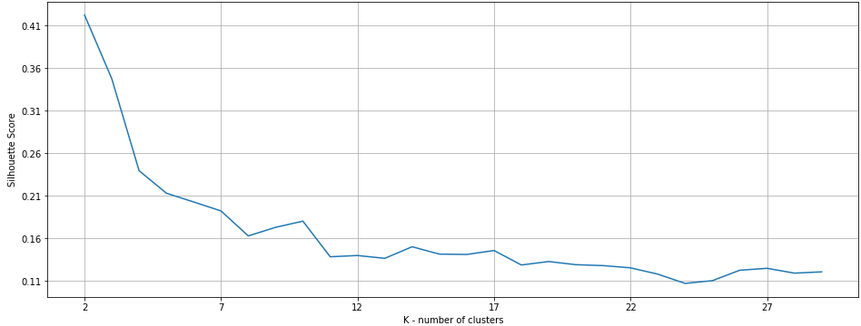
Laplacian NN silhouette

Slide 14
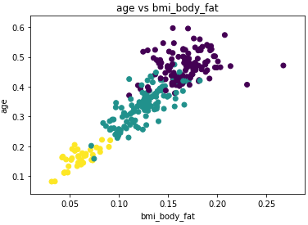
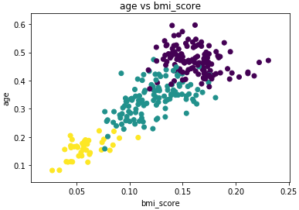
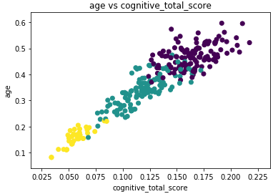
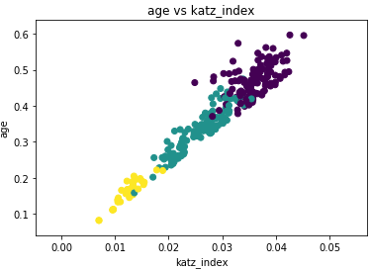
Clustering Visualization (1)

Slide 15
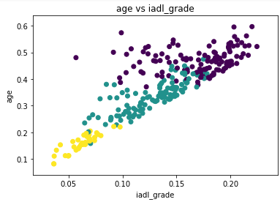
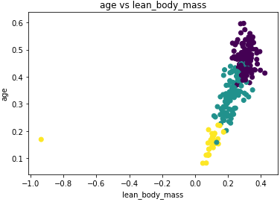
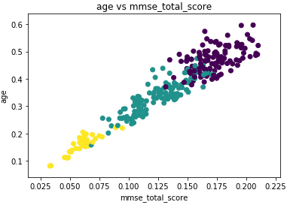
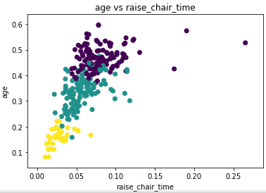
Clustering Visualization (2)

Slide 16
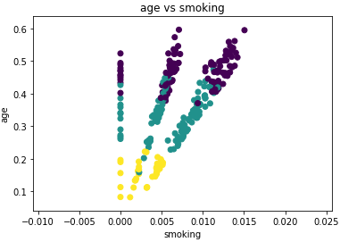
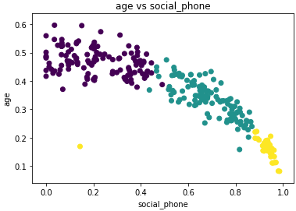
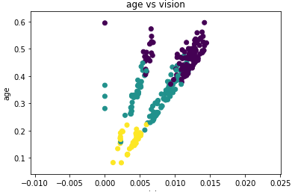
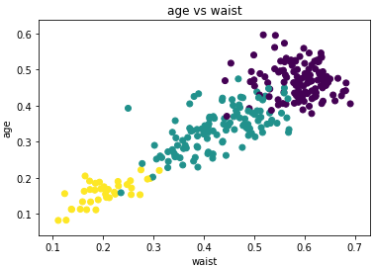
Clustering Visualization (3)

Slide 17
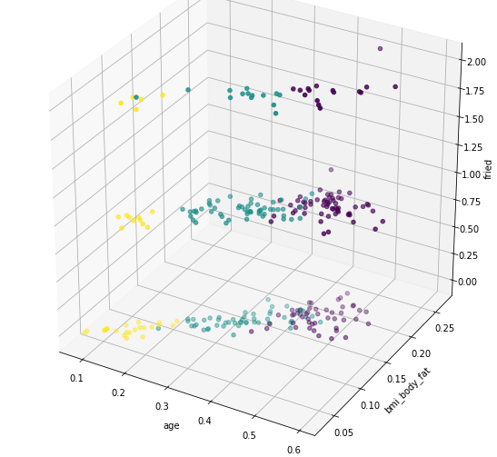
Clustering Visualization (Fried)

Slide 18
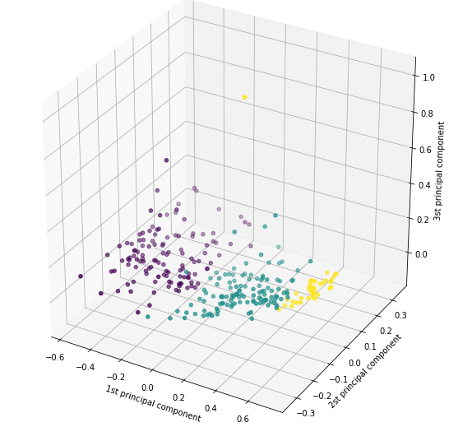
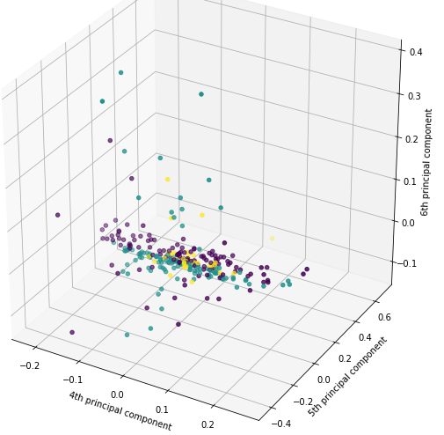
PCA Visualization

Slide 19
Ευχαριστώ!

