Slide 1
Droning on about drones
(super high level)

Slide 2
Drones… where?
Photography
Military
Agriculture
Racing
Search and Rescue
Making conference audiences nervous…
And so on…..

Slide 3
Programming drones…
More industries and jobs are using drones/quads… so better learn to use them!
NOT talking about DJI + MS partnership…

Slide 4
Budget issues…
DJI Phantom 4 $2399
DJI Mavik Pro $1399
DJI Mavik Air $1299
ImpulseRC Helix $600
.
.
.
Eachine 010 ……..… $20
Our budget!

Slide 5

DUCK!!!

Slide 6
FUN!
End goal is to have something for Will to race/chase.
(Real end goal is Skynet, but sssshhhhhh)

Slide 7
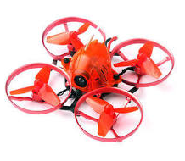
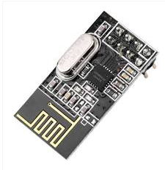

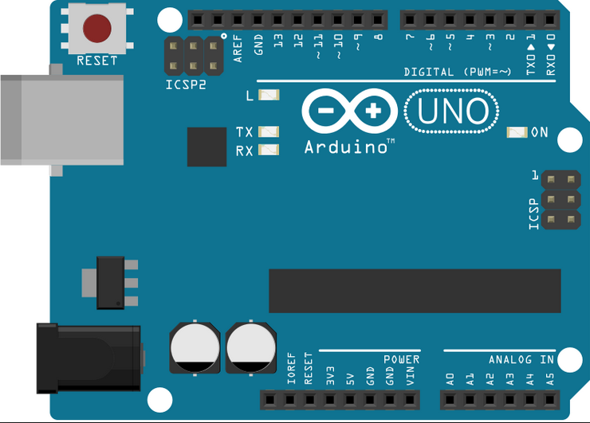
Drone
Arduino Uno
Radio Transmitter

Slide 8
Drone
Arduino Uno
Serial
Radio Transmitter

Slide 9
Running on laptop
Outputs to USB 4 simple numbers: throttle, yaw, pitch, roll

Slide 10
Running on laptop
Outputs to USB 4 simple numbers: throttle, yaw, pitch, roll
Any language will do, as long as it can open the USB device

Slide 11
Running on laptop
Outputs to USB 4 simple numbers: throttle, yaw, pitch, roll
Any language will do, as long as it can open the USB device
https://github.com/perrytsao/nrf24_cx10_pc

Slide 12
Throttle up!!!
options := serial.OpenOptions{
PortName: "COM5",
BaudRate: 115200,
DataBits: 8,
StopBits: 1,
MinimumReadSize: 4,
}
port, _ := serial.Open(options)
// write throttle, roll, pitch, rudder
b := []byte("1200,50,50,50")
_, _ = port.Write(b)

Slide 13
Drone
Arduino Uno
PPM voodoo
Radio Transmitter

Slide 14
Arduino code (hard stuff)
Converts serial input (USB) to PPM protocol

Slide 15
Arduino code (hard stuff)
Converts serial input (USB) to PPM protocol
Someone WAAAYYY smarter than myself wrote it

Slide 16
Arduino code (hard stuff)
Converts serial input (USB) to PPM protocol
Someone WAAAYYY smarter than myself wrote it
Different drones have different receivers (so slightly different comms code)

Slide 17
Arduino code (hard stuff)
Converts serial input (USB) to PPM protocol
Someone WAAAYYY smarter than myself wrote it
Different drones have different receivers (so slightly different comms code)
PPM is a starting point. Can proceed to IBus, SBus etc.

Slide 18
Arduino code (hard stuff)
Converts serial input (USB) to PPM protocol
Someone WAAAYYY smarter than myself wrote it
Different drones have different receivers (so slightly different comms code)
PPM is a starting point. Can proceed to IBus, SBus etc.
https://github.com/goebish/nrf24_multipro

Slide 19
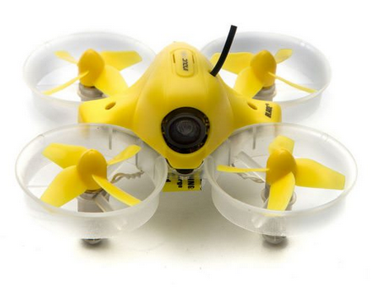
D1
Arduino Uno
D2
PPM
Radio Transmitter

Slide 20
Reference
Github.com/kpfaulkner/drones

Slide 21

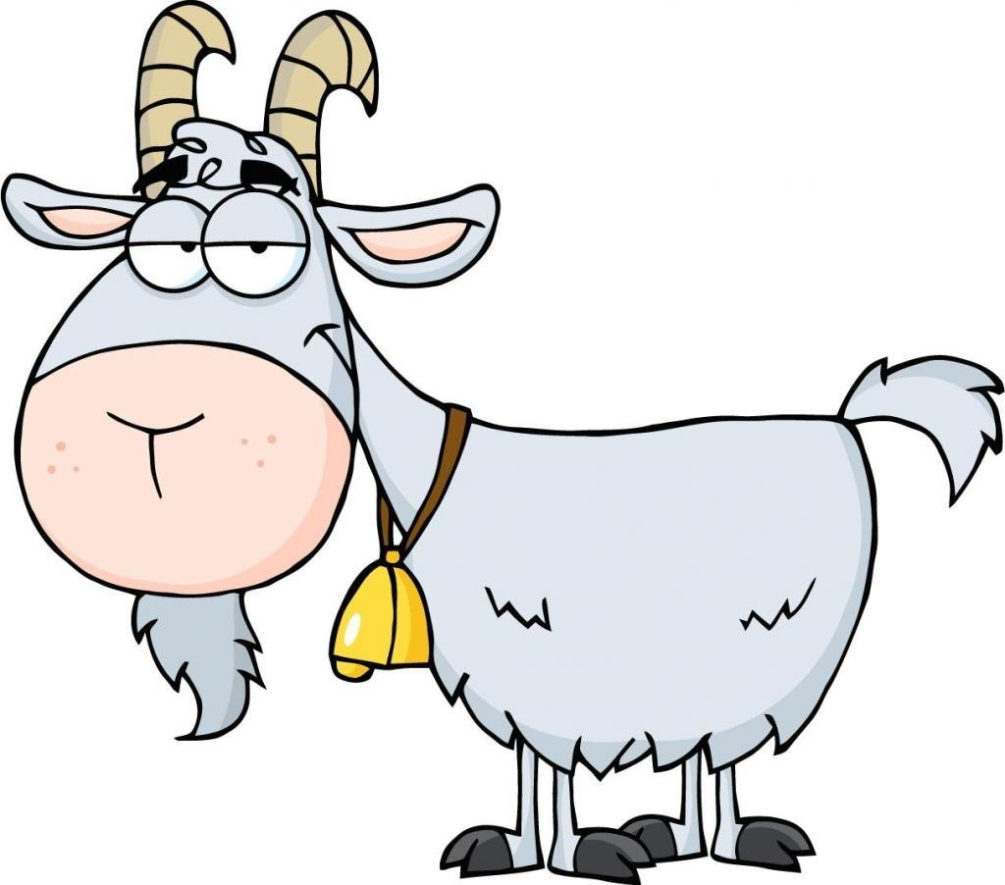
Prepare sacrifice to demo gods..

