Slide 1
Physical basis for modulation of folding state in a disordered protein: out of the CPU and into the cell
Kelly Brock, Ayelet-Chen Abraham, Dan Kaganovich, Jeremy England

Slide 2
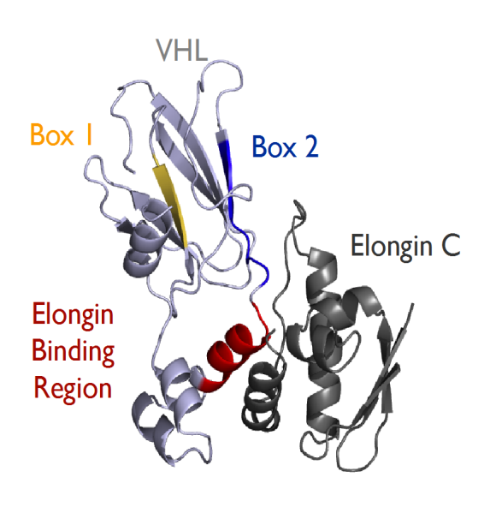
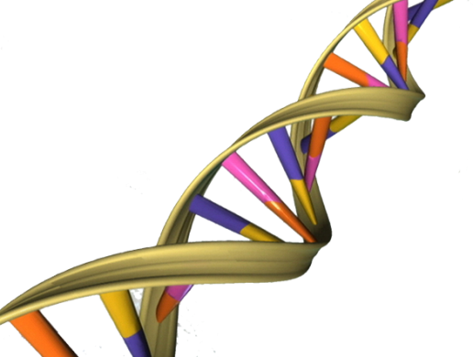
Proteins: The Origin Story
DNA
RNA
Protein
5’AUGUUUCAUCAC…UAG
Transcription
Translation
What happens at the end of this process?

Slide 3
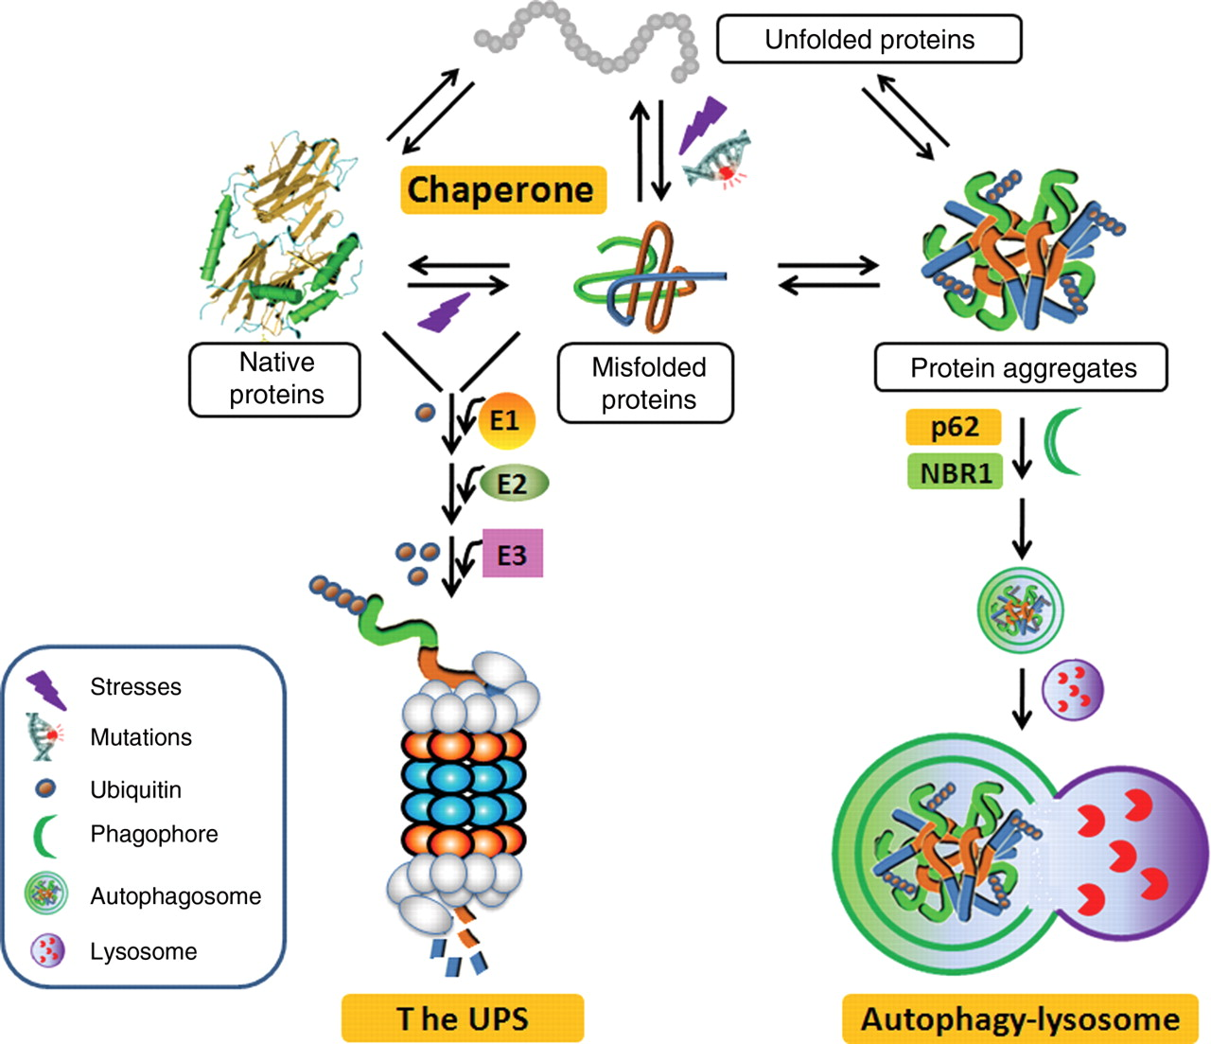
Proteins gone rogue
Su, H and Wang, X. The ubiquitin-proteasome system in cardiac proteinopathy: a quality control perspective. Cardiovasc Res (2010) 85 (2): 253-262.

Slide 4
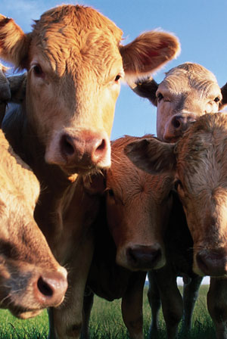
Why do we care?

Slide 5
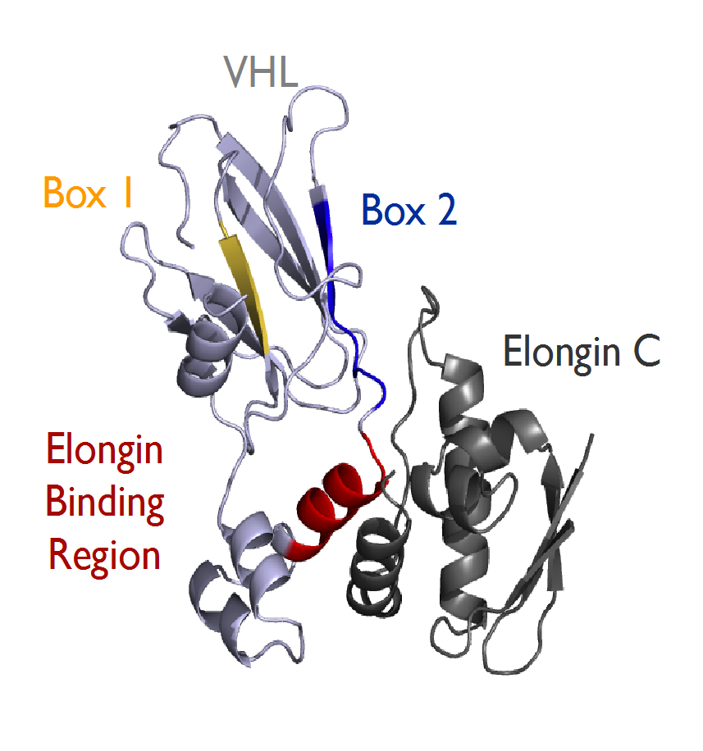
What is VHL?
Von Hippel-Lindau Protein
Found in humans, but not yeast
Forms part of VCB-CUL2 complex
Ubiquitin-ligase complex that
degrades HIF-alpha
213 amino acids long
Is used as a model disordered protein in yeast

Slide 6
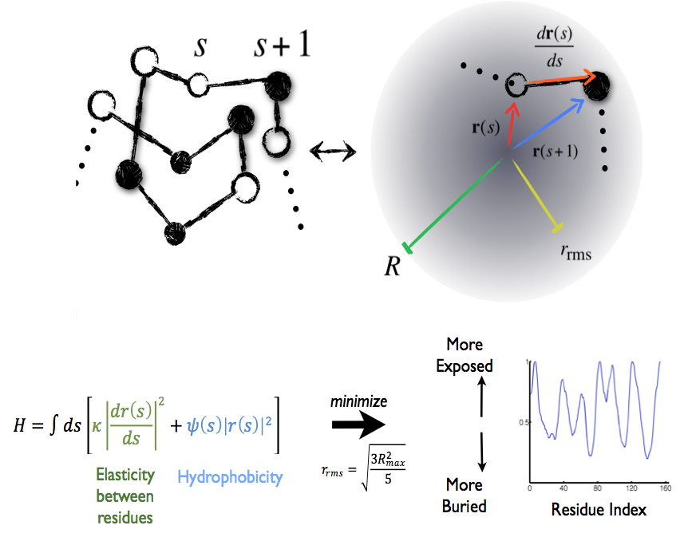

Slide 7
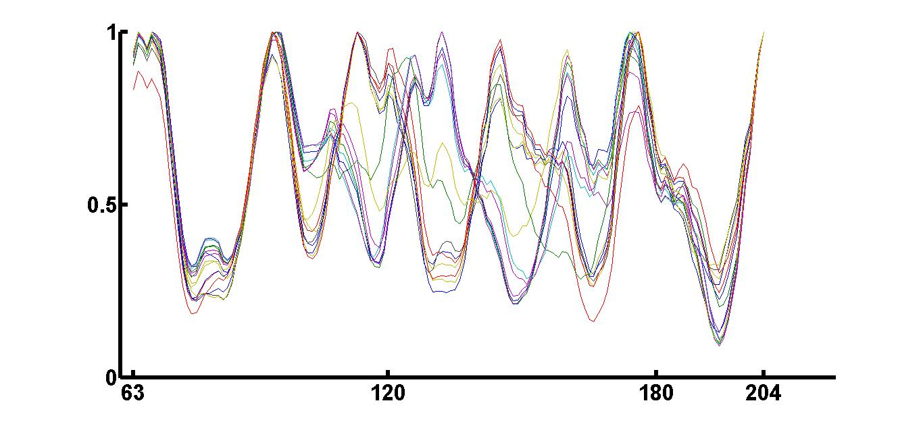
Structural variability
R²/R²max
Residue Index

Slide 8
Picky, picky: choosing the mutants
Low Structural Variability
Control
K171 P61
R176 G14
V20 R3
P99 V74
V66 P40
K171 P5
V20 R4
R167 A11
C162 N7
Q203 N109
E173 K196
E70 G19
V155 G19
T124 K159
T157 V194
D28 A56
G93 V181
R69 S168
L201 E173
S183 C162

Slide 9
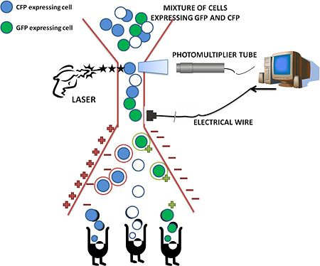
How can we tell if they’re stable?
<http://2010.igem.org/FACS_analysis_of_fluorescent_proteins>

Slide 10
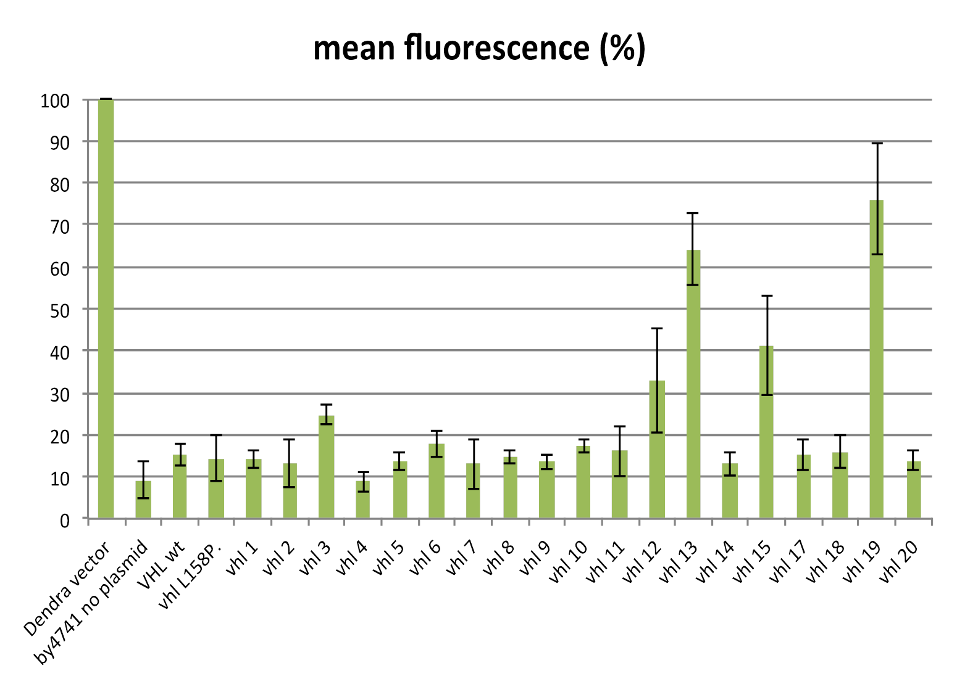
Mutants! (not of the teenage ninja turtle variety)

Slide 11
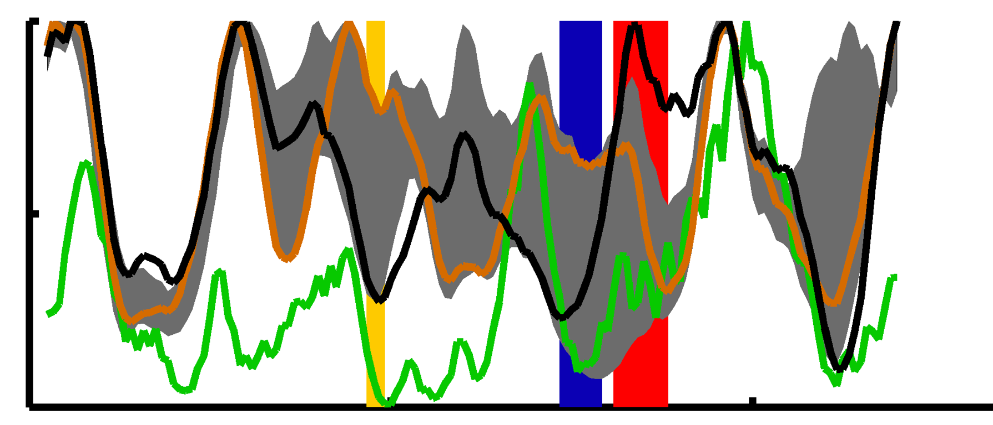
Linking burial patterns to stability
1
L201
E173
Wildtype
Crystal structure
Possible values
of other mutants
0.5
R²/R²max
Box 1
Box 2
Elongin
Binding
Region
0
63
120
180
204
Residue Index

Slide 12
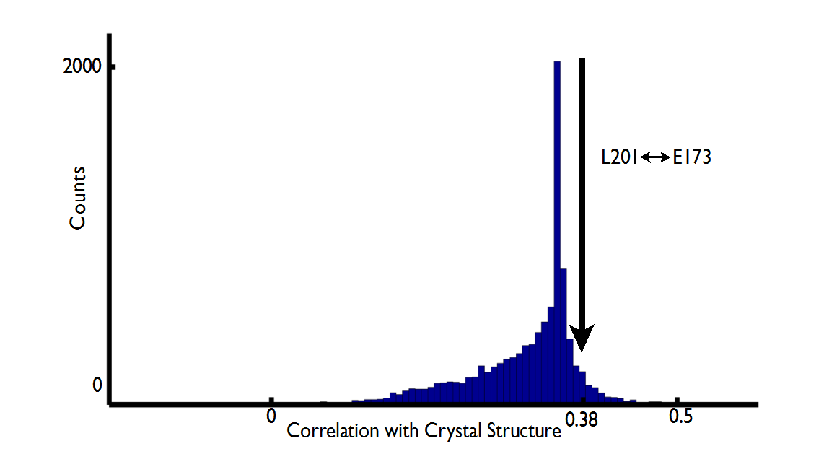
How special is this mutant?

Slide 13
Yes, but how special is it in terms of burying and exposing interaction regions?

Slide 14
This special!

Slide 15
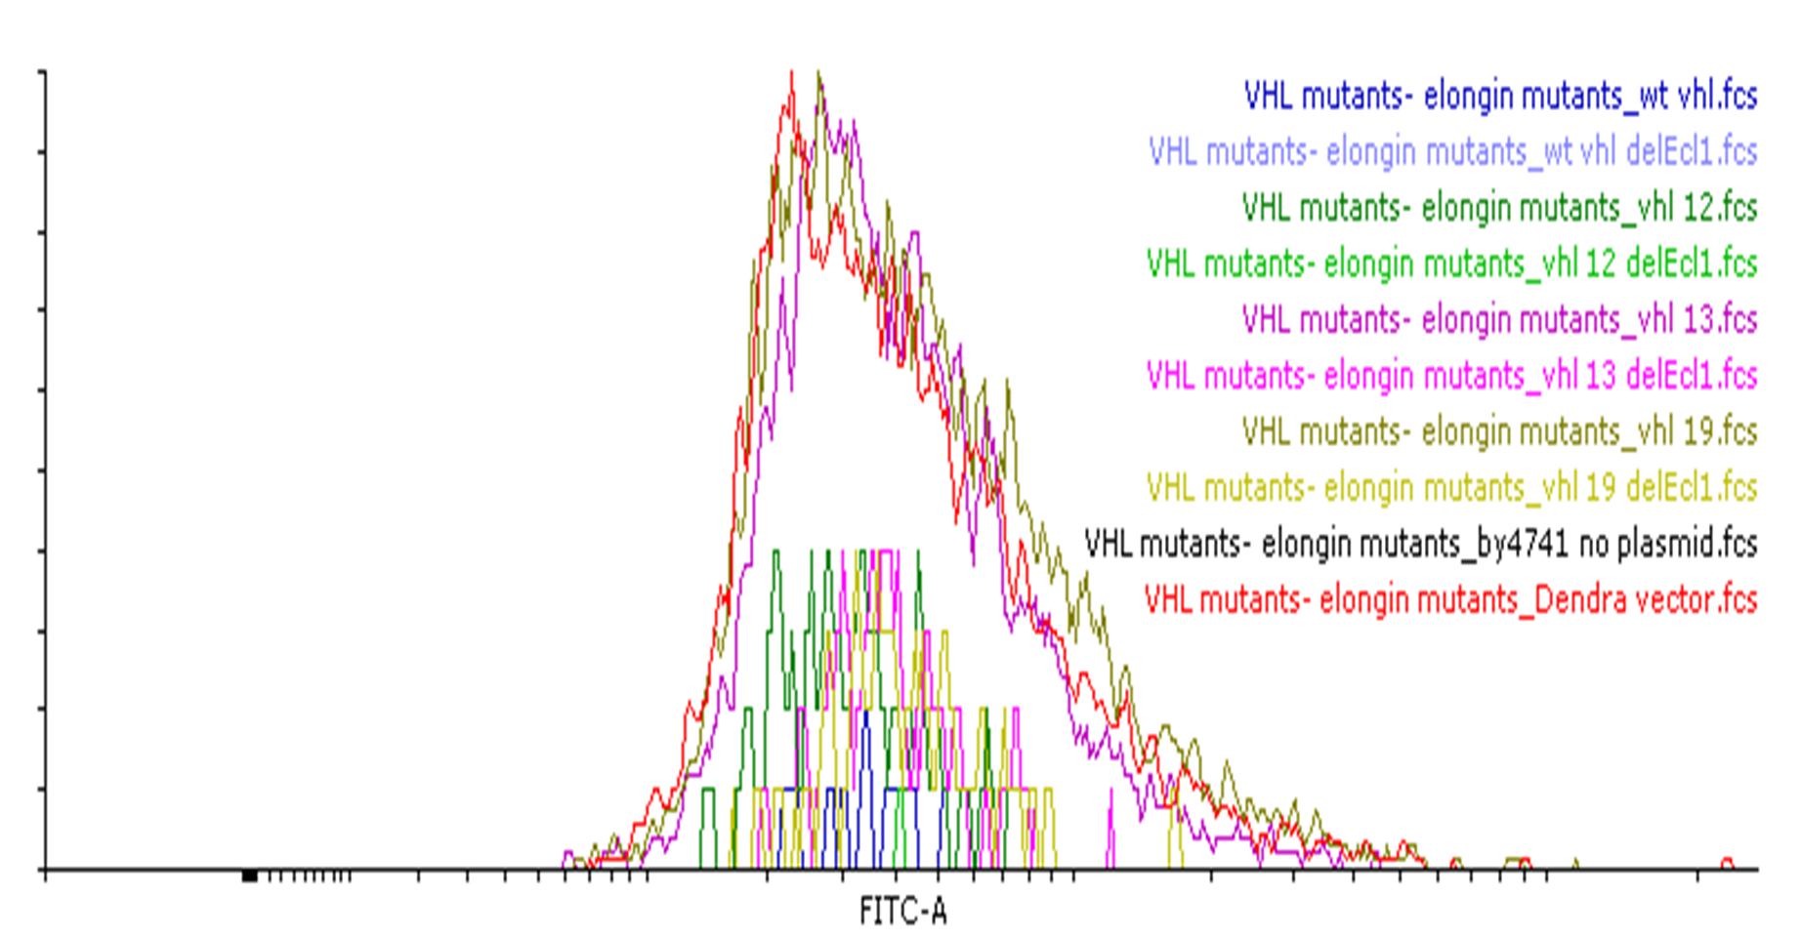
Experimental results (Part Deux)
Counts
Fluorescence

Slide 16
What next?
More experiments!
Depending on the experiments, more computation!
New project!

Slide 17
Acknowledgements
Jeremy England
Dan Kaganovich
Ayelet-Chen Abraham
Rotem, Bobby, Kolya, Tanya, Eugene, Anton, and all y’all!

