Slide 1

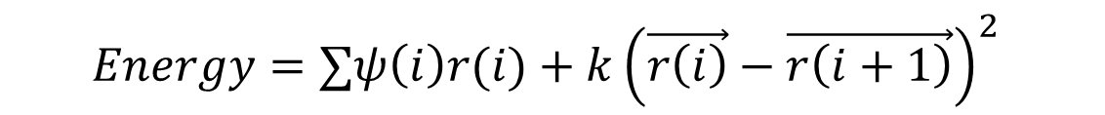
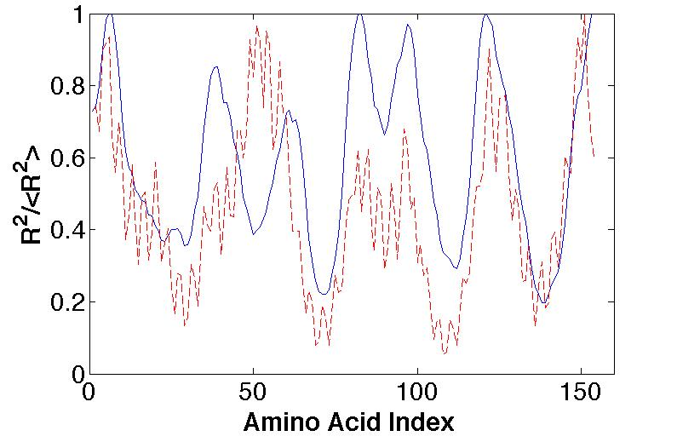
MSEQRL...
MVLSEG...
k
r(i+1)
r(i)
Center of Mass
Rmax
Fig. 1. Overview of modeling assumptions. a) The original model, with folding energy consisting of both hydrophobic and stretching components. b) Concatenation of two sequences to simulate aggregation. c) Sample output burial trace and associated energy.

Slide 2
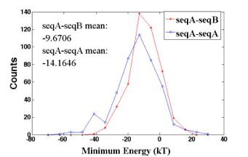
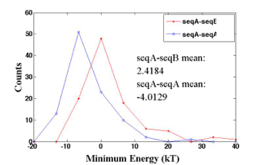
Change these!
Fig. 2. Energy distributions of two-protein aggregation. a) Histogram of minimum energies for real proteins, both for self-self pairings (seqA-seqA) and heterogenous pairings (seqA-seqB). b) Histogram of minimum energies for random permutations of real proteins for both identical sequences and dissimilar sequences in aggregate.

Slide 3
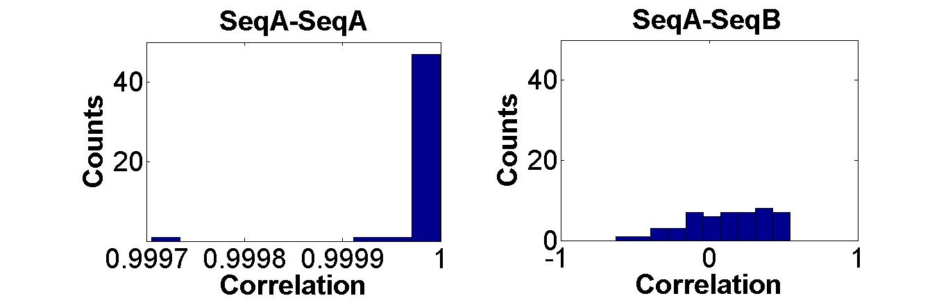
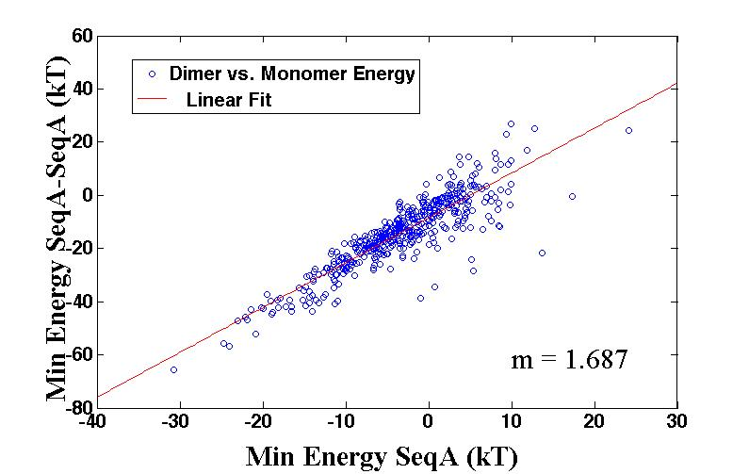
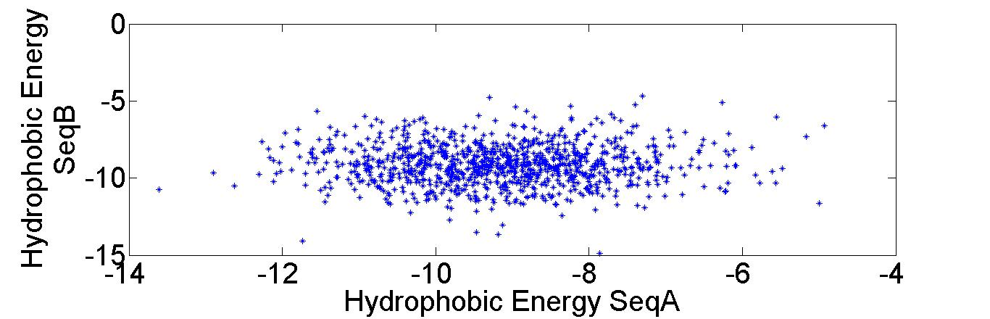

Slide 4
Fig. 4. a) If we are looking for an extrema like an energy minimum, then a higher variance in a sample distribution results in more accessible lower energies on average.

