Slide 1
NoteVert Value & Promotional Services
Value the Brand

Slide 2
LensNote Value & Promotional Services

Slide 3
LensNote Value & Promotional Services

Slide 4
About Us
Founded in 2013 as LensTr
Based in Gwalior
Supports Low Maturity National and International Brands
Promotes Apps, Products, Services, Brands, Public Awareness programs, NGOs, company CSR etc.
Publisher base in North, Central and East India.

Slide 5
Our Presence
We have strong publisher base mainly in Central and East India.
Publisher base in Madhya Pradesh, covering all four major cities viz Bhopal, Gwalior, Indore and Jabalpur.
Covers East India and most part of North East India via Kolkata; covers West Bengal, Jharkhand, Bihar, Parts of Odisha and North East India.
We also cover Gujarat, Rajasthan and parts of UP, .

Slide 6
Our Partners
Collaborated with prominent and popular Stationary Notebooks Brands - Shivalal, Ganesh, Surya, Bharti, Onwards, iPage, Pioneer and Oxford.

Slide 7
Our Present Capacity
20 lakh+ per month circulation in East India.
60 lakh+ per month circulation in Central India.
25 lakh+ per month circulation in North & West India.

Slide 8
Our Services
STRATEGY
VISION
TARGET
CREAVTIVE
USER FRIENDLY PROMOTION
BRAND
AWARENESS
BRAND
EHNANCEMENT
IMPRESSION
Creative and user friendly advertising giving mouth publicity.
Promotion of low maturity national and international brands, products and services.
Promotes apps, individual brands, products, services, public awareness programs, NGOs, travel & tourism, company CSR etc.
Ad integration with popular and prominent stationery notebook brands.
Effective target advertising in requested available potential market regions in India by means of distributers of publishers.
Targets age groups according to the products and services.

Slide 9


Slide 10
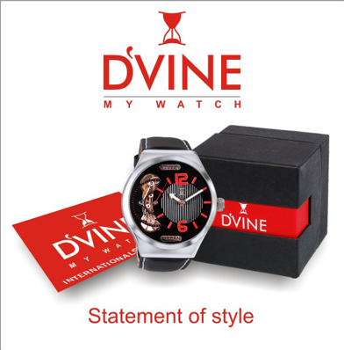

Slide 11
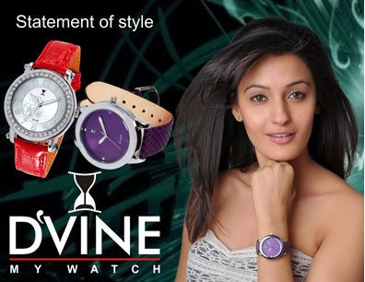
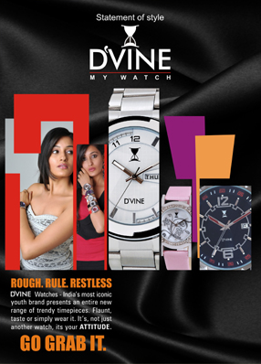
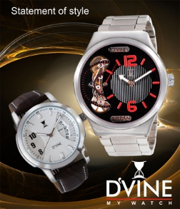
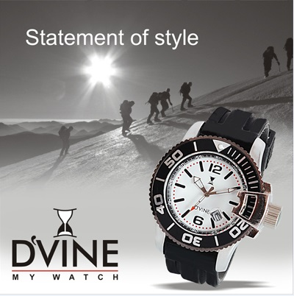
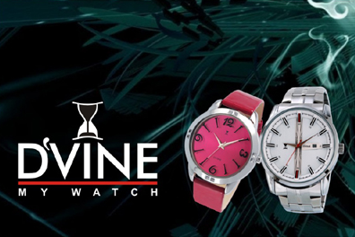

Slide 12
Your statements. . . . and Our solutions
All products are especially developed and designed for YOUTH.
“As of today, the country is driven by the youth, and watches have become a style statement for today’s youth. The Brand Dvine presents you a collection of designs, where each design is a masterpiece of craftsmanship and every watch becomes extension of the personality of its owner.”
“The focus of Dvine brand will be the youth of this country, the watches launched under the Dvine brand will be in category of sports watches having contemporary designs to suit the today youth.”

Slide 13
Notebook Advertising Deals With The Youth Very Directly And Most Effectively
Youth these days gets most of the news from online news sources, facebook, twitter etc. which are more popular with them rather than newspapers and magazines.
Notebook advertising seems the best possible way to target your right customers in most effective manner.

Slide 14
“Our design and construction is unique which we refresh after every two to three months according to the need of the market.” (We also got such reviews from a local shopkeepers at Bada, Gwalior)
Fashion watches at reasonable prices.
Our products are as per the TREND.
“As of today, Indian Watch Industry is still in its nascent stage, where only a handful of options are available in the sports watch segment. We, at 'Varun,' launched this brand to fill the gap of affordable Sports Watch in the industry.”

Slide 15
Brand Value Enhancement
Notebook advertising is capable of delivering mouth popularity.
Remember, WeChat, Hike and Line provides way better features and user friendly services than WhatsApp do. But still WhatsApp has way more customers and valuation than any of them.
Why? B’coz WhatsApp has Mouth Popularity.

Slide 16
MISSION TO BECOME THE SECOND LARGEST WRIST WATCH BRAND IN INDIA.

Slide 17
Newspaper, Magazine Ads Vs Notebook Ads

Slide 18
Catch seconds vs months
The time period for which a person sees an ad in newspaper is less than
a second to a few seconds.
Small ads have good chances to get neglected.
Large size ad pages are usually quickly turned and skipped.
While in Notebooks advertising
It is not for few seconds. . .
A person, in general, interacts with his notebook many times a day and not just for a few days or weeks but for many months or even years.
It is impossible to miss the promotional content in notebook

Slide 19
Impressions vague vs permanent
Newspaper once red in a day, hardly it is seen again.
Only 5-20% ads are noticed.
Out of it 80% are vaguely remembered and forgotten with time.
Notebooks are always kept close.
The promotional content is seen again and again. Can’t be forgotten.
A notebook not only interacts it’s owner but goes frequently through his friends, teachers, parents etc.
Deliver the deepest and permanent Impression

Slide 20
Figures and Conversion Rate (CR)
Charges are for lakhs of people but only a few hundred of people generally see an advertisement.
Conversion Rate is less than 20%.
Circular of the newspaper are not fixed. Lots of newspaper company gives the wrong figure about the circular for which nothing thing can be done.
Conversion Rate is 100%. You are paying for every impression.
The figures of circulation of notebooks are exact.

Slide 21
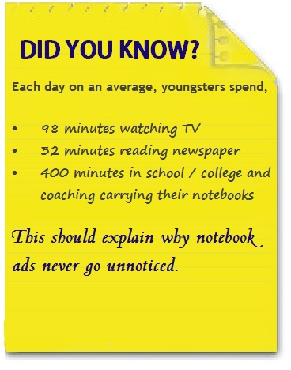

Slide 22
Most people develops a common tendency to skip and neglect the advertisement filled areas.
There are only few areas in print media where advertisements are clearly noticed. The advertisements in newspaper are generally of low quality.
Notebook advertisements can never be missed.
High quality colourful advertisement are published in Notebooks.

Slide 23
Attributes of Notebook Advertising in India
The book stays with the student or any person for an entire semester or even a year.
The notebook not only interacts with the user student. It reaches his college / school friends, mates, parents and teachers as well.

Slide 24
It is not like any typical advertising
The promotional content is integrated with the notebook.
This all is done in such a way that the brand product is as interactive and valuable as it used to be, only difference being that it is promoted.
It is User Friendly
Call it interactive advertising

Slide 25

Advertisement is Targeted
The advertisements are promoted in requested regions like Indore, Gwalior, Bhopal, Delhi, West Bengal, Odisha, North East etc. by means of various regional distributers of the notebook brands who supplies notebooks in their respective regions.
Notebooks are available for different age groups and standards. This enables to target particular age groups.

Slide 26
Our View
Your turnover is 2-5 crore as you have stated in indiamart.
Major players in wrist watch market in India are Titan, Sonata and Fastrack. These have great mouth publicity which they have got after spending aggressively on marketing and advertising.
Titan claims 70% market share. Titan Watches Industries reported a turnover of Rs. 6520.89 crores for the year 2010-11.

Slide 27
You have promoted or advertised your brand in many prominent daily newspapers, websites, magazines and university events.
Most companies generally spend from 2% to 20% of their revenue in advertising and promotion.
For your company has good presence in North, East and West India. We would like to start from Central India.

Slide 28
Case Study I
Dainik Bhaskar Group
India’s biggest newspaper.

Slide 29
Madhya Pradesh
1. All MP
Basic Advertising Rate = 5010 Rs/sqcm [basic rate; least of all rates: front, front page non solus, P3, back page]
Readership (Rd) = 25lk ( Urban = 19lk)
Size of typical advertisement = 500 sqcm
Cost of advertiment = 5010 Rs/sqcm x 500sqcm = Rs 20lacs

Slide 30
CPI (Cost Per Impression) = Total Cost of Advertisement/Readership
CPI = 20lk/25lk = 0.8 Rs/Impression

Slide 31
2. Gwalior
Current Basic advertising rate = 535 Rs/sqcm
Sole DB Readership in Gwalior = 1.06lk
Cost of typical ad in 500sqcm space = Rs 2.67lk
CPI = 2.52 Rs/Imp

Slide 32
3. Bhopal
Current Basic advertising rate = 1155 Rs/sqcm
Sole DB Readership in Bhopal = 2.41lk
Cost of typical ad in 500sqcm space = Rs5.78lk
CPI = 2.4 Rs/Imp

Slide 33
4. Indore
Current Basic advertising rate = 1620 Rs/sqcm
Sole DB Readership in Indore = 2.21lk
Cost of typical ad in 500sqcm space = Rs 8.1lk
CPI = 3.67 Rs/Imp

Slide 34
Online Advertising
Google AdSense
Bing
Facebook

Slide 35
Google Adsense
CPM (Cost Per Mille) = Rs72 CPM per keyword idea.
Generally 4-10 keywords for search are taken.
Cost for 4 keywords = Rs288 CPM = 0.288 Rs/Imp
CTR (Click Through Rate) can from 1% to above 40% in general.
Average CPC (Cost Per Click) for AdSense = 150 Rs/click
Cost for 5% CTR at Rs150 CPC = 150x(5/100) = Rs7.5
Total Cost = (CPM cost) +(CTR-CPC cost)
CPI = 0.288 + 7.5 =7.79 Rs/Imp

Slide 36
Microsoft Bing
CPM = Rs600 CPM
For 5% CTR and Rs 72 CPC
CPI = 0.60 + (5/100)*72 = 4.2 Rs/Imp

Slide 37
Channels | Newspaper | Google AdSense | Bing | Facebook | Notebook
Quality of Ad | low | Average | Average | Good | Good
User friendliness Ad | Average | low | low | Average | Friendly
Demo | limited | limited | limited | Accurate, extensive | Accurate, extensive
Effectiveness in India | Less effective | Online users; less effective | Online Users; less effective | Youth; effective | Youth; Very effective
Geo targeting | No | Yes | Yes | Yes | Yes
Age Targeting | No | No | No | Yes | Yes
CPI (Rs/Imp) | 2-4 | 7 - 15 | 4 - 9 | 4 - 10 | >2
Duration of Impression | Few seconds | Few seconds | Few seconds | Few seconds | Days, months or even year.

Slide 38
Thank You)

