Slide 1

Using RStudio and GitHub for Reproducible Science

Slide 2
AGENDA
Importance of Reproducible Science
Project Organization
Rprojects and GitHub
Connecting to GitHub

Slide 3
Importance of Reproducible Science

Slide 4
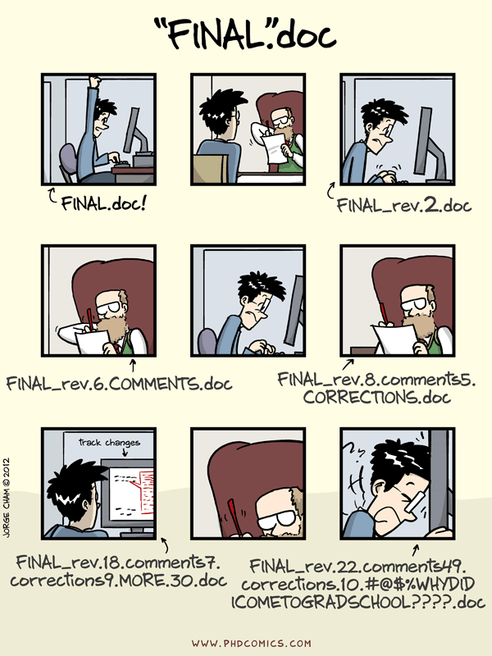
Importance of Reproducible Science
Project Organization
Everything meaningful in one folder structure
Folder Structure
Project-based
Activity-based
File Naming

