Slide 1
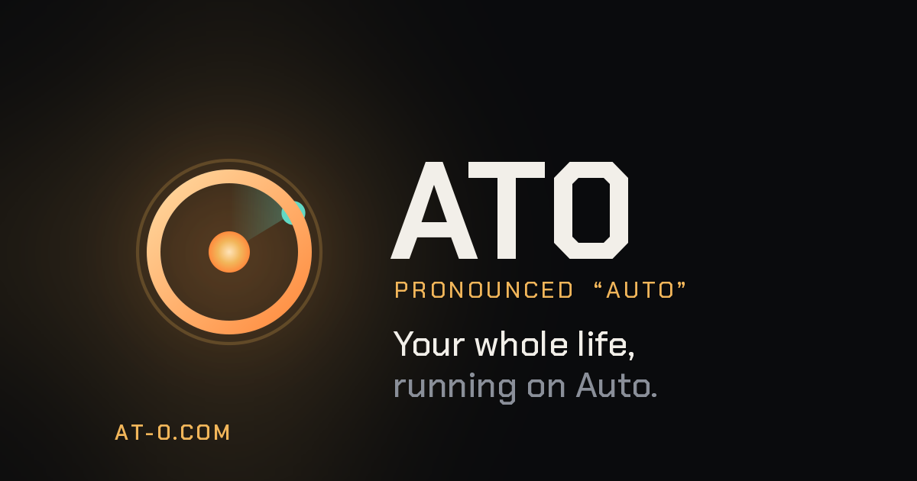

Slide 2
THE PROBLEM
Cloud AI has three problems.
01
02
03
It forgets you
It isn't yours
You're the product
Every session starts from zero. No memory, no context.
It runs on someone else's servers, on their terms.
Your life becomes their training data.

Slide 3
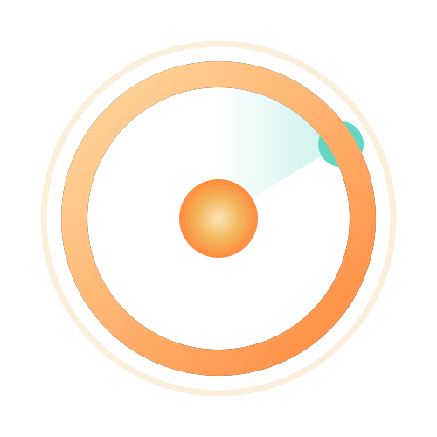
WHAT AT0 IS
Not an assistant for tasks.
One for your life.
AT0 (“Auto”) is a private, always-on personal AI. It runs the real domains of your life — family, finances, health, fabrication, and code — from a single beacon. Memory that never resets. Autonomy you control. On your own hardware. Nothing sold, shared, or sent to the cloud.

Slide 4
WHY IT'S DIFFERENT
Three things that matter.
Private by design
Memory that never resets
Autonomy you control
Runs on your hardware. Nothing sold, shared, or sent to the cloud.
Continuity across every conversation and every domain.
It acts on your behalf — only inside guardrails you can see.

Slide 5
HOW I BUILD
Built for how your mind works.
I'm dyslexic. I build with AI the way my mind works — structure over walls of text, choices over paragraphs. For neurodivergent thinkers, prompting isn't a workaround. It's the unlock.
AT0 is built on that: AI should meet your mind where it already is.

Slide 6
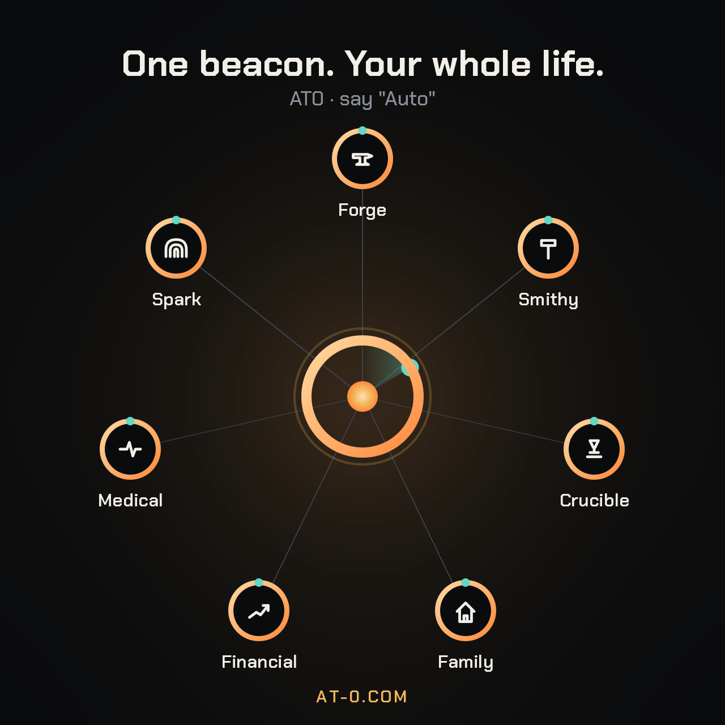
ONE BEACON, EVERY DOMAIN
Your whole life — in one system.

Slide 7
WHY IT MATTERS
AT0 vs cloud assistants.
 | Cloud assistant | AT0
Where it runs | Their servers | Your own hardware
Your data | Theirs to keep | Yours — never leaves
Memory | Resets each session | Never resets
Autonomy | None / locked | Yours, guardrailed
Scope | A chat box | Family · money · health · code

Slide 8
WHERE IT'S GOING
I'm building it in public.
1
Open journey
Sharing the wins, the architecture calls, the dead ends.
2
For builders
Private AI, self-hosting, tools for neurodivergent minds.
3
Early access
Opening in waves — real users shape what ships next.

Slide 9
Your whole life, on Auto.
Request early access
AT-0.COM

