Slide 1

DS-DE CEDT Project
Teeihaiturtangjai group
Kawinwat
Tinna
Photchara
Penpitcha
Phithukwonglerd
Jiarawapee
Kallayanasiri
Yoohoon
6633010521
6633082721
6633158821
6633178321

Slide 2

Objective
Our group want to use data about researches from Scopus and Sprinker Nature link to predict open access of each research

Slide 3

Pipeline
Diagram
Web Scraping
-Selenium
Data Preparation
-Pandas
DE and AI / ML
-Spark
Data Visualization
-Power BI

Slide 4



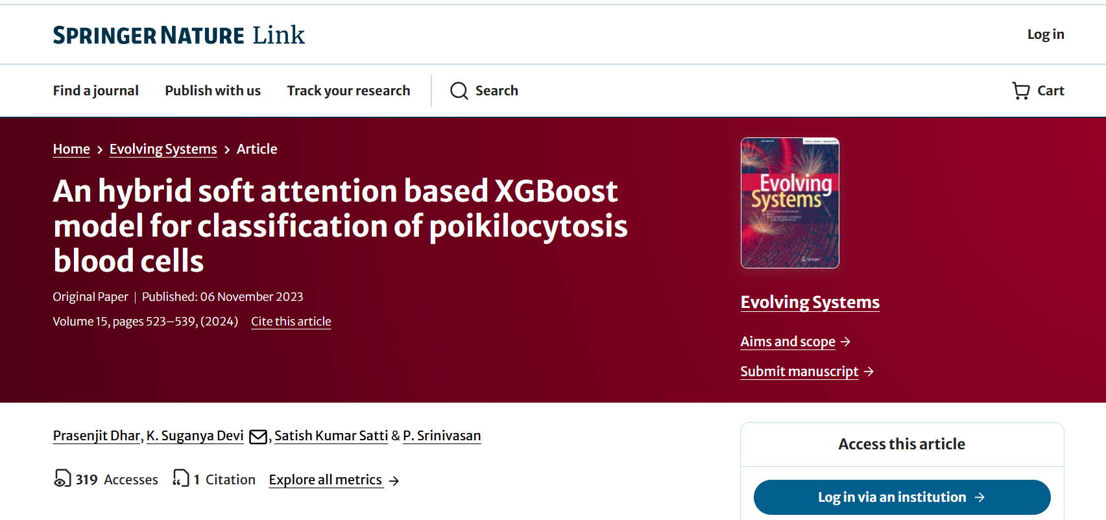
01 - Web Scraping
tool : selenium
scraping data :
title, publication_year, age_of_paper, aggregation_type, reference_count, publisher, has_funding_info, citation_count, open_access
source : https://link.springer.com
example of research :

Slide 5
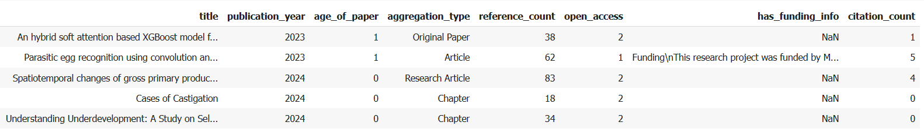
01 - Web Scraping
Example of data after web scraping :

Slide 6

02 - Data preparation
tool : pandas
selected column from given data :
filename, title, subject_name, subject_abbreviation, subject_code, keywords, publication_year, aggregation_type, reference_count, publisher, has_funding_info, citation_count, open_access
added column :
supergroup is from subject_name, subject_abbreviation, subject_code
keywords_list is from keywords
age_of_paper is from publication_year
citation_count_log is from citation_count
reference_count_log is from reference_count

Slide 7
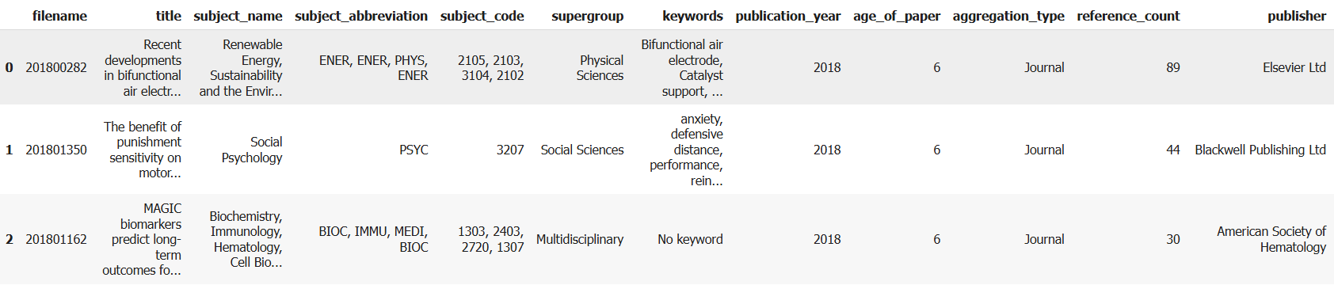
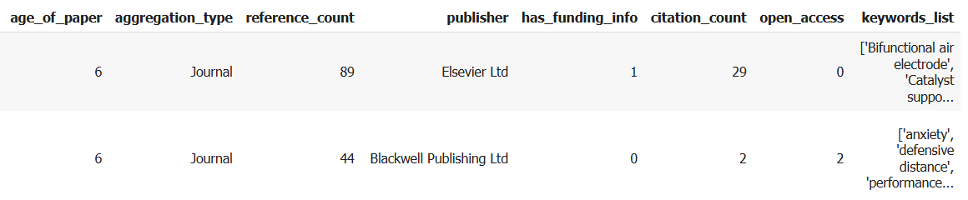
02 - Data preparation
Example of data after data preparation :

Slide 8


03 - DE and AI / ML
tool : Spark ML
training data : the given data and the scraping data
data transformation : use log transformation to reference_count and citation_count
algorithm : Random Forest Classifier
Validator : Params Grid, Cross Validator
features : age_of_paper, citation_count_log, reference_count_log
target : open_acess

Slide 9
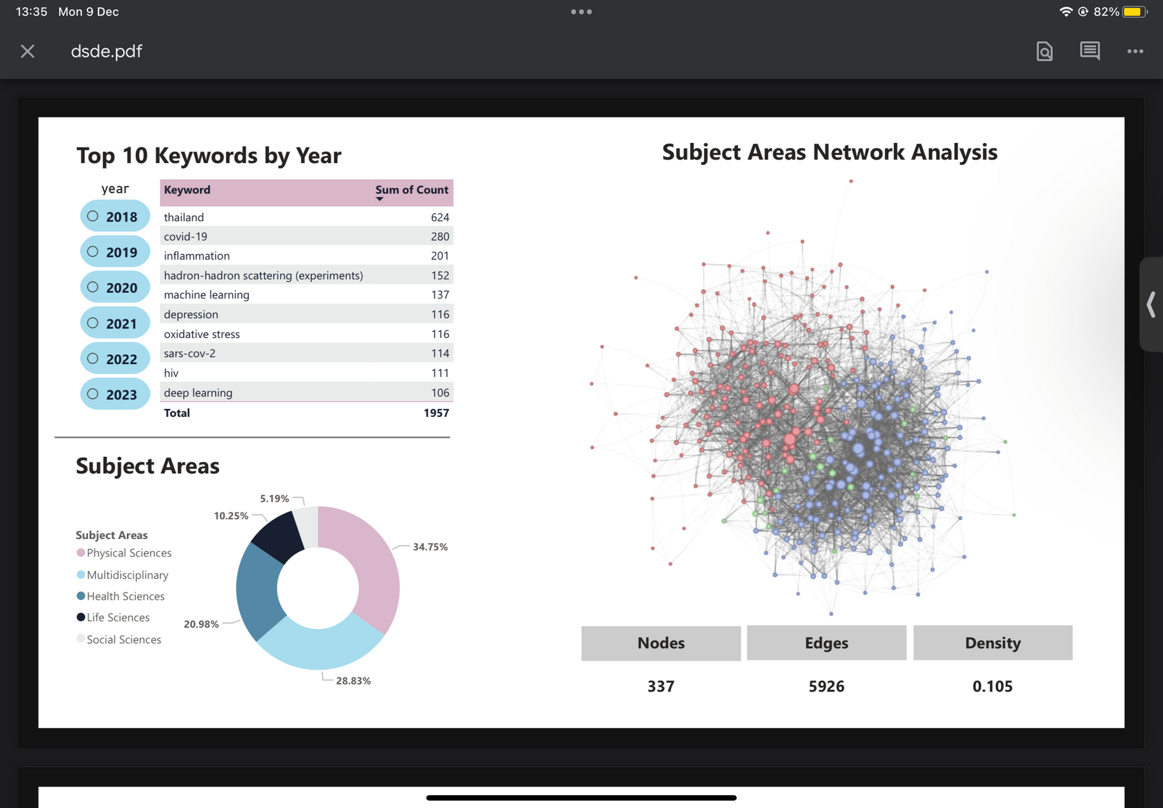
04 - Data Visualization

Slide 10
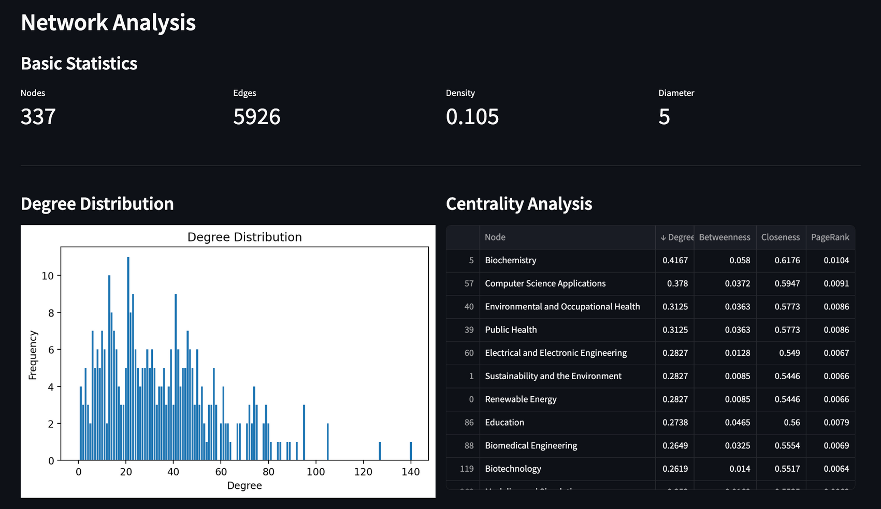
04 - Data Visualization

Slide 11
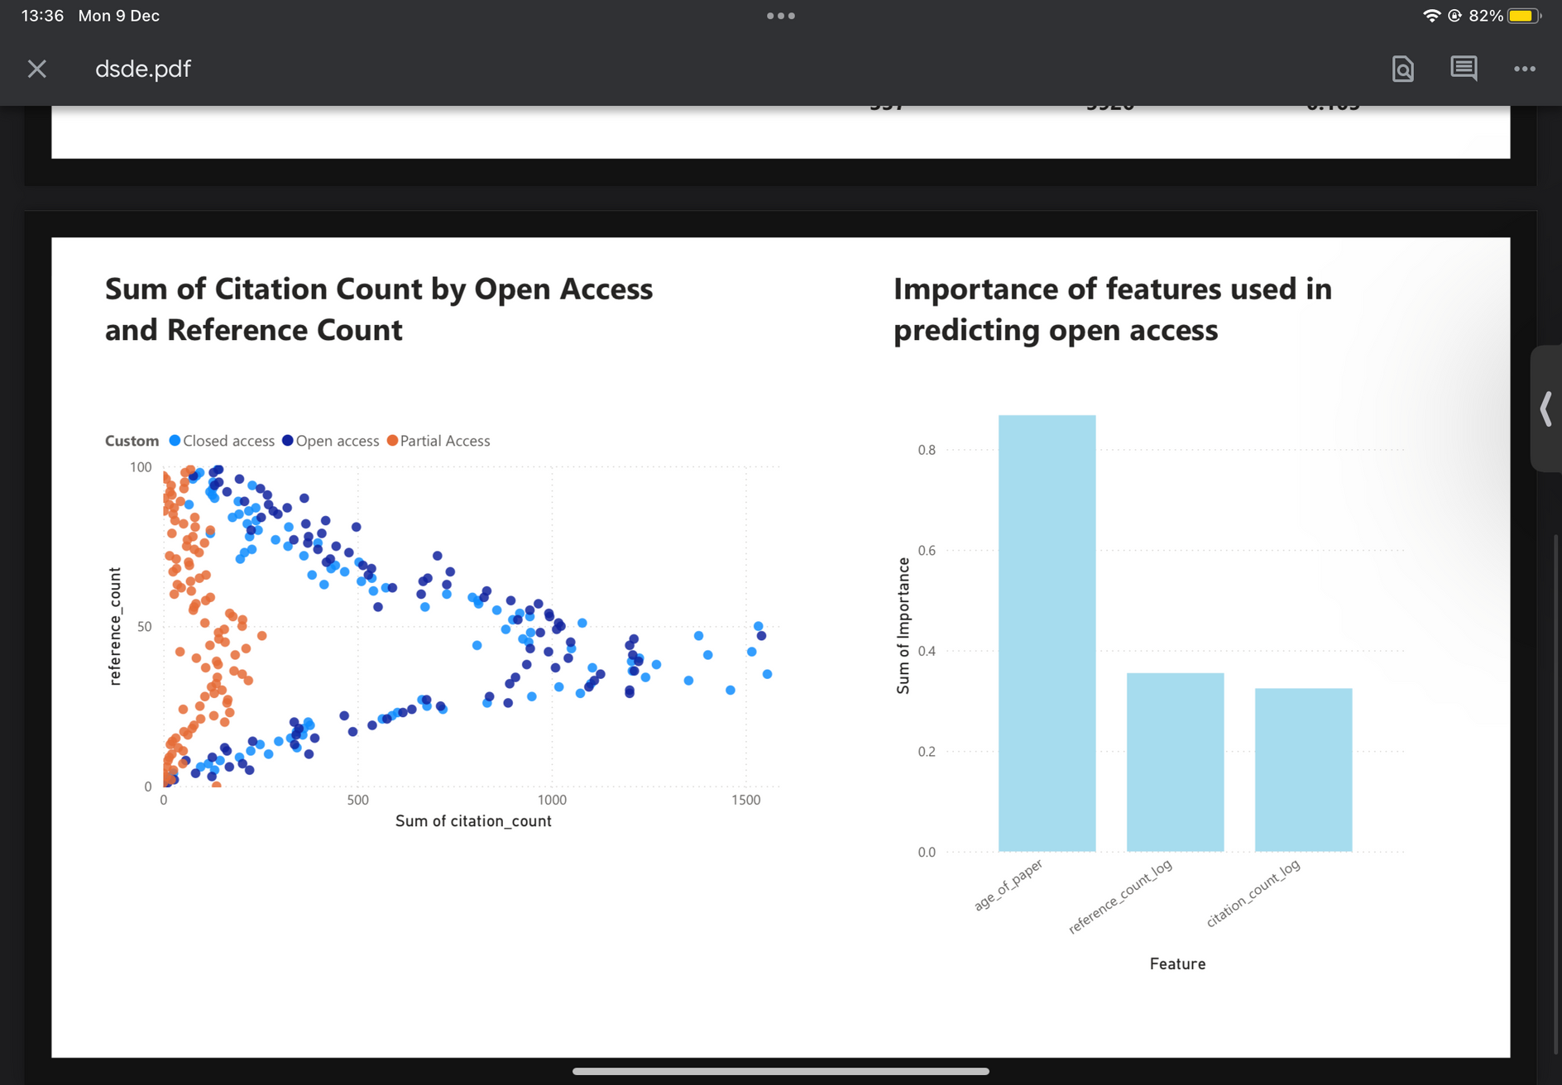
04 - Data Visualization

Slide 12


Demonstration

Slide 13
Presentation
https://youtu.be/kVF2nZcYXXQ?si=4sTsJNfRgpJL4tVV

Slide 14
Thank you
Data visualization simplifies the communication of analysis findings

