Slide 1
Greek Text Categorization
Margaritis Georgios
Pinitas Kosmas

Slide 2
Defining the problem
Document Categorization:
Assignment of one or more classes to a document
In our case:
Supervised Machine Learning (class labels are known)
Assignment of exactly one class to a document (1 → 1)

Slide 3
More Details
Dataset:
ENET (Εφημερίδα Ελευθεροτυπία)
7305 articles
More than 60000 distinct words
6 categories:
Art
Economy
Greece
Politics
Sports
World

Slide 4
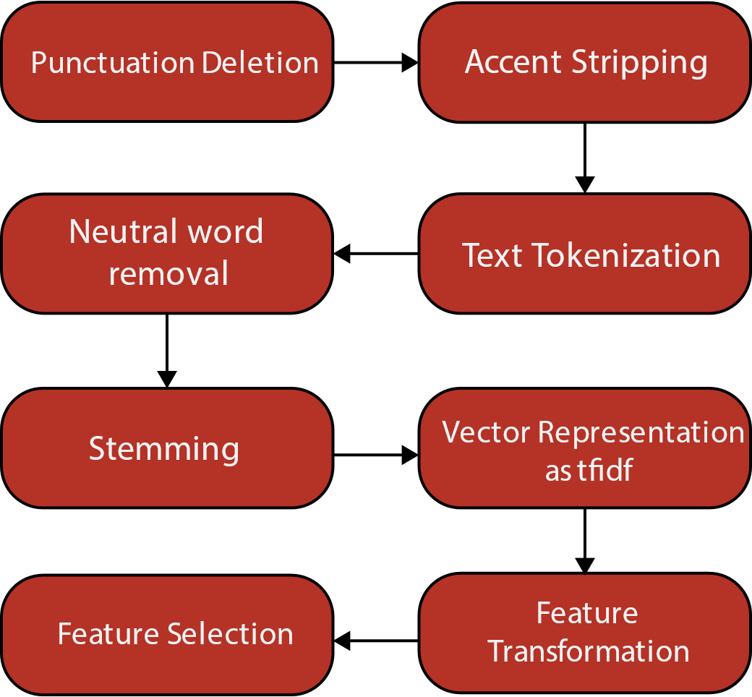
Preprocessing

Slide 5
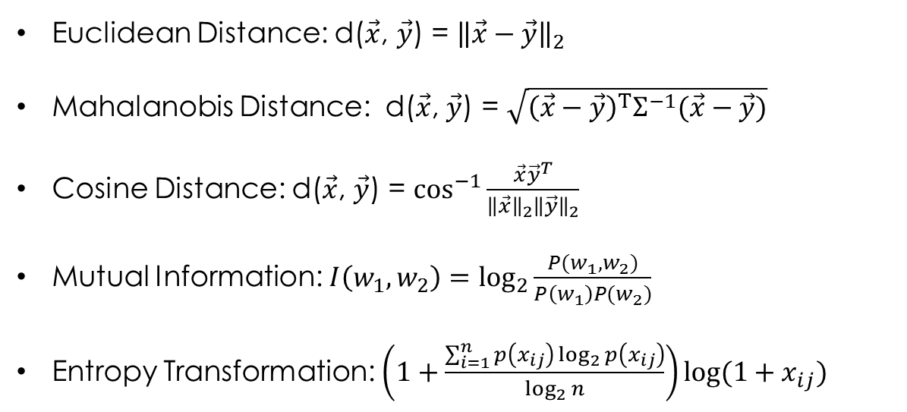
Important Formulas
Euclidean Distance: d($\vec{x}$, $\vec{y}$) = ${\left\|\vec{x}−\vec{y}\right\|}_{2}$
Mahalanobis Distance: d($\vec{x}$, $\vec{y}$) = $\sqrt{{\left(\vec{x}−\vec{y}\right)}^{Τ}Σ^{−1}(\vec{x}−\vec{y})}$
Cosine Distance: d($\vec{x}$, $\vec{y}$) = $\cos^{−1}\frac{\vec{x}{\vec{y}}^{T}}{{\left\|\vec{x}\right\|}_{2}{\left\|\vec{y}\right\|}_{2}}$
Mutual Information: $I\left(w_{1},w_{2}\right)=\log_{2}{\frac{P(w_{1},w_{2})}{P\left(w_{1}\right)P(w_{2})}}$
Entropy Transformation: $\left(1+\frac{\sum_{i=1}^{n}{p\left(x_{ij}\right)\log_{2}{p\left(x_{ij}\right)}}}{\log_{2}{n}}\right)log⁡(1+x_{ij})$

Slide 6
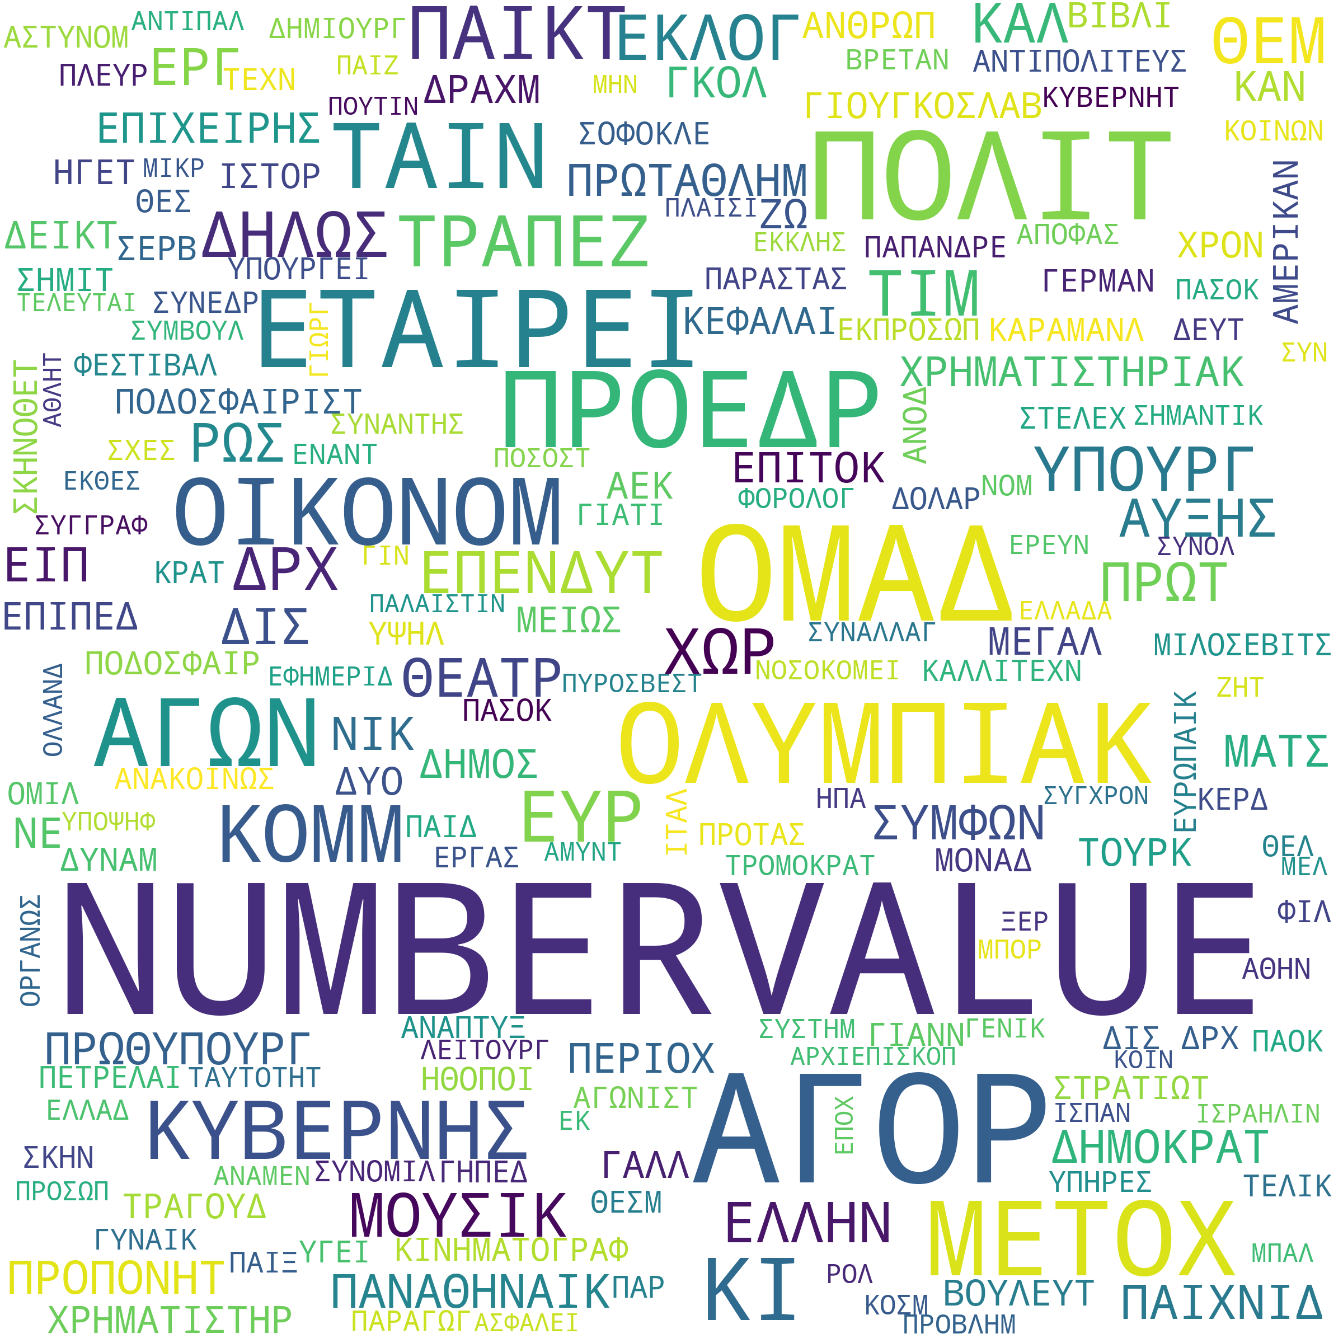
Most Descriptive Terms

Slide 7
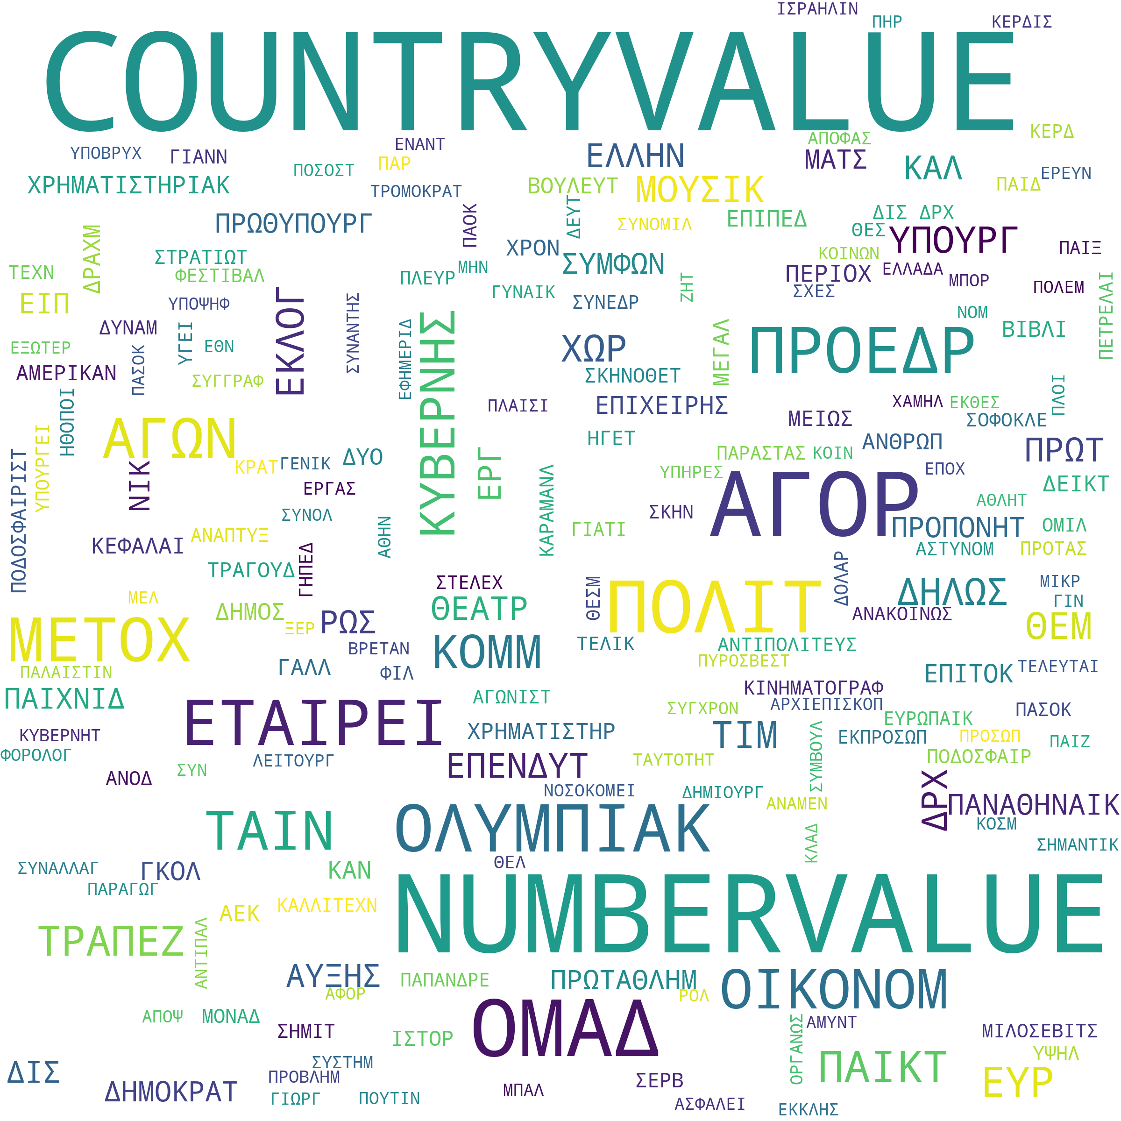
Most Descriptive Terms (cont.)

Slide 8
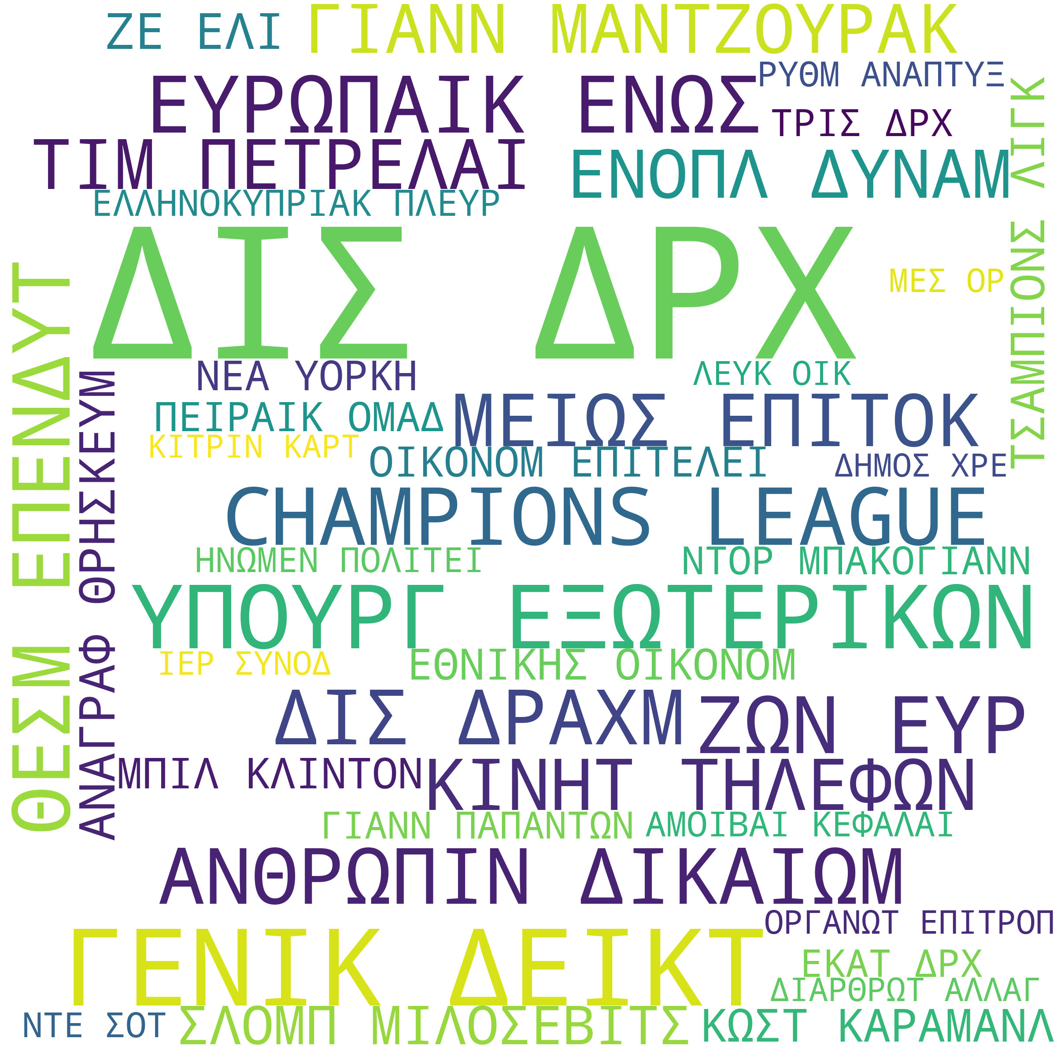
Bigrams

Slide 9
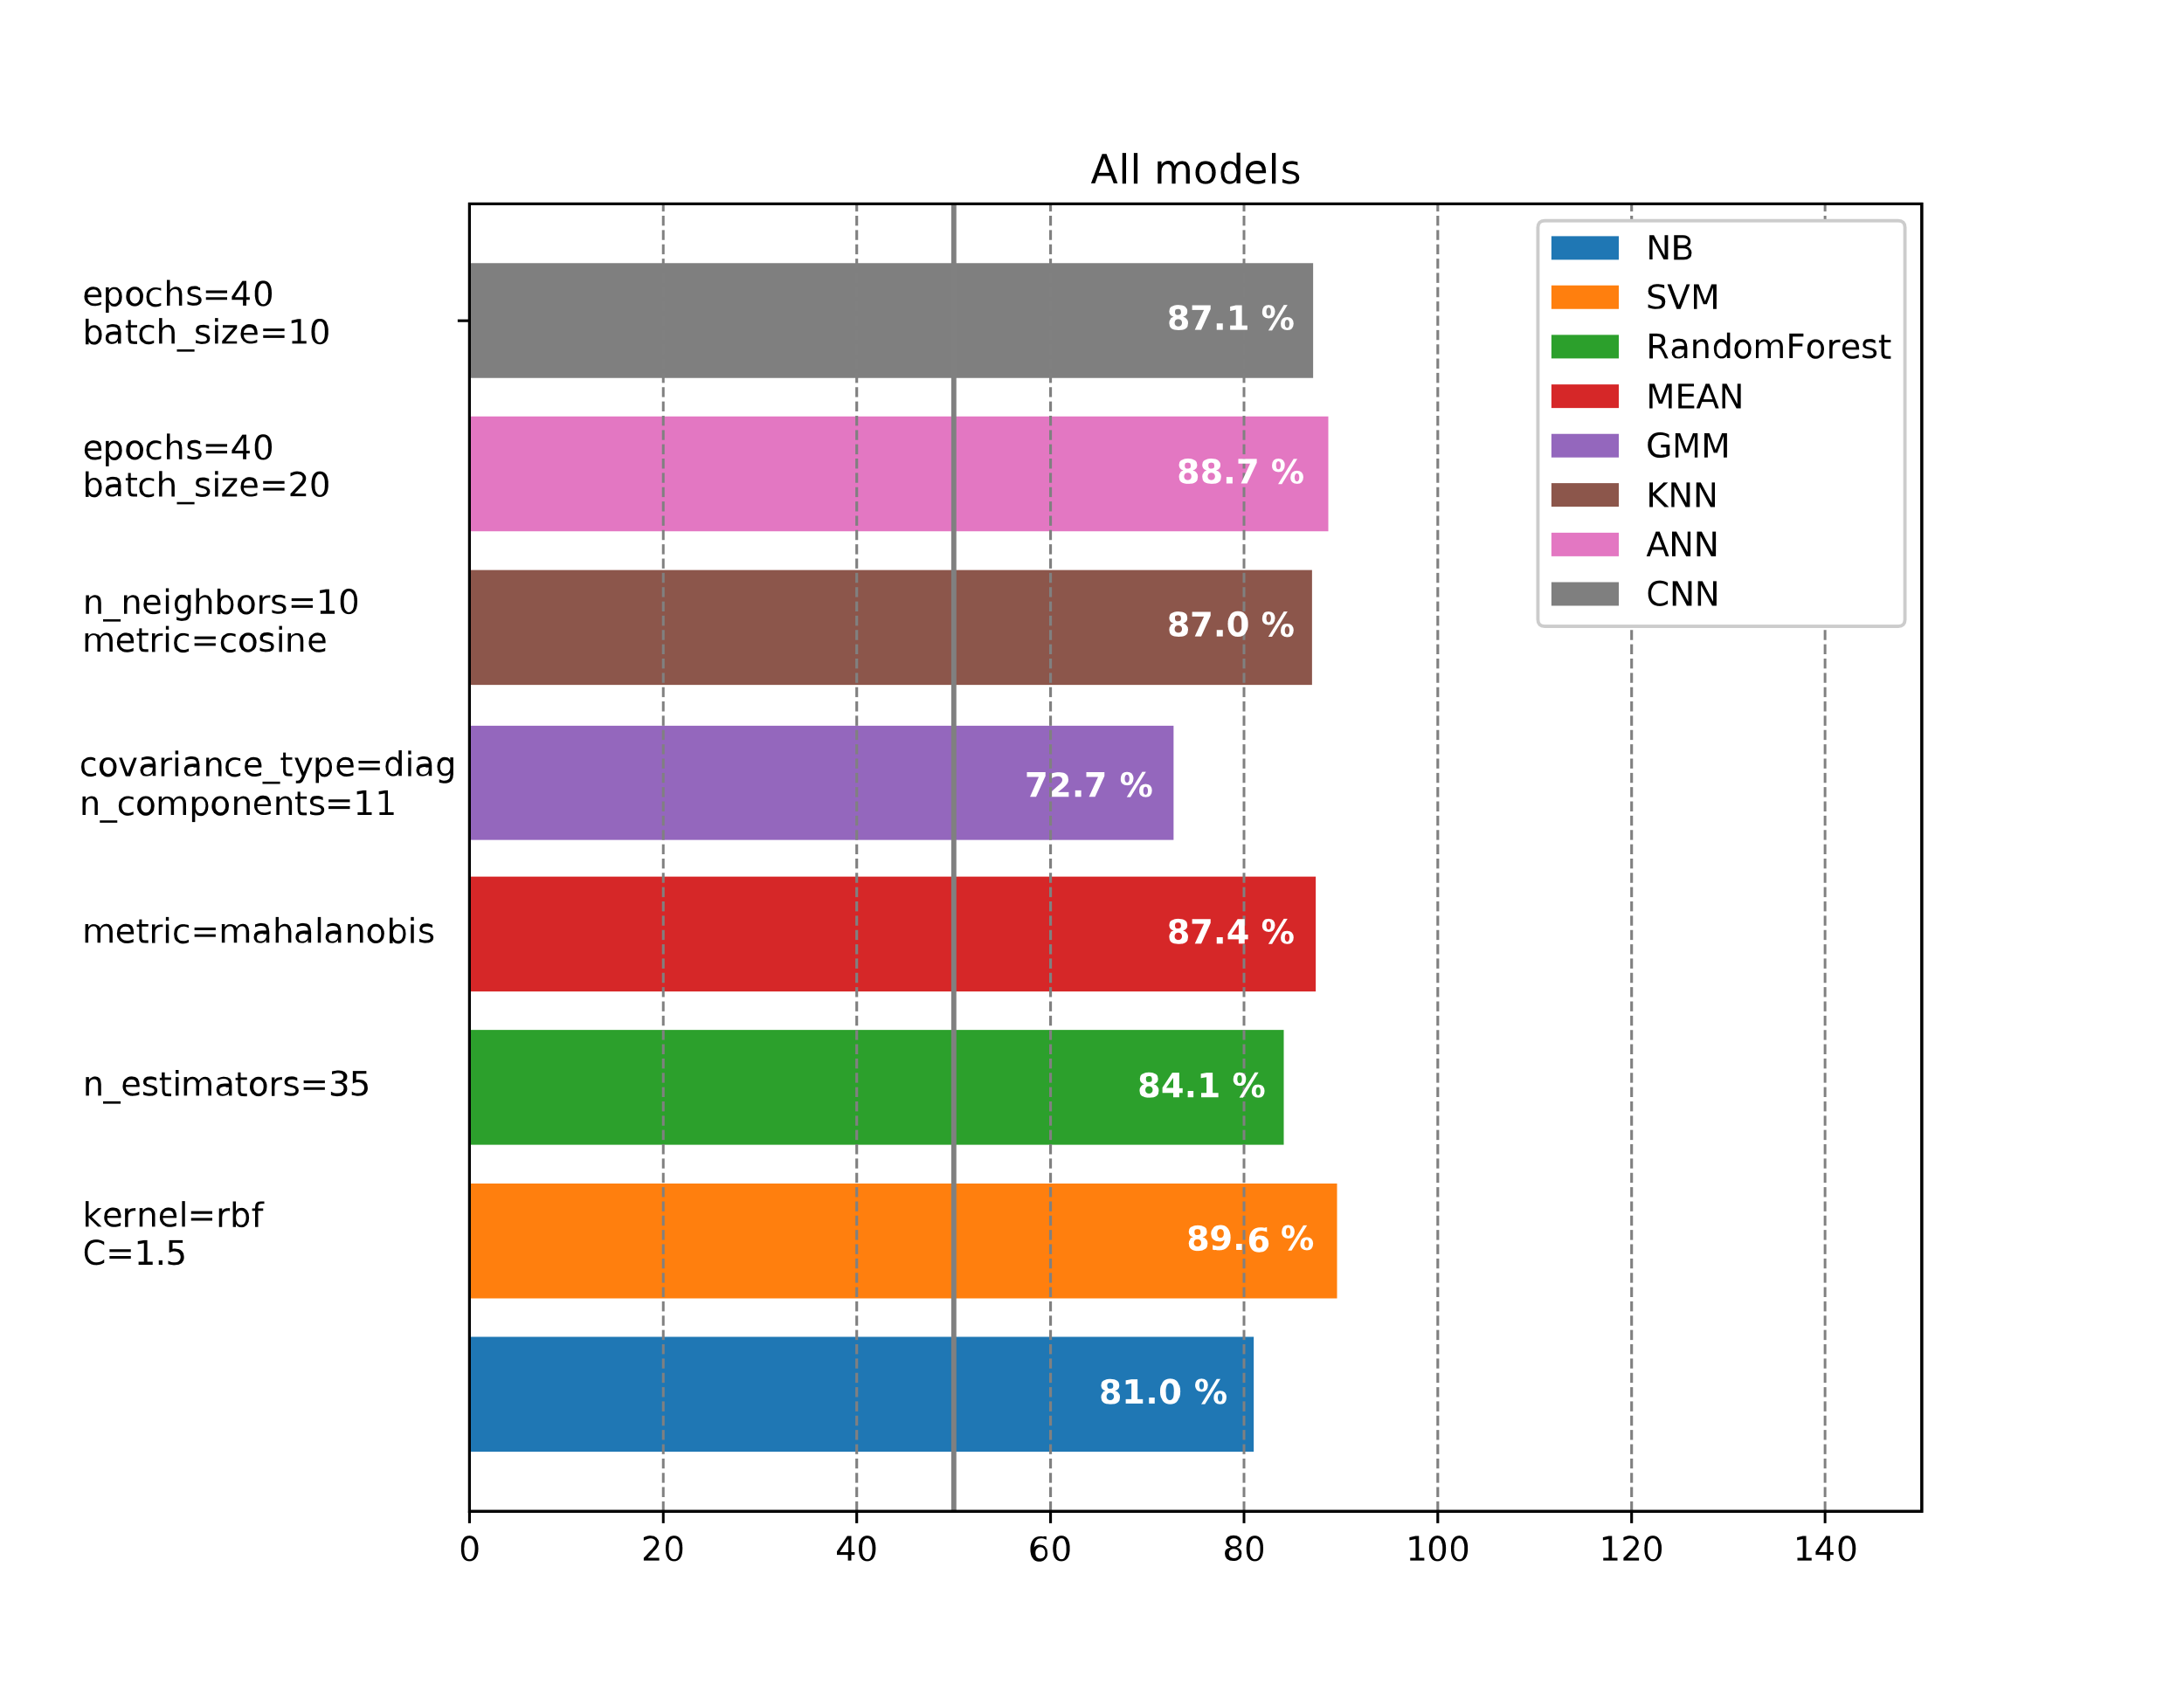
Entropy PCA

Slide 10
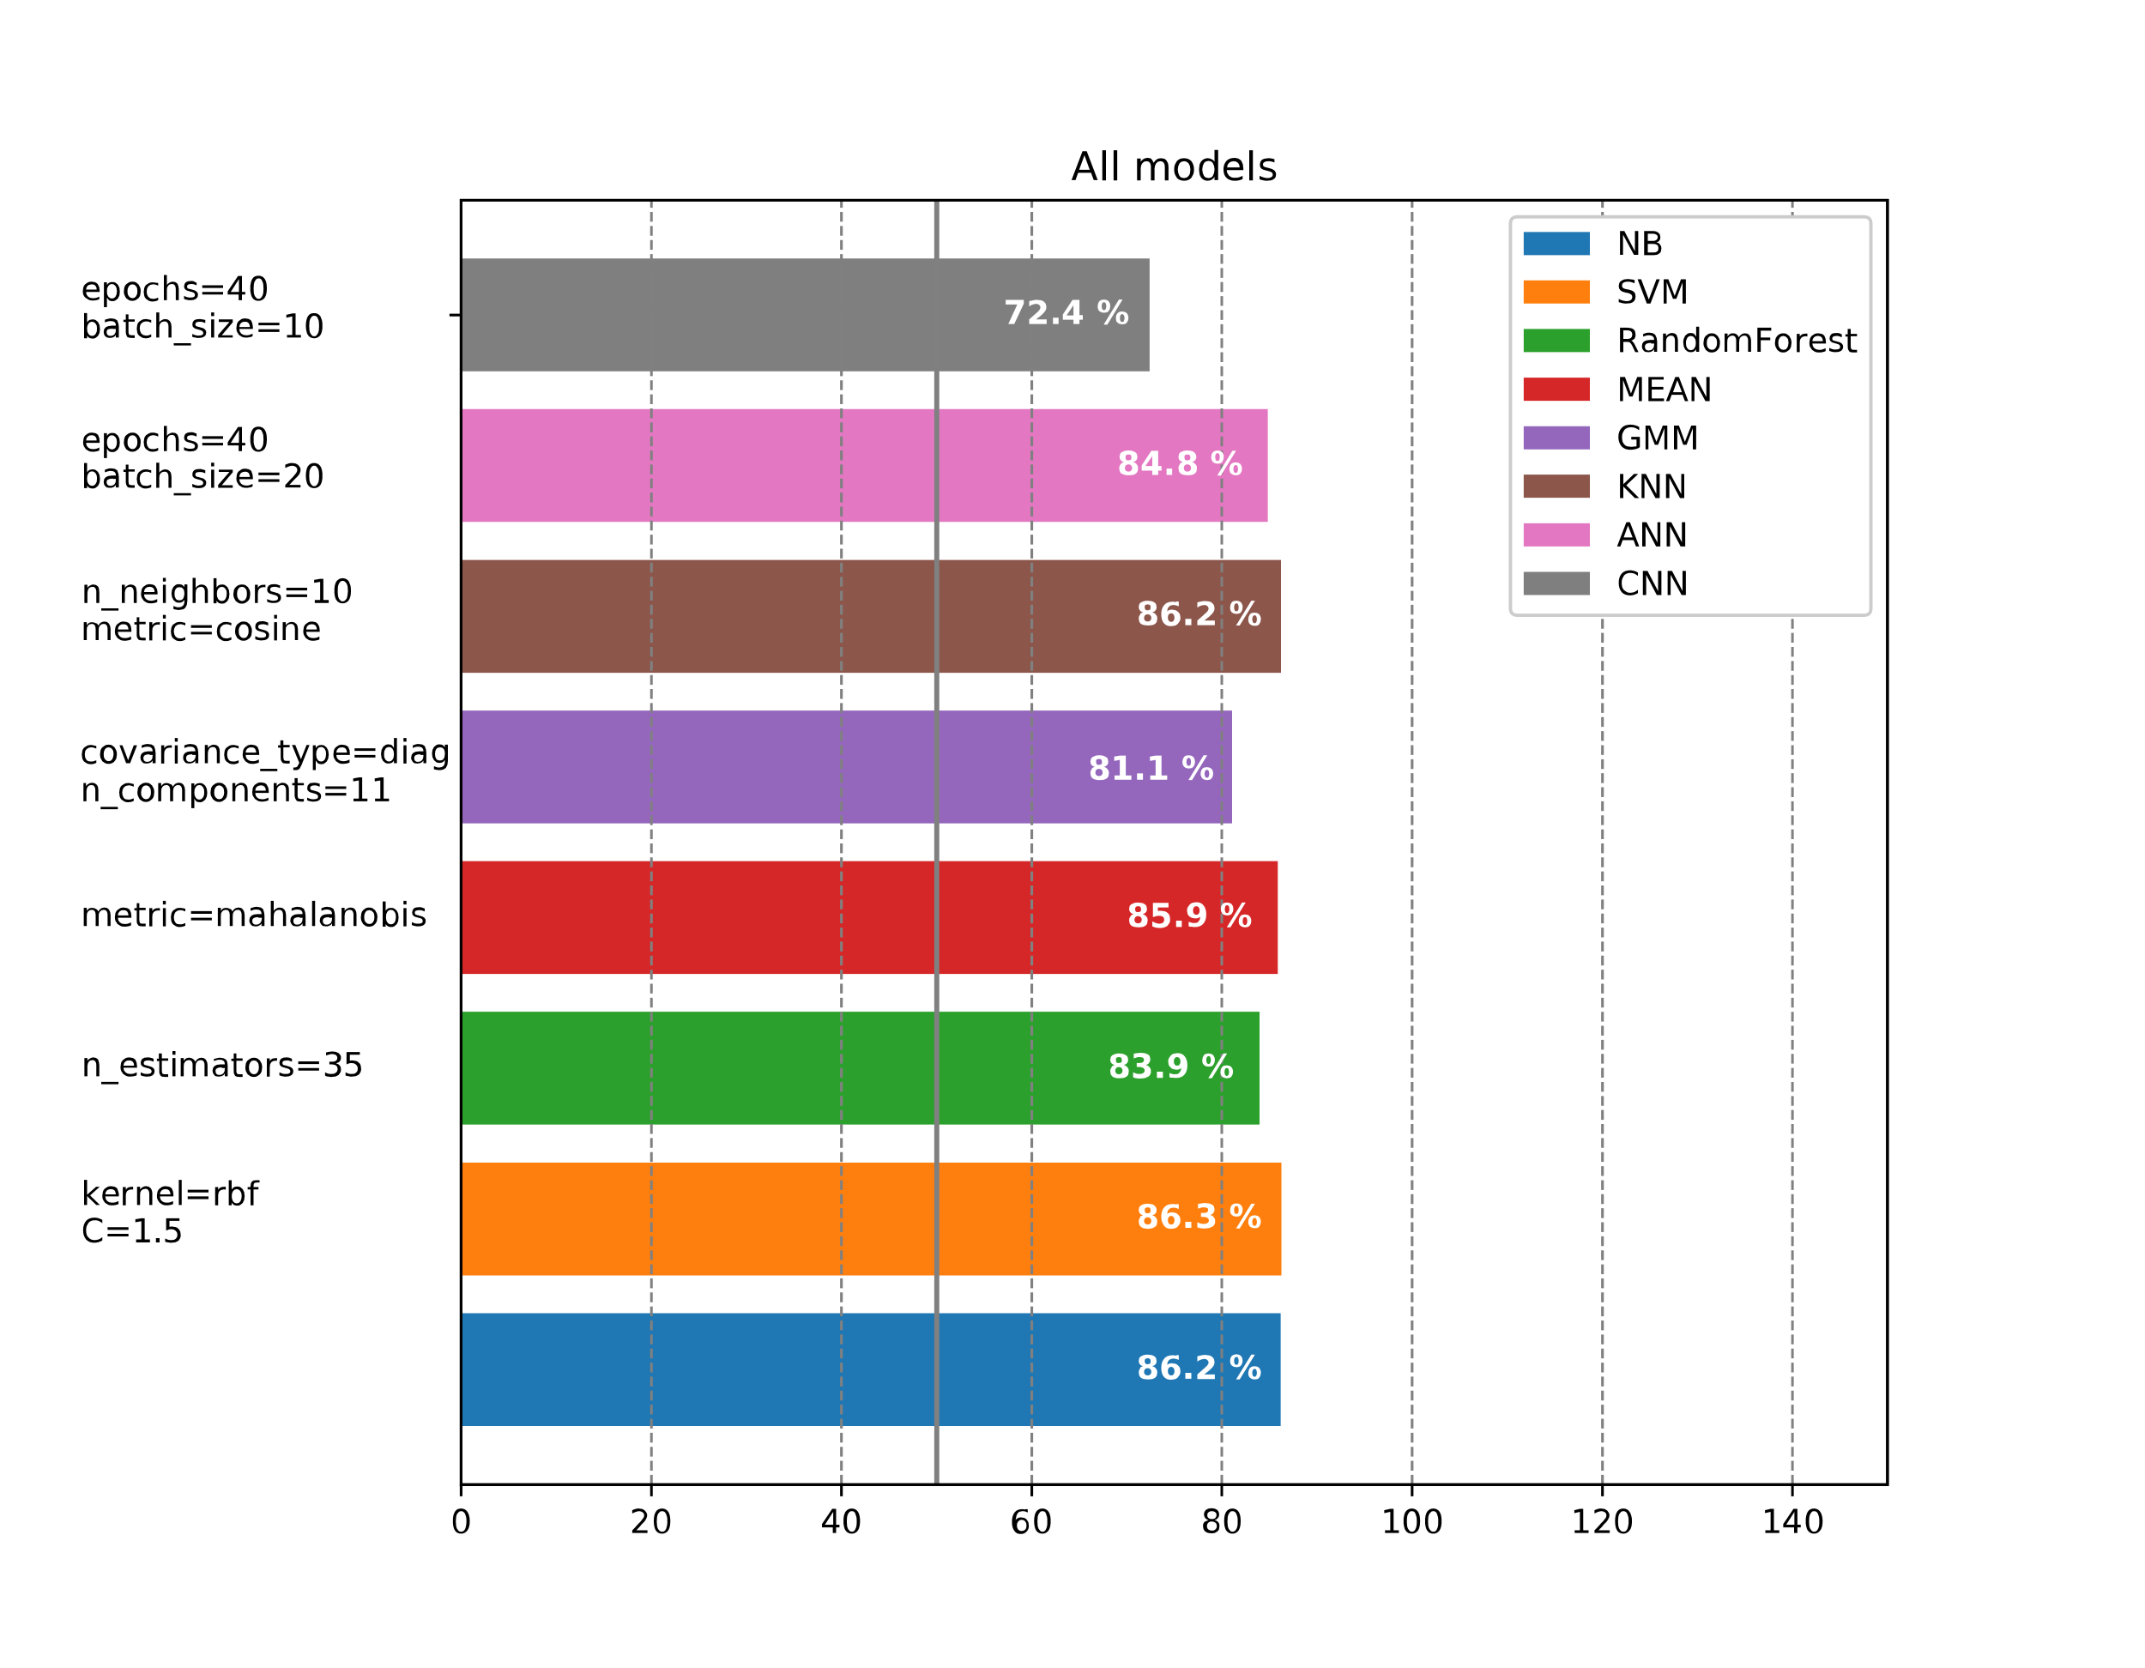
Entropy LDA

Slide 11
ΕΥΧΑΡΙΣΤ

