Slide 1
DTSE methodology
Brahim Al Farisi, Alexia Kourfali and Karel Heyse
Complex Systems Design Methodology – DTSE methodology – Ghent University – Academic year 2013-2014

Slide 2
DTSE methodology
Data Transfer and Storage Exploration (DTSE)
Roadmap for a more efficient memory usage
Developed by our friends from

Slide 3
Goal of the methodology
Improving memory usage
Minimize memory
Less memory accesses
Improve data flow
In order to
Reduce power consumption
Reduce execution time

Slide 4
Reduction of power consumption (1)
All accesses to the main memory
Power: 100% x 1 = 1
processor
data track
registers
main memory
1
100% accesses

Slide 5
Reduction of power consumption (2)
Spread the accesses between the main memory and scratch pad memory
Power: 100% x 0.1 + 10% x 1 = 0.2
0.1
100%
processor
data track
registers
scratch
main memory
1
10%
Notes:
Update image

Slide 6
Meant for ….
Software and hardware
Data driven applications
Processing of media (sound, images)
Video compression

Slide 7
Steps
Trimming and preparation
Dataflow transformations
Global loop transformations
Data reuse
Memory organization
Data structure optimization
Optimization of address calculation
Notes:
Overview of steps to take

Slide 8
1. Trimming and preparation
Profiling
Identifying hot code
Change the code
Focus on useful code
Reduction of complexity
Increase exploration freedom (static single assignment form)

Slide 9
2. Dataflow transformations
Improve the dataflow in the program
Removal of useless memory accesses

Slide 10
3. Loop transformations
Improvement of temporal locality and regularity
Simple transformations

Slide 11
4. Data reuse
Exploiting the locality
Introduction of the memory hierarchy

Slide 12
5. Memory organization
Data grouping inside memories
Adding of timing constraints
Trade off between speed and power consumption

Slide 13
6. Data structure
Removal of static single assignment form
Storing two dimensional data in one dimension
Taking into account liveness of data
Place arrays into the same memory

Slide 14
7. Optimization of calculations
Simplifying address computation
Removing redundant control structures

Slide 15
Results
500
Original
400
Data transformation
Loop transformation
300
Data reuse
200
Optimization
100
accesses
size
clock cycles

Slide 16
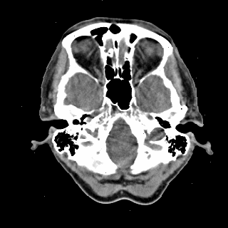

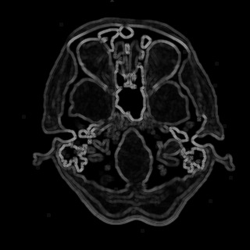
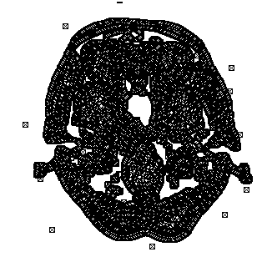
Cavity detector
Standard example from IMEC
Medical image processing: computer tomography (CT)
Detection of holes on a CT scan

Slide 17
Cavity detector
Algorithm in three steps
Gaussian blurring (2 sub steps)
Edge detection
Detecting the actual cavities
Cooked up by an Medical Doctor
Different implementations can produce same result

Slide 18
Gaussian blur (1)
Horizontal filtering
Filter coefficients: (2, 3, 2)
ct-scan.bmp becomes gtemp.bmp

Slide 19
Gaussian blur (2)
Vertical filtering
Filter coefficients: (2, 3, 2)
gtemp.bmp becomes gaus.bmp

Slide 20
Edge detection
Compare each pixel with all its neighbours
On an edge their difference will be big
The intensity of edge.bmp is maximal absolute difference

Slide 21
Detect cavities
Convert edge.bmp into out.bmp (black-white)
Compare each pixel with its neighbours
At least one lighter: color black
Otherwise: color white

Slide 22
1. Trimming and preparation (1)
Focus on useful code
Hide other code in separate files
Example: input and output
Reduction of complexity
diff = gauss[x+k][y+l] - gauss[x][y];
diff = diff < 0 ? -diff : diff;
edge[x][y] = diff > edge[x][y] ?
diff : edge[x][y];
edge[x][y] = maxDiff(gauss[x][y],
gauss[x+k][y+l], edge[x][y]);

Slide 23
1. Trimming and preparation (2)
Increase the exploration freedom
Dataflow is not always clear
j
int sum;
for (i=0; i<100; i++) {
sum = 0;
for (j=0; j<100; j++) {
sum += A[i][j];
}
... = f(sum);
}
i

Slide 24
1. Trimming and preparation (3)
Increase the exploration freedom
Dataflow is not always clear
Static single assignment form (SSA)
int sum[100];
for (i=0; i<100; i++) {
sum[i] = 0;
for (j=0; j<100; j++) {
sum[i] += A[i][j];
}
... = f(sum[i]);
}
explicit
dataflow
Notes:
TODO: translation again

Slide 25
1. Trimming and preparation (4)
Overview code cavity detector
testbench.cpp
original.h, step1.h, step2.h
// testbench.cpp
#define NUMBER_OF_TEST_RUNS 10
#define COUNT_MEMORY_ACCESSES
#include "original.h"
// original.h
#define VERSION "original"
void cavityDetection(...);

Slide 26
1. Trimming and preparation (4)
original.h contains the original code
step1.h contains the code after trimming and preparation
Differences:
New function maxDiff
accux and accuy are in SSA form
Notes:
TODO: afwerken

Slide 27
2. Dataflow transformations (1)
Remove useless memory accesses
Data that is written but not read
Propagation of data that is known in advance
Multiple ways to remove unnecessary data accesses
Try to keep loops in the program
Use additional conditions (if) within the loop body instead

Slide 28
2. Dataflow transformations (2)
Propagation of data that is known in advance
j
for (i=0; i<N; i++) A[i][0]=0;
for (j=1; j<M; j++) {
for (i=0; i<N; i++) {
A[i][j] = A[i][j-1] +
f(B[i], j);
}
}
i

Slide 29
2. Dataflow transformations (3)
Propagation of data that is known in advance
for (i=0; i<N; i++) A[i][1] = f(B[i], 1);
for (j=2; j<M; j++) {
for (i=0; i<N; i++) {
A[i][j] = A[i][j-1] + f(B[i], j);
}
}

Slide 30
Assignment (1)
Download cavity detector (Minerva)
Compare original.h and step1.h
Make step2.h and extend
Data that is never used
Propagation of data that is know in advance
Automatically verifies result
Check for differences via output-diff.bmp
Measure and compare with original.h
Execution time and number of memory accesses

Slide 31
Assignment (2)
Measure execution time and number of accesses separately
Edit the following to make appropriate measurements
// testbench.cpp
#define NUMBER_OF_TEST_RUNS 10
#define COUNT_MEMORY_ACCESSES
#include "original.h"

