Slide 1
AE630 Assignment : 4
Submitted by : Piyush Kumar
Roll No. : 190601
B. Tech, EE
Submitted to : Dr. Mangal Kothari sir

Slide 2
CONTENTS
Equations
Attitude Stabilisation MATLAB code explanation
Position Stabilisation MATLAB code explanation
Forward dynamics code explanation
Main code explanation & plots

Slide 3
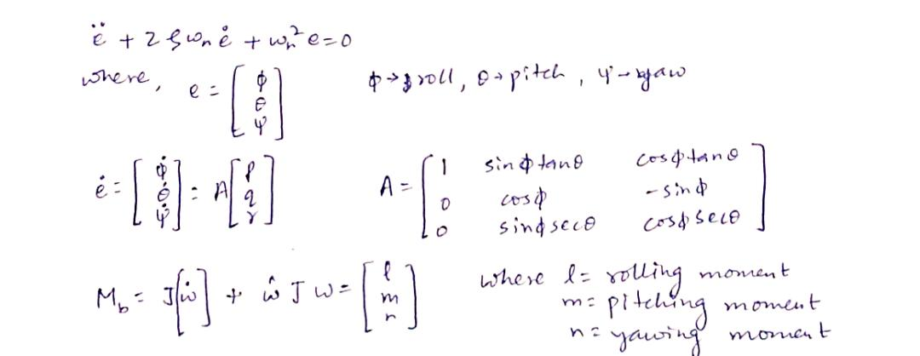
Equations
The equations that I have used for the assignment are:

Slide 4

Attitude Stabilisation MATLAB code explanation
Gives l(rolling moment), m(pitching moment) and n(yawing moment) as outputs.
Takes current attitude, desired attitude and body rate as inputs.
Calculates the error between the attitude and the desired attitude.
Equates derivative of the error to a matrix A times the body rates(p,q,r),where A is:
Calculates the double derivative of the error using the standard second order equation written on previous page.

Slide 5

Attitude Stabilisation MATLAB code explanation
Calculates the moments using the equation given on previously.
Calculates rolling,pitching and yawing moments as :

Slide 6
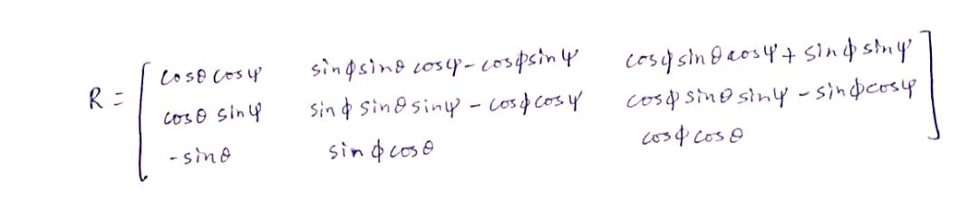
Position Stabilisation MATLAB code explanation
Gives thrust, desired phi and desired theta as the outputs.
Takes desired position, current position,attitude,velocity,body rates,mass,acceleration due to gravity, damping ratio,natural frequency,maximum phi and maximum theta as inputs.
Defines error as the difference between current position and desired position.
Calculates derivative of error as a matrix R times velocity, where R is :

Slide 7


Position Stabilisation MATLAB code explanation
Calculates derivative of R, then double derivative of error and then derivative of velocity as below:
Calculates force :
Calculates the desired theta :
Calculates the desired phi :
Calculates the thrust :

Slide 8


Forward dynamics code explanation
Gives the new values of attitudes :
Calculates new values of A and rotation matrix for body to inertial frames and using them gives the new values of body rates :
Gives new values of position :
Gives new values of velocity :

Slide 9
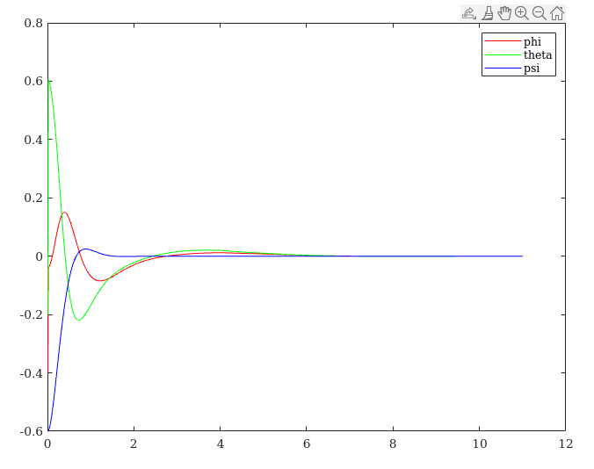
Main code explanation & plots
Calculates the error between current attitude and desired attitude, updates the current attitude, stores all the error values and then plot it against time axis :

Slide 10
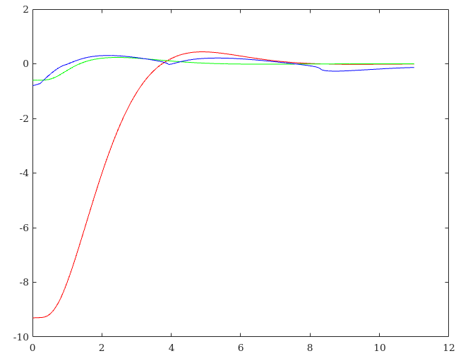
Main code explanation & plots
Calculates the error between current position and desired position, updates the current position, stores all the error values and then plot it against time axis :

Slide 11
THANK YOU!
Thank you sir for everything. I have a lot of takeaway from this course.

