Slide 1
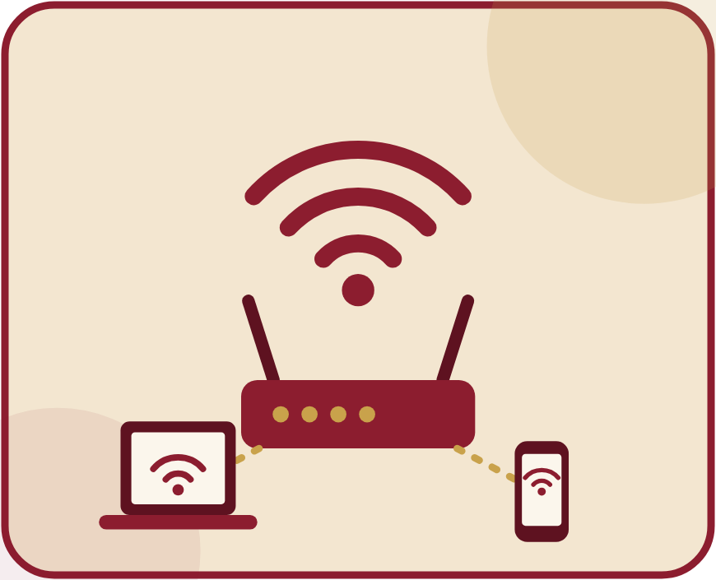
MULANA MUKTHAR AHMAD NADVI TECHNICAL CAMPUS (MMANTC)
MAHARASHTRA STATE BOARD OF TECHNICAL EDUCATION (MSBTE)
DIPLOMA IN COMPUTER ENGINEERING (SEMESTER V - K SCHEME)
SEMINAR PRESENTATION ON
WI-FI 6 AND MODERN WIRELESS NETWORKING
Student Name: KRISHNAKANT PAWAN JADHAV
Roll No: 30 | Enrolment No: 24612410379
Course & Code: Seminar and Project Initiation Course (315003)
Institute Name: MMANTC Malegaon
Guided By: Prof. Faizee Razee | Academic Year: 2025-2026

Slide 2


1. INTRODUCTION
• Wi-Fi 6 is the sixth-generation wireless networking standard based on the IEEE 802.11ax specification.
• Officially designated as High-Efficiency Wireless (HEW), succeeding Wi-Fi 5 (IEEE 802.11ac).
• Shifts focus from single-device peak speed to overall network capacity, stability, and spectral efficiency.
• Operates concurrently across both 2.4 GHz (extended range) and 5 GHz (high throughput) bands.
• Why it is Important: Rapid growth of IoT sensors, 4K/8K streaming, and smart campuses requires congestion-free wireless connectivity.
Seminar & Project Initiation Course (315003) | Roll No: 30 - Krishnakant Pawan Jadhav
Slide 2 of 15

Slide 3
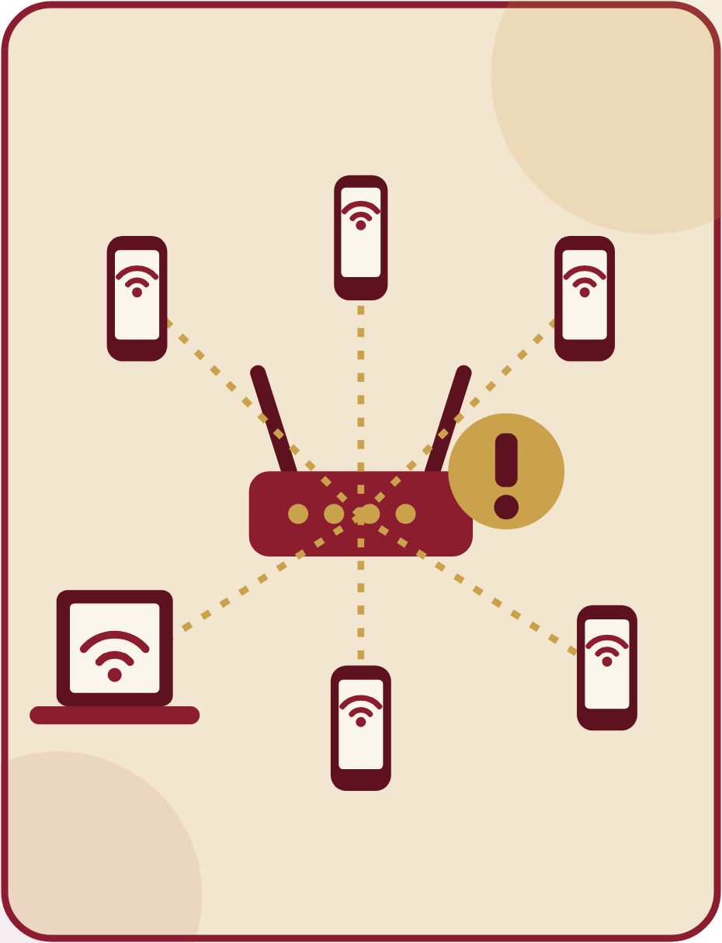
2. PROBLEM / NEED / MOTIVATION
• Severe High-Density Congestion: Legacy Wi-Fi 4 and Wi-Fi 5 suffer drastic slowdowns in crowded classrooms, offices, and airports.
• Single-User Bottleneck: Traditional OFDM allows only one device to transmit on a channel at any given microsecond.
• High Latency & Jitter: Contention delays degrade real-time applications like VoIP, online gaming, and video conferencing.
• Battery Drain: Connected smartphones and IoT devices must keep their wireless radios constantly awake.
• Motivation: Need for a deterministic, multi-user wireless standard capable of handling dozens of simultaneous devices efficiently.
Seminar & Project Initiation Course (315003) | Roll No: 30 - Krishnakant Pawan Jadhav
Slide 3 of 15

Slide 4

3. OBJECTIVES AND SCOPE
• Objective 1: To study the physical (PHY) and MAC layer architecture of the IEEE 802.11ax (Wi-Fi 6) standard.
• Objective 2: To analyse how OFDMA, 8x8 MU-MIMO, and BSS Colouring eliminate wireless congestion.
• Objective 3: To explore enterprise deployment tools, WPA3 security enhancements, and real-world applications.
• Scope of Seminar: Covers Wi-Fi 6 technical fundamentals, comparison with Wi-Fi 5, and practical campus/enterprise use cases.
• Boundaries: Focuses on IEEE 802.11ax WLAN deployment and outlines future transitions toward Wi-Fi 6E and Wi-Fi 7.
Seminar & Project Initiation Course (315003) | Roll No: 30 - Krishnakant Pawan Jadhav
Slide 4 of 15

Slide 5
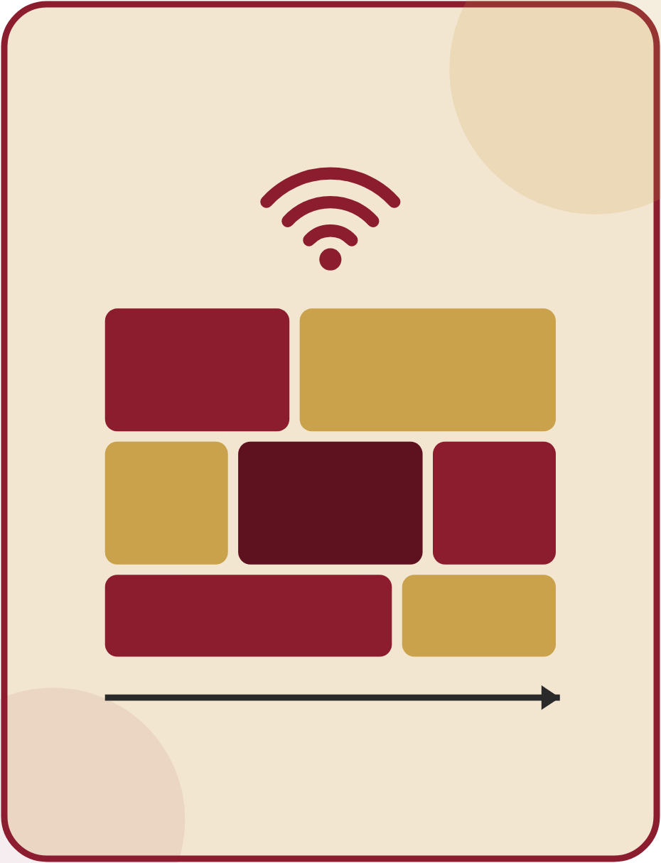
4. BASIC CONCEPTS / TERMINOLOGY
• IEEE 802.11ax: Official IEEE technical standard governing physical and MAC layer operations of Wi-Fi 6.
• OFDMA (Orthogonal Frequency-Division Multiple Access): Splits a channel into smaller Resource Units (RUs) to serve multiple users simultaneously.
• MU-MIMO (Multi-User MIMO): Allows an Access Point to transmit and receive data from up to 8 devices concurrently.
• BSS Colouring (Basic Service Set): Assigns a 6-bit numerical tag to frames to ignore co-channel interference from neighbouring networks.
• TWT (Target Wake Time): Schedules exact wake and sleep times for client devices to conserve battery life.
Seminar & Project Initiation Course (315003) | Roll No: 30 - Krishnakant Pawan Jadhav
Slide 5 of 15

Slide 6

5. TECHNOLOGY / ARCHITECTURE
• Dual-Band Operation: Simultaneous operation across 2.4 GHz and 5 GHz spectrums.
• 1024-QAM Modulation: Packs 10 bits per symbol (vs 8 bits in Wi-Fi 5), increasing raw throughput by 25%.
• 8x8 Uplink/Downlink MU-MIMO: Supports 8 spatial streams in both directions (up to 9.6 Gbps max speed).
• Wider Channel Bandwidth: Supports 20 MHz, 40 MHz, 80 MHz, and 160 MHz channel bonding.
Wi-Fi 6 Access Point
(1024-QAM + 8x8 MU-MIMO)
OFDMA Channel Split
Resource Units (RU1 | RU2 | RU3)
Simultaneous Clients
Laptop + Smartphone + IoT
➔
➔
Seminar & Project Initiation Course (315003) | Roll No: 30 - Krishnakant Pawan Jadhav
Slide 6 of 15

Slide 7

6. WORKING PRINCIPLE / PROCESS
• Step 1 (Channel Sensing & BSS Colouring): The Access Point checks the medium and reads 6-bit BSS colour tags to bypass overlapping channel interference.
• Step 2 (Resource Unit Allocation via OFDMA): The AP sends a Trigger Frame and divides the channel into smaller Resource Units (RUs) based on user traffic needs.
• Step 3 (Multi-User Beamforming): Using 8x8 MU-MIMO, the AP focuses radio signals toward up to 8 client devices simultaneously.
• Step 4 (High-Density Encoding): Payload bits are modulated using 1024-QAM (10 bits/symbol) for rapid delivery.
• Step 5 (Target Wake Time Scheduling): Idle smartphones and IoT sensors enter sleep mode until their next scheduled transmission window.
Seminar & Project Initiation Course (315003) | Roll No: 30 - Krishnakant Pawan Jadhav
Slide 7 of 15

Slide 8
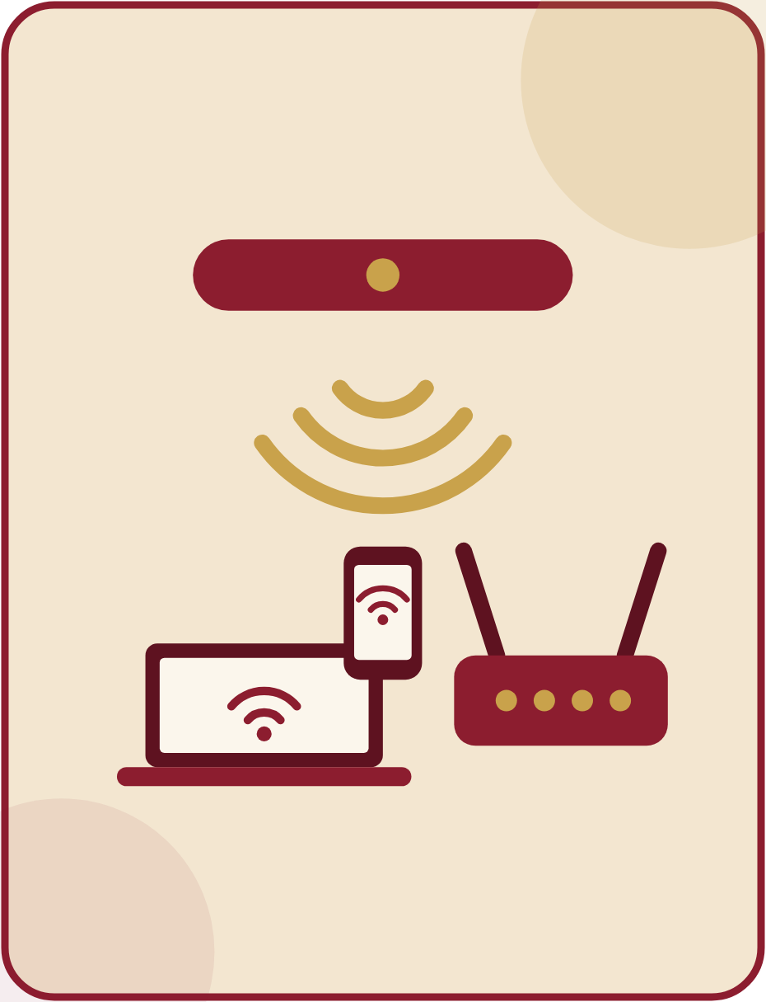
7. TOOLS, PLATFORMS AND TECHNOLOGIES
• Enterprise Access Point Hardware: Cisco Catalyst 9100 Series, HPE Aruba 510 Series, and Ubiquiti UniFi 6 Pro.
• Client Network Interface Cards (NICs): Intel Wi-Fi 6 AX200 / AX210 adapters and Qualcomm FastConnect 6800.
• Site Survey & RF Planning Software: Ekahau AI Pro and NetSpot for wireless heat-mapping and channel optimisation.
• Packet Analysis & Simulation Tools: Wireshark (for 802.11ax frame capture) and NS-3 (Network Simulator 3).
• Security Protocol: Mandatory WPA3 (Wi-Fi Protected Access 3) with SAE encryption.
Seminar & Project Initiation Course (315003) | Roll No: 30 - Krishnakant Pawan Jadhav
Slide 8 of 15

Slide 9

8. APPLICATIONS / REAL-WORLD USE CASES
• Smart Campuses & Universities: High-density wireless connectivity in lecture halls, computer labs, and digital libraries.
• Modern Enterprise Offices: Supports cloud-first workplaces, HD video conferencing (Zoom/Teams), and VoIP.
• Smart Healthcare (Hospitals): Reliable connectivity for telemetry and wireless patient monitoring systems.
• Public Transit & Stadiums: Connects thousands of concurrent users at airports, railway stations, and arenas.
• Industrial IoT (Industry 4.0): Low-latency wireless control for warehouse robotics and smart manufacturing sensors.
Seminar & Project Initiation Course (315003) | Roll No: 30 - Krishnakant Pawan Jadhav
Slide 9 of 15

Slide 10

9. CASE STUDY / EXAMPLE
• Case Study: High-Density University Campus Upgrade Using Cisco Catalyst Wi-Fi 6 (IEEE 802.11ax).
• Problem Statement: A university campus with 15,000+ students faced frequent disconnections and high latency during peak hours on legacy Wi-Fi 5.
• Implementation: Upgraded lecture halls and hostels to Cisco Catalyst 9120 Wi-Fi 6 Access Points with OFDMA, MU-MIMO, and WPA3 enabled.
• Key Result 1: Achieved a 4x increase in overall user capacity inside crowded 300-seat auditoriums.
• Key Result 2: Reduced average latency by 65% for online examinations and extended student battery life via TWT.
Seminar & Project Initiation Course (315003) | Roll No: 30 - Krishnakant Pawan Jadhav
Slide 10 of 15

Slide 11

10. ADVANTAGES
• Higher Peak Data Rates: Delivers up to 9.6 Gbps theoretical throughput (compared to 3.5 Gbps in Wi-Fi 5).
• Superior High-Density Efficiency: Provides 4x higher average throughput per user in crowded environments.
• Ultra-Low Deterministic Latency: Reduces network latency by up to 75%, ideal for AR/VR, gaming, and voice calls.
• Extended Battery Life: Target Wake Time (TWT) reduces radio power consumption by up to 7x for IoT sensors.
• Stronger Wireless Security: Mandatory WPA3 protects against offline brute-force dictionary attacks.
Seminar & Project Initiation Course (315003) | Roll No: 30 - Krishnakant Pawan Jadhav
Slide 11 of 15

Slide 12

11. LIMITATIONS / CHALLENGES
• High Initial Upgrade Cost: Requires replacing both legacy Access Points and client network adapters.
• Wired Backhaul Bottlenecks: High wireless speeds exceed 1 Gbps Ethernet ports, requiring costly Multi-Gigabit (2.5G/5G) switches.
• Limited Range on 5 GHz Band: Higher frequency signals experience stronger attenuation through thick walls than 2.4 GHz.
• Configuration Complexity: Tuning OFDMA, BSS Colouring, and channel bonding requires skilled network administrators.
Seminar & Project Initiation Course (315003) | Roll No: 30 - Krishnakant Pawan Jadhav
Slide 12 of 15

Slide 13

12. FUTURE SCOPE / EMERGING DEVELOPMENTS
• Wi-Fi 6E (Extended): Expands Wi-Fi 6 into the unlicensed 6 GHz band, adding up to seven 160 MHz channels with zero legacy interference.
• Evolution to Wi-Fi 7 (IEEE 802.11be): Introduces 320 MHz ultra-wide channels, 4096-QAM, and speeds up to 46 Gbps.
• Multi-Link Operation (MLO): Enables devices to transmit and receive data across multiple frequency bands simultaneously.
• AI-Driven Wireless Networking: Automated Radio Resource Management (RRM) and self-healing enterprise WLANs.
• 5G and Wi-Fi 6 Convergence: Seamless handover between private 5G cellular networks and enterprise Wi-Fi 6.
Seminar & Project Initiation Course (315003) | Roll No: 30 - Krishnakant Pawan Jadhav
Slide 13 of 15

Slide 14

13. CONCLUSION AND REFERENCES
• Conclusion: Wi-Fi 6 (IEEE 802.11ax) transforms modern wireless networking by prioritising multi-user efficiency, deterministic low latency, strong WPA3 security, and IoT scalability through OFDMA, 8x8 MU-MIMO, and TWT.
• References:
1. IEEE Standard 802.11ax-2021, 'Wireless LAN MAC and PHY Specifications', IEEE Standards Association, 2021.
2. E. Khorov et al., 'A Tutorial on IEEE 802.11ax High Efficiency WLANs', IEEE Communications Surveys & Tutorials, 2019.
3. Cisco Systems, 'Cisco Wi-Fi 6 (802.11ax) Technical White Paper', Official Documentation, 2023.
4. Wi-Fi Alliance, 'Wi-Fi CERTIFIED 6: Technology Overview', www.wi-fi.org.
Seminar & Project Initiation Course (315003) | Roll No: 30 - Krishnakant Pawan Jadhav
Slide 14 of 15

Slide 15

THANK YOU!
Questions & Answers (Q&A)
Presented By: KRISHNAKANT PAWAN JADHAV (Roll No: 30)
Topic: Wi-Fi 6 and Modern Wireless Networking
Diploma in Computer Engineering (Semester V - MSBTE K Scheme)

