Slide 1
Podcast Plus: A Redux-Inspired Podcast App with Dynamic Themes for Android

Slide 2
OBJECTIVE:
Podcast Plus aims to revolutionize the podcast listening experience on Android by integrating Redux-inspired state management and dynamic themes. The app will efficiently manage state using Redux, ensuring predictable and maintainable code. Users will enjoy a personalized experience with secure authentication, allowing account creation and profile management. Podcast discovery will be seamless, integrating popular directories and robust search functionality. Subscription management will provide notifications and a personalized feed. The app will feature a robust audio player with essential controls, supporting background playback and offline listening. User preferences, including playback settings, will be customizable and persisted across sessions. Dynamic themes will offer light, dark, and custom options, with manual and automatic switching. Analytics will track user engagement, providing insights for continuous improvement. The technical stack includes Kotlin and Jetpack Compose for the frontend, Redux for state management, Firebase or Node.js for the backend, OAuth and Firebase for authentication, Firestore or SQLite for the database, and Firebase Analytics for tracking. Podcast Plus aims to deliver a seamless, engaging, and scalable podcast app for Android users.

Slide 3
CODE:
package com.example.podcastplayer
import android.content.Context
import android.media.MediaPlayer
import android.os.Bundle
import androidx.activity.ComponentActivity
import androidx.activity.compose.setContent
import androidx.compose.foundation.BorderStroke
import androidx.compose.foundation.Image
import androidx.compose.foundation.layout.*
import androidx.compose.foundation.rememberScrollState
import androidx.compose.foundation.verticalScroll

Slide 4
import androidx.compose.material.*
import androidx.compose.runtime.*
import androidx.compose.ui.Alignment
import androidx.compose.ui.Modifier
import androidx.compose.ui.graphics.Color
import androidx.compose.ui.res.painterResource
import androidx.compose.ui.text.font.FontWeight
import androidx.compose.ui.text.style.TextAlign
import androidx.compose.ui.unit.dp
import androidx.compose.ui.unit.em
import androidx.compose.ui.unit.sp
import com.example.podcastplayer.ui.theme.PodcastPlayerTheme

Slide 5
class MainActivity : ComponentActivity() {
override fun onCreate(savedInstanceState: Bundle?) {
super.onCreate(savedInstanceState)
setContent {
PodcastPlayerTheme {
// A surface container using the 'background' color from the theme
Surface(
modifier = Modifier.fillMaxSize(),
color = MaterialTheme.colors.background
) {
playAudio(this)
}
}
}
}
}

Slide 6
@Composable
fun playAudio(context: Context) {
Column(modifier = Modifier.fillMaxSize()) {
Column(horizontalAlignment = Alignment.CenterHorizontally, verticalArrangement = Arrangement.Center) {
Text(text = "PODCAST",
modifier = Modifier.fillMaxWidth(),
textAlign = TextAlign.Center,
color = Color(0xFF6a3ef9),
fontWeight = FontWeight.Bold,
fontSize = 36.sp,
style = MaterialTheme.typography.h1,
letterSpacing = 0.1.em
)
}

Slide 7
Column(modifier = Modifier
.fillMaxSize()
.verticalScroll(rememberScrollState())) {
Card(
elevation = 12.dp,
border = BorderStroke(1.dp, Color.Magenta),
modifier = Modifier
.padding(16.dp)
.fillMaxWidth()
.height(250.dp)
)

Slide 8
{
val mp: MediaPlayer = MediaPlayer.create(context, R.raw.audio)
Column(
modifier = Modifier.fillMaxSize(),
horizontalAlignment = Alignment.CenterHorizontally
) {
Image(
painter = painterResource(id = R.drawable.img),
contentDescription = null,
modifier = Modifier
.height(150.dp)
.width(200.dp),
)

Slide 9
Text(
text = "GaurGopalDas Returns To TRS - Life, Monkhood & Spirituality",
textAlign = TextAlign.Center,
modifier = Modifier.padding(start = 20.dp, end = 20.dp)
)
Row() {
IconButton(onClick = { mp.start() }, modifier = Modifier.size(35.dp)) {
Icon(
painter = painterResource(id = R.drawable.play),
contentDescription = ""
)
}
}
}

Slide 10
Card(
elevation = 12.dp,
border = BorderStroke(1.dp, Color.Magenta),
modifier = Modifier
.padding(16.dp)
.fillMaxWidth()
.height(250.dp)
)

Slide 11
{
val mp: MediaPlayer = MediaPlayer.create(context, R.raw.audio_1)
Column(
modifier = Modifier.fillMaxSize(),
horizontalAlignment = Alignment.CenterHorizontally
) {
Image(
painter = painterResource(id = R.drawable.img_1),
contentDescription = null,
modifier = Modifier
.height(150.dp)
.width(200.dp)
)

Slide 12
Text(
text = "Haunted Houses, Evil Spirits & The Paranormal Explained | Sarbajeet Mohanty",
textAlign = TextAlign.Center,
modifier = Modifier.padding(start = 20.dp, end = 20.dp)
)
Row() {
IconButton(onClick = { mp.start() }, modifier = Modifier.size(35.dp)) {
Icon(
painter = painterResource(id = R.drawable.play),
contentDescription = ""
)
}

Slide 13
IconButton(onClick = { mp.pause() }, modifier = Modifier.size(35.dp)) {
Icon(
painter = painterResource(id = R.drawable.pause),
contentDescription = ""
)
}
}
}
}

Slide 14
Card(
elevation = 12.dp,
border = BorderStroke(1.dp, Color.Magenta),
modifier = Modifier
.padding(16.dp)
.fillMaxWidth()
.height(250.dp)
)
{
val mp: MediaPlayer = MediaPlayer.create(context, R.raw.audio_2)
Column(
modifier = Modifier.fillMaxSize(),
horizontalAlignment = Alignment.CenterHorizontally
)

Slide 15
{
Image(
painter = painterResource(id = R.drawable.img_2),
contentDescription = null,
modifier = Modifier
.height(150.dp)
.width(200.dp)
)
Text(
text = "Kaali Mata ki kahani - Black Magic & Aghoris ft. Dr Vineet Aggarwal",
textAlign = TextAlign.Center,
modifier = Modifier.padding(start = 20.dp, end = 20.dp)
)
Row()

Slide 16
{
IconButton(onClick = { mp.start() }, modifier = Modifier.size(35.dp)) {
Icon(
painter = painterResource(id = R.drawable.play),
contentDescription = ""
)
}
IconButton(onClick = { mp.pause() }, modifier = Modifier.size(35.dp)) {
Icon(
painter = painterResource(id = R.drawable.pause),
contentDescription = ""
)
}
}
}
}

Slide 17
Card(
elevation = 12.dp,
border = BorderStroke(1.dp, Color.Magenta),
modifier = Modifier
.padding(16.dp)
.fillMaxWidth()
.height(250.dp)
)
{
val mp: MediaPlayer = MediaPlayer.create(context, R.raw.audio_3)
Column(
modifier = Modifier.fillMaxSize(),
horizontalAlignment = Alignment.CenterHorizontally
)

Slide 18
{
Image(
painter = painterResource(id = R.drawable.img_3),
contentDescription = null,
modifier = Modifier
.height(150.dp)
.width(200.dp),
)

Slide 19
Text(
text = "Tantra Explained Simply | Rajarshi Nandy - Mata, Bhairav & Kamakhya Devi",
textAlign = TextAlign.Center,
modifier = Modifier.padding(start = 20.dp, end = 20.dp)
)
Row() {
IconButton(onClick = { mp.start() }, modifier = Modifier.size(35.dp)) {
Icon(
painter = painterResource(id = R.drawable.play),
contentDescription = ""
)
}

Slide 20
IconButton(onClick = { mp.pause() }, modifier = Modifier.size(35.dp)) {
Icon(
painter = painterResource(id = R.drawable.pause),
contentDescription = ""
)
}
}
}
}
Card(
elevation = 12.dp,
border = BorderStroke(1.dp, Color.Magenta),
modifier = Modifier
.padding(16.dp)
.fillMaxWidth()
.height(250.dp)
)

Slide 21
{
val mp: MediaPlayer = MediaPlayer.create(context, R.raw.audio_4)
Column(
modifier = Modifier.fillMaxSize(),
horizontalAlignment = Alignment.CenterHorizontally
) {
Image(
painter = painterResource(id = R.drawable.img_4),
contentDescription = null,
modifier = Modifier
.height(150.dp)
.width(200.dp),
)

Slide 22
Text(
text = "Complete Story Of Shri Krishna - Explained In 20 Minutes",
textAlign = TextAlign.Center,
modifier = Modifier.padding(start = 20.dp, end = 20.dp)
)
Row() {
IconButton(onClick = { mp.start() }, modifier = Modifier.size(35.dp)) {
Icon(
painter = painterResource(id = R.drawable.play),
contentDescription = ""
)
}

Slide 23
IconButton(onClick = { mp.pause() }, modifier = Modifier.size(35.dp)) {
Icon(
painter = painterResource(id = R.drawable.pause),
contentDescription = ""
)
}
}
}
}

Slide 24
Card(
elevation = 12.dp,
border = BorderStroke(1.dp, Color.Magenta),
modifier = Modifier
.padding(16.dp)
.fillMaxWidth()
.height(250.dp)
)

Slide 25
{
val mp: MediaPlayer = MediaPlayer.create(context, R.raw.audio_5)
Column(
modifier = Modifier.fillMaxSize(),
horizontalAlignment = Alignment.CenterHorizontally
) {
Image(
painter = painterResource(id = R.drawable.img_5),
contentDescription = null,
modifier = Modifier
.height(150.dp)
.width(200.dp),
)

Slide 26
Text(
text = "Mahabharat Ki Poori Kahaani - Arjun, Shri Krishna & Yuddh - Ami Ganatra ",
textAlign = TextAlign.Center,
modifier = Modifier.padding(start = 20.dp, end = 20.dp)
)
Row()
{
IconButton(onClick = { mp.start() }, modifier = Modifier.size(35.dp)) {
Icon(
painter = painterResource(id = R.drawable.play),
contentDescription = ""
)
}

Slide 27
IconButton(onClick = { mp.pause() }, modifier = Modifier.size(35.dp)) {
Icon(
painter = painterResource(id = R.drawable.pause),
contentDescription = ""
)
}
}
}
}

Slide 28

OUTPUT:

Slide 29
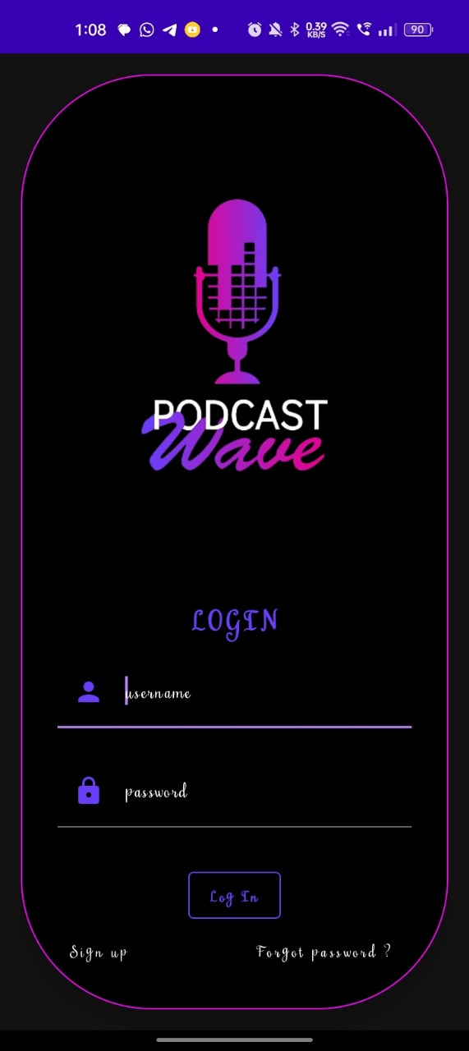

Slide 30
