Slide 1
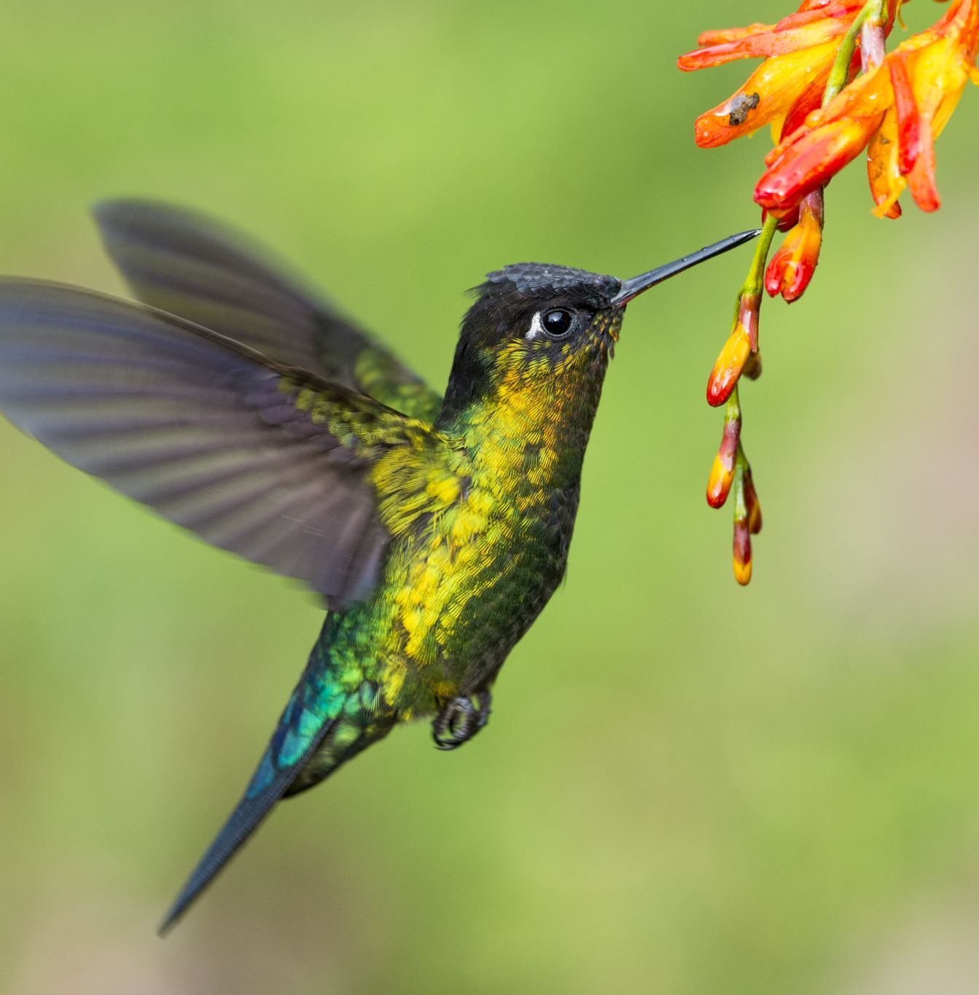
Birds
Presented by:
Combat Wombats
(Joe Lubrano, Kevin Lam,
Rafael Rodriguez, Ramyata Upmaka,
TOM)

Slide 2
Goal: Identify the highest risk factors that lead to bird strikes to airplanes

Slide 3
Clean the database

Slide 4
Which month has the highest rate of bird strikes?
Season: Summer
Month: August

Slide 5
Is there a type of bird that contributes to the highest rate of bird strikes, overall?
Bird: Mourning Dove

Slide 6
At what point during the flight phase do most bird strikes take place, overall?
On Approach

Slide 7
Do commercial or military airlines have the most bird strikes, overall?
Commercial

Slide 8
Where do most bird strikes take place?
FAA Region: ASO (Southern Region)

Slide 9
Where do most bird strikes take place?
By FAA Region: ASO (Southern Region)
By State: Texas

Slide 10
Where do most bird strikes take place? (Contd.)
Heatmap of top 100 airports in the U.S.

Slide 11
Which part of the plane has the most bird strikes? - RU
Part
% of time an “engine” is hit, that led to injuries and fatalities

Slide 12
At what time of day do the most bird strikes happen?
Visibility (dawn, day, dusk, night)

Slide 13
Which weather conditions lead to the most bird strikes?
Precipitation (fog, rain, snow...)

Slide 14
Observations
The summer season, and especially the month of August, has the most bird strikes
We have identified the top 10 known bird species in this dataset that contribute to the most bird strikes, generally they hit the plane one at a time
The most bird strikes happen “On Approach”
Commercial planes are more impacted by bird strikes than military planes
The “ASO” FAA region, which includes states in the southeastern region of the U.S., has the highest incidence of bird strikes. However, Texas which is in ASW region, is the state with the most bird strikes.
[PLACEHOLDER] – PART OF PLANE – RU WILL UPDATE
[PLACEHOLDER] – VISIBILITY
[PLACEHOLDER] – PRECIP

