Slide 1
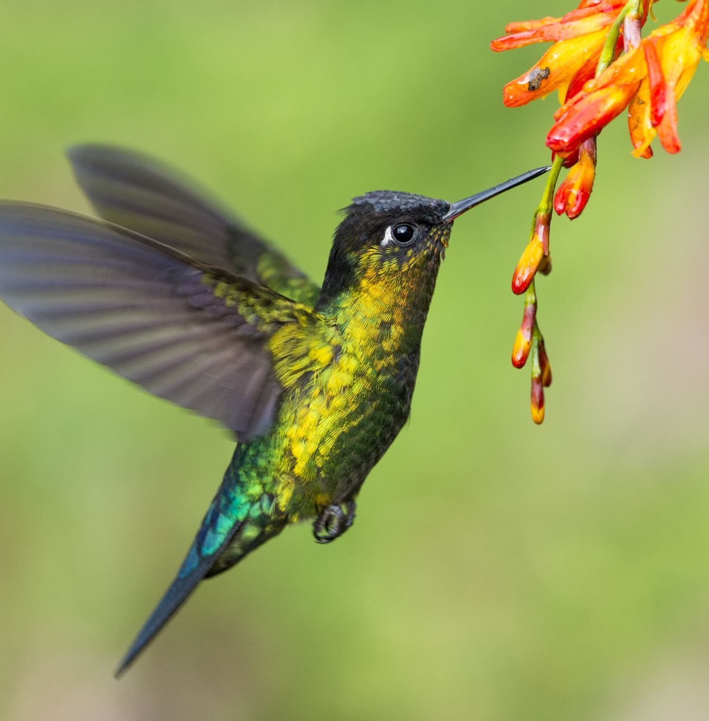
Birds and PLanes
Presented by The Combat Wombats
Joe Lubrano, Kevin Lam, Rafael Rodriguez, Ramyata Upmaka, Rongjun Ding

Slide 2
Goal: Create awareness of the issue of birds striking airplanes and identify important factors related to this occurrence

Slide 3
Clean the database, and set up GitHub
Dataset retrieved from Kaggle, covers bird strikes reported for the U.S. and Canada over the time period from 1990-2015.
Reviewed the dataset and determined which variables were relevant for analysis, examined data types, etc.
Decided to remove certain rows of data:
Airplane “operator” is unknown
Non-bird species in the dataset
Published the cleaned data into a new “Cleaned_data.csv”
Team created branches for each question, and used the “Cleaned_data.csv” to do the analysis in respective branches
Once each branch was complete, it was pushed to the main

Slide 4
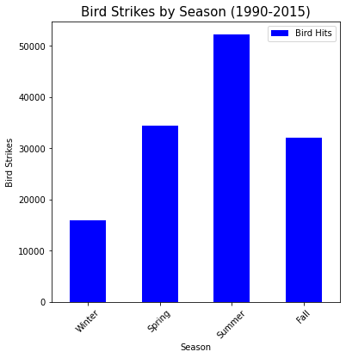
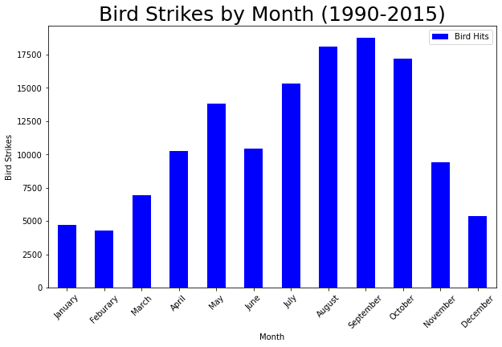
Which month has the highest rate of bird strikes?
Season: Summer, Month: September

Slide 5
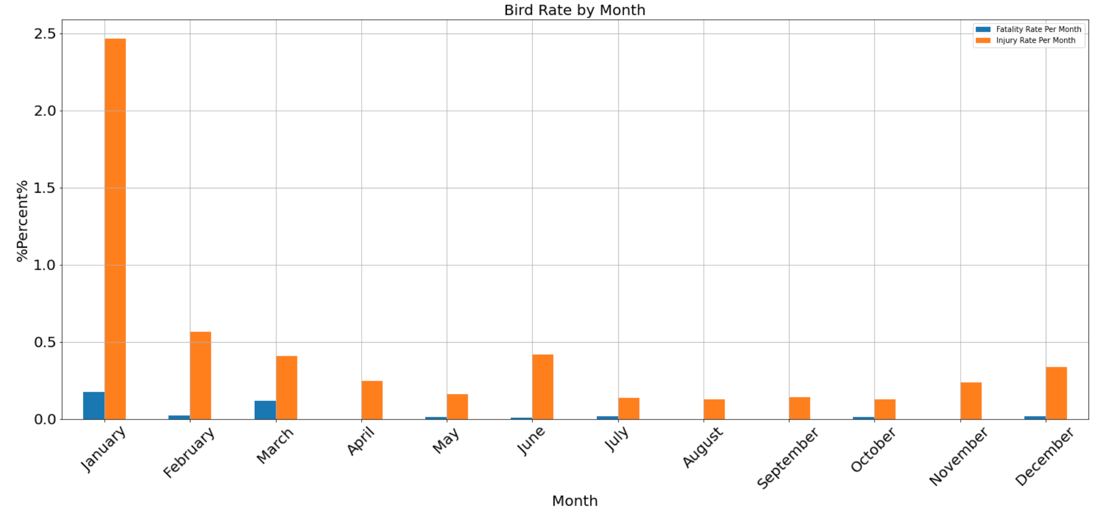
Fatalities and injuries per month over the 15 year-period

Slide 6
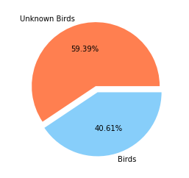
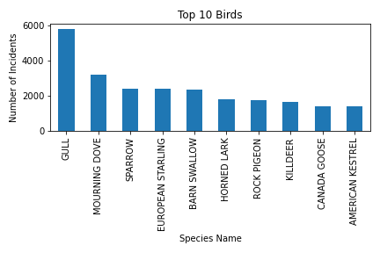
Is there a type of bird that contributes to the highest rate of bird strikes, overall?
Gull

Slide 7
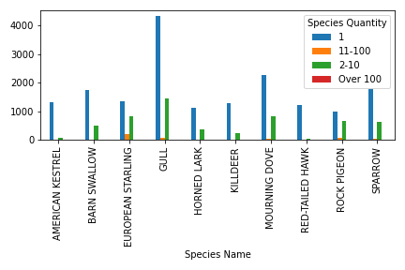
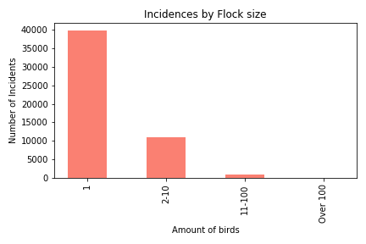
Is there a type of bird that contributes to the highest rate of bird strikes, overall? (Contd.)

Slide 8
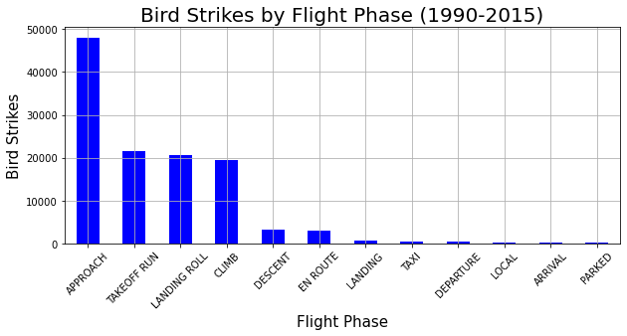
At what point during the flight phase do most bird strikes take place, overall?
On Approach

Slide 9
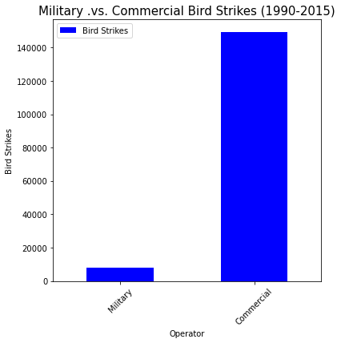
Do commercial or military airlines have the most bird strikes, overall?
Commercial

Slide 10
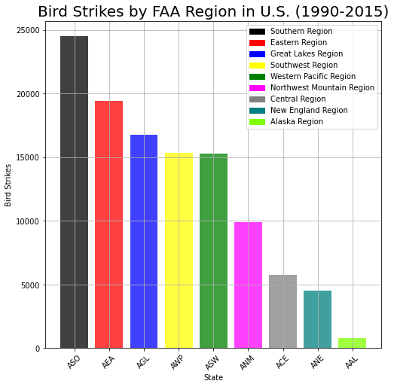
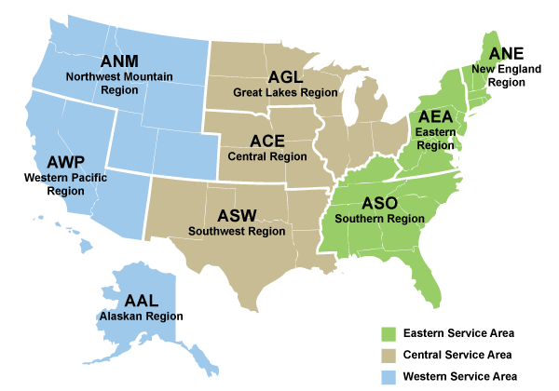
Where do most bird strikes take place?
FAA Region: ASO (Southern Region)

Slide 11
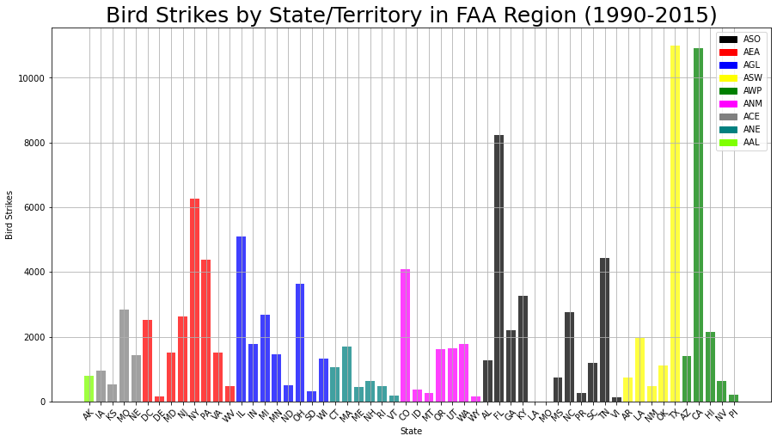
States with the most bird strikes

Slide 12
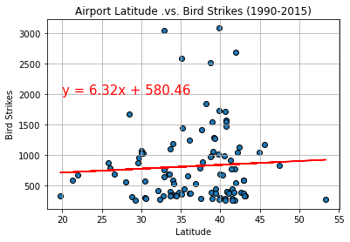
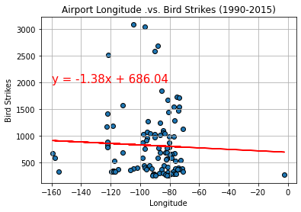
Correlation between airport latitude and longitude and bird strikes
r² = 0.003, p-value = 0.56
p-value >0.05, latitude does not have a significant effect on bird strikes
r² = 0.002, p-value = 0.65
p-value >0.05, longitude does not have a significant effect on bird strikes

Slide 13
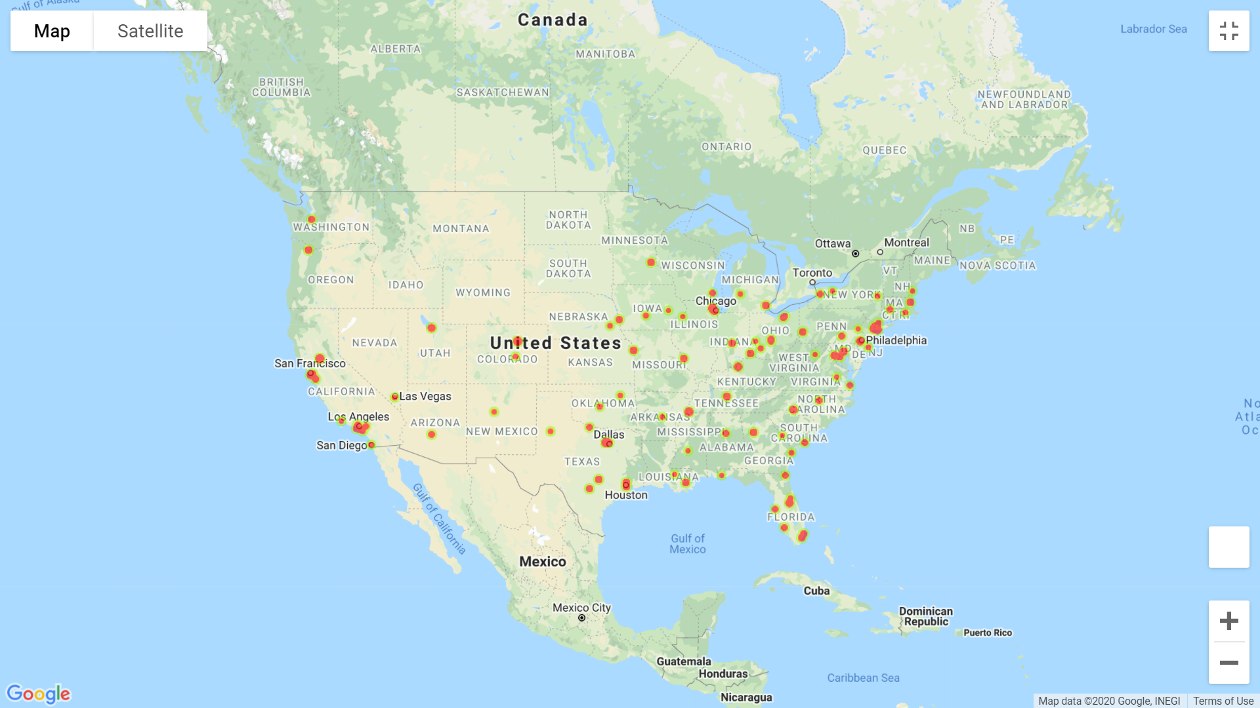
Top 100 airports across the 50 states in the U.S. with bird strikes from 1990-2015

Slide 14
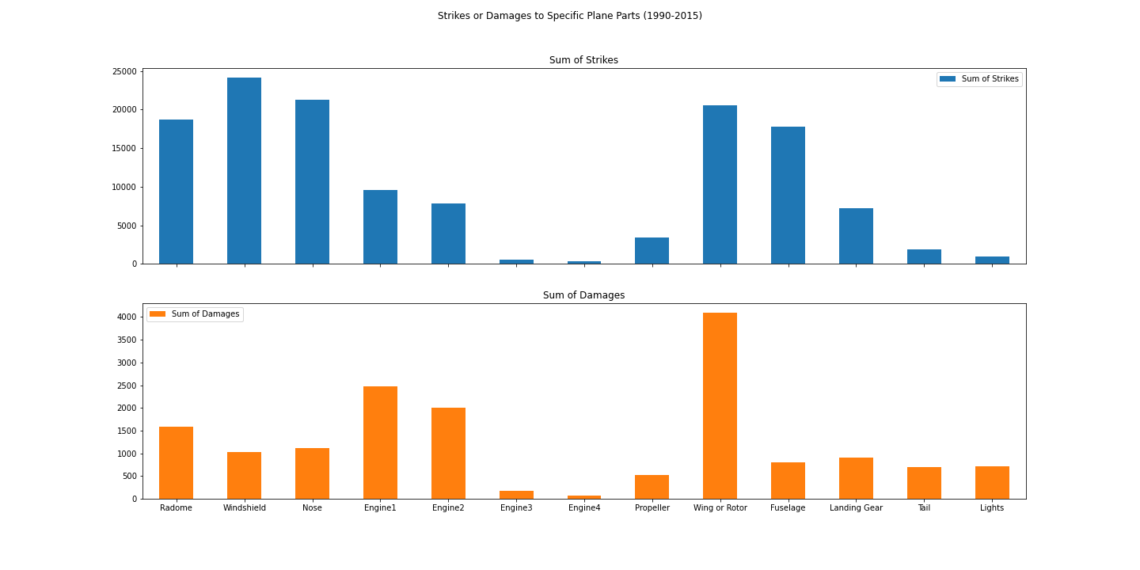
Which part of the plane has the most bird strikes? (Overall)

Slide 15
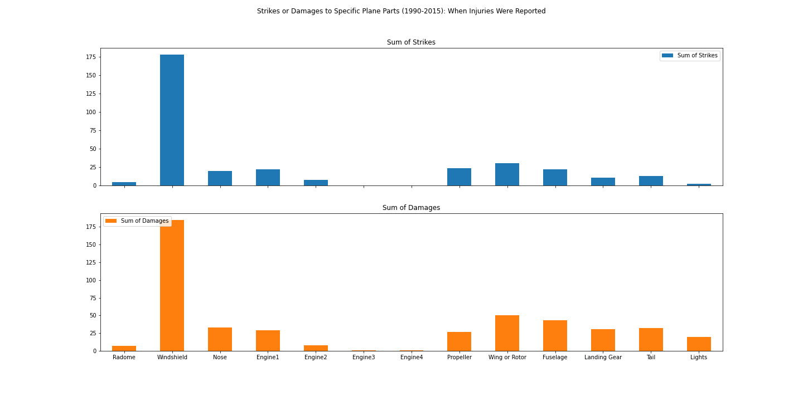
When injuries were reported, which part of the plane has the most bird strikes?

Slide 16
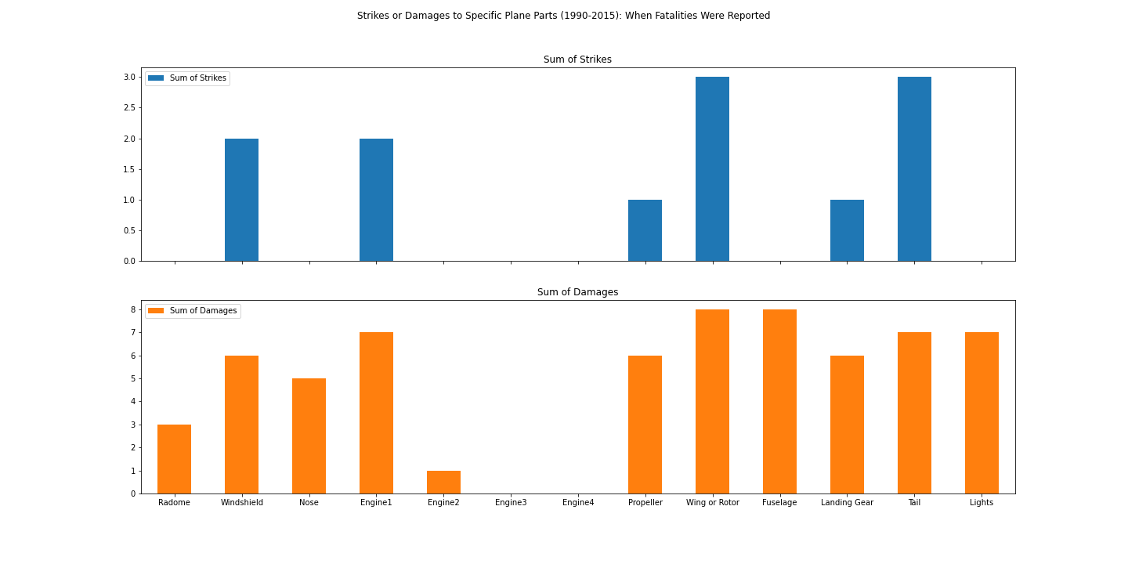
When fatalities were reported, which part of the plane has the most bird strikes?

Slide 17
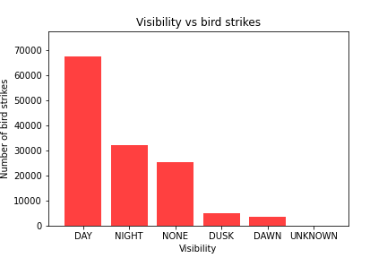
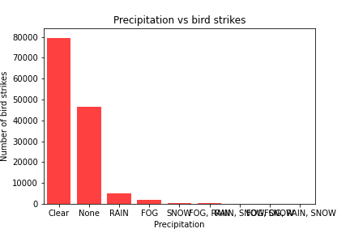
Time of day and weather conditions that lead to the most bird strikes
Time of day: Visibility (dawn, day, dusk, night)
Weather conditions: Precipitation (clear, fog, rain, snow...)

Slide 18
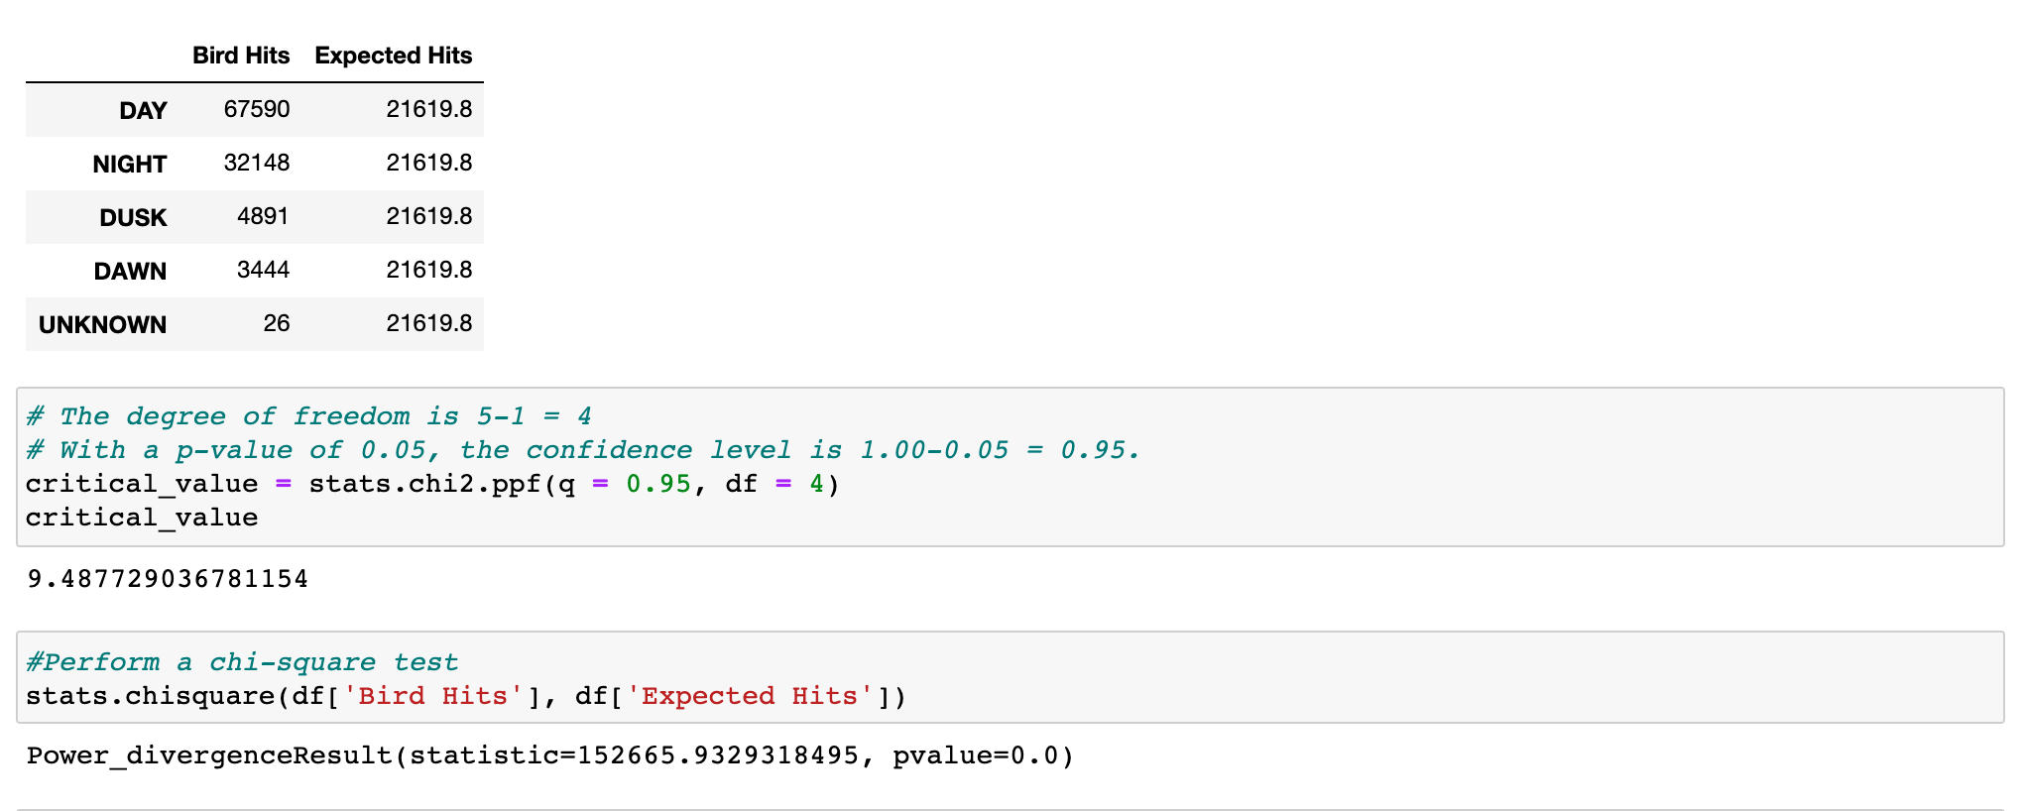
Which time of day leads to the most bird strikes?

Slide 19
Observations
The summer season, and especially the month of September, has the most bird strikes. However, strikes in January may lead to more injuries.
We have identified the top 10 known bird species in this dataset that contribute to the most bird strikes, generally they hit the plane one at a time in flocks.
The most bird strikes happen on approach and commercial planes are more impacted by bird strikes than military planes.
The “ASO” FAA region, which includes states in the southeastern region of the U.S., has the highest incidence of bird strikes. However, Texas (ASW) and California (AWP) are the states with the most bird strikes.
While the windshield, nose, wing/rotor were stuck most often over the 15-year period, the most damaged part was the wing/rotor. Looking at just the strikes that caused injuries, the strike most frequently happened to the windshield. Windshields may not be damaged as easily, but can be dangerous!
Most bird strikes happen during the day and in clear weather.

Slide 20
Questions?

