Slide 1
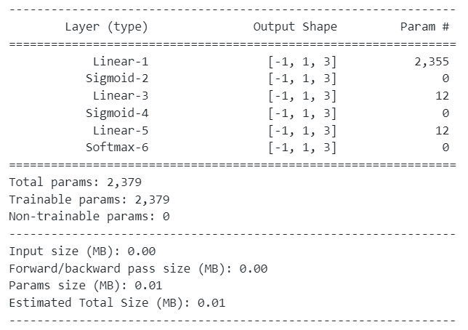

Slide 2
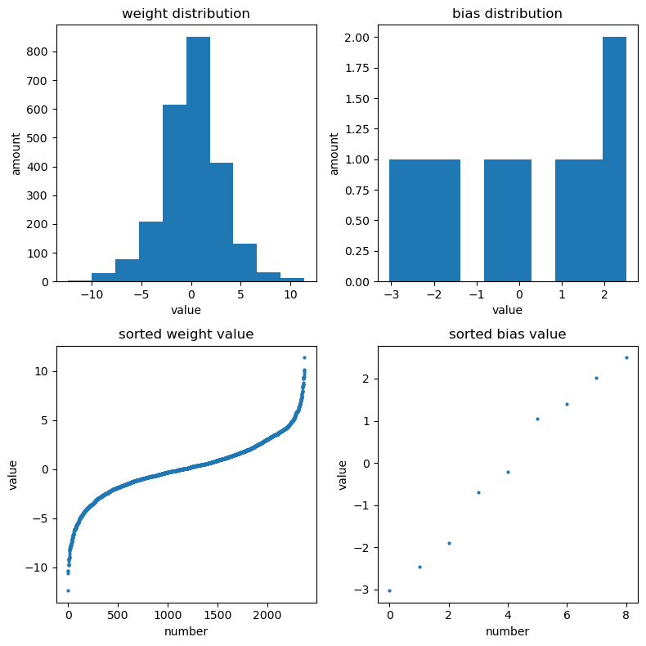
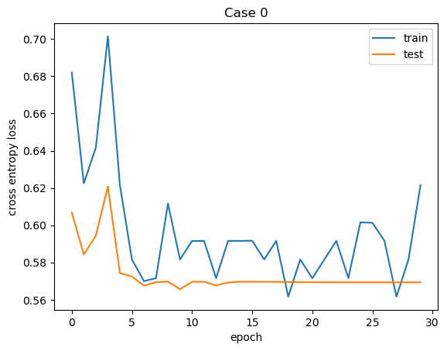
Case0
Dataset: MNIST ‘3’, ‘6’, ‘8’
Best Test Accuracy: 96.2610 %
Cross entropy loss: 0.5657

Slide 3
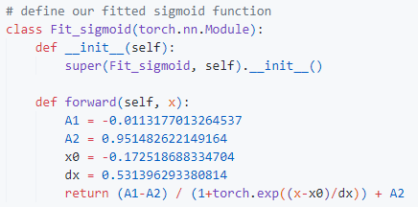
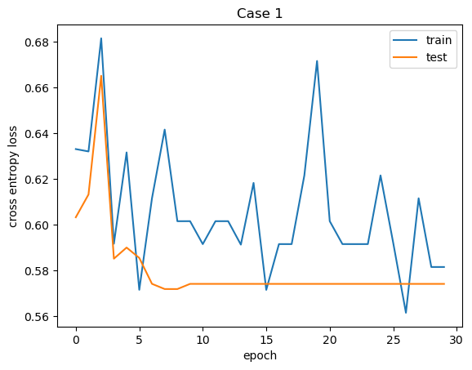
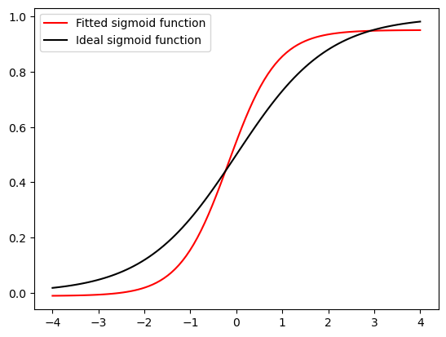
Case1
Dataset: MNIST ‘3’, ‘6’, ‘8’
Oringin lab
Boltzmann
Best Test Accuracy: 95.7172 %
Cross entropy loss: 0.5719

Slide 4
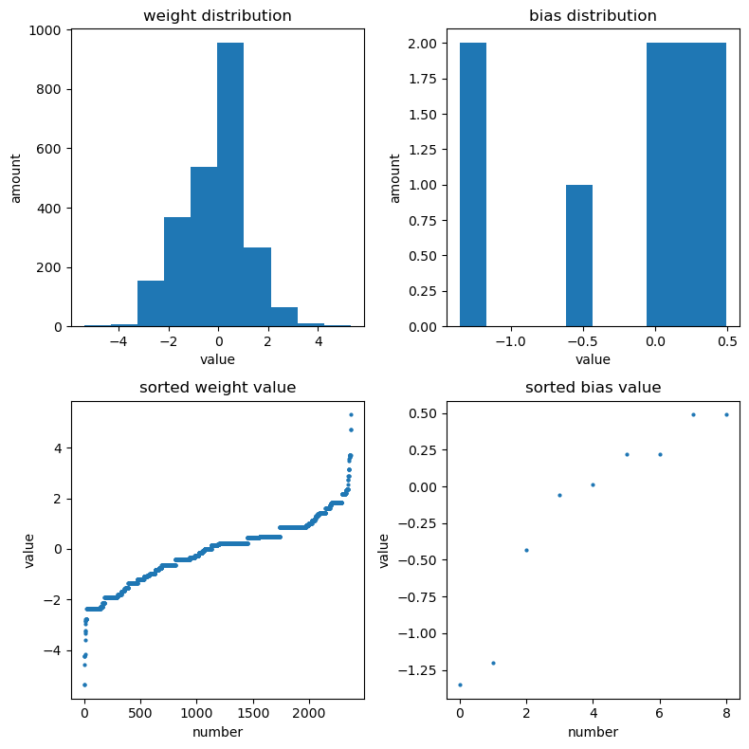
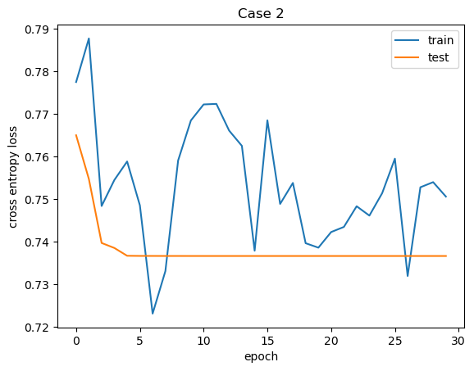
Case2
Dataset: MNIST ‘3’, ‘6’, ‘8’
Best Test Accuracy: 93.3719 %
Cross entropy loss: 0.7366

Slide 5
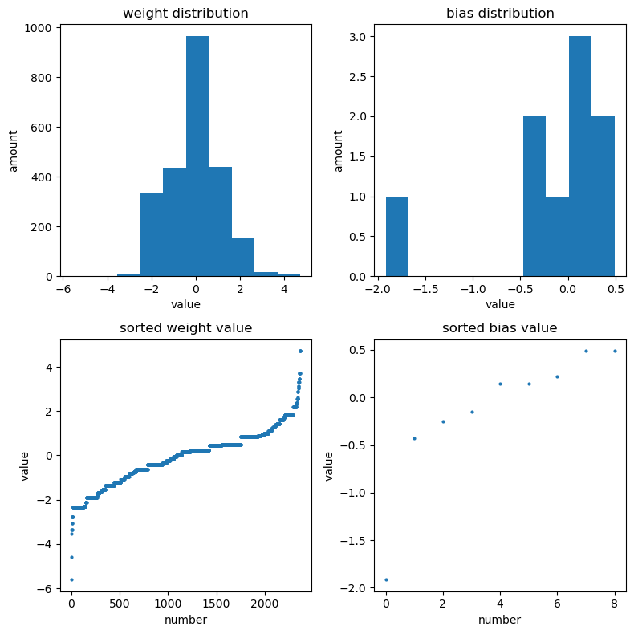
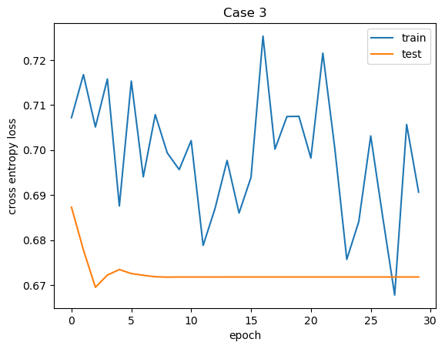
Case3 (-6, 6)
Dataset: MNIST ‘3’, ‘6’, ‘8’
Best Test Accuracy: 93.2699 %
Cross entropy loss: 0.6696

Slide 6
Case3 (-2, 2)
Dataset: MNIST ‘3’, ‘6’, ‘8’
Best Test Accuracy: 96.3630 %
Best Loss: 0.6100

Slide 7
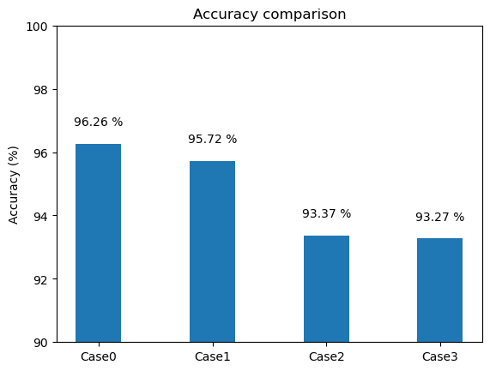

Slide 8
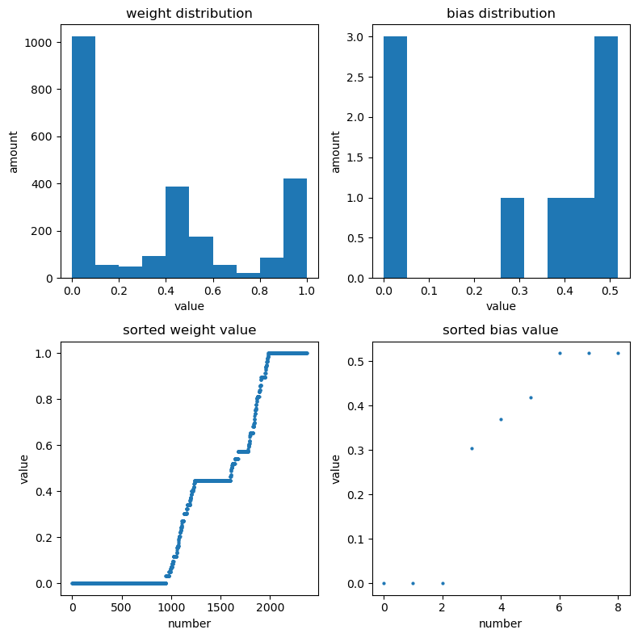
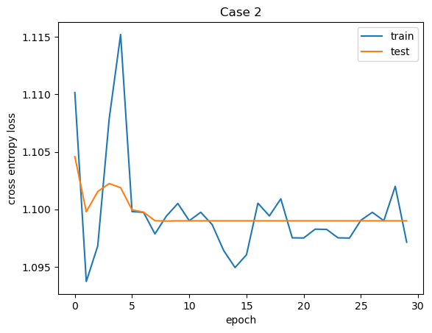
Case2 weight range(0, 1)
Best Test Accuracy: 33.1067 % Best Loss: 1.0990

Slide 9
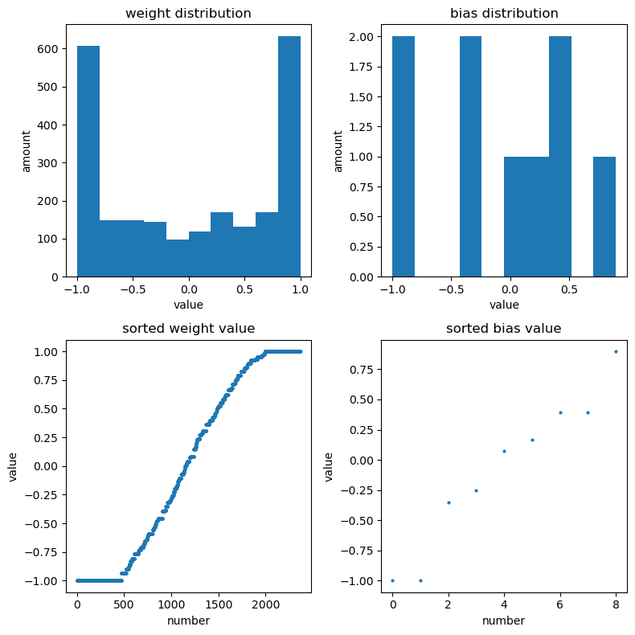
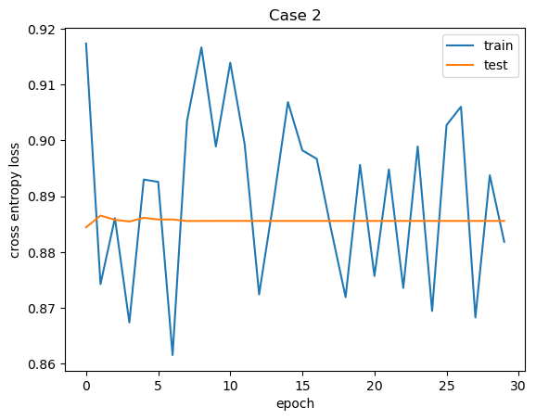
Case2 weight range(-1, 1)
Best Test Accuracy: 66.2475 % Best Loss: 0.8844

Slide 10
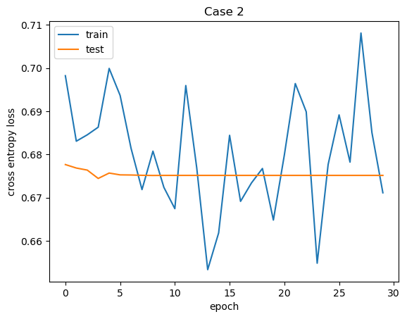
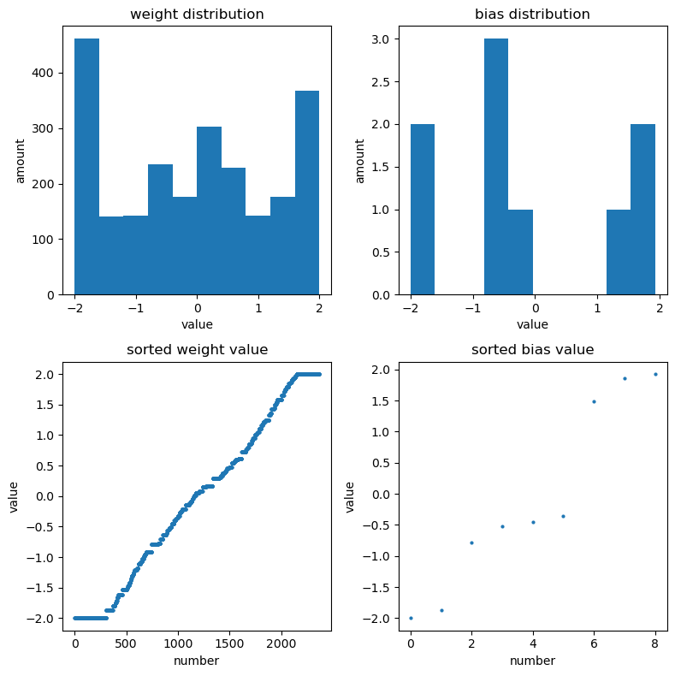
Case2 weight range(-2, 2)
Best Test Accuracy: 96.7369 % Best Loss: 0.6299

Slide 11
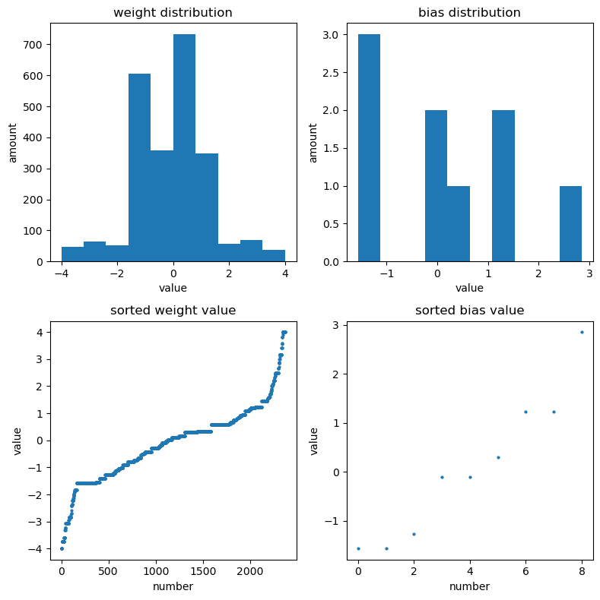
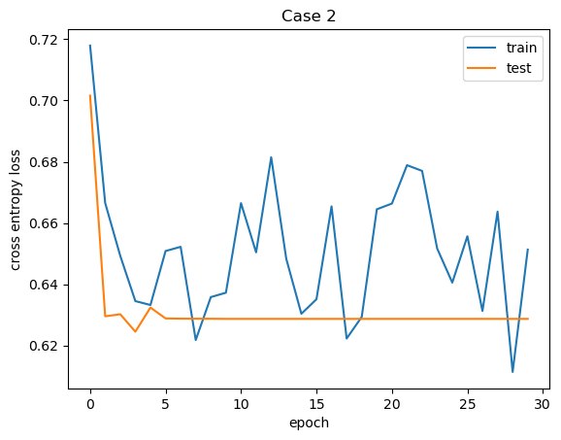
Case2 weight range(-4, 4)
Best Test Accuracy: 95.9891 %
Best Loss: 0.6245

Slide 12
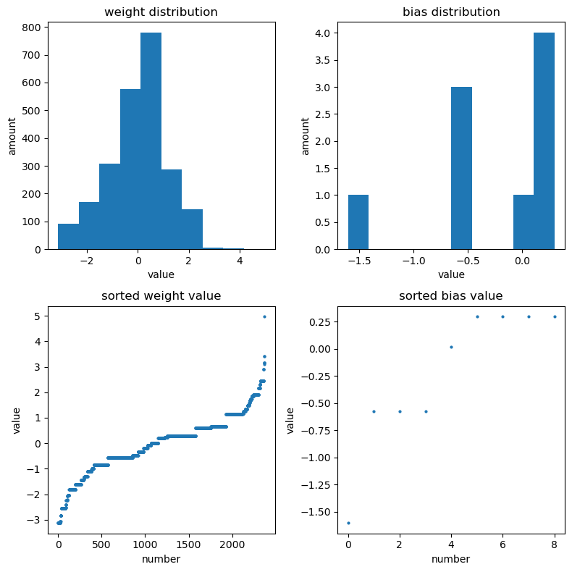
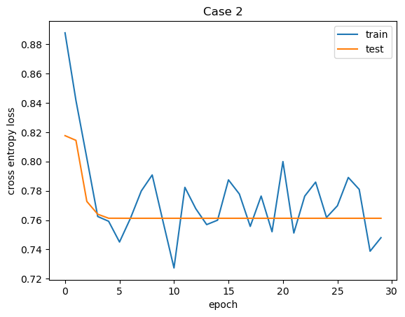
Case2 weight range(-8, 8)
Best Test Accuracy: 91.8763 % Best Loss: 0.7612

Slide 13
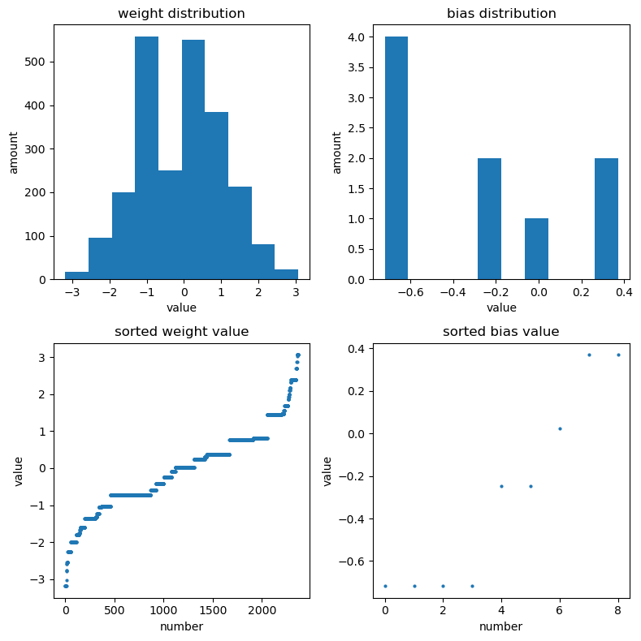
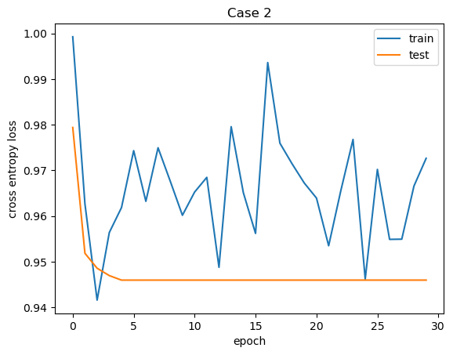
Case2 weight range(-10, 10)
Best Test Accuracy: 84.1944 % Best Loss: 0.9460

Slide 14
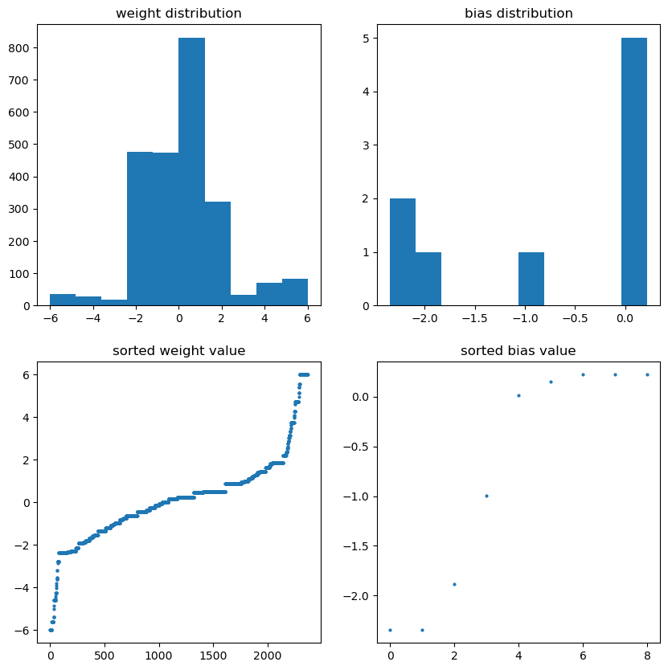
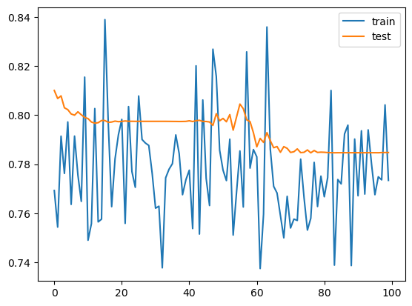
Case2 weight range(-6, 6)
Best Test Accuracy: 98.4112 %

Slide 15
