Slide 1
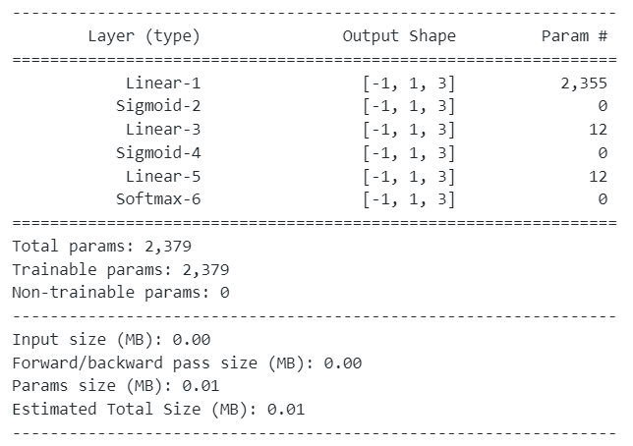

Slide 2
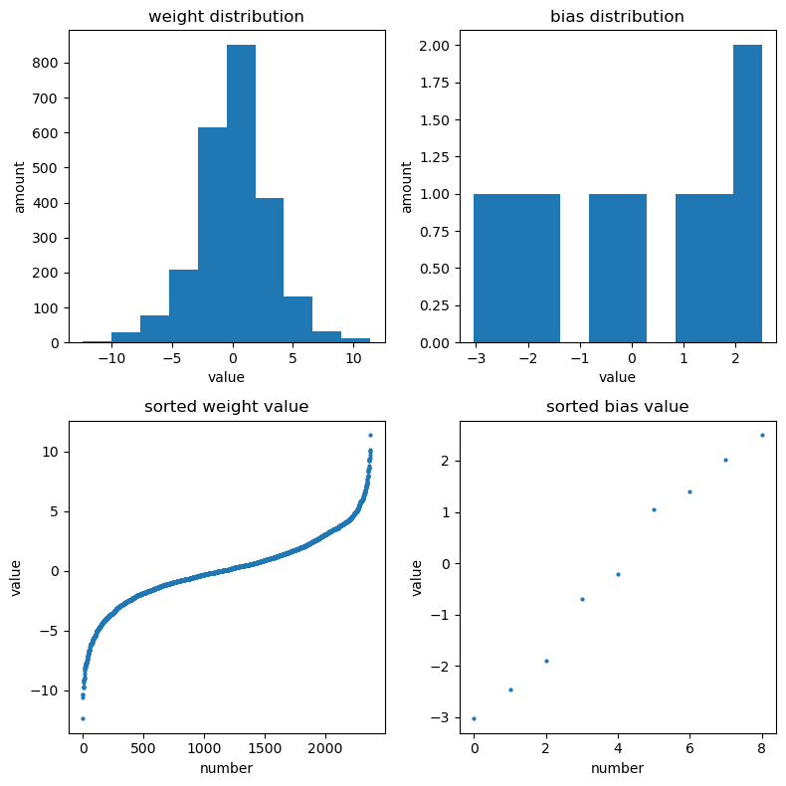
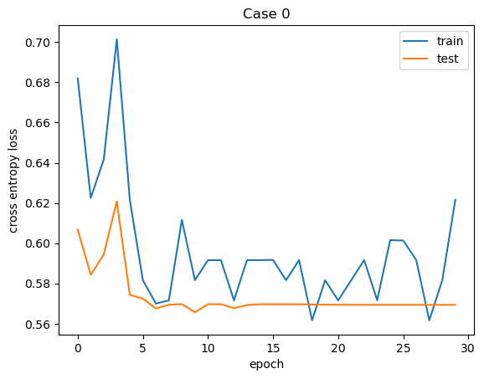
Case0
Dataset: MNIST ‘3’, ‘6’, ‘8’
Best Test Accuracy: 96.2610 %
Cross entropy loss: 0.5657

Slide 3
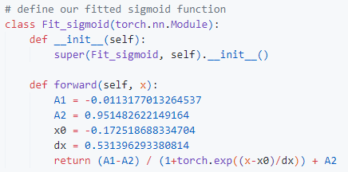
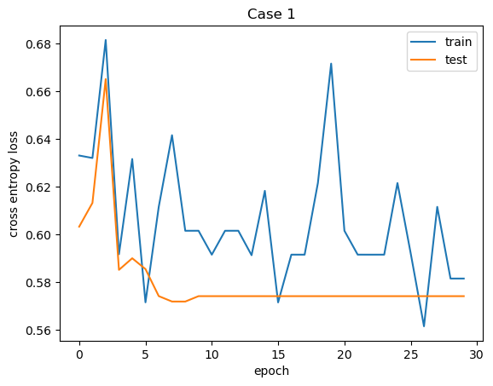
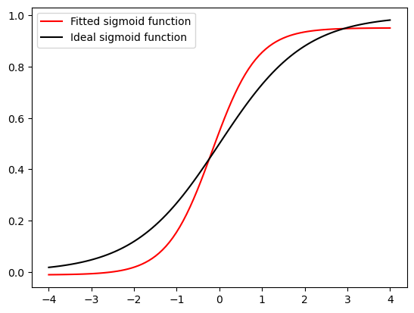
Case1
Dataset: MNIST ‘3’, ‘6’, ‘8’
Oringin lab
Boltzmann
Best Test Accuracy: 95.7172 %
Cross entropy loss: 0.5719

Slide 4
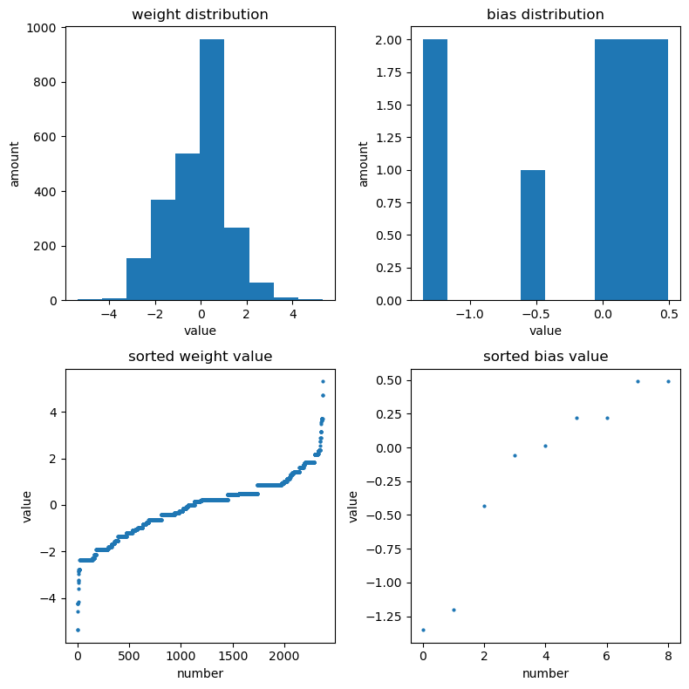
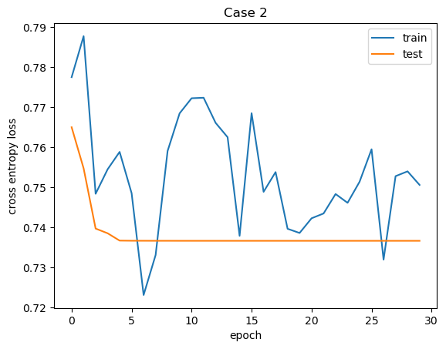
Case2
Dataset: MNIST ‘3’, ‘6’, ‘8’
Best Test Accuracy: 93.3719 %
Cross entropy loss: 0.7366

Slide 5
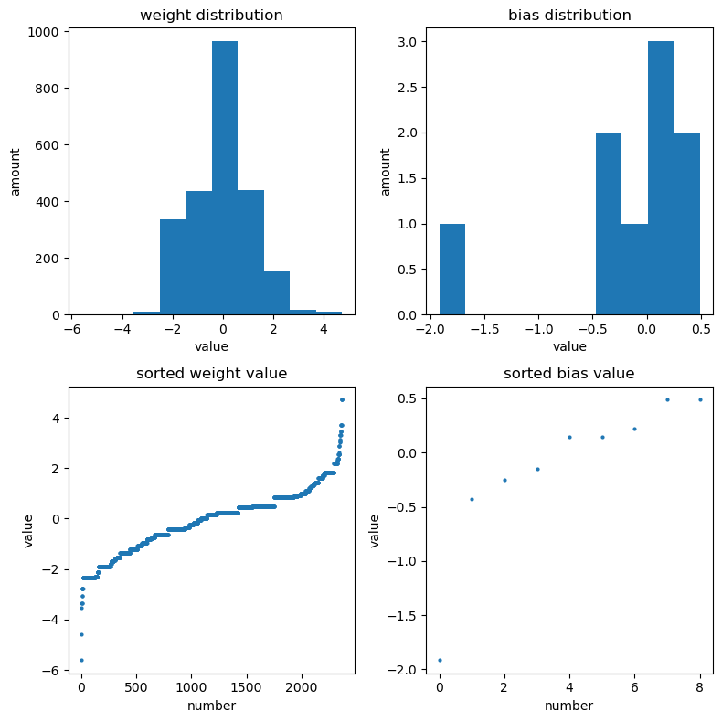
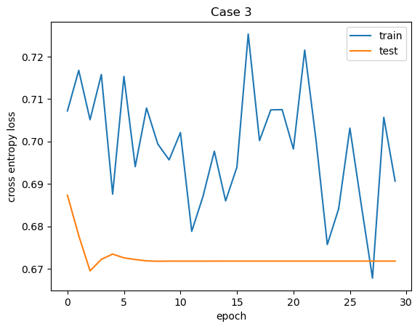
Case3
Dataset: MNIST ‘3’, ‘6’, ‘8’
Best Test Accuracy: 93.2699 %
Cross entropy loss: 0.6696

Slide 6
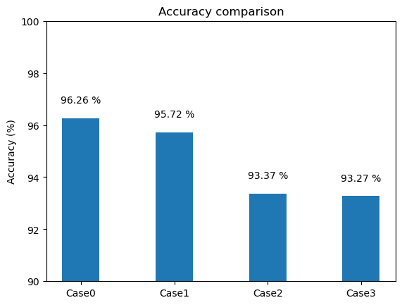

Slide 7
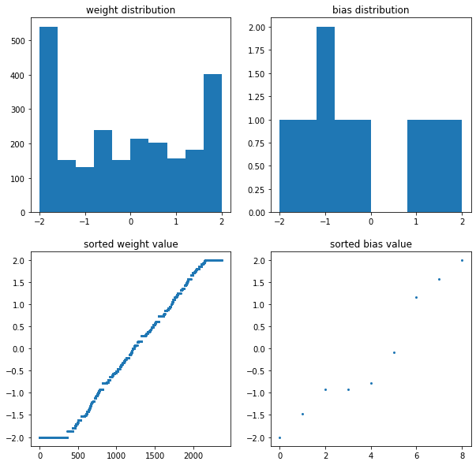
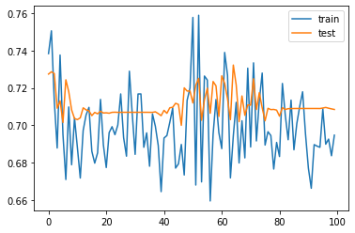
Case2 weight range(-2, 2)
Best Test Accuracy: 99.1420 %

Slide 8
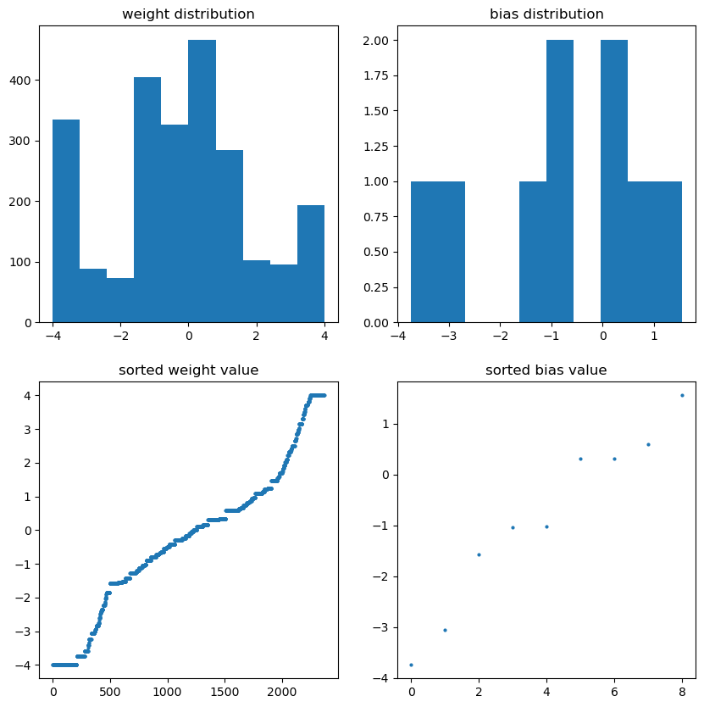
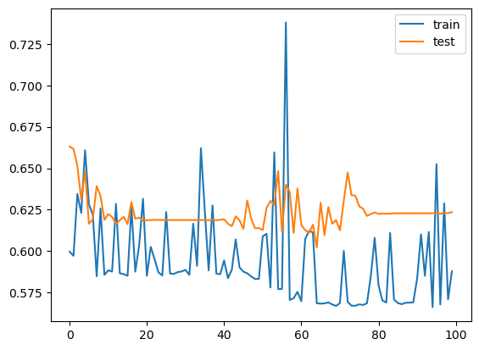
Case2 weight range(-4, 4)
Best Test Accuracy: 98.9196 %

Slide 9
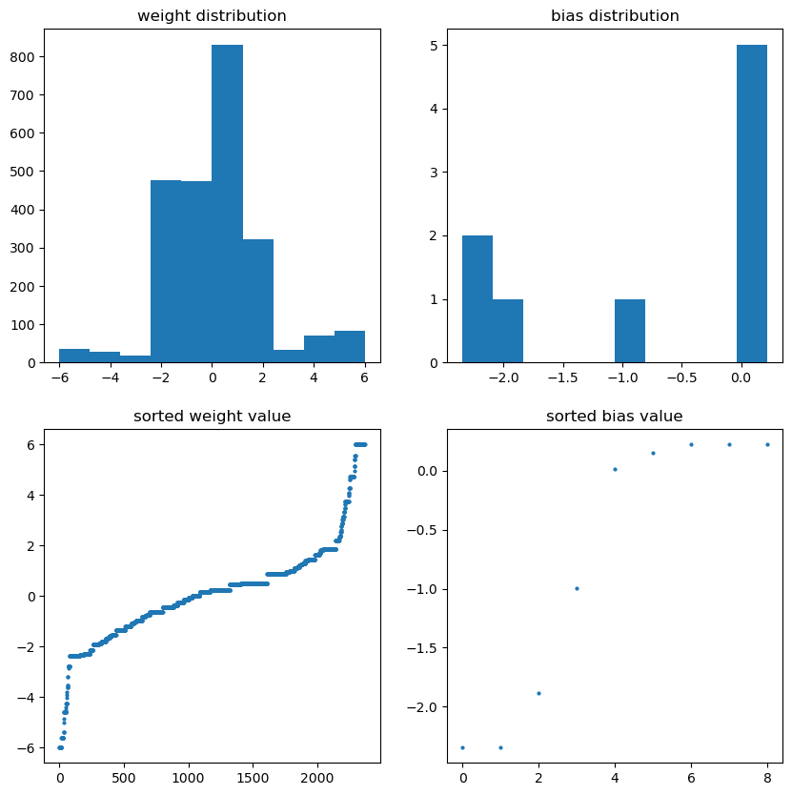
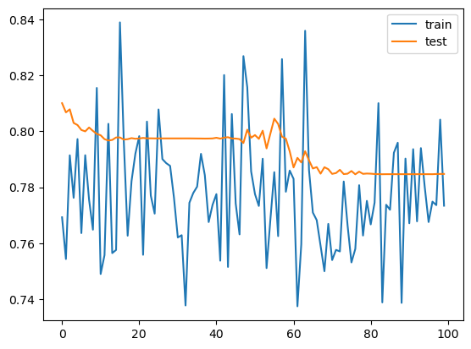
Case2 weight range(-6, 6)
Best Test Accuracy: 98.4112 %

