Slide 1

Happy Fishing
Krishna Matta
Brandon Fields

Slide 2
Happy Fishing Intro
Spear fishing game with multiple levels
Score points by hitting fish with the spear.
Hitting obstacles will result in negative points.
Accumulate the target number of points to advance to the next level.

Slide 3
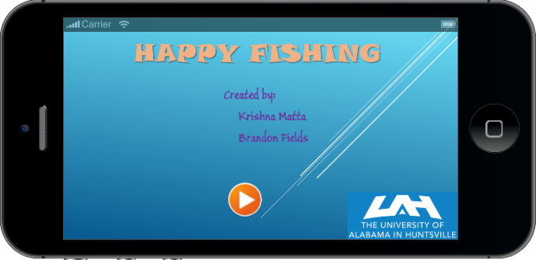
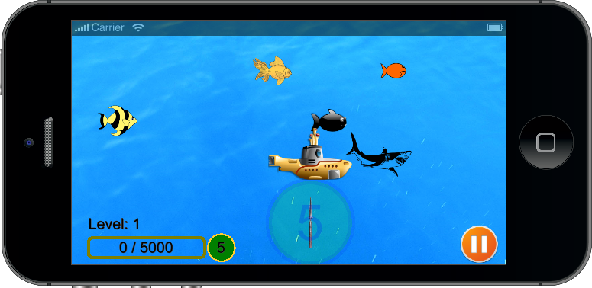
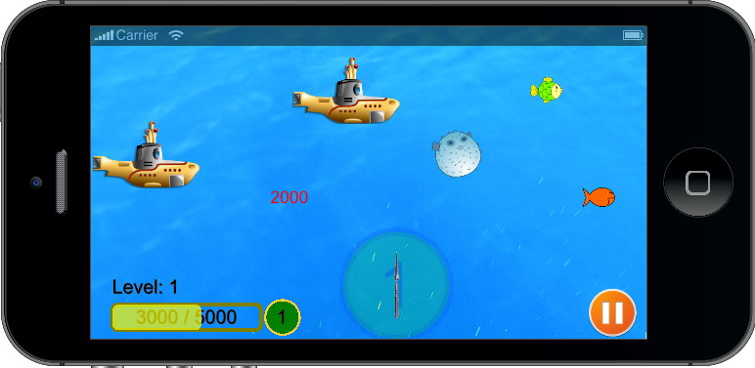
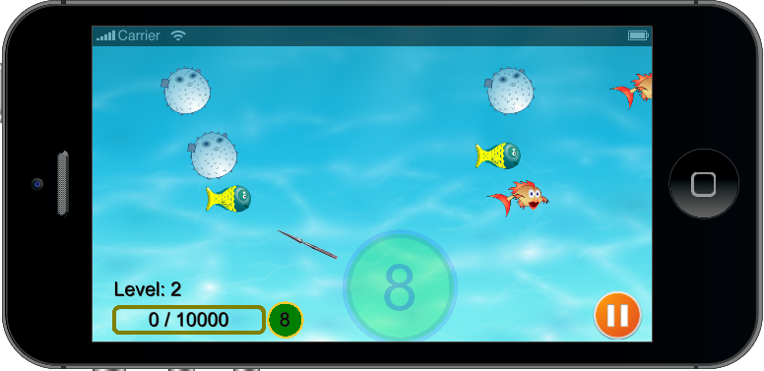
Game Screen Shots

Slide 4
Project Challenges
Positioning the spear on the screen
Manually creating new levels
Handling touch events for the spear
Finding the required images and buttons
Build issues

Slide 5
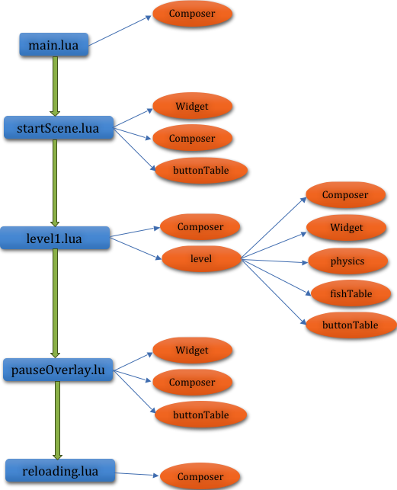
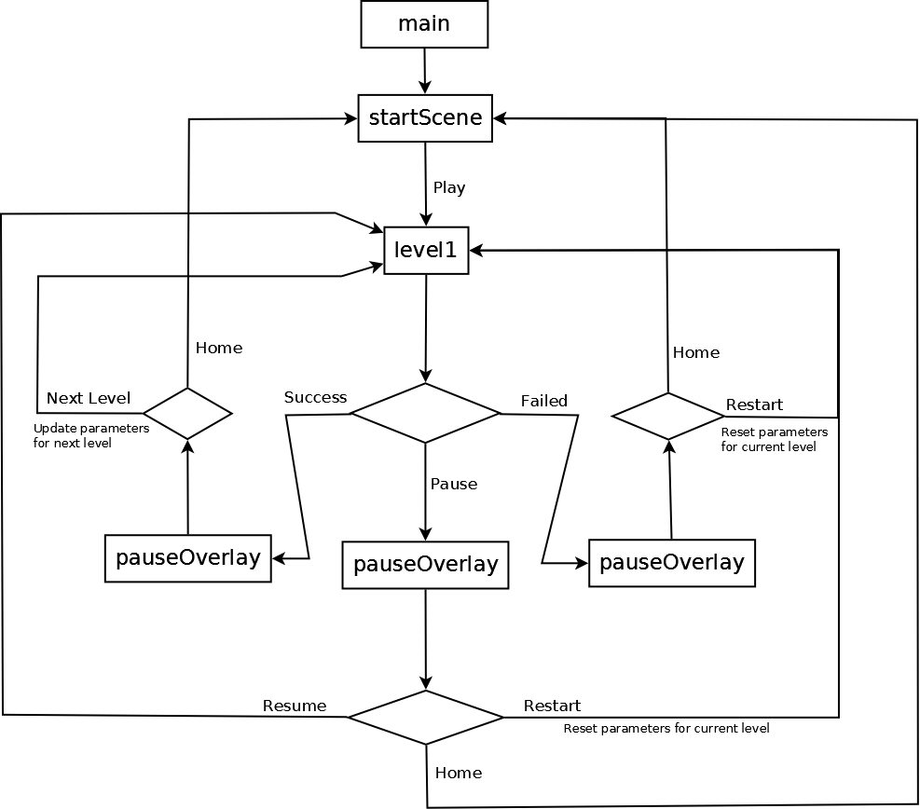
Flowchart and Components

