Slide 1
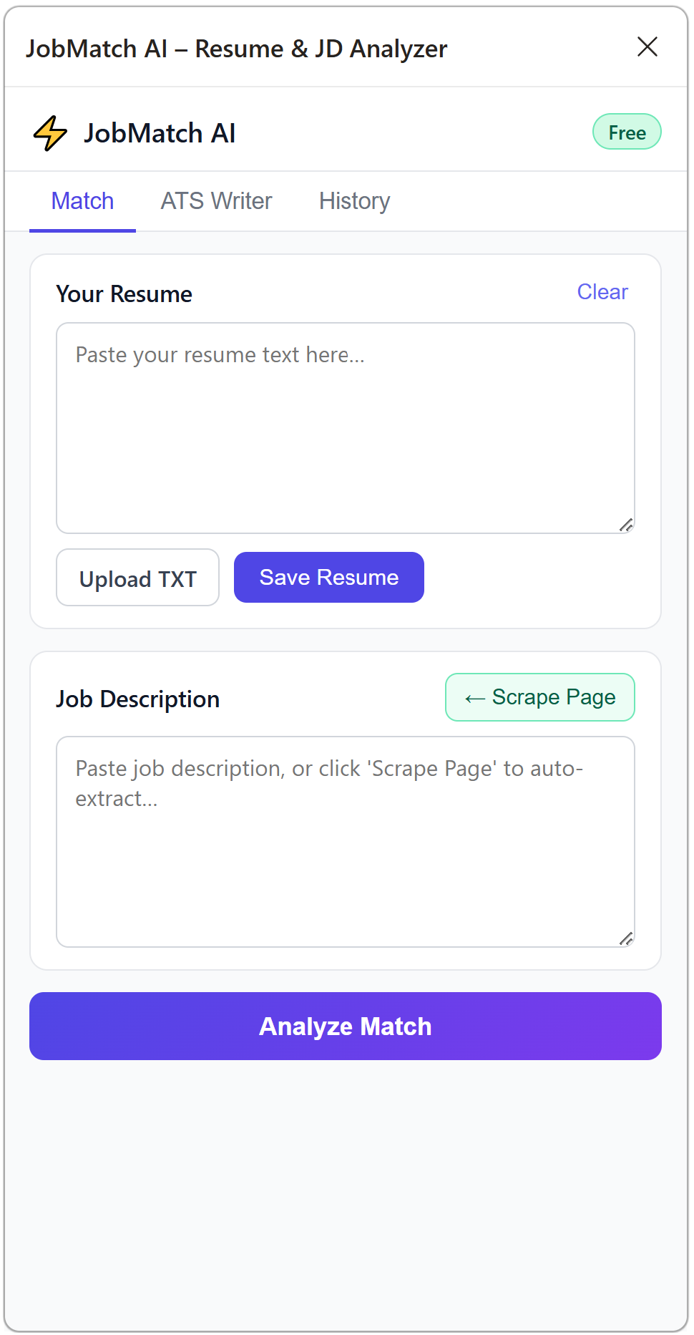

Slide 2
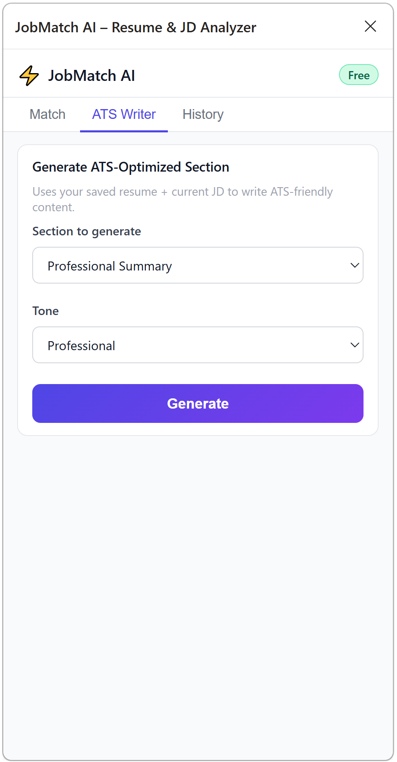

Slide 3
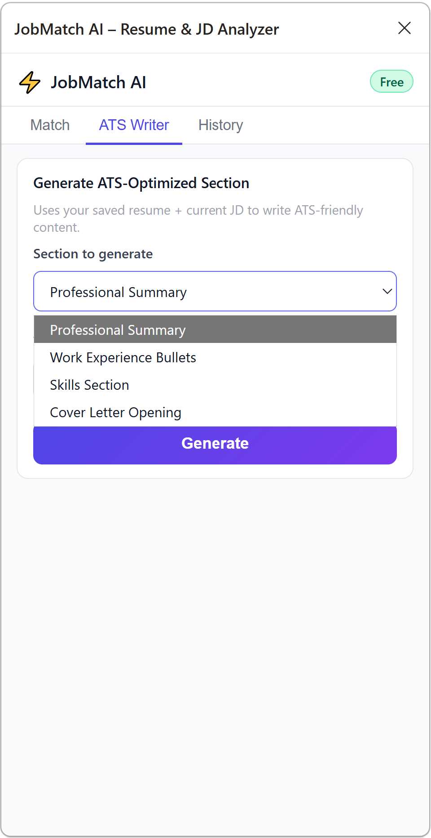

Slide 4
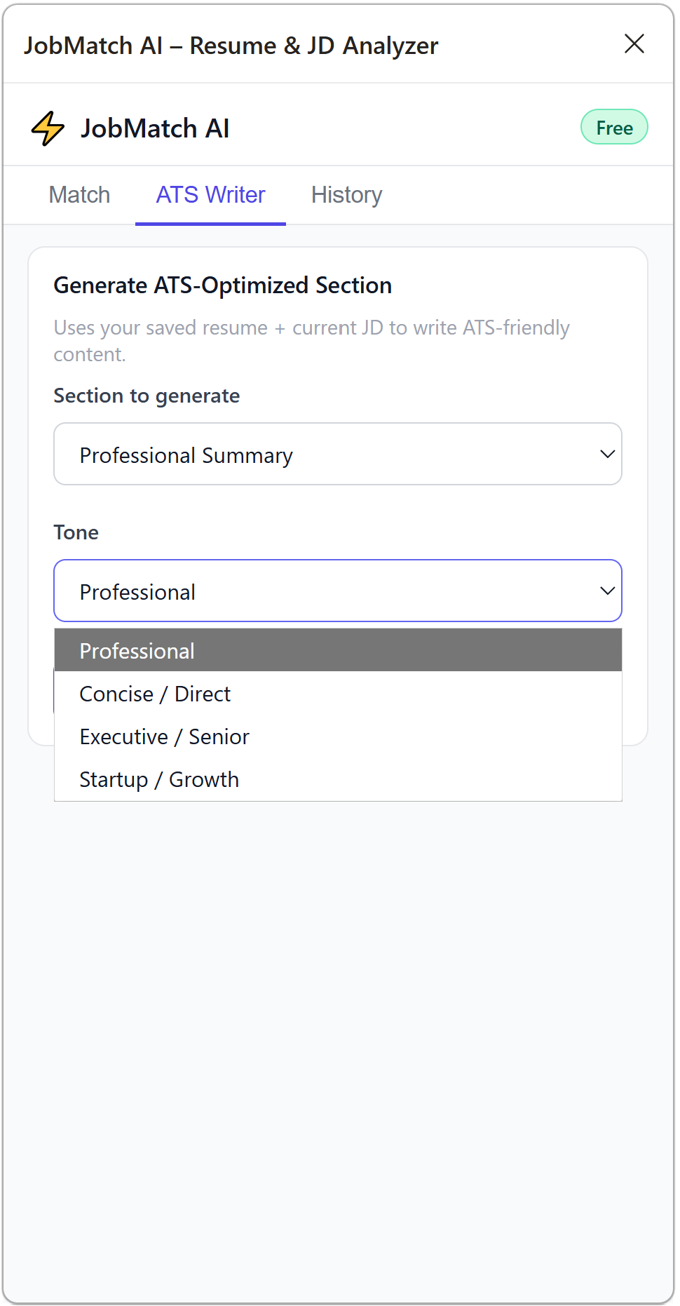

Slide 5
A
B
C

Slide 6
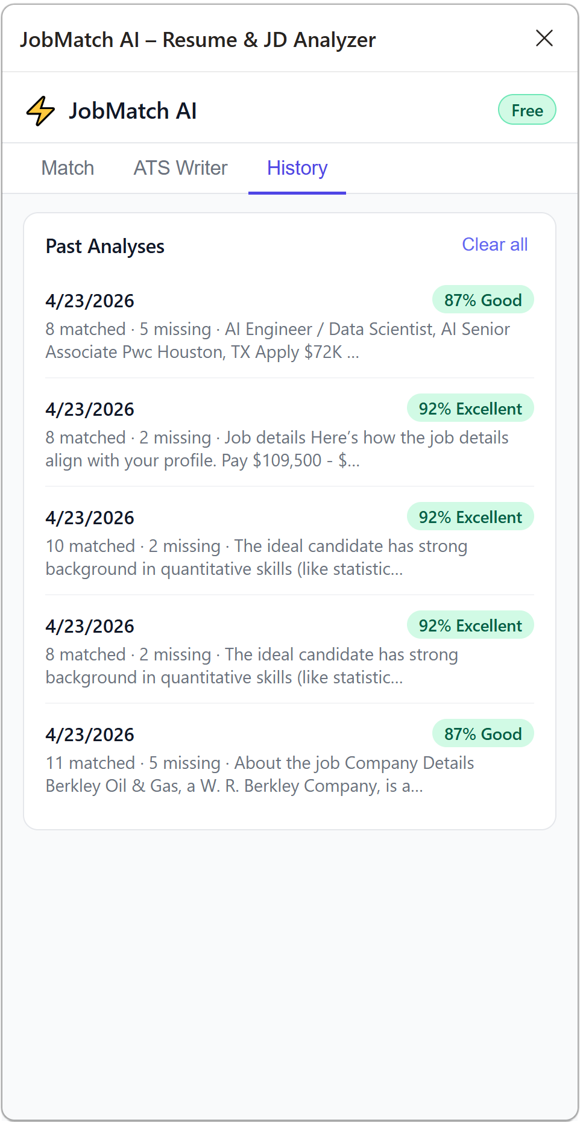

Slide 8




Job board
Chrome
Extension
content.js
Scrapes job text
sidepanel.js
UI + resume input
background.js
API relay + routing
request
response
Cloudflare
Worker
Cloudflare Worker
CORS + rate limiting
KV store
30 req/hr/IP
check/increment
request
response
AI
Groq – Llama 3.3 70B

