Slide 1
GoSharp …
Dr. Pócza Krisztián
kpocza@kpocza.net

Slide 2
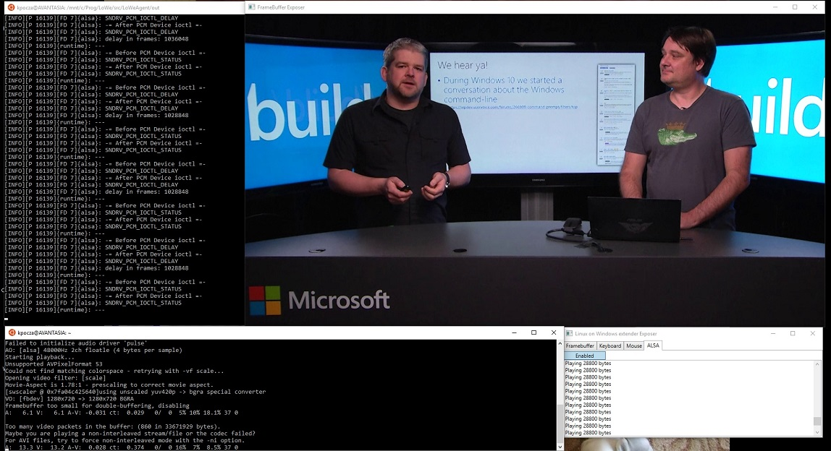
throw new ReferPrevConfTalkException();
Introduction to WSL (Ubuntu on Windows)
Presenting LoWe -> X and sound support for Ubuntu on Windows

Slide 3
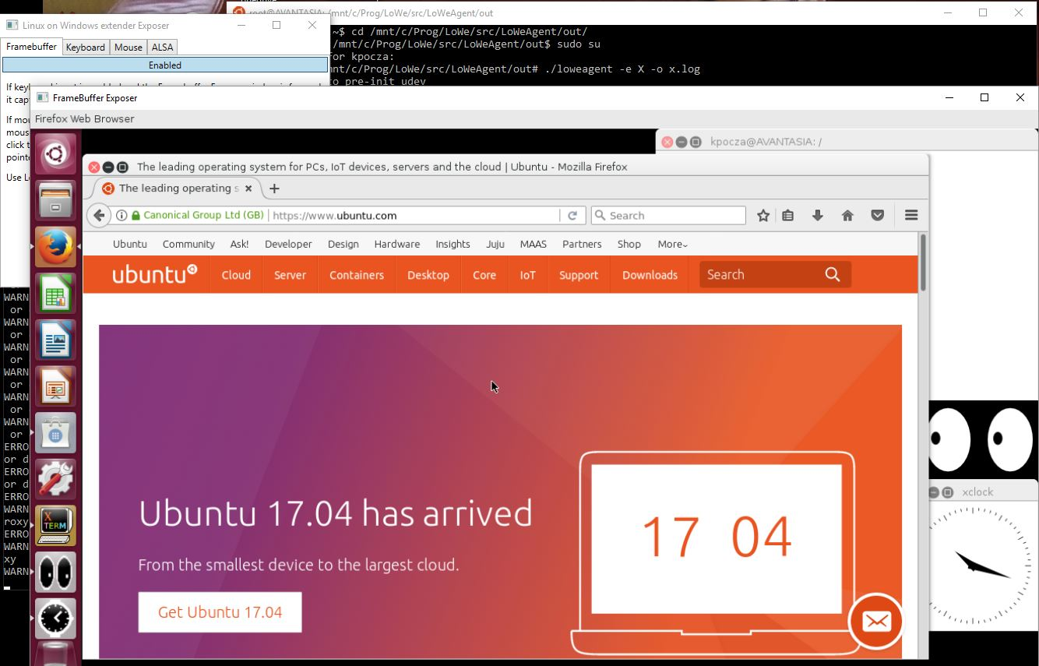
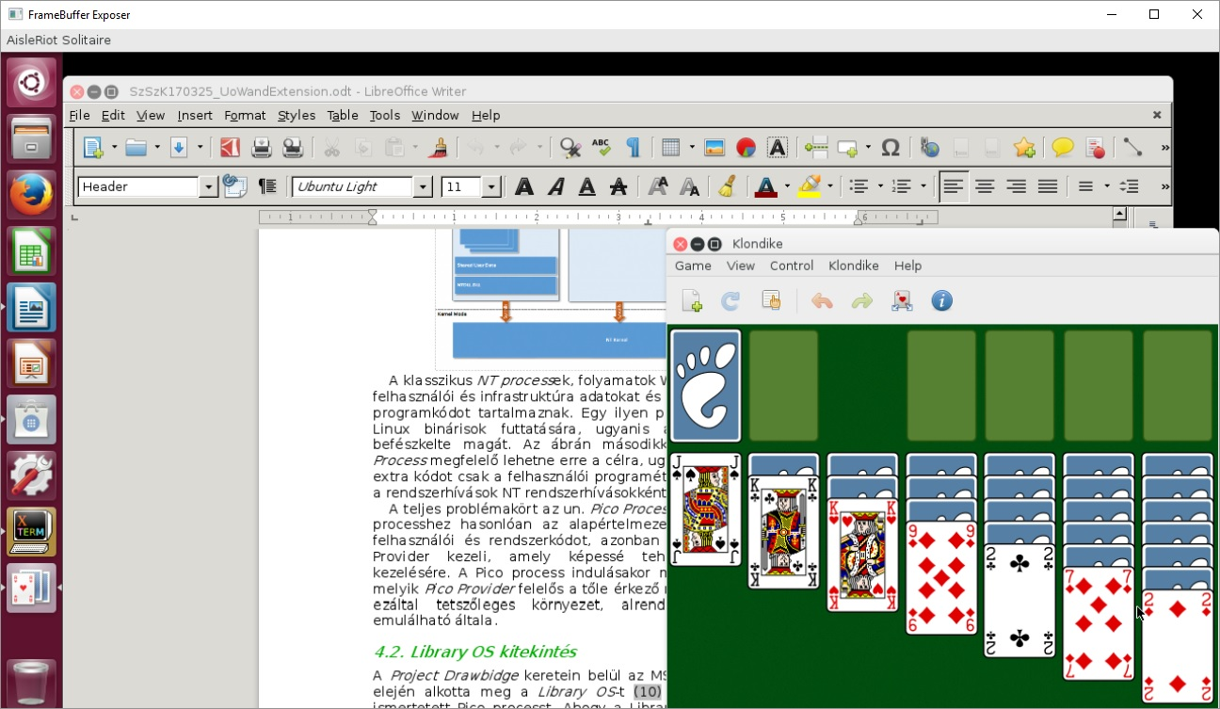
throw new ReferPrevConfTalkException();

Slide 4
Intro
Making programs run faster and serve more requests at the same time
Parallelism vs Concurrency
Processes, threads
Shared memory, shared data structures
Mutexes, semaphores, critical sections, locks

Slide 5
Concurrency
Demo
(multithreading)

Slide 6
Concurrency – Thread schedulers
1:1
  Like Linux, Windows, Mac,
  *BSD, Solaris,…
N:1
User space
Kernel space
User space
Kernel space

Slide 7
Concurrency – Threading models
M:N
  Like Go, .NET TPL
User space
Kernel space

Slide 8
Lock free data structures, collections
Data structures where individual operations are thread safe without locking (or minimal):
  No locks: ConcurrentQueue<T>, ConcurrentStack<T>
  Minimize need: ConcurrentBag<T>
  Fine grained: ConcurrentDictionary<T1, T2>
Technique:
  CAS
    CompareAndExchange
    eg. long CompareExchange(ref long location, long newValue, long comparand)
  Spinning and retry
M:N

Slide 9
Concurrency
Demo
(M:N)

Slide 10
Go concurrency
Do not communicate by sharing memory; instead,
share memory by communicating.

Slide 11
Go concurrency
Go as programming language
Tony Hoare – Communicating Sequential Processes (CSP)
A formal model that consists of:
  Concurrently executing entities
  Communicating by sending messages through channels to each other
Actual implementation:
  go routines
    Lightweight thread, task, M:N
  channels
    thread safe queue
    non-buffered or buffered
Super-efficient

Slide 12
Go scheduler
Goroutines
Global/local queues (P specific)
OS thread (T)
Stealing
Preemptive
Blocking
File/Network IO
global queue
local queue
local queue
T
T
T
P1
P2

Slide 13
Go goroutines and channels
  package main
  import "fmt"
  import "time"
  type Ball struct {
  hits int
  }
  func player(name string, table chan *Ball) {
  for {
  ball := <-table
  ball.hits++
  fmt.Println(name, ball.hits)
  time.Sleep(100 * time.Millisecond)
  table <- ball
  }
  }
  func main() {
  table := make(chan *Ball)
  go player("ping", table)
  go player("pong", table)
  table <- new(Ball)
  time.Sleep(1 * time.Second)
  <-table
  }

Slide 14
Go goroutines and channels
Demo
(Go ping-pong)

Slide 15
Go - select
  chan1 := make(chan int)
  chan2 := make(chan string)
  go func() {
  time.Sleep(time.Second)
  chan1 <- 1
  }()
  go func() {
  time.Sleep(time.Second * 2)
  chan2 <- "two"
  }()
  for i := 0; i < 2; i++ {
  select {
  case msg1:= <- chan1:
  fmt.Println("recvd:", msg1)
  case msg2:= <- chan2:
  fmt.Println("recvd:", msg2)
  }
  }

Slide 16
Go timers, tickers
  Time: Select supports timeout
  Timer fires once
  Ticker can tick several times, eg.
  ticker:= time.NewTicker(time.Millisecond * 100)
  go func() {
  for t:= range ticker.C {
  fmt.Println("Tick at", t)
  }
  }()
  time.Sleep(time.Second)
  ticker.Stop()

Slide 17
.NET/C# concurrency
Go was designed with concurrency in mind, C# not
In .NET we have:
  Threads – heavyweight
  Synchronization primitives, timers
  BeginXXX – EndXXX, callbacks, BackgroundWorker
  Later
    Tasks – lightweight threads, like goroutines
    TPL – M:N
Old behavior of language and API couldn’t be altered by making them asynchronous by default
  New Language constructs: async/await
  Async counterparts of synchronous functions

Slide 18
.NET/C# concurrency
Synchronous code
Asynchronous code
public string GetContents(string url, string filePath)
{
var webClient = new WebClient();
var webData = webClient.DownloadString(url);
var fileData = File.ReadAllText(filePath);
return webData + filePath;
}
public async Task<string> GetContentsAsync(string url, string filePath)
{
var webClient = new WebClient();
var webData = await webClient.DownloadStringTaskAsync(url);
var fileData = await File.ReadAllTextAsync(filePath);
return webData + filePath;
}
public int AddUser(UserContext userContext, User user)
{
userContext.Add(user);
userContext.SaveChanges();
return user.Id;
}
public async Task<int> AddUserAsync(UserContext userContext, User user)
{
userContext.Add(user);
await userContext.SaveChangesAsync();
return user.Id;
}

Slide 19
.NET/C# concurrency
Mostly IO intensive, like websites
Syntax mirrors the behavior
IO
More influenceable however more complex
If A is async and B is calling A then B should be async furthermore if C is calling B then C should be async, etc.
How to escape this “hell”:
  Call task.Result or Task.Wait{All,Any}(…), Task.When{All,Any}(…)
  Let the Framework, async Action in MVC Controller, async unit test case, etc.

Slide 20
Go#
“This library provides a mini embedded DSL for C# that mimics Go concurrency statements like channels, select, timers and tickers.”
Open source, MIT licence, NuGet
https://github.com/kpocza/GoSharp
Goal: Go-like flexibility
Syntax is quite close to Go
Some higher level constructs like Merge, Zip, Buffer, Broadcast and Pipeline
High performance

Slide 21
Go# – Side-by-side comparison
func sendRecv() {
messages := make(chan string)
go func() {
messages <- "ping"
}()
msg := <-messages
fmt.Println(msg)
}
private async Task sendRecv()
{
var messages = Channel<string>.CreateNonBuffered();
Go.Run(async () =>
{
await messages.SendAsync("ping");
});
var msg = await messages.RecvAsync();
Console.WriteLine(msg);
}
private void sendRecvSync()
{
var messages = Channel<string>.CreateNonBuffered();
Go.Run(() =>
{
messages.Send("ping");
});
var msg = messages.Recv();
Console.WriteLine(msg);
}

Slide 22
Go# – Side-by-side comparison
func sendRecvBuf() {
messages := make(chan string, 2)
messages <- "ping"
messages <- "ping2"
fmt.Println(<-messages)
fmt.Println(<-messages)
}
private async Task sendRecvBuf()
{
var messages = Channel<string>.CreateBuffered(2);
await messages.SendAsync("ping");
await messages.SendAsync("ping2");
Console.WriteLine(await messages.RecvAsync());
Console.WriteLine(await messages.RecvAsync());
}

Slide 23
Go# – Side-by-side comparison
func chanSync() {
done := make(chan bool)
go func() {
fmt.Println("begin")
time.Sleep(time.Second)
fmt.Println("done")
done <- true
}()
<- done
fmt.Println("end")
}
private async Task chanSync()
{
var done = Channel<bool>.CreateNonBuffered();
Go.Run(async () =>
{
Console.WriteLine("begin");
await Task.Delay(TimeSpan.FromSeconds(1));
Console.WriteLine("done");
await done.SendAsync(true);
});
await done.RecvAsync();
Console.WriteLine("end");
}

Slide 24
Go# – Side-by-side comparison
func simpleSelect() {
chan1 := make(chan int)
chan2 := make(chan string)
go func() {
time.Sleep(time.Second)
chan1 <- 1
}()
go func() {
time.Sleep(time.Second * 2)
chan2 <- "two"
}()
for i := 0; i < 2; i++ {
select {
case msg1:= <- chan1:
fmt.Println("recvd:", msg1)
case msg2:= <- chan2:
fmt.Println("recvd:", msg2)
}
}
}
private void simpleSelectSync()
{
var chan1 = Channel<int>.CreateNonBuffered();
var chan2 = Channel<string>.CreateNonBuffered();
Go.Run(() =>
{
Thread.Sleep(TimeSpan.FromSeconds(1));
chan1.Send(1);
});
Go.Run(() =>
{
Thread.Sleep(TimeSpan.FromSeconds(2));
chan2.Send("two");
});
for (int i = 0; i < 2; i++)
{
Select
.CaseRecv(chan1, msg1 => Console.WriteLine($"recvd: {msg1}"))
.CaseRecv(chan2, msg2 => Console.WriteLine($"recvd: {msg2}"))
.Go();
}
}

Slide 25
Go# – Side-by-side comparison
func noActSelect() {
chan1 := make(chan string)
chan2 := make(chan string)
select {
case msg:= <- chan1:
fmt.Println("rcvd:", msg);
default:
fmt.Println("nothing rcvd")
}
select {
case chan1 <- "hi":
fmt.Println("msg sent");
default:
fmt.Println("nothing sent")
}
select {
case msg1:= <- chan1:
fmt.Println("rcvd1:", msg1)
case msg2:= <- chan2:
fmt.Println("rcvd2:", msg2)
default:
fmt.Println("no activity")
}
}
private async Task noActSelect()
{
var chan1 = Channel<string>.CreateNonBuffered();
var chan2 = Channel<string>.CreateNonBuffered();
await Select
.CaseRecv(chan1, msg => Console.WriteLine($"rcvd: {msg}"))
.DefaultAsync(() => Console.WriteLine("nothing rcvd"));
await Select
.CaseSend(chan1, "hi")
.DefaultAsync(() => Console.WriteLine("nothing sent"));
await Select
.CaseRecv(chan1, msg1 => Console.WriteLine($"rcvd: {msg1}"))
.CaseRecv(chan2, msg2 => Console.WriteLine($"rcvd: {msg2}"))
.DefaultAsync(() => Console.WriteLine("no activity"));
}

Slide 26
Go# – Side-by-side comparison
func defSelect() {
ch := make(chan string, 1)
ch <- "hi"
select {
case msg:= <- ch:
fmt.Println("rcvd:", msg);
default:
fmt.Println("nothing rcvd")
}
}
private async Task defSelect()
{
var ch = Channel<string>.CreateBuffered(1);
await ch.SendAsync("hi");
await Select
.CaseRecv(ch, msg => Console.WriteLine($"rcvd: {msg}"))
.DefaultAsync(() => Console.WriteLine("nothing rcvd"));
}

Slide 27
Go# – Side-by-side comparison
func closeChannel() {
messages := make(chan int)
go func() {
for {
fmt.Println("waiting...")
msg:= <- messages
fmt.Println(msg)
}
}()
for i:= 0;i <= 10; i++ {
messages <- i
}
close(messages)
fmt.Println("closed");
}
private async Task closeChannel()
{
var messages = Channel<int>.CreateNonBuffered();
Go.Run(async () =>
{
try
{
while (true)
{
Console.WriteLine("waiting...");
var msg = await messages.RecvAsync();
Console.WriteLine(msg);
}
}
catch (ChannelClosedException)
{
Console.WriteLine("ChannelClosedException caught");
}
});
for (int i = 0; i < 10; i++)
{
await messages.SendAsync(i);
}
messages.Close();
Console.WriteLine("closed");
}

Slide 28
Go# – Side-by-side comparison
func rangeChannel() {
messages := make(chan int)
go func() {
for msg:= range messages {
fmt.Println(msg)
}
}()
for i:= 0;i <= 10; i++ {
messages <- i
}
close(messages)
}
private async Task rangeChannel()
{
var messages = Channel<int>.CreateNonBuffered();
Go.Run(() =>
{
foreach (var msg in messages.Range)
{
Console.WriteLine(msg);
}
});
for (int i = 0; i < 10; i++)
{
await messages.SendAsync(i);
}
messages.Close();
}

Slide 29
Go# – Side-by-side comparison
func timerEx() {
timer:= time.NewTimer(time.Second)
fmt.Println("waiting for the timer to expired")
<- timer.C
fmt.Println("Timer expired")
}
private async Task timer()
{
var timer = new Timer(TimeSpan.FromSeconds(1));
timer.Start();
Console.WriteLine("Waiting for timer to expire");
await timer.RecvAsync();
Console.WriteLine("Timer expired");
}

Slide 30
Go# – Side-by-side comparison
func tickerEx() {
ticker:= time.NewTicker(time.Millisecond * 100)
go func() {
for t:= range ticker.C {
fmt.Println("Tick at", t)
}
}()
time.Sleep(time.Second)
ticker.Stop()
}
private async Task ticker()
{
var ticker = new Ticker(TimeSpan.FromMilliseconds(100));
Go.Run(() =>
{
foreach (var t in ticker.Range)
{
Console.WriteLine($"Tick at: {t}");
}
});
ticker.Start();
await Task.Delay(TimeSpan.FromSeconds(1));
ticker.Stop();
}

Slide 31
Go# – Side-by-side comparison
func timeoutSelect() {
chan1 := make(chan int)
chan2 := make(chan string)
go func() {
time.Sleep(time.Second)
chan1 <- 1
}()
go func() {
time.Sleep(time.Second * 2)
chan2 <- "two"
}()
for i := 0; i < 2; i++ {
select {
case msg1:= <- chan1:
fmt.Println("recvd:", msg1)
case msg2:= <- chan2:
fmt.Println("recvd:", msg2)
case <- time.After(time.Millisecond * 100):
fmt.Println("timeout")
}
}
}
private async Task timeoutSimpleSelect()
{
var chan1 = Channel<int>.CreateNonBuffered();
var chan2 = Channel<string>.CreateNonBuffered();
Go.Run(async () =>
{
await Task.Delay(TimeSpan.FromSeconds(1));
await chan1.SendAsync(1);
});
Go.Run(async () =>
{
await Task.Delay(TimeSpan.FromSeconds(2));
await chan2.SendAsync("two");
});
for (int i = 0; i < 2; i++)
{
await Select
.CaseRecv(chan1, msg1 => Console.WriteLine($"recvd: {msg1}"))
.CaseRecv(chan2, msg2 => Console.WriteLine($"recvd: {msg2}"))
.TimeoutAsync(TimeSpan.FromSeconds(0.4), () => Console.WriteLine("timeout"));
}
}

Slide 32
Go#
Demo
(Go# perftest)

Slide 33
Thank you
Q&A
kpocza@kpocza.net
http://kpocza.net/
https://github.com/kpocza/GoSharp

