Slide 1
The Pursuit of Happiness
Informing Public Policy and Predicting Global Needs

Slide 2
Purpose
Socioeconomic Policies Focusing on Happiness
Predicting happiness scores to guide public policy
Money can’t buy happiness
Positive feedback loop
Increased GDP
More Productive and Engaged Citizens
Notes:
It is heard time and time again that money can’t buy happiness. However, the main strategy for many countries to promote happiness is to increase its GDP. While these two statements seem contradictory, that line of thinking holds some truth as the happiest countries also have the highest GDP. But, this is not the whole story as the UN’s Global Happiness Report has found that many of the most affluent nations are actually declining in happiness. These reports indicate that the relationship between GDP and happiness is actually reversed due to the fact that happier people are more engaged and productive and that this increased productivity is what actually drives GDP growth. During this presentation we will examine this relationship further and demonstrate that focusing public policy on happiness can create a positive feedback loop where happiness breeds more happiness.

Slide 3
Methods
GWP Survey Data
Gallop World Poll 2005-2018
Model Stacking and Semi-Supervised Learning to improve accuracy
Model Stacking
Pseudo-Labeling
Increased Performance!!
Notes:
To aid our exploration of the relationship between socioeconomic policies, happiness, and GDP, we will use the Gallop World Poll global survey data from 2005 to 2018. We paired this data with the findings from the UN Global Happiness reports and created a model to predict happiness scores for the years prior to its initial publication in 2012. We employed multiple advanced techniques to improve the overall performance of our model and thus are able to predict happiness scores with just under 90% accuracy.

Slide 4
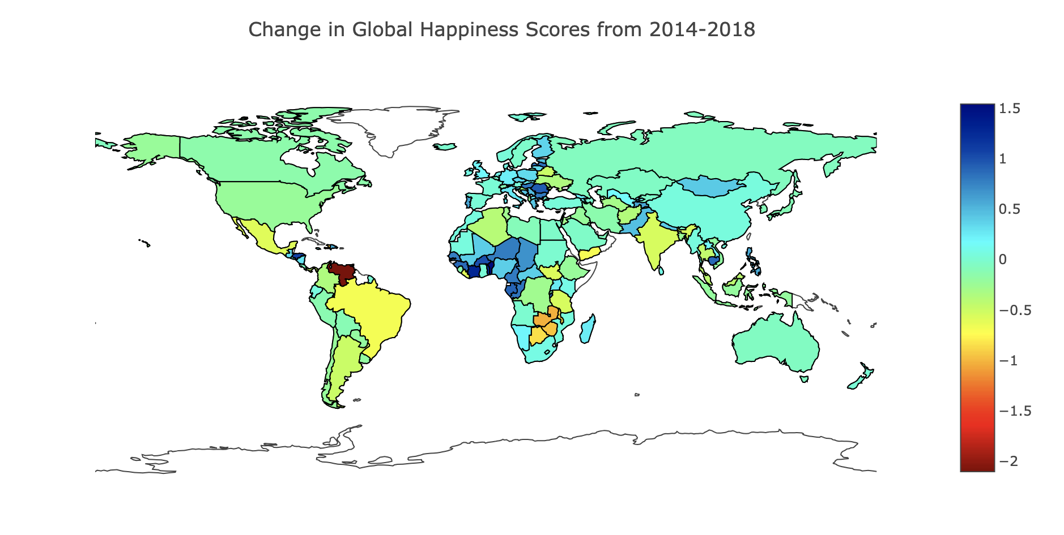
Evaluating Changes in Global Happiness Scores
Venezuela
Notes:
We will use Venezuela as a specific example to evaluate how happiness scores change in response to public policy as it has seen some dramatic changes in the past 10 years. In 2014, it was ranked the 22nd happiest country in the world. Since then, it has fallen 85 spots to 107th and made international headlines with growing concerns over its current socioeconomic crisis.

Slide 5
Happiness Feedback Loop
Socioeconomic Policies Focusing on Happiness
Increased GDP
More Productive and Engaged Citizens
Notes:
Before we touch on any specific measures, let’s recall the happiness feedback loop mentioned at the beginning of this presentation. It asserts that a country with happiness-focused public policy leads to greater social engagement and productivity from its citizens, which in turn increases its GDP, which can then be used to fund additional happiness-focused policies and projects.

Slide 6
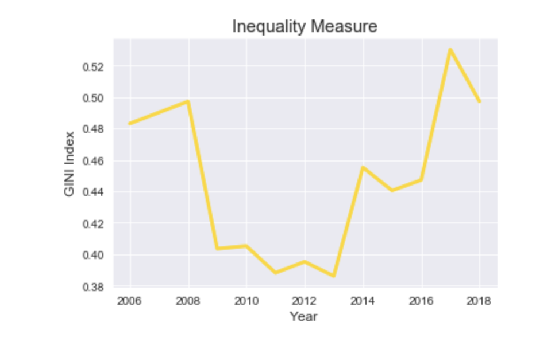
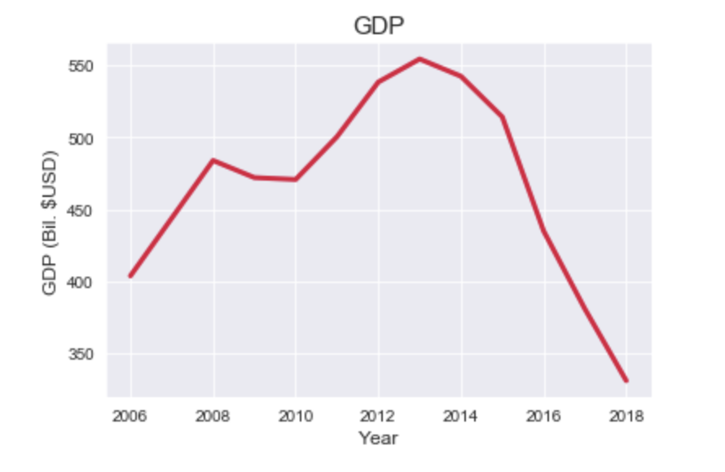
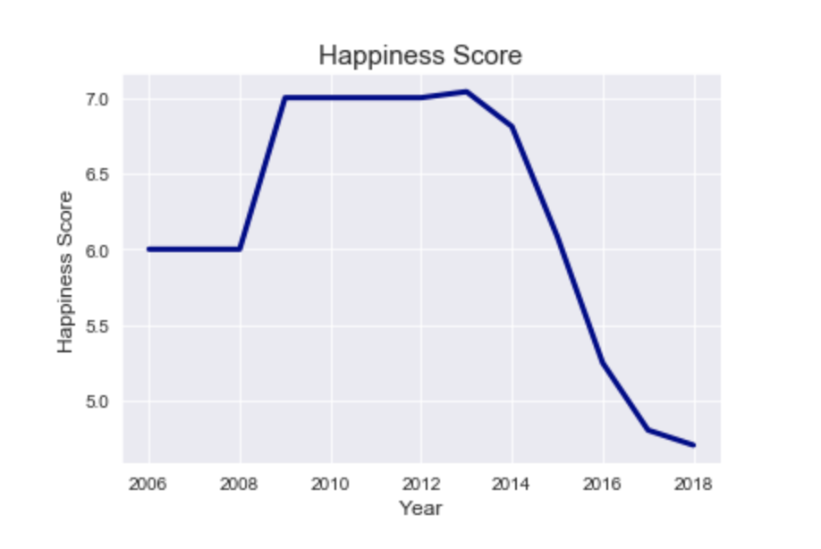
Venezuela
Notes:
These three graphs represent the three points on the happiness feedback loop. The graph at the top of the screen displays the change in Venezuela’s socioeconomic equality from 2006 to 2018. The graph in the bottom right of the screen displays its happiness scores over that same time period and the graph in the bottom left displays its GDP.

Slide 7
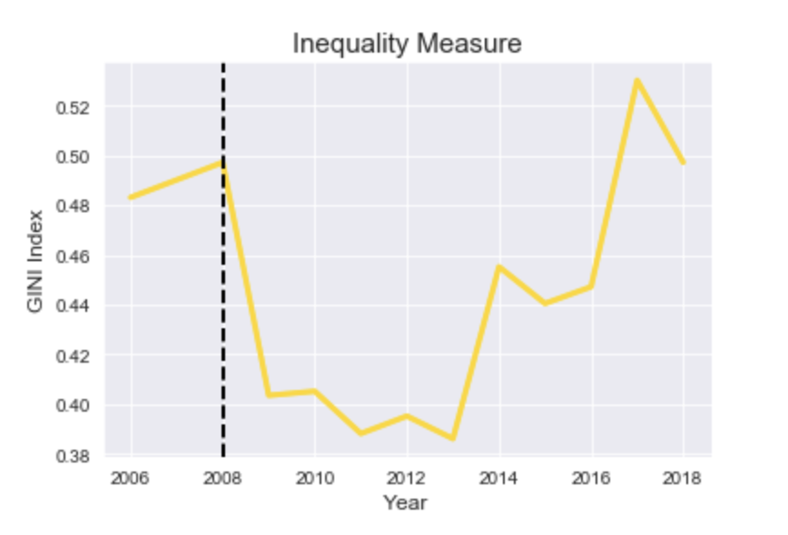
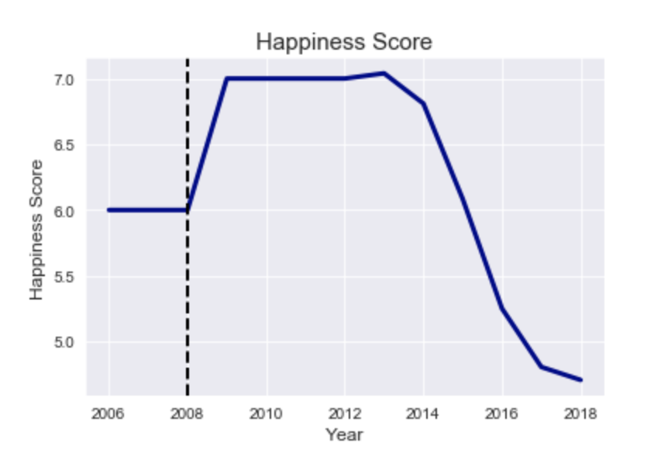
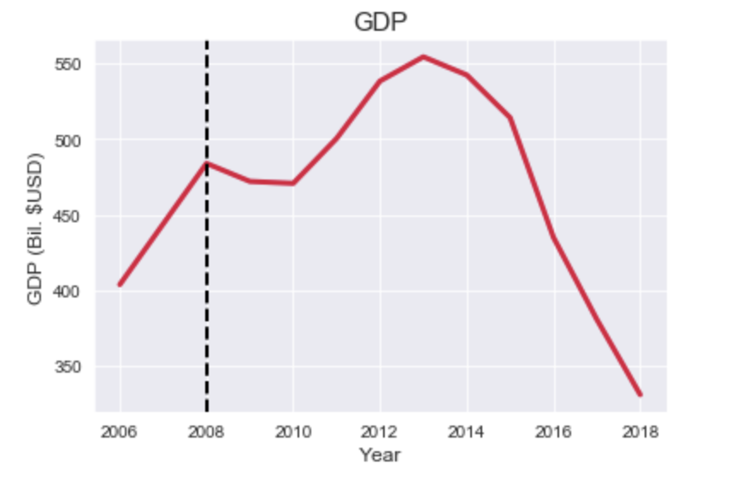
Venezuela
Notes:
Beginning with GDP, we can see a sharp increase between 2006-2008. As Venezuela is one of the world’s leading oil exporters, this is most likely in response to the rebound of oil prices in the early 2000’s. This increased revenue then funded numerous populist social policies that dramatically decreased wealth inequality, as shown by the steep drop in the yellow line in the top graph. This decrease in inequality corresponds with an increase in national happiness as displayed in the bottom right graph.

Slide 8
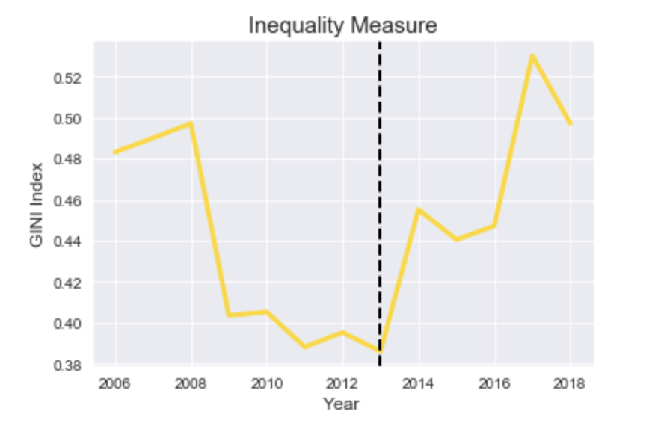
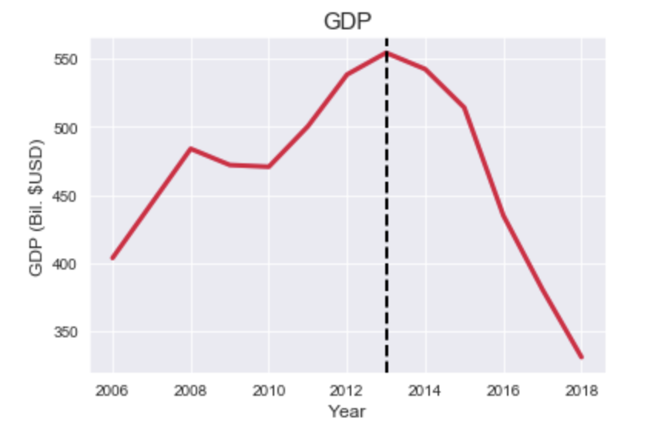
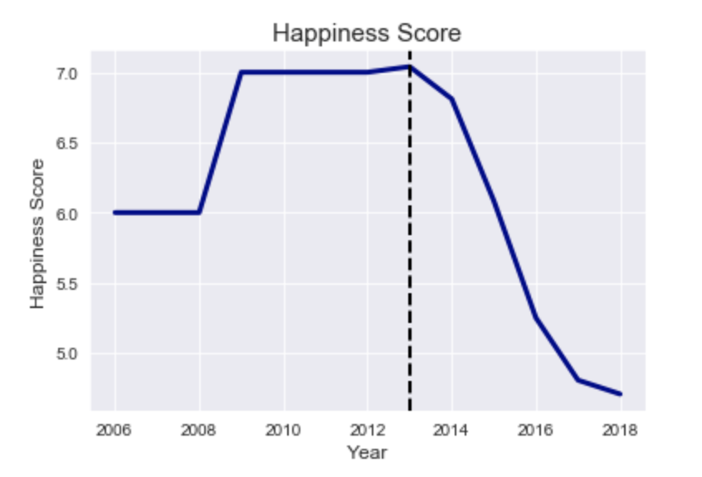
Venezuela
Notes:
Happiness scores remained high until 2013, when a contested election following the death of Hugo Chavez and widespread corruption sent the country on its current downward spiral. The sharp increase seen in the inequality measure aligns with the drastic decrease in both the nation’s happiness scores and GDP. To frame this in the context of the happiness feedback loop. Rising levels of inequality have lead to an unhappy and unproductive economy, which has in turn resulted in a decrease in GDP and thus fewer available funds to invest in prosocial public policies and projects.

Slide 9
Recommendations
Develop public policy centered around increasing happiness
Increase happiness to increase GDP
Allocate revenue from increased GDP to finance more happiness-focused public policy and projects
Notes:
As our walk through Venezuela has shown, there is a strong relationship between public policy, happiness, and GDP. Thus the main take-away from this presentation is that a country can exploit the happiness feedback loop to increase its GDP by developing public policy aimed at fostering happiness.

Slide 10
Future Work
Do other other economic factors influence the happiness feedback loop?
Do the trends hold on a local level?
Transform into a regression model to extrapolate predictions of future happiness
Notes:
The results from this project could be extended in several ways. First, further analysis could be performed to determine which other features of the data have significant influence on happiness so that other sectors of the economy can be incorporated into the feedback loop.
Second, grouping this data on a subnational level could give insight into if the happiness feedback loop is applicable on a smaller scale.
Lastly, transforming this work into a regression model would give the added ability to extrapolate happiness predictions into the future and thus better inform discussions surrounding socioeconomic policies.

Slide 11
Thank You
Questions?

