Slide 1
The Pursuit of Happiness
Informing Public Policy and Predicting Global Needs

Slide 2
Purpose
United Nations Sustainable Development Solutions Network
Money can’t but happiness
Positive feedback loop
Notes:
Since the publication of the Wealth of Nations by Adam Smith in the 1700’s, it has been thought that a nation’s wealth is directly proportional to its citizen's happiness. And for the most part, that is true as 15 of the top 25 happiest countries in 2019 are also in the top 25 countries with the highest GDP. Thus, most current governmental policies are focused on increasing GDP as the main strategy for promoting the happiness of its citizens. However, the Global Happiness report, an annual publication from the United Nation’s Sustainable Development Solutions Network summarizing global happiness measures, has found that while the world is becoming richer as a whole there is still considerable unhappiness and that many of the most affluent nations are actually declining in happiness. In a sense, we now have data to prove the old saying that money can’t buy happiness.
To combat the socioeconomic burden of declining mental health, the Global Council for Happiness and Well-Being analyzes the findings and data from these reports with the aim of creating a framework for government policy makers to follow that will promote happiness in accordance with 17 sustainable development goals. These goals outline a holistic approach to the development of happiness by focusing on fostering equitable and inclusive economies, quality education, accessible healthcare, social protection, and the preservation of the natural environment. The council has found that not only do the policies of the happiest countries align with a majority of the sustainable development goals, but that the citizens of the happiest countries are also more prosocial, engaged in government, and productive. Essentially, happiness breeds more happiness. Because the Global Happiness Report’s initial publication was in 2012, the long-term effects of adhering to the sustainable development goals is unknown. But, being able to model happiness scores for a nation will better inform that nation’s policy makers on developing a stable and productive environment for its citizens.

Slide 3
Model Stacking Schema
Data
Gradient Boosting
SVC
XGBoost
Final Prediction
Predictions
+
Data
???
Random Forest
Logistic Regression
SVC
Base Level Estimators
Metaclassifier
Notes:
The data used for this project was a collection of survey responses to the Gallop World Poll from the citizens of different nations from 2005 to 2018 covering topics such as life expectancy, perceptions of corruption, freedom of choice, and accessibility to social support. The model created to predict the global happiness scores from this data employed a stacking strategy where a collection of base-level classifying models make happiness score predictions, which are then presented along with the original data to a second-level classifying model to make the final happiness prediction. This strategy has been used with significant success in many national data science competitions and was selected for this project to increase the overall accuracy of the model.

Slide 4
Data
Generate Pseudo-Labels
Gradient Boosting
SVC
XGBoost
Final Prediction
Predictions
+
Data
???
Random Forest
Logistic Regression
SVC
Base Level Estimators
Metaclassifier
Notes:
Additionally, while the survey responses from the Gallop World Poll were accessible back to the year 2005 for most countries, only the most recent 5 years of happiness scores were available. Thus, this project utilized a technique called semi-supervised learning where the data points without actual reported happiness scores were given pseudo-labels equal to the predicted happiness scores from the stacked model. This technique is used by major companies such as Google and Microsoft to increase the amount of usable data without having to pay and wait for a human to label the data by hand. Semi-supervised learning was used in this project to increase the performance of the model we created by giving it access to a greater amount of information from the data describing its underlying structure and trends.

Slide 5
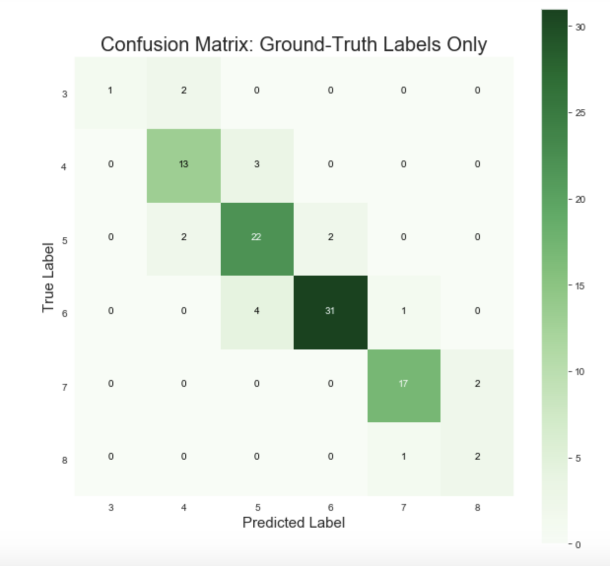
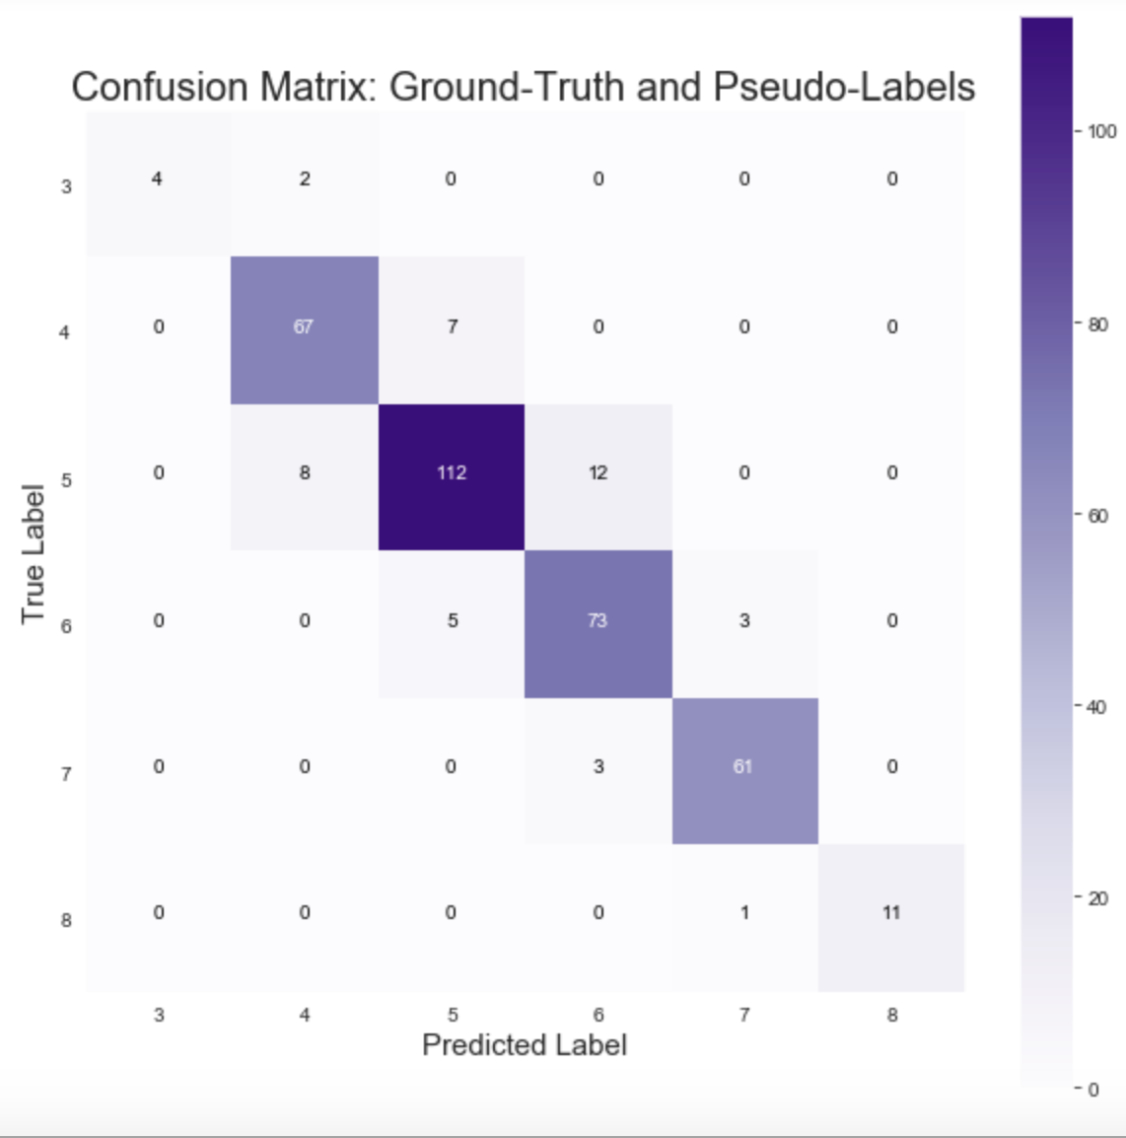
Model Performance
83.5% Accuracy
88.9% Accuracy
Notes:
Our additional efforts were successful as the model trained on the ground-truth labeled and pseudo-labeled data scored 5% higher than the model trained on the ground-truth labels alone. Thus, we can conclude that our model is able to predict the happiness scores of a nation based on the Gallop World Poll survey responses with roughly 90% accuracy.

Slide 6
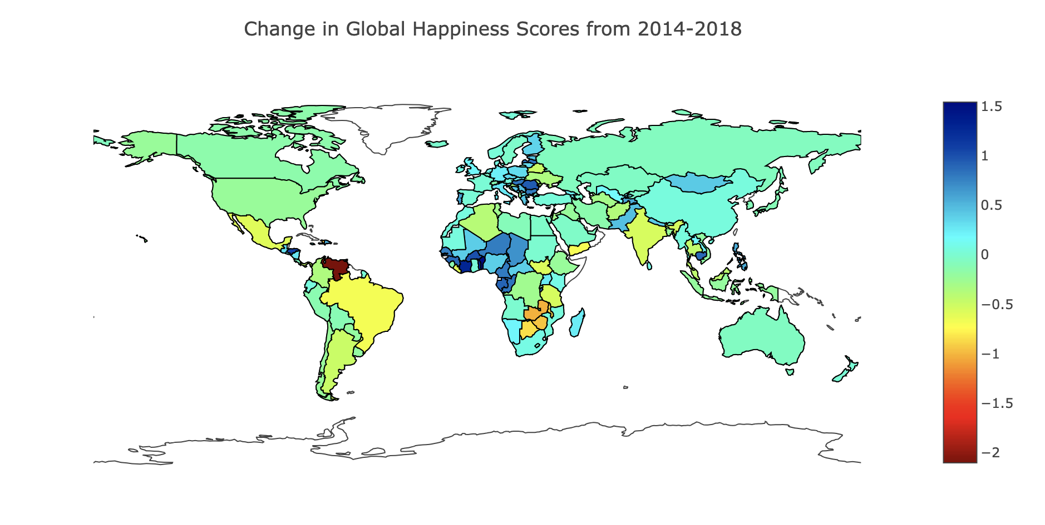
Evaluating Changes in Global Happiness Scores
Venezuela
Benin
Notes:
This graphic displays the change in national happiness scores from 2014 to 2018 where a darker blue equates to a larger increase in happiness scores and a darker red indicates a larger decrease in happiness scores. Please direct your attention to Venezuela and Benin and note that these two countries represent the nations with the greatest negative and positive changes, respectively, to their happiness scores.

Slide 7
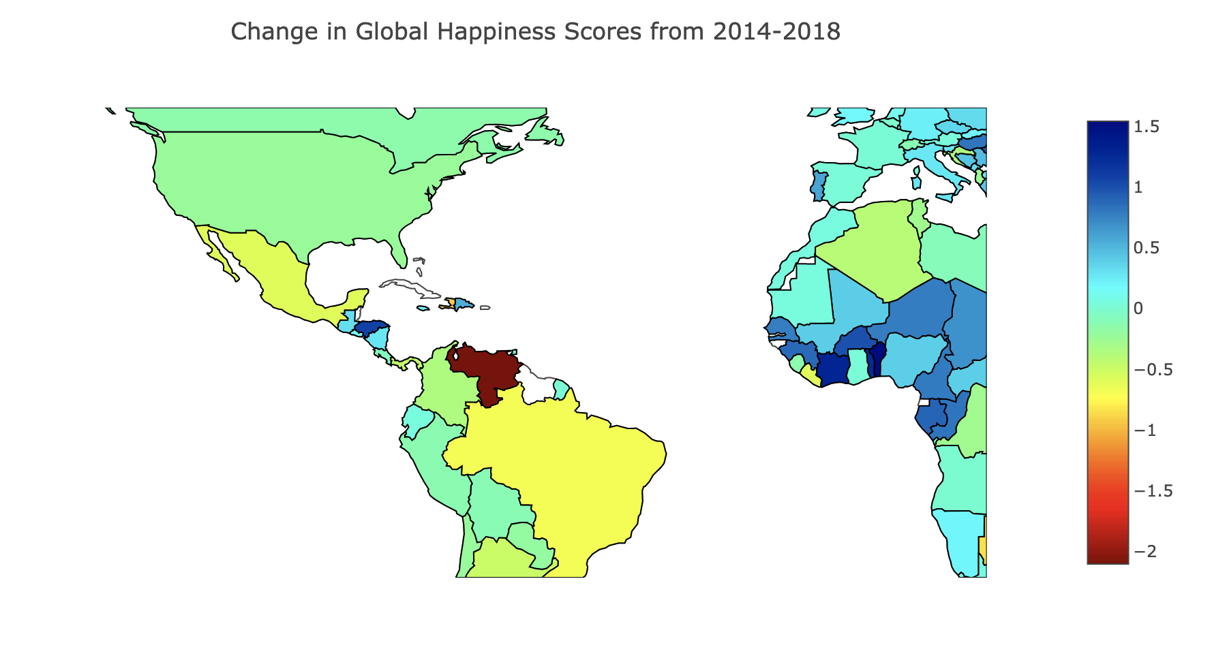
Venezuela
Largest drop since 2014
Debt Rollercoaster
Socioeconomic Crisis
Notes:
In the 2015 Global Happiness Report, Venezuela was ranked 22nd with a happiness score of 6.8. Since then it has fallen 85 spots to 107th in the 2019 report and dropped its happiness score by 2.1 points. The dramatic decline of the happiness of this nation’s citizens is a direct result of it current socioeconomic crisis. Venezuela is currently experiencing shortages of basic goods, increased child mortality and disease, rapidly rising unemployment rates, and unprecedented hyperinflation. Understandably, Venezuelans are unhappy, which has led the the mass emigration of 3 million people to the surrounding countries.
While it is impossible to blame a single policy for the current crisis. Analyzing its recent history may give some insight into what sent Venezuela on this path of decline. Oil was discovered in the country in the early 1900’s and it has been one of the world’s leading exporters ever since. Oil prices dropped in the 1980s in response to a surplus of crude oil, sending the country into a foreign debt crisis and destabilized the economy. Oil prices recovered in the early 2000’s and the government established populist social welfare policies in response to the increased revenue. These policies focused on reducing economic inequality and initially boosted social spending and happiness. However, widespread corruption and diversion of funds away from other sectors of the country not related to increasing oil exports has led to the current crisis.

Slide 8
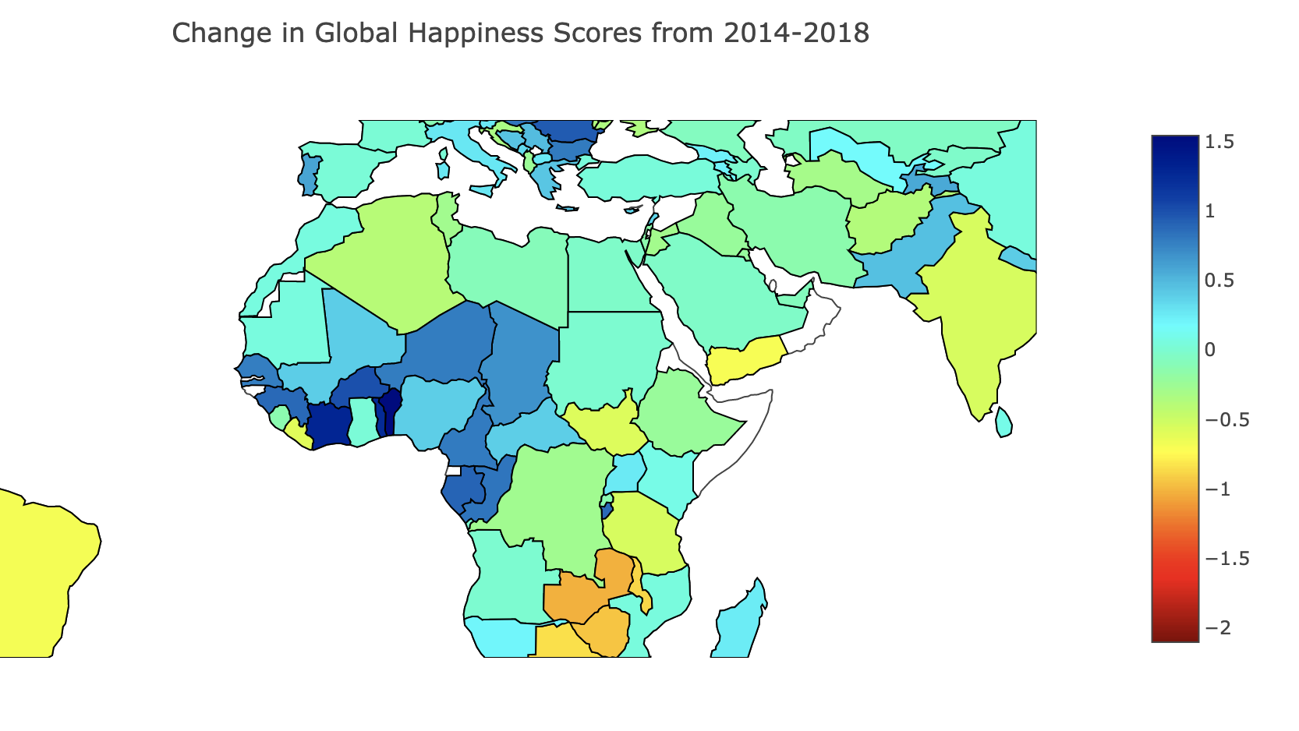
Benin
Largest increase since 2014
Rocky history since gaining independence in 1960
Multiple projects and grants to improve the nation
Notes:
The country of Benin, on the other hand, has shown significant increases in happiness measures since 2014, due in large part to grants aimed at improving many aspects of the nation such as its judicial system, healthcare, and accessibility to the internet. It was awarded 307 million dollars as part of the Millennium Challenge Grant in 2006. These funds went to developing an off-grid clean energy facility, financing small businesses, and investing in the agricultural sector to promote greater access to food in rural areas. Additionally, the recent Bamako initiative directs funds towards the revitalization of the healthcare system and expansion of immunization programs in rural areas. These efforts align with the sustainable development goals, and thus Benin has seen an increase in its happiness scores and global happiness rank since 2014. The country has risen 53 positions and increased its happiness score by 1.5 points.
Increased 1.5 in happiness score since 2014 (3.3– 4.9)
Increased 53 positions in rank since 2014 (154th to 101st)
Former French colony, gained full independence in 1960. since has had different democratic governments, military coups, and was Communist 1975 – 1990. In 1979 had a show election where there was only Mathieu Kerekou on the ballot. During his term, multiple policy changes caused foreign nations to withdraw their investments and for teachers in the country to leave. This reorganization was financed by agreeing to take nuclear waste from the Soviet Union and France.
In 2006, Benin had their first free and fair election and received 307 million dollars as part of the Millenium Challenge Grant to improve their judicial system, international commerce, and financial sector.
Africa Coast to Europe Cable in 2011 (reduce prices of data and increase access to internet)
Bamako Initiative (improvements to health)

Slide 9
Recommendations
Use happiness predictions to identify countries at risk for civil unrest
Inform policy decisions of developing countries
Predict the effects of proposed policy changes
Notes:
Since there is a correlation between unhappiness and displays of civil unrest, a model that is able to predict happiness scores could be used to identify countries at risk of turmoil and give international governing bodies more time to plan for the repercussions or coordinate an intervention.
Additionally, the model built as part of this project could be used to predict the effects of proposed policy changes and thus guide their implementation
Lastly, the insights gained from tracking and predicting the effects of policy changes could help guide the development countries recovering from turmoil to encourage stability.
1. Direct resources and intervene

Slide 10
Future Work
Determine which features have the most influence on happiness scores
Correlate with emigration data
Transform into a regression model to extrapolate predictions of future happiness
Notes:
The results from this project could be extended in several ways. First, further analysis could be performed to determine which features of the data have the most influence on happiness scores and thus direct immediate policy changes in those areas of struggling countries.
Second, it is human nature to try to avoid a source of unhappiness. The data used in this project could be combined with emigration data to better predict levels of emigration so that international governing bodies can allocate aid and resources to the nations most likely to receive the migrating people.
Lastly, the data is available to transform this classification model into a regression model. This would give the added ability to extrapolate happiness predictions into the future and better inform discussions surrounding socioeconomic policies.
2. Allocate aid and resources

Slide 11
Thank You
Questions?

