Slide 1
NFL Player Evaluation
Team: Melaku Dubie, Rich Lee, Long Chen, Kivan Polimis

Slide 2
nflgame’s appeal

Slide 5
How nflgame works

Slide 6
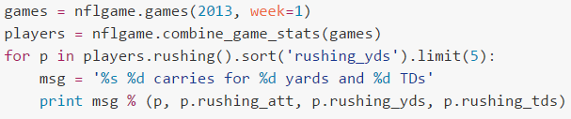
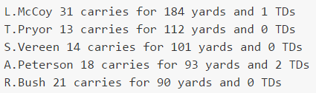
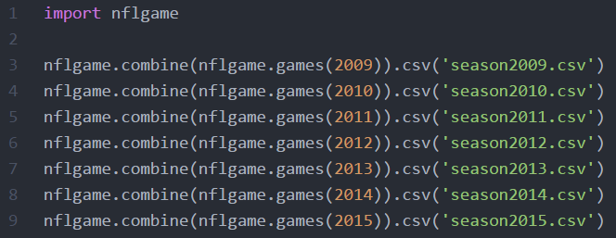

Slide 7
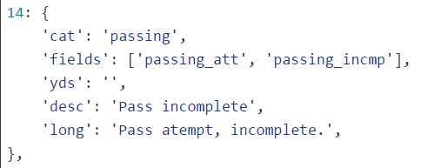
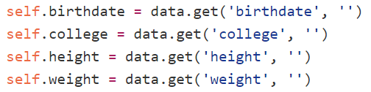
Game data from NFL.com GameCenter live JSON feed (2009-2015)
Player information populated from NFL.com profile pages

Slide 8
Drawbacks of nflgame

Slide 11
Title Goes Here
Subtitle Goes Here

