Slide 1
LSTM in time series
khanhphamdinh, Ha Noi, 2021

Slide 2
Content
Application of RNN
RNN architecture
LSTM/GRU architecture
Practice

Slide 3

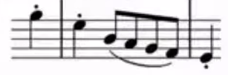

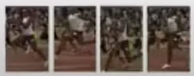
Application RNN
The quick brown fox jumped over the lazy dog
Speech Recognition
Genre generation
Sentiment Analysis Classification
DNA sequence analysis
Machine learning translation
Video activity recognition
Name Entity Recognition
nothing
I very like this movie
AGCCCTGTGAGGATCAAG
AGCCCTGTGAGGATCAAG
c'est un excellent élève dans cette classe
he is an excellent student in this class
running
Yesterday, Harry Potter meet me in my dream
Yesterday, Harry Potter meet me in my dream

Slide 4
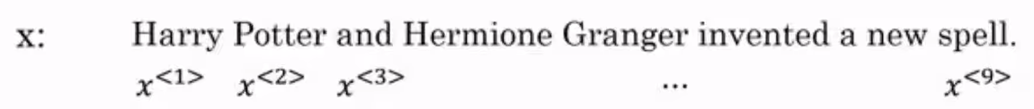
Name Entity Recognition
Training example
1 1 0 1 1 0 0 0 0
y:

Slide 5
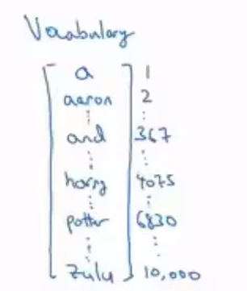
Name Entity Recognition
Embedding for input based on dictionary

Slide 6
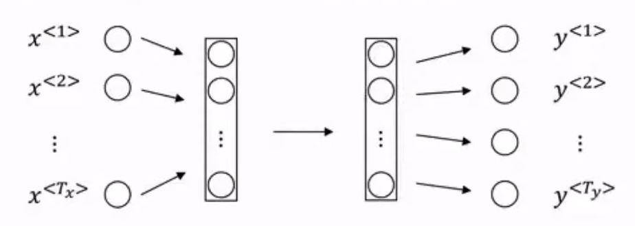
Why not standard neural network?
Problem:
Input and output can have a different length in different examples
do not share weight across the different position of text.

Slide 7
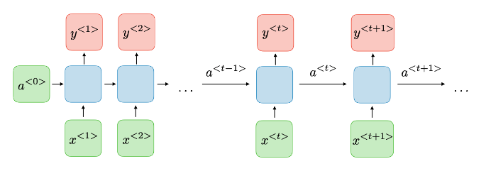
RNN architecture
1. Architecture
https://stanford.edu/~shervine/teaching/cs-230/cheatsheet-recurrent-neural-networks

Slide 8



RNN architecture
2. Feed Forward
Activation value at t timestep:
Predict value timestep:
Shared coefficients:
https://stanford.edu/~shervine/teaching/cs-230/cheatsheet-recurrent-neural-networks

Slide 9
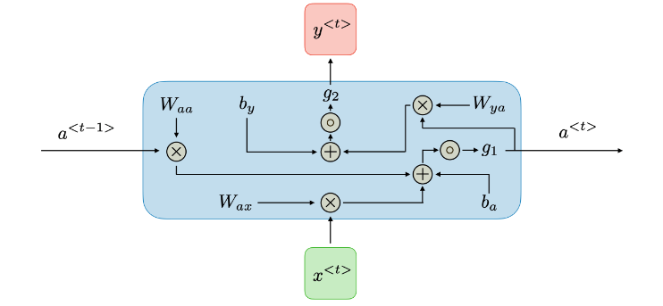
RNN architecture
2. Feed Forward
Activation value at t timestep:
Predict value timestep:
Shared coefficients:
https://stanford.edu/~shervine/teaching/cs-230/cheatsheet-recurrent-neural-networks

Slide 10
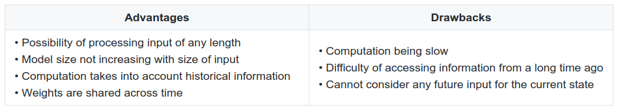
RNN Pros and cons
https://stanford.edu/~shervine/teaching/cs-230/cheatsheet-recurrent-neural-networks

Slide 11
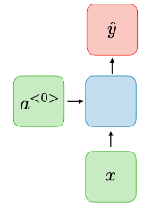
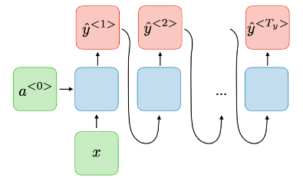
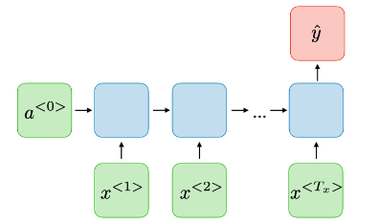
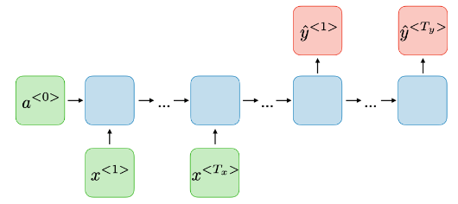
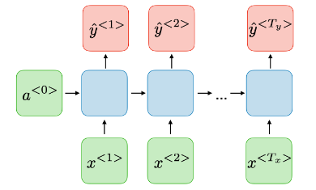
RNN type
one-to-one
one-to-many
many-to-one
many-to-many (Tx >< Ty)
many-to-many (Tx == Ty)
https://stanford.edu/~shervine/teaching/cs-230/cheatsheet-recurrent-neural-networks

Slide 12
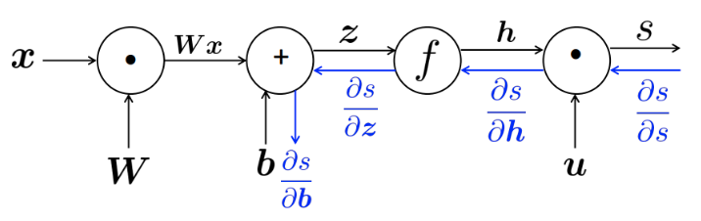
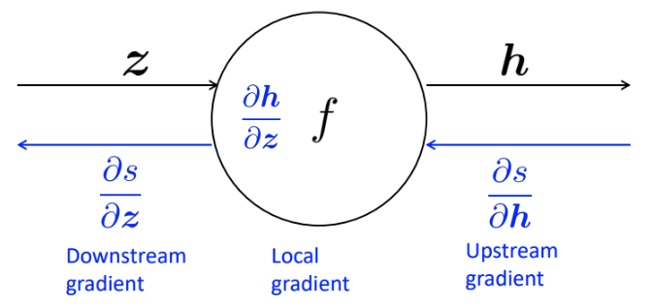

RNN
3. Back propagation
chain rule:
https://stanford.edu/~shervine/teaching/cs-230/cheatsheet-recurrent-neural-networks

Slide 13



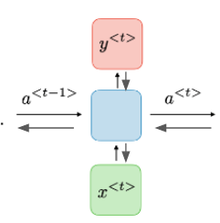




RNN
3. Back propagation
Loss function:
Derivative:
https://stanford.edu/~shervine/teaching/cs-230/cheatsheet-recurrent-neural-networks

Slide 14
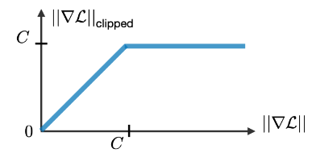

LSTM/GRU
1. Vanishing/exploding gradient: Usually happen in RNNs
Multiplicative gradient can be exponentially decreasing/increasing
Long term dependency is difficult to capture
2. How to fix it?
Gradient clipped
Applied special types of gates

Slide 15
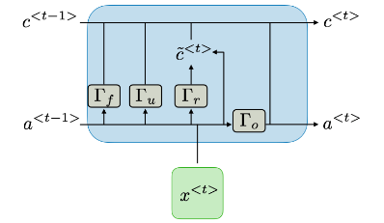
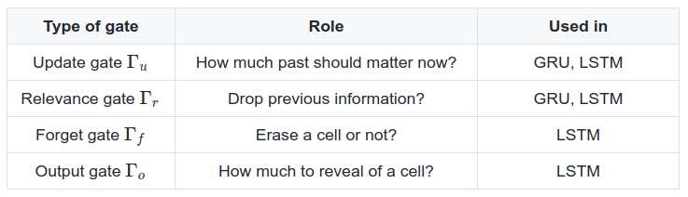
LSTM/GRU
2. Types of gates in LSTM/GRU
LSTM unit

Slide 16
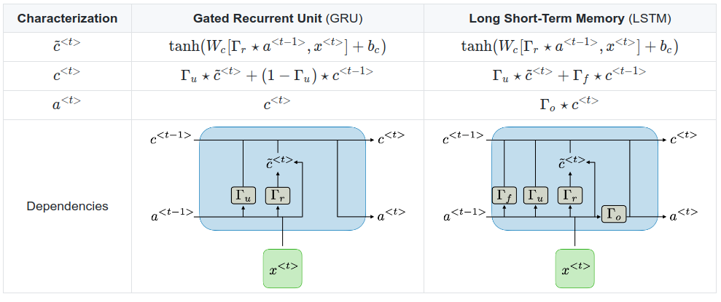
LSTM/GRU
2. Types of gates in LSTM/GRU

Slide 17
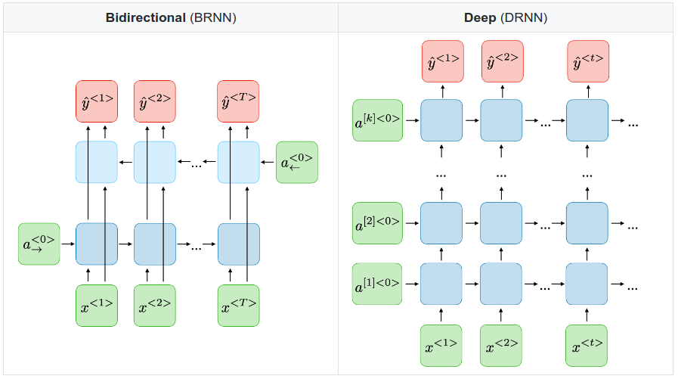
Variants of RNNs

Slide 18
Practices
https://colab.research.google.com/drive/1DQxRD1myBMvNMUsedEl5GxO5dwoIB3wl?usp=sharing
times
t=1
t=2
...
t=n
time step

