Slide 1


Slide 2
Model Deployment

Slide 3
Content
tflite
Model Maker on colab notebook
Deploy model in java

Slide 4


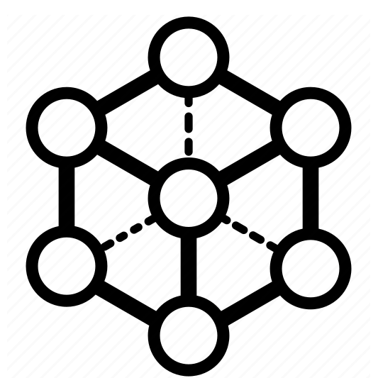
Train a flower recognizer using Colab
tflite-model-maker is a library simplifying the process of training and converting a TensorFlow neural-network into tflite model.
You can deploy this model for on-device ML applications.
Model maker Colab Notebook
Input dataset
tflite-model-maker library
tflite model
android application

Slide 5
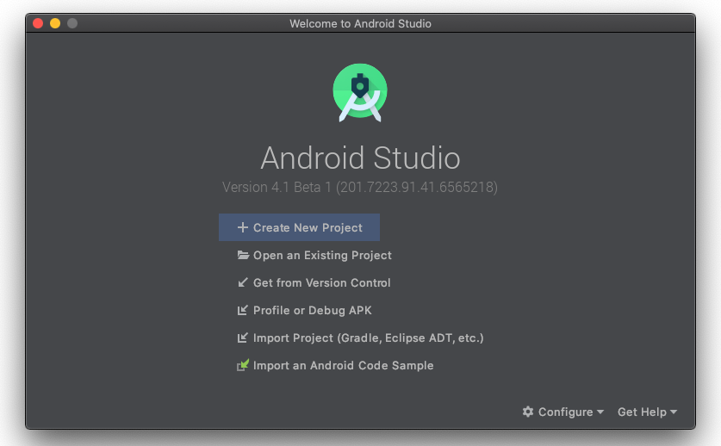
Set android skeleton app
Clone repository:
git clone https://github.com/hoitab/TFLClassify.git
Install android 4.1 or above:

Slide 6
Set android skeleton app
Build gradle:
gradle is an advanced toolkit that defines the dependencies and custom build logic.
Android skeleton app

