Slide 1

Face Recognition
Khanh Pham Dinh
Hà Nội, 18/03/2021,

Slide 2
Content
Definition of Face Recognition
One shot learning
Siam network
Triplet loss function
Choose triplet (A, P, N)

Slide 3
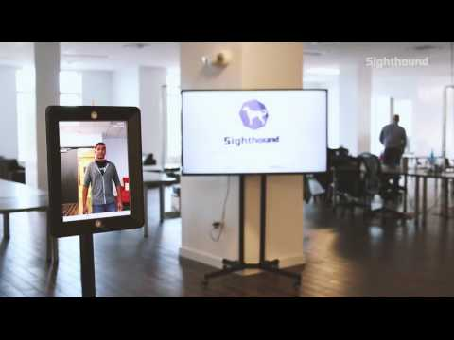
Face Application
A demo of face recognition system

Slide 4
Face Recognition vs Face Verification
Verification:
Input image, name/ID
Output whether the input image is that of the claimed person
→ Unlock door, phone, application
Recognition:
Has a database of K person
Get an input image
Output ID if an input image belongs to any of K persons (or “not recognized”)
→ Timekeeping in office, managing classroom.

Slide 5
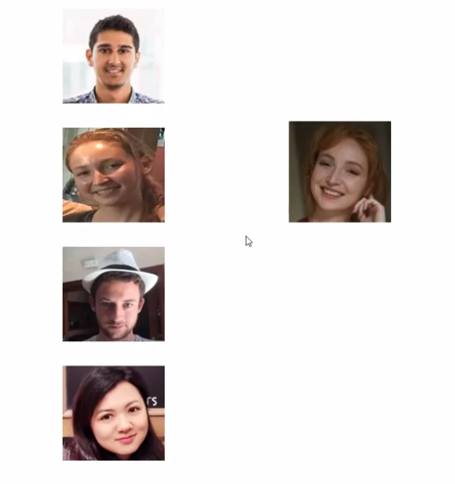
One-shot learning
You only use one image of each person to recognize who they are.
Need to train a network to recognize who is the new image?
New image
Input images

Slide 6
One-shot learning
You only use one image of each person to recognize who they are.
K+1 probability scores
(for K people and 1 unknown)
Input images
CNN network
Softmax distribution

Slide 7
One-shot learning
You only use one image of each person to recognize who they are.
Disadvantage: Have to retrain network each time have a newone.
K+1 probability scores
(for K people and 1 unknown)
Input images
CNN network
Softmax distribution

Slide 8
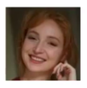
Learning a similarity function
Train a network to find a embedding vector representing to each person.
CNN model
Embedding vector
Define d(image1, image2) = degree of difference between image 1 vs image 2
Verification task:
d(image1, image2) >= r → not matched
d(image1, image2) < r → matched
Recognition task:
8.0
0.1
5.0
2.0

Slide 9
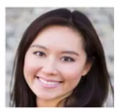
Learning a similarity function
Train a network to find a embedding vector representing to each person.
CNN model
Embedding vector
Define d(image1, image2) = degree of difference between image 1 vs image 2
Verification task:
d(image1, image2) >= r → not matched
d(image1, image2) < r → matched
Recognition task:
8.0
7.0
d(img, target) > r, for all img
→ unknown
5.0
2.0

Slide 10

Siamese network
Forwarding a pair of images in the identical CNN network and then comparing them is siamese network.
Difference between two images
shared weights
Yaniv Taigman, DeepFace: Closing the Gap to Human-Level Performance in Face Verification, CVPR 2014

Slide 11
Siamese network - The goal of learning
Define an encoding of image x → f(x)
Learning parameter so that:
If belong to same person: is small
If belong to different people: is large
Yaniv Taigman, DeepFace: Closing the Gap to Human-Level Performance in Face Verification, CVPR 2014

Slide 12
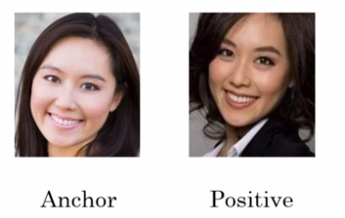
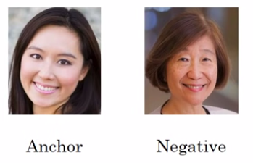

Triplet loss
Define triplet (Anchor, Positive, Negative):
Anchor: a representative image of each person
Positive: image of person who is the same as Anchor person
Negative: image of person who is different from Anchor person
Our expectation:
Anchor and Positive is similarity: d(A, P) is low
Anchor and Negative is different: d(A, N) is high
Target of training:
f(X) is
representative function
What unexpected representative function can happen?
Florian Schroff, et al, FaceNet: A Unified Embedding for Face Recognition and Clustering, CVPR 2015

Slide 13
Triplet loss
Define triplet images (Anchor, Positive, Negative):
Anchor: a representative image of each person
Positive: image of person who is the same as Anchor person
Negative: image of person who is different from Anchor person
Our expectation:
Anchor and Positive is similarity: d(A, P) is low
Anchor and Negative is different: d(A, N) is high
Target of training:
f(X) is
representative function
What unexpected representative function can happen?
Florian Schroff, et al, FaceNet: A Unified Embedding for Face Recognition and Clustering, CVPR 2015

Slide 14
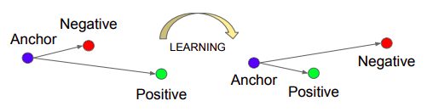
Triplet loss
Plus a positive margin to avoid the identical zero function:
⇒ In order to satisfy the condition: A and P must be pulled into similarity, simultaneously A and N must be pushed away.
Florian Schroff, et al, FaceNet: A Unified Embedding for Face Recognition and Clustering, CVPR 2015

Slide 15
Triplet loss
Input is a triplet loss (A, P, N). Need to minimize the loss function:
Why we need maximum function in outside ?
With triplet (A, P, N) satisfies:
⇒ We do not need to care about learning representation because they can be easily discriminated
With triplet (A, P, N) satisfies:
⇒ triplet is hard case and we need to reduce distance between negative loss and anchor in order to reduce the loss function.
Florian Schroff, et al, FaceNet: A Unified Embedding for Face Recognition and Clustering, CVPR 2015

Slide 16
Triplet loss
Input is a triplet loss (A, P, N). Need to minimize the loss function:
Sample triplets (A, P, N) from training dataset X (for example 10k images per 1k people) to minimize total loss function:
Notice: To train model, a person requires at least two anchor (A) and positive (P) images
Florian Schroff, et al, FaceNet: A Unified Embedding for Face Recognition and Clustering, CVPR 2015

Slide 17
Choose Triplets (A, P, N)
If we randomly choose (A, P, N):
The condition can be easy to satisfy.
Need to select hard triplets (A, P, N):
Increase the left hand side d(A, P): Anchor and Positive image must be different.
Or decrease the right hand side d(A, N): Negative image is very similar to Anchor image.
⇒ Apply choosing hard triplets can increase computational efficiency of learning algorithm
Florian Schroff, et al, FaceNet: A Unified Embedding for Face Recognition and Clustering, CVPR 2015

Slide 18
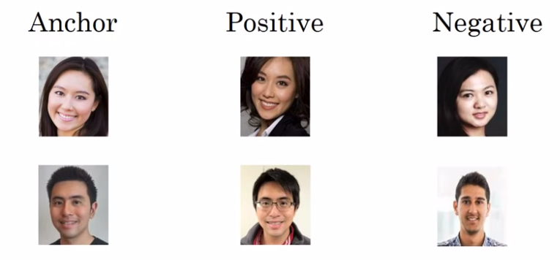
Summarization
Choose triplet (A, P, N) in which:
Anchor: a representative image of each person
Positive: image of person who is the same as Anchor person
Negative: image of person who is different from Anchor person
Expect to choose hard cases, means that: A and P is similar; A and N is different
Use gradient descent to minimize total loss function and update weights of neural network through back propagation.
.
.
.
.
.
.
.
.
.
Florian Schroff, et al, FaceNet: A Unified Embedding for Face Recognition and Clustering, CVPR 2015

Slide 19
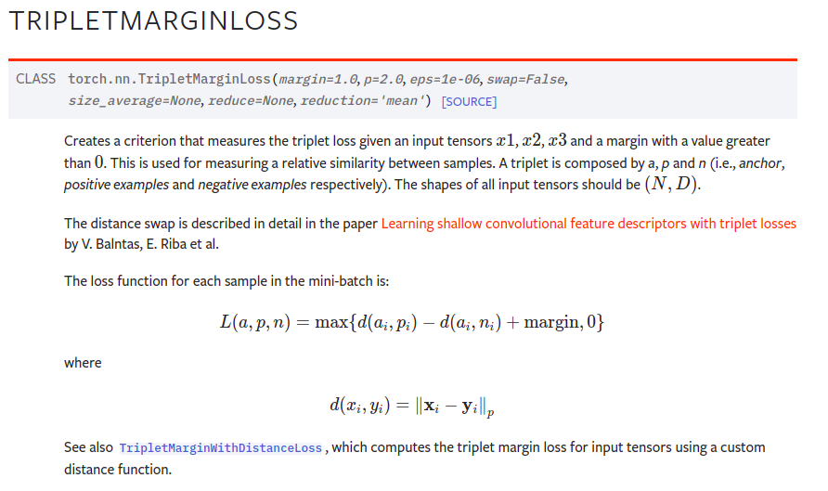
Triplet lost in pytorch
torch.nn.TripletMarginLoss

Slide 20
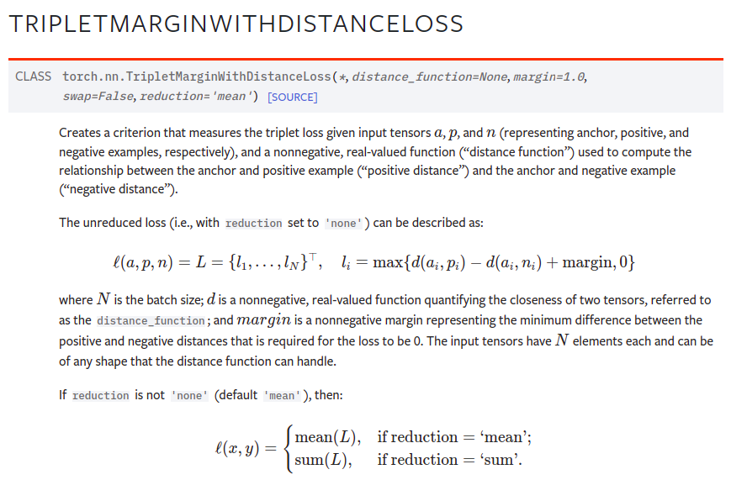
Triplet lost in pytorch
torch.nn.TripletMarginWithDistanceLoss

Slide 21
Repo Face Recognition
Siamese triplet:
https://github.com/adambielski/siamese-triplet
Facenet:
https://github.com/davidsandberg/facenet
https://github.com/timesler/facenet-pytorch
https://github.com/tamerthamoqa/facenet-pytorch-glint360k
Deepface:
https://github.com/serengil/deepface
https://github.com/iperov/DeepFaceLab
Triplet Loss:
https://github.com/CoinCheung/pytorch-loss/blob/master/triplet_loss.py
Papers with code:
https://paperswithcode.com/task/face-recognition

