Slide 1
Lab 3. Dynamic Memory Manager Module System Programming Assignment
Juyoung Park
SNU TNET Lab.

Slide 2
What Have You Learned
#include <stdlib.h> void *malloc(size_t size); void free(void *ptr);
0
Heap
p1
char *p1 = malloc(3);
char *p2 = malloc(1);
char *p3 = malloc(4);
free(p2);
char *p4 = malloc(6);
free(p3);
char *p5 = malloc(2);
free(p1);
free(p4);
free(p5);
p2
}
p3
p4
Heap
Stack
0xffffffff
2

Slide 3
What Have You Learned
Stack
Shared libraries
Run-time heap managed by libc
Read/write data
Read-only code and data
User application
User space
malloc(), calloc(), realloc(), free(), sbrk()
C standard library
end of heap
managed by kernel
at request of libc
Kernel
System call interface
brk/mmap
Kernel space

Slide 4
What Have You Learned
K&R Heap Manager
Free list
In
use
In
use
8
In
use
50
20

Slide 5
Dynamic Memory Manager Module
Build a library that implements malloc() and free()
Without using GNU malloc(), free(), calloc(), or realloc()
The code for your reference(heapmgrgnu.c, heapmgrkr.c) and baseline code (heapmgrbase.c) will be given
Guidance on the assignment can also be found on README.md

Slide 6
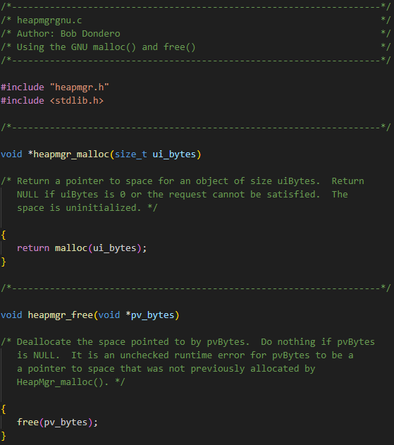
Given Code - heapmgrgnu.c
Implementation that simply calls the GNU malloc() and free()

Slide 7
Given Code - heapmgrkr.c
Kernighan and Ritchie (K&R) implementation
With small modification for the sake of simplicity
void *heapmgr_malloc(size_t nbytes)
void heapmgr_free(void *ap)
Header *morecore(unsigned int nu)
A circular, singly-linked list

Slide 8
Given Code - heapmgrbase.c
Implements baseline code
You can start the task with this code
void *heapmgr_malloc(size_t size)
void heapmgr_free(void *m)
int check_heap_validity(void)
Validity check for entire data structures for chunks
Other functions for implementation
A non-circular, singly-linked list

Slide 9
Chunk Structure
/* chunkbase.h */
typedef struct Chunk *Chunk_T;
/* chunkbase.c */
struct Chunk {
/* Pointer to the next chunk in the free chunk list */
Chunk_T next;
/* Capacity of a chunk (chunk units) */
int units;
/* CHUNK_FREE or CHUNK_IN_USE */
int status;
};

Slide 10
Chunk and Block
Chunk: base unit for allocate memory
Block: set of contiguous chunks that store same data
Free blocks are connected in a linked list
which is called a free list

Slide 11
Useful Functions in chunkbase.c & chunkbase.h
chunk_get_status(Chunk_T c)
Returns a chunk's status
chunk_set_status(Chunk_T c, int status)
Set the status of the chunk
chunk_get_units(Chunk_T c)
Returns the size of a chunk
chunk_set_units(Chunk_T c, int units)
Sets the current size in 'units' of 'c'

Slide 12
Useful Functions in chunkbase.c & chunkbase.h
chunk_get_next_free_chunk(Chunk_T c)
Returns the next free chunk in free chunk list
chunk_set_next_free_chunk(Chunk_T c, Chunk_T next)
Sets the next free chunk of 'c' to 'next'
chunk_get_next_adjacent(Chunk_T c, void *start, void *end)
Returns the next adjacent chunk to 'c' in memory space
chunk_is_valid(Chunk_T c, void *start, void *end);
Checks the validity of a chunk

Slide 13
Given Code - heapmgrbase.c
int check_heap_validity(void)
Checks the validity of chunk data structures (chunk: a base unit for allocation)
Returns 1 on success or 0 (zero) on failure
assert(condition);
If “condition” evaluates to false, the program will print an error message and terminate
heapmgrbase.c calls assert(check_heap_validity())
At leading and trailing edges of heapmgr_malloc() and heapmgr_free()
Checks the integrity of the heap
If this assert() fails, it implies that something’s wrong

Slide 14
Your to-do: Make free() faster
Base requirement for assignment 3 (write code in heapmgr1.c)
Implement a doubly-linked free list with the chunk data structure
Each block now contains a header and a footer (as described in lectures)
Chunk is a base unit (e.g., allocate memory in multiples of this unit)
h
e
a
d
f
o
o
t
Notes:
Linear search ( O(N) ) / O(1)

Slide 15
Your to-do: Make free() faster
Header
Size of the block (in # of units)
Flag indicating whether the block is free or in use
A pointer to the next free block
Footer
Size of the block (in # of units)
A pointer to the previous free block
heapmgr1.c (with footer) should make free() faster
Without needing to find/maintain the “previous” node for inserting a freed memory into the free list (K&R)
h
e
a
d
f
o
o
t
Notes:
Linear search ( O(N) ) / O(1)

Slide 16
Navigating Next Contiguous Block
Start with the user’s data portion of the block
Go backwards to the head of the block
Easy, since you know the size of the header
Go forward to the head of the next block
Easy, since you know the size of the current block

Slide 17
Navigating Previous Contiguous Block
Start with the user’s data portion of the block
Go backwards to the head of the block
Easy, since you know the size of the header
Go backwards to the footer of the previous block
Easy, since you know the size of the footer
Go backwards to the header of the previous block
Easy, since you know the size from the footer

Slide 18
Navigating Next Free Block
Start with the user’s data portion of the block
Go backwards to the head of the block
Easy, since you know the size of the header
Go forwards to the next free block
Easy, since you have the next free pointer

Slide 19
Navigating Previous Free Block
Start with the user’s data portion of the block
Go backwards to the head of the block
Easy, since you know the size of the header
Go forwards to the footer of the block
Easy, since you know the block size from the header
Go backwards to the previous free block
Easy, since you have the previous free pointer

Slide 20
Strategy for Implementing heapmgr1.c
You can start with heapmgrbase.c and enhance it
Or you can ignore heapmgrbase.c and do your own way
You can implement either circular or non-circular list

Slide 21
Extra-credit: Make malloc() faster
heapmgr1.c shows poor worst-case behavior, so try to enhance it
Finding the free block will traverse the list in heapmgr1.c
Use multiple doubly-linked lists, alias bins (as described in lectures)

Slide 22
Strategy for Binning
How to set the range of sizes covered by bin?
Fixed: 1-10, 11-20, 21-30, …
Exponential: 1-2, 3-4, 5-8, 9-16, …
How to handle the newly allocated large memory?
Split into small chunks in advance
Allocate in large bin and wait for split in malloc()
How to coalesce when free() from binning?
Check after coalesce and move to proper bin
Move to final bin first and coalesce

Slide 23
Memory Utilization
Implement the strategies for good memory utilization
All techniques learned in class
Check blocks in free list before allocate new memory
Divide the free block if free block is bigger then requested
Check lower/upper neighbor and coalesce
If you ignore memory utilization, you won't get points no matter how fast your implementation is

Slide 24
Given Codes
/reference: reference and baseline codes
heapmgr.h simply declares heapmgr_malloc()/free() function
/src: chunk.c, chunk.h
almost empty
/test: codes to test your implementation
testheapimp / testheap1 / testheap2 : Bash shell scripts
testheapmgr.c: a client program that tests the heapmgr module
assignment3
|- reference
| |- chunkbase.c / chunkbase.h
| |- heapmgr.h
| |- heapmgrgnu.c / heapmgrkr.c
| `- heapmgrbase.c
|- src
| `- chunk.c / chunk.h
|- test
| |- heapmgr.h
| |- testheapimp / testheap1 / testheap2
| `- testheapmgr.c
|- readme.md
`-Makefile

Slide 25
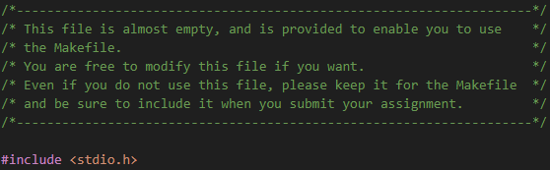
Given chunk.c and chunk.h
You can find chunk.c and chunk.h in /src which are almost empty

Slide 26
Given chunk.c and chunk.h
You can find chunk.c and chunk.h in /src which are almost empty
heapmgrbase.c uses chunkbase.c and chunkbase.h to use ‘struct Chunk’ and functions
If you use heapmgrbase.c as baseline code, you can use chunkbase.c and chunkbase.h for chunk.c and chunk.h
If you do not use heapmgrbase.c, you have two choices:
1. Define useful structures and functions in chunk.c and chunk.h and use them
2. Just leave chunk.c and chunk.h as is for Makefile

Slide 27
How to Test Your Code
To test your heapmgr implementations:
$ gcc800 -std=gnu99 testheapmgr.c heapmgr1.c chunk.c -o testheapmgr1
$ gcc800 -std=gnu99 testheapmgr.c heapmgr2.c chunk.c -o testheapmgr2
To collect timing statistics:
$ gcc800 -O3 -D NDEBUG -std=gnu99 testheapmgr.c heapmgrgnu.c -o testheapmgrgnu
$ gcc800 -O3 -D NDEBUG -std=gnu99 testheapmgr.c heapmgrkr.c -o testheapmgrkr
$ gcc800 -O3 -D NDEBUG -std=gnu99 testheapmgr.c heapmgrbase.c chunkbase.c -o testheapmgrbase
$ gcc800 -O3 -D NDEBUG -std=gnu99 testheapmgr.c heapmgr1.c chunk.c -o testheapmgr1
$ gcc800 -O3 -D NDEBUG -std=gnu99 testheapmgr.c heapmgr2.c chunk.c -o testheapmgr2
Don't forget -std=gnu99 ; otherwise you'll get error while compiling

Slide 28
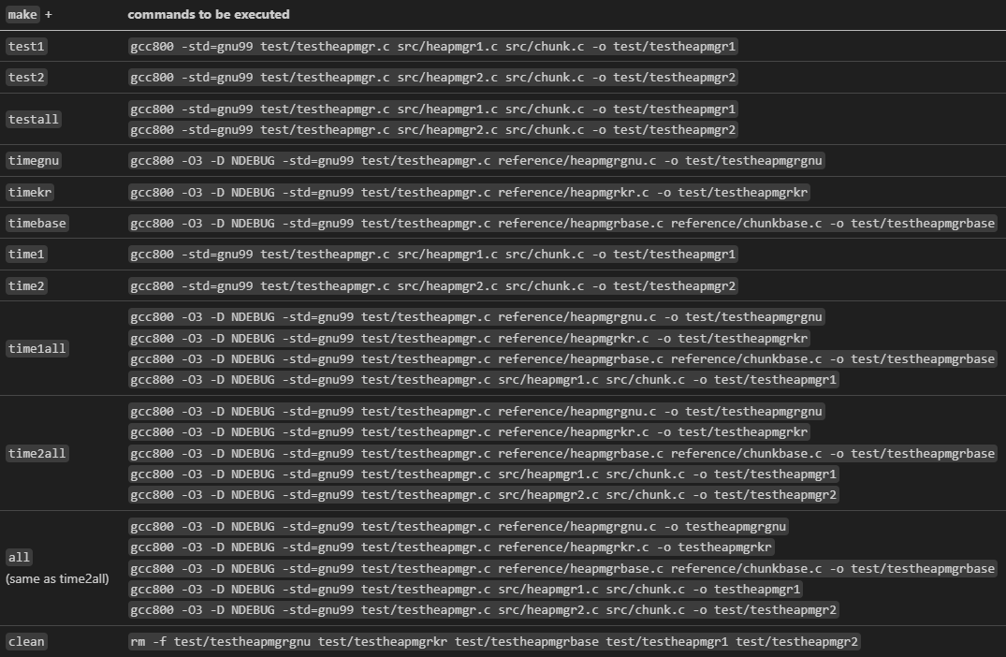
How to Test Your Code
You can also use Makefile to build executable files

Slide 29
How to Test Your Code
If you want to use Makefile, move the codes you implemented (chunk.c, chunk.h, heapmgr1.c, hepmgr2.c) in /src
You don’t need to move the existing codes
Executable files will be created in the /test
assignment3
|- reference
| |- chunkbase.c / chunkbase.h
| |- heapmgr.h
| |- heapmgrgnu.c / heapmgrkr.c
| `- heapmgrbase.c
|- src
| |- chunk.c / chunk.h
| `- heapmgr1.c / heapmgr2.c
|- test
| |- heapmgr.h
| |- testheapimp / testheap1 / testheap2
| `- testheapmgr.c
`-Makefile

Slide 30
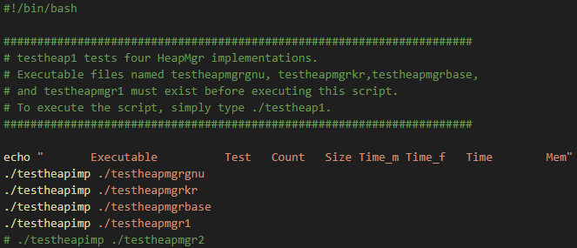
How to Test Your Code
Bash shell scripts (testheap1 & testheap2) provided in /test
testheap1 test four cases (heapmgrgnu, heapmgrkr, heapmgrbase, heapmgr1) and reports timing and memory usage statistics, with call count 50000, and with maximum chunk sizes 1000 and 10000

Slide 31
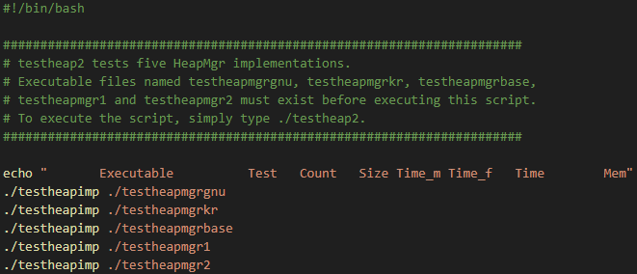
How to Test Your Code
testheap2 test five cases (heapmgrgnu, heapmgrkr, heapmgrbase, heapmgr1, and heapmgr2) and reports timing and memory usage statistics, with call count 50000, and with maximum chunk sizes 1000 and 10000

Slide 32
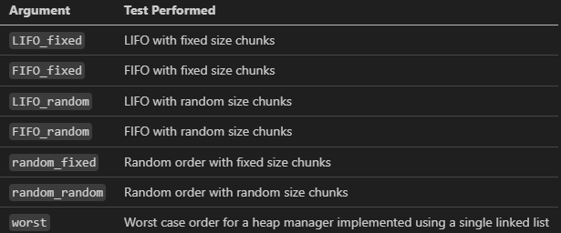
How to Test Your Code

Slide 33
How to Test Your Code
$ ./testheap1 ( or ./testheap2)
Provides timing and memory usage statistics for all codes
$ ./testheapmgr1 LIFO_fixed 100 1000
Perform a LIFO_fixed test with testheapmgr1
Run heapmgr_malloc() and heapmgr_free() 100 times
The (maximum) size of each memory chunk is 1000 bytes

Slide 34
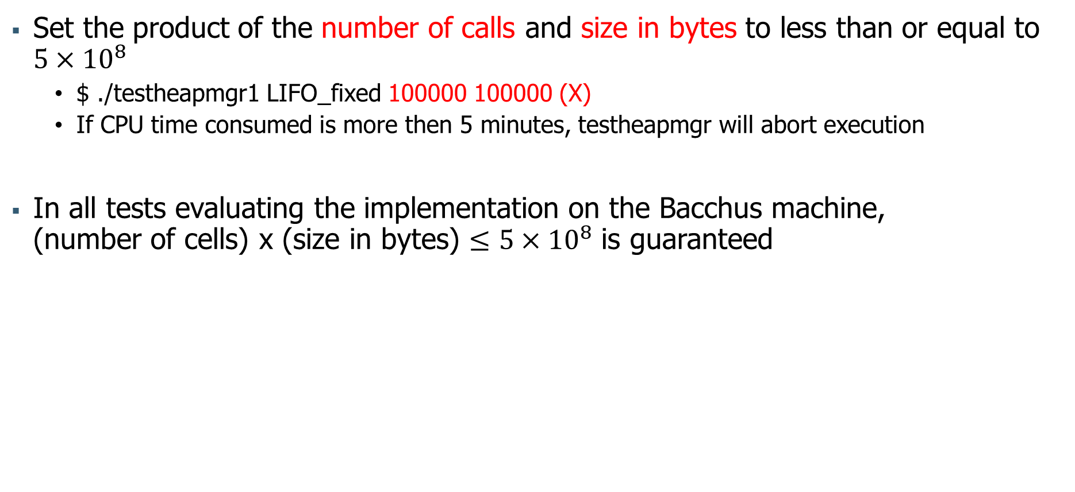
How to Test Your Code
Set the product of the number of calls and size in bytes to less than or equal to ${5×10}^{8}$
$ ./testheapmgr1 LIFO_fixed 100000 100000 (X)
If CPU time consumed is more then 5 minutes, testheapmgr will abort execution
In all tests evaluating the implementation on the Bacchus machine, (number of cells) x (size in bytes) $≤{5×10}^{8}$ is guaranteed

Slide 35
Grading - heapmgr1.c
Submit format (12 / 100)
readme, files with proper names
Evaluation from the user’ viewpoint: function correctness (78 / 100)
heapmgr_malloc(), heapmgr_free() are well-designed (include validity check)
your code executes all malloc() and free() without any memory errors
time consumption: faster than heapmgrkr and heapmgrbase
free() should be faster (LIFO_fixed, LIFO_random, FIFO_random)
Total time should be faster (random_fixed, random_random)
Evaluation from the programmer’s viewpoint (10 / 100)
Clarity (names, comments, line lengths, indentation, etc.)
Parameter validation using assert()

Slide 36
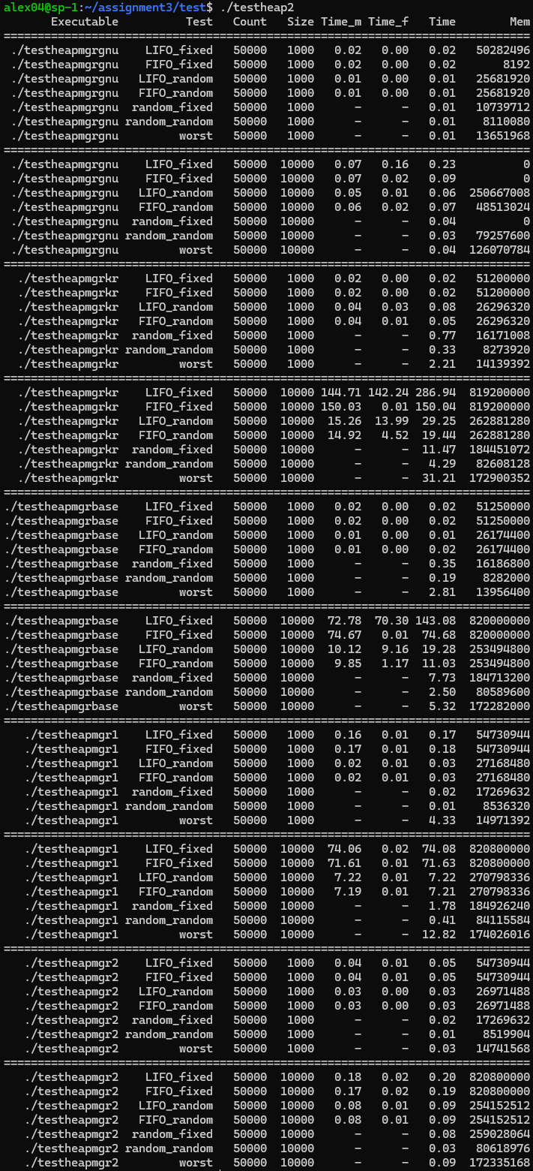
Grading - heapmgr1.c

Slide 37
Grading - heapmgr2.c (Extra Credit)
Evaluation from the user’ viewpoint: function correctness (+30%)
heapmgr_malloc(), heapmgr_free() are well-designed (using bins) (include validity check)
time consumption: faster than heapmgrkr, heapmgrbase and heapmgr1
Total time should be faster (in all 7 cases)
Extra credit
Up to 30% of the scores you earn for implementing heapmgr1.c
You will not get the 30% extra credit just by submitting heapmgr2
If you do not get a perfect score on heapmgr2, extra credit you receive will be reduced

Slide 38
Grading - heapmgr2.c (Extra Credit)

Slide 39
Content of readme file
Your name and student ID
Result of ./testheap1 or ./testheap2 (paste the output of the testheap1 or testheap2 script)
(Optionally) An indication of how much time you spent doing the assignment
(Optionally) Your assessment of the assignment
(Optionally) Any information that will help us to grade your work in the most favorable light

Slide 40
How to Submit?
Make a directory (assuming your ID is 202500000)
$ mkdir 202500000_assign3
Move your code and readme file there
$ mv heapmgr1.c (heapmgr2.c) chunk.c chunk.h readme 202500000_assign3
Make a gzipped tar file for submission
$ tar zcf 202500000_assign3.tar.gz 202500000_assign3
You must submit chunk.c and chunk.h even if you did not use them in your implementation
In this case, submit chunk.c and chunk.h given in the assignment without modification

Slide 41
How to Submit?
Structure of directory:
YourID_assign3 (don’t use dash)
|-heapmgr1.c
|-heapmgr2.c (optional)
|-chunk.c
|-chunk.h
`-readme (don’t use extension such as .txt, .md, …)
Example:
202500000_assign3
|-heapmgr1.c
|-chunk.c
|-chunk.h
`-readme
Please set files and directory’s names to match the examples above
Don’t use any extension for readme file
Don’t use dash for submit files
Structure files and directories as shown above, then proceed with compression
Deadline: ~5.1(Thu) 21:00
0 points if deadline is missed

