Slide 1
CS5100: Foundations of Artificial Intelligence Propositional Logic
Dr. Rutu Mulkar-Mehta
Lecture 4
Some slides and images used from Cornell CS4700 course notes, with permission

Slide 2
Administrative
Tonight at 11:59PM Project 1 is due
Please email your solutions to:
Professor: me@rutumulkar.com
TA: k.porterfield7@gmail.com
Subject: [PROJECT 1] <FirstName> <LastName>
Your work will be evaluated in 3 ways:
MOSS → general uniqueness of code, and plagiarism detection
Autograder → High level running and working of code
Readme File → Your understanding of the problem, and partial credit
Code Review

Slide 3
Administrative
Assignment 2 – graded and returned to you
EC1 – Grading in progress – will be returned next week
Logic Project: Out next week
Enjoy your project free week!
Next week – In class assignment. You may bring your computer to class and implement it in SWI-Prolog
Anyone who cannot bring their laptops to class?

Slide 4
Assignment 2 Solutions

Slide 5
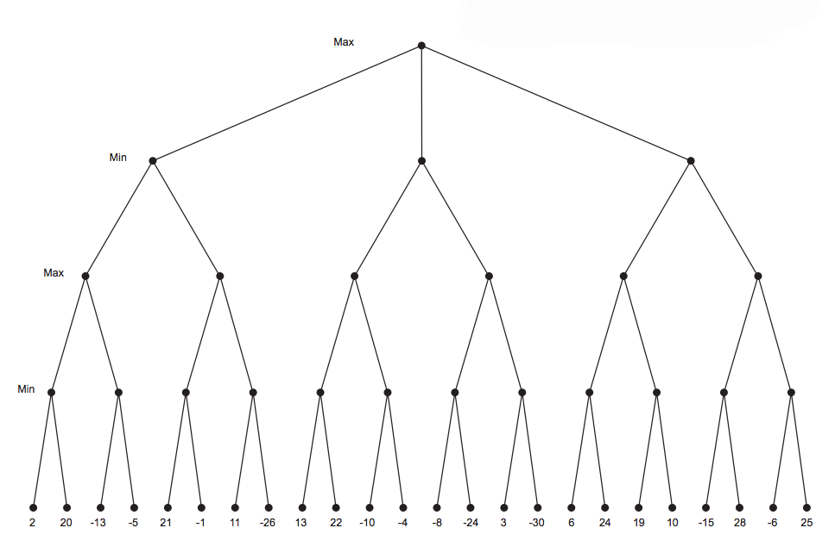
-1
-1
-24
-6
-1
13
2
-24
10
-6
2
-13
-1
-26
-10
-30
6
10
13
-24
-15
-6

Slide 6
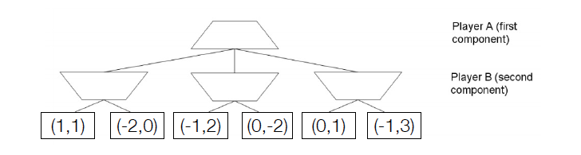
(1,1)
(1,1)
(-1,2)
(-1,3)

Slide 7
(1pt) What is the best move for Player A? Is this an optimal move for Player B?
(1,1), Not optimal for B
(1pt) Briefly explain why no alpha-beta style pruning is possible in the general non-zero sum case.
Hint : think First about the case where UA (s ) = UB (s ) for all nodes.
Dependency between the optimizations
Possibility of a win-win case

Slide 8
Back to Lecture 5

Slide 9
Outline of the Course
Search
Informed, Uninformed, CSP’s, Games
Logic
Today through the next few weeks
Very important part of Artificial Intelligence
Statistics and Learning

Slide 10
Today:
Knowledge-based agents
Logic in general - models and entailment
Propositional (Boolean) logic
Wumpus world
Inference rules and theorem proving
forward chaining
backward chaining
resolution
First Order Logic

Slide 11

Human Agents
Human Intelligence is achieved by a process of complex reasoning, operating over internal representations of knowledge
E.g. The light doesn’t turn on..
Are other lights working?
Is there electricity?
Is the bulb working?
Do the taps have water?
(unlikely to consider this)

Slide 12
Logical Agents (Examples)
Medical diagnosis
physician diagnosing a patient infers what disease, based on the knowledge he/she acquired as a student, textbooks, prior cases
Common sense knowledge / reasoning
common everyday assumptions / inferences
e.g., “lecture starts at four” infer pm not am
when traveling, I assume there is some way to get from the airport to the hotel.
e.g. CYC: http://www.cyc.com/ : Commonsense Knowledgebase

Slide 13
Logical Agents
Agents with some representation of the complex knowledge about the world / its environment, and uses inference to derive new information from that knowledge combined with new inputs (e.g. via perception).
Key issues:
Knowledge Representation
How to capture knowledge so that there is least information loss
Reasoning and inference processes
How can we use that knowledge and do smart reasoning

Slide 14
Inference Engine
Why not just run some if-then statements to capture domain logic?
Fails quickly when new logic is introduced
May not capture all logical relationships
e.g. “patient doesn’t have cough” (negation)
It is domain specific
What if we switch to “manufacturing” from “healthcare”

Slide 15
Logical Agents
Knowledge Base (Domain specific)
A set of sentences that describe facts about the world in some formal (representational) language
Inference Engine (Domain independent)
A set of procedures that use the representational language to infer new facts from known ones or answer a variety of KB queries. Inferences typically require search.
Knowledge Base
Inference Engine
Notes:
Focus of this class is on the Inference Engine
In the real world, you will have a “domain expert” who provides the knowledge (e.g. physican provides their knowledge about diagnosis). Your job as AI/CS specialist, is to integrate it in code and execute their logic.

Slide 16
Propositional Logic
Propositional logic P:
defines a language for symbolic reasoning
Proposition:
a statement that can hold a true or false value Examples of propositions:
This class is great.
France is in Europe.
It is raining outside.
How are you? Not a proposition.

Slide 17
Syntax of Propositional Logic
Formally propositional logic P:
Is defined by Syntax + Semantics + Interpretation of P
Syntax: Symbols (alphabet) in P:
Constants: True, False
Propositional symbols
Examples:
P
Northeastern University is in South Lake Union.
It is raining outside, etc.
A set of connectives in order of operator precedence
¬,∧ ,∨ ,⇒ ,⇔

Slide 18
Syntax of Propositional Logic
Sentences in the propositional logic:
Atomic sentences:
Constructed from constants and propositional symbols
True, False are (atomic) sentences
P, Q or Light in the room is on, It rains outside are all (atomic) sentences
Composite sentences:
Constructed from valid sentences via connectives
If A, B are sentences then
¬ A ,( A ∧ B ), ( A ∨ B ), ( A ⇒ B ), ( A ⇔ B ) etc.
( A ∨ B ) ∧ ( A ∨ ¬ B ) etc.
are sentences
Notes:
Constants are uppercase, variables are lower case

Slide 19
Syntax
Sentence → Atomic Sentence | Complex Sentence
Atomic Sentence → True | False | P | Q | R …
Complex Sentence → ¬ Sentence |
Sentence ∧ Sentence
Sentence ∨ Sentence
Sentence ⇒ Sentence
Connective Precedence: ¬,∧ ,∨ ,⇒ ,⇔
(Backus Naur Form or BNF)
Notes:
BNF -> basis on which natural language is constructed. e.g. noun phrase, verb phrase etc.

Slide 20
Semantics of Propositional Logic
The semantics are the meaning of the sentences.
The semantics in the propositional logic is defined by:
Interpretation of propositional symbols and constants
Semantics of atomic sentences
Through the meaning of connectives
Meaning (semantics) of composite sentences

Slide 21
Semantics of Propositional Logic
A propositional symbol
a statement about the world that is either true or false
Examples:
It is raining outside
Light in the room is on
Propositional symbols are mapped to one of the two values:
True (T), or False (F), depending on whether the symbol is satisfied in the world
Light in the room is on -> True
Light in the room is on -> False

Slide 22
Semantic Value of Propositional Logic
The meaning (value) of the propositional symbol for a specific interpretation is given by its interpretation
Light in the room is on -> True
V(Light in the room is on) = True
It is raining outside -> False
V( It rains outside) = False

Slide 23
Semantics of Composite Sentences
We can compute truth value (V) of Propositional Statements using truth tables
P | Q | ¬P | P ∧ Q | P ∨ Q | P ⇒ Q | P ⇔ Q
True | True | False | True | True | True | True
True | False | False | False | True | False | False
False | True | True | False | True | True | False
False | False | True | False | False | True | True

Slide 24
Exercise: 10 minutes
Consider the following statements:
p = It is sunny this afternoon
q = it is colder than yesterday
r = We will go swimming
s = we will take a canoe trip
t = We will be home by sunset
Convert the following to propositional logic:
It is not sunny this afternoon and it is colder than yesterday.
We will go swimming only if it is sunny.
If we do not go swimming then we will take a canoe trip.
If we take a canoe trip, then we will be home by sunset.
Notes:
not p and q
r -> p
not r -> s
s -> t

Slide 25
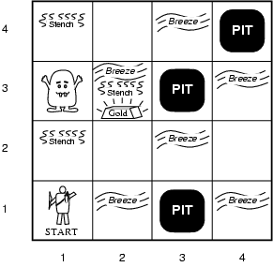
Wumpus World PEAS description
The Wumpus World is a cave consisting of rooms connected by passageways
Goal
Get the gold
Avoid the Wumpus (beast)
Avoid the bottomless pits
Sensors:
If there is a breeze → you are close to a pit
If there is a Stench → you are close to the Wumpus
If you see glitter, you are in the same square as the gold

Slide 26
Wumpus World PEAS description
Performance measure
gold +1000, death -1000
-1 per step, -10 for using the arrow
Environment
Squares adjacent to wumpus are smelly
Squares adjacent to pit are breezy
Glitter iff gold is in the same square
Shooting kills wumpus if you are facing it
Shooting uses up the only arrow
Grabbing picks up gold if in same square
Releasing drops the gold in same square
Actuators: Left turn, Right turn, Forward, Grab, Release, Shoot
Sensors: Stench, Breeze, Glitter, Bump, Scream

Slide 27
Exploring a Wumpus world
4
3
2
1
OK
OK | OK
A
1 2 3 4
Agent Position: (1,1)
No stench (¬S₁₁), No breeze (¬B₁₁) ➔
no pit (¬P₁₁) and no Wumpus in (2,1) or (1,2) (¬W₂₁, ¬W₁₂)
Agent still alive, so no pit or Wumpus in (1,1).
Agent moves to (2,1)

Slide 28
Exploring a Wumpus world
4
3
2
1
OK
OK | OK
P?
B
A
A
P?
1 2 3 4
Agent Position: (2,1)
Breeze in (2,1) B₂₁ →
there must be a pit in (1,1), (2,2) or (3,1) P₁₁∨P₂₂∨P₃₁
Player already ruled out (1,1) (¬P₁₁)
Since there is danger in moving to (3,1) and (2,2), player moves back to (1,1)

Slide 29
Exploring a Wumpus world
4
3
2
1
OK
OK | OK
P?
B
A
A
P?
1 2 3 4
Agent Position: (1,1)
Move to Position (1,2) as that is the safest next place to explore

Slide 30
Exploring a Wumpus world
4
3
2
1
OK
OK | OK
W
S
OK
P?
A
B
A
A
P?
P
1 2 3 4
Agent Position: (1,2)
Stench in this position S₁₂ → W₁₃ V W₂₂ V W₁₁
We know that ¬W_{11 and} ¬W₂₂
Therefore W₁₃
Next available safe spot → (2,2,) …. and so on

Slide 31
Takeaways
Agent draws conclusions based on available information
Conclusion is guaranteed to be correct if the information is correct
The agent keeps adding new information to its model based on its percepts
The agent updates its incomplete model based on new percepts

Slide 32
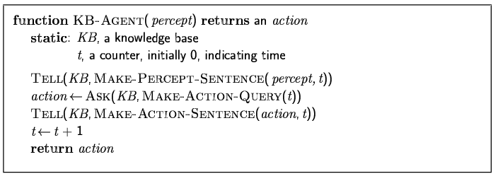
A simple knowledge-based agent
The agent must be able to:
Represent states, actions, etc.
Incorporate new percepts
Update internal representations of the world
Deduce hidden properties of the world
Deduce appropriate actions

Slide 33
Wumpus world characterization
Fully Observable:
No – only local perception
Deterministic:
Yes – outcomes exactly specified
Episodic:
No – sequential at the level of actions
Static:
Yes – Wumpus and Pits do not move
Discrete:
Yes
Single-agent:
Yes – Wumpus is essentially a natural feature

Slide 34
Logic in general
Logic is formal language that is used for representing information such that conclusions can be drawn from it
Syntax defines the sentences in the language
Semantics define the "meaning" of sentences;
i.e., define truth of a sentence in a world
E.g., the language of arithmetic
x+2 ≥ y is a sentence; x2+y > {} is not a sentence
x+2 ≥ y is true iff the number x+2 is no less than the number y
x+2 ≥ y is true in a world where x = 7, y = 1
x+2 ≥ y is false in a world where x = 0, y = 6

Slide 35
Contradiction and Tautology
Contradiction and Tautology
Contradiction is Always False
e.g. P ∧ ¬P
Tautology is Always True
e.g. P ∨¬P

Slide 36
Sound and Complete Inference
Soundness:
An inference algorithm that derives only entailed sentences is called a sound or truth preserving algorithm
Completeness
An inference algorithm is complete if it can derive any sentence that is entailed.
Notes:
Soundness:
An inference algorithm that derives only entailed sentences is called a sound or truth preserving algorithm
Completeness
An inference algorithm is complete if it can derive any sentence that is entailed.

Slide 37
Satisfiability
A sentence (or set of sentences) is satisfiable if there exists some interpretation that makes it true
An interpretation satisfies a set of sentences if it makes them true

Slide 38
Validity
A sentence (or set of sentences) is valid if
it is true under all interpretations
Example: P v ~P

Slide 39
Model, Validity and Satisfiability
Model: “Possible World” or Mathematical Abstraction of the real world
A sentence is satisfiable if there is at least one interpretation under which the sentence can evaluate to True
A sentence is valid if it is True in all interpretations
Satisfiable Sentence
Valid Sentence
P | Q | P ∨ Q | (P ∨ Q) ∧¬Q | ((P ∨ Q) ∧¬Q ) ⇒ Q
True | True | True | False | True
True | False | True | True | True
False | True | True | False | True
False | False | False | False | True

Slide 40
Entailment
A |= B
All interpretations that satisfy A also satisfy B

Slide 41
Logical Equivalences
Sentences A and B are logically equivalent if:
they are true under exactly the same interpretations
A |= B and B |= A

Slide 42
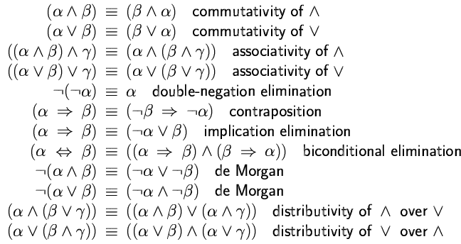
Logical equivalence
Two sentences are logically equivalent iff true in same models: α ≡ ß iff α╞ β and β╞ α

Slide 43
Entailment
Entailment reflects the relation of one fact in the world following from others
A |= B
Under all interpretations in which A is true, B is true as well
All models of A are models of B
Whenever A is true, B is true as well
A entails B
B logically follows from A

Slide 44
Models
Logicians typically think in terms of models, which are formally structured worlds with respect to which truth can be evaluated
We say m is a model of a sentence α if α is true in m
M(α) is the set of all models of α
Then KB ╞ α iff M(KB) ⊆ M(α)
E.g. KB = Giants won and Reds won
α = Giants won
If KB is true then α must be true r When KB is false α can be anything

Slide 45
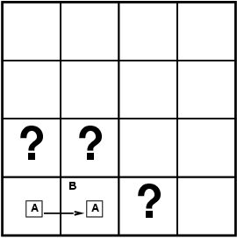
Entailment in the wumpus world
Situation after detecting nothing in [1,1], moving right, breeze in [2,1]
Consider possible models for KB assuming only pits
3 Boolean choices ⇒ 8 possible models

Slide 46
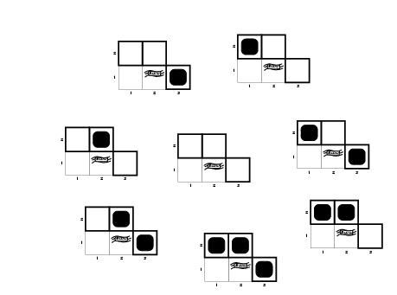
Wumpus models

Slide 47
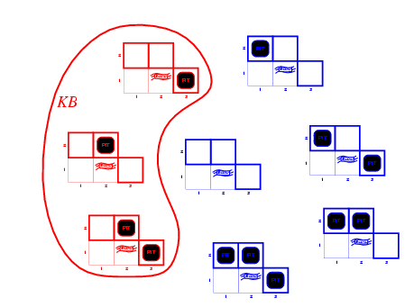
Wumpus models
KB = wumpus-world rules + observations

Slide 48
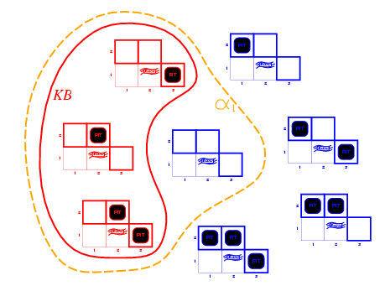
Wumpus models
KB = wumpus-world rules + observations
α₁ = "[1,2] is safe", KB ╞ α₁, proved by model checking

Slide 49
Wumpus models
KB = wumpus-world rules + observations

Slide 50
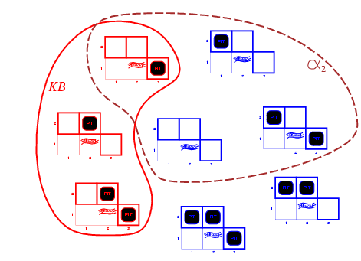
Wumpus models
KB = wumpus-world rules + observations
α₂ = "[2,2] is safe", KB ╞ α₂

Slide 51
Solving Logical Inference Problems
Three Approaches:
Truth Table Approach
Inference Rules Approach
Resolution – Refutation Approach

Slide 52
Truth Table Approach
Problem: KB |= α?
We need to check all the possible interpretations for which the KB is true (models of KB) whether α is true for each of them
Truth Table
Enumerates the truth values of sentences for all possible interpretations

Slide 53
Truth Table Approach
Problem: KB |= α?
A, B entails A∧B?
Solution
Generate table for all possible interpretations
Check whether α is true whenever KB is true
KB
α
A | B | A ∧ B
F | F | F
F | F | F
F | T | F
F | T | F
T | F | F
T | F | F
T | T | T
T | T | T
A,B, Entails A∧B

Slide 54
Truth Table Approach
Problem: KB |= α ?
KB = A ^ C, C
α = B ^ C
KB
α
A | B | C | A ∧ C | B ∧ C
F | F | F | F | F
F | F | T | F | F
F | T | F | F | F
F | T | T | F | T
T | F | F | F | F
T | F | T | T | F
T | T | F | F | F
T | T | T | T | T
A^C, C does not entail B∧C

Slide 55
Truth Table Approach
The Truth Table approach is sound and complete for Propositional Logic
Notes:
Soundness:
An inference algorithm that derives only entailed sentences is called a sound or truth preserving algorithm
Completeness
An inference algorithm is complete if it can derive any sentence that is entailed.

Slide 56
Limitations of Truth Table Approach
Search Space for truth tables is exponential.
3 variables – 2^3 = 8
10 variables – 2^ 10 = 1024
KB is true only in a small set of interpretations
We need to make the process more efficient if we want to use this on a larger scale

Slide 57
Inference Rules Approach
…
We need to make the process more efficient if we want to use this on a larger scale
Solution:
Check only the entries where KB = True
This is the idea behind the inference rules approach

Slide 58
Inference Rules for Logic
Modus Ponens
A => B, A
B
If the premise is true then the conclusion is also true
Exercise – Can you prove this using the truth table?
Premise
Conclusion

Slide 59
A | B | A => B
True | True | True
True | False | False
False | True | True
False | False | True
A => B, A
B
Notes:
A => B, is T, F T, T

Slide 60
Inference Rules for Logic
And Elimination
A ^ B
A
From the conjunction any of the conjuncts can be inferred
Bi-Conditional Elimination
A ⬄ B
(A=> B) ^ (B => A)
Double Negation Elimination
¬¬A
A

Slide 61
Inference Rules for Logic: Resolution
Resolution takes two clauses and produces a new clause containing all the literals of the two original clauses except the two complementary literals
A V B, ¬A
B

Slide 62
Solve using Inference
KB: (B₁₁ ⬄ (P₁₂ v P₂₁)); ¬B₁₁
Prove: ¬P₁₂.
KB:
¬B_{1,1} ∨ P_{1,2} ∨ P_{2,1}
¬P_{1,2} ∨ B_{1,1}
¬P_{2,1} ∨ B_{1,1}
¬B₁₁
¬P_{2,1} (From (3) and (4) And-elimination)
¬P_{1,2} (From (2) and (4 And Elimination)
Proved!

Slide 63
Conversion to CNF
B_{1,1} ⇔ (P_{1,2} ∨ P_{2,1})
Eliminate ⇔, replacing α ⇔ β with (α ⇒ β)∧(β ⇒ α).
(B_{1,1} ⇒ (P_{1,2} ∨ P_{2,1})) ∧ ((P_{1,2} ∨ P_{2,1}) ⇒ B_{1,1})
2. Eliminate ⇒, replacing α ⇒ β with ¬α∨ β.
(¬B_{1,1} ∨ P_{1,2} ∨ P_{2,1}) ∧ (¬(P_{1,2} ∨ P_{2,1}) ∨ B_{1,1})
3. Move ¬ inwards using de Morgan's rules and double-negation:
(¬B_{1,1} ∨ P_{1,2} ∨ P_{2,1}) ∧ ((¬P_{1,2} ∧ ¬P_{2,1}) ∨ B_{1,1})
4. Apply distributivity law (∧ over ∨) and flatten:
(¬B_{1,1} ∨ P_{1,2} ∨ P_{2,1}) ∧ (¬P_{1,2} ∨ B_{1,1}) ∧ (¬P_{2,1} ∨ B_{1,1})

Slide 64
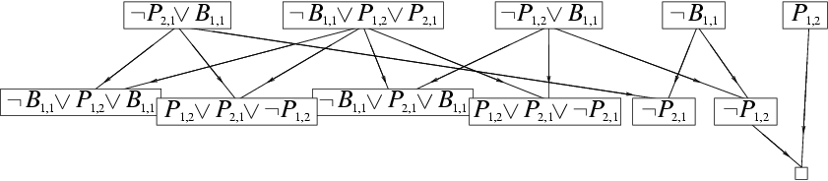
Resolution example
KB = (B_{1,1} ⇔ (P_{1,2}∨ P_{2,1})) ∧¬ B_{1,1}
α = ¬P_{1,2}

Slide 65
Resolution Example
winter V summer
¬winter V cold
Either winter or ¬winter is true, so we know that summer or cold is true
Resolution rule:
Given: P₁ ∨ P₂ ∨ P_{3 …}∨ P_{n,} and ¬P₁ ∨ Q_{1 …}∨ Q_{m}
Conclude: P₂ ∨ P_{3 …}∨ P_{n} ∨ Q_{1 …}∨ Q_{m}
Complementary literals P₁ and ¬P₁ “cancel out”

Slide 66
Resolution in Wumpus World
There is a pit at 2,1 or 2,3 or 1,2 or 3,2
P₂₁ ∨ P₂₃ ∨ P₁₂ ∨ P₃₂
There is no pit at 2,1
¬P₂₁
Therefore (by resolution) the pit must be at 2,3 or 1,2 or 3,2
P₂₃ ∨ P₁₂ ∨ P₃₂
P₂₁ ∨ P₂₃ ∨ P₁₂ ∨ P₃₂, ¬P₂₁
P₂₃ ∨ P₁₂ ∨ P₃₂

Slide 67
Resolution
Any complete search algorithm, applying only the resolution rule, can derive any conclusion entailed by any KB in propositional logic.

Slide 68
Proof using Resolution
To try to prove P from KB:
Convert KB and P into CNF
(Conjunctive Normal Form – Conjunction of clauses, clauses joined by ‘and’ relation)
To prove P, prove KB ∧ ¬P is contradictory (empty clause)
Specifically, apply resolution using a complete search algorithm until:
No new clauses can be added, (KB does not entail P)
The empty clause is derived (KB does entail P).

Slide 69
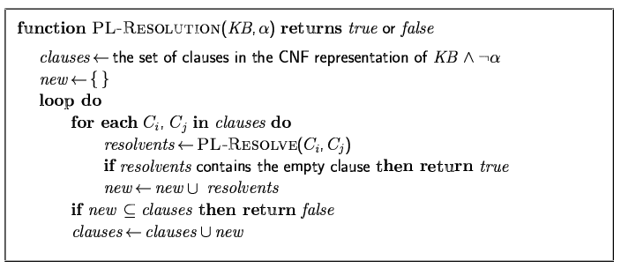
Resolution algorithm
Proof by contradiction, i.e., show KB∧¬α unsatisfiable

Slide 70
Simple Resolution EG
When the agent is in 1,1, there is no breeze, so there can be no pits in neighboring squares
KB: (B₁₁ ⬄ (P₁₂ v P₂₁)); ¬B₁₁
Prove: ¬P₁₂.

Slide 71
Forward and backward chaining
Horn Form (restricted)
KB = conjunction of Horn clauses Horn Clauss is a clause with at most one positive literal
Horn clause =
proposition symbol; or
(conjunction of symbols) ⇒ symbol
E.g., C ∧ (B ⇒ A) ∧ (C ∧ D ⇒ B)
Modus Ponens (for Horn Form): complete for Horn KBs
α₁, … ,α_{n}, α₁ ∧ … ∧ α_{n} ⇒ β
β
Can be used with forward chaining or backward chaining.
These algorithms are very natural and run in linear time

Slide 72
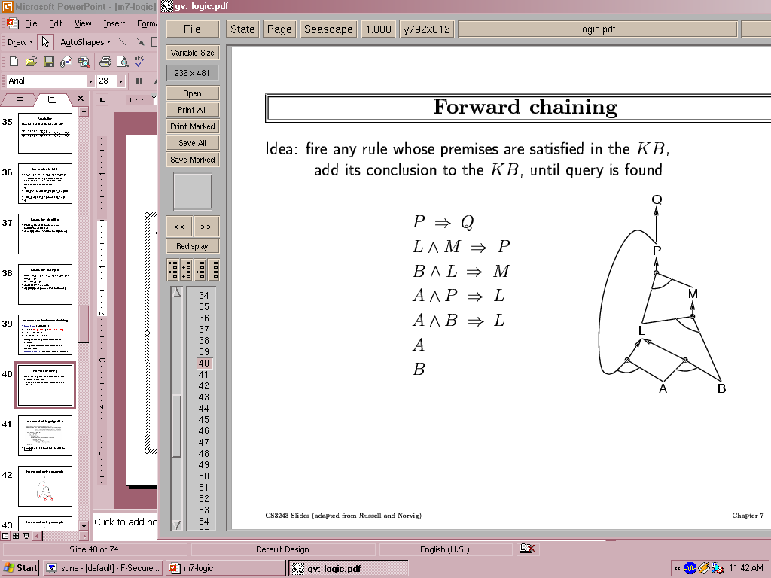
Forward chaining
Idea: fire any rule whose premises are satisfied in the KB,
add its conclusion to the KB, until query is found

Slide 73
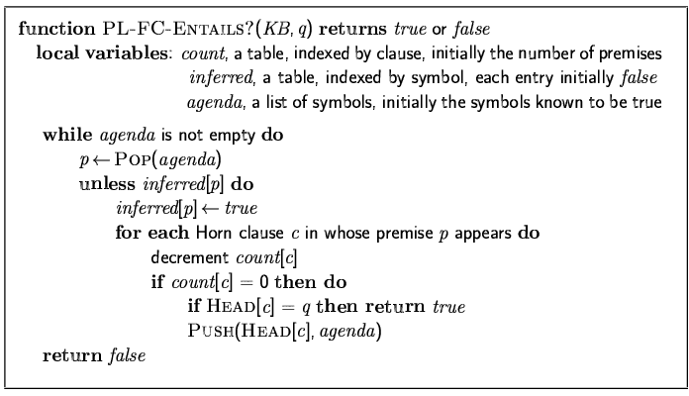
Forward chaining algorithm
Forward chaining is sound and complete for Horn KB

Slide 74
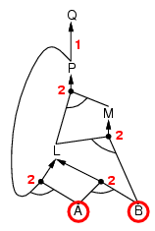
Forward chaining example

Slide 75
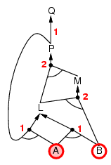
Forward chaining example

Slide 76
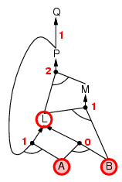
Forward chaining example

Slide 77
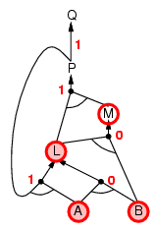
Forward chaining example

Slide 78
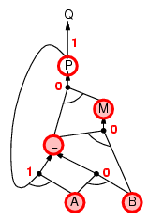
Forward chaining example

Slide 79
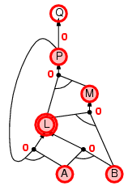
Forward chaining example

Slide 80
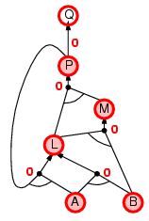
Forward chaining example

Slide 81

Forward chaining example

Slide 82
Proof of completeness
FC derives every atomic sentence that is entailed by KB
FC reaches a fixed point where no new atomic sentences are derived
Consider the final state as a model m, assigning true/false to symbols
Every clause in the original KB is true in m
a₁ ∧ … ∧ a_{k ⇒} b
Hence m is a model of KB
If KB╞ q, q is true in every model of KB, including m

Slide 83
Backward chaining
Idea: work backwards from the query q:
to prove q by BC,
check if q is known already, or
prove by BC all premises of some rule concluding q
Avoid loops: check if new subgoal is already on the goal stack
Avoid repeated work: check if new subgoal
has already been proved true, or
has already failed

Slide 84
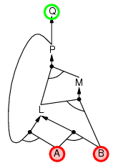
Backward chaining example

Slide 85
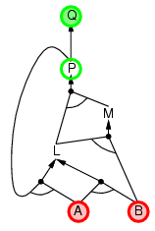
Backward chaining example

Slide 86
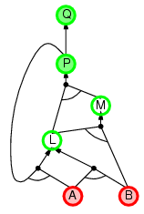
Backward chaining example

Slide 87
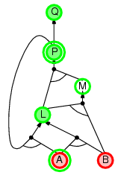
Backward chaining example

Slide 88
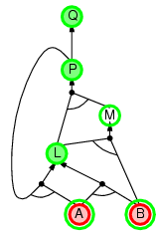
Backward chaining example

Slide 89
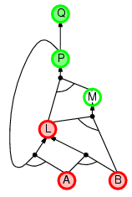
Backward chaining example

Slide 90
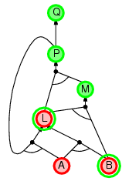
Backward chaining example

Slide 91
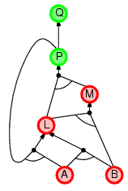
Backward chaining example

Slide 92
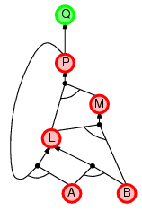
Backward chaining example

Slide 93
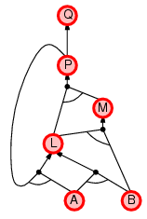
Backward chaining example

Slide 94
Forward vs. backward chaining
FC is data-driven, automatic, unconscious processing,
e.g., object recognition, routine decisions
May do lots of work that is irrelevant to the goal
BC is goal-driven, appropriate for problem-solving,
e.g., Where are my keys? How do I get into a PhD program?
Complexity of BC can be much less than linear in size of KB

Slide 95
Expressiveness limitation of propositional logic
KB contains "physics" sentences for every single square
For every time t and every location [x,y],
L_{x,y} ∧ FacingRight^{t} ∧ Forward^{t} ⇒ L_{x+1,y}
Rapid proliferation of clauses
t
t

Slide 96
Proposition Logic Summary
Logical agents apply inference to a knowledge base to derive new information and make decisions
Basic concepts of logic:
syntax: formal structure of sentences
semantics: truth of sentences wrt models
entailment: necessary truth of one sentence given another
inference: deriving sentences from other sentences
soundness: derivations produce only entailed sentences
completeness: derivations can produce all entailed sentences
Wumpus world requires the ability to represent partial and negated information, reason by cases, etc.
Resolution is complete for propositional logic Forward, backward chaining are linear-time, complete for Horn clauses
Propositional logic lacks expressive power

Slide 97
Exercises
According to some political pundits, a person who is radical (R) is electable (E) if he/she is conservative (C), but otherwise is not electable.
Which of the following represent this assertion?
(R ^ E) ⬄ C
R ➔ (E⬄ C)
R ➔ ((C ➔ E) V ~E)
Notes:
Correct representations of “a person who is radical is electable if he/she is conservative,
but otherwise is not electable”:
(i) (R ∧ E) ⇐⇒ C
No; this sentence asserts, among other things, that all conservatives are radical,
which is not what was stated.
(ii) R ⇒ (E ⇐⇒ C)
Yes, this says that if a person is a radical then they are electable if and only if they
are conservative.
(iii) R ⇒ ((C ⇒ E) ∨ Å E)
No, this is equivalent to Å R ∨ Å C ∨ E ∨ Å E which is a tautology, true under any
assignment.

Slide 98
Next Week
We will cover concepts on First Order Logic
Get a head start by installing: SWI-Prolog
http://www.swi-prolog.org/Download.html
Quick SWI-Prolog Demo

