Slide 1
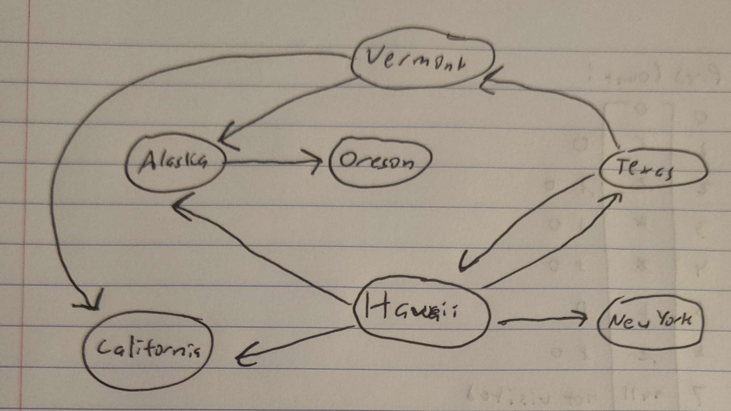
CMSC204
Kartchner
V(StateGraph) = {Oregon, Alaska, Texas, Hawaii, Vermont, NewYork, California}
E(StateGraph) = {(Alaska, Oregon), (Hawaii, Alaska), (Hawaii, Texas), (Texas, Hawaii), (Hawaii, California), (Hawaii, New York), (Texas, Vermont), (Vermont, California), (Vermont, Alaska)}
1. Draw the StateGraph
{Oregon, Alaska, Texas, Hawaii, Vermont, New York, California}
{(Alaska, Oregon), (Hawaii, Alaska), (Hawaii, Texas), (Texas, Hawaii), (Hawaii, California), (Hawaii, New York), (Texas, Vermont), (Vermont, California), (Vermont, Alaska)}
No
Yes
Texas

Slide 2
a. Show the adjacency matrix that would describe the edges in the graph. Store the vertices in alphabetical order
States
Oregon
Alaska
Texas
Hawaii
Vermont
NewYork
California
0 0 0 0 0 0 0
1 0 0 0 0 0 0
0 0 0 1 1 0 0
0 1 1 0 0 1 1
0 1 0 0 0 0 1
0 0 0 0 0 0 0
0 0 0 0 0 0 0
3. b. Show the adjacency lists
that would describe the edges in the graph
Oregon
Alaska
Texas
Hawaii
Vermont
NewYork
California
Oregon
Hawaii
Vermont
Alaska
New York
California
Texas
Alaska
California

Slide 3
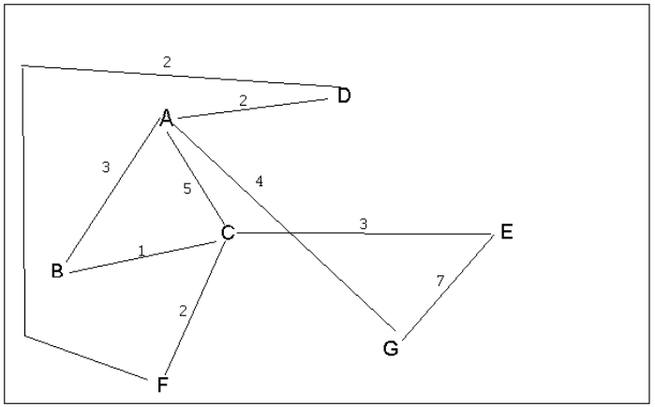
4 a. Which of the following lists the graph nodes in depth first order beginning with E?
A) E, G, F, C, D, B, A
B) G, A, E, C, B, F, D
C) E, G, A, D, F, C, B
D) E, C, F, B, A, D, G
4 b. Which of the following lists the graph nodes in breadth first order beginning at F?
A) F, C, D, A, B, E, G
B) F, D, C, A, B, C, G
C) F, C, D, B, G, A, E
D) a, b, and c are all breadth first traversals

Slide 4
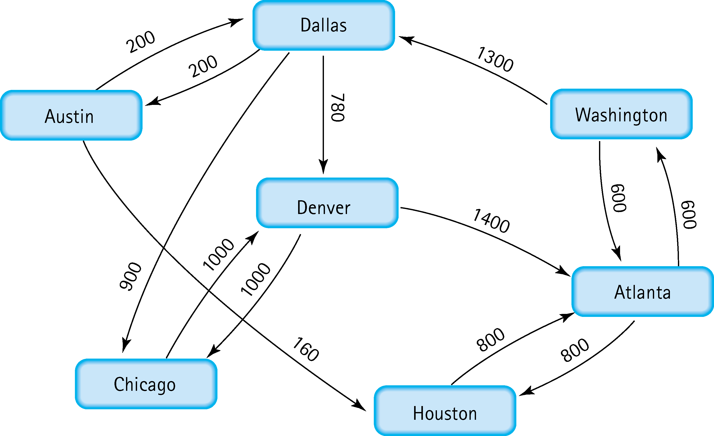
5. Find the shortest distance from Atlanta to every other city
City | Previous | Cost
Atlanta | - | -
Houston | Atlanta | 900
Washington | Atlanta | 600
Dallas | Washington | 1900
Austin | Dallas | 2100
Denver | Dallas | 2680
Chicago | Dallas | 2800

Slide 5
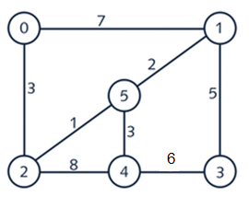
6. Find the minimal spanning tree using Prim’s algorithm. Use
0 as the source vertex . Show the steps.
Visited:
0 -> 2 -> 5 -> 1 -> 4 -> 4 -> 3
Minimum Cost: 3 + 1 + 2 + 3 + + 5 = 14
Minimum Span: 0, 2, 5, 1 , 4, 3
0
2
1
3
5
1
5
2
4
3

Slide 6
7. Find the minimal spanning tree using Kruskal’s algorithm.
Show the weights in order and the steps.
(2,5) = 1
2. (5,1) = 2
3. (0,2) = 3
4. (5,4) = 3
5. (1,3) = 5
0
2
1
3
5
1
5
2
4
3

Slide 7
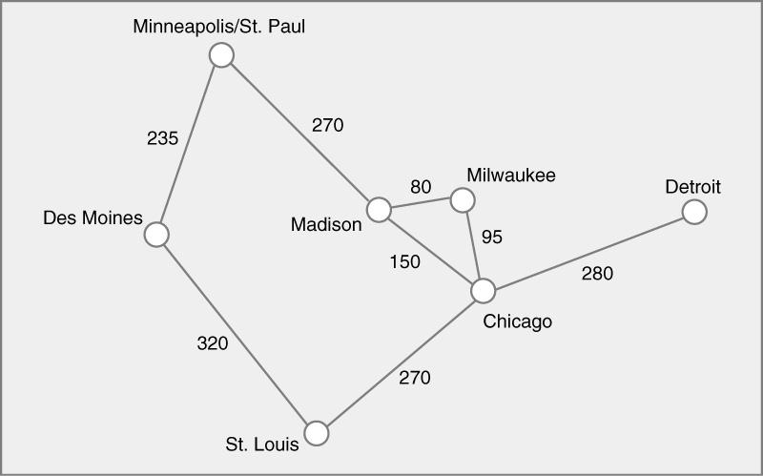
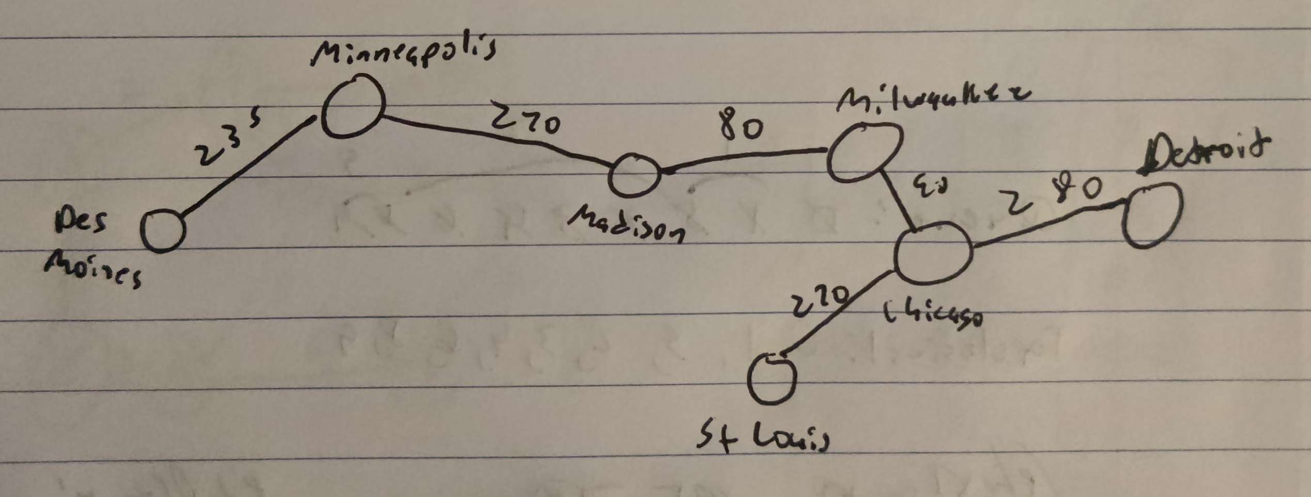
8. Find the minimal spanning tree using the algorithm you prefer. Use
Minneapolis/St. Paul as the source vertex
Prism's Algorithm

Slide 8
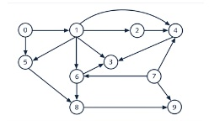
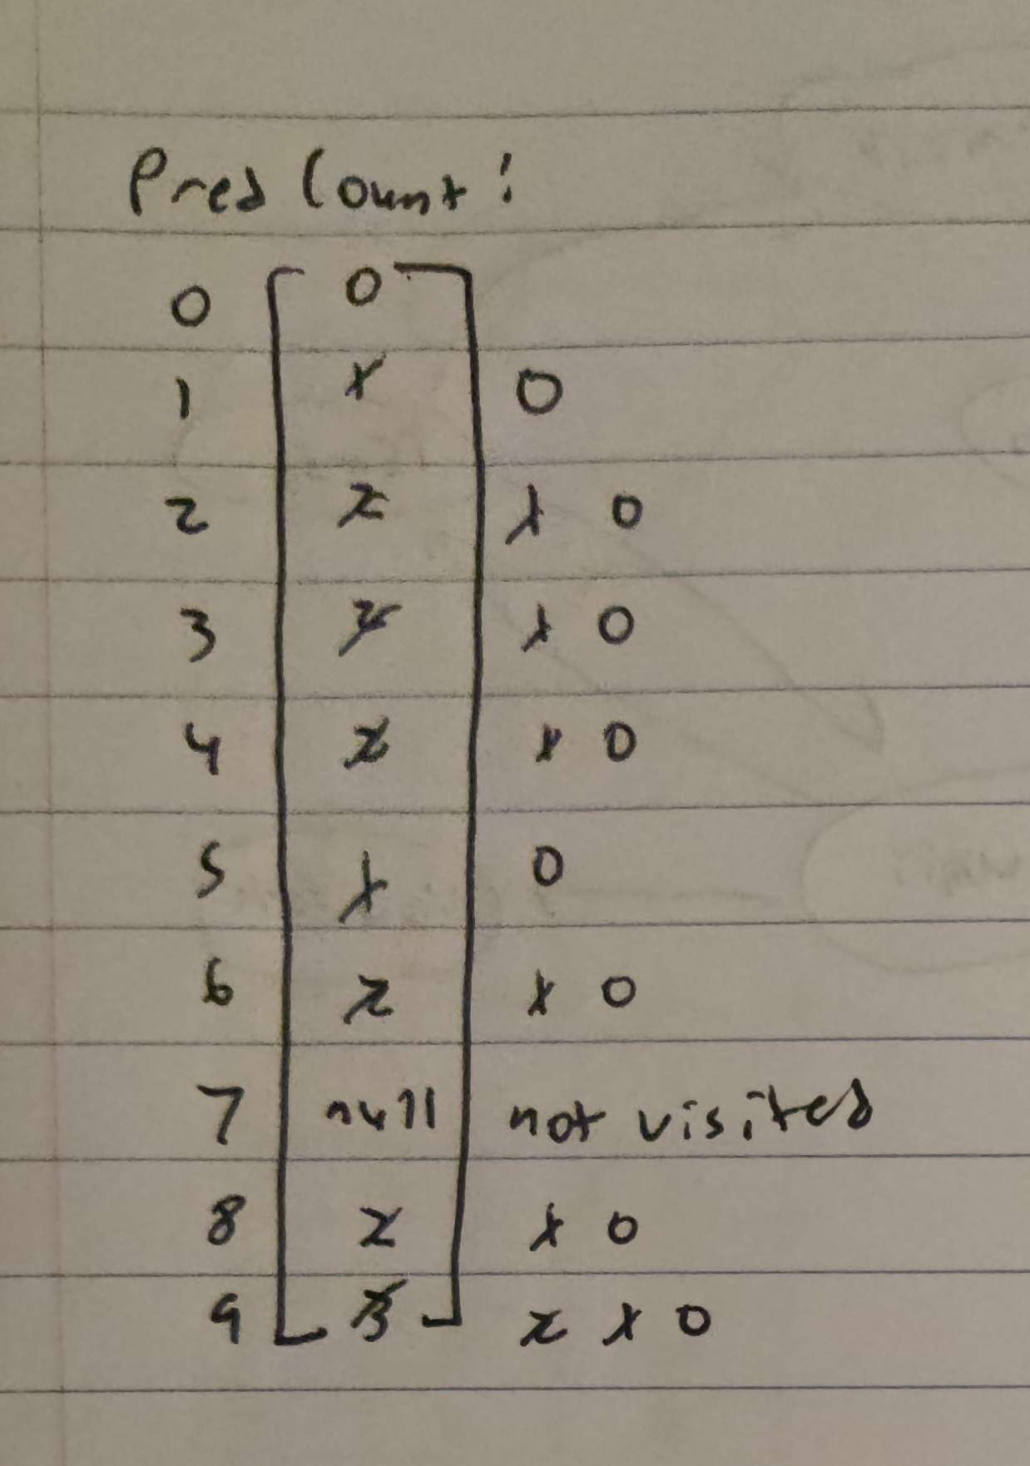
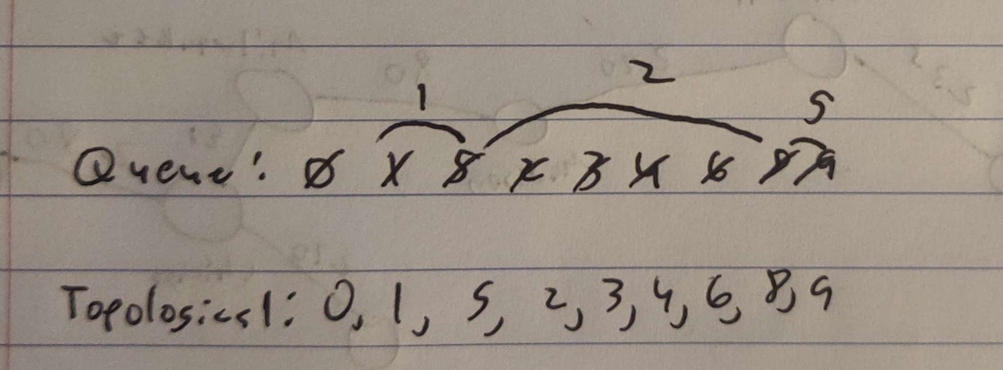
9. List the nodes of the graph in a breadth first topological ordering. Show the
steps using arrays predCount, topologicalOrder and a queue

Slide 9
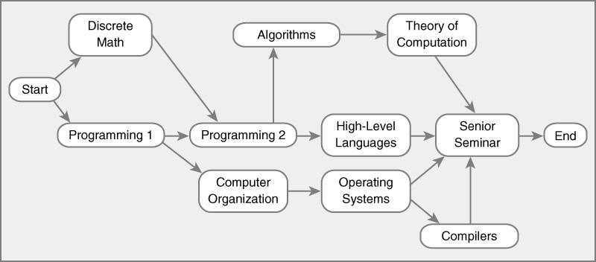
10. List the nodes of the graph in a breadth first topological ordering.
Start -> Discrete Math -> Programming 1 -> Programming 2 -> Computer Organization -> Algorithms -> High-Level Languages -> Operating Systems -> Theory of Computation -> Senior Seminar -> Compilers -> End

