Slide 1

Empowering You to Stay Safe in the Digital World

Slide 2
AGENDA
01
02
05
introduction
04
UI/Ux Design
Technology
Researches and References
03
Working Method / Architecture

Slide 3
01
Introduction

Slide 4
1. Introduction
In today's digital world, scams and frauds are becoming more sophisticated, targeting individuals and businesses alike. To combat this growing issue, we have developed a Scam Information App, a platform where users can report scams, find solutions to protect themselves and help others stay informed.
Our app serves as a community-driven hub for scam awareness, allowing users to share their experiences, verify potential frauds, and access expert advice on staying safe. With real-time updates and AI-driven scam detection, we aim to empower people with knowledge and reduce the impact of fraudulent activities.
TRCE

Slide 5
Core Features :
Scam Reporting
Secure & Anonymous Reporting
Tips & Protection Guides
User Discussions & Community Support
Report scams to inform others
A forum where users can share experiences and advice.
Protects user identity when reporting scams
Real-Time Scam Alerts
Sends notifications about trending scams
Educates users on how to identify and avoid scams

Slide 6
02
Technology

Slide 7
02. Technology
Frontend Technologies React.js – A powerful JavaScript library for building interactive and responsive user interfaces. Next.js (Optional) – Enhances performance with server-side rendering (SSR) and static site generation (SSG). Tailwind CSS / Material-UI – For modern and responsive UI design.
Backend Technologies Node.js with Express.js – Lightweight and scalable backend for handling API requests. Django / Flask (Python) – If AI-based chatbot integration requires Python’s AI/ML ecosystem. REST API – For efficient data fetching and management.

Slide 8
02. Technology
Database & Storage MongoDB – Storing scam reports, user data, and interactions. Cloud Storage (AWS S3 / Firebase Storage) – For storing media files like images and videos.
AI & Machine Learning Integration Chatbot (Dialogflow / Rasa / OpenAI GPT) – AI-driven chatbot for scam detection and recommendations. Machine Learning (TensorFlow / PyTorch) – AI-based scam pattern analysis and user suggestions.
Authentication & Security OAuth (Google, Facebook Login) – Secure authentication for users. JWT (JSON Web Tokens) – For user session management.

Slide 9
03
Working Method/ Architecture

Slide 10
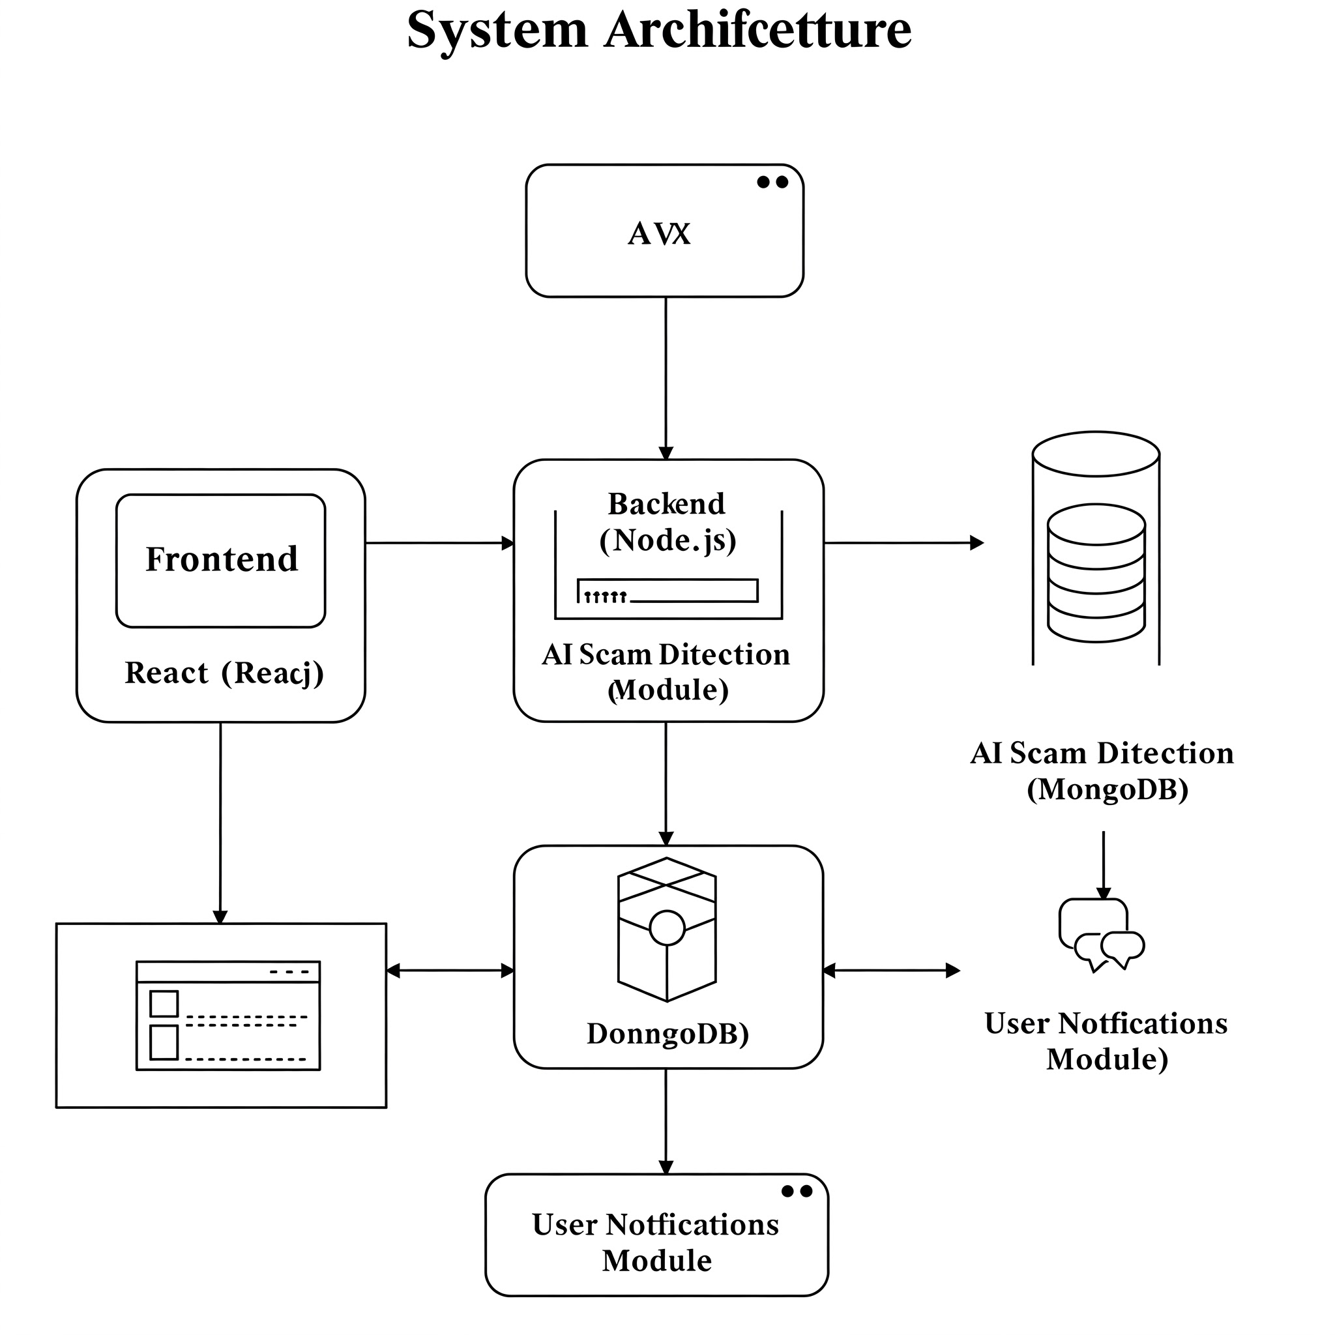
03. Working Method
Components:
🔹 Frontend (React.js): User interface for interactions. 🔹 Backend (Node.js): Handles requests, authentication, and data processing. 🔹 AI Scam Detection: Analyzes posts for scam content using NLP. 🔹 Database (MongoDB): Stores user data, scam reports, and AI results. 🔹 User Notifications: Sends scam alerts and updates to users.
Interactions:
➡ Frontend ↔ Backend: User requests & responses. ➡ Backend ↔ AI Scam Detection: Sends data for scam analysis. ➡ Backend ↔ Database: Stores & retrieves data. ➡ Backend ↔ Notifications: Sends alerts to users.

Slide 11
03. Working Method
Workflow:
1️⃣ User interacts with the app. 2️⃣ Frontend sends requests to the backend. 3️⃣ Backend processes requests & interacts with AI and DB . 4️⃣ Scam alerts & responses are sent back to the frontend in form of comment . 5️⃣ Notifications are triggered if needed.
Key Focus:
✅ AI-powered scam solution provider. ✅ Secure & scalable architecture. ✅ Social media of scam alerts with user engagement

Slide 12
04
UI/UX Design

Slide 13
05. UI/UX Design
UI/UX Design for Scam Information Designed Using Figma Used Figma to create interactive, user-friendly wireframes and prototypes.
Ensures a smooth design workflow and easy collaboration.
Clean and User-Friendly Interface Inspired by Quora’s simple, readable layout.
Prioritizes clarity, accessibility, and ease of navigation.
Minimalist design to keep the focus on scam reports and discussions.

Slide 14
05. UI/UX Design
Scam Reporting and Verification Step-by-step scam reporting with clear prompts (similar to Quora’s answer submission).
Users can verify reports through discussions and fact-checking tools. Color Scheme and Branding: Professional yet approachable look with clean, readable colors (similar to Quora).
Designed to create trust and keep users engaged.
Search and Filter Functions Powerful search & filter system (Reddit-inspired) to find scams by region, type, or urgency.
Mobile and Desktop Consistency Responsive design ensures a seamless experience across devices.

Slide 15
05
Researches and References

Slide 16
06. Researches and References
AI Chatbots for Scam Detection Conversational AI to Combat Scammers: Researchers in Australia have developed an AI chatbot designed to engage with scammers, effectively disrupting their operations. This approach demonstrates the potential of AI-driven chatbots in identifying and mitigating scam attempts.
AI-Based Fraud Detection in Social Media AI Techniques in Fraud Prevention: Artificial intelligence techniques, such as machine learning (ML), deep learning, and natural language processing (NLP), have revolutionized fraud detection and prevention. ML algorithms, particularly supervised learning models like decision trees and neural networks, are extensively used to identify fraudulent transactions by learning from historical data.

Slide 17
06. Researches and References
AI-generated content and Scam Amplification AI-Generated Images in Scams: Research indicates that scammers are leveraging AI-generated images on social media platforms like Facebook to enhance their deceptive tactics. The study analyzed numerous accounts using AI-generated profile pictures to spread scams and spam, highlighting the sophisticated methods employed by fraudsters.
AI in Financial Fraud Detection AI in Financial Security: A systematic review evaluates the effectiveness of AI-based techniques in detecting financial fraud and identifies the challenges and limitations associated with their implementation.

Slide 18
Thank Youu!

