Slide 1
Renewable Energy on the Western Slope
Created by: Kyle Perez

Slide 2
Agenda
Executive Summary
History Of Energy Production
Energy Consumption
Dam Repurposing
Areas for New Dams
River Flows
Conclusion
Q & A

Slide 3
Executive Summary
Colorado's shift to renewable energy is inevitable with a goal of 2040.
The most energy is consumed by Mesa County and regions along the Colorado River.
Colorado's Western Slope exports a significant amount of energy.
Hydroelectric generation is the most reliable and proven renewable source of energy. Least amount of emissions.
Dam repurposing can lower ecological impact.
Many areas on the western slope are good candidates for hydroelectric dams.

Slide 4
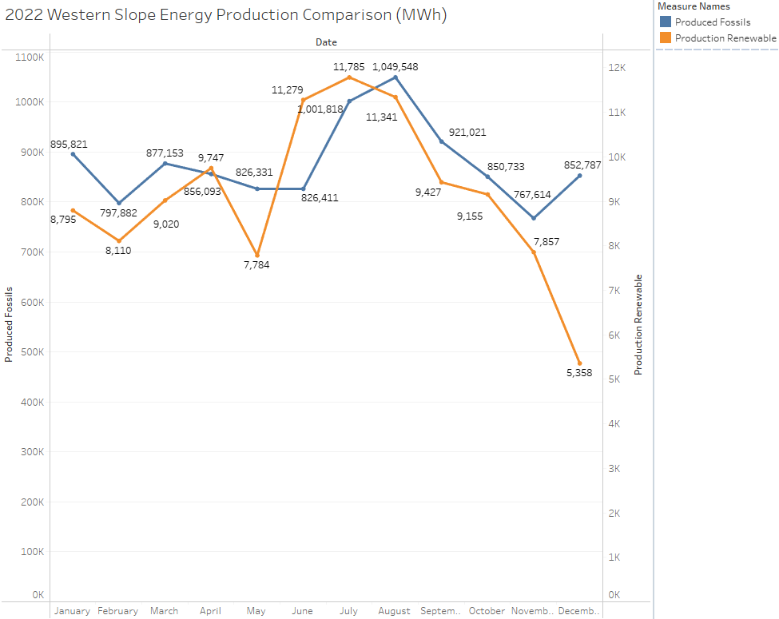
History of Energy Production
According to the U.S. Energy Information Administration (2021) and Colorado's Western Electricity Coordinating Council (WECC), Colorado generated approximately:
52% of its electricity from coal
29% from natural gas
9% from wind
4% from hydroelectric power
3% from solar power

Slide 5
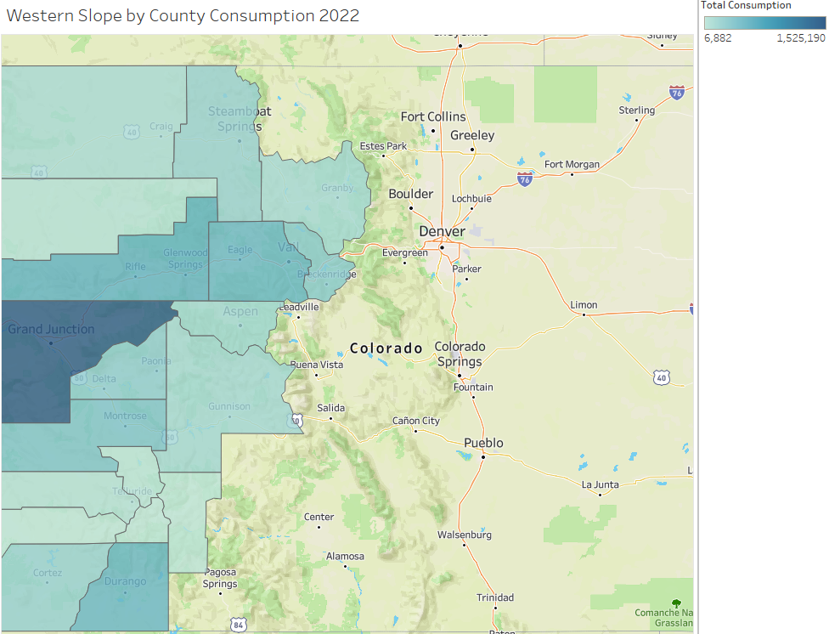
Energy Consumption Patterns
Cities located along the Colorado river consume more electricity.
The largest amount of electricity consumption in the Western Slope region is attributed to Mesa County.
Mesa county has the largest population and business density.

Slide 6
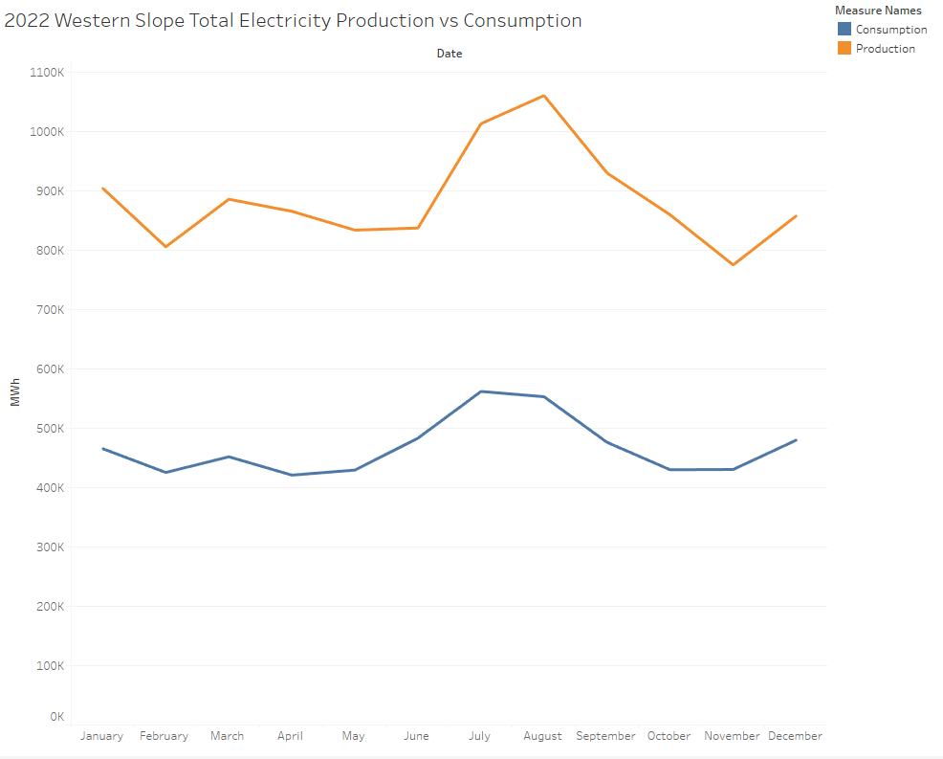
Energy Production vs Consumption
Western Colorado experiences an excess in electricity production.
Hydroelectric dams can reduce the region's reliance on fossil fuels for electricity generation.
Electricity produced from hydroelectric dams decreases energy bills for consumers.

Slide 7
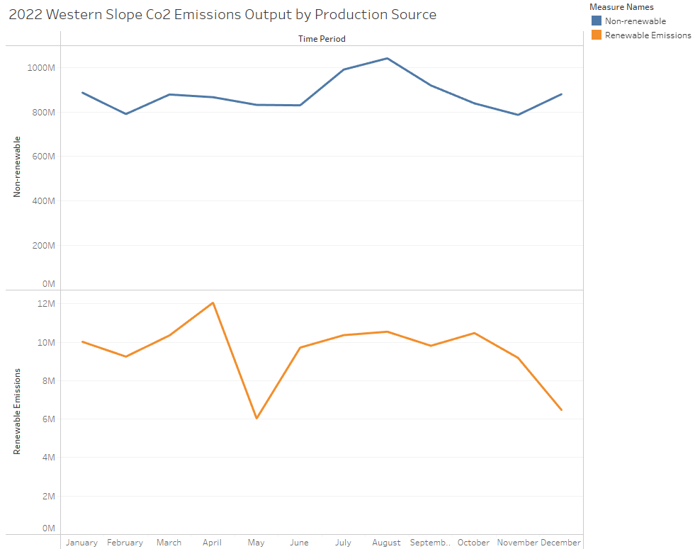
Greenhouse Emissions
Compared to renewable sources, fossil fuels contribute significantly more CO2 emissions when generating electricity.
Hydroelectric dams reduce the overall greenhouse emissions.

Slide 8
Why Hydroelectric?
Colorado’s geographical features are perfect for hydroelectric dams.
Water is not used up in the process and the supply is endless (unless weather patterns significantly change).
It is the largest renewable source of electricity.
60% of Renewable energy comes from Hydrogeneration (Kafafi, 2021)
Considered to be the most “mature” source of renewable energy.
Other countries with proven success:
96% of energy in Quebec
91% of energy in British Colombia

Slide 9
Dam Repurposing
Using existing dams could help lower the ecological impact of transitioning to renewable energy.
Could also lower the cost associated with building hydroelectric dams.
Existing dams already have a structure that can be modified to make them more versatile.
This will create more value for a dam to invest in maintenance, reservoir recreation accommodations (e.g. boat launch, parks), and other ecological restoration.

Slide 10
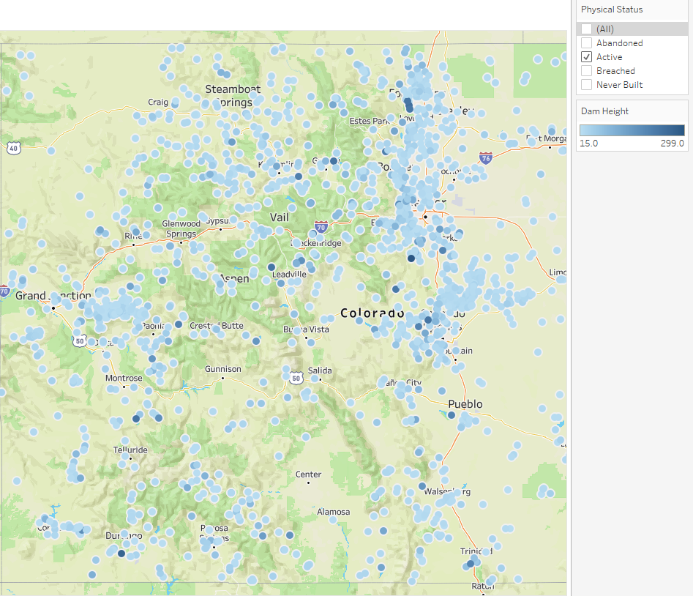
Where are Existing Dam Candidates?
The western slope has many existing dams and reservoirs.
Along the Colorado, Gunnison, and Yampa rivers.
On and below mountain ranges such as the Grand Mesa and San Juan Mountains
Figure Data Source: (Franz, 2023) https://data.colorado.gov/Water/Jurisdictional-Dams/85wh-8h2z

Slide 11
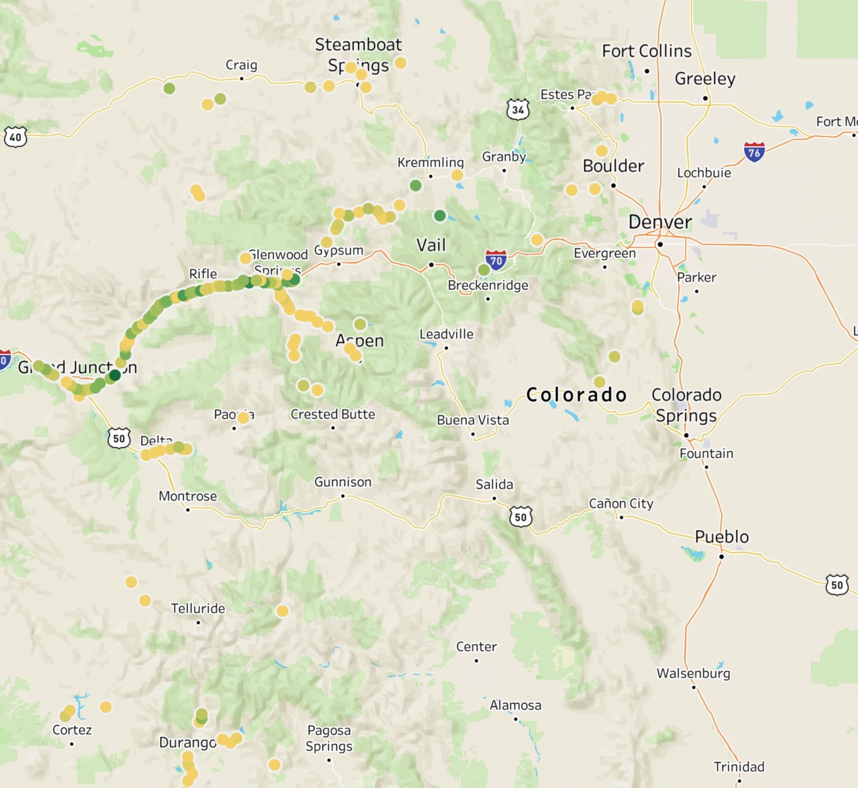
New Dams
The Western slope has lots of potential sites for new dams
Along the Colorado River
Hot Spots in Delta and Durango following the Gunnison and Animas River respectively

Slide 12
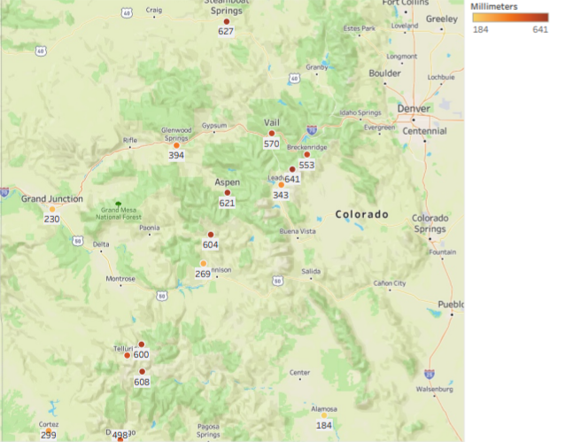
Precipitation
River flows are often determined by the amount of Precipitation
Singled out the Western Slope
High density precipitation along the Colorado River, Glenwood Springs, and Telluride

Slide 13
Flow Rate of the Colorado River
Higher rate of flow in Summer months due to snowmelt
Around 15,000-36,000 cubic feet per second from May-July
August through April have lower rates of flow
2,000-3,000 cubic feet per second on average
Has higher rate of flow in Grand Junction and Fruita due to it joining its largest tributary, the Gunnison River

Slide 14
Conclusion
Hydroelectric Energy is the most reliable source of renewable energy.
To avoid economic repercussions, we must continue producing enough energy to export.
Repurposing dams could mitigate additional costs and ecological impacts.
The Colorado River and Gunnison River are ideal areas for hydroelectric dams due to their geographical features.

Slide 15
Thank You
Any Questions?

Slide 16
Sources
Colorado Energy Office. (n.d.). Renewable Energy. https://www.colorado.gov/energyoffice/renewable-energy
Feasible small hydro project sites in Colorado: Colorado Information Marketplace. Feasible Small Hydro Project Sites in Colorado | Colorado Information Marketplace. (2022, June 30). https://data.colorado.gov/Water/Feasible-Small-Hydro-Project-Sites-in-Colorado/mxfq-jecf
Franz, J. (2023, April 15). Jurisdictional dams: Colorado Information Marketplace. Colorado Information Marketplace. Retrieved April 15, 2023, from https://data.colorado.gov/Water/Jurisdictional-Dams/85wh-8h2z
Kafafi, A. (2021). CLEAN POWER GRID SUCCESSES, LESSONS FOR ISES IN ENERGY: Hydropower can supplement renewable sources but comes with drawbacks. ISE: Industrial & Systems Engineering at Work, 53(7), 26–31.
U.S. Energy Information Administration. (2021, April 20). Colorado - State Energy Profile Overview - U.S. Energy Information Administration (EIA). Retrieved from https://www.eia.gov/state/?sid=CO#tabs-4

