Slide 1
Development of information technology
From analogous computer to LLM
(1970-2025)
(K.-P. Pleissner- Alumni meeting 30.08.2025)

Slide 2
Analogous computer
Digital computer
Personal computer
Internet with HTML (~1991) (game changer)
Mobil phone, Laptop, mini PC
Big server farms, Cloud computing
Artificial Intelligence (AI) with Large Language Models (LLM) (game changer)

Slide 3

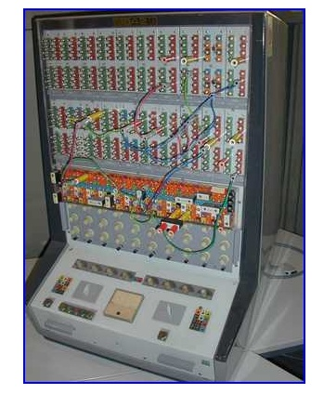

Electrical components:
Amplifiers
Multiplicators
Integrators
Differentiators
Resistors
X-y plotter
Potentiometers
Programming by connecting components using cords

Slide 4
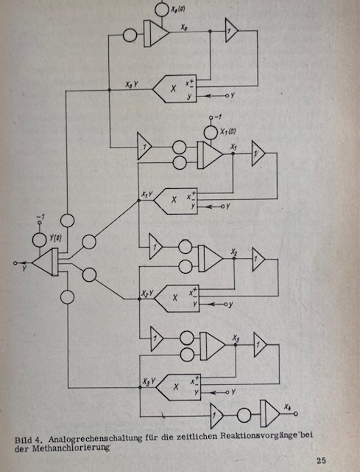

Slide 5
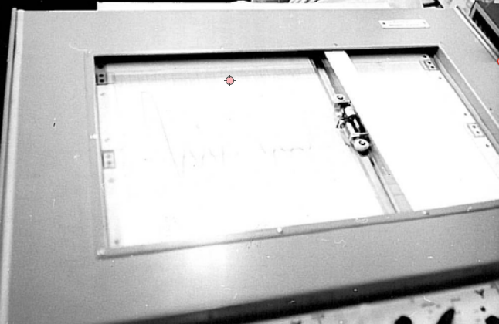

Slide 6
Digital computer
Process computer KRS 4200
Collection and analysis of data
of physical devices used in molecular
biological research such as
MS, ESR, X-Ray Diffractometer etc.

Slide 7
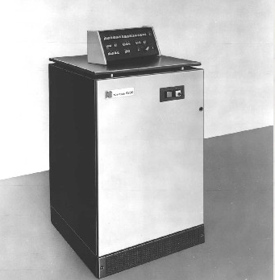
MiniComputer /Process computer
KRS 4200
All infos under:
http://www.robotrontechnik.de/index.htm?/html/computer/r4200.htm

Slide 8
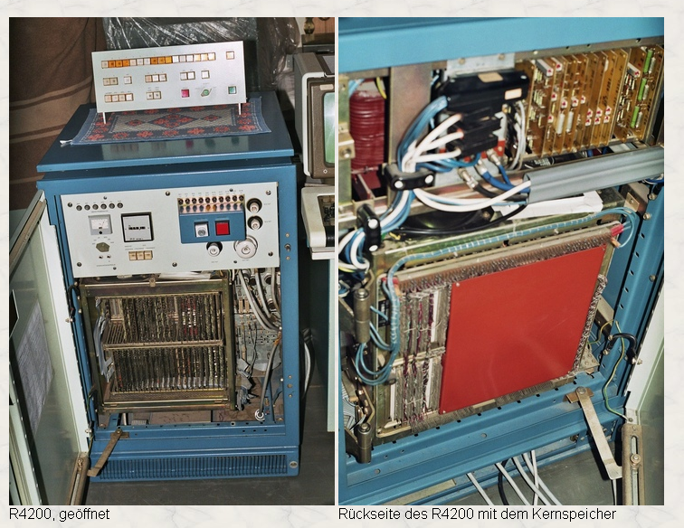
Terminal
Tablecloth
CPU
Magnetic core memory
(16 KByte)

Slide 9

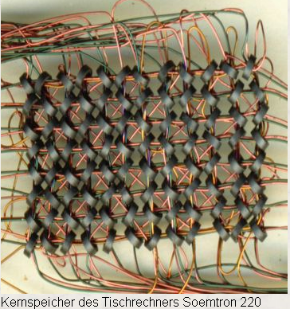
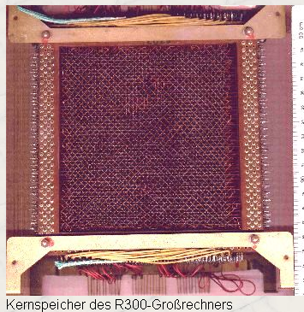
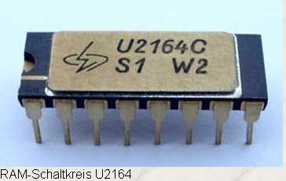
(RAM)
Magnetic core memory
Electrical circuit

Slide 10

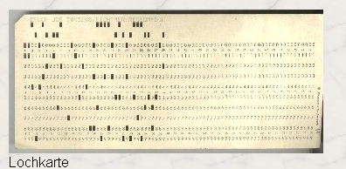

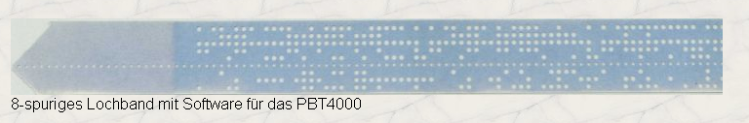
External
Punch card
Perforated paper tape
Program debugging:
1: by new perforation
2. Manual input of code via terminal

Slide 11
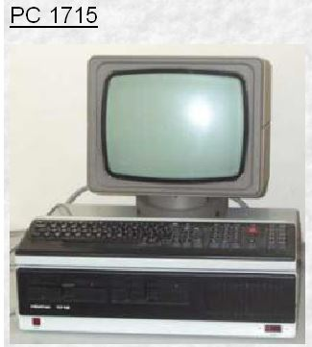
Personal Computer PC1715

Slide 12
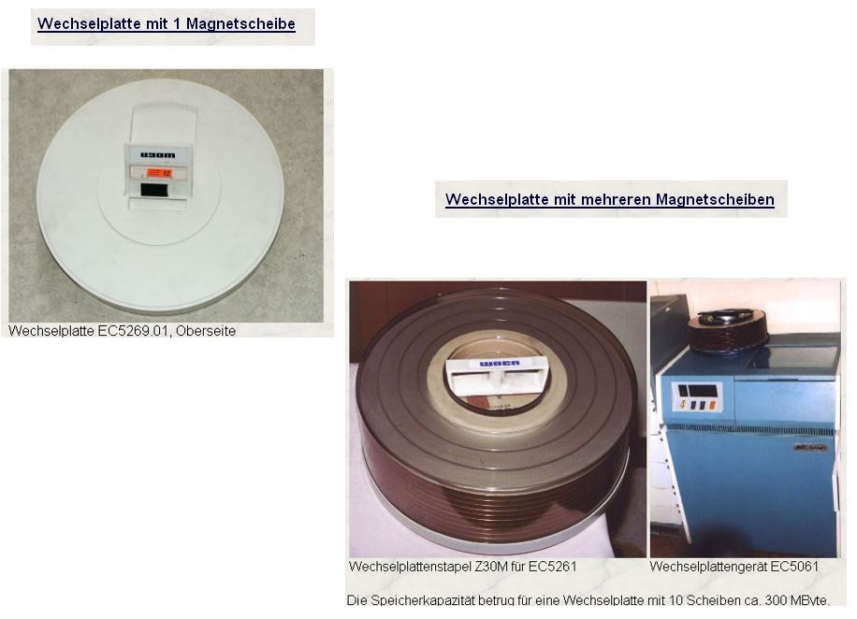
1 MByte
300 MByte

Slide 13

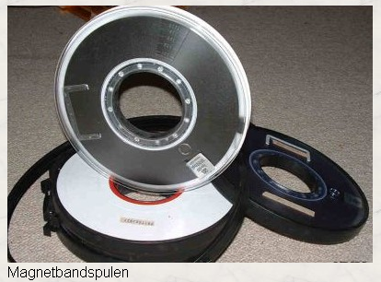

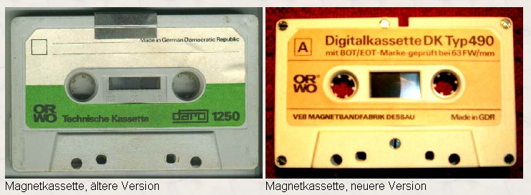
Magnetic tape
Magnetic tape cartridge

Slide 14

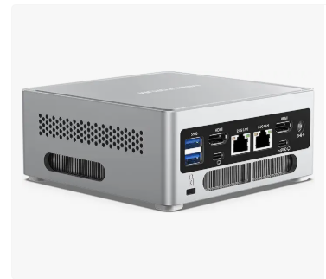
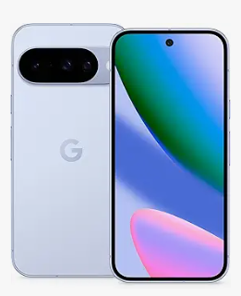
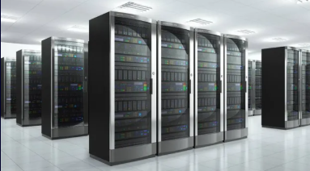

Slide 15
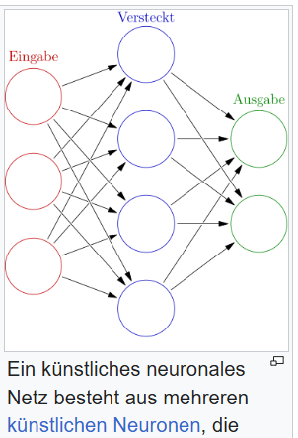
Software development
Programming languages
Assembler
FORTRAN
HTML
JAVA
DELPHI
PHP
Perl
KNIME
R
Python
IDEs
Emacs
Borland
Turb Pascal
Eclipse
PyCharm
Netbeans
IntelliJ
Spider
RStudio
  with AI support:
    VS Code
    Positron
    Windsurf
    Cursor
KNN
Operating systems
Unix/Linux
Windows
Mac

Slide 16
My intensions:
Searching of all publications of Thomas F. Meyer in PubMed ?
via PubMed search
Using AI
Creating own LLM using information of publications
AI assisted coding
Working with models (in future)

Slide 17
Publication search in PubMed
(using the [author Meyer, TF] as example)

Slide 18
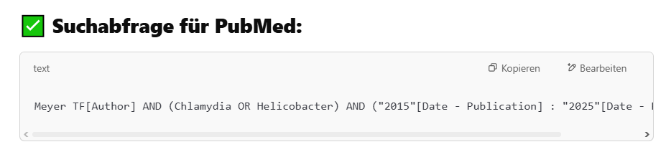

Slide 19
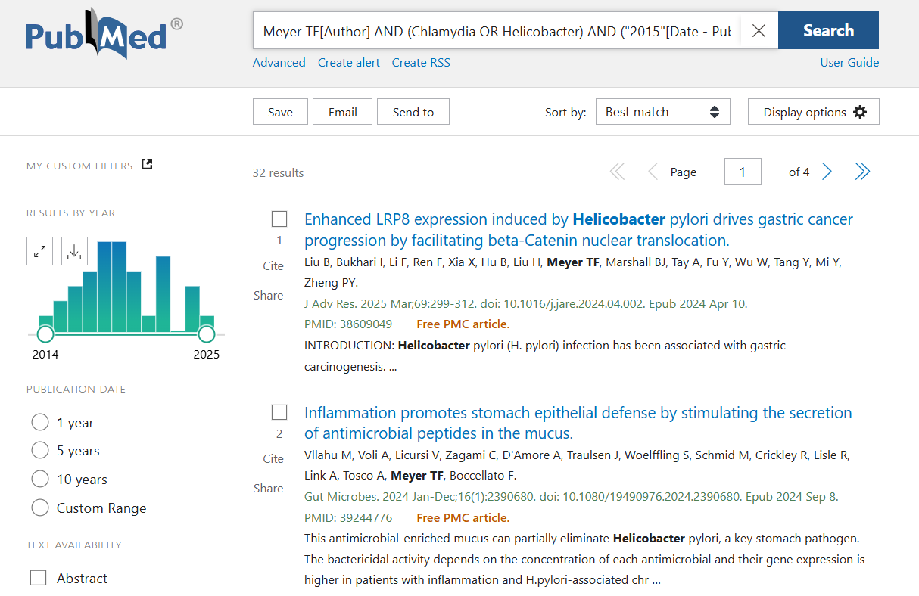

Slide 20
Artificial Intelligence (AI)
(Better to be naturally stupid than artificially intelligent ?? )

Slide 21
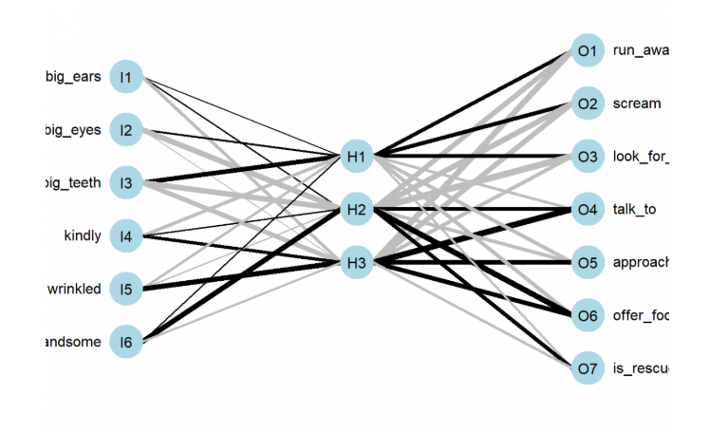
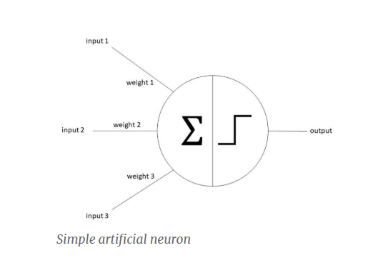
Neural net (NN)

Slide 22
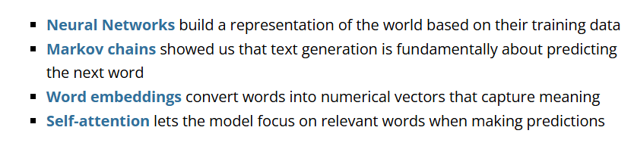
Tranformer- Large Language Model
The Unreasonable Effectiveness of Transformers
What’s truly remarkable is that this simple architecture –
predicting the next word using self-attention –
gives rise to seemingly intelligent behavior.
Our tiny model learned:
Grammar rules (without being taught grammar)
Character relationships (without being told who’s who)
Story structure (without understanding “plot”)
Writing style (without lessons in literature)
Die “vernunftwidrige” Effektivität von Transformatoren
Das wirklich Bemerkenswerte daran ist,
dass diese einfache Architektur –
die Vorhersage des nächsten Wortes mithilfe von Selbstaufmerksamkeit –
zu einem scheinbar intelligenten Verhalten führt.
Unser kleines Modell hat Folgendes gelernt:
Grammatikregeln (ohne Grammatikunterricht)
Beziehungen zwischen Charakteren (ohne zu wissen, wer wer ist)
Story-Struktur (ohne „Handlung” zu verstehen)
Schreibstil (ohne Literaturunterricht)

Slide 23
ChatGPT
(Generative Pre-trained Transformer)
AI-Chatbot based on LLM
It can:
Understanding natural language
create answers
Writing / analysing text
creating / analysing images (GPT-4o)
etc.
Creating code in different programming languages (AI-assisted coding) - Copilot

Slide 24
AI-assisted publication search
(using the [author Meyer, TF] as example)

Slide 25
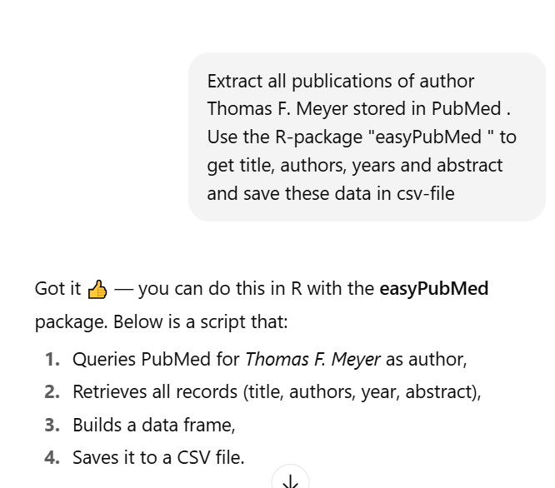
A prompt for ChatGPT is a textual instruction that guides the AI to generate a specific response,
A prompt for ChatGPT is a textual instruction that guides the AI to generate a specific response,
Prompt for ChatGPT -->

Slide 26
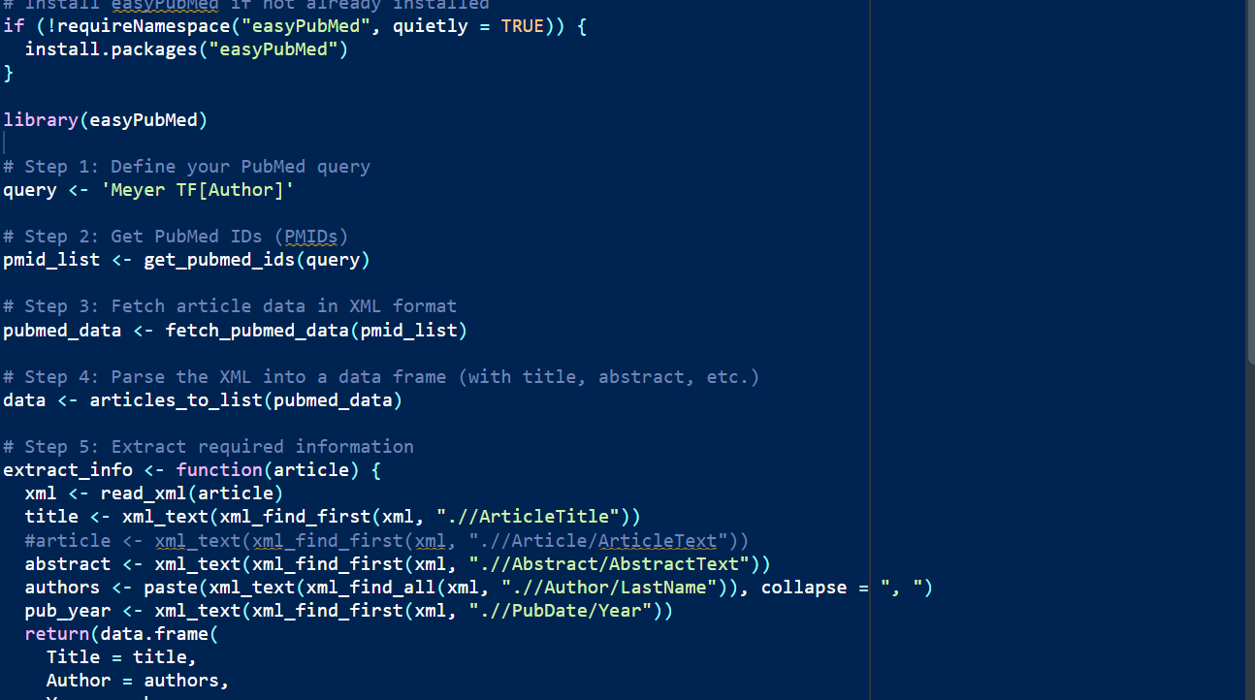
Code generated by ChatGPT

Slide 27
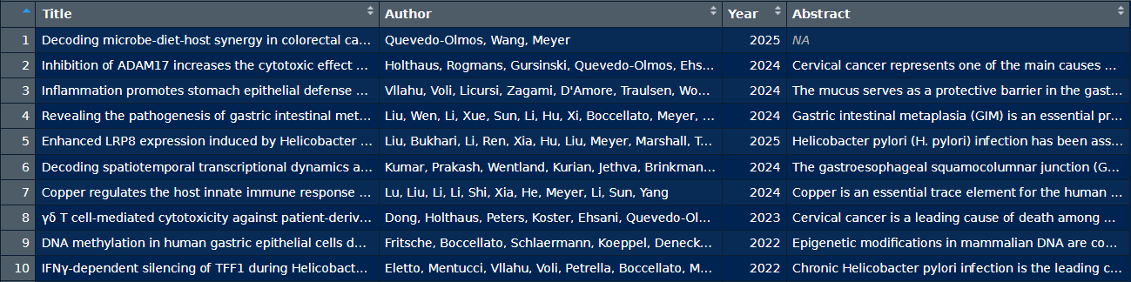
Search result as .csv-file:

Slide 28
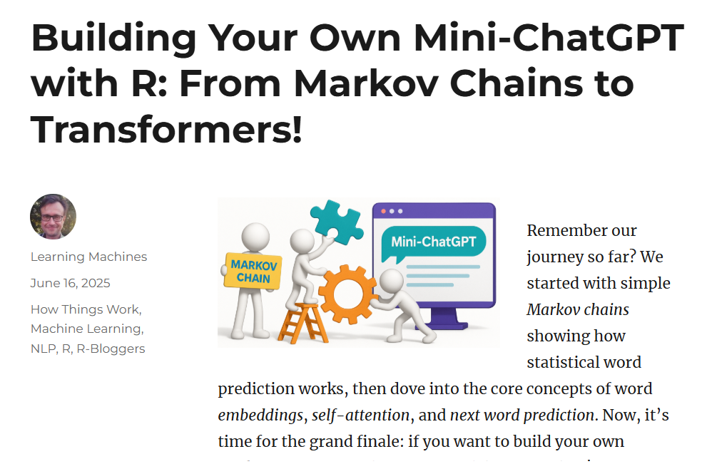

Slide 29
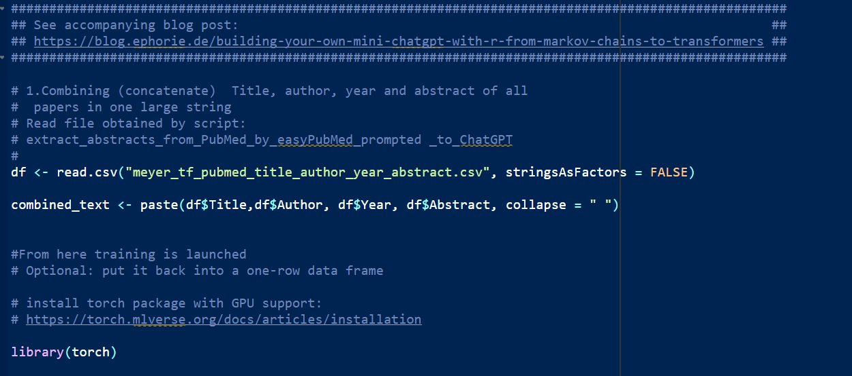
R-script in RStudio
“mini_ChatGPT_extended_by_saving_model.R” (method: copy / paste)”
Result: model.pt (python torch .pt-file)

Slide 30
AI - assisted coding

Slide 31
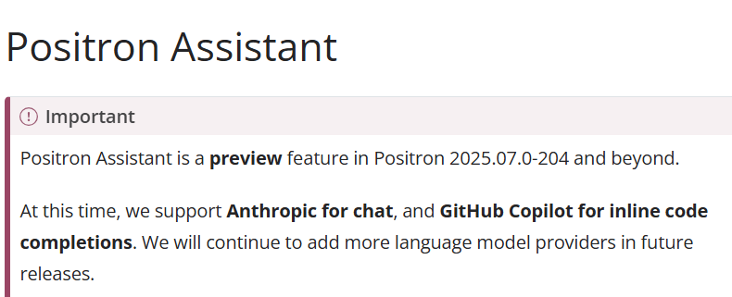
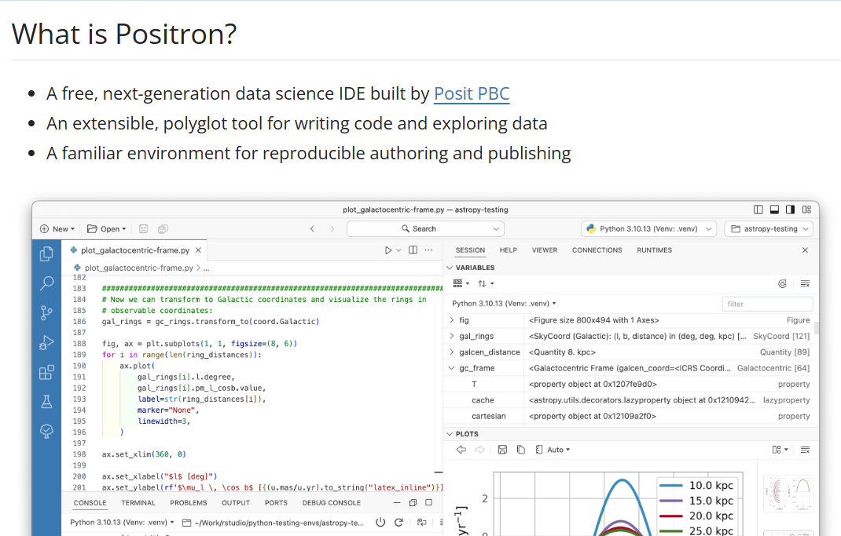
IDE Positron with AI-assistant

Slide 32
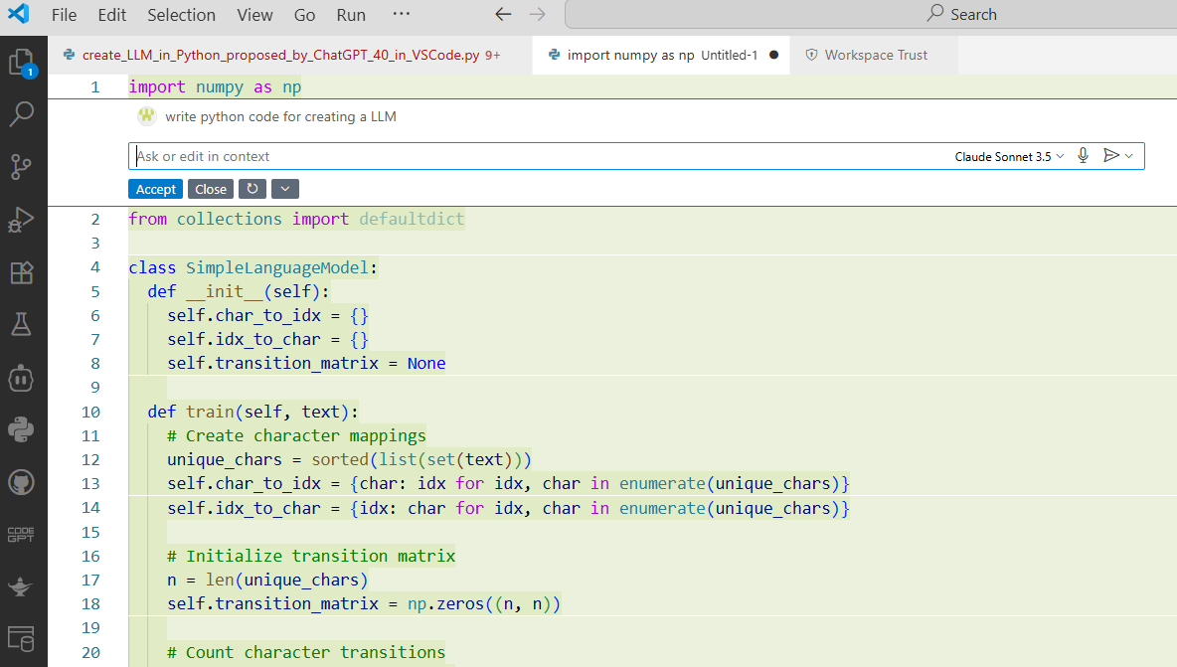
IDE: VSCode

Slide 33
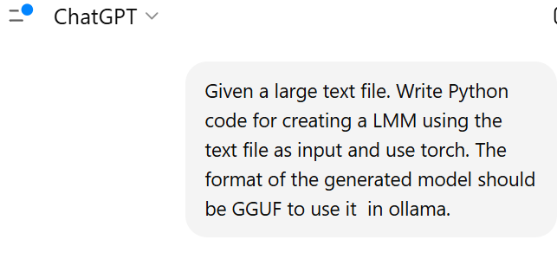
Prompt for ChatGPT -->

Slide 34
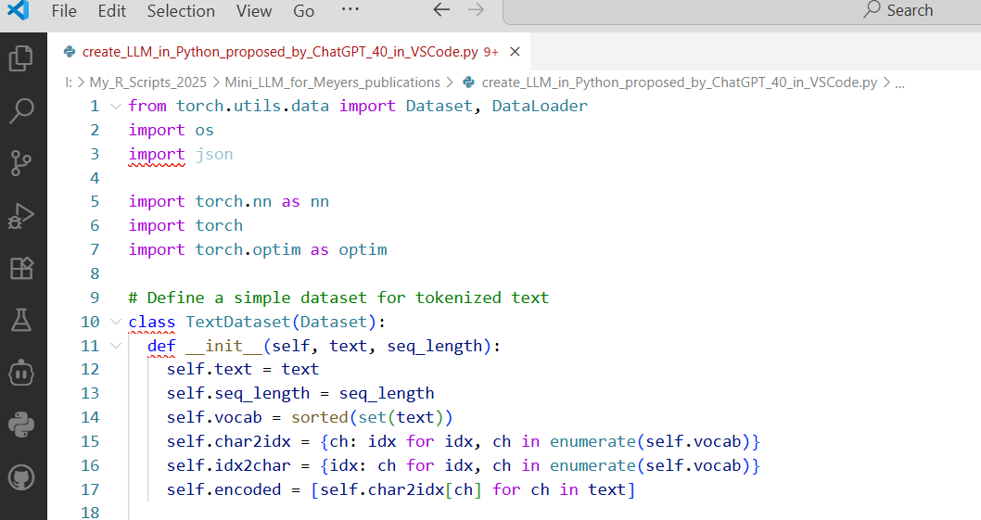
Python script proposed by ChatGPT in VSCode
“create_LLM_in_Python_proposed_by_ChatGPT_40_in_VSCode.py”
Result: model.gguf ( GPT-Generated Unified Format )

Slide 35
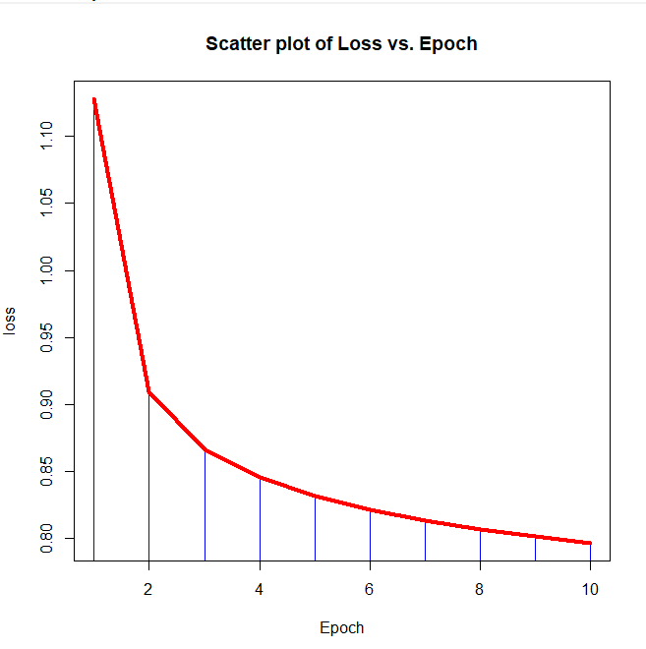
Time of calculation on my Laptop:
~ 4 h
Enhancement of training quality
by iteration (loss vs. epochs):
( see plot)

Slide 36
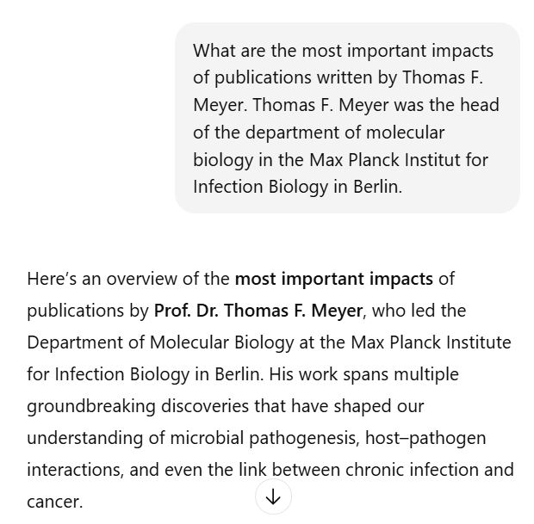
LLM in usage (Prompting / Response)
Prompt for ChatGPT -->

Slide 37
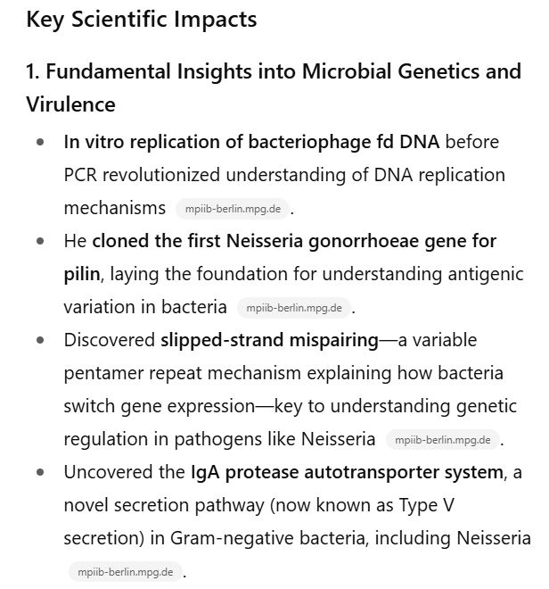

Slide 38
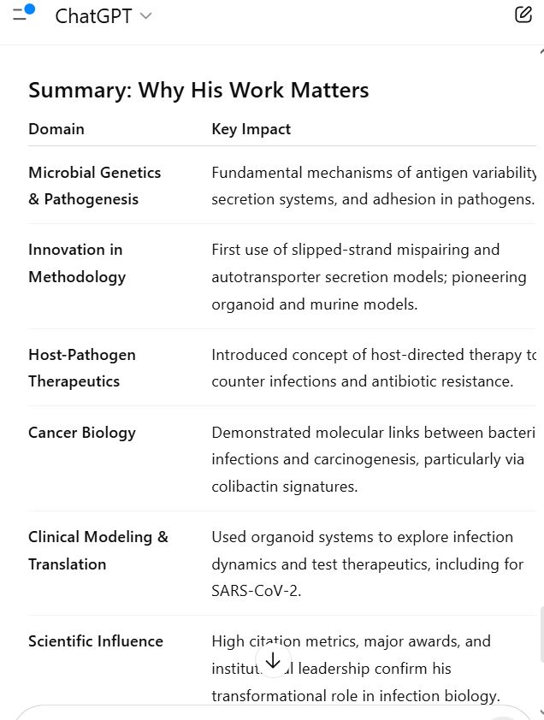

Slide 39
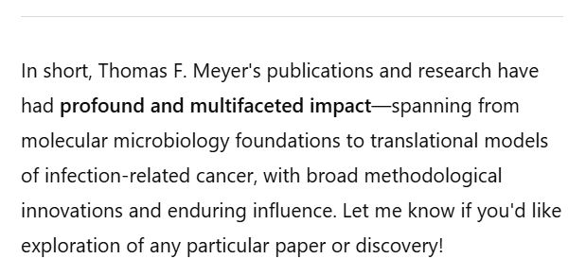

Slide 40
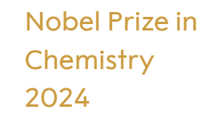
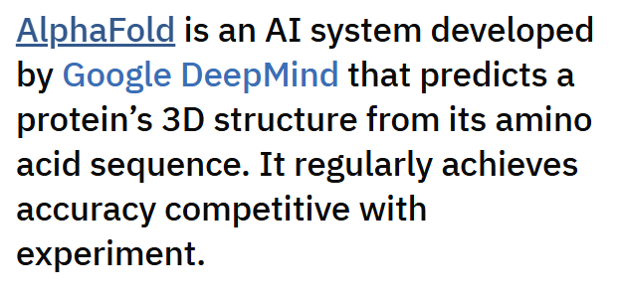
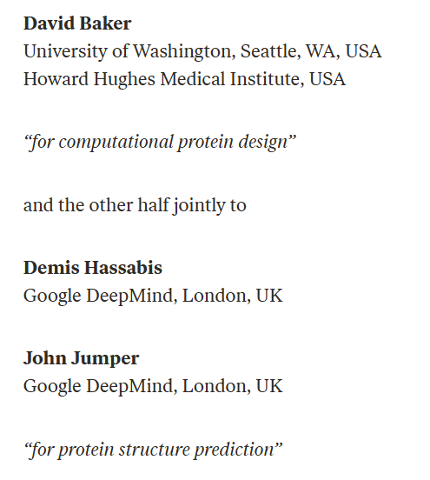
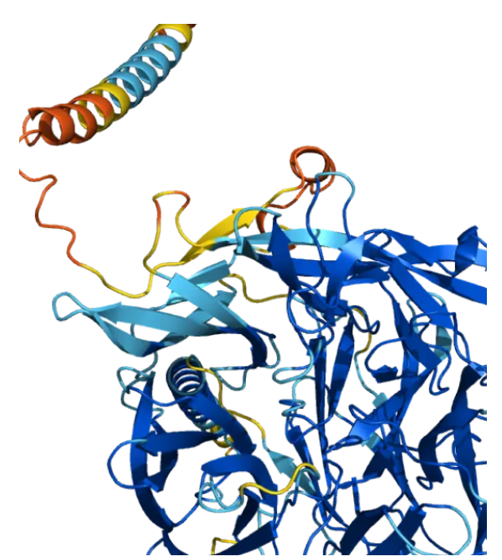
Applied AI

Slide 41


Slide 42
Take home message
Breathtaking advances in digital information technology
Increased computing power (factor > 1000-1000000) for cpu, storage, connectivity
Intelligent software (AI) with databases and packages (CRAN, BioConductor, PyPi)
Game changers: Internet LLM
Creating own LLM is possible. They can be used for specialized applications
Overwhelming flood of information (for LLM)
LLM revolutionizes software development
What I have learned over 50 years:
  Nothing stays the same !
  Something can happen and suddenly everything is different

Slide 43
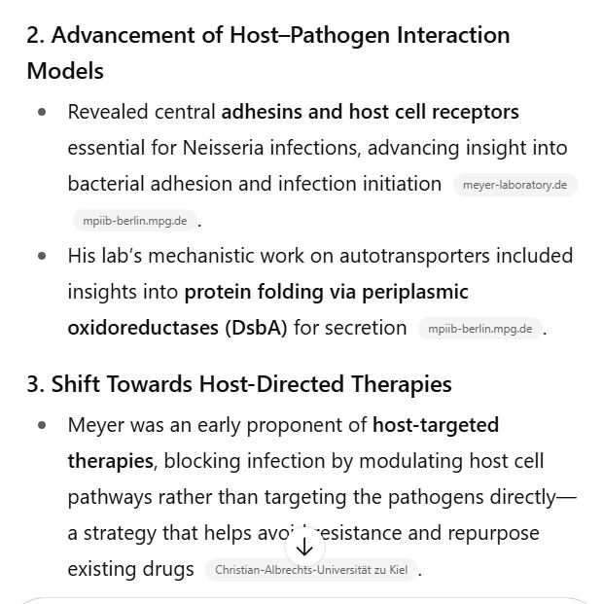

Slide 44
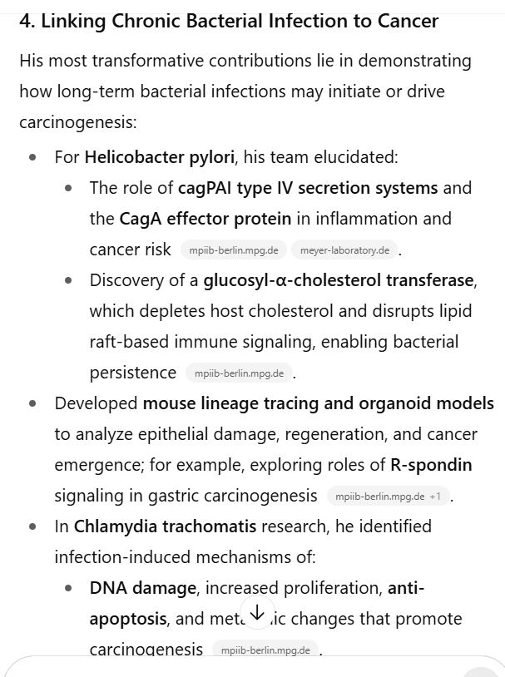

Slide 45
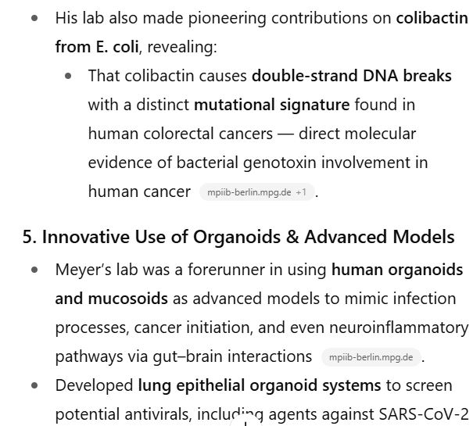

Slide 46


