Slide 1
What is Bootstrap?
Bootstrap is a free front-end framework for faster and easier web development
Bootstrap includes HTML and CSS based design templates for typography, forms, buttons, tables, navigation, modals, image carousels and many other, as well as optional JavaScript plugins
Bootstrap also gives you the ability to easily create responsive designs
Bootstrap is a free, open-source and is the most popular HTML, CSS, and JavaScript framework developed by twitter for creating responsive web applications.
It can be used to create a web application built with any server side technologies like ASP.NET, JAVA, PHP etc.
What is Responsive Web Design? Responsive web design is about creating web sites which automatically adjust themselves to look good on all devices, from small phones to large desktops.

Slide 2
History
Bootstrap was developed by Mark Otto and Jacob Thornton at Twitter (Twitter Blueprint). It was released as an open source product in August 2011 on GitHub.
Version 2.0 supports Responsive web design.
Version 3.0 adopted a mobile- first design.
Version 4.0 alpha added Sass and Flexbox support.
What Bootstrap Package Includes?
Scaffolding: Bootstrap provides a basic structure with Grid System, link styles, background.
CSS: Bootstrap comes with feature of global CSS settings, fundamental HTML elements and enhanced with extensible classes, and an advanced grid system.
Components: Bootstrap contains over a dozen reusable components built to provide iconography, dropdowns, navigation, alerts, popovers, and much more.

Slide 3
What Bootstrap Package Includes?
JavaScript Plugins: Bootstrap contains a variety of customized jQuery plugins. We can easily include them all, or one by one.
Customize: We can customize Bootstrap's components and jQuery plugins to get your very own version.

Slide 4
Why Use Bootstrap?
Advantages of Bootstrap:
Easy to use: Anybody with just basic knowledge of HTML and CSS can start using Bootstrap
Responsive features: Bootstrap's responsive CSS adjusts to phones, tablets, and desktops
Mobile-first approach: In Bootstrap 3, mobile-first styles are part of the core framework
Browser compatibility: Bootstrap is compatible with all modern browsers (Chrome, Firefox, Internet Explorer, Safari, and Opera)
Where to Get Bootstrap?
There are two ways to start using Bootstrap on your own web site.
You can:
Download Bootstrap from getbootstrap.com
Include Bootstrap from a CDN

Slide 5
Downloading Bootstrap
If you want to download and host Bootstrap yourself, go to getbootstrap.com, and follow the instructions there.
Bootstrap CDN
If you don't want to download and host Bootstrap yourself, you can include it from a CDN (Content Delivery Network).
MaxCDN provides CDN support for Bootstrap's CSS and JavaScript. You must also include jQuery:
<!-- Latest compiled and minified CSS --> <link rel="stylesheet" href="https://maxcdn.bootstrapcdn.com/bootstrap/3.3.7/css/bootstrap.min.css"> <!-- jQuery library --> <script src="https://ajax.googleapis.com/ajax/libs/jquery/3.2.0/jquery.min.js"></script> <!-- Latest compiled JavaScript --> <script src="https://maxcdn.bootstrapcdn.com/bootstrap/3.3.7/js/bootstrap.min.js"></script>

Slide 6
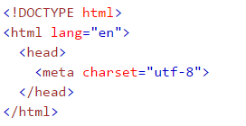
One advantage of using the Bootstrap CDN:
Many users already have downloaded Bootstrap from MaxCDN when visiting another site. As a result, it will be loaded from cache when they visit your site, which leads to faster loading time. Also, most CDN's will make sure that once a user requests a file from it, it will be served from the server closest to them, which also leads to faster loading time.
Create First Web Page With Bootstrap
1. Add the HTML5 doctype
Always include the HTML5 doctype at the beginning of the page, along with the lang attribute and the correct character set:

Slide 7

2. Bootstrap 3 is mobile-first
Bootstrap 3 is designed to be responsive to mobile devices. Mobile-first styles are part of the core framework.
To ensure proper rendering and touch zooming, add the following <meta> tag inside the <head> element:
The width=device-width part sets the width of the page to follow the screen-width of the device (which will vary depending on the device).
The initial-scale=1 part sets the initial zoom level when the page is first loaded by the browser.
Mobile first design is an approach outlined in 2009. Put simply, mobile first is an approach to responsive design: design for smaller screens first, then add more features and content for bigger and bigger screens.

Slide 8
3. Containers
Bootstrap also requires a containing element to wrap site contents.
There are two container classes to choose from:
The .container class provides a responsive fixed width container
The .container-fluid class provides a full width container, spanning the entire width of the viewport
Note: Containers are not nestable (you cannot put a container inside another container).

Slide 9
What is a Grid?
Grid is a structure (usually two-dimensional) made up of a series of intersecting straight (vertical, horizontal) lines used to structure the content.
In web design, it is a very effective method to create a consistent layout rapidly and effectively using HTML and CSS.
It organize and structure content, makes the websites easy to scan and reduces the load on users.
Bootstrap's grid system is responsive, and the columns will re-arrange automatically depending on the screen size.

Slide 10
Grid System Description
Grid System consists of 12 columns.
The Grid system is used for creating page layouts through a series of rows and columns.
Rows must be placed with a .container (fixed –width) or .container –fluid (full-width) for proper alignment and padding.
Use rows to create horizontal group of columns.
Content should be placed within columns, and only columns may be immediate children of rows.
Bootstrap's grid system allows up to 12 columns across the page.
If you do not want to use all 12 columns individually, you can group the columns together to create wider columns:

Slide 11
Grid System Structure
col-*-1 | col-*-1 | col-*-1 | col-*-1 | col-*-1 | col-*-1 | col-*-1 | col-*-1 | col-*-1 | col-*-1 | col-*-1 | col-*-1
col-md-1 | col-md-1 | col-md-1 | col-md-1 | col-md-1 | col-*-1 | col-*-1 | col-*-1 | col-*-1 | col-*-1 | col-*-1 | col-*-1
col- * - 4 |  |  |  | col- * - 4 |  |  |  | col- * - 4
col- * - 4 |  |  |  | col- * - 8
col- * - 12
First; create a row (<div class="row">).
Then, add the desired number of columns (tags with appropriate .col-*-* classes).
Note that numbers in .col-*-* should always add up to 12 for each row.

Slide 12
Working of Bootstrap Grid System
Grid systems are used for creating page layouts through a series of rows and columns that house your content.
Here's how the Bootstrap grid system works:
Rows must be placed within a .container class for proper alignment and padding.
Use rows to create horizontal groups of columns.
Content should be placed within columns, and only columns may be immediate children of rows.
Predefined grid classes like .row and .col-*-* are available for quickly making grid layouts.
Columns create gutters (gaps between column content) via padding. That padding is offset in rows for the first and last column via negative margin on .rows.
Grid columns are created by specifying the number of twelve available columns you wish to span.
If more than 12 columns are placed within a single row, each group of extra columns wrap onto a new line.

Slide 13
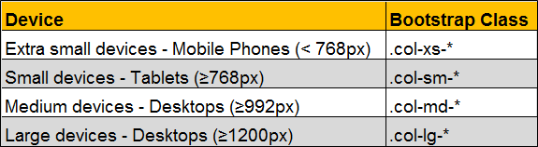
Grid Classes
The Bootstrap grid system has four classes:
xs (for phones)
sm (for tablets)
md (for desktops)
lg (for larger desktops)

Slide 14
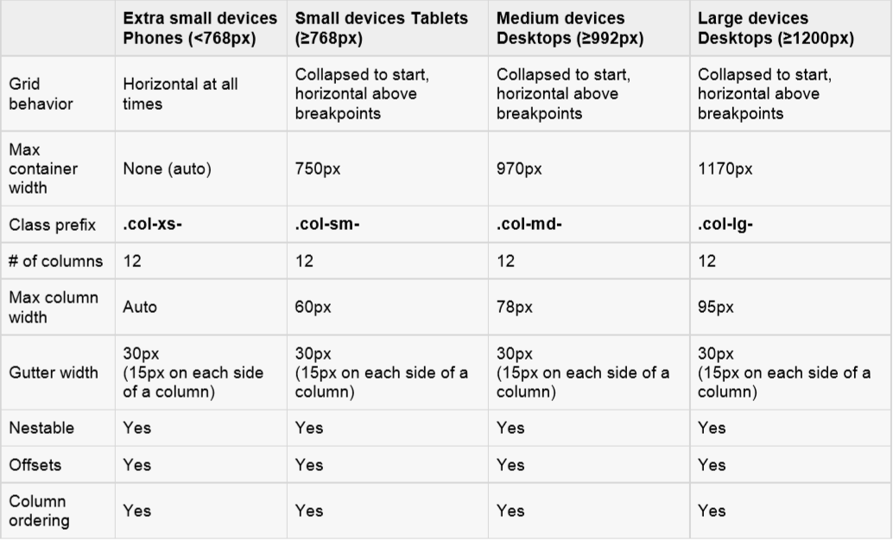
Grid options
The following table summarizes aspects of how Bootstrap grid system works across multiple devices:

Slide 15
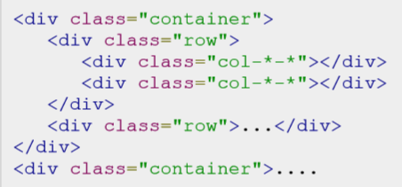
BASIC GRID STRUCTURE
Following is basic structure of Bootstrap grid:

Slide 16
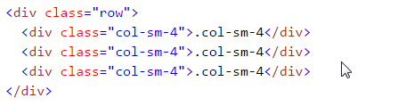
Bootstrap Grid System Example:
The following example shows how to get a three equal-width columns starting at tablets and scaling to large desktops. On mobile phones, the columns will automatically stack:
Notes:
Explain about program

Slide 17
Bootstrap Grid System Example: Three Equal Columns
The following example shows how to get a three equal-width columns starting at tablets and scaling to large desktops. On mobile phones, the columns will automatically stack:
Notes:
Explain about program

Slide 18

Bootstrap Grid System Example: Two Unequal Columns
The following example shows how to get two various-width columns starting at tablets and scaling to large desktops:
Notes:
Explain about program

Slide 19
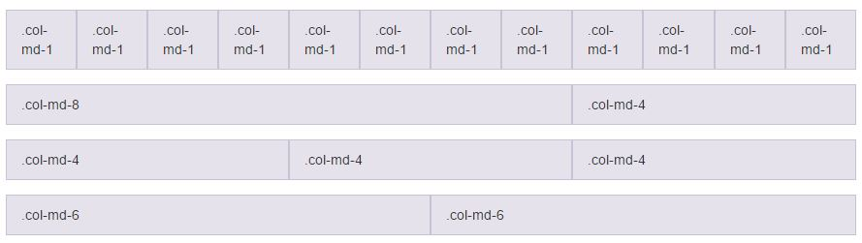
Bootstrap Grid System Example: Stacked-to-horizontal
Notes:
Explain about program

Slide 20
Stacked-to-horizontal
Container class is added to ensure the proper centering and maximum width of the layout.
Once container is added, we need to think in terms of rows. Add <div class = "row">...</div> and columns <div class = "col-md-6"></div> inside the rows
In the example we have two columns each made of 6 units wide.(6+6 =12).
Notes:
Explain about program

Slide 21
Column Wrapping
More than 12 columns are placed within a single row, Each group of extra columns will wrap onto a new line.
Notes:
Program 6

Slide 22
Responsive column resets
Assume that four tiers of grids available, we run into issues where at certain breakpoints.
Columns are don’t clear quite right as one is taller than the other.
To fix this issue, We can use class .clearfix.
Notes:
Explain Program 7

Slide 23
Offsetting columns
It can be used for push columns over for more spacing.
.col-md-offset-* class increases the left margin of a column range form 1 to 11.
Offset class moves the content to the right depending upon the given value.
Notes:
Explain program 8.

Slide 24
Nesting columns
To nest your content with the default grid, add a new row and set of columns within an existing column.
Nested rows should include a set of columns that add up to 12.
Notes:
Explain program 9

Slide 25
Column Ordering
To write columns in an order and show them in one another one by using push and pull modifier classes where ranges form 1 to 11.
Syntax:
.col-md-push-*
.col-md-pull-*
Notes:
Program 10

Slide 26
Typography
Bootstrap uses Helvetica Neue, Helvetica, Arial, and sans-serif in its default font stack. Using typography feature of Bootstrap you can create headings, paragraphs, lists and other inline elements.
Default font-size is 14px. with a line –height of 1.428.(Applied to <body> and all paragraphs).
Paragraph <p> elements have a bottom margin that equals half their computed line-height (10px by default).
Headings:
All HTML headings (h1 to h6) are styled in Bootstrap. An example is as shown below:
<h1>I'm Heading1 h1</h1> Semibold 36px
<h2>I'm Heading2 h2</h2> Semibold 30px
<h3>I'm Heading3 h3</h3> Semibold 24px
<h4>I'm Heading4 h4</h4> Semibold 18px
<h5>I'm Heading5 h5</h5> Semibold 14px
<h6>I'm Heading6 h6</h6> Semibold 12px

Slide 27
Typography
INLINE SUBHEADINGS:
To add an inline subheading to any of the headings, simply add <small> around any of the elements or add .small class and you will get smaller text in a lighter color as shown in the example below:
<h1>I'm Heading1 h1. <small>I'm secondary Heading1 h1</small></h1>
<h2>I'm Heading2 h2. <small>I'm secondary Heading2 h2</small></h2>
<h3>I'm Heading3 h3. <small>I'm secondary Heading3 h3</small></h3>
<h4>I'm Heading4 h4. <small>I'm secondary Heading4 h4</small></h4>
<h5>I'm Heading5 h5. <small>I'm secondary Heading5 h5</small></h5>
<h6>I'm Heading6 h6. <small>I'm secondary Heading1 h6</small></h6>
Notes:
Program 11

Slide 28
Inline text elements
Marked Text: Highlight the text using <mark> tag.
Deleted Text: Blocks of text have been deleted using <del> tag.
Strikethrough Text: Blocks of text that are no longer relevant using the <s> tag.
Inserted text: The <ins> tag defines a text that has been inserted into a document.
Underline Text: The <u>tag defines a underline text.
Small Text: Use the <small> tag to set the text at 85% the size of the parent.
Bold: Text with a heavier font-weight can be done by <strong> tag.
Italics: For Emphasizing of text with italics done by <em> tag.
Notes:
Program 12

Slide 29
Alignment classes
Realign text can be done with text alignment classes.
text-left class used for Left aligned text.
text-right class used for Right aligned text.
text-center class used for Center aligned text.
text-justify class used for Justified text.
text-nowrap class used for No wrap text.
Notes:
Program 12

Slide 30
Abbreviations
Basic Abbreviation :An abbreviation of the word attribute is attr.
Syntax :<abbr title="attribute">attr</abbr>
Initialism: Add .Initialism to an abbreviation for a slightly smaller font-size.
Syntax :<abbr title="HyperText Markup Language" class="initialism">HTML</abbr>
Addresses
To represent contact information by using <address> tag.
Syntax : <address>……. </address>
Notes:
Program 15

Slide 31
Blockquotes
Default blockquote
The blockquote element is used to present content from another source using <p> tag.
Block quote options
Naming a source : Style and content changes for simple variations on a standard <bolckquote>.Add a <footer> for identifying the source.
Alternate Displays:Add .bolckquote-reverse class right –aligned content.
Syntax:<blockquote class="blockquote-reverse"> ...</blockquote>
Notes:
Program 15

Slide 32
Inline: Place all list items on a single line with padding.
Syntax :<ul class="list-inline">
<li>...</li>
</ul>
Description: A list of terms with their associated descriptions.
Syntax:<dl>
<dt>...</dt>
<dd>...</dd>
</dl>
Horizontal description
Syntax:<dl class="dl-horizontal">
<dt>...</dt>
<dd>...</dd>
</dl>

Slide 33
Tables
Basic Table:
If you want a nice, basic table style with just some light padding and horizontal dividers, add the base class of .table to any table .
Syntax:
<table class="table">
…………..
</table>

Slide 34
Tables
STRIPED TABLE :
By adding the .table-striped class, you will get zebra-striping to any rows within the <tbody>.
Syntax:
<table class="table table-striped">
…………
</table>

Slide 35
Tables
BORDERED TABLE :
By adding the .table-bordered class, you will get borders surrounding every element and rounded corners around the entire table.
Syntax:
<table class="table table-bordered">
………….
</table>

Slide 36
Tables
HOVER TABLE :
By adding the .table-hover class, a light gray background will be added to rows while the cursor hovers over them.
Syntax:
<table class="table table-hover">
…………….
</table>

Slide 37
Tables
Condensed table
By adding the .table-condesend class, to make tables more compat by cutting cell padding in half.
Syntax:
<table class="table table-condensed">
…………….
</table>

Slide 38
Tables
RESPONSIVE TABLES:
By wrapping any .table in .table-responsive class, you will make the table scroll horizontally up to small devices (under 768px). When viewing on anything larger than 768px wide, you will not see any difference in these tables.
Syntax:
<div class="table-responsive">
<table class="table">
………….
</table>
</div>

Slide 39
Contextual classes
Use contextual classes to color table rows or individual cells.
Class | Description
.active | Applies the hover color to a particular row or cell
.success | Indicates a successful or positive action
.info | Indicates a neutral informative change or action
.warning | Indicates a warning that might need attention
.danger | Indicates a dangerous or potentially negative action

