Slide 1
Bootstrap Components

Slide 2
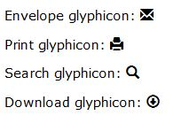
Glyphicons
Bootstrap provides 250 to 260 glyphicons from the Glyphicons Halflings set.
Glyphicons can be used in text, buttons, toolbars, navigation, forms, etc.
Example:
Glyphicon Syntax:
<span class="glyphicon glyphicon-name"></span>

Slide 3
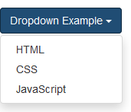
Dropdowns
A dropdown menu is a toggleable menu that allows the user to choose one value from a predefined list.
Example:
The .dropdown class indicates a dropdown menu.
To open the dropdown menu, use a button or a link with a class of .dropdown-toggle and the data-toggle="dropdown" attribute.
The .caret class creates a caret arrow icon (), which indicates that the button is a dropdown.
Add the .dropdown-menu class to a <ul> element to actually build the dropdown menu.

Slide 4
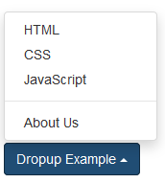
Dropup
The dropdown menu to expand upwards instead of downwards, change the <div> element with class="dropdown" to “dropup”.
Example:
Syntax :<div class="dropup">…….</div>
Divider:
Add a divider to separate series of links in a dropdown menu.
Syntax:<ul class="dropdown-menu" >
...
<li role="separator" class="divider"> </li>
...
</ul>

Slide 5


Button Groups
Bootstrap allows you to group a series of buttons together (on a single line).
Use a <div> element with class .btn-group to create a button group.
Syntax :
Button toolbar:
Combine sets of <div class="btn-group"> into a <div class="btn-toolbar"> for more complex components.
Example:<div class="btn-toolbar" role="toolbar" aria-label="...">
<div class="btn-group" role="group" aria-label="...">
</div> <div class="btn-group" role="group" aria-label="...">.
</div> <div class="btn-group" role="group" aria-label="...">
</div> </div>

Slide 6
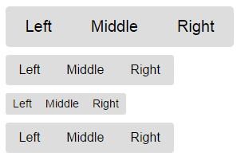
Sizing:
Instead of applying button sizing classes to every button in a group, just add .btn-group-* to each .btn-group, including when nesting multiple groups.
Example:
<div class="btn-group btn-group-lg" role="group" aria-label="...">
</div><div class="btn-group" role="group" aria-label="..."></div>
<div class="btn-group btn-group-sm" role="group" aria-label="..."></div>
<div class="btn-group btn-group-xs" role="group" aria-label="..."></div>

Slide 7

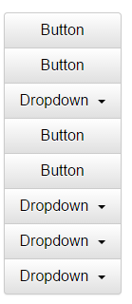
Nesting:
Place a .btn-group within another .btn-group when you want dropdown menus mixed with a series of buttons.
Example:
Vertical variation:
Make a set of buttons appear vertically stacked rather than
horizontally.

Slide 8
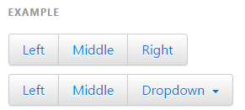

Justified button groups:
With <a> elements: Wrap a series of .btns in .btn-group.btn-group
justified.
With <button> elements: Justified button groups with
<button> elements, must wrap each button in a button group.

Slide 9

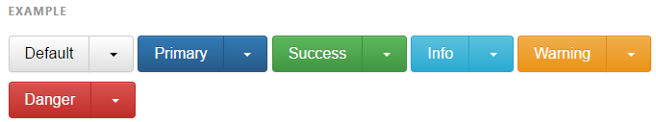
Button dropdowns:
Use any button to trigger a dropdown menu by placing it within a .btn-group and providing the proper menu markup.
Single button dropdowns:
Turn a button into a dropdown toggle with some markup changes.
Split button dropdowns:
create split button dropdowns with the same markup changes, only with a separate button.

Slide 10
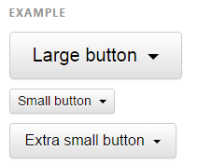

Sizing:
Button dropdowns work with buttons of all sizes.
Dropup variation:
Trigger dropdown menus above elements by adding .dropup to the parent.

Slide 11
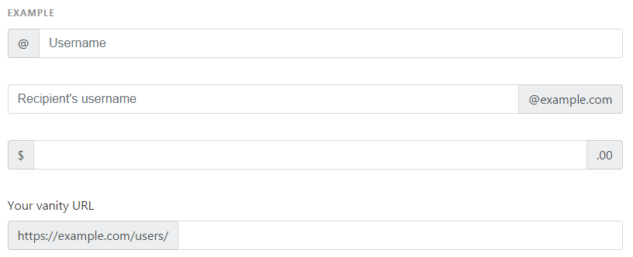
Input groups:
Extend form controls by adding text or buttons before, after, or on both sides of any text-based <input>. Use .input-group with an .input-group-addon or .input-group-btn to prepend or append elements to a single .form-control.
Place one add-on or button on either side of an input. You may also place one on both sides of
an input.

Slide 12
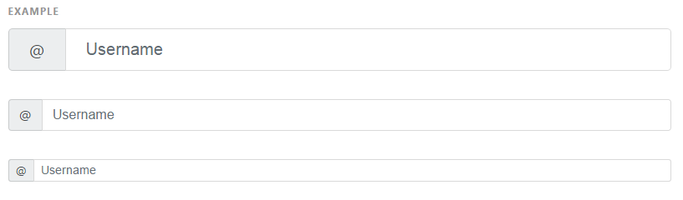
Sizing:
Add the relative form sizing classes to the .input-group itself and contents within will automatically resize
No need for repeating the form control size classes on each element.

Slide 13



Checkboxes and radio addons:
Checkbox or radio option will be placed within an input group's addon
instead of text.
Button addons:
Buttons in input groups are a bit different and require one extra level of
nesting. Instead of .input-group-addon, you'll need to use .input-group
btn to wrap the buttons.

Slide 14
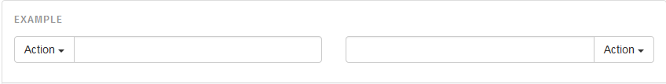
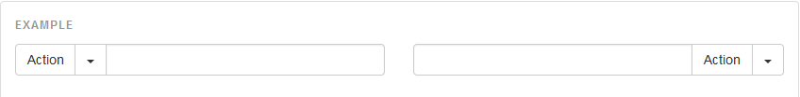
Buttons with dropdowns:
It shows the buttons with dropdowns.
Segmented buttons:
The input text can contain text, button and a dropdown.

Slide 15
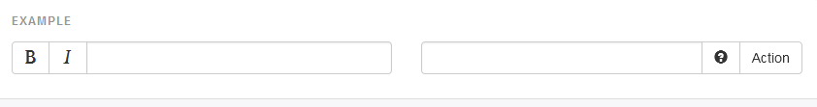
Multiple buttons:
While you can only have one add-on per side, you can have multiple buttons inside a single .input-group-btn.

Slide 16
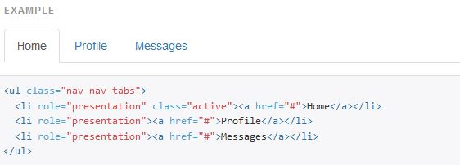
Navs
Bootstrap provides an easy and quick way to create basic nav components like tabs and pills which are very flexible and elegant.
All the Bootstrap's nav components—tabs and pills—share the same base markup and styles through the base .nav class.
Tabs
Tabs are created with <ul class="nav nav-tabs">
Also mark the current page with <li class="active">.

Slide 17
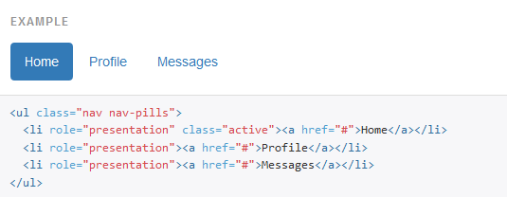
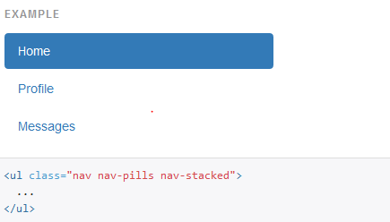
Pills:
Pills are created with <ul class="nav nav-pills">. Also mark the current page with <li class="active">
Pills are also vertically stackable. Just add .nav.stacked.

Slide 18
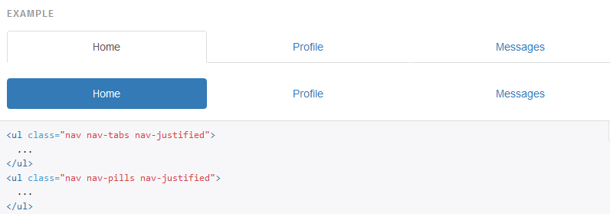
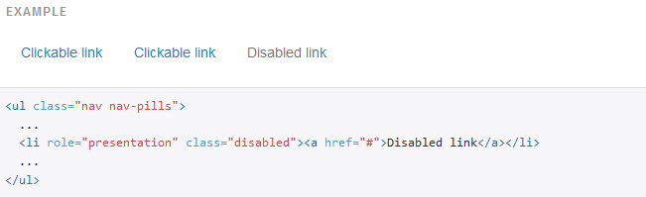
Justified:
Easily make tabs or pills equal widths of their parent at screens wider than 768px with .nav-justified. On smaller screens, the nav links are stacked.
Disabled links:
For any nav component (tabs or pills), add .disabled for gray links and no hover effects.

Slide 19
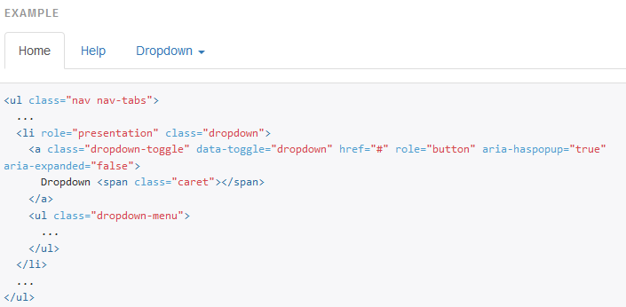
Using dropdowns: Add dropdown menus for tabs and pills by using this syntax classes: Tabs with dropdowns:

Slide 20
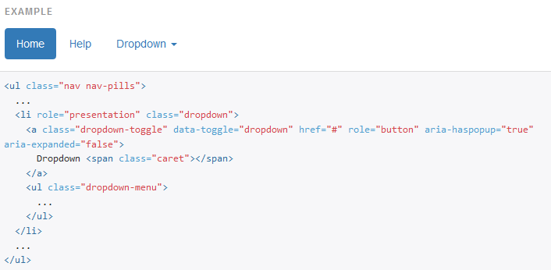
Pills with dropdowns:

Slide 21
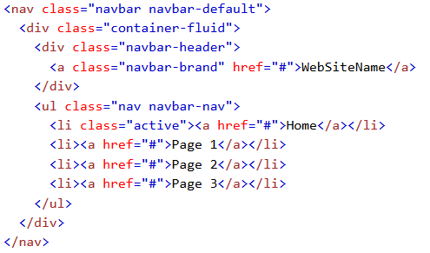
Navbar
A navigation bar is a navigation header that is placed at the top of the page.
With navigation bar can extend or collapse, depending on the screen size.
A standard navigation bar is created with <nav class="navbar navbar-default">
Example :
Syntax :

Slide 22

Inverted navbar
Just change the .navbar-default class into .navbar-inverse.
Example :
Syntax:

Slide 23
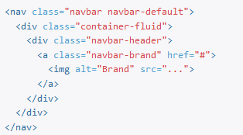
Navbar Brand image
Replace the navbar brand with your own image by swapping the text for an <img>
Syntax :

Slide 24
Navbar Forms
To add form elements inside the navbar, add the .navbar-form. class to a form element and add an input(s).
we have added a .form-group class to the div container holding the input. This adds proper padding if you have more than one inputs
Navbar Buttons
Add buttons inside the navbar, add the .navbar-btn class on a button.
Navbar Text
strings of text in an element with .navbar-text with proper padding and text color.(vertical alignment of elements inside the navbar in bootstrap)

Slide 25
Fixed Navigation Bar
The navigation bar can also be fixed at the top or at the bottom of the page.
A fixed navigation bar stays visible in a fixed position (top or bottom) independent of the page scroll.
Fixed to top
The .navbar-fixed-top class makes the navigation bar fixed at the top.
Fixed to bottom
The .navbar-fixed-bottom class makes the navigation bar fixed at the bottom.
Static top
navbar that scrolls away with the page by adding the class .navbar-static-top.

Slide 26
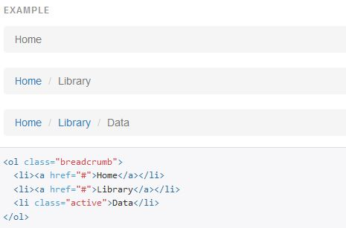
Breadcrumbs
A breadcrumb is a navigation scheme that indicates current page's location to the user within a website or application.
Breadcrumb navigation can greatly enhance the accessibility of the websites having a large number of pages.

Slide 27
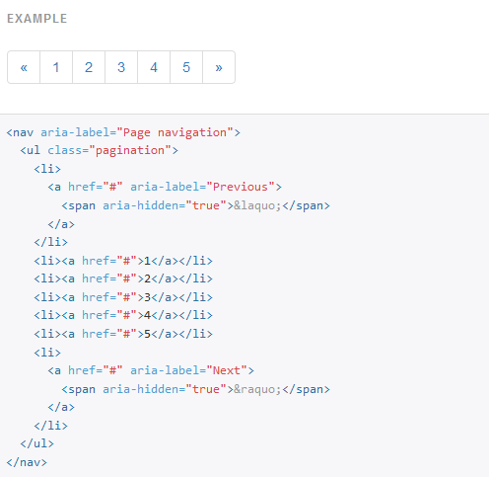
Pagination
A web site with lots of pages, you may wish to add some sort of pagination to each page.

Slide 28


Active State
The active state shows what is the current page
Add class .active to let the user know which page he/she is on.
Example:
Disabled State
A disabled link cannot be clicked:
Add class .disabled if a link is disabled.
Example :

Slide 29
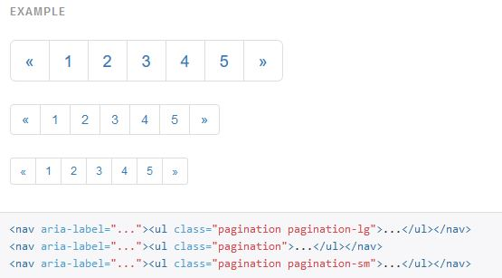
Pagination Sizing
Pagination blocks can also be sized to a larger size or a smaller size.
Add class .pagination-lg for larger blocks or
Add class .pagination-sm for larger blocks.

Slide 30
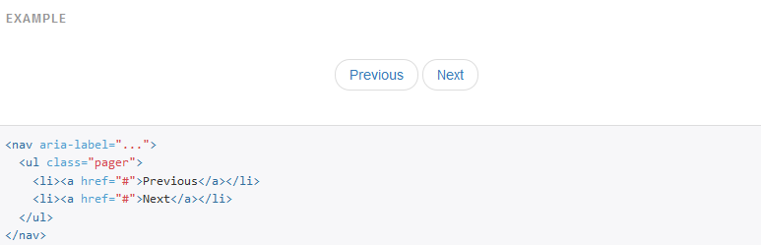
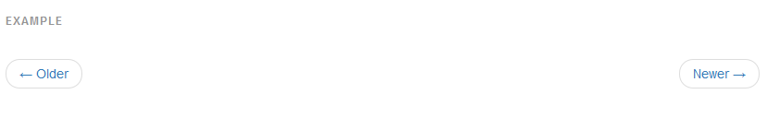
Pager
Pager provides previous and next buttons or links.
Previous/next buttons created by add .pager class to <ul> element.
Aligned links or Buttons: align each link or a button to the sides of the page.

Slide 31
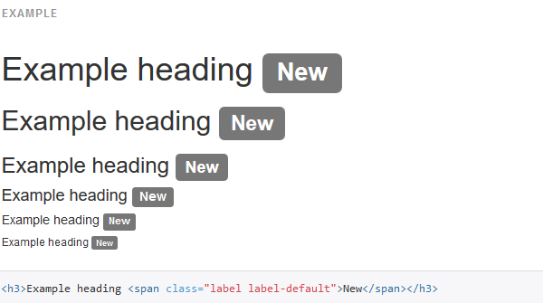
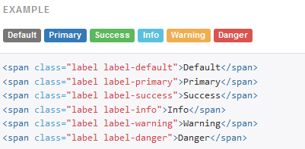
Labels
Labels are used to provide additional information about something.
Available variations:Add any of the below mentioned modifier classes to change the appearance of a label.

Slide 32
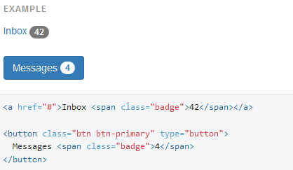
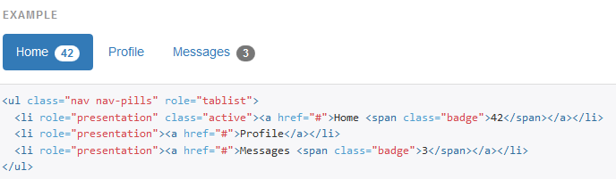
Badges
Badges are numerical indicators of how many items are associated with a link
Active nav states:Built-in styles are included for placing badges in active states in pill navigations.

Slide 33
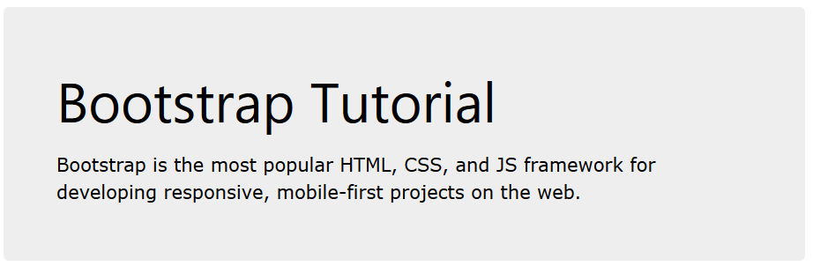
Jumbotron
A jumbotron indicates a big box for calling extra attention to some special content or information.
A jumbotron is displayed as a grey box with rounded corners. It also enlarges the font sizes of the text inside it.
Use a <div> element with class .jumbotron to create a jumbotron.

Slide 34
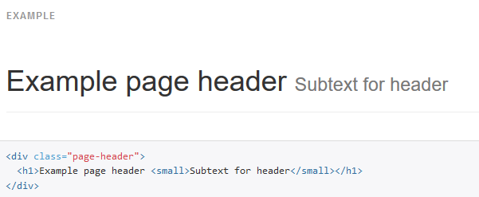
Page header
A page header is like a section divider.
The .page-header class adds a horizontal line under the heading (+ adds some extra space around the element)

Slide 35
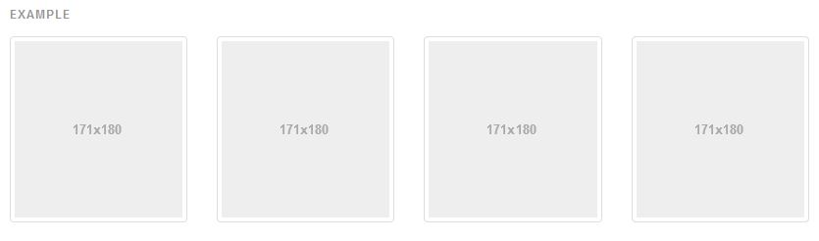
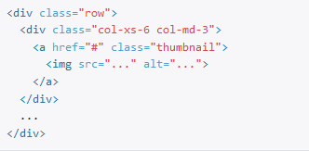
Thumbnails
The thumbnail component to easily display grids of images, videos, text, and more.
Add an <a> tag with the class of .thumbnail around an image.
Syntax :

Slide 36
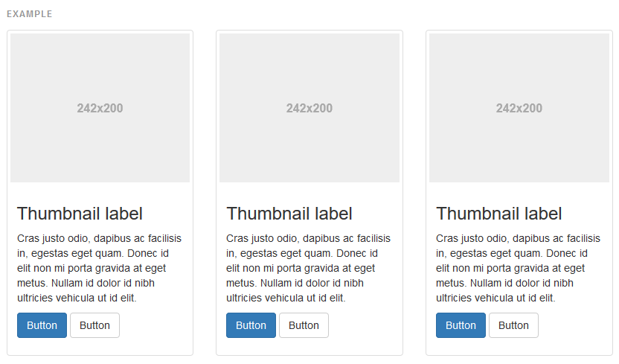
Adding Custom Content
it's possible to add any kind of HTML content like headings, paragraphs, or buttons into thumbnails.

Slide 37
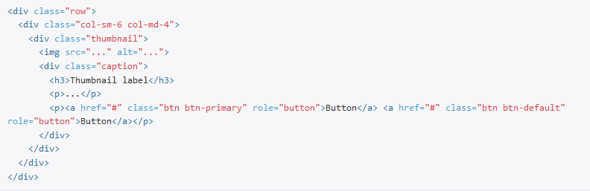
Syntax:

Slide 38
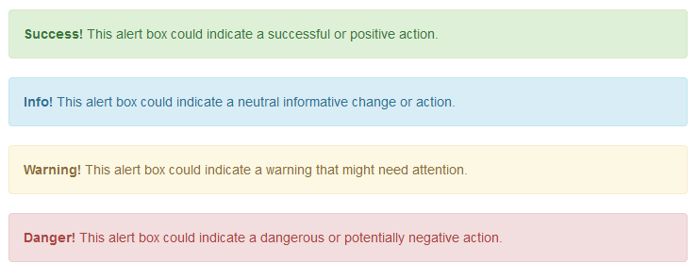

Alerts
Bootstrap provides an easy way to create predefined alert messages.
Alerts are created with the .alert class, followed by one of the four contextual classes . alert-success, alert-info, alert-warning or alert-danger.
Syntax:

Slide 39
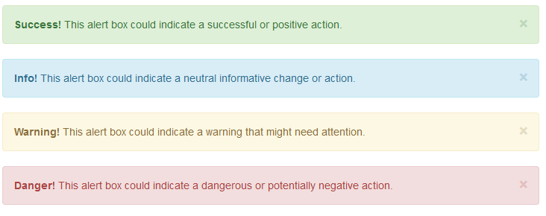

Dismissible alerts
To close the alert message, add a .alert-dismissable class to the alert container. Then add class="close" and data-dismiss="alert" to a link or a button element (when you click on this the alert box will disappear).
Example:

Slide 40
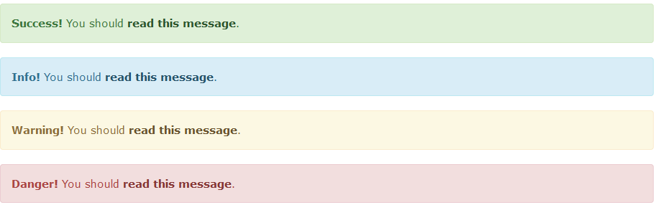
Links in alerts
Add the alert-link class to any links inside the alert box to create "matching colored links“.
Syntax:

Slide 41
Animated Alerts
The .fade and .in classes adds a fading effect when closing the alert message.
Syntax:<div class="alert alert-danger fade in">

Slide 42
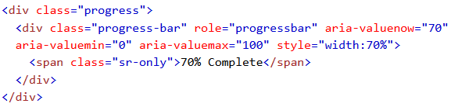
Progress bars
A progress bar can be used to show a user how far along he/she is in a process.
A default progress bar in Bootstrap looks like this:
Example :
To create a default progress bar,add a .progress class to a <div> element:
Syntax:

Slide 43
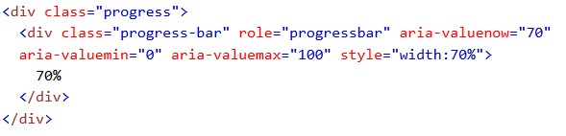
Progress Bar With Label A progress bar with a label looks like this: Remove the .sr-only class form the progress bar to show a visible percentage. Syntax:

Slide 44
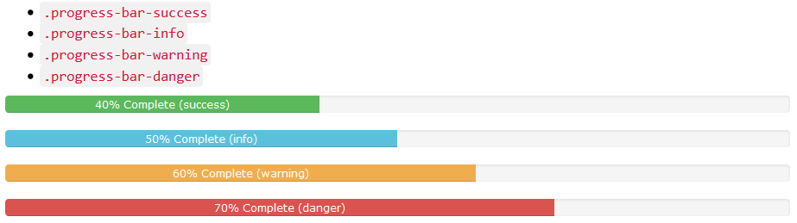
Colored Progress Bars
Contextual classes are used to provide "meaning through colors".
The contextual classes that can be used with progress bars are:

Slide 45
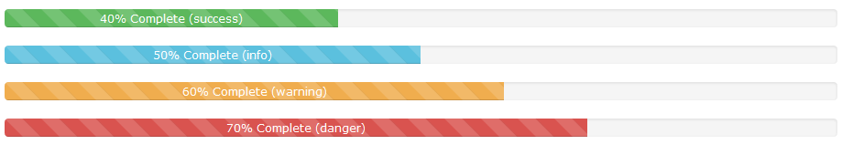
Striped Progress Bars
Progress bars can also be striped.
Add class .progress-bar-stripped to add stripes to the progress bars.
Animated Progress Bar
Add class .Active to animate the progress bar
Stacked Progress Bars
Create a stacked progress bar by placing multiple bars into the same <div class="progress">.

Slide 46
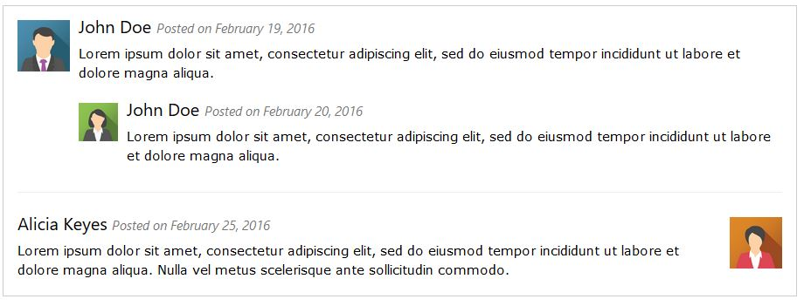
Media Objects
Bootstrap provides an easy way to align media objects (like images or videos) to the left or to the right of some content.
This can be used to display blog comments, tweets and so on

Slide 47
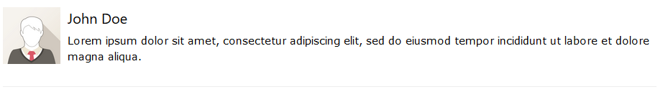
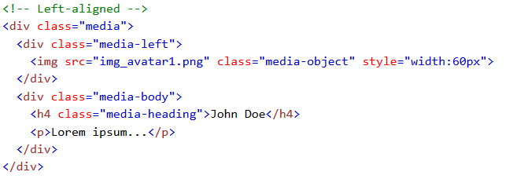
Basic Media Object
Left aligned :
Syntax :

Slide 48
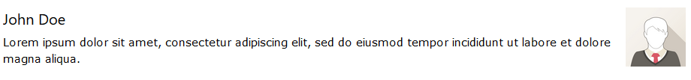
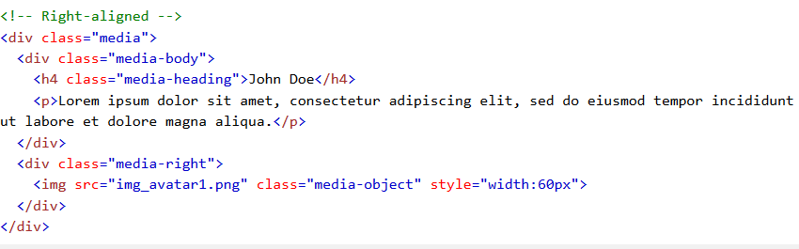
Right Aligned :
Example :
Syntax:

Slide 49
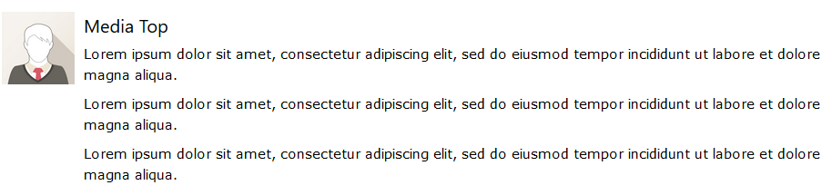


Top, Middle or Bottom Alignment
The media object can also be top, middle or bottom aligned with the media-top, media-middle or media-bottom class.

Slide 50

Nesting Media Objects
Media objects can also be nested (a media object inside a media object).

Slide 51

Another Example of Nesting

Slide 52

List Groups
The most basic list group is an unordered list with list items.
Example:
.
To create a basic list group, use an <ul> element with class .list-group, and <li> elements with class .list-group-item
Syntax:
<ul class="list-group"> <li class="list-group-item">First item</li> <li class="list-group-item">Second item</li> <li class="list-group-item">Third item</li> </ul>

Slide 53

List Group With Badges
You can also add badges to a list group. The badges will automatically be positioned on the right.
Example :
To create a badge, create a <span> element with class .badge inside the list item.
Syntax:
<ul class="list-group"> <li class="list-group-item">New <span class="badge">12</span></li> <li class="list-group-item">Deleted <span class="badge">5</span></li> <li class="list-group-item">Warnings <span class="badge">3</span></li> </ul>

Slide 54
List Group With Linked Items
The items in a list group can also be hyperlinks. This will add a grey background color on hover
To create a list group with linked items, use <div> instead of <ul> and <a> instead of <li>
Example :
Syntax:
<div class="list-group"> <a href="#" class="list-group-item">First item</a> <a href="#" class="list-group-item">Second item</a> <a href="#" class="list-group-item">Third item</a> </div>

Slide 55

Active State
Use the .active class to highlight the current item
Example :
Syntax:
<div class="list-group"> <a href="#" class="list-group-item active">First item</a> <a href="#" class="list-group-item">Second item</a> <a href="#" class="list-group-item">Third item</a> </div>

Slide 56

Disabled Item
To disable an item, add the .disabled class:
Example :
Syntax:
<div class="list-group"> <a href="#" class="list-group-item disabled">First item</a> <a href="#" class="list-group-item">Second item</a> <a href="#" class="list-group-item">Third item</a> </div>

Slide 57

Contextual Classes
Contextual classes can be used to color list items
The classes for coloring list-items are: .list-group-item-success, list-group-item-info, list-group-item-warning, and .list-group-item-danger
Example :
Syntax :
<ul class="list-group"> <li class="list-group-item list-group-item-success">First item</li> <li class="list-group-item list-group-item-info">Second item</li> <li class="list-group-item list-group-item-warning">Third item</li> <li class="list-group-item list-group-item-danger">Fourth item</li> </ul>

Slide 58
Custom Content
Add any HTML inside a list group item.
Bootstrap provides the classes .list-group-item-heading and .list-group-item-text.
Syntax:
<div class="list-group"> <a href="#" class="list-group-item active"> <h4 class="list-group-item-heading">First List Group Item Heading</h4> <p class="list-group-item-text">List Group Item Text</p> </a> <a href="#" class="list-group-item"> <h4 class="list-group-item-heading">Second List Group Item Heading</h4> <p class="list-group-item-text">List Group Item Text</p> </a> <a href="#" class="list-group-item"> <h4 class="list-group-item-heading">Third List Group Item Heading</h4> <p class="list-group-item-text">List Group Item Text</p> </a> </div>

Slide 59

Example:

Slide 60
Panels
A panel in bootstrap is a bordered box with some padding around its content.
Panels are created with the .panel class, and the content inside the panel has a .panel-body class.
Example :
Syntax:
<div class="panel panel-default"> <div class="panel-body">A Basic Panel</div> </div>

Slide 61

Panel Heading
The .panel-heading class adds a heading to the panel.
Example :
Syntax:
<div class="panel panel-default"> <div class="panel-heading">Panel Heading</div> <div class="panel-body">Panel Content</div> </div>

Slide 62

Panel Footer
The .panel-footer class adds a footer to the panel.
Example :
Syntax:
<div class="panel panel-default"> <div class="panel-body">Panel Content</div> <div class="panel-footer">Panel Footer</div> </div>

Slide 63
Panel Group
To group many panels together, wrap a <div> with class .panel-group around them.
The .panel-group class clears the bottom-margin of each panel.
Syntax :
<div class="panel-group"> <div class="panel panel-default"> <div class="panel-body">Panel Content</div> </div> <div class="panel panel-default"> <div class="panel-body">Panel Content</div> </div> </div>

Slide 64

Panels with Contextual Classes
To color the panel, use contextual classes (.panel-default, .panel-primary, .panel-success, .panel-info, .panel-warning, or .panel-danger).

Slide 65

Responsive embed
Bootstrap's responsive embed component provides an easy way to scale videos and slide shows to their containing block.
The responsive embed component can be used on <iframe>, <video>, <object>, and <embed> elements.
To apply the responsive embed component to one of these elements, wrap the element within a <div> element with the .embed-responsive class, along with an intrinsic ratio class (eg, .responsive-embed-16by9 or .responsive-embed-4by3).
Syntax:

Slide 66

Wells
The .well class adds a rounded border around an element with a gray background color and some padding
Example :
Syntax:
<div class="well">Basic Well</div>
Well size :Change the size of the well by adding the .well-sm class for small wells or .well-lg class for large wells.

Slide 67

Modal
The Modal plugin is a dialog box/popup window that is displayed on top of the current page.
Syntax:

Slide 68
Example Explanation
The "Trigger" part:
To trigger the modal window, you need to use a button or a link.
Then include the two data-* attributes:
data-toggle="modal" opens the modal window
data-target="#myModal" points to the id of the modal
The "Modal" part:
The parent <div> of the modal must have an ID that is the same as the value of the data-target attribute used to trigger the modal ("myModal").
The .modal class identifies the content of <div> as a modal and brings focus to it.
The .fade class adds a transition effect which fades the modal in and out. Remove this class if you do not want this effect.
The attribute role="dialog" improves accessibility for people using screen readers.
The .modal-dialog class sets the proper width and margin of the modal.
The "Modal content" part:
The <div> with class="modal-content" styles the modal (border, background-color, etc.). Inside this <div>, add the modal's header, body, and footer.
The .modal-header class is used to define the style for the header of the modal. The <button> inside the header has a data-dismiss="modal" attribute which closes the modal if you click on it. The .close class styles the close button, and the .modal-title class styles the header with a proper line-height.
The .modal-body class is used to define the style for the body of the modal. Add any HTML markup here; paragraphs, images, videos, etc.
The .modal-footer class is used to define the style for the footer of the modal. Note that this area is right aligned by default.

Slide 69
Model size
Change the size of the modal by adding the .modal-sm class for small modals or .modal-lg class for large modals.
Add the size class to the <div> element with class .modal-dialog.
Small Modal:
<div class="modal-dialog modal-sm">
Large Modal:
<div class="modal-dialog modal-lg">

Slide 70

Scrollspy
The Scrollspy plugin is used to automatically update links in a navigation list based on scroll position.
Example:

Slide 71
Syntax:
<!-- The scrollable area --> <body data-spy="scroll" data-target=".navbar" data-offset="50"> <!-- The navbar - The <a> elements are used to jump to a section in the scrollable area --> <nav class="navbar navbar-inverse navbar-fixed-top"> ... <ul class="nav navbar-nav"> <li><a href="#section1">Section 1</a></li> ... </nav> <!-- Section 1 --> <div id="section1"> <h1>Section 1</h1> <p>Try to scroll this page and look at the navigation bar while scrolling!</p> </div> ... </body>

Slide 72
Example Explanation:
Add data-spy="scroll" to the element that should be used as the scrollable area (often this is the <body> element).
Then add the data-target attribute with a value of the id or the class name of the navigation bar (.navbar). This is to make sure that the navbar is connected with the scrollable area.
Note that scrollable elements must match the ID of the links inside the navbar's list items (<div id="section1"> matches <a href="#section1">).
The optional data-offset attribute specifies the number of pixels to offset from top when calculating the position of scroll. This is useful when you feel that the links inside the navbar changes the active state too soon or too early when jumping to the scrollable elements. Default is 10 pixels.

Slide 73
Carousel
The Carousel plugin is a component for cycling through elements, like a carousel (slideshow).
<div id="myCarousel" class="carousel slide" data-ride="carousel"> <!-- Indicators --> <ol class="carousel-indicators"> <li data-target="#myCarousel" data-slide-to="0" class="active"></li> <li data-target="#myCarousel" data-slide-to="1"></li> <li data-target="#myCarousel" data-slide-to="2"></li> <li data-target="#myCarousel" data-slide-to="3"></li> </ol>

Slide 74
<!-- Wrapper for slides --> <div class="carousel-inner" role="listbox"> <div class="item active"> <img src="img_chania.jpg" alt="Chania"> </div> <div class="item"> <img src="img_chania2.jpg" alt="Chania"> </div> <div class="item"> <img src="img_flower.jpg" alt="Flower"> </div> <div class="item"> <img src="img_flower2.jpg" alt="Flower"> </div> </div>

Slide 75
<!-- Left and right controls --> <a class="left carousel-control" href="#myCarousel" role="button" data-slide="prev"> <span class="glyphicon glyphicon-chevron-left" aria-hidden="true"></span> <span class="sr-only">Previous</span> </a> <a class="right carousel-control" href="#myCarousel" role="button" data-slide="next"> <span class="glyphicon glyphicon-chevron-right" aria-hidden="true"></span> <span class="sr-only">Next</span> </a> </div>

Slide 76

Affix
The Affix plugin allows an element to become affixed (locked) to an area on the page.
Navigation menus or social icon buttons, to make them "stick" at a specific area while scrolling up and down the page.
The plugin toggles this behavior on and off (changes the value of CSS position from static to fixed), depending on scroll position.

Slide 77


