Slide 1
Introduction
This case study aims to give you an idea of applying EDA in a real business scenario. In this case study, apart from applying the techniques that you have learnt in the EDA module, you will also develop a basic understanding of risk analytics in banking and financial services and understand how data is used to minimize the risk of losing money while lending to customers.

Slide 2
Business Objectives
This case study aims to identify patterns which indicate if a client has difficulty paying their installments which may be used for taking actions such as denying the loan, reducing the amount of loan, lending (to risky applicants) at a higher interest rate, etc. This will ensure that the consumers capable of repaying the loan are not rejected. Identification of such applicants' using EDA is the aim of this case study.
In other words, the company wants to understand the driving factors (or driver variables) behind loan default, i.e. the variables which are strong indicators of default. The company can utilize this knowledge for its portfolio and risk assessment.
When the company receives a loan application, the company has to decide for loan approval based on the applicant’s profile. Two types of risks are associated with the bank’s decision:
If the applicant is likely to repay the loan, then not approving the loan results in a loss of business to the company
If the applicant is not likely to repay the loan, i.e. he/she is likely to default, then approving the loan may lead to a financial loss for the company.
The data given below contains the information about the loan application at the time of applying for the loan. It contains two types of scenarios:
The client with payment difficulties: he/she had late payment more than X days on at least one of the first Y instalments of the loan in our sample,
All other cases: All other cases when the payment is paid on time.

Slide 3
application_data.csv
Data Checks:
Info
Head
Shape
Columns
describe

Slide 4
Steps for Data Cleanup/Data Handling/Outlier Analysis/Sanity Checks
Drop columns more than 30% null values
Drop Flag_Document columns due to imbalanced data
Drop columns with weak correlation
Drop columns without logical correlation with probability of default
Correct DataTypes
Handling Outliers
Standardize values
Impute/Remove required values
Check for Imbalanced Data

Slide 5
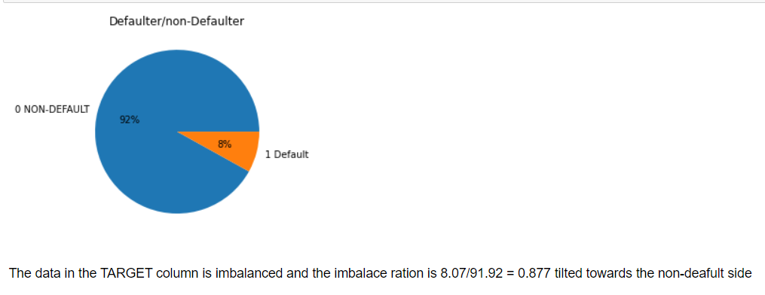
TARGET – Imbalanced Dataset
The TARGET variable distribution is highly imbalanced. Only 8.07% of the customers had payment difficulties.

Slide 6
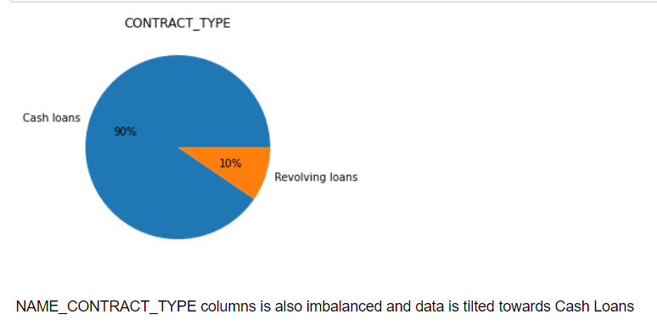
NAME_CONTRACT_TYPE
Revolving loans do not have strict annuities associated, hence it is expected to have less percentage of default as compared to Cash Loans.

Slide 7
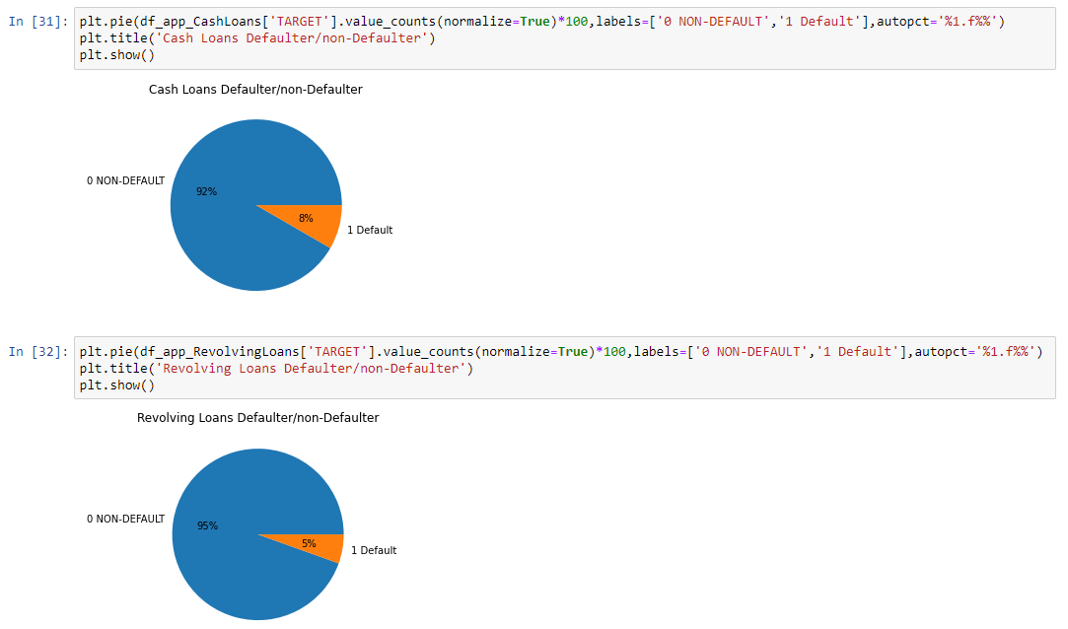
Cash Loans vs Revolving Loans : Revolving loans have lower chances of default

Slide 8
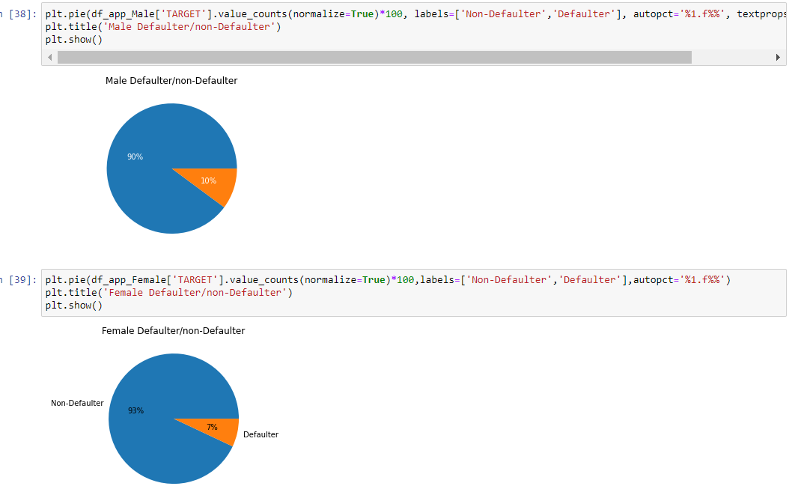
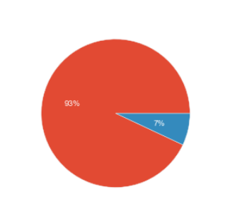
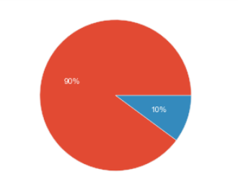
CODE_GENDER: Men are more likely to default as compared to women (10:7)
Distribution of Target Variable for Males
Distribution of Target Variable for Males

Slide 9
Categorical ordered/unordered features analysis

Slide 10
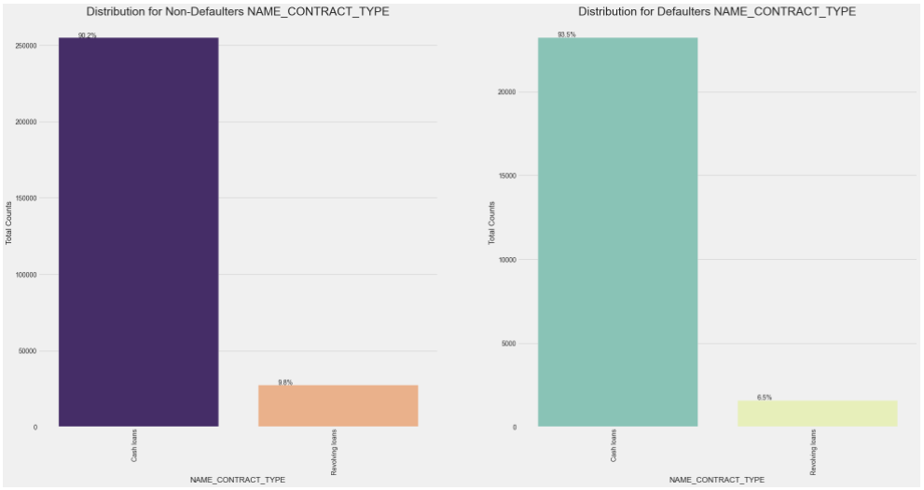
NAME_CONTRACT_TYPE: Cash Loans have a slight higher possibility of default as compared to revolving loans

Slide 11
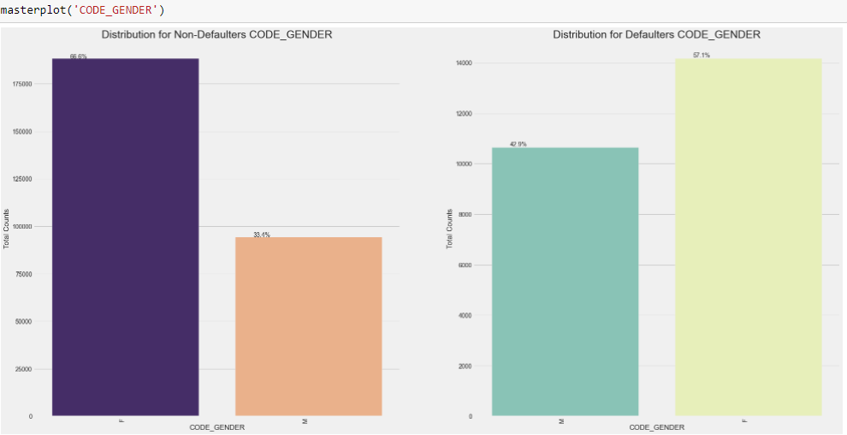
CODE_GENDER : Male customers have a higher chance of default as compared to females

Slide 12
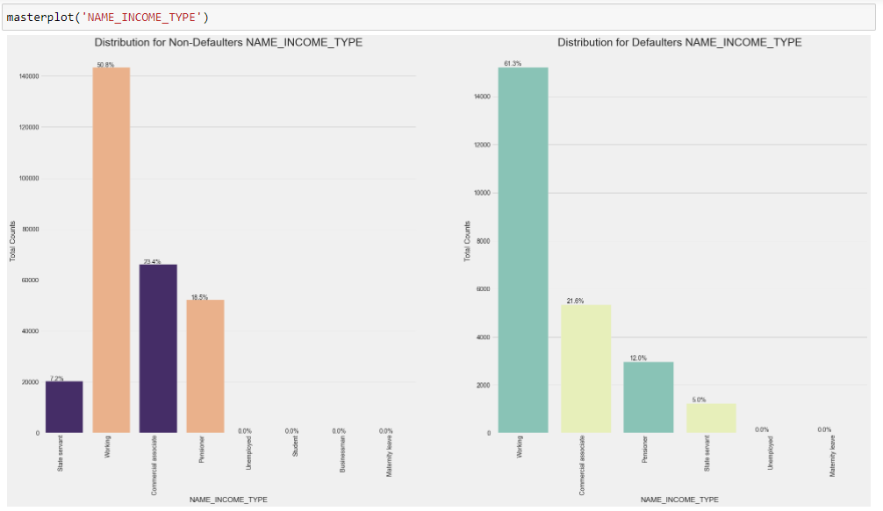
NAME_INCOME_TYPE: Pensioner and State servant have less chances of default, working class has higher possibility of default

Slide 13
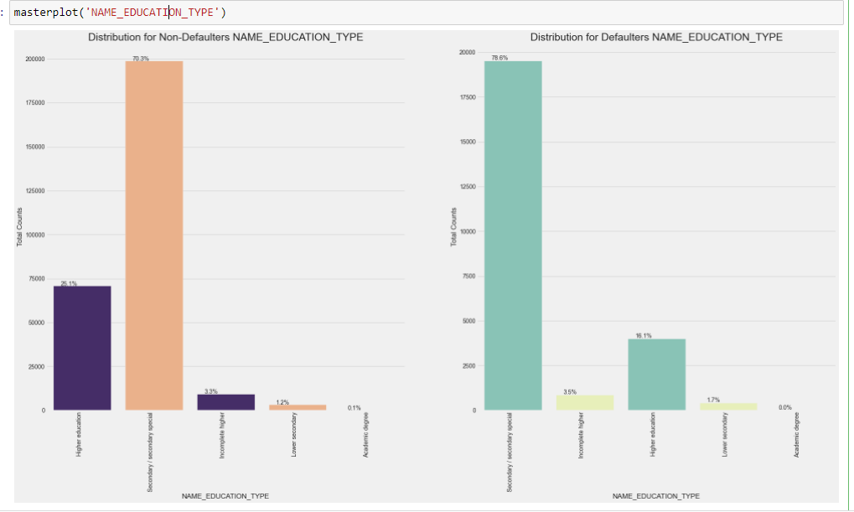
NAME_EDUCATION_TYPE: Lower Secondary and secondary customers are at a higher chance of default. Whereas Higher education customers are at a lower risk

Slide 14
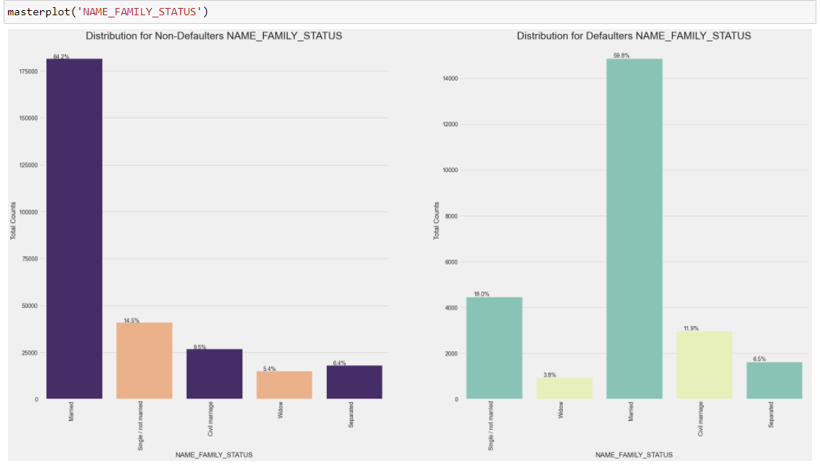
NAME_FAMILY_STATUS : Single/Unmarried & civil marriage have a higher chance of default. Where as widow customers are a safer class of customers

Slide 15
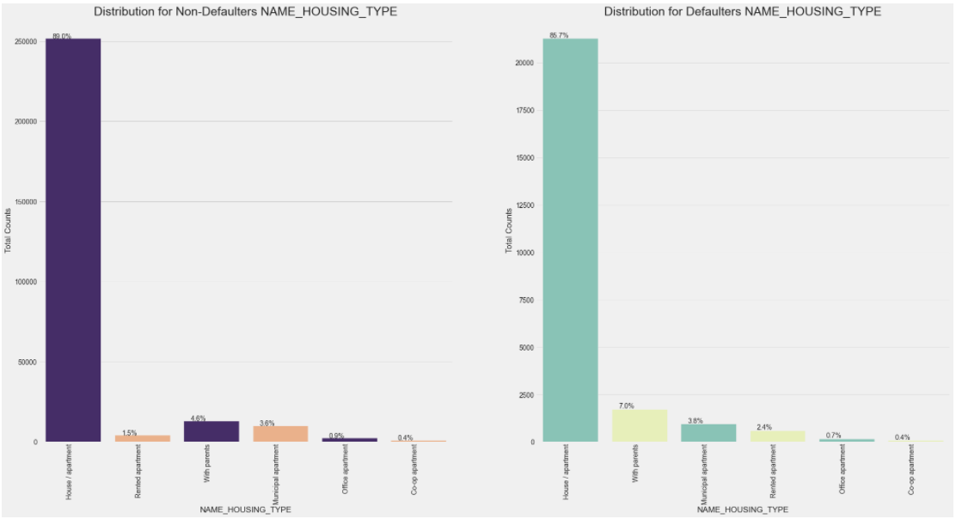
NAME_HOUSING_TYPE : Customers who stay in rented apartments and with parents, have a higher chance of defaulting on a credit.

Slide 16
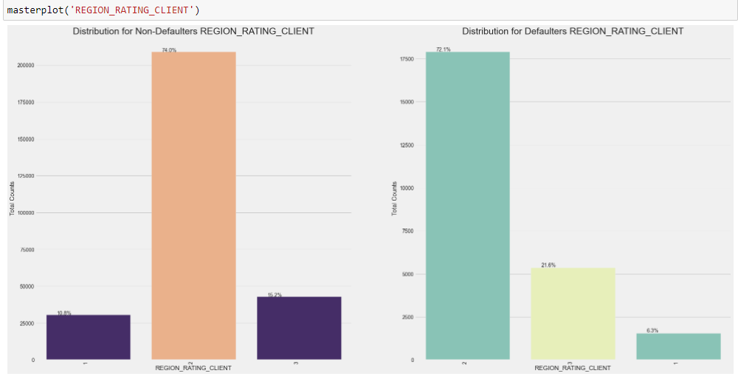
REGION_RATING_CLIENT: Customers from Region rating 3 have a higher possibility of defaulting on a loan, whereas from Region rating 1 have the least possibility.

Slide 17

REGION_RATING_CLIENT_W_CITY: Customers with rating 3 have a higher possibility of default, whereas from rating 1 is least

Slide 18
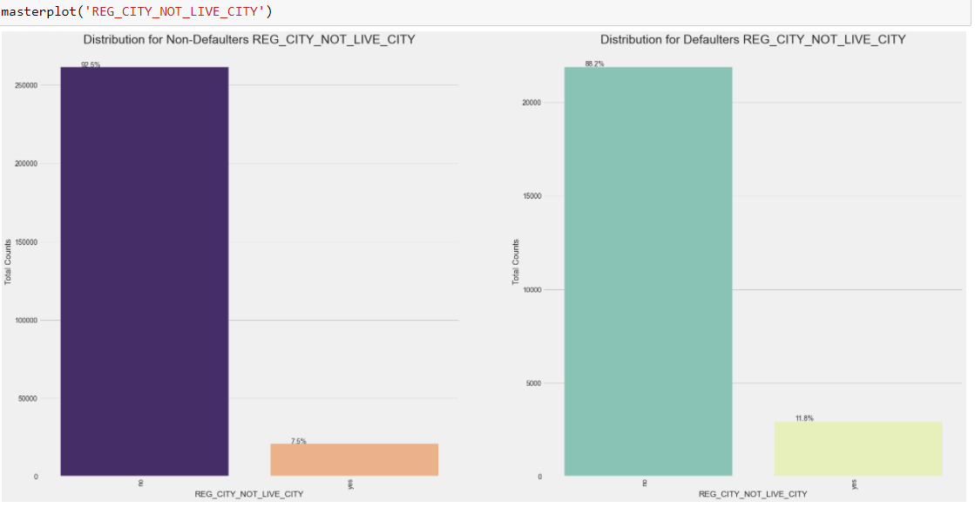
REG_CITY_NOT_LIVE_CITY: Customers who are registered in city and do not live in the city, are at a higher risk of default.

Slide 19
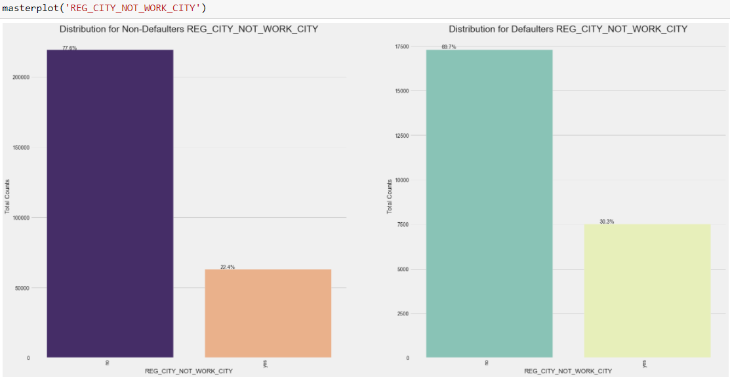
REG_CITY_NOT_WORK_CITY: Customers who are registered in city and do not work in the city are at a higher risk of defaulting.

Slide 20
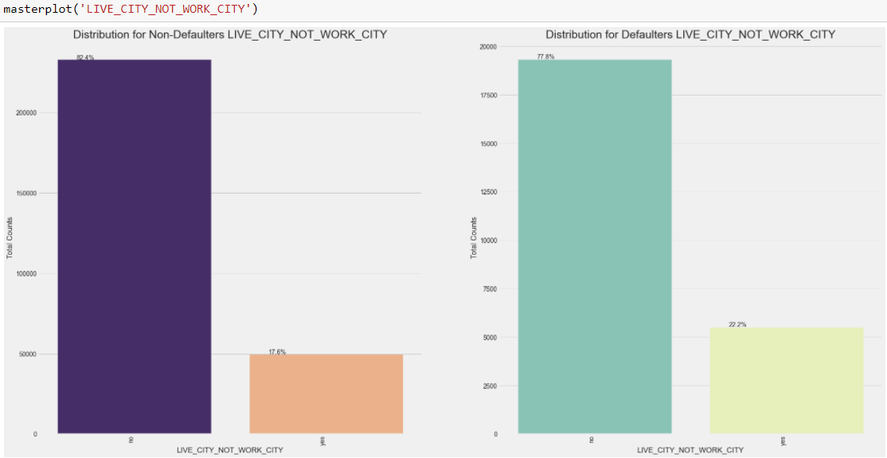
LIVE_CITY_NOT_WORK_CITY: Customers who live in the city and do not work in the city are at a higher risk of default

Slide 21
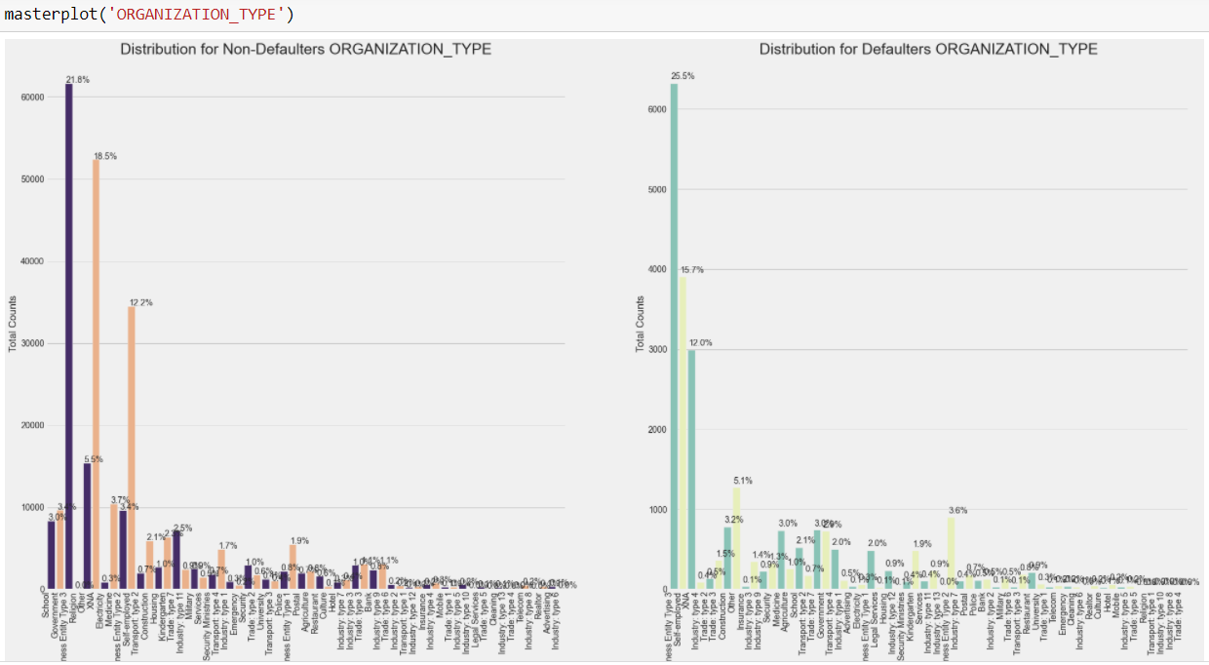
ORGANIZATION_TYPE: Low-skill labour , cookin staff, Drivers customers are more likely to default on a loan. Trade type 4 and industry type 12 least.

Slide 22
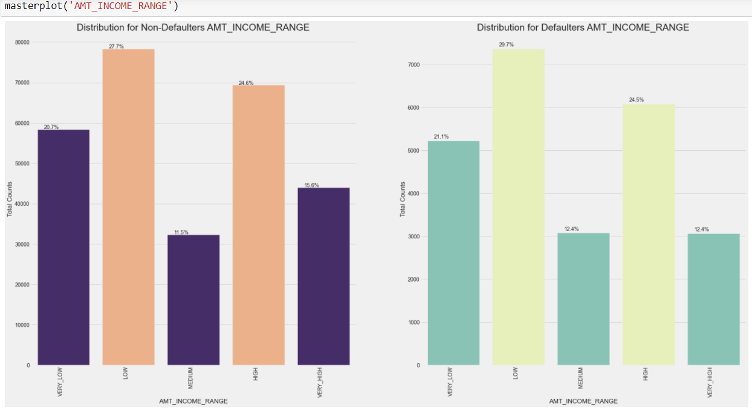
AMT_INCOME_RANGE: Customers having incomes from 0:50 %ile i.e very low to medium, are more susceptible to default

Slide 23
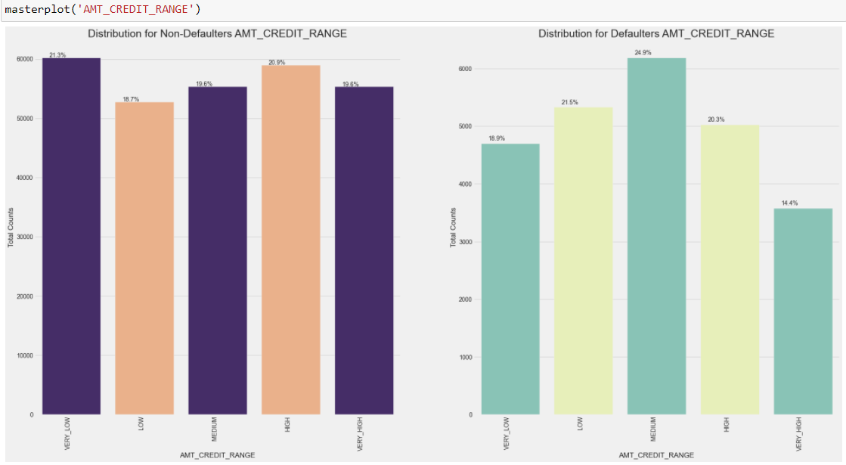
AMT_CREDIT_RANGE: Low and medium category credits, i.e credit amount in the range of 20:60 %ile have the highest possibility of default

Slide 24
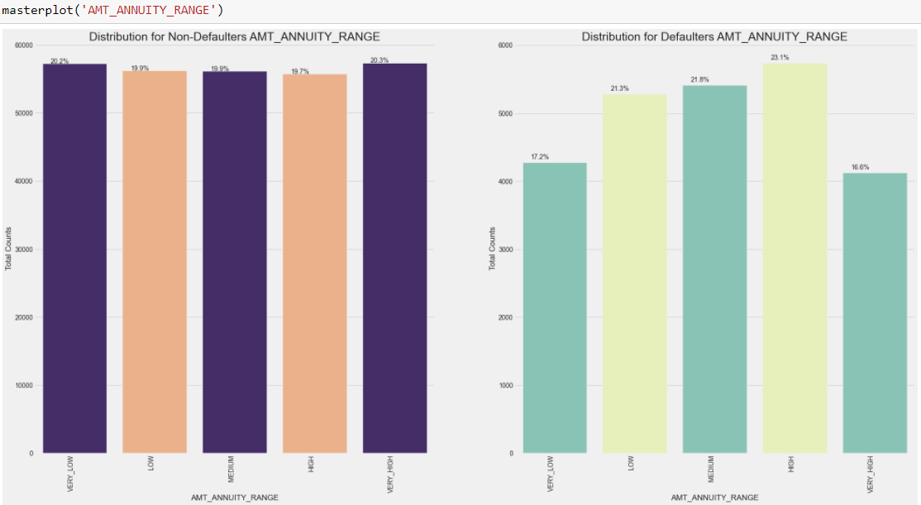
AMT_ANNUITY_RANGE: High annuity amounts in the range of 60-80%ile have the highest possibility of default

Slide 25

REG_CITY_NOT_LIVE_CITY: Customers who are registered in the city and not do not live in the city have a significantly higher chance of default

Slide 26
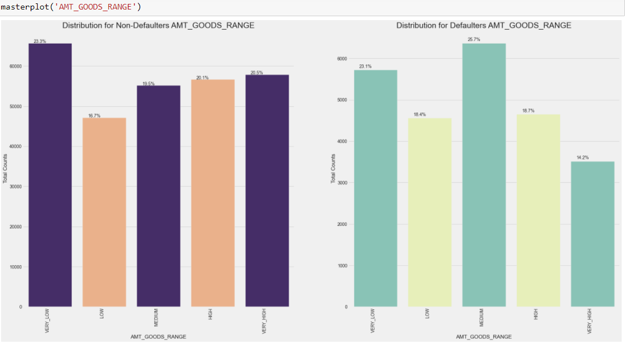
AMT_GOODS_RANGE: Goods amount in the range of 40-60%ile have a higher possibility of default

Slide 27
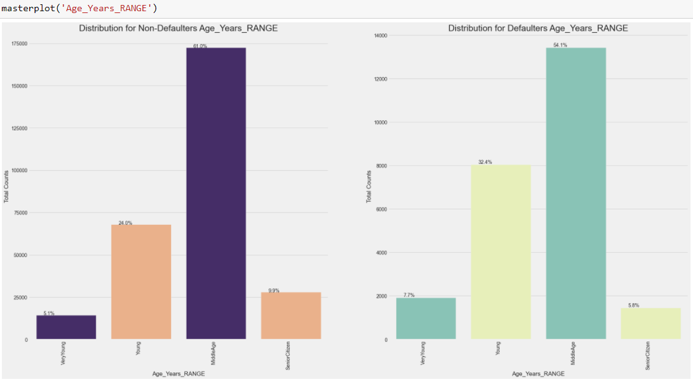
Age_Years_RANGE: Customers in the age range of 19-35 have higher %age of defaulting, whereas senior citizens above 60 have the least.

Slide 28
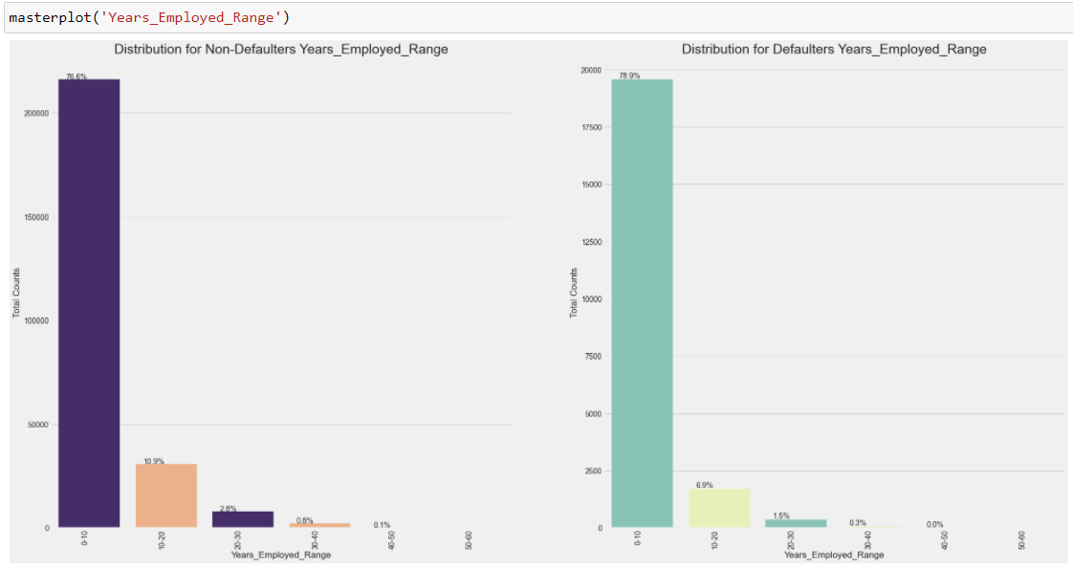
Years_Employed_Range: Customers in the employment range of 0-10 yrs have a slight higher chance of default, whereas in the risk reduces post the range of 20 yrs.

Slide 29
Numerical Features Analysis

Slide 30
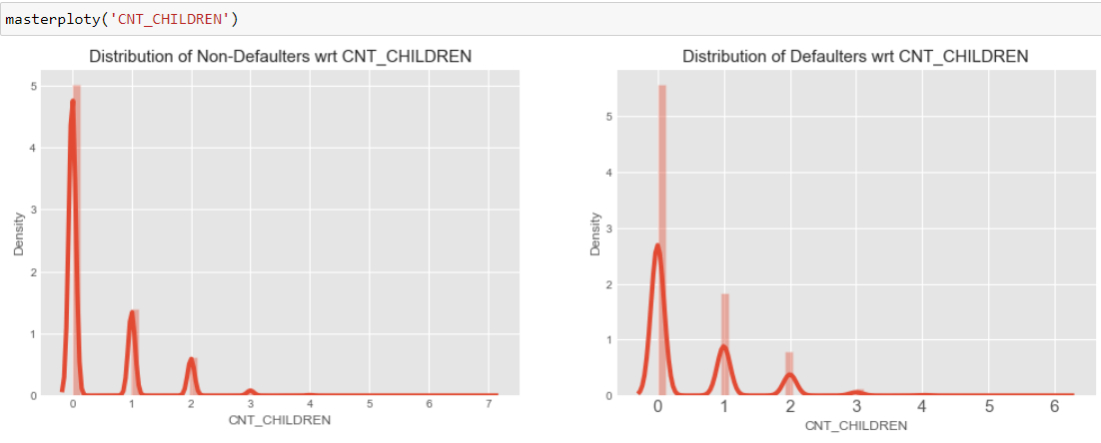
CNT_CHILDREN: Customers with 0-1 children have a lower percentage of default

Slide 31
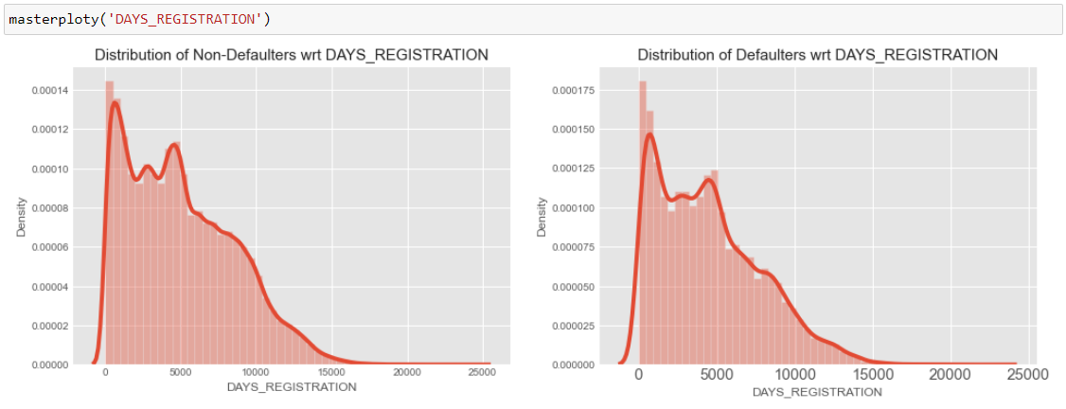
There is a more likely scenario of default when the customer changes his registration before application.

Slide 32
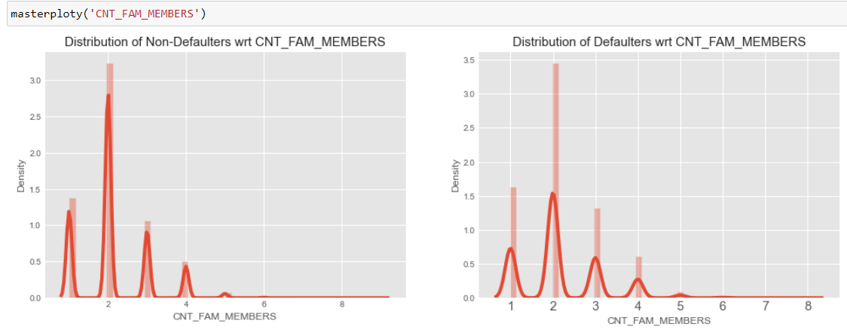
CNT_FAM_MEMBERS: From the right hand side plot, I can see that for family members 3-4, there is a slight increase in chances of default. For higher family members, the graph is not clearly visible

Slide 33
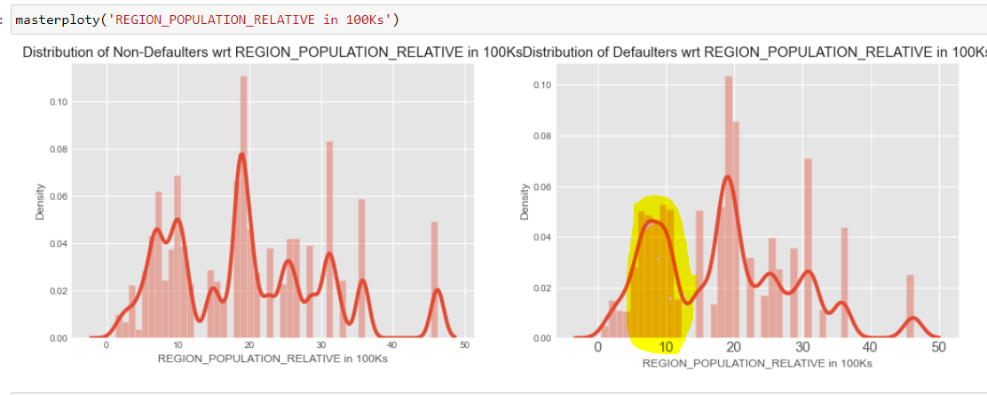
REGION_POPULATION_RELATIVE: Customers residing in regions with population from 0.2 to1.2 mil, have a slightly higher chance of default.

Slide 34
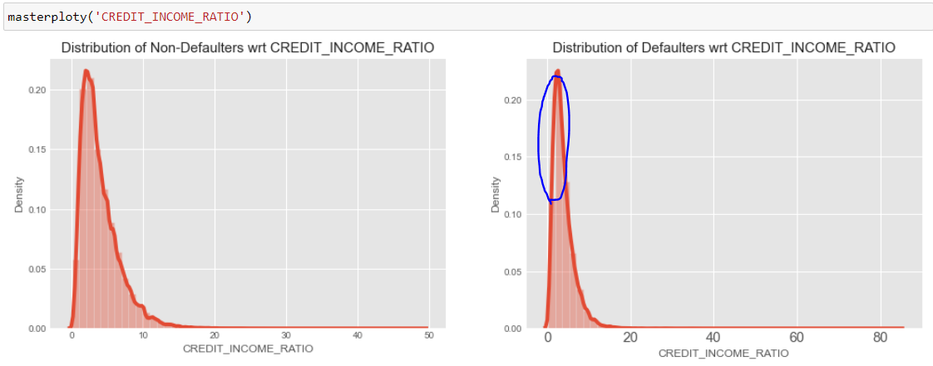
CREDIT_INCOME_RATIO: We can see between 0:0.1 in credit income ratio, i.e when income is greater than credit, there is a very less possibility of default.

Slide 35
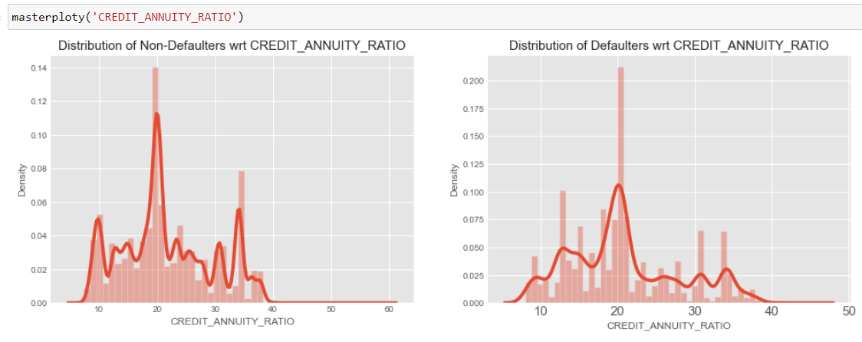
CREDIT_ANNUITY_RATIO: When credit to annuity ratio is around 10 or 35, there is a drop in rate of defaults.

Slide 36
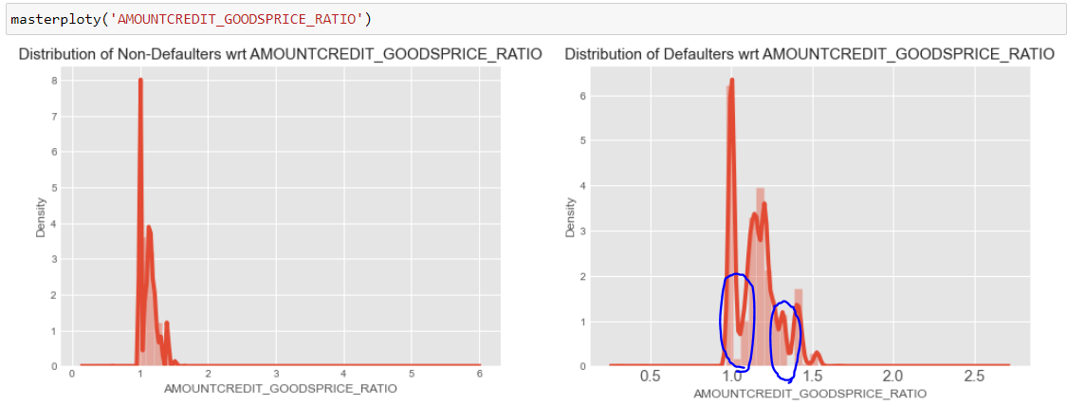
AMOUNTCREDIT_GOODSPRICE_RATIO: When AMOUNTCREDIT_GOODSPRICE_RATIO is at 1.05 and around 1.35. There are no defaults.

Slide 37
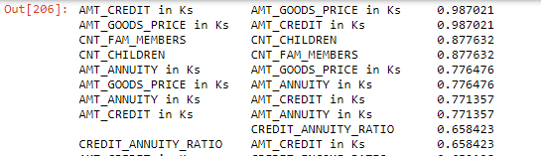
Top 10 corr for TARGET 0

Slide 38
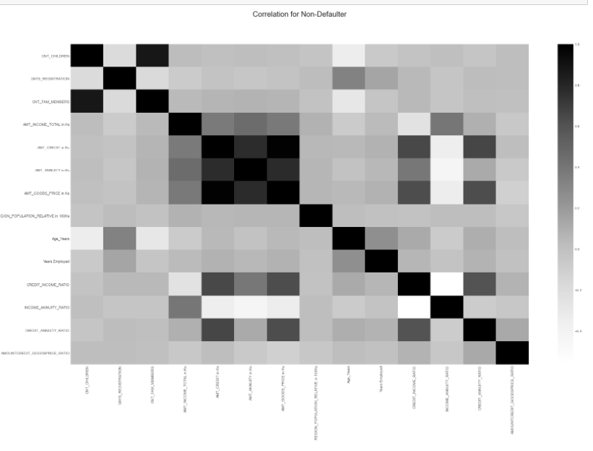

Slide 39
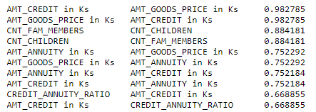
Top 10 corr for TARGET 1

Slide 40
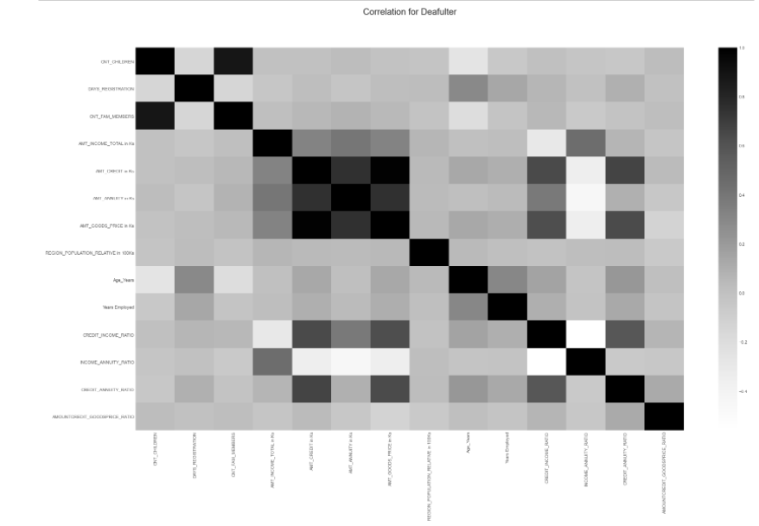

Slide 41
Bi/MultiVariate Analysis

Slide 42
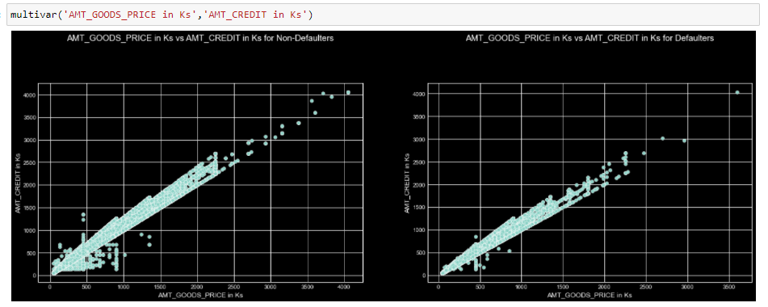
('AMT_GOODS_PRICE in Ks','AMT_CREDIT in Ks’) : For crdeit amount <500k and Goods price <1 mil, there are significantly less defaulters

Slide 43
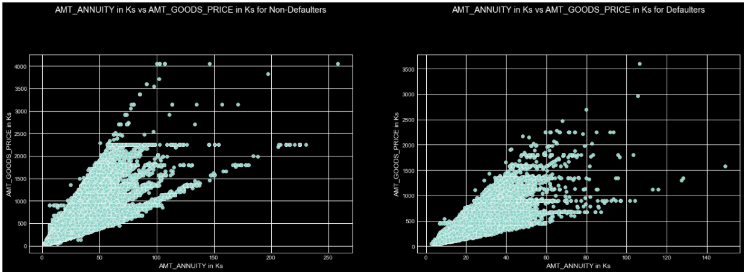
('AMT_ANNUITY in Ks','AMT_GOODS_PRICE in Ks’) : Less defaulters in highlighted region

Slide 44
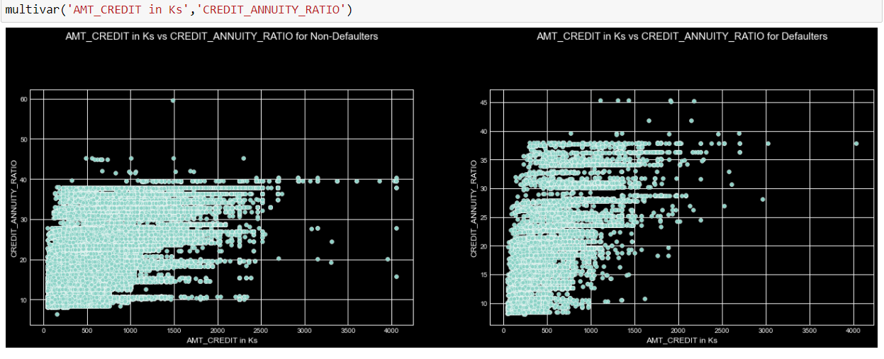
('AMT_CREDIT in Ks’ , 'CREDIT_ANNUITY_RATIO’): Less defaulters in highlighted region

Slide 45
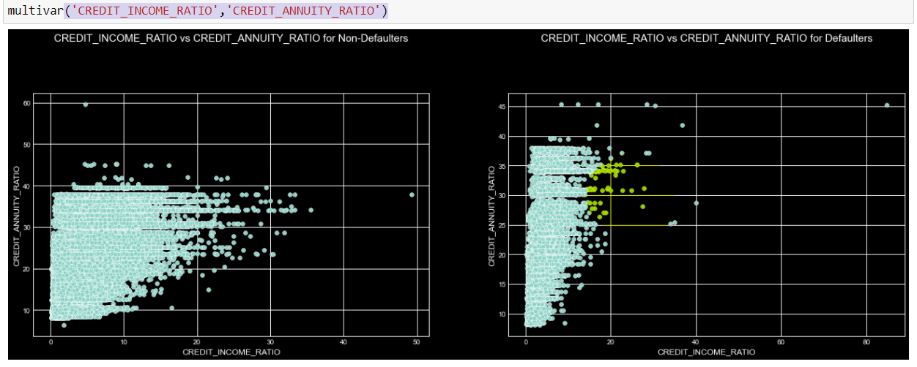
('CREDIT_INCOME_RATIO','CREDIT_ANNUITY_RATIO’) : Less defaulters in highlighted region

Slide 46
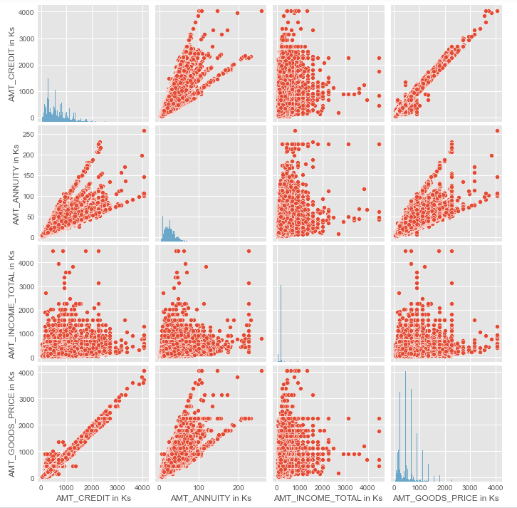
MultiVariate Analysis wrt entire dataset

Slide 47
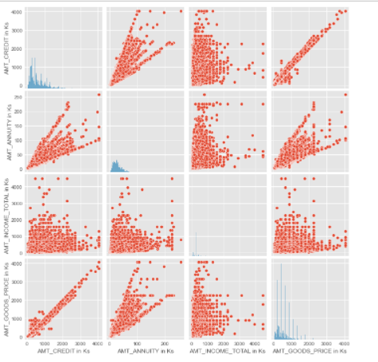
MultiVariate Analysis wrt Target 1

Slide 48
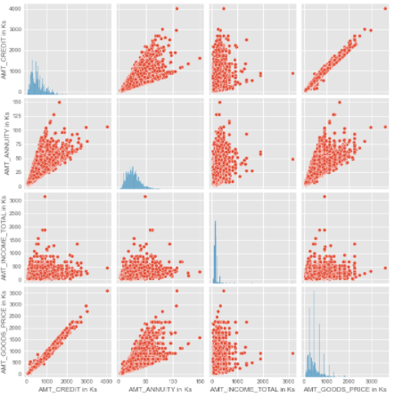
MultiVariate Analysis wrt Target 0

Slide 49
previous_application.csv

Slide 50
application_data.csv
Data Checks:
Info
Head
Shape
Columns
describe

Slide 51
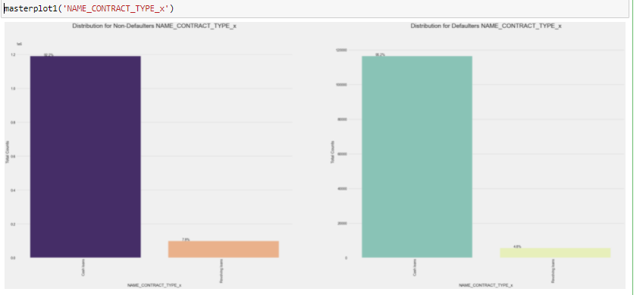
NAME_CONTRACT_TYPE_x: As per previous application data, Cash loans have greater default as per previous application data

Slide 52
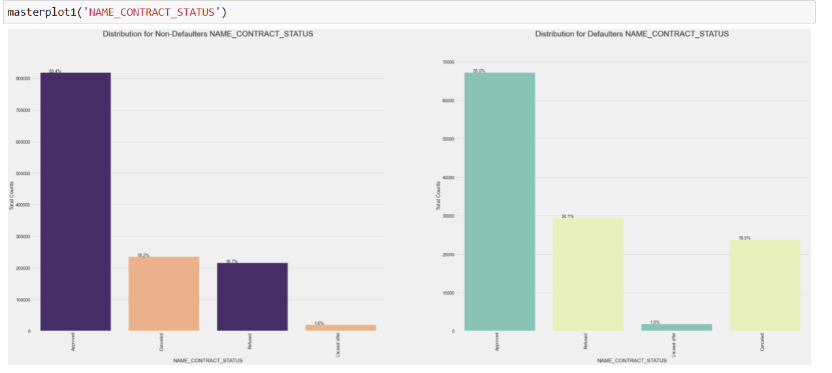
NAME_CONTRACT_STATUS: Refused offers had more percentage of defaults as per previous application data

Slide 53
NAME_CLIENT_TYPE: Refreshed offers have lesser defaults as compared to other categories

Slide 54
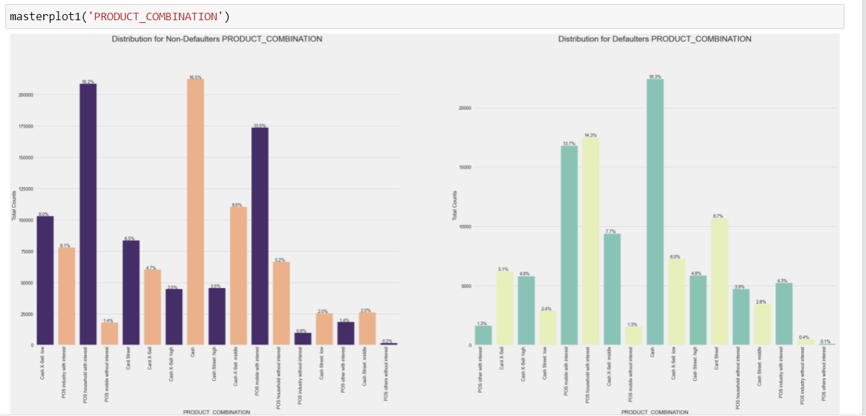
PRODUCT_COMBINATION: Cash Sheet, Cash sheet high, Cash X-sell high, Cash street low, Cash --> more defaults as per previous app data POS Household without internet, Cash X-sell low,Cash sheet middle, POS industry with internet, POS household with internet, Cash Xsell with middle, POS industry without internet --> Lesser defaults as per current app data

Slide 55
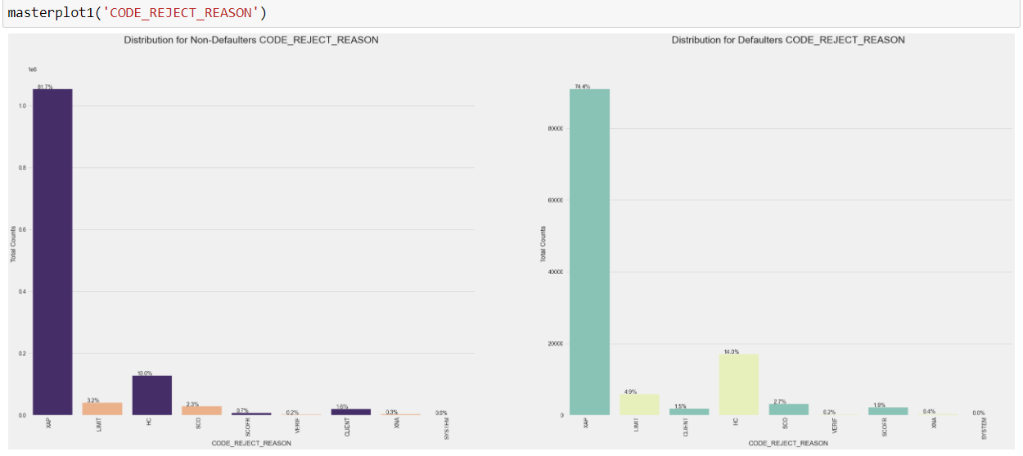
CODE_REJECT_REASON: LMIT, SCO, HC reject reasons of previous application have higher default rates

Slide 56
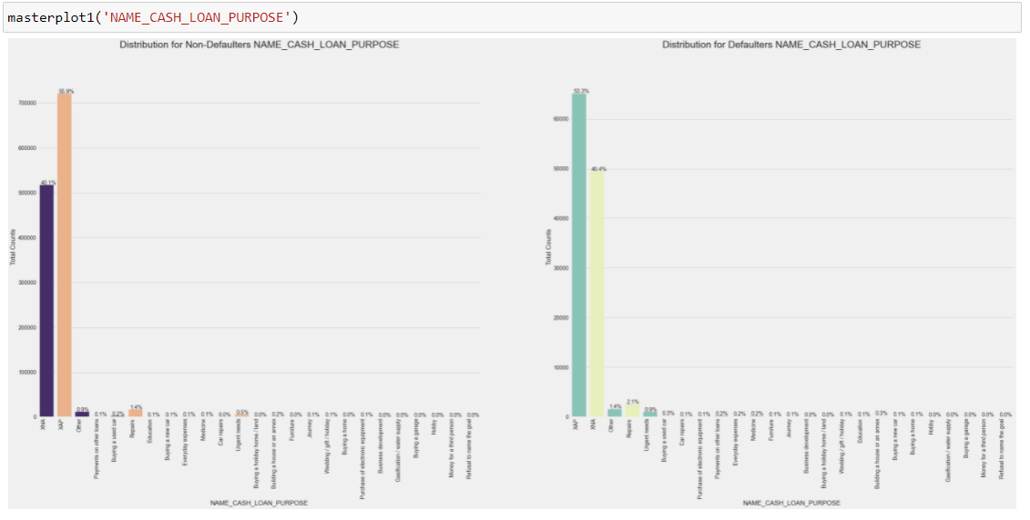
NAME_CASH_LOAN_PURPOSE: Repairs, Others and Urgent needs as loan purposes of previous applications had higher default rates

Slide 57
Summary : whom to offer loans
Revolving loans have less default chances, so the bank can focus to grow on the revolving loan segment.
Men should be scrutinized more as compared to women before approving a loan
Serve cash loans to Pensioner and State servant & revolving loans to working class
As with higher education the customer is less likely to default, they can be provided more cash loans
Widowed customers are a safer class to offer credits.
Trade type 4 and industry type 12 are safest organizations to offer loans
senior citizens above 60 are the least risky in terms of age category
Customers with 0-1 children have a lower percentage of default
Applications with refreshed offers have lesser defaults as compared to other categories

Slide 58
Summary : whom not to offer loans
Reduce loan offers for purposes like Repairs, Others and Urgent needs
Loan offers to Customers having secondary or lower secondary education should be reduced
Single/Unmarried & civil marriage should be scrutinized more as compared to other family classes.
Customers who stay in rented apartments and with parents, have a higher chance of defaulting on a credit.
Customers from Region rating 3 have a higher possibility of defaulting on a loan
Customers who are registered in city and do not live in the city, are at a higher risk of default.
Customers who are registered in city and do not stay in the city are at a higher risk of defaulting.
Customers who are registered in city and do not work in the city are at a higher risk of defaulting.
Customers who live in the city and do not work in the city are at a higher risk of default
Low-skill labour , cooking staff, Drivers are more likely to default on a loan as compared to other skills.
Customers having low to medium incomes should be screened, for credit ratings

Slide 59
Summary : whom not to offer loans
Low and medium category credits, i.e credit amount in the range of 20:60 %ile have the highest possibility of default
High annuity amounts in the range of 60-80%ile have the highest possibility of default
Customers who are registered in the city and not do not live in the city have a significantly higher chance of default
Goods amount in the range of 40-60%ile have a higher possibility of default
senior citizens above 60 are the least risky in terms of age category
Customers in the age range of 19-35 have higher %age of defaulting
There is a more likely scenario of default when the customer changes his registration immediately application.
Customers residing in regions with population from 0.2 to1.2 mil, have a slightly higher chance of default.
We can see between 0:0.1 in credit income ratio, i.e when income is greater than credit, there is a very less possibility of default.
Customers with Refused offers had more percentage of defaults as per previous application data
Bank should avoid offering loans to individuals whose prev application was/were rejected with LMIT, SCO, HC codes

